Slide 1
Reversi
Mark Erends
Traineeship Java
Young Capital Professionals

Slide 2

Reversi rules?

Slide 3
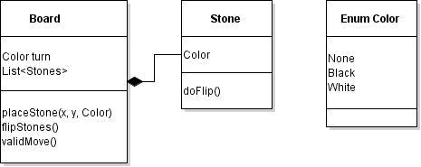
Pojo’s

Slide 4
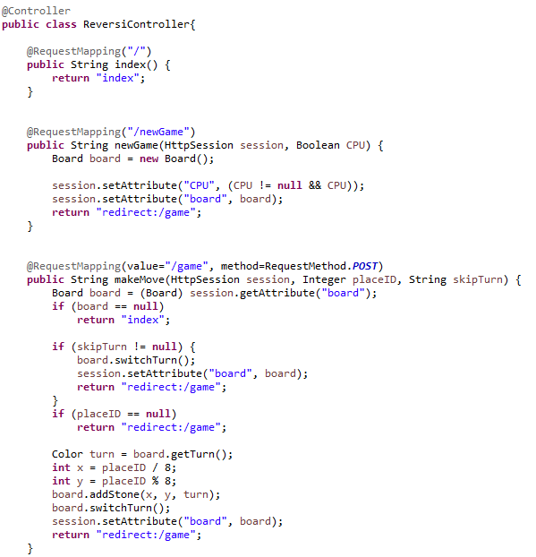
Spring MVC - Controller

Slide 5
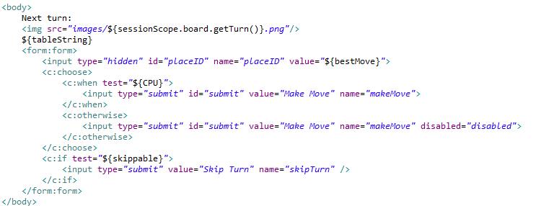

Spring MVC - View

Slide 6
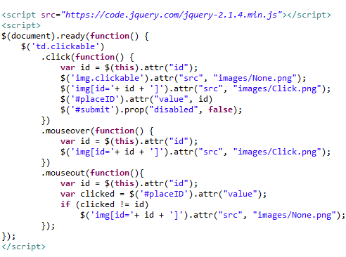


JavaScript & jQuery CSS

Slide 7
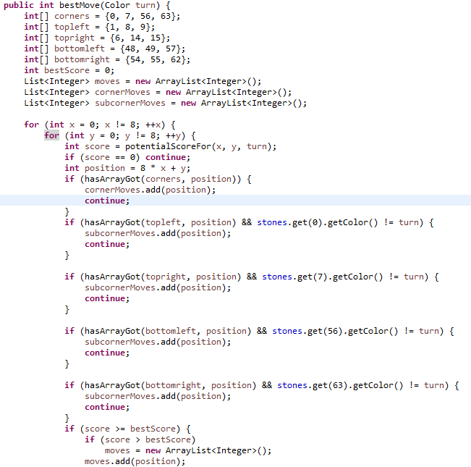

Play versus A.I.

Slide 8
DEMO!

Slide 9
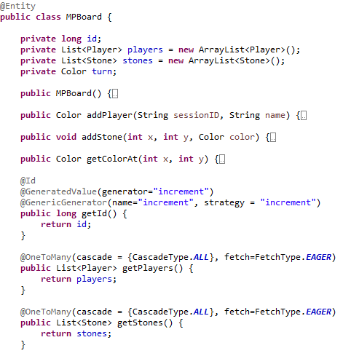
Play online, Store in database!
JPA & Hibernate
@

Slide 10
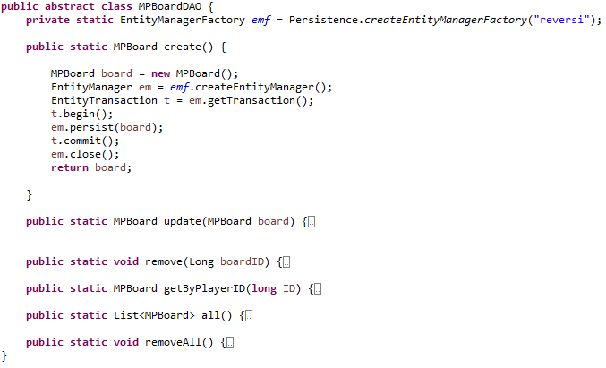
Data Access Object (DAO)

Slide 11
To do
Waiting room: looking for opponent
Opponents move? API call to refresh with AJAX
High scores

Slide 12

Thank you for your attention

