Slide 1
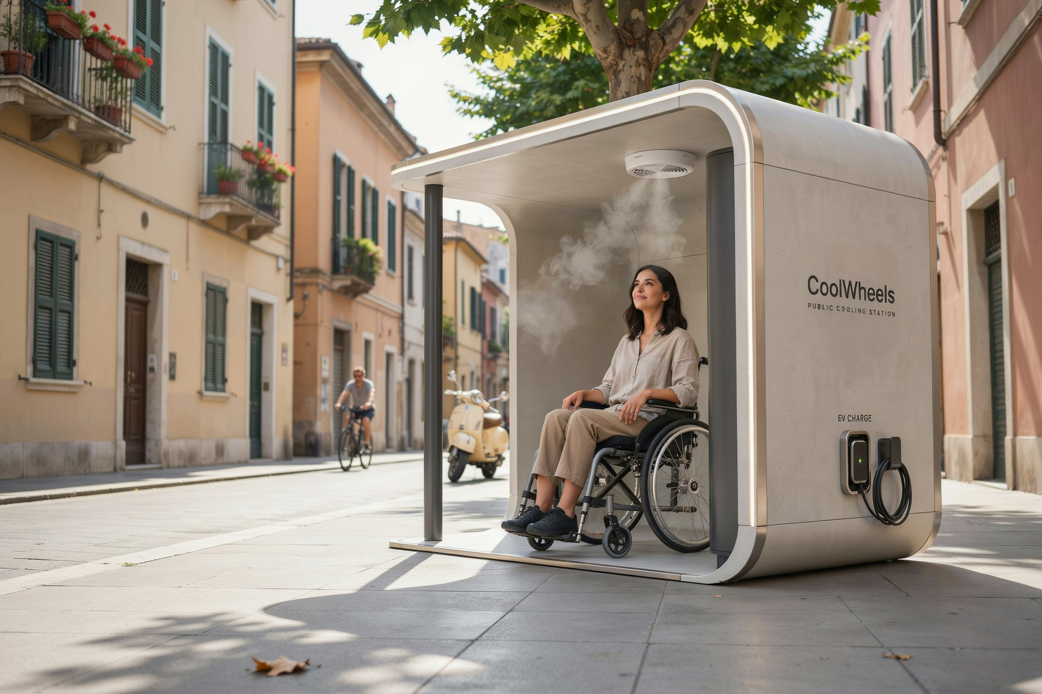
COOLING EUROPE · GROUP 5
61,672 people died from heat across Europe
in summer 2022 alone.
For wheelchair users, there's still nowhere to cool down.
Source: Ballester et al., Nature Medicine (2023)
CoolWheels
Solar-powered cooling stations for wheelchair users
Reinrollen. Abkühlen. Weiterfahren.
1

Slide 2
PROBLEM / CUSTOMER
Heatwaves are intensifying, and Europe's wheelchair users have no accessible place to cool down.
61,672
1
Battery drain & overheating
Electric wheelchair batteries and joystick controllers overheat and drain faster in direct sun.
heat-related deaths across Europe, summer 2022 alone.
2
Shade that can't be reached
Existing shaded rest points are often blocked by high curbs or lack wheelchair clearance.
Source: Ballester et al., “Heat-related mortality in Europe during the summer of 2022,” Nature Medicine (2023)
3
No way to plan around it
Users can't reliably plan routes around where they can rest or recharge during a heatwave.
“Battery packs drain faster and overheat under direct sun, joystick controllers become hot to use.” — Lucas, electric wheelchair user (Group 5 interview)
2

Slide 3
SOLUTION
CoolWheels gives wheelchair users a shaded, misted, solar-powered place to rest and recharge.
We install accessible cooling pods along the wheelchair routes people already use — unlocked only by an existing municipal accessibility credential.
☀
Shade + misting
Passive shade with an active misting fan for immediate relief.
⚡
Wheelchair charging
Insulated outlet for electric wheelchairs and mobility aids.
☉
Solar-powered
Rooftop panels power the pod directly — no grid connection needed.
✓
ID Austria / CityGraz entry
Opens with an existing municipal accessibility credential.
3

Slide 4
PRODUCT & DIFFERENTIATION
Two pod tiers, built from proven technology, in a wheelchair-first configuration nobody else offers.
Tier | Includes | Best placed at
Standard | Shade, misting, wheelchair charging, solar power | Residential streets, parks, everyday routes
Plus | Standard + device charging + fold-down desk + Wi-Fi | Transit hubs, squares, high-dwell locations
What makes it work
— Off-the-shelf misting & solar tech — low technical risk
— Insulated, weatherproof charging built for mobility aids
— Credential-gated access, integrated with city ID systems
The only cooling solution co-designed with wheelchair users.
Access is gated through ID Austria / CityGraz, so pods stay available for the people who need them and can't be vandalized or misused — a hard-to-copy control layer, not just a physical structure.
4

Slide 5
TECHNICAL & SAFETY RISK
Water next to electric charging is the obvious risk — here's how we design around it.
!
Water + electrical charging
Misting system sits in a physically separate, sealed compartment from the charging outlet, with IP-rated (water-resistant) enclosures on all electrical components — standard practice in outdoor EV charging.
!
Hygiene of the misting system
Closed-loop, filtered water supply with scheduled maintenance, the same approach used in commercial public misting installations.
!
Regulatory approval
Prototype goes through standard certification and permitting (e.g. electrical safety, public-installation approval) before public deployment — not a novel regulatory category.
Engineering assessment: no blocking technical risk identified. Full certification follows prototype fabrication.
5

Slide 6
BUSINESS MODEL
We earn through municipal service contracts — solar power keeps running costs near zero.
1
Pilot pod
~€18,000 installed
Fabrication, certification & installation (see Financials)
2
Service contract
€2,500 / year / station
Municipal maintenance & access-credential management
3
Plus-tier sponsorship
~20% of install cost
Local CSR partners (insurers, mobility-aid brands)
4
Post-pilot user fee
Minimal, insurance-covered
Introduced only once the pilot proves demand
6

Slide 7
UNIT ECONOMICS & REVENUE PROJECTION
Our usage assumptions are hypotheses — the pilot is designed to test them.
Per-pod hypothesis (to validate in the 3-month pilot)
1 user
~15 min
TBD / day
at a time, per pod
max session length — a rest stop, not a destination
utilization rate — explicitly unvalidated, measured during pilot
Rough 3-year projection (illustrative, pending pilot data)
Year 1
1 pilot pod (Graz)
Service contract + crowdfunding
Year 2
2–3 pods (Graz + Freiberg/Chemnitz)
Municipal contracts + CSR sponsorship
Year 3
City-wide rollout, pending pilot results
Multi-year municipal contracts
We will not present these as validated numbers — they're the hypothesis our pilot is designed to test.
7

Slide 8

MARKET & GO-TO-MARKET
The EU needs ~€70B/year in climate adaptation investment — we're entering through cities ready to act.
TAM
SAM
SOM
€70B / yr
21 of 38
2 pilot cities
EU climate-adaptation investment need through 2050
European countries (EEA) with national heat-health action plans
Graz & Freiberg/Chemnitz — to test different municipal ID systems
Sources: European Commission adaptation investment needs report (2025); European Environment Agency (2024)
Go-to-market
1
Partner with Graz's disability & accessibility office for the first pilot
Give feedback
2
Prove impact over a 3-month pilot: usage, dwell time, user comfort
3
Expand to a second city (Freiberg/Chemnitz) to test a different municipal ID system
tally.so/r/7RGbPa
8

Slide 9
COMPETITIVE LANDSCAPE
Existing shade and misting solutions weren't designed for wheelchair users — we are.
Solution | Shade | Misting | Wheelchair charging | Solar powered | Access control
Public misting stations | ✓ | ✓ | — | — | —
Green-roof bus shelters | ✓ | — | — | — | —
Wearable cooling gear | — | — | — | — | —
CoolWheels | ✓ | ✓ | ✓ | ✓ | ✓
Scan in ~30 seconds: every box CoolWheels fills is a box the alternatives leave empty.
9

Slide 10
TEAM
An international, cross-disciplinary team from the EURECA-PRO Deep Dive Intensive Course.
M
Muhammad Huzaifa Tasleem
M
Mohammad Eskandarian
Chief Innovation Officer at Dayholi,
AustriaEx Head of Operations at Hive Social, Sydney Australia Engineering & Management
MDRS student(Mathematics for Data Science) TU Freiberg · Data Analyst
www.linkedin.com/in/mohamadsky19
Samira Sadipishkamar
Mukkaram Ejaz
S
PhD student.
Silesian University of Technology. Applicafion of Parametric design for Urban Neighbourhood Optimization.
W
PhD scholar and Senior technical specialist at Silesian University of Technology Poland
Marco Novoa M.
Robert Csermak
M
R
Wisdom Kote Gogo-Abbey
W
10

Slide 11
FINANCIALS / THE ASK
We're seeking €23,000 total — split between safety compliance and economic validation.
Safety & Compliance
Economic Validation
€18,000
€5,000
Fabrication to code, insulated/weatherproof electrical components, certification & permitting (electrical safety, public-installation approval).
Pilot operations, usage/comfort data collection, landing page & survey outreach, site-partnership admin costs.
Milestones
1
Municipal partner & site confirmed (Graz)
2
Pod fabricated, certified & installed
3
3-month pilot: usage, dwell time, comfort data
4
Go / no-go decision on second-city expansion
11

Slide 12

CoolWheels
Reinrollen. Abkühlen. Weiterfahren.
A place to cool down, charge up, and keep moving — built with wheelchair users, for wheelchair users.
See the pilot site:
tinyurl.com/coolwheels-pilot
Give feedback:
tally.so/r/7RGbPa
Group 5 — Cooling Europe · EURECA-PRO Deep Dive Intensive Course 2026
Scan for the live pilot site
12

