Slide 1
Applications and Challenges of Multimodal Models in ISIC Melanoma Recognition
Group Member: Rongrong Wang, Jinying Xing, Shujun Jiang, Zhe Zhou
Fall 2024 Research Methods in Health Informatics and Data Visualization

Slide 2
Introduction
Medical Need
Melanoma is the deadliest skin cancer, causing over 60,000 deaths annually.
Early detection can achieve a 95% survival rate.
Technological Opportunity
Affordable dermatoscope attachments and smartphones enable automated image analysis.
These tools can improve access to accurate diagnoses, especially in low-resource areas.
Notes:
Gastric cancer: from “most common cancer” to “regionally prevalent disease”.
Peptic ulcer disease: from an incurable chronic disease to a reduced prevalence due to Helicobacter pylori treatment.

Slide 3
Introduction
Multi-Convolutional Neural Network for Skin Lesion Classification (Guo & Ashour, 2018)
Dataset: ISIC 2018
Method: Trained multiple CNNs with additive sample learning.
Results: Effective classification of seven skin disease types.
Melatect: Machine Learning for Melanoma Detection (Meel & Bodepudi, 2021)
Dataset: ISIC archive + additional 18,400 images
Method: Integrated into an iOS app for real-time diagnosis.
Results: Achieved 96.6% accuracy in melanoma detection.
Notes:
Gastric cancer: from “most common cancer” to “regionally prevalent disease”.
Peptic ulcer disease: from an incurable chronic disease to a reduced prevalence due to Helicobacter pylori treatment.

Slide 4
Introduction
Semantic Segmentation of Skin Lesions (Goyal et al., 2017)
Dataset: ISIC 2017
Method: Fully Convolutional Networks (FCN) with transfer learning.
Results: End-to-end solution for multi-class segmentation.
Melanoma Risk Classification with Computer Vision (Yao, 2023)
Dataset: ISIC 2016–2020
Method: Advanced deep learning workflow for risk classification.
Results: AUC > 94%, sensitivity > 90% on validation sets.
Notes:
Gastric cancer: from “most common cancer” to “regionally prevalent disease”.
Peptic ulcer disease: from an incurable chronic disease to a reduced prevalence due to Helicobacter pylori treatment.

Slide 5
Introduction
Existing Challenges
Current diagnosis relies on doctors, leading to subjectivity and time costs.
Remote diagnosis and treatment of melanoma faces the pain point of high data collection threshold.
Many algorithms don’t combine image data with metadata, limiting accuracy.
Notes:
Gastric cancer: from “most common cancer” to “regionally prevalent disease”.
Peptic ulcer disease: from an incurable chronic disease to a reduced prevalence due to Helicobacter pylori treatment.

Slide 6
Research Questions
1. Feature Exploration
What features are linked to melanoma?
Which feature could be provided by patients themselves.
2. Model Development
How can we combine images and metadata (e.g., age, gender) for better diagnosis to develop a model that improves melanoma diagnostic accuracy?
Can multimodal models outperform single-modality models?
Notes:
Gastric cancer: from “most common cancer” to “regionally prevalent disease”.
Peptic ulcer disease: from an incurable chronic disease to a reduced prevalence due to Helicobacter pylori treatment.

Slide 7
Study Design
Methodology
Data Preprocessing:
Use ISIC database (401,059 images).
Binary classification (melanoma or not).
Clean missing values and standardize metadata.
Visualize data to understand relationships.
Model Development:
Image Processing: Use CNN for feature extraction.
Metadata Analysis: Use Random Forest to analyze variables
Notes:
Gastric cancer: from “most common cancer” to “regionally prevalent disease”.
Peptic ulcer disease: from an incurable chronic disease to a reduced prevalence due to Helicobacter pylori treatment.

Slide 8
Study Design
Design
1. Develop a model that improves melanoma diagnostic accuracy.
2. Explore how multimodal modeling improves diagnostic performance.
3. Combine deep learning and machine learning to analyze and integrate image and metadata.
Notes:
Gastric cancer: from “most common cancer” to “regionally prevalent disease”.
Peptic ulcer disease: from an incurable chronic disease to a reduced prevalence due to Helicobacter pylori treatment.

Slide 9
Study Design
Methodology
Evaluation:
Metrics: Accuracy, recall, F1-score.
Analyze feature importance across variables.
Visualization:
Use Tableau to showcase relationships and model outputs.
Notes:
Gastric cancer: from “most common cancer” to “regionally prevalent disease”.
Peptic ulcer disease: from an incurable chronic disease to a reduced prevalence due to Helicobacter pylori treatment.

Slide 10
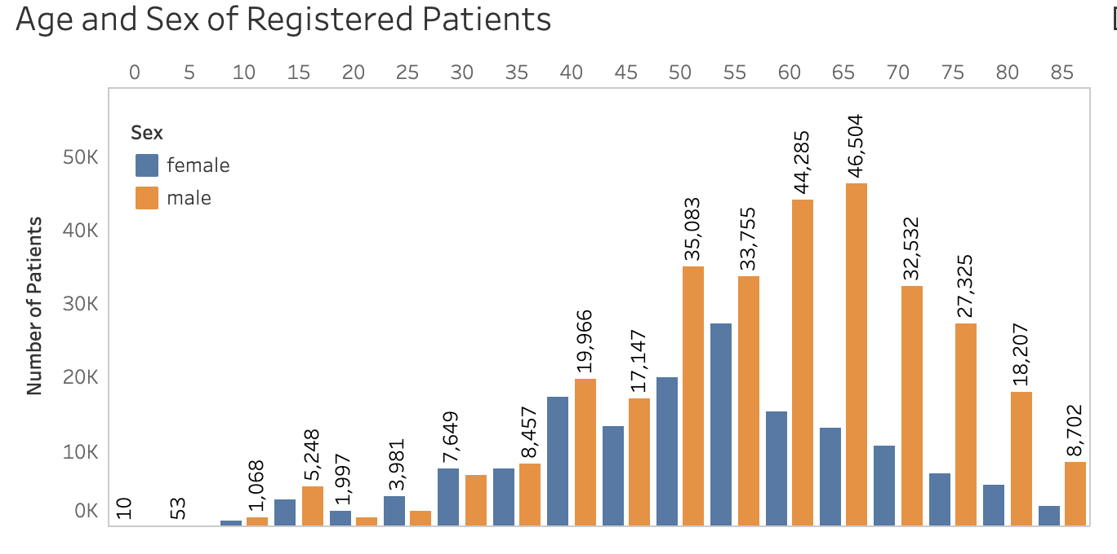
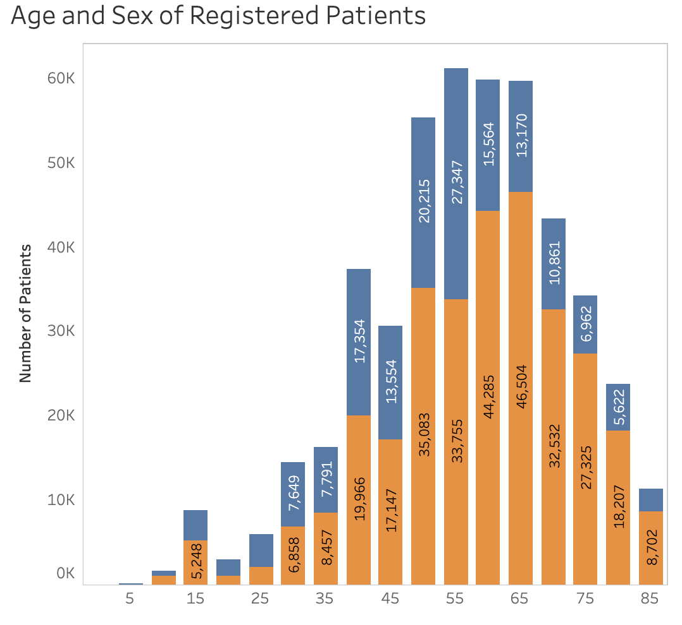
Data Sources
Dataset: ISIC Database
Source: ISIC-2024 .
Size: 401,059 images.
Type: Dermatology images with metadata (e.g., gender, age, diagnosis).
Quality: High-quality, well-annotated medical images suitable for deep learning training.
Time Frame:
2024 version with data spanning multiple years of medical image collection.
Notes:
Gastric cancer: from “most common cancer” to “regionally prevalent disease”.
Peptic ulcer disease: from an incurable chronic disease to a reduced prevalence due to Helicobacter pylori treatment.

Slide 11
Data Sources
Rationale for Selection
Rich Data: Covers diverse lesion types and metadata features.
Transparency: Openly accessible, ideal for model development and comparison.
High Quality: Accurate annotations ensure reliability for research.
Notes:
Gastric cancer: from “most common cancer” to “regionally prevalent disease”.
Peptic ulcer disease: from an incurable chronic disease to a reduced prevalence due to Helicobacter pylori treatment.

Slide 12
Variables
Independent Variables
Image Features: High-dimensional features extracted using CNN.
Metadata Features: Gender, age, ethnicity, lesion location, etc.
Dependent Variables
Binary classification (melanoma or not)- for the Melanoma Diagnosis
Covariates
Image Conditions: Lightness, resolution, etc.
Health Status: Other skin conditions.
Notes:
Gastric cancer: from “most common cancer” to “regionally prevalent disease”.
Peptic ulcer disease: from an incurable chronic disease to a reduced prevalence due to Helicobacter pylori treatment.

Slide 13
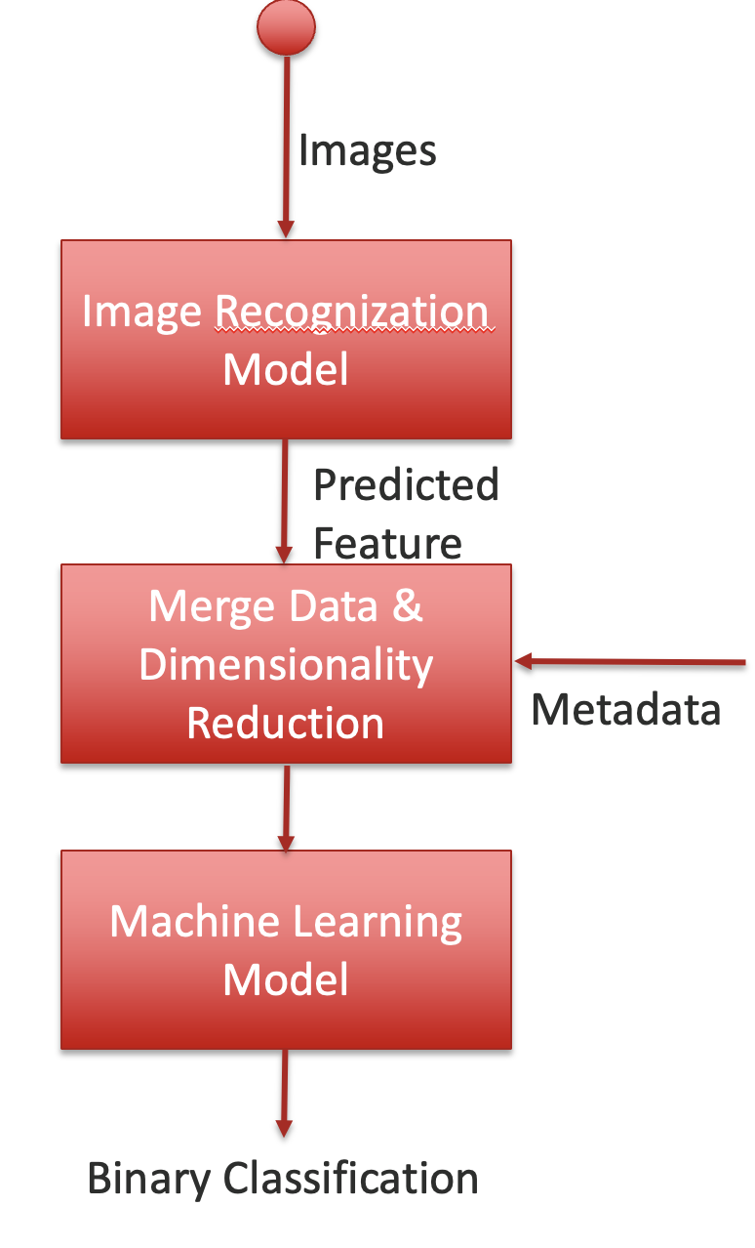
Variables
Images
Conceptual Framework
Input Layer
Image Data: Feature extraction via deep learning.
Metadata: Feature importance analysis using machine learning.
Fusion Layer:
Dimensionality reduction with PCA.
Multimodal fusion using Random Forest, Catboost, XGBoost, SVM and MLP.
Output Layer:
Binary classification (melanoma or not).
Image Recognization Model
Predicted Feature
Merge Data & Dimensionality Reduction
Metadata
Machine Learning Model
Binary Classification
Notes:
Gastric cancer: from “most common cancer” to “regionally prevalent disease”.
Peptic ulcer disease: from an incurable chronic disease to a reduced prevalence due to Helicobacter pylori treatment.

Slide 14
Hypothesis
Compared to methods that rely only on a single modality, multimodal models can provide higher classification accuracy, sensitivity, and specificity by integrating different types of data sources, leading to more precise identification of melanoma.
H₀ (null hypothesis): The performance (e.g., accuracy, sensitivity, specificity, AUC value) of multimodal models in melanoma detection is not significantly improved compared to unimodal models.

Slide 15
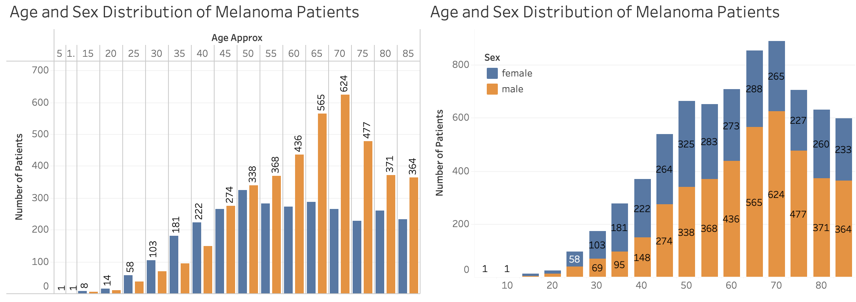
Data Analysis

Slide 16
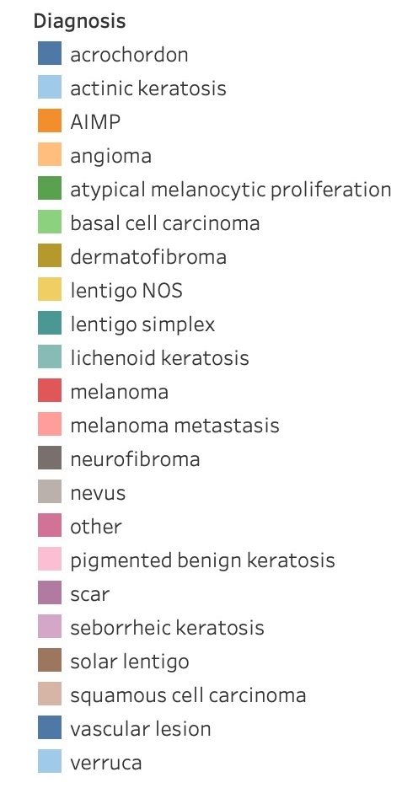
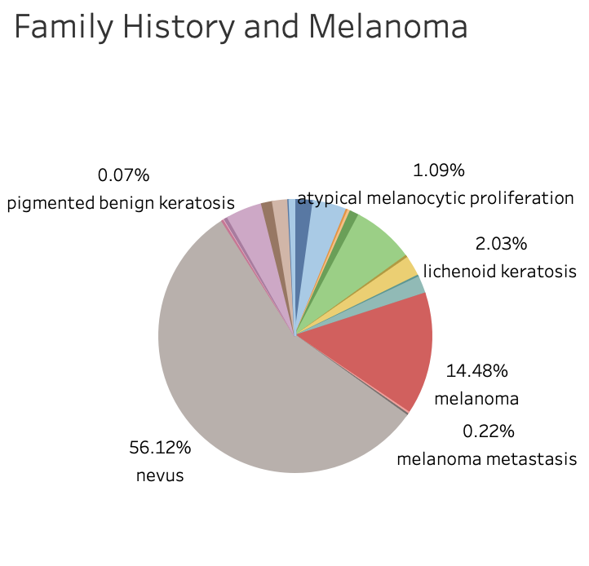
Data Analysis

Slide 17
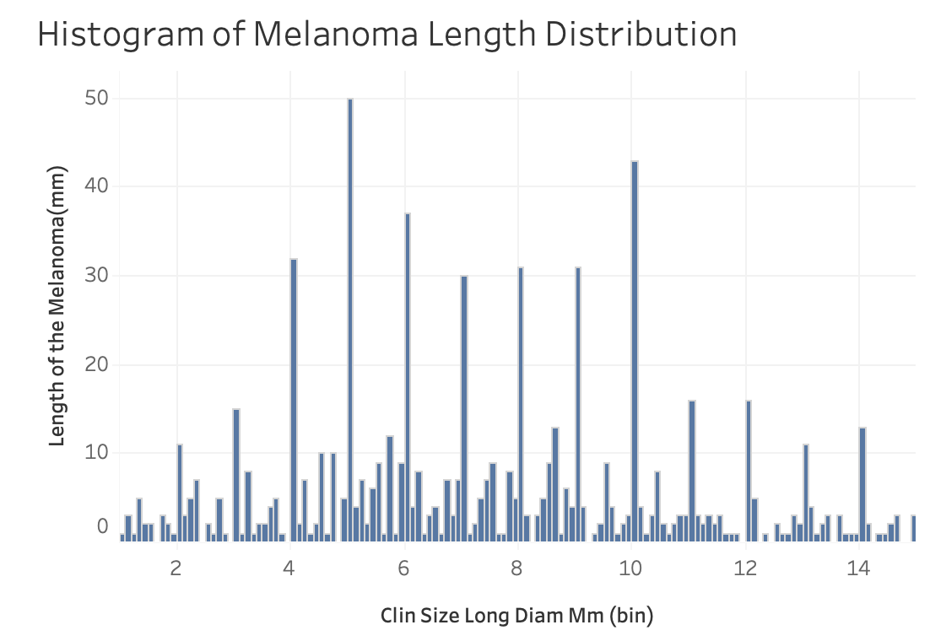
Data Analysis

Slide 18
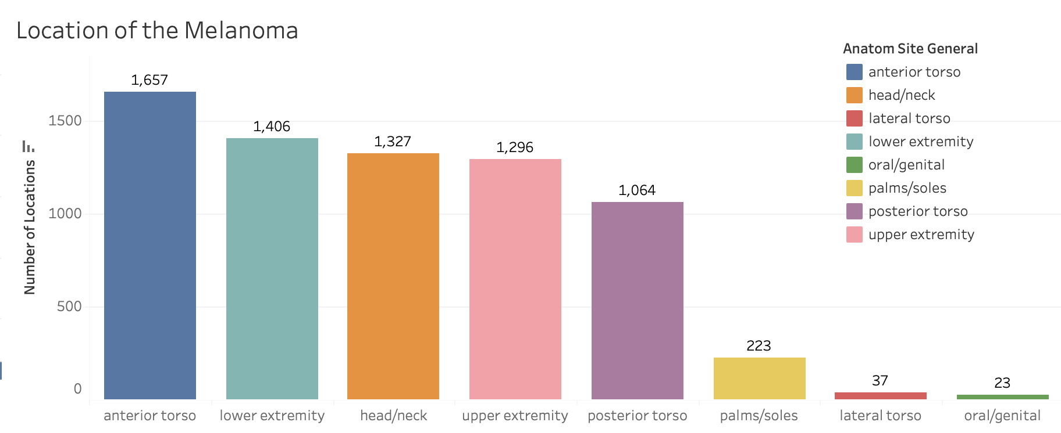
Data Analysis

Slide 19
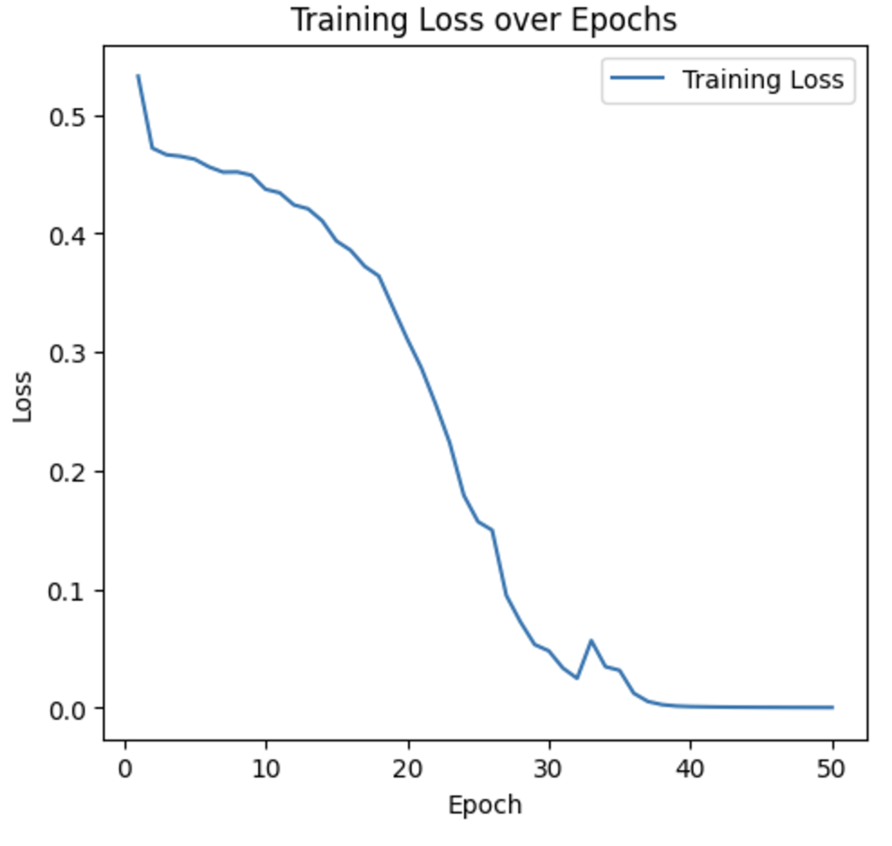
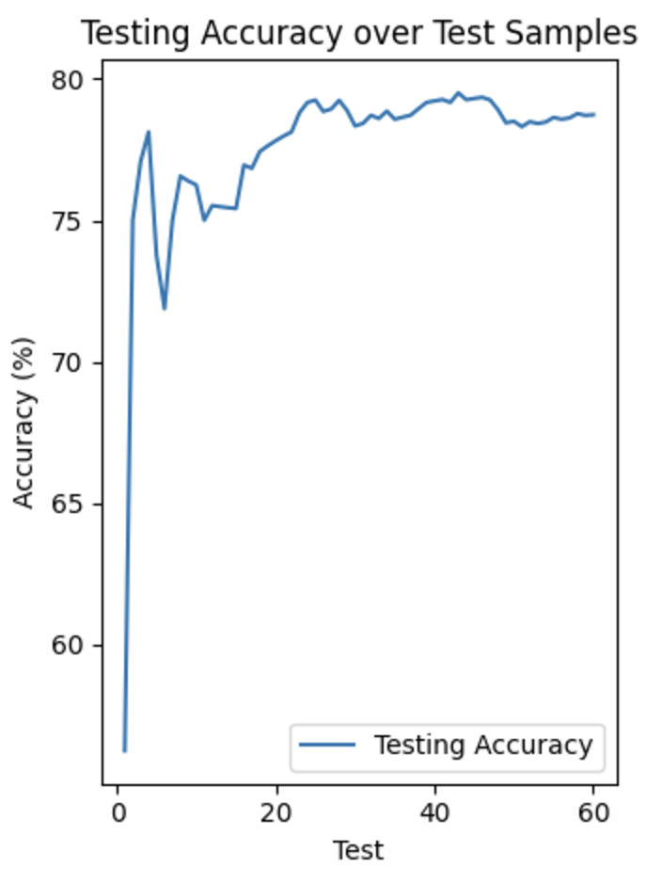
Results —— CNN
The loss value gradually decreases with training iterations, indicating that the model's fit on the training set gradually improves.
The final loss converges to 0, indicating that the model converges well. The test accuracy gradually improves and stabilizes, eventually reaching about 80% or more, indicating that the model has good generalization ability on the test set.
The final recognition accuracy of our CNN model is 78.73%. It is able to recognize most non-melanoma cases, but it is not accurate enough for melanoma.

Slide 20
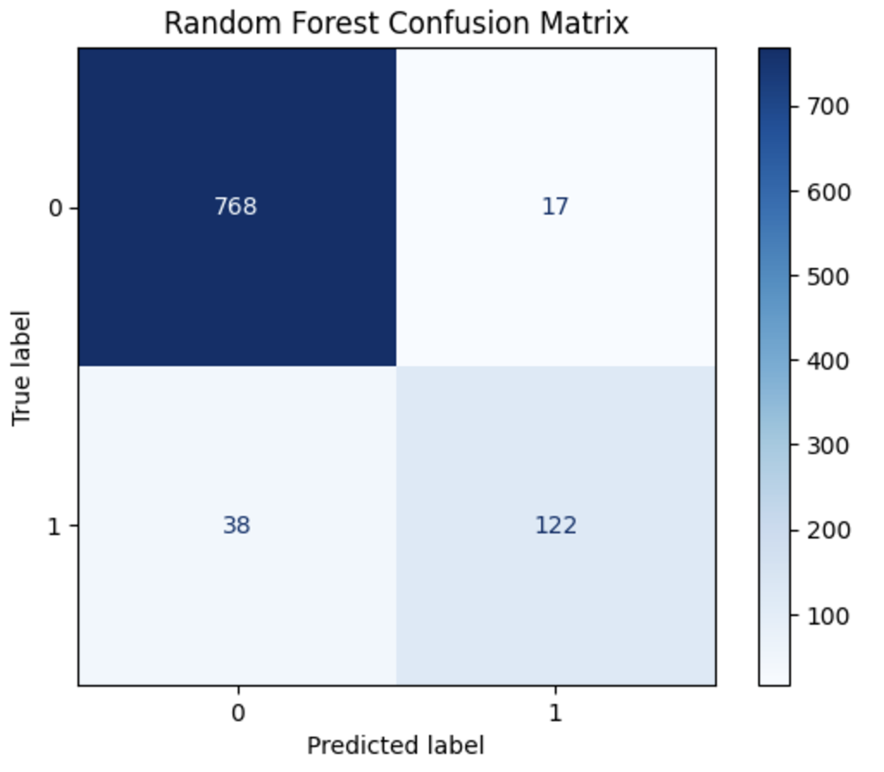
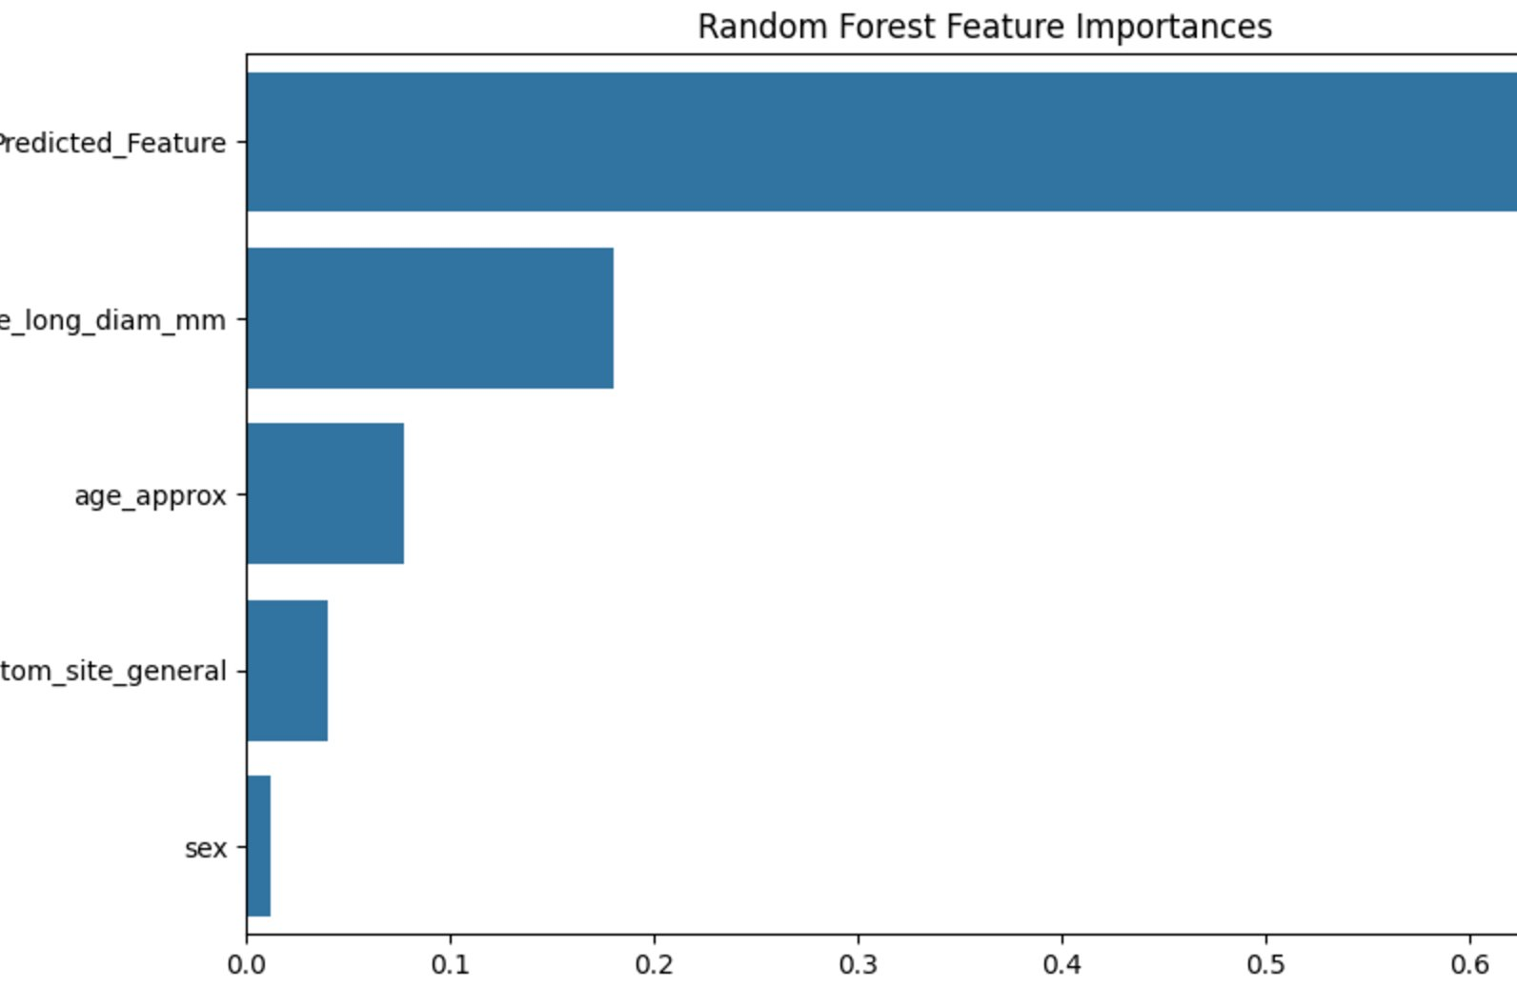
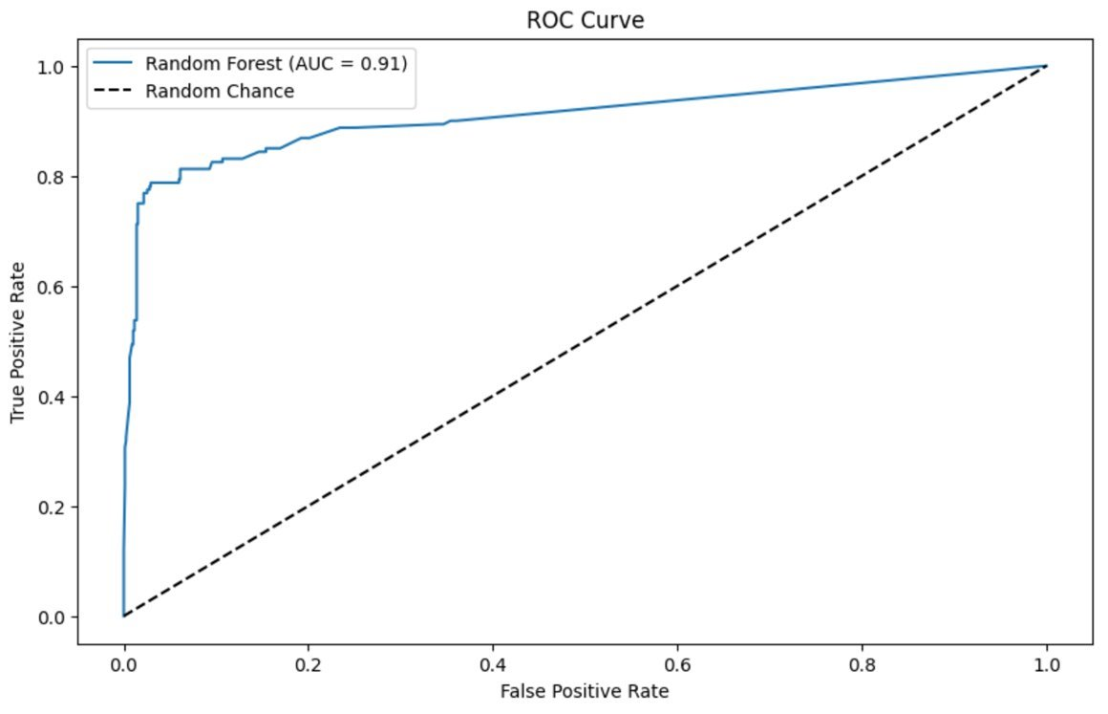
Results —— Random Forest
With the confusion matrix we can calculate the accuracy, precision, recall, etc. to evaluate the model.
We chose to use histograms to understand, the contribution or importance of features in the black box.
We plotted the ROC graph to evaluate the performance of the binary classification model.
Recognition accuracy after using the random forest model is 94.18%

Slide 21
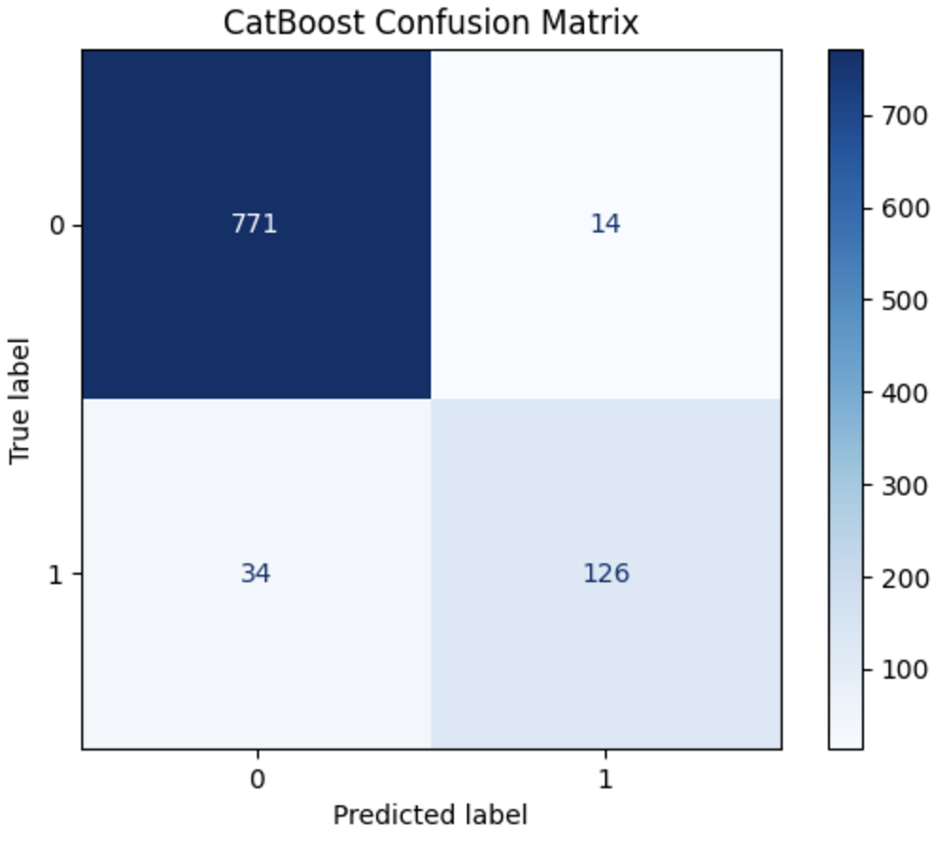
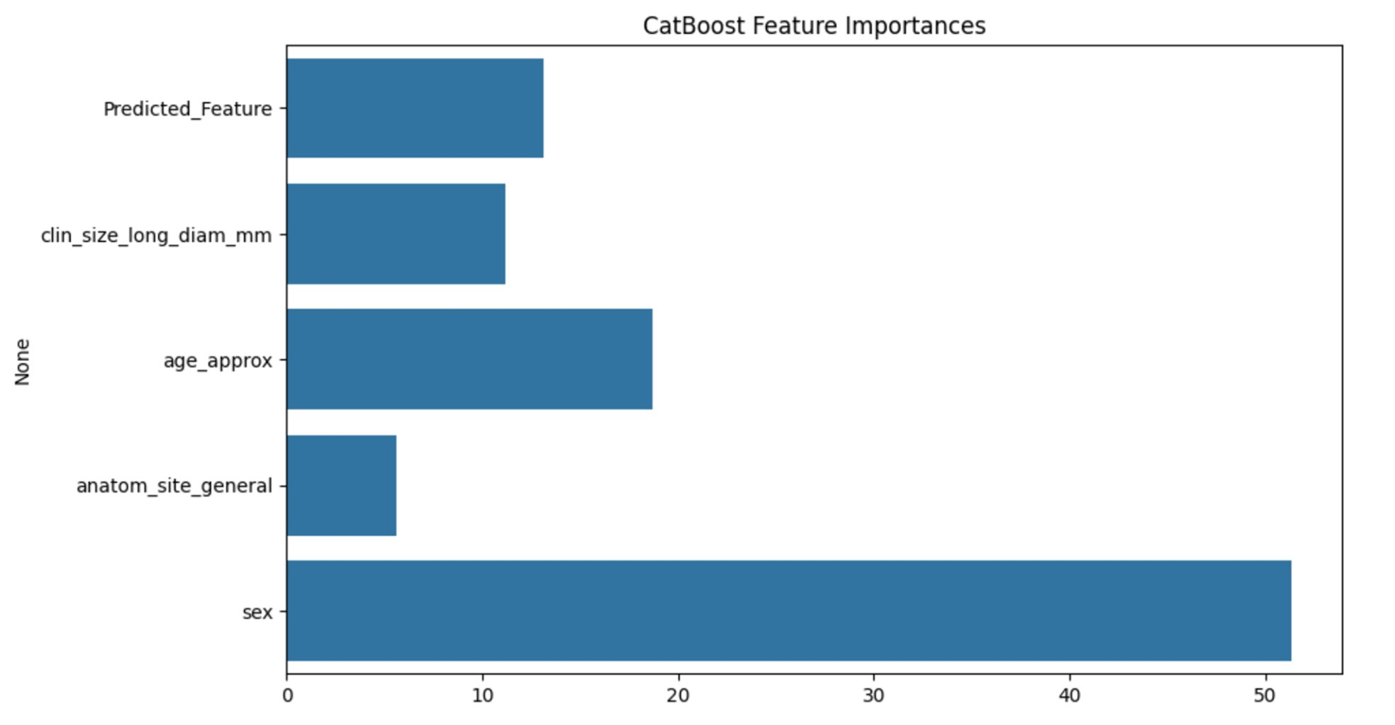
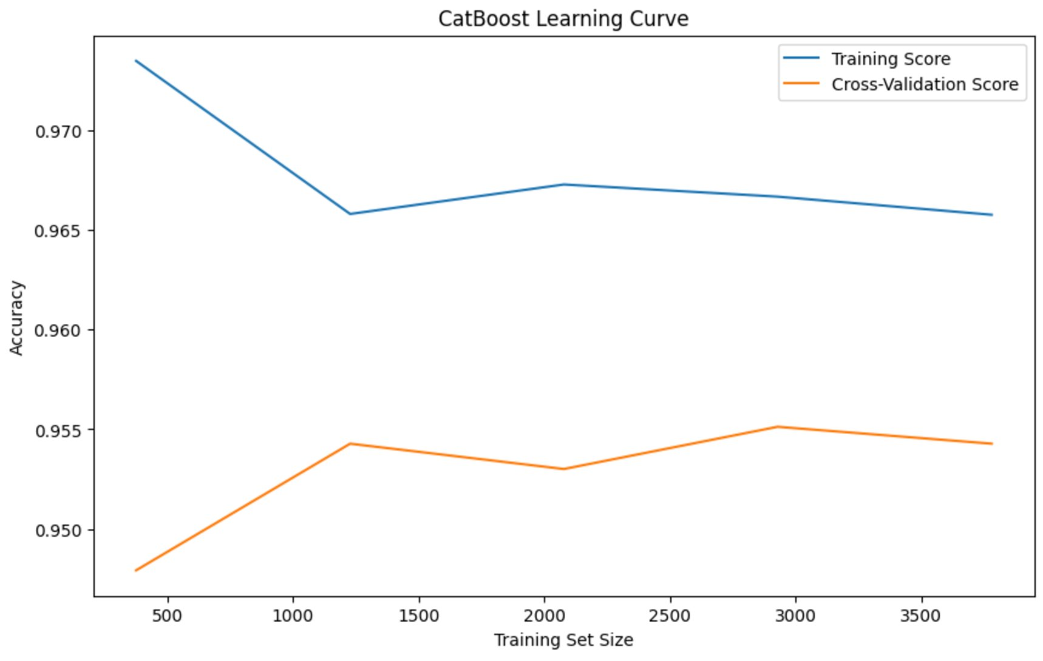

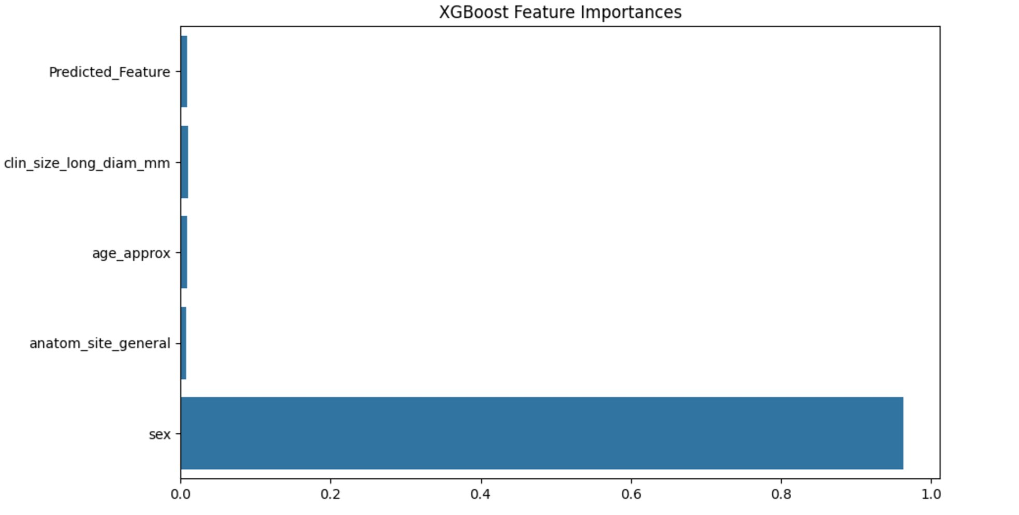
Results —— CatBoost & XGBoost
The blue curve shows that the model's accuracy on the training set is consistently higher than the cross-validation accuracy, indicating that the model fits the training data well.
The orange curve gradually rises and stabilizes with the increase of training samples, indicating that the model's performance on unseen data gradually improves as the amount of data grows.
The gap between the blue and orange curves reflects the degree of overfitting of the model.
We ended up with an accuracy of 94.92% with Catboost and 94.29% with XGBoost.

Slide 22
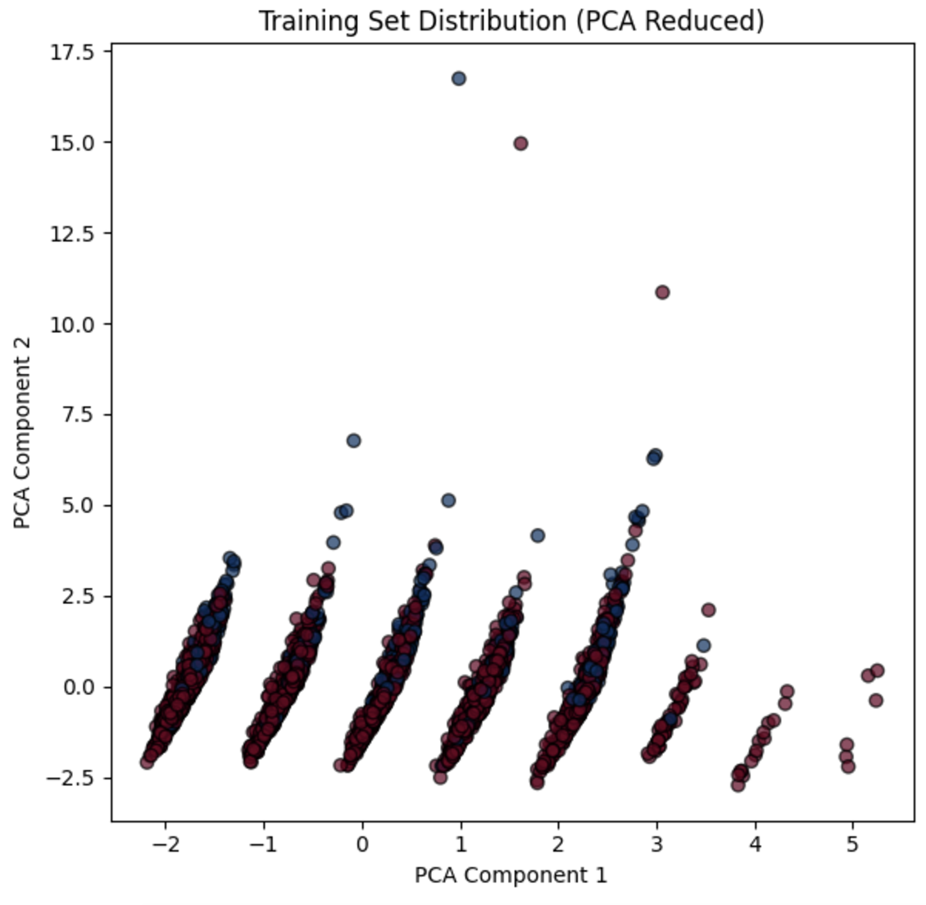
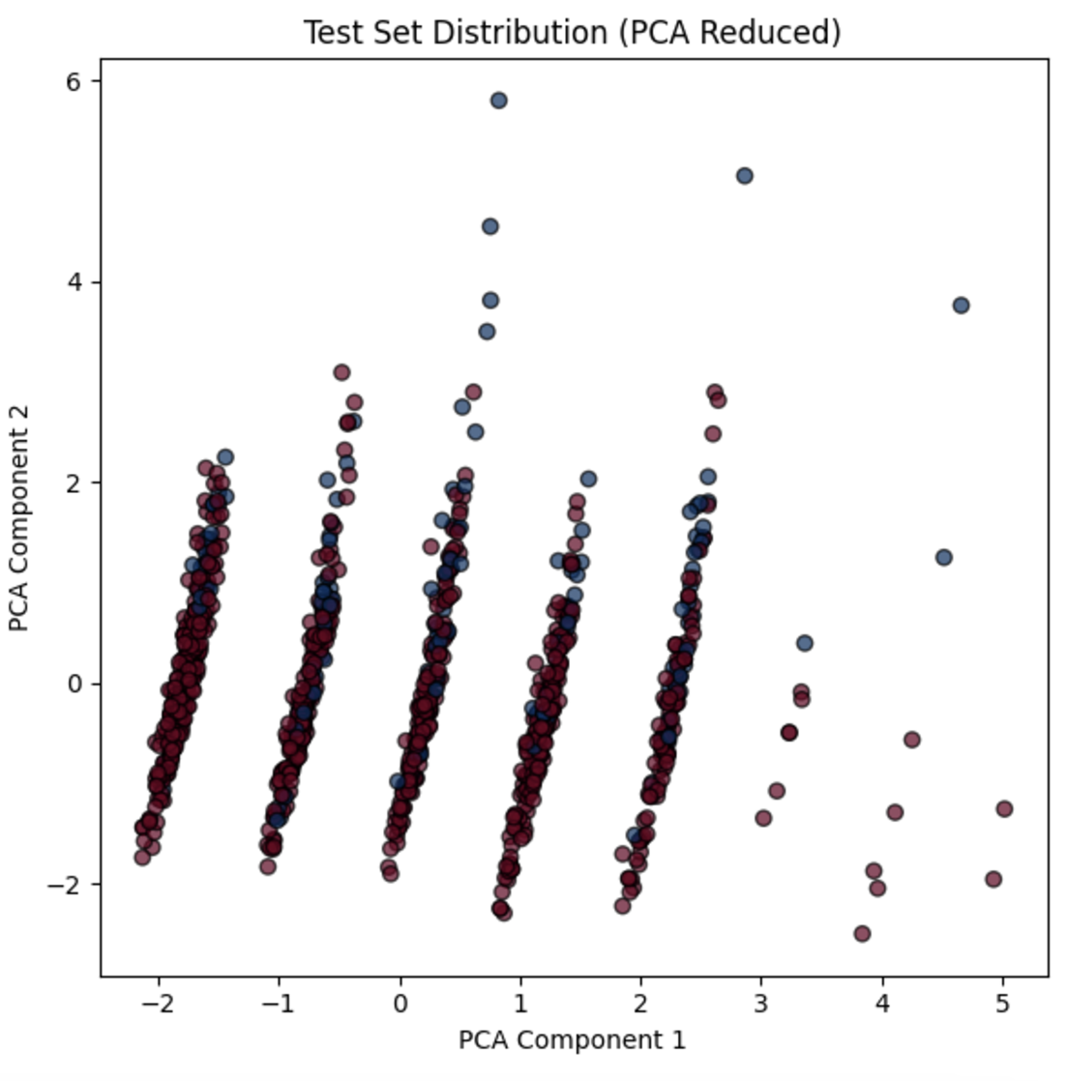
Results —— SVM
The distribution graph after dimensionality reduction by PCA shows that the distribution of data features in the training set and test set is consistent, and the model has good generalization ability.
However, the overlapping region between the data points may indicate the difficulty of distinguishing between the categories, and the classification effect needs to be further improved by more complex models or feature engineering.

Slide 23
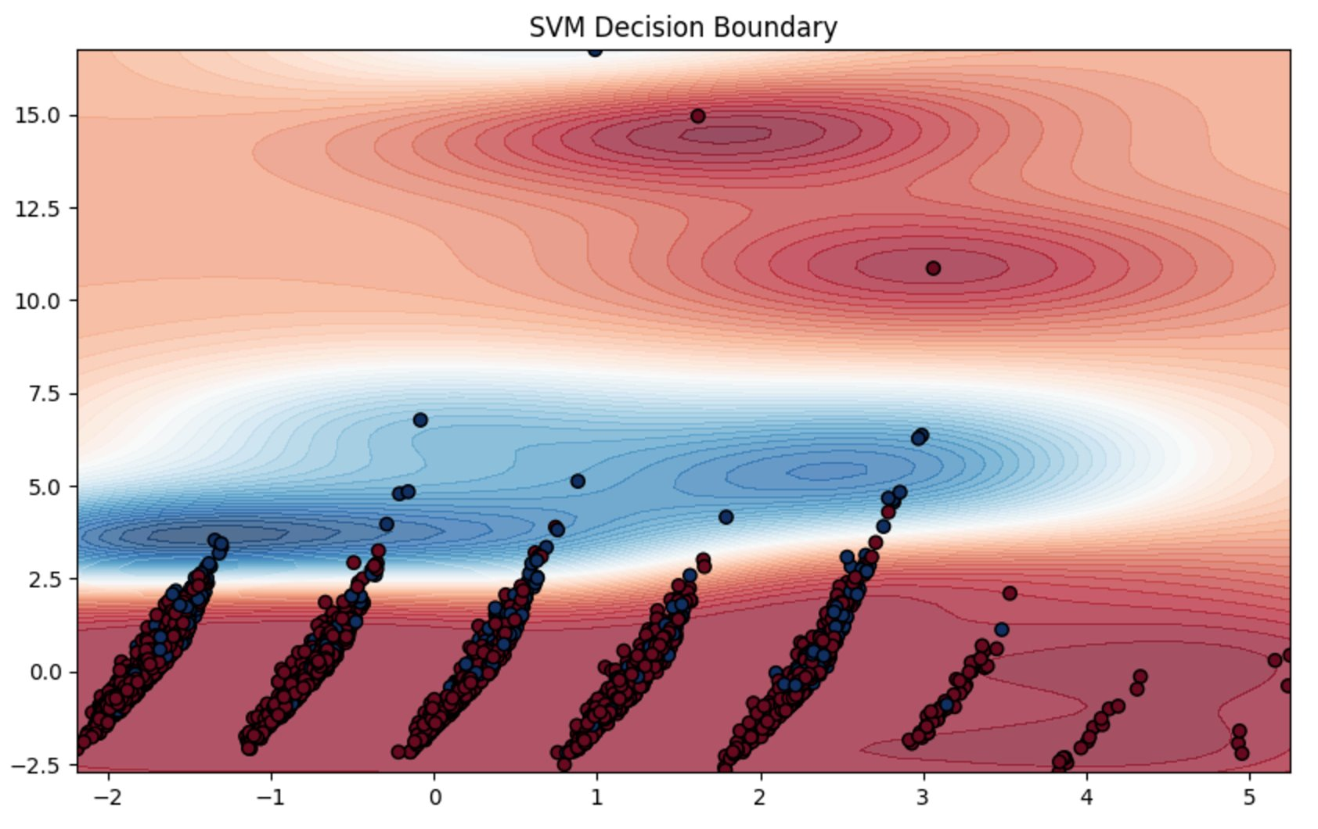
Results —— SVM
The red area indicates the range belonging to category 1, and the blue area indicates the range belonging to category 2. The gradient color indicates the model's confidence in the classification. The darker the color, the more certain the classification is; the lighter the color, it represents an increase in uncertainty and approaching the decision boundary.

Slide 24
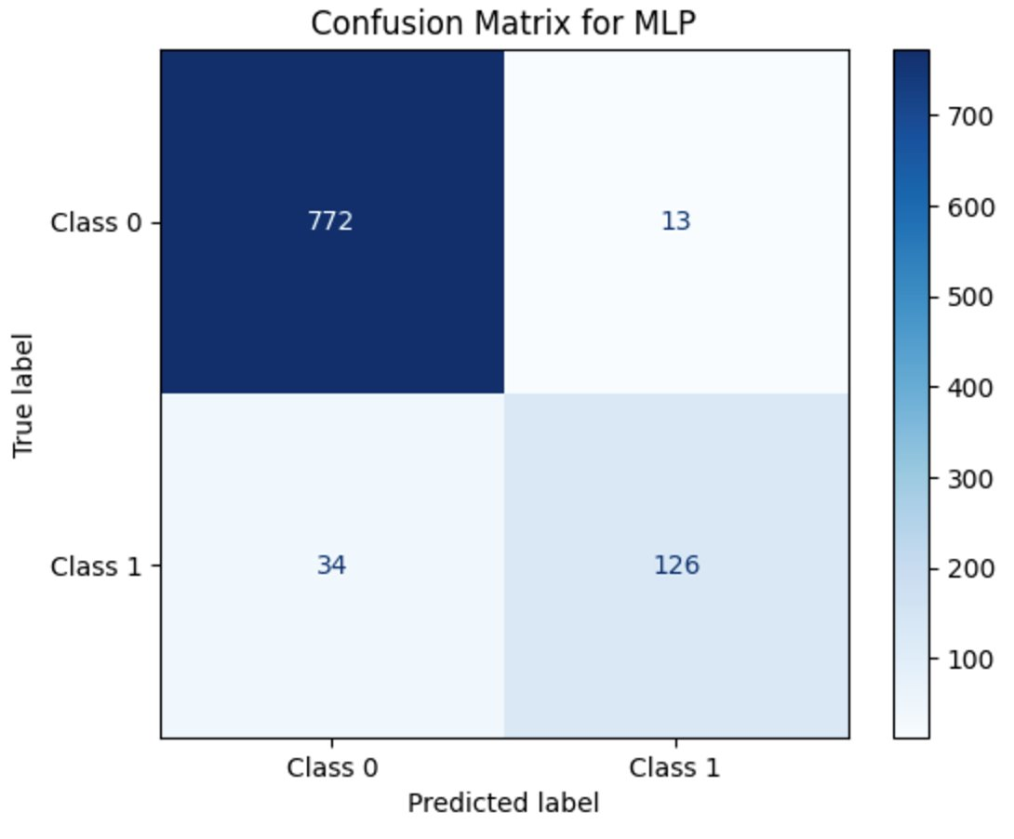
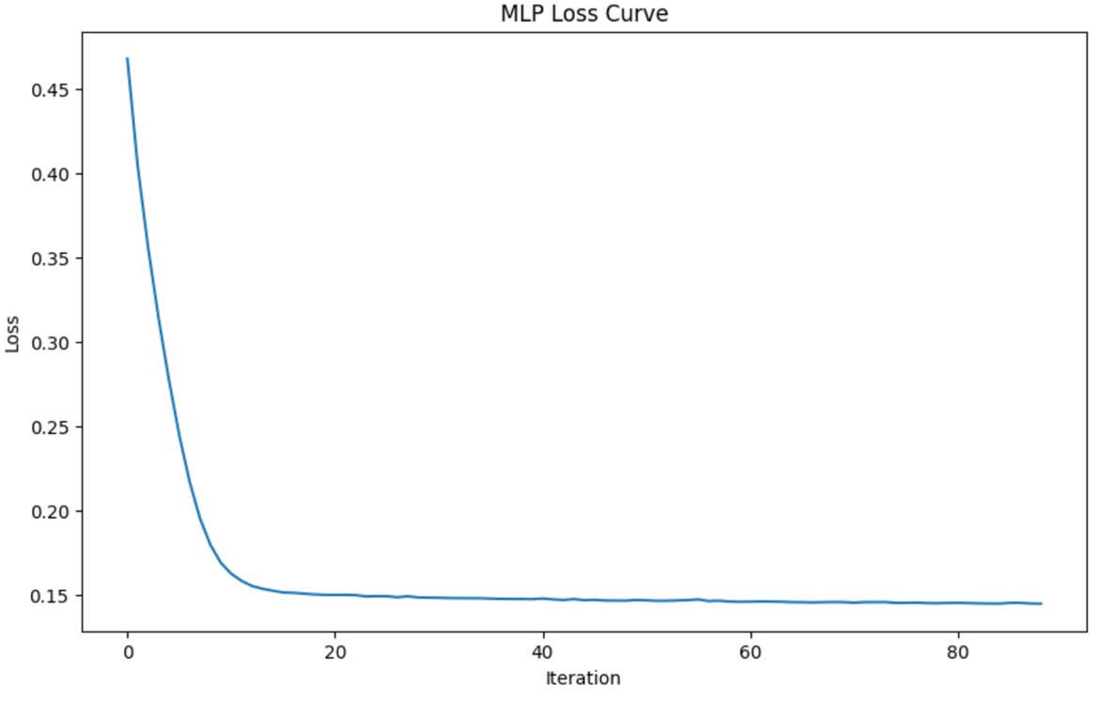
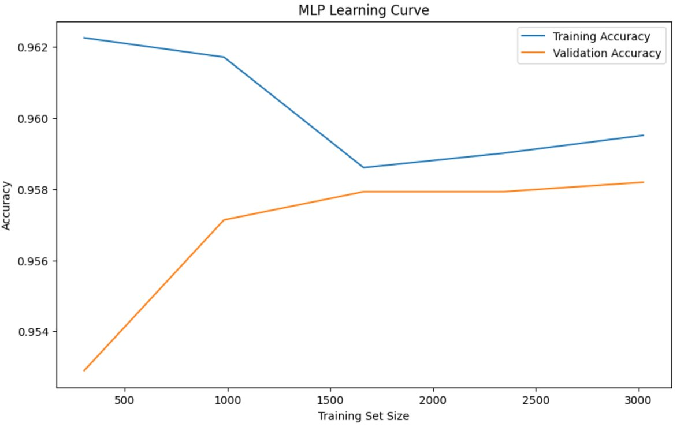
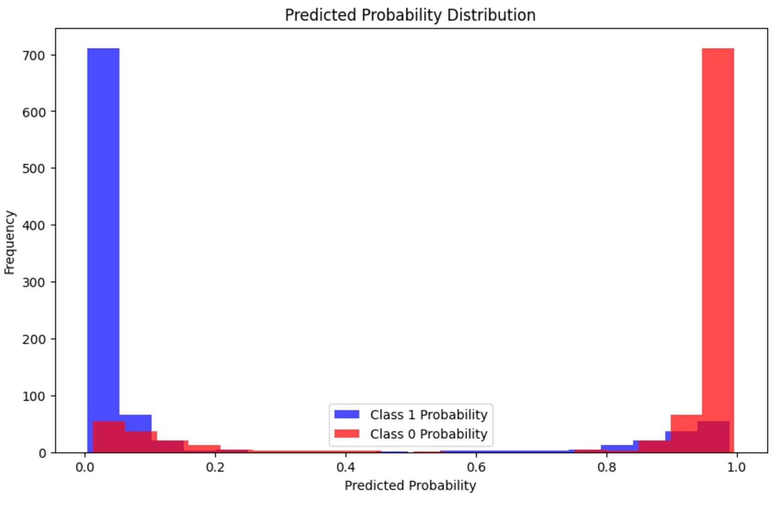
Results —— MLP

Slide 25
Results
Model | Accuracy
CNN | 78.73%
CNN+Random Forest | 94.18%
CNN+Catboost | 94.92%
CNN+XGBoost | 94.29%
CNN+SVM | 83.39%
CNN+MLP | 95.03%

Slide 26
Strengths
Data collection is more flexible, with patients providing their own images (e.g., photographs of lesion locations) and basic physiological characteristics (e.g., gender, age, etc.), which lowers the threshold for collecting specialised medical data and allows for a wider range of technology applications.
CNN results are stored in metadata as a ‘feature’ of the ‘diagnostic recommendation’ and predicted using a deep learning model, which improves the prediction accuracy compared to traditional methods.

Slide 27
Limitations
While the model performs well on this dataset, performance in real clinical scenarios may be affected by differences in data distribution or untreated artefacts, reducing its applicability.
Some of the methods may require higher computational resources, which limits their practical application in low-resource environments.

Slide 28
Future Directions
While conducting the literature review, we found some studies that used hair elimination algorithms to process images in the data preprocessing stage and demonstrated that the method has a positive effect on melanoma identification. However, due to time constraints, we were not able to reproduce this work, which can be used as a direction for future improvement.

Slide 29
Future Directions
In terms of data dimensionality reduction, we mainly process image data through convolution and pooling, while for metadata sets, we adopt the PCA method. However, in the subsequent learning, we realize that t-SNE may be a better choice for dimensionality reduction, which is worth exploring and trying in the future.

Slide 30
Future Directions
we plan to introduce a ResNet model to compare with the underlying CNN model to explore which image recognition model is better suited for this task, as well as to enrich our presentation. This part of the work can be further optimized in the future.

Slide 31
Conclusion
Multimodal models, by integrating multiple data sources, demonstrate significantly superior performance in terms of classification accuracy, sensitivity, specificity, and AUC values compared to unimodal models.
Among the submodels within the multimodal framework, the Multi-Layer Perceptron (MLP) model stands out, achieving the highest performance metrics across all submodels, thereby demonstrating its exceptional applicability and potential within the multimodal framework.
The model (CNN+MLP) achieving a notably high accuracy, with a performance of 95.03%, highlighting its superior effectiveness in classification tasks.

Slide 32
Reference
Akram, T., Khan, M. A., Sharif, M., & Yasmin, M. (2018). Skin lesion segmentation and recognition using multichannel saliency estimation and M-SVM on selected serially fused features. Journal of Ambient Intelligence and Humanized Computing. https://doi.org/10.1007/s12652-018-1051-5
Faizi, M. I., & Adnan, S. M. (2024). Improved segmentation model for melanoma lesion detection using normalized cross-correlation-based k-means clustering. IEEE Access. https://doi.org/10.1109/ACCESS.2024.3360223
Goyal, M., Yap, M. H., & Hassanpour, S. (2017). Multi-class semantic segmentation of skin lesions via fully convolutional networks. arXiv preprint arXiv:1711.10449. https://doi.org/10.48550/arXiv.1711.10449
Guo, Y., & Ashour, A. S. (2018). Multiple convolutional neural networks for skin dermoscopic image classification. arXiv preprint arXiv:1807.08114. https://doi.org/10.48550/arXiv.1807.08114
Meel, V., & Bodepudi, A. (2021). Melatect: A machine learning model approach for identifying malignant melanoma in skin growths. arXiv preprint arXiv:2109.03310. https://doi.org/10.48550/arXiv.2109.03310
Nugroho, E. S., Ardiyanto, I., & Nugroho, H. A. (2024). Addressing imbalance ISIC-2019 dataset in dermoscopic pigmented skin lesion classification. ICIC Express Letters, 18(6), 563–573.
Yao, C. (2023). A comprehensive evaluation study on risk level classification of melanoma by computer vision on ISIC 2016-2020 datasets. arXiv preprint arXiv:2302.09528. https://doi.org/10.48550/arXiv.2302.09528

Slide 33
Thank you for your time and attention.

Slide 34
Bar Chart
Bar charts are better for quantitative comparisons across categories.
The bar chart format allows for an easy comparison of melanoma incidence across age groups and between sexes. This detailed view highlights the age-related trends and gender disparities in melanoma diagnoses, emphasizing the need for targeted prevention and early detection strategies for high-risk groups, particularly older males.

Slide 35
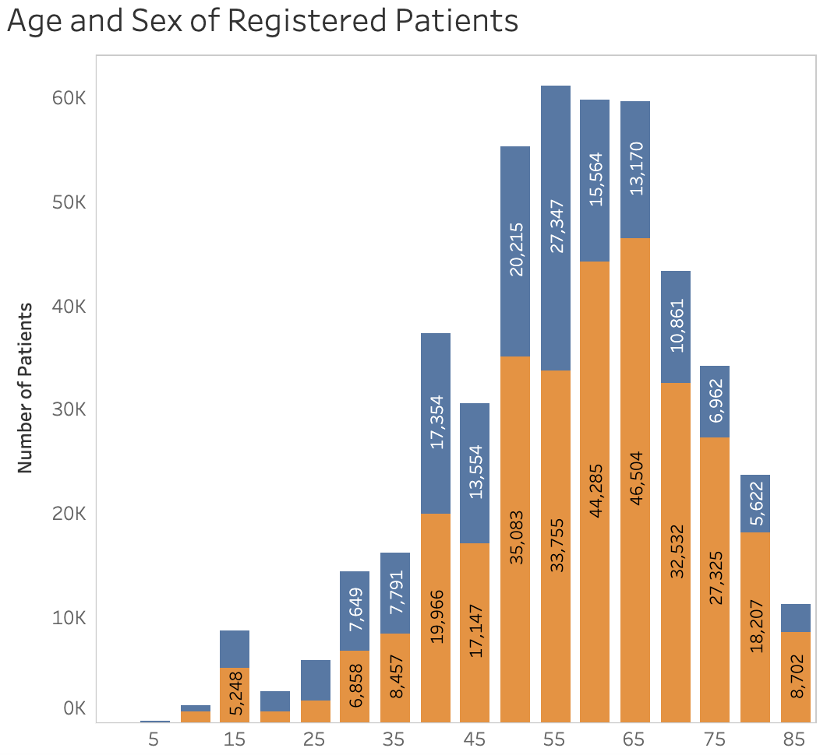
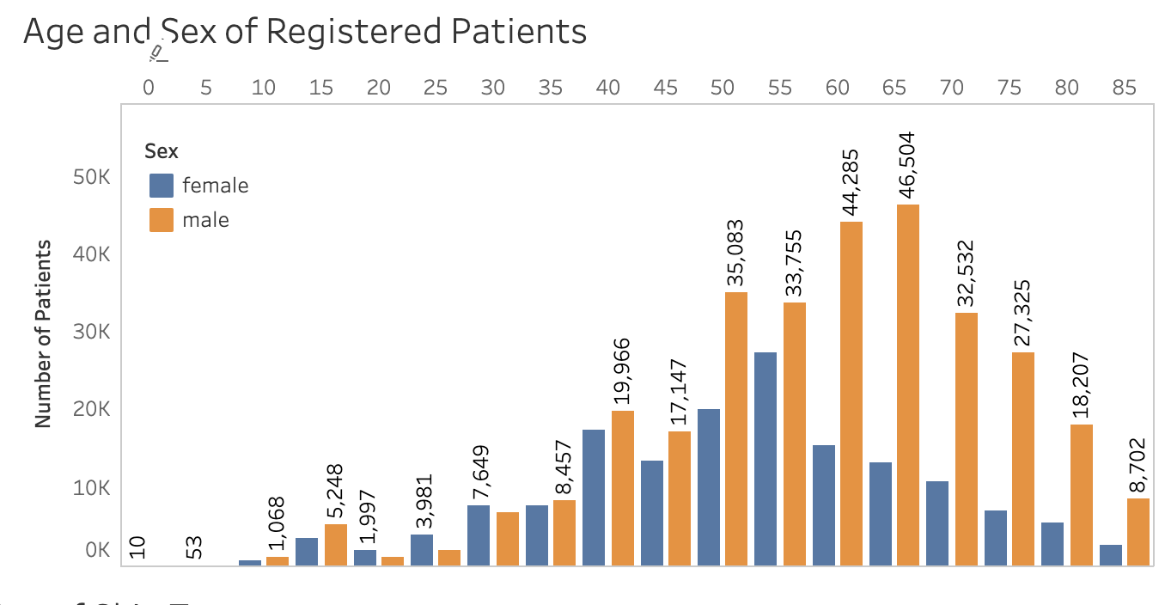
Bar Chart
Bar charts are especially useful for quantitative comparisons between categories, as shown here, where the differences in male and female patient numbers at various age ranges can be directly observed and analyzed. It provides a clear visualization of the number of male and female patients across different age groups, making it easy to identify trends and patterns.

Slide 36
Bar Chart
Bar charts are better for quantitative comparisons across categories.
The bar chart is ideal for showing this frequency distribution across melanoma sizes, making it easy to identify common length ranges. It emphasizes the importance of focusing diagnostic tools on the most frequently observed tumor sizes while also working to improve the early detection of smaller lesions. This data is crucial for refining diagnostic techniques and understanding tumor progression.
Tumor size is an important diagnostic and prognostic factor for melanoma. The chart’s distribution reflects typical tumor sizes at diagnosis, which can help guide expectations for early screening and management practices.

Slide 37
Bar Chart
Bar charts are better for quantitative comparisons across categories.
The bar chart effectively visualizes the distribution of melanoma locations, making it easy to compare prevalence across body regions. This information helps prioritize screening efforts and develop location-specific diagnostic tools, improving early detection in both common and rare sites of melanoma.

Slide 38
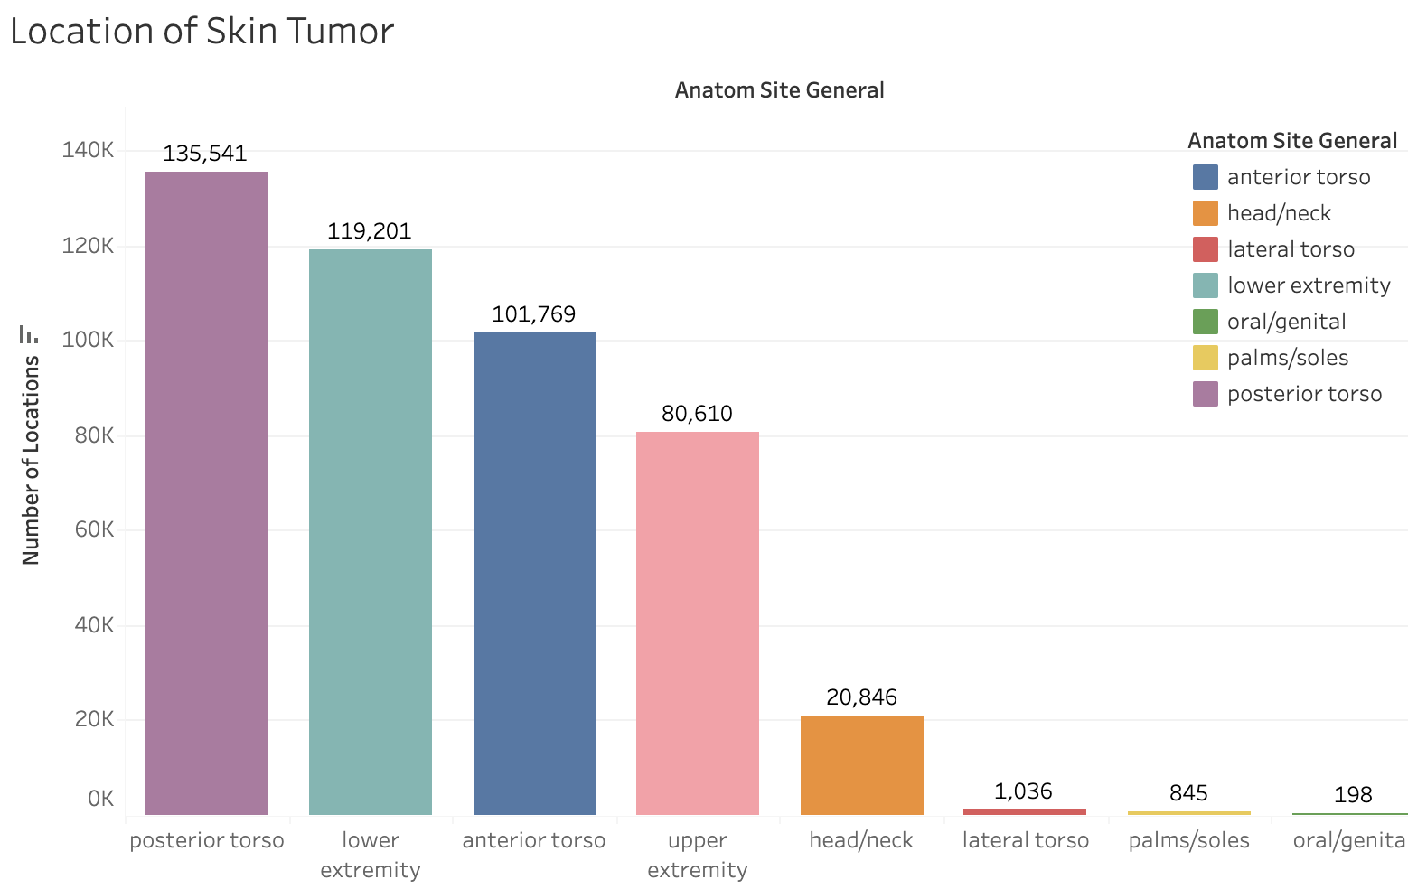
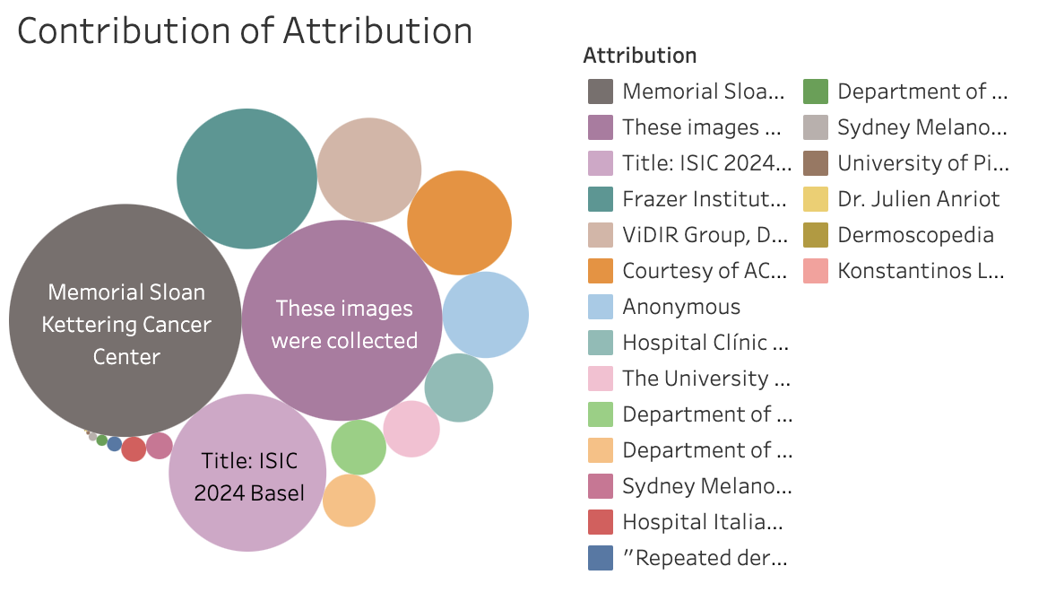
Bar Chart
This histogram shows the distribution of lesion diameters in millimeters across the dataset.
Bar charts clearly display these comparisons, making it easy to see which locations are more or less affected.
Each bar’s height represents the exact number of tumors for a specific location. This makes it simple to determine the relative frequency of tumors in different regions, such as the high prevalence in the torso compared to rare locations like the palms/soles.

Slide 39
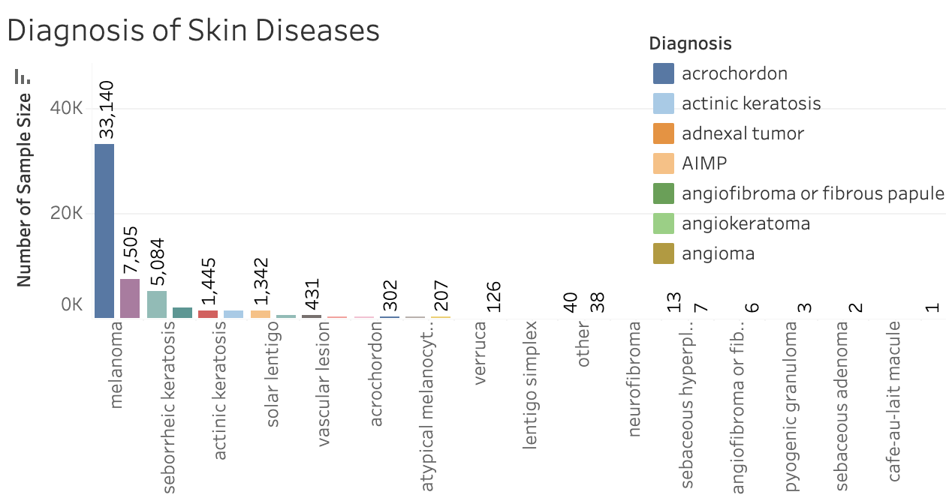
Bar Chart
Each disease (e.g., melanoma, keratosis) represents a category, not a continuous variable. A bar chart is ideal for displaying the number of cases in these discrete categories.

Slide 40
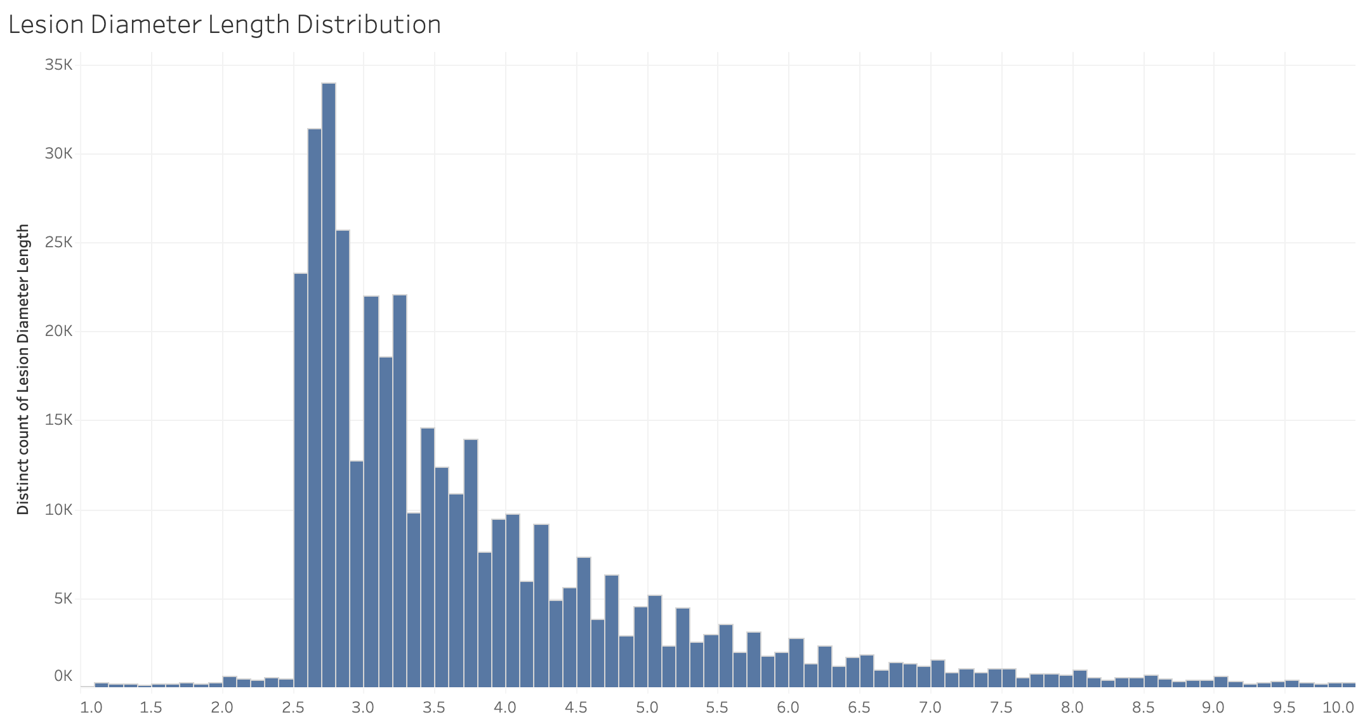
Bar Chart
Lesion diameter is a continuous variable, and a bar chart (histogram) is ideal for visualizing its frequency distribution.
The bar chart effectively highlights patterns, such as whether smaller or larger lesions are more common. It provides an overview of the most frequent lesion sizes, aiding in understanding the dataset's characteristics.

Slide 41
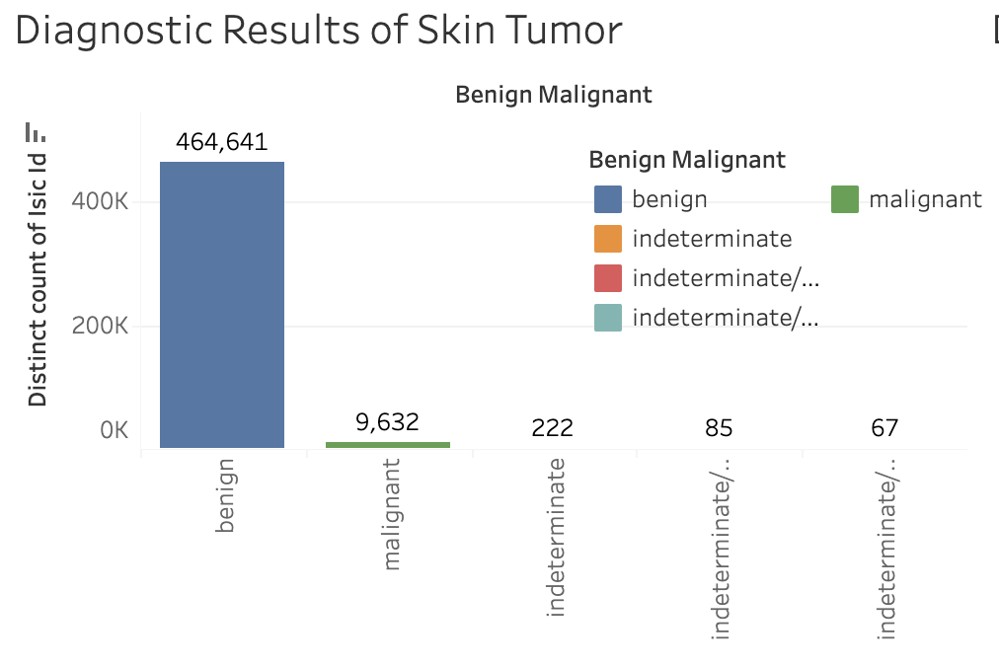
Bar Chart
the bar chart enables researchers to compare the relative frequencies of each diagnostic category quantitatively. This is critical for identifying potential class imbalances in the data, which could influence the performance of machine learning models. Such insights guide the development of more balanced and effective predictive models.
This bar chart is used to clearly visualize the distribution of diagnostic results for skin tumors across different categories (e.g., benign, malignant, and indeterminate). By presenting the data in a straightforward format, it highlights the prevalence of benign cases compared to malignant and indeterminate cases, allowing for a quick and effective understanding of the dataset’s composition.

Slide 42
Pie Chart
Pie charts are better for showing proportions of a whole when the focus is on understanding how much each part contributes to the total.
The pie chart is used here because it effectively communicates proportions and helps viewers quickly understand which factors are more prominent in the family history of melanoma patients. It highlights the overwhelming contribution of nevi and melanoma compared to other conditions. This visualization emphasizes the need to further study these dominant categories for their role in melanoma development

Slide 43
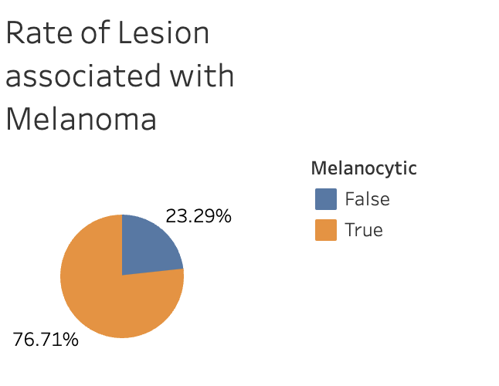
Pie Chart
The pie chart highlights potential imbalances between the two categories, which could be critical for model development and evaluation. Understanding the distribution of melanocytic versus non-melanocytic lesions ensures that machine learning algorithms are trained on a representative dataset and helps identify any potential biases in diagnostic outcomes.
This pie chart is used to present the proportion of lesions associated with melanoma, classified as either melanocytic or non-melanocytic. By visualizing the data as a percentage distribution, the chart provides a clear and immediate understanding of the relative frequency of melanoma-associated lesions, making it easier to grasp the overall dataset composition.

Slide 44
Confusion Matrix
The confusion matrix is an intuitive tool for evaluating the performance of a classification model. It shows the correspondence between the predictions and the true labels in a tabular form, where diagonal lines indicate the number of correct classifications and off-diagonal lines indicate the number of misclassifications. The confusion matrix makes it clear on which categories the model performs well and on which categories there are classification errors, revealing possible error patterns such as confusion between certain categories or higher errors for specific categories.
In addition, the confusion matrix is the basis for calculating key performance metrics (e.g., precision, recall, F1 score, etc.). These metrics provide a more comprehensive picture of the model's strengths and weaknesses than a single accuracy rate, and provide direction for optimization. Especially in multi-category classification problems, the confusion matrix can show the specific performance of the model for each category, which is an indispensable tool for analyzing and improving the model.

Slide 45
Feature Importance Bar Chart
The feature importance bar chart is drawn to visualize how much each feature in the model contributes to the prediction results, thus helping us to understand the decision logic of the model. Feature importance reflects the role that each feature plays in the model, with higher values indicating that the feature has a greater impact on the prediction results. With the histogram, researchers can quickly identify key features as well as features that contribute less to the results.
In addition, feature importance bar charts are particularly important for model optimization and interpretation. It can guide feature engineering, such as removing unimportant features to simplify the model, reducing computational costs, or focusing on enhancing data quality for important features. At the same time, this visualization enhances the interpretability of the model, especially in real-world applications, providing a clear basis for decision-making and increasing the credibility of the results.

Slide 46
Learning, Lossing and Test Curve
The learning curve shows how the model's performance on the training and validation sets changes as the number of training rounds or the amount of data increases. This can help determine whether the model is overfitting or underfitting: if the performance on the training set is high but the performance on the validation set is low, the model is overfitting; if the performance on both the training and validation sets is low, the model is underfitting. In addition, the learning curve can reveal the learning progress of the model, helping to determine whether more data is needed or to adjust the model complexity.
The loss curve records the change in loss values during model training and is usually plotted over time (training rounds). It visually demonstrates whether the model is converging gradually and reflects the stability and efficiency of the optimization process. If the loss value plateaus or fluctuates at a certain stage, it may indicate that the model has reached an optimal state or that the learning rate needs to be adjusted. By observing the loss curve, you can determine whether you need to stop early, adjust the hyperparameters or the optimizer.
The test curve describes the variation of a model's performance on a test set and is used to assess its generalization ability and performance on unseen data. It is an important means of verifying whether the model has practical application value. By observing the difference between the test curve and the validation curve, it is possible to find out whether there is any data leakage or distribution difference between the validation set and the test set, and to ensure the consistency and reliability of the model's performance.

Slide 47
ROC Curve
The ROC curve (Receiver Operating Characteristic Curve) is plotted to evaluate the performance of the classification model, especially the model's ability to classify under different thresholds. By demonstrating the relationship between the True Positive Rate (TPR) and the False Positive Rate (FPR), the ROC curve is able to visualize how well the model performs when balancing recall (sensitivity) and specificity.
The area under the curve (AUC, Area Under the Curve) is an important indicator of model performance. The closer the AUC value is to 1, the more superior the model is; close to 0.5 indicates that the model performance is close to random guessing. In addition, the ROC curve can help select the best classification threshold and compare the performance of different models. In practical applications, different scenarios may have different requirements for recall and specificity, and the most suitable threshold can be selected by observing the ROC curve. At the same time, the ROC curves of different models can visualize their advantages and disadvantages, which is convenient for decision makers to choose the optimal model for deployment.

Slide 48
PCA Scatter Diagram
PCA Distribution Scatter Plot (Principal Component Analysis Scatter Plot) is designed to visualize the structure and distribution of high-dimensional data in a low-dimensional space, which facilitates the analysis of the data's characteristic patterns and underlying relationships.PCA extracts the most dominant directions of change in the data by downscaling, and projects the high-dimensional data onto a few principal components, thus retaining as much information as possible while reducing the complexity of the data.
This visualization method is useful for discovering the cluster structure and classification boundaries of the data. In multi-category data, PCA scatter plots can visualize the distributional relationships between different categories and help identify potential patterns or outliers. In addition, such plots can be used as a reference for model optimization to determine whether the feature selection is reasonable and whether the reduced dimensionality data is suitable for further modeling.

Slide 49
SVM Decision Boundary Graph
Plotting the SVM decision boundary (with scatter plots, heatmaps, or contour plots) is a way to visually demonstrate how the Support Vector Machine separates different classes of data. SVM works by finding the maximum-margin hyperplane for classification, and the decision boundary plot clearly shows these boundaries and their influence on data points. This visualization allows us to intuitively understand how the model classifies data in different regions, especially when handling both linear and non-linear data, helping us understand the model's decision-making process.
Additionally, the SVM decision boundary plot is useful for diagnosing model performance and tuning. By observing the shape and position of the decision boundaries, we can identify issues such as overfitting or underfitting. Adjusting different kernel functions (such as polynomial or RBF kernels) and analyzing the resulting decision boundary provides intuitive feedback, which can guide parameter tuning and improve classification performance.

Slide 50
Predicted Probability Distribution Graph
The predicted probability distribution is plotted to visualize the distribution of the model's predicted probabilities for different categories. This visualization helps us understand the level of confidence in the model's predictions on each category, as well as the model's confidence in categorizing different data points. If the predicted probabilities of certain categories are concentrated at a particular value, it means that the model has a high level of certainty about these categories; conversely, if the probability distribution is relatively flat, it may indicate that the model has a high level of uncertainty about these categories.
Additionally, a predictive probability distribution plot can help diagnose the performance of a model. By looking at the shape of the probability distributions, it is possible to determine whether the model is overconfident (i.e., most probabilities are close to 0 or 1, which may result in overfitting) or underconfident (i.e., the probability distributions are smoother, which may result in underfitting). This graphical presentation helps to adjust the model's thresholds, regularization parameters, etc. to improve the model's generalization ability and stability.

