Slide 1
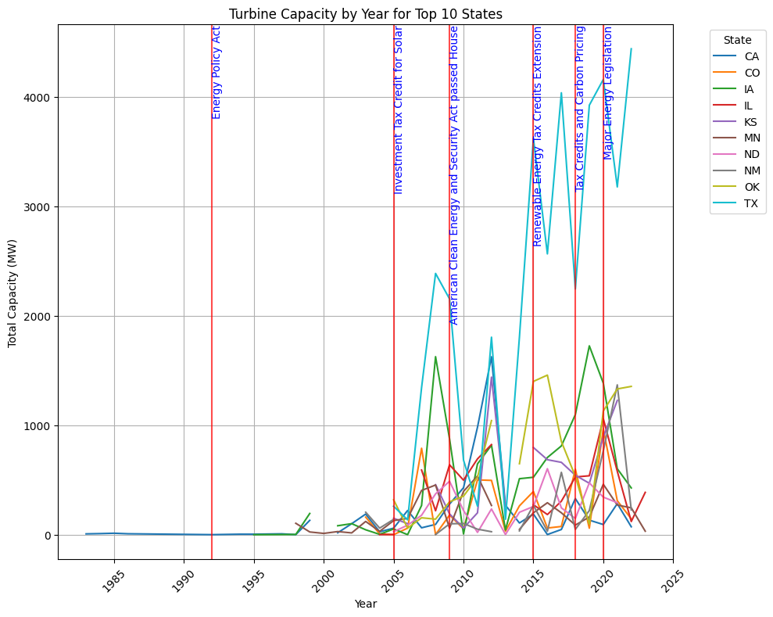

Slide 2
Analyzing Trends in Turbine Capacity
Analysis
The line graph represents the growth of turbine capacity in megawatts (MW) for the top 10 states from the early 1980s to 2025.
There is a general upward trend in turbine capacity over time, with significant growth observed after policy initiatives, indicated by the vertical lines.
The most substantial increases coincide with the Energy Policy Act and various tax credits, suggesting these policies have positively influenced turbine installations.
States like Texas (TX) and Iowa (IA) show particularly strong growth, which may be influenced by their natural wind resources in addition to policy support.

Slide 3
Conclusions and Future Directions
Conclusions:
Policy measures, particularly tax incentives and renewable energy legislation, are critical drivers of turbine capacity expansion.
The fluctuations and drops in some states' capacity post-policy expiration indicate the importance of sustained policy support.
The data suggests a correlation between policy initiatives and investment in turbine capacity, with lead times for reaction to policy changes.
For continued growth, a combination of long-term policies and natural resource utilization is recommended.

Slide 4
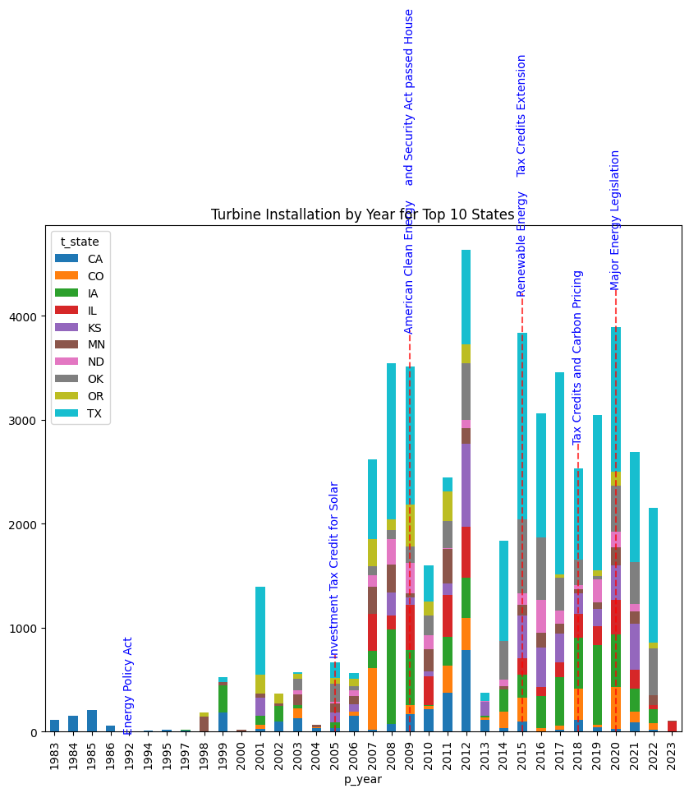

Slide 5
Analysis of Turbine Installation Trends
The plot illustrates the turbine installation trends by year across the top 10 states.
There is a noticeable increase in installations following specific policy implementations, such as tax credits and renewable energy legislation.
Texas (TX) consistently leads in the number of installations, which could be attributed to its favorable policies and possibly its geographic and wind profile.
The impact of policy is evident, with spikes in installations aligning with the introduction of tax credits and pricing incentives.

Slide 6
Conclusions and Implications
Policy incentives play a crucial role in the adoption of wind energy technologies, as indicated by the installation surges post-policy enactments.
The cyclical nature of installations suggests that temporary incentives may lead to a 'boom-bust' pattern, pointing to the need for stable long-term policies.
The variance among states highlights the importance of state-specific policies and incentives in driving renewable energy investments.
Future strategies should focus on sustaining growth through consistent policy support to avoid market volatility and to continue driving renewable energy adoption.

Slide 7
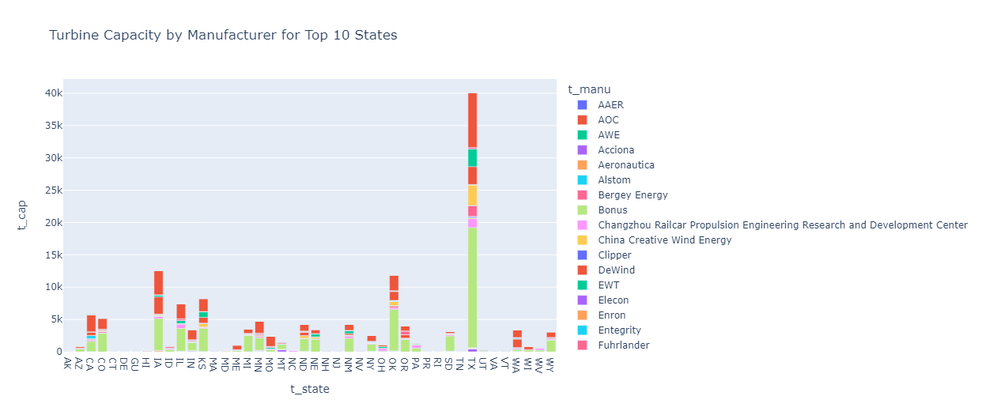

Slide 8
Analysis of Turbine Capacity by Manufacturer across Top 10 States
Analysis:
The distribution of turbine capacities varies significantly across manufacturers and states.
Certain manufacturers, such as those represented by the red bars, have a dominant presence in multiple states, indicating a strong market position.
The diversity of manufacturers within each state suggests a competitive market with multiple players.
Some states show a concentration of capacity from a single manufacturer, hinting at possible state-level agreements or preferences.

Slide 9
Conclusion
The wind energy market is both diverse and competitive, with no single manufacturer monopolizing the capacity across the top 10 states.
Manufacturers with a broader presence across states may benefit from economies of scale, potentially offering them a competitive advantage.
Policy makers and new market entrants should consider the varying state preferences and existing market shares when planning for expansion or entry.
Further analysis could explore the reasons behind the market share distribution, such as economic incentives, manufacturer reliability, or state renewable energy policies.

