Slide 1
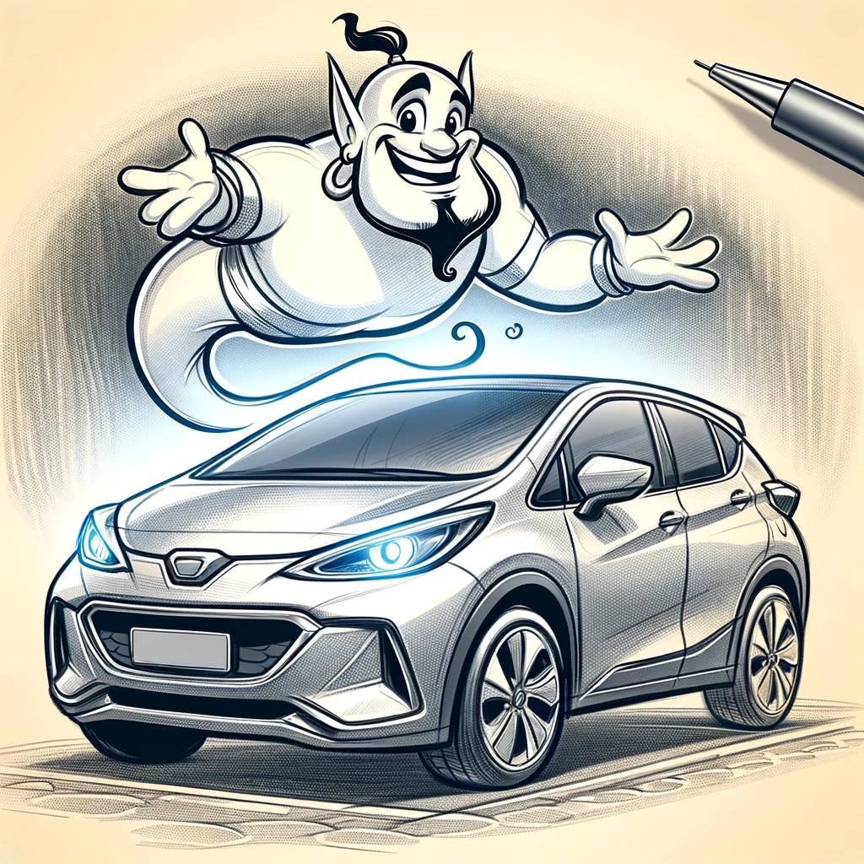
CarGenie
“How much will your next car cost?”

Slide 2
Question
How much will your next car cost?
Or
Can we predict used car prices with ML?

Slide 3
Source Data: “Vehicle Sales and Market Trends Dataset”
The "Vehicle Sales and Market Trends Dataset" provides a comprehensive collection of information pertaining to the sales transactions of various vehicles. This dataset encompasses details such as the year, make, model, trim, body type, transmission type, VIN (Vehicle Identification Number), state of registration, condition rating, odometer reading, exterior and interior colors, seller information, MMR (Manheim Market Report) values, selling price, and sale date.
https://www.kaggle.com/datasets/syedanwarafridi/vehicle-sales-data/data

Slide 4
Exploratory Data Analysis 1
# Column Non-Null Count Dtype
--- ------ -------------- -----
0 year 558837 non-null int64
1 make 548536 non-null object
2 model 548438 non-null object
3 trim 548186 non-null object
4 body 545642 non-null object
5 transmission 493485 non-null object
6 vin 558833 non-null object
7 state 558837 non-null object
8 condition 547017 non-null float64
9 odometer 558743 non-null float64
10 color 558088 non-null object
11 interior 558088 non-null object
12 seller 558837 non-null object
13 mmr 558799 non-null float64
14 sellingprice 558825 non-null float64
15 saledate 558825 non-null object
Number of unique values:
make 96
model 973
trim 1963
body 87
transmission 4
vin 550297
state 64
color 46
interior 17
seller 14263
saledate 3766

Slide 5
Exploratory Data Analysis 2
Minimum values:
year 1982.0
condition 1.0
odometer 1.0
mmr 25.0
sellingprice 1.0
Maximum values:
year 2015.0
condition 49.0
odometer 999999.0
mmr 182000.0
sellingprice 230000.0

Slide 6
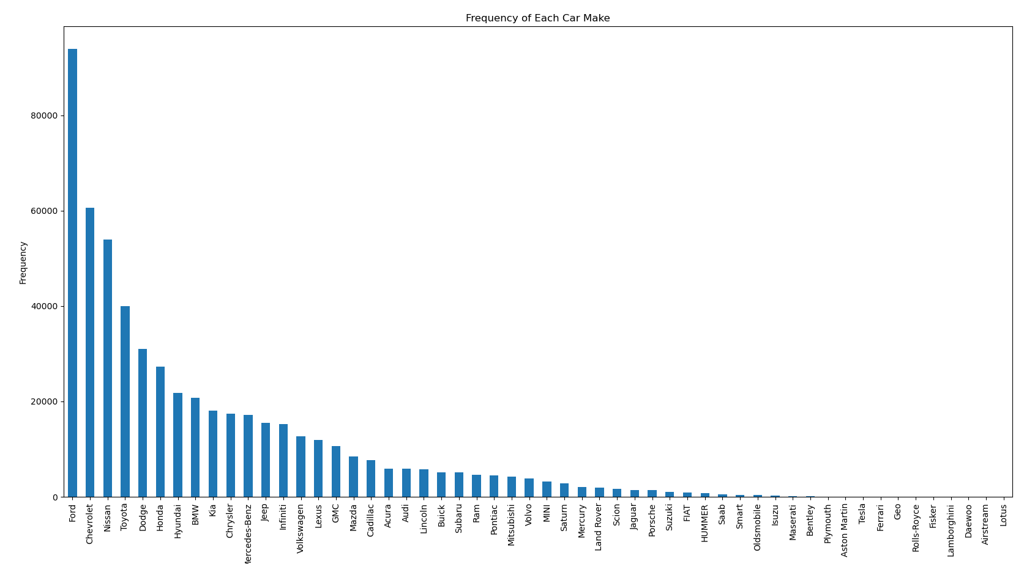
Exploratory Data Analysis 3

Slide 7
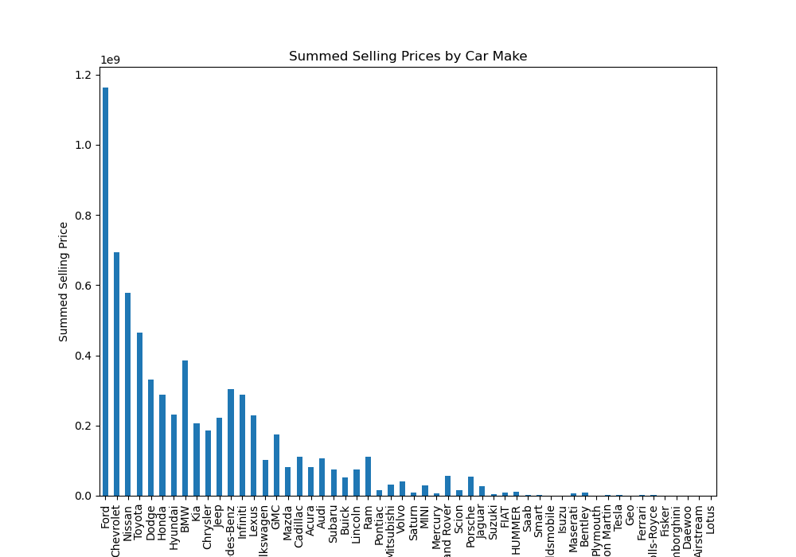
Exploratory Data Analysis 4

Slide 8
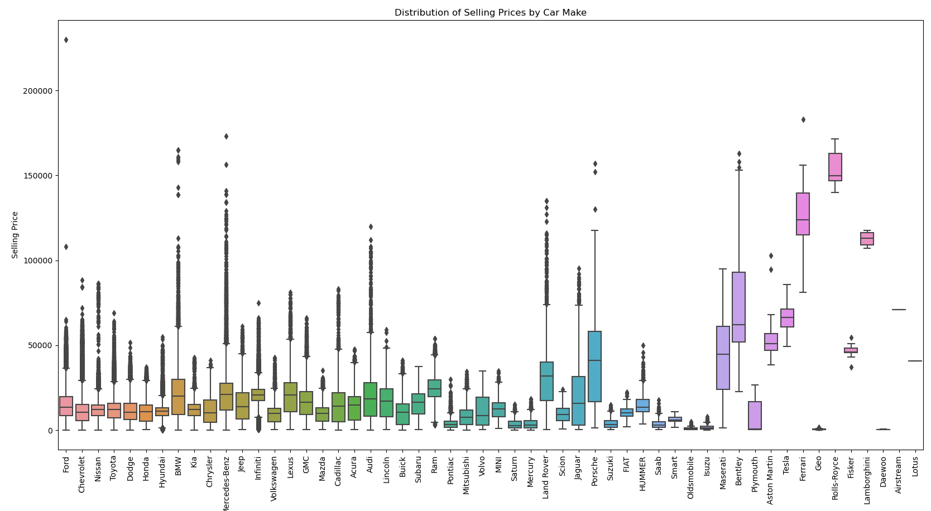
Exploratory Data Analysis 5
Ford
Mercedes
Rolls Royce
Bentley
Ferrari
Land Rover
Maserati

Slide 9
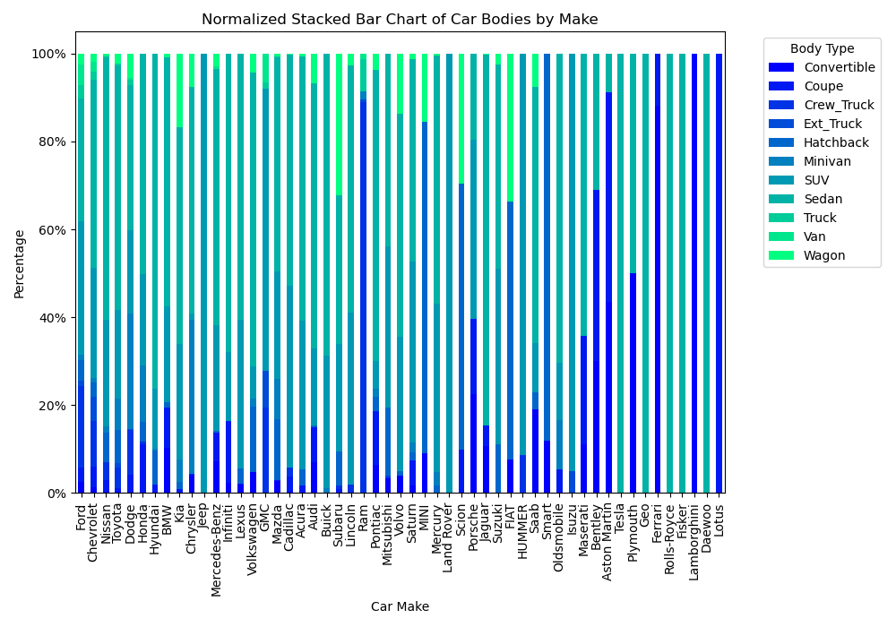
Exploratory Data Analysis 6

Slide 10
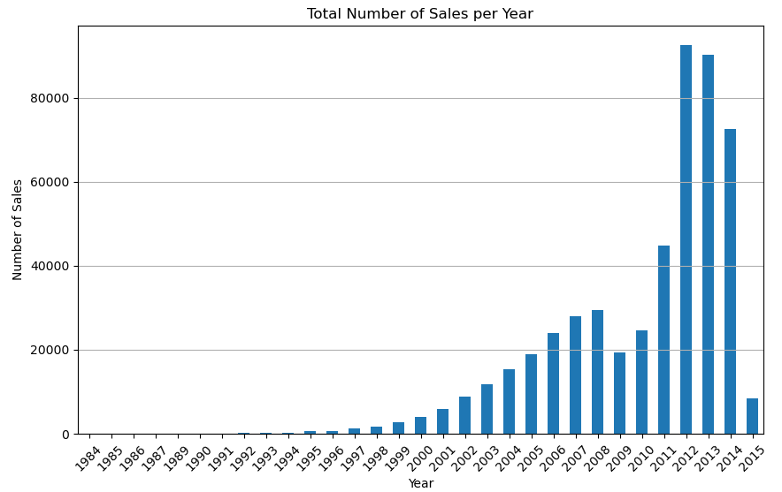
Exploratory Data Analysis 7

Slide 11
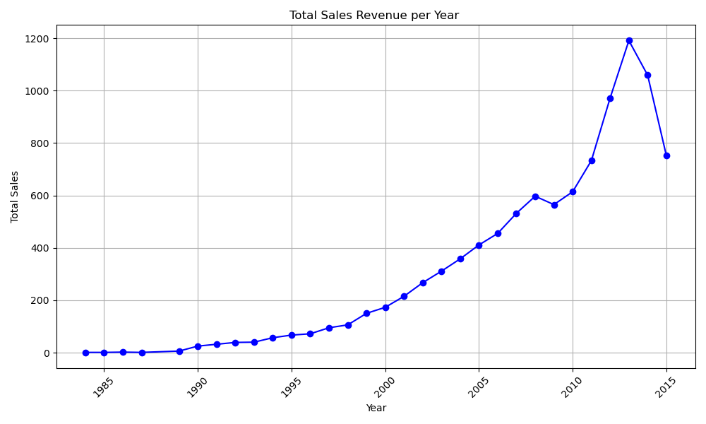
Exploratory Data Analysis 8

Slide 12
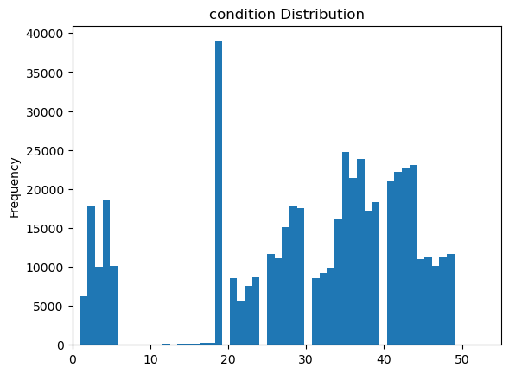
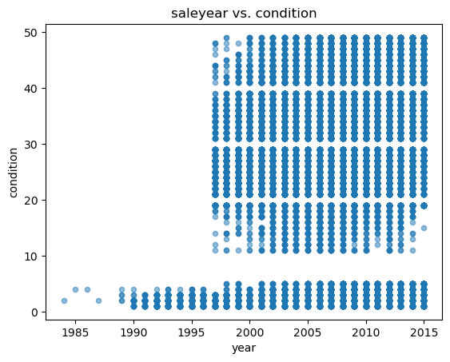
Exploratory Data Analysis 9

Slide 13
EDA Summary
Drop price outliers
# Column Non-Null Count Dtype
--- ------ -------------- -----
0 year 558837 non-null int64
1 make 548536 non-null object
2 model 548438 non-null object
3 trim 548186 non-null object
4 body 545642 non-null object
5 transmission 493485 non-null object
6 vin 558833 non-null object
7 state 558837 non-null object
8 condition 547017 non-null float64
9 odometer 558743 non-null float64
10 color 558088 non-null object
11 interior 558088 non-null object
12 seller 558837 non-null object
13 mmr 558799 non-null float64
14 sellingprice 558825 non-null float64
15 saledate 558825 non-null object
Drop 2015
Get dummies
Groupby?
Scale. Drop outliers?
Cat. Encode
Cat. Encode
Target
Scale

Slide 14
Cleaning 1
# Column Non-Null Count Dtype
--- ------ -------------- -----
0 year 440066 non-null int64
1 make 440066 non-null object
2 body 440066 non-null object
3 transmission 440066 non-null object
4 odometer 440066 non-null float64
5 color 440066 non-null object
6 interior 440066 non-null object
7 mmr 440066 non-null float64
8 sellingprice 440066 non-null float64
Number of unique values:
year 26
make 41
body 11*
transmission 2
odometer 157678
color 19
interior 16
mmr 1076
sellingprice 1750
* 'SUV', 'Sedan', 'Convertible', 'Coupe', 'Wagon', 'Hatchback’, 'Crew_Truck', 'Minivan', 'Van', 'Ext_Truck', 'Truck'
Results output to ‘Resources/model_car_prices.csv’

Slide 15
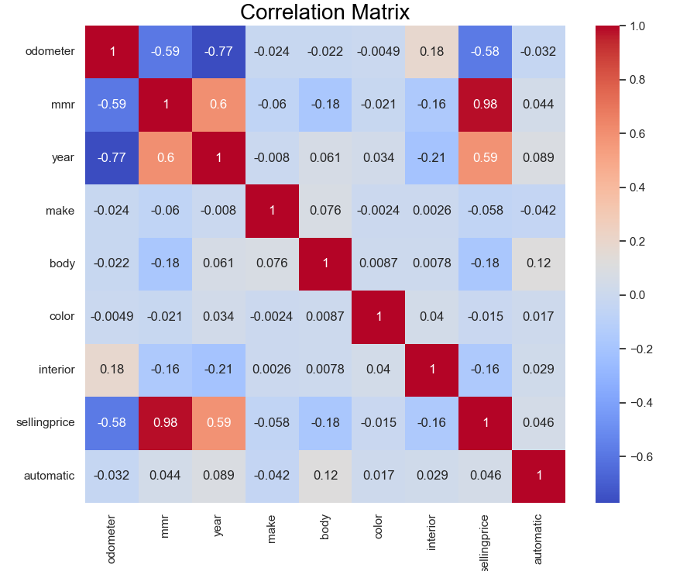
Cleaning 2
What is this?

Slide 16
Cleaning 3
What is MMR?
Manheim Market Report (MMR)
“Precise Pricing: The MMR is based on over 10 million sales transactions from the previous 13 months. Unlike guidebooks, it provides unmatched precision in pricing. These calculations are refreshed nightly, ensuring access to the most accurate prices^{1”}
1. https://site.manheim.com/en/services/valuation.html

Slide 17
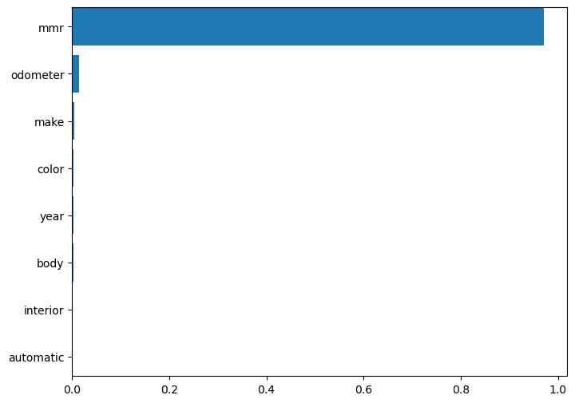
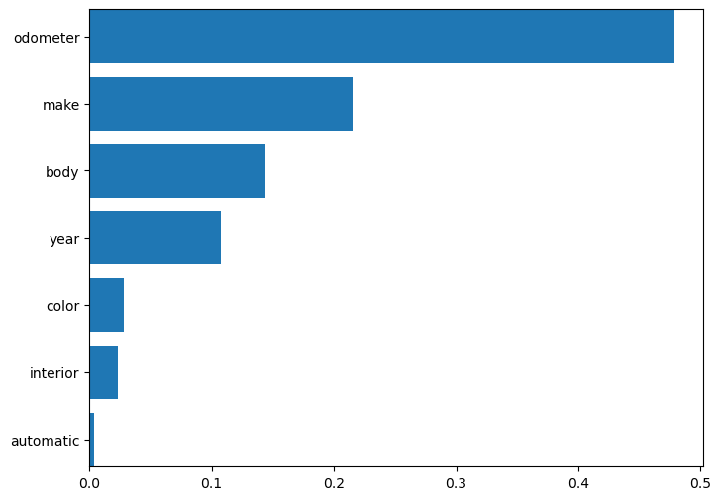
Data Analysis: Multiple Linear Regression
mean squared error (MSE) including MMR: 3178083.7117
R-squared (R2) including MMR: 0.9638
mean squared error (MSE) excluding MMR: 49583493.7931
R-squared (R2) including MMR: 0.4357

Slide 18
Data Analysis: Multiple Linear Regression
Removed MMR and processed by Body
Results for body type: Crew_Truck
mean squared error (MSE) for Crew_Truck: 33294312.57
R-squared (R2) for Crew_Truck: 0.67
Results for body type: Minivan
mean squared error (MSE) for Minivan: 11154783.67
R-squared (R2) for Minivan: 0.77
Results for body type: Van
mean squared error (MSE) for Van: 7420032.39
R-squared (R2) for Van: 0.87
Results for body type: Ext_Truck
mean squared error (MSE) for Ext_Truck: 13246497.52
R-squared (R2) for Ext_Truck: 0.77
Results for body type: Truck
mean squared error (MSE) for Truck: 10260255.72
R-squared (R2) for Truck: 0.76
Results for body type: SUV
mean squared error (MSE) for SUV: 54607811.64
R-squared (R2) for SUV: 0.50
Results for body type: Sedan
mean squared error (MSE) for Sedan: 35156409.56
R-squared (R2) for Sedan: 0.42
Results for body type: Convertible
mean squared error (MSE) for Convertible: 115407667.93
R-squared (R2) for Convertible: 0.45
Results for body type: Coupe
mean squared error (MSE) for Coupe: 102127727.84
R-squared (R2) for Coupe: 0.42
Results for body type: Wagon
mean squared error (MSE) for Wagon: 18477654.07
R-squared (R2) for Wagon: 0.66
Results for body type: Hatchback
mean squared error (MSE) for Hatchback: 16822493.29
R-squared (R2) for Hatchback: 0.42

Slide 19
Data Analysis: Random Forest
Removed MMR and Odometer outliers and processed by Body
Results for body type: Crew_Truck
Mean Squared Error (MSE) for Crew_Truck: 27749827.72891401
R-squared for Crew_Truck: 0.72
Results for body type: Minivan
Mean Squared Error (MSE) for Minivan: 4355316.656488592
R-squared for Minivan: 0.91
Results for body type: Van
Mean Squared Error (MSE) for Van: 5103588.641798687
R-squared for Van: 0.90
Results for body type: Ext_Truck
Mean Squared Error (MSE) for Ext_Truck: 10897783.038772535
R-squared for Ext_Truck: 0.80
Results for body type: Truck
Mean Squared Error (MSE) for Truck: 6157521.683741982
R-squared for Truck: 0.85
Results for body type: SUV
Mean Squared Error (MSE) for SUV: 30171491.491845623
R-squared for SUV: 0.73
Results for body type: Sedan
Mean Squared Error (MSE) for Sedan: 13128699.078272583
R-squared for Sedan: 0.78
Results for body type: Convertible
Mean Squared Error (MSE) for Convertible: 33964613.780782
R-squared for Convertible: 0.83
Results for body type: Coupe
Mean Squared Error (MSE) for Coupe: 44814381.02653974
R-squared for Coupe: 0.76
Results for body type: Wagon
Mean Squared Error (MSE) for Wagon: 5515284.175321737
R-squared for Wagon: 0.90
Results for body type: Hatchback
Mean Squared Error (MSE) for Hatchback: 7261070.286251895
R-squared for Hatchback: 0.75

Slide 20
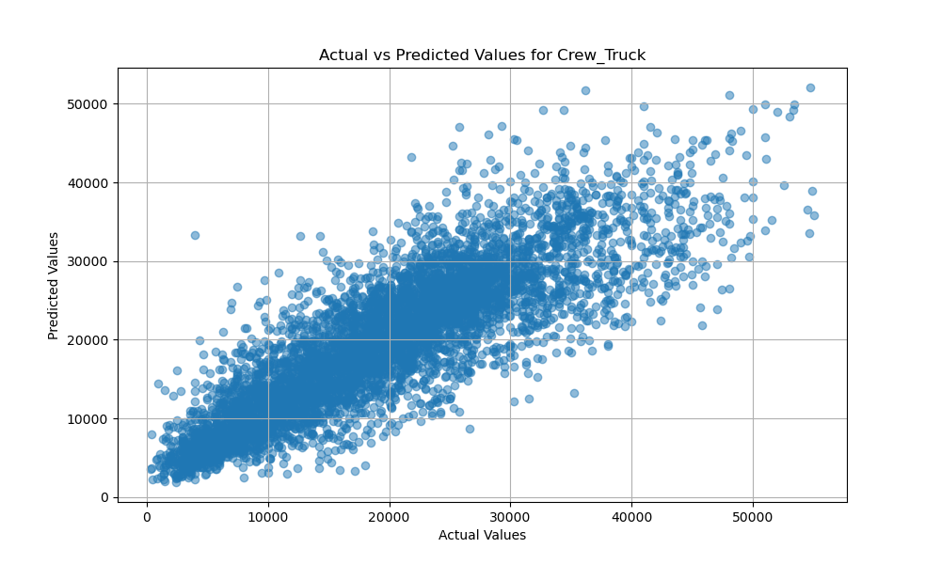
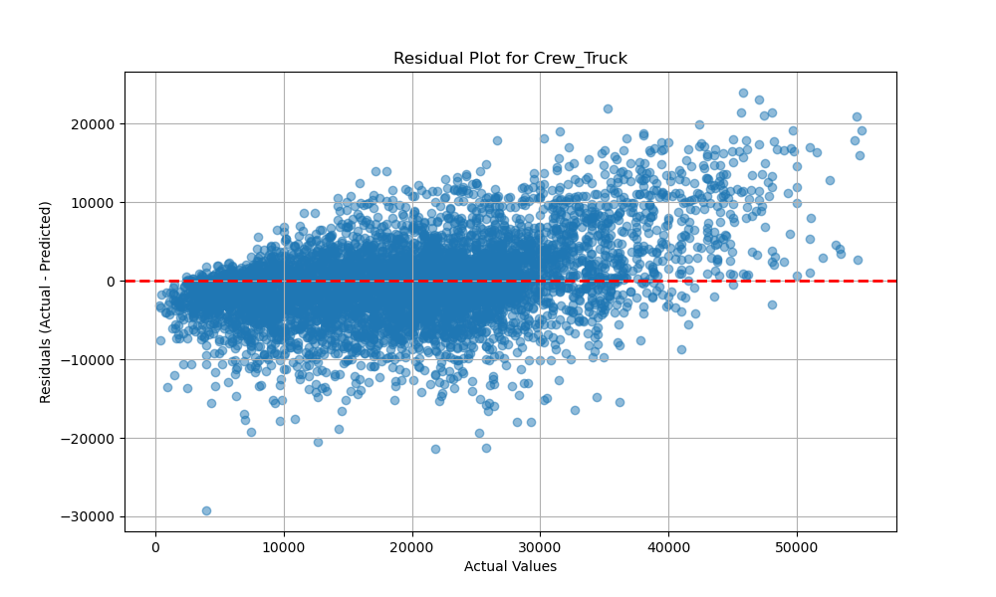
Data Analysis: Summary
Results for body type: Crew_Truck
Mean Squared Error (MSE) for Crew_Truck: 27749827.72891401
R-squared for Crew_Truck: 0.72

Slide 21
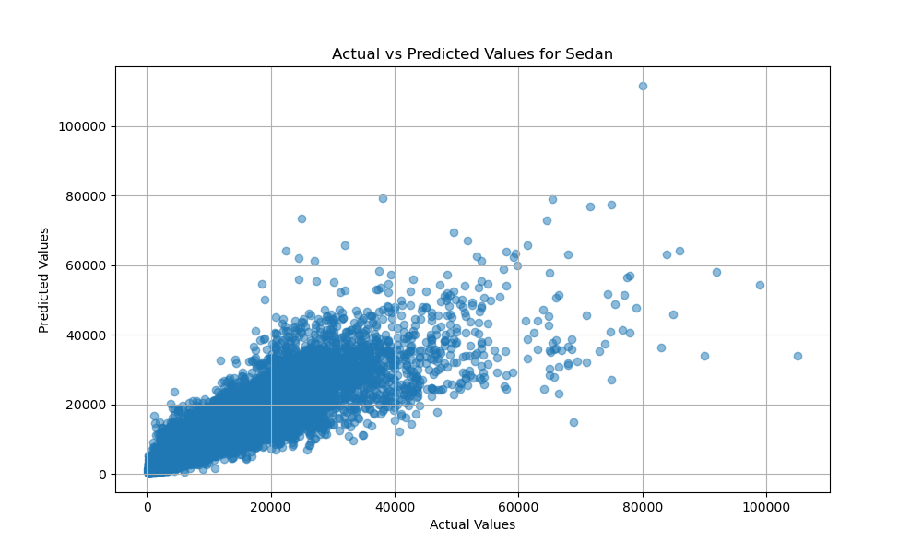
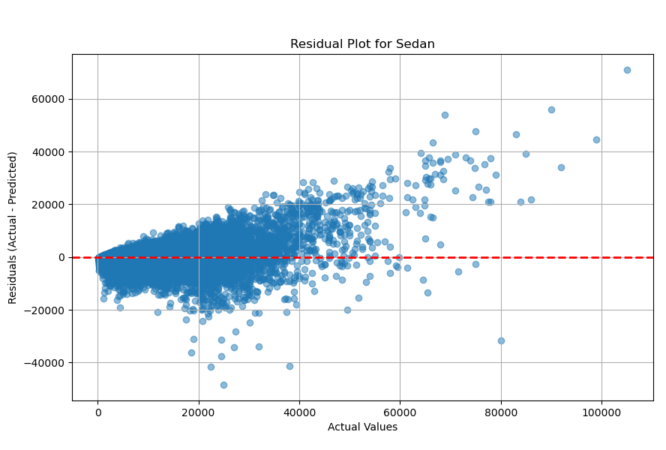
Data Analysis: Summary
Results for body type: Sedan
Mean Squared Error (MSE) for Sedan: 13128699.078272583
R-squared for Sedan: 0.78

Slide 22
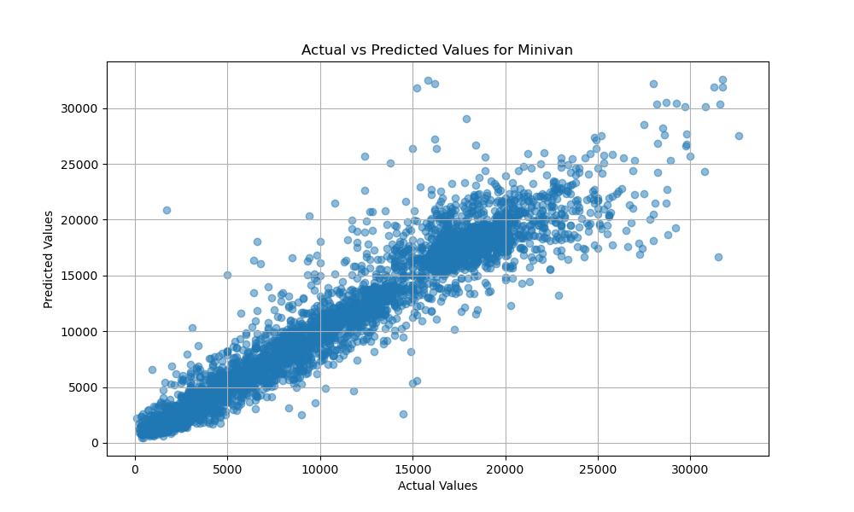
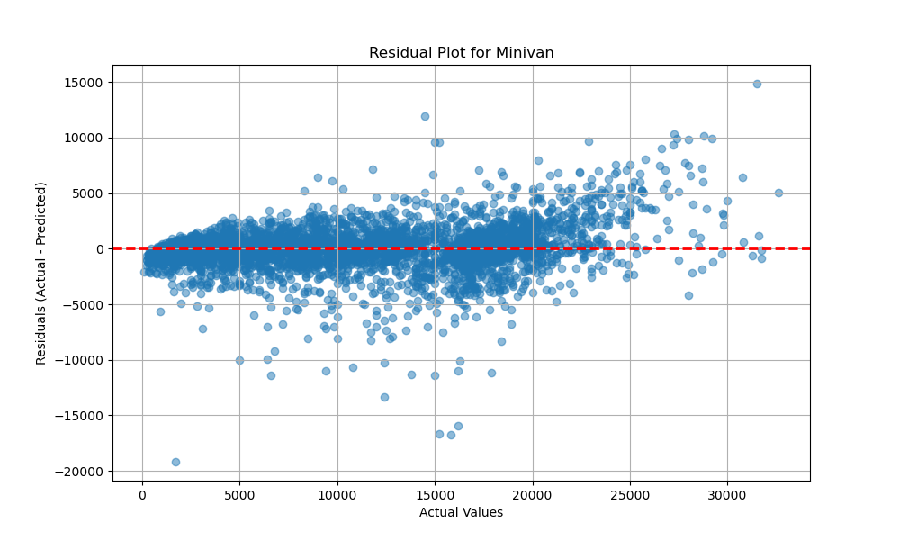
Data Analysis: Summary
Results for body type: Minivan
Mean Squared Error (MSE) for Minivan: 4355316.656488592
R-squared for Minivan: 0.91

Slide 23
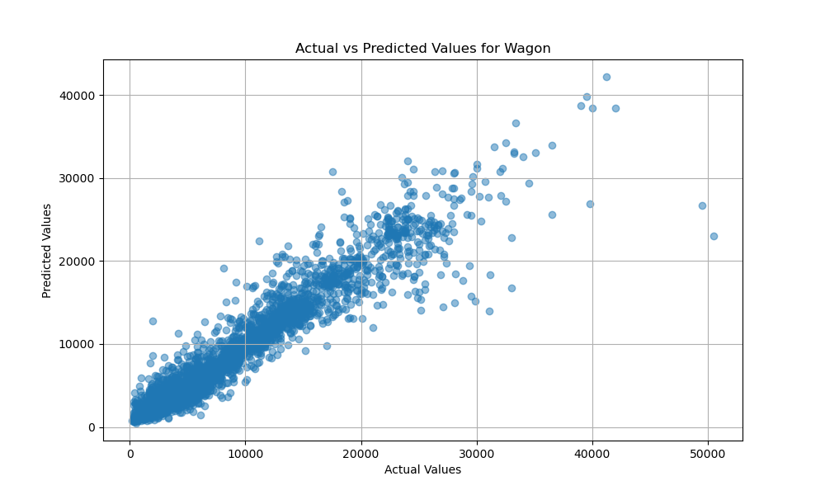
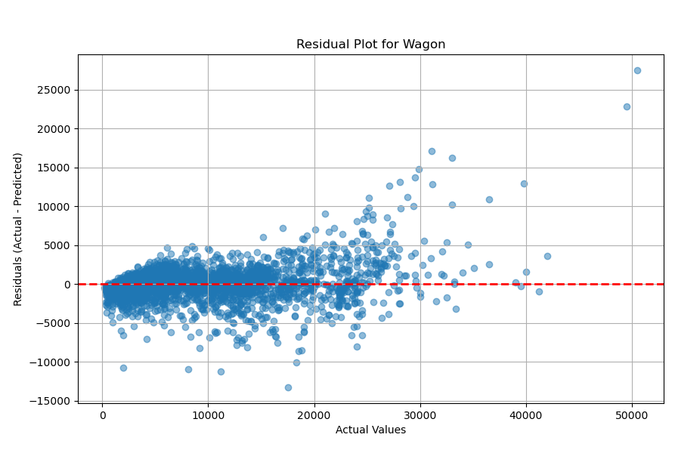
Data Analysis: Summary
Results for body type: Wagon
Mean Squared Error (MSE) for Wagon: 5515284.175321737
R-squared for Wagon: 0.90

Slide 24
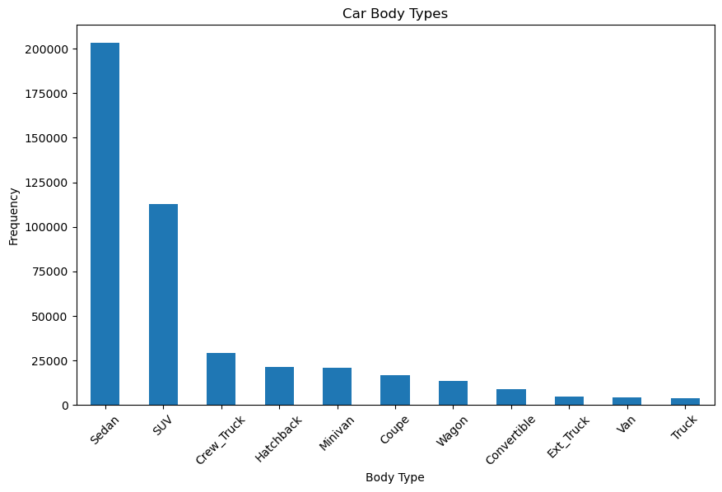
Data Analysis: Summary
0.78
0.73
0.72
0.75
0.91
0.76
0.90
0.83
0.80
0.90
0.85
r²

Slide 25
Conclusion
Began development of CarGenie with analysis of public data.
Identified MMR as a source of bias.
Applied multiple regression analysis methods.
Separating car body types and using a random forest model gave the higher r2 values and lowest residuals.

