Slide 1


Category Review: Chips
Quantium Data Analytics Virtual Experience Program
June 2021
Retail Analytics
By Xuan Fang

Slide 2
Notes:
To view Privacy video explaining how important data privacy is to Quantium, please click here: https://www.youtube.com/watch?v=Zq1QDAkoRzU
or here Q:\Company Reference\Brand & Design\Brand videos\Q Privacy.mp4
At Quantium, we believe that data is the behavioural footprint of humanity and that it has to be treated with the utmost care and responsibility.
Histories, attitudes, indeed lives are stored within it in ways that aren’t always apparent – and that’s what makes its potential so powerful.
To work with it responsibly, sensitively, we set ourselves the highest data privacy protection and governance standards.
We have spent 17 years perfecting privacy-by-design and secure-by-design principles. Central to this is not holding any personally identifiable information about people –
we neither receive it, and put the necessary protections in place to be unable to decipher it.
Every aspect of handling data is safeguarded: from its de-identification, to its encryption – data security is paramount and of the highest grade.
We pride ourselves on gaining the trust of iconic organisations around the world through years of securely working with their data,
and in turn the trust that builds with their stakeholders.

Slide 3
Executive summary
01
Task 1
The sales increase in the month of December before the Christmas (except the day itself). So, these are the crucial times.
Kettle is the most popular brand followed by Smiths, Doritos and Pringles. So, they need to be in stock. Also 175 gram packets are the most sold.
Mainstream young singles/couples, retirees are the most common customers and also account for a great share of chips sale.
Budget older families have the maximum contribution to sales.
02
Task 2
One control store was selected for each trial store and the values of metrics were compared in trial and pre-trial period.
The results for trial stores 77 and 88 during the trial period show a significant difference in at least two of the three trial months but this is not the case for trial store 86.

Slide 4
01
Customer Analysis

Slide 5
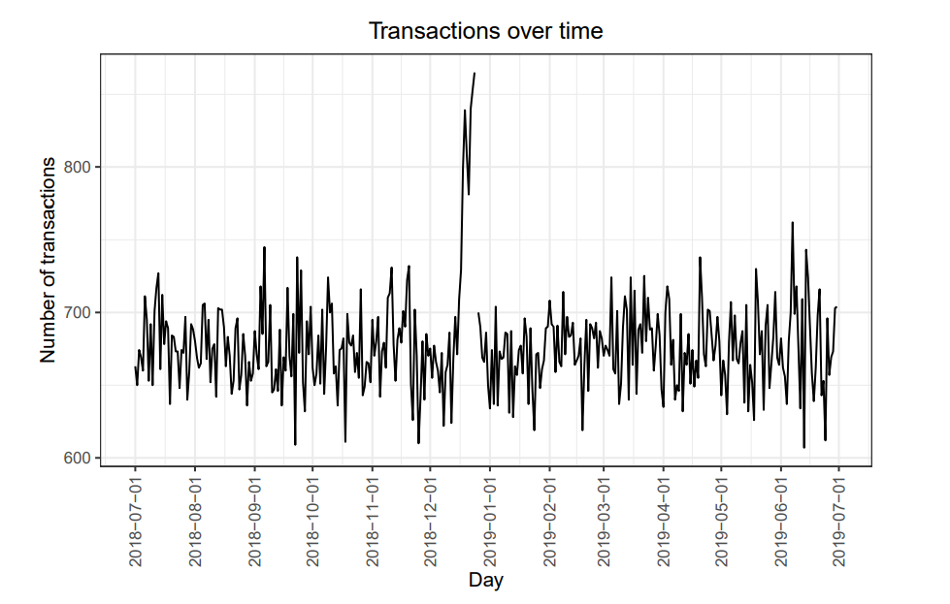
01
Sales distribution
The increase in sales occurs in the lead-up to Christmas and that there are zero sales on Christmas day itself. This is due to shops being closed on Christmas day

Slide 6
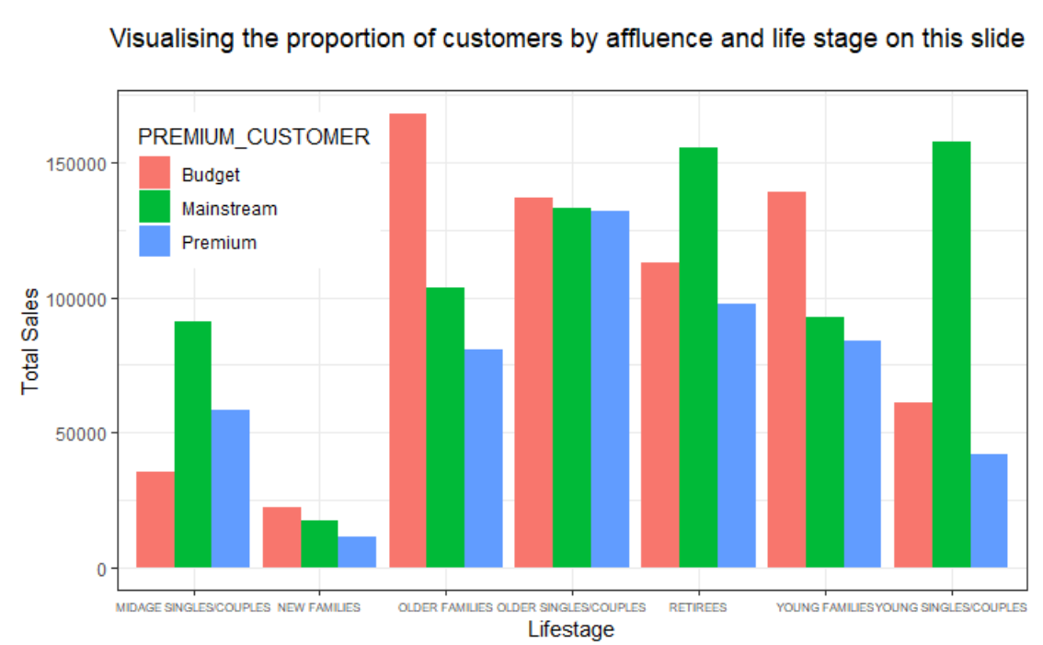
01
Visualising the proportion of customers by affluence and life stage on this slide
It can be clearly visualized that Budget - older families, Mainstream-young singles/couples, and Mainstream- retirees are customers contributing the most sales

Slide 7
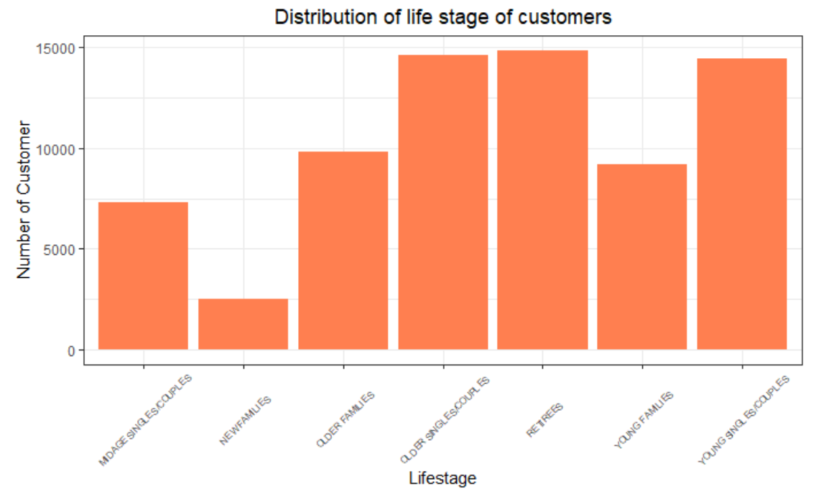
01
Distribution of life stage of customers
It shows that retirees, older singles/couples, young singles/couples are the most common customers

Slide 8
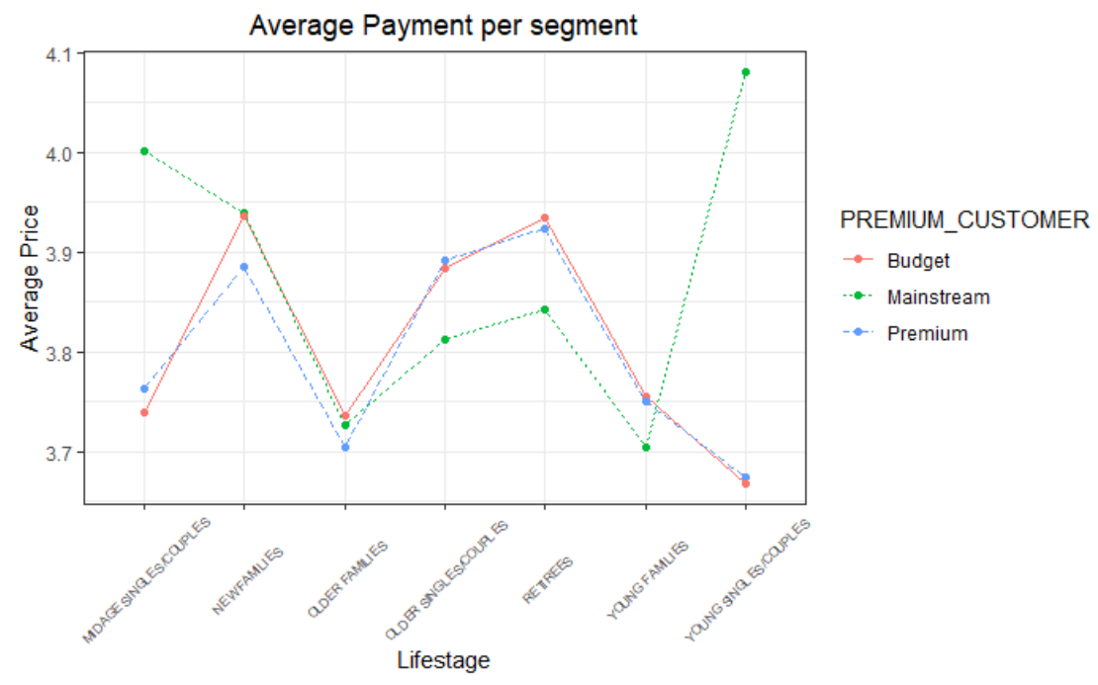
01
Average payment per segment
Mainstream young singles/couples spend the most, followed by mid-age single/couples

Slide 9
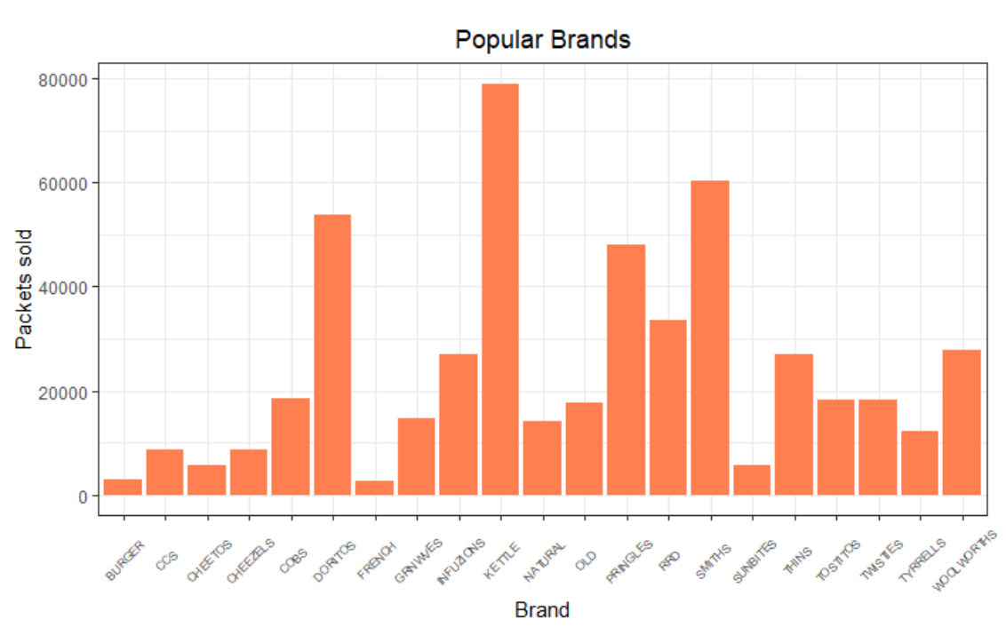
01
Popular brands
Kettle is the most popular brand followed by Smiths, Doritos and Pringles

Slide 10
01
01 Customer Analysis Summary
The sales increase in the month of December before the Christmas (except the day itself). So, these are the crucial times.
Budget older families have the maximum contribution to sales
Mainstream young singles/couples, retirees are the most common customers and also account for a great share of chips sale.
Mainstream young singles/couples and mid-age single/couples pay more per packet than any other group.
Kettle is the most popular brand followed by Smiths, Doritos and Pringles.

Slide 11
02
Trial Store Performance

Slide 12
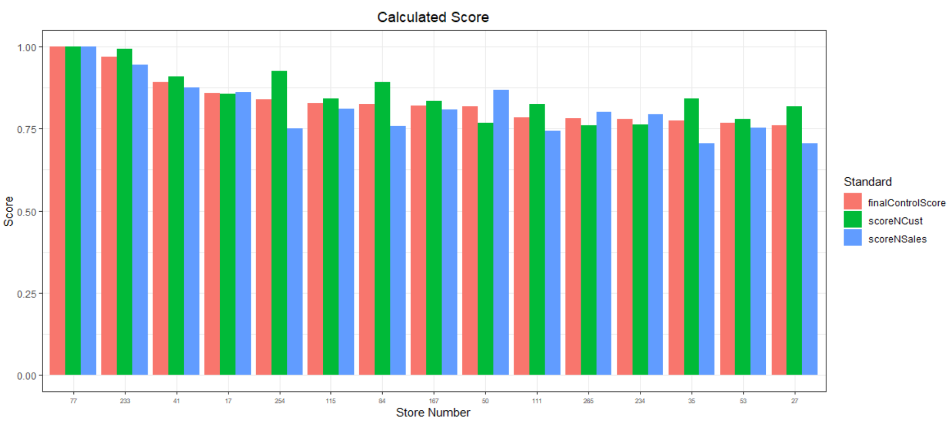
01
Calculated scores of the control store 77 vs other stores
Stores with maximum similarities have the highest score. Thus, store 233 will be a control store for trial store 77.

Slide 13
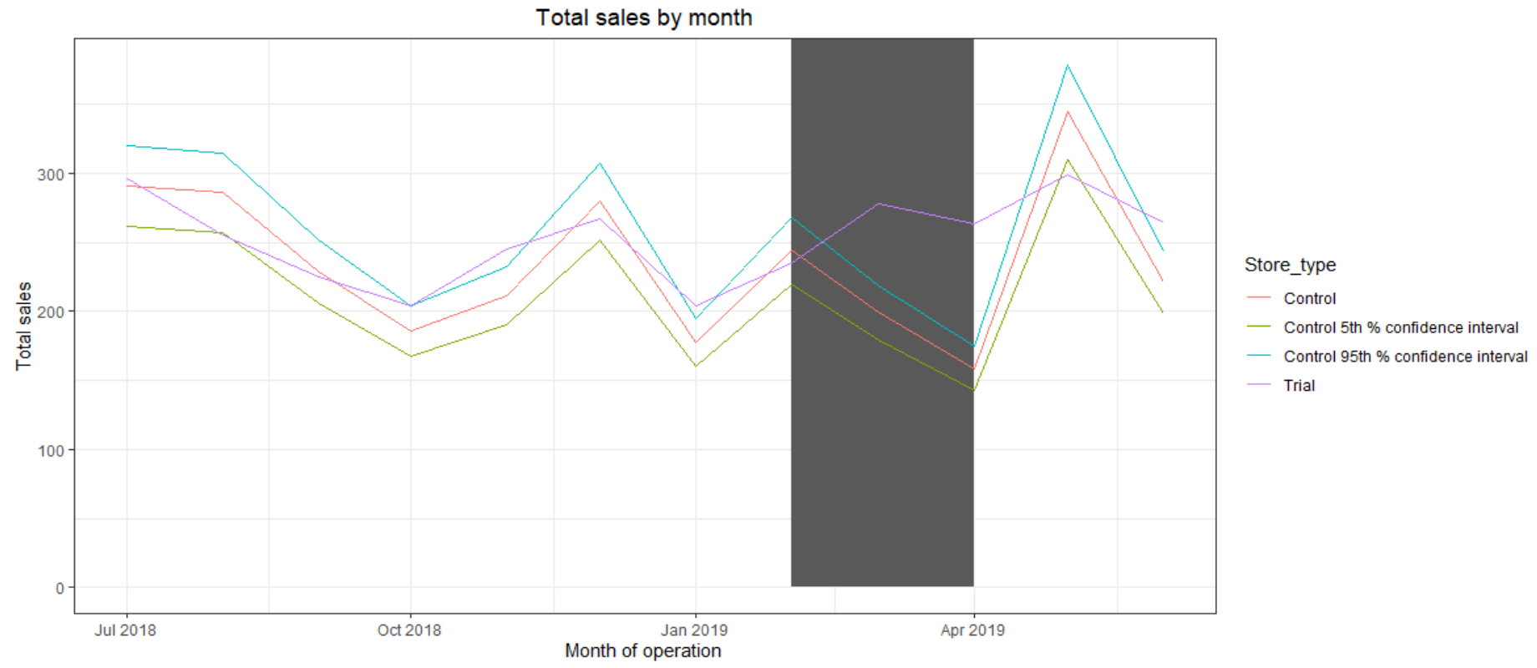
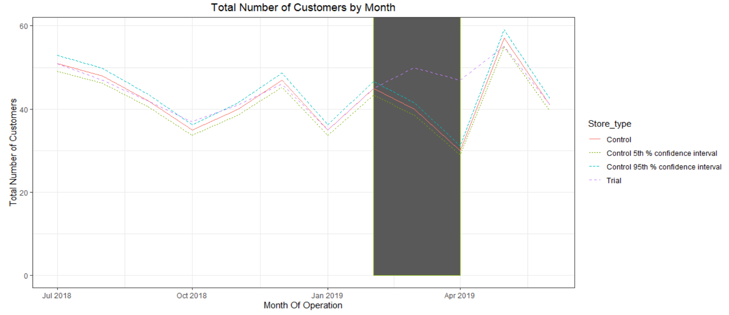
Trial store 77 vs Store 233: Total Sales & Number of Customers
The results show that the trial in store 77 is significantly different to its control store in the trial period as the trial store performance lies outside the 5% to 95% confidence interval of the control store in two of the three trial months.

Slide 14
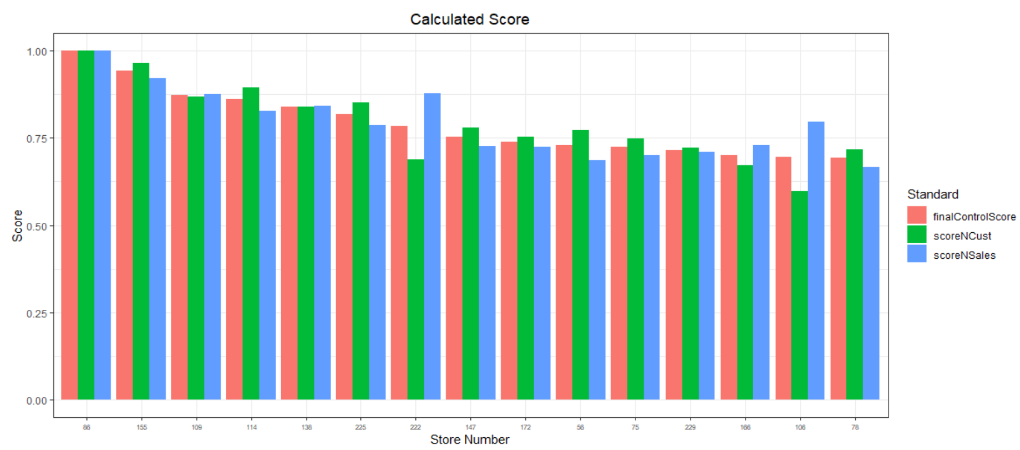
01
Calculated scores of the control store 86 vs other stores
Stores with maximum similarities have the highest score. Thus, store 155 will be a control store for trial store 86.

Slide 15
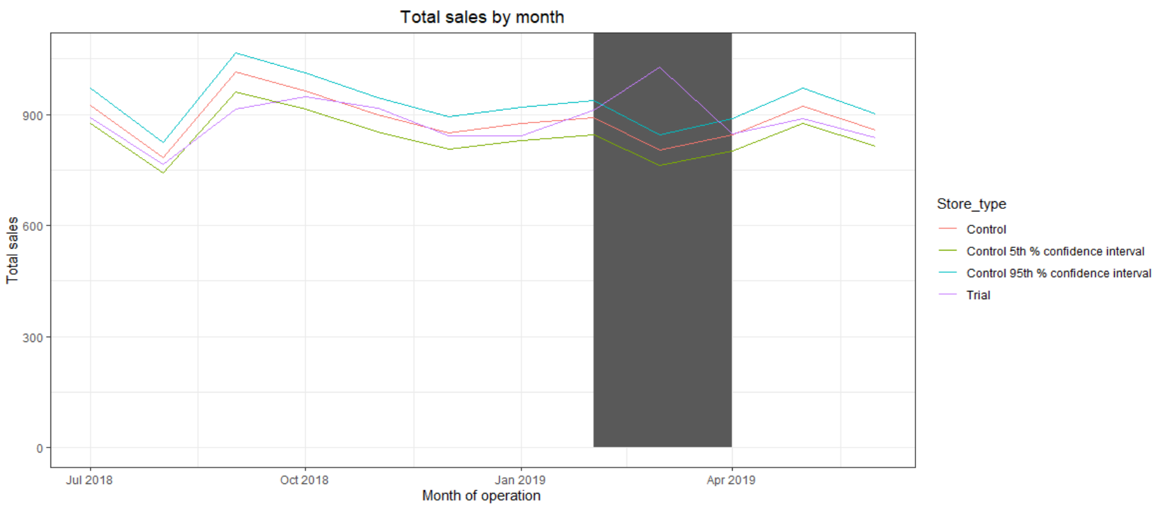
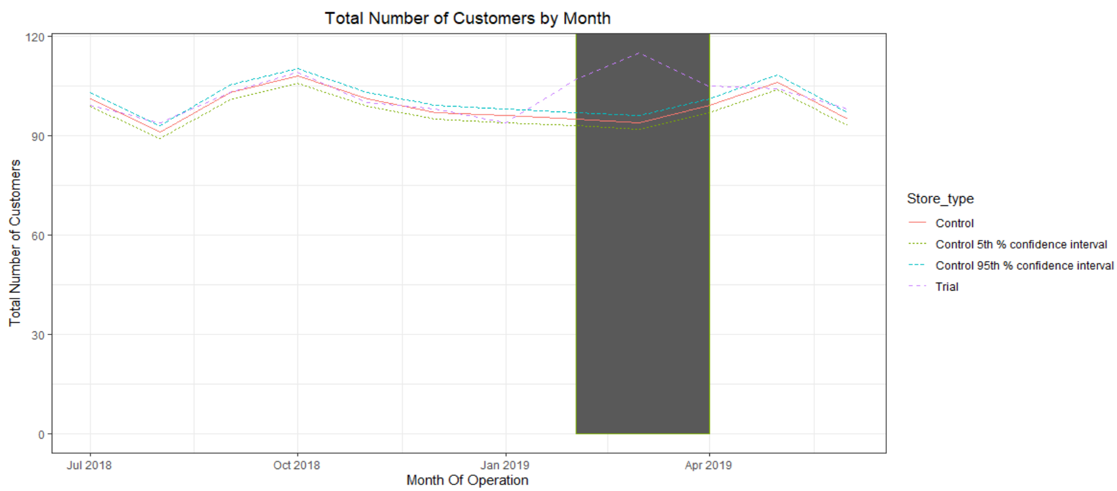
01
Trial store 86 vs Store 155: Total Sales & Number of Customers
The results show that the trial in store 86 is significantly different to its control store in March as the trial store performance lies outside of the 5% to 95% confidence interval of the control store in one of the three trial months.

Slide 16
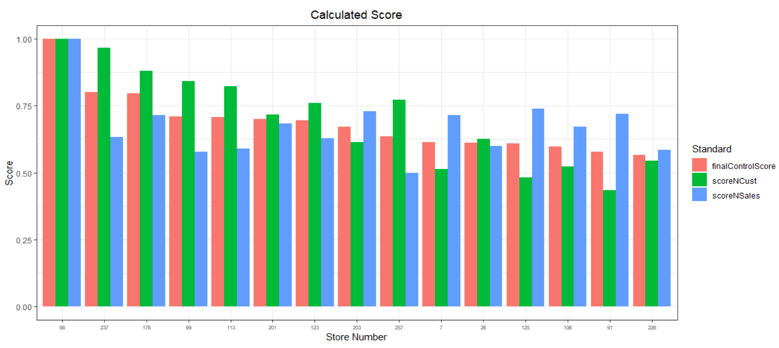
01
Calculated scores of the control store 88 vs other stores
Stores with maximum similarities have the highest score. Thus, store 237 will be a control store for trial store 77.

Slide 17
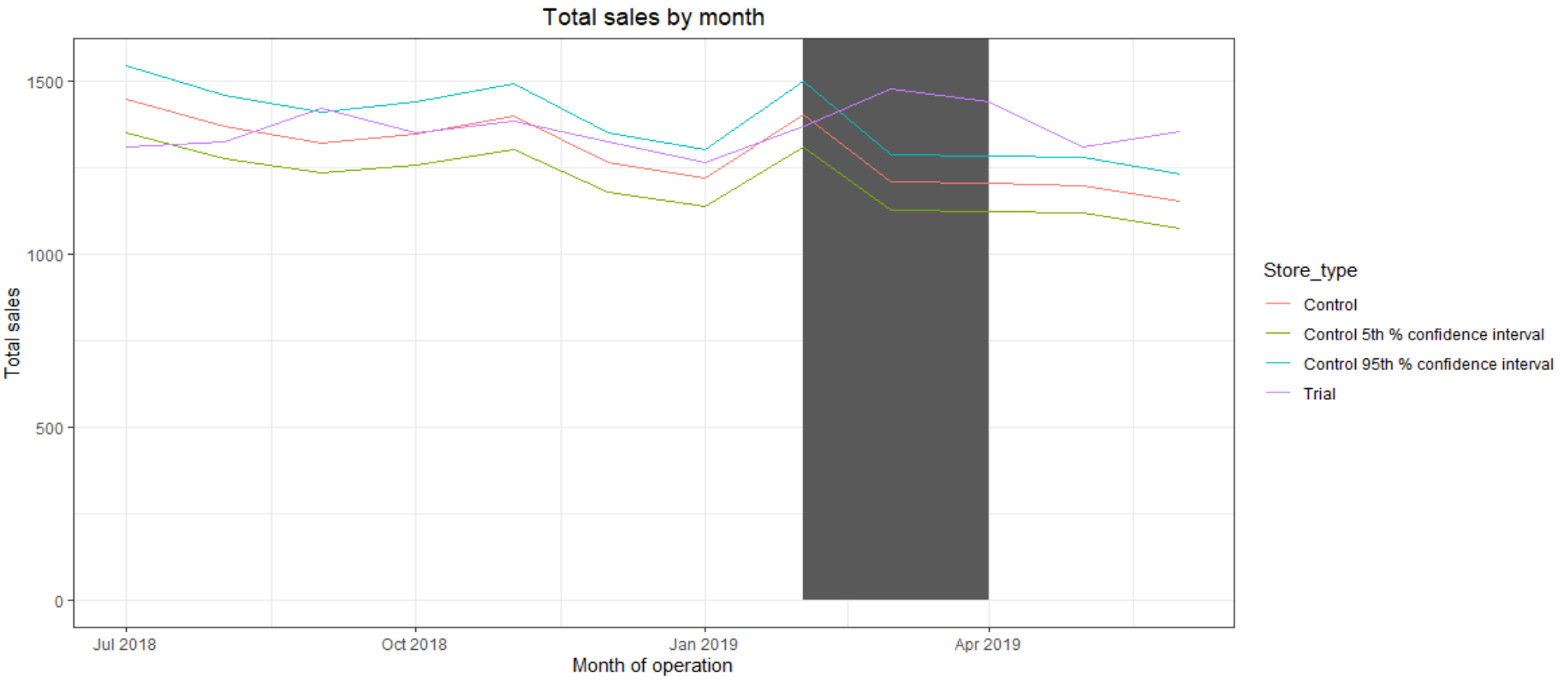
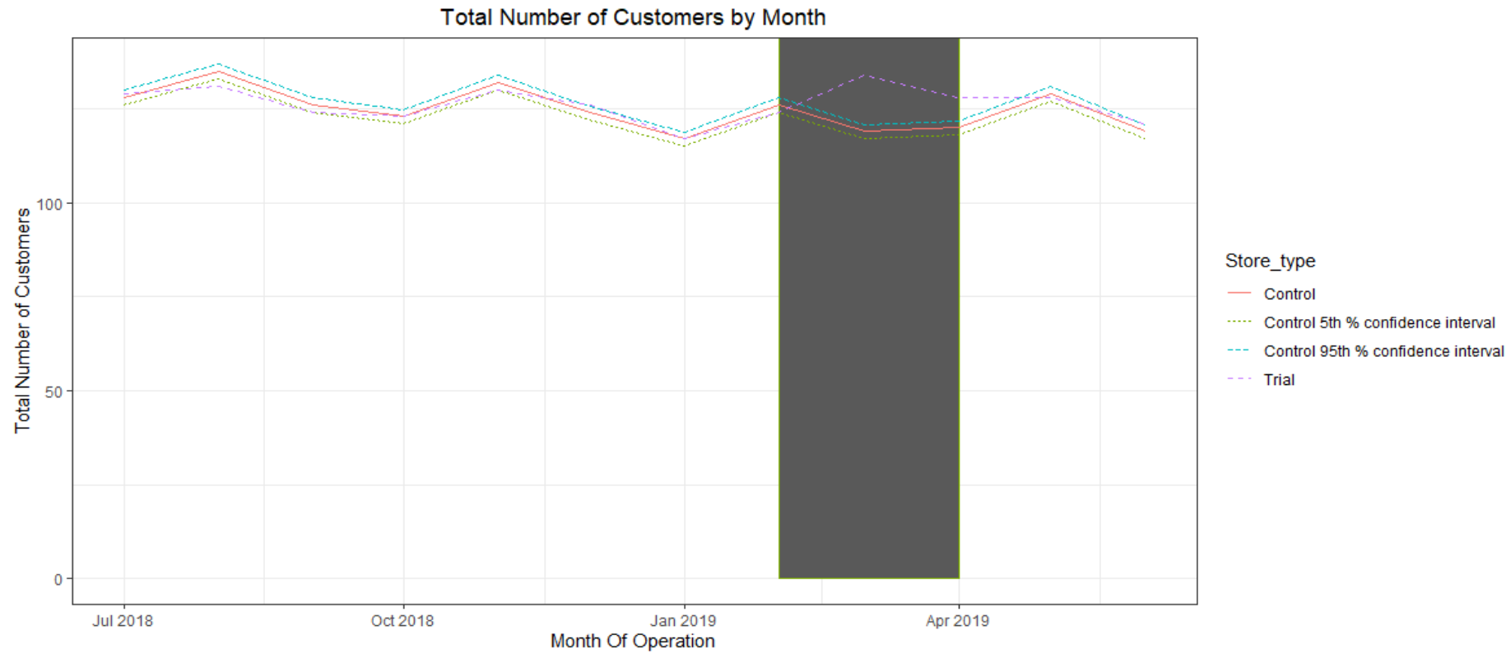
Trial store 88 vs Store 237: Total Sales & Number of Customers
The results show that the trial in store 88 is significantly different to its control store in the trial period as the trial store performance lies outside the 5% to 95% confidence interval of the control store in two of the three trial months.

Slide 18
01
02 Trial Store Performance Summary
We've found control stores 233, 155, 237 for trial stores 77, 86 and 88 respectively.
The results for trial stores 77 and 88 during the trial period show a significant difference in at least two of the three trial months but this is not the case for trial store 86.
We can check with the client if the implementation of the trial was different in trial store 86 but overall, the trial shows a significant increase in sales.

Slide 19
Recommendations
01
Task 1
Stocks should be high in December before the Christmas.
Kettle, Smiths, Doritos and Pringles should be kept in stocks as they are the most sold.
02
Task 2
Mainstream young singles/couples, retirees are the account for a great share of chips sale, so they need much attention.
Budget older families have the maximum contribution to sales.
Control stores 233, 155, 237 for trial stores 77, 86 and 88 respectively would be a good choice.

