Slide 1
In The Name of GOD
TurboTransformers: An Efficient GPU Serving System
For Transformer Models
Mohammad Fateh | 810198448
Fall 1402

Slide 2
Outline
The problems
  Challenges of transformer model
  Similar tool kits
Design
Computational Optimizations
  Kernel Fusion
  GPU-based Batch-Reduction
Memory management
Serving Framework
Experimental Results
Conclusion

Slide 3
The problems – Challenges of transformer model
Today, transformer models became a favorite model
But they need a massive amount of computation.
E.g.the inference of a 40 words sequence, the base BERT model requires 6.9 Gflops
Besides enhanced computation requirement, transformer models introduced the problem of variable-length

Slide 4
The problem – Similar tool kits
1. Inference tasks
  employing a training framework, such as TensorFlow or PyTorch, on inference tasks is not able to fully utilize the hardware resources.
  Inference does not perform backward propagation; this process require extra memory space for intermediate tensors and eliminate the opportunity for operator fusion
2. Variable-length inputs
  Second, currently existing DL inference frameworks such as onnxruntime, TenorFlow XLA, TVM [3], tensorRT use techniques designed for fixed-length input workloads and have insufficient capability in dealing with variable-length input
  They usually convert variable-length requests into fixed-length requests through Zero padding, which introduces additional overhead
3. Using the model in Serving Systems
  Serving is the process of using the model to response a remote user at the time
  The serving framework wraps the runtime into a service exposing gRPC/HTTP as endpoints
  None of the existing solutions have investigated serving optimization for variable-length input workloads

Slide 5
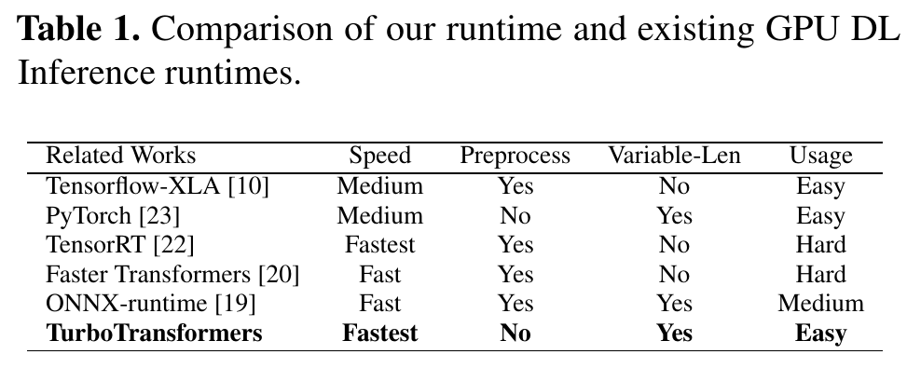
The problem – Similar tool kits

Slide 6
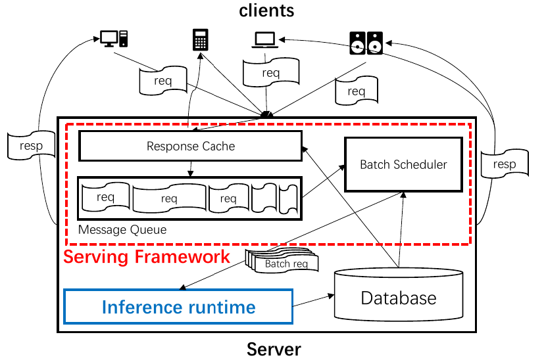
Design
As shown in the Figure 2, there are two parts in TurboTransformers project:
  1. Inference runtime: Inference runtime focuses on increasing computation efficiency and optimizing memory allocation.
  2. Serving frame work: Reduces latency of
  the user request by batching and scheduling

Slide 7
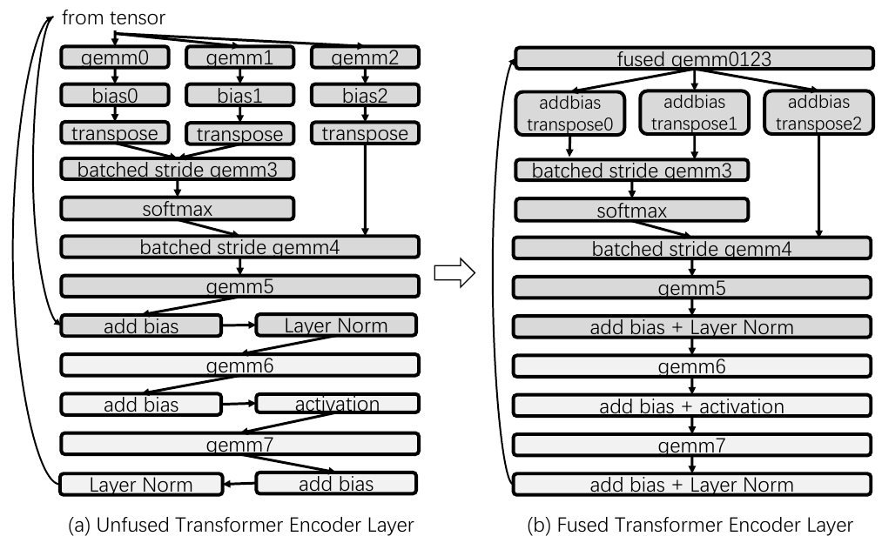
Computational Optimizations - Kernel Fusion
In BERT inference on a Tesla V100 GPU with a batch size of 20 and sequence length of 128:
  61.8% of the processing time is dedicated to GEMM
  38.2% is allocated to non-GEMM intensive operations, including LayerNorm, Softmax, Add Bias, and Transpose.
Kernel fusion is able to increase computation efficiency by reducing the number of memory accesses, increasing cache, and reducing kernel launch overhead.
As is shown in Figure 3, the computation graph of a transformer can be more compact by fusing all the kernels between two GEMM kernels into a single one.

Slide 8
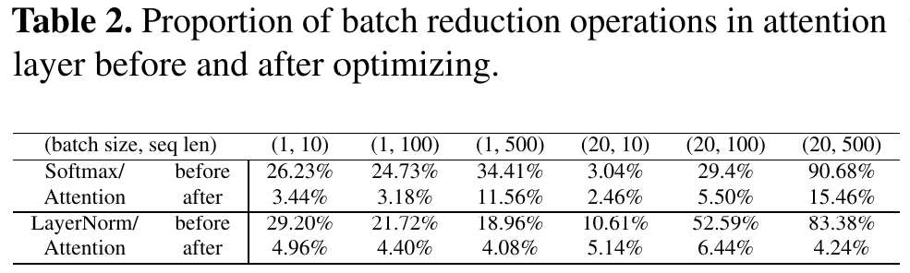
Computational Optimizations - GPU-based Batch-Reduction
Batch Reduction means combine data of two kinds of input data and give them into GPU kernel at ones instead of separately
Both of Softmax and LayerNorm based kernels can be viewed as Batch Reduction operations
On the lower dimension of a 2D tensor, Softmax calculates summation and maximum and LayerNorm calculates the mean and variance. In other words, they both need to reduce a batch of 1D arrays in parallel.

Slide 9
Computational Optimizations - GPU-based Batch-Reduction
Batch Reduction means combine data of two kinds of input data and give them into GPU kernel at ones instead of separately
Both of Softmax and LayerNorm based kernels can be viewed as Batch Reduction operations
On the lower dimension of a 2D tensor, Softmax calculates summation and maximum and LayerNorm calculates the mean and variance. In other words, they both need to reduce a batch of 1D arrays in parallel.

Slide 10
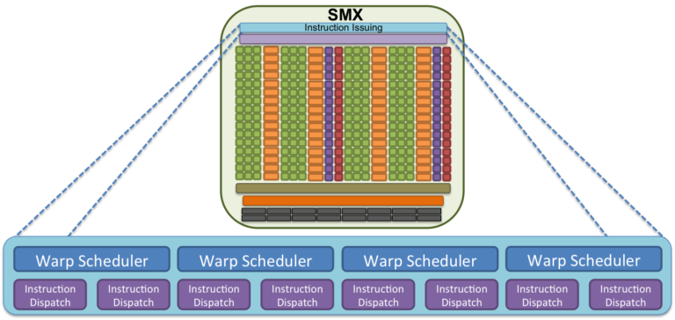
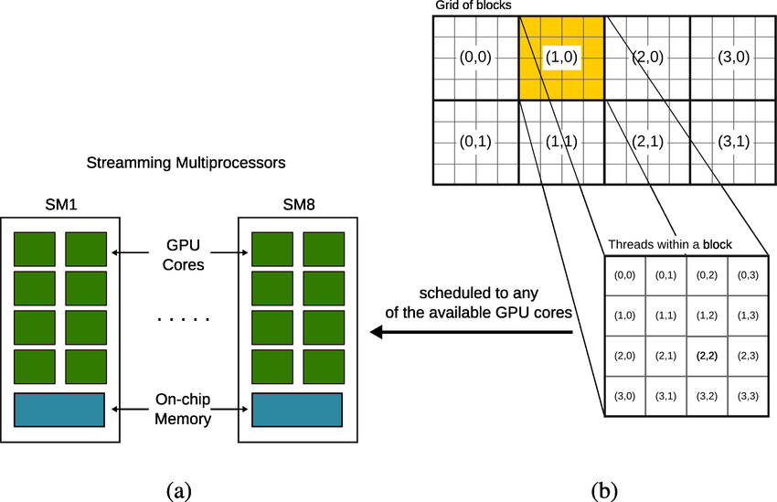
Computational Optimizations - GPU-based Batch-Reduction
Warp: hardware groups threads that execute the same instruction in to warps
thread block: Several warps constitute a thread block
SM: Several thread blocks are assigned to a Streaming Multiprocessor (SM)

Slide 11
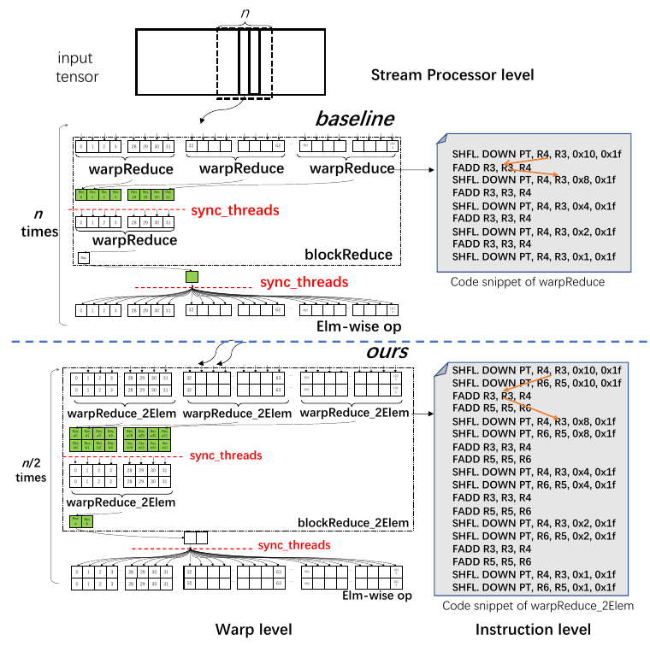
Computational Optimizations - GPU-based Batch-Reduction
A new subroutine warpAllReduceSum_XElem (X = 2) is introduced, which combine X warp as a batch and do their reduction together.
In the blockReduceSum_XElem method, only one synchronization is needed for the reduction of X elements, reducing synchronization cost by (X − 1)/X.
Merging X independent boundary processing into a single operation helps in minimizing warp divergence.

Slide 12
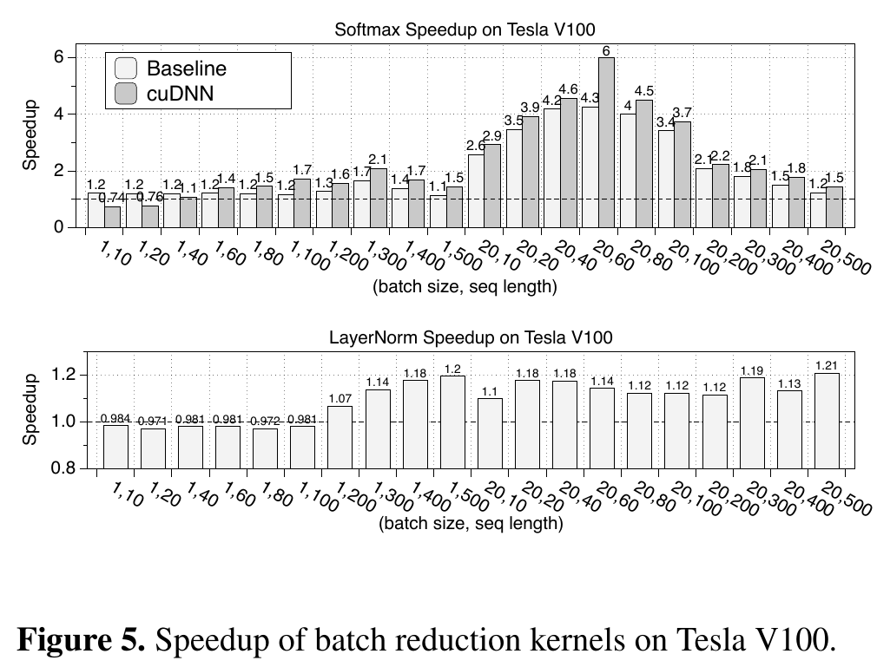
Computational Optimizations - GPU-based Batch-Reduction
Also a computational trick has been used for LayerNorm kernel
There are two equivalent formulas of variance, as shown in the Equation 1. The first one used in requires two separate reductions for x and x − E (x)
The Alternative form can simultaneously reduce x and x 2 ,

Slide 13
Memory management
Memory management in DNN runtime is evaluated by allocation efficiency and memory footprint
Memory footprint affects the possible size of the model as well as the maximum batch size of requests
- Variable-length input requires adaptive memory allocation due to changing intermediate tensor dimensions, contrasting with fixed-length input's pre-optimized positions.
The challenge lies in balancing high allocation efficiency and a small memory footprint for variable-length input scenarios.
Optimizing memory footprint involves allocating and releasing memory for intermediate tensors as needed, but frequent small allocations may degrade GPU runtime efficiency.
For efficient memory allocation, advance allocation and caching are preferred, yet predicting long-term serving memory usage proves challenging.- Prolonged occupation of a large memory amount, even if maximum usage is known, can lead to poor memory footprints.
TurboTransformers employs an innovative memory optimization method for variable-dimension intermediate tensors, utilizing a lightweight variable-length-aware memory manager.
  The allocator combines memory cache and graph-topology-aware space reuse for efficiency and a smaller footprint.
  Memory space is organized in chunks, small blocks like 2MB, enhancing allocation efficiency by reusing already allocated chunks.

Slide 14
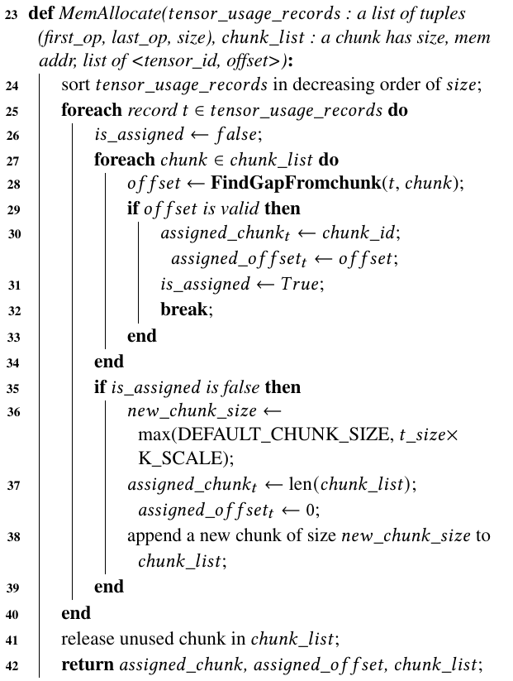
Memory management
first_op, last_op are indices of the first and last operator that use the tensor.
It first sorts the usage records in non-increasing order based on the size of the tensor.
FindGapFromchunk is used to determine if there exists a free gap inside a chunk to fit for that tensor.
If no such gap is found in all existing chunks, we append a new chunk to the end of the chunk list.
If no such gap is found in all existing chunks, we append a new chunk to the end of the chunk list.
Therefore, we can as sign each chunk a maximum inference idle times, and release it after it reaches the time limit
Refer to the paper for details of FindGapFromchunk

Slide 15
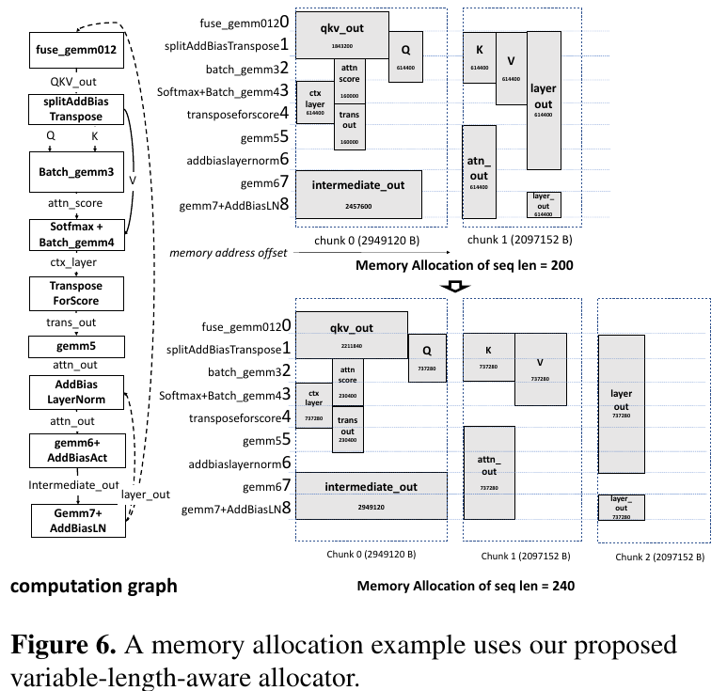
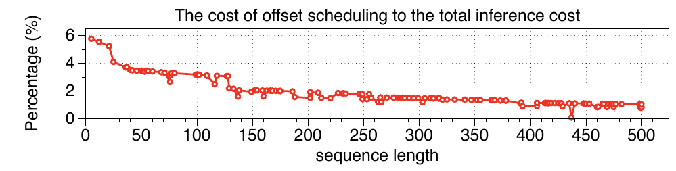
Memory management
Figure 6 shows an example of applying our algorithm on a BERT inference application. When the input length changes from 200 to 240, we allocate one more chunk and adjust the offsets.
As shown in Fig. 13., the average cost of offset scheduling (cost of Algorithm 1) is 1.8% on average (0.07%-5.77%) of DNN inference latency.
The overhead of the algorithm is extremely low and its benefit

Slide 16
Serving Framework
A serving framework is crucial for achieving high serving throughput while meeting latency constraints to satisfy Service Level Objectives (SLOs).
TurboTransformers' serving framework includes Message Queue (MQ) for incoming requests, followed by two optimizations: Caching and Batching.
Caching, similar to Clipper, stores frequent inference results in a database to respond quickly to common requests without model evaluation.
Batching is managed by the Batch Scheduler component, packaging requests received within a time period into batches. Small batch sizes can lead to low GPU utilization, and batching multiple requests together improves hardware utilization.
Traditional serving systems like TF-serving and Nexus package fixed-length requests into batches and lack the capability to efficiently handle variable-length requests.

Slide 17
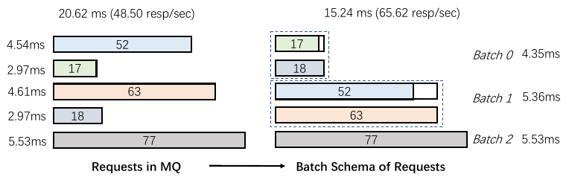
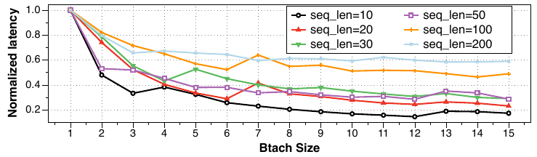
Serving Framework
Serving in batches results in significant speedup, especially for short sequences, as shown in Figure 7.
Batching variable-length requests for optimal throughput is challenging due to zero-padding issues.
Packaging requests of different lengths into a batch results in zero-padding to the maximum length, introducing extra computations.
For instance, if there are five requests with lengths 17, 18, 52, 63, and 77, a single batch is less efficient than no batching.
- The optimal batching scheme involves packing three batches, improving response throughput by 35%, as demonstrated in Figure 8.
Figure 8
Figure 7

Slide 18
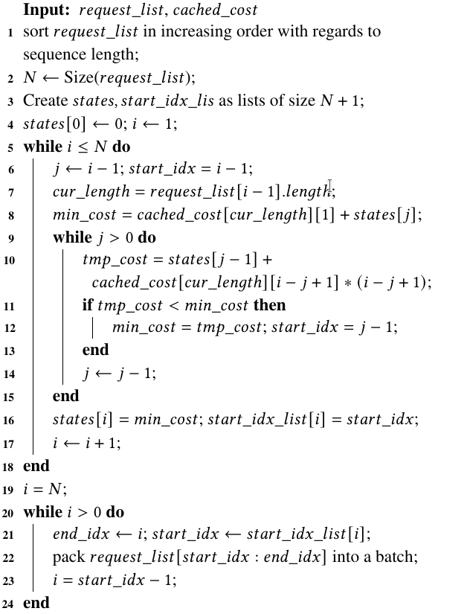

Serving Framework – Batch Scheduler
The core idea is to use dynamic programming (DP) to solve an optimization problem in O (n^2 )
request_list is the list of input requests with variable length
The cached_cost is a dictionary: maps (sequence length, batch size) to (inference cost collected in warm-up phase).
The request_list are sorted in increasing order according to the sequence length
state [i] records the minimum time overhead for processing the sublist request_list [0 : I]
Traverses each request in request_list
Update the state [i] at the corresponding position i.

Slide 19
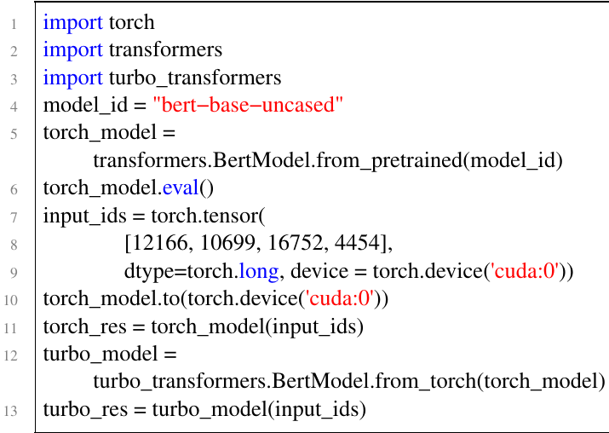
Experimental Results
We evaluated the performance of both the runtime and the serving system on a server equipped with an AMD Ryzen 7
3700X CPU and one RTX 2060 GPU.
Usability :
  Both C++ and Python APIs provided
  the following code snippet, adding 3 lines of
  python code (L3, 12, 13)
  can bring end-to-end speedup

Slide 20
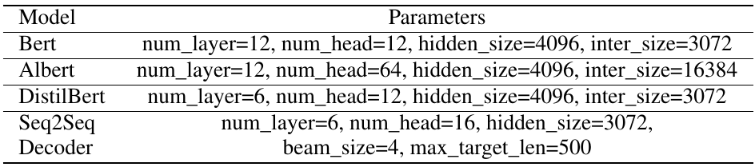
Experimental Results – Performance and runtime
Test environment
  four transformer DNNs, including Bert, Albert , DistilBert and a Seq2Seq Decoder has been implemented separately
  both encoder and decoder structure and is applied in a Neural Machine Translation system

Slide 21
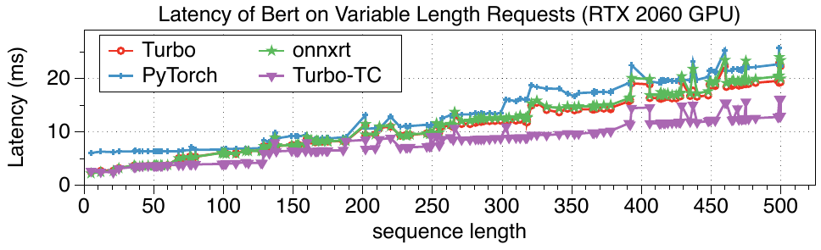
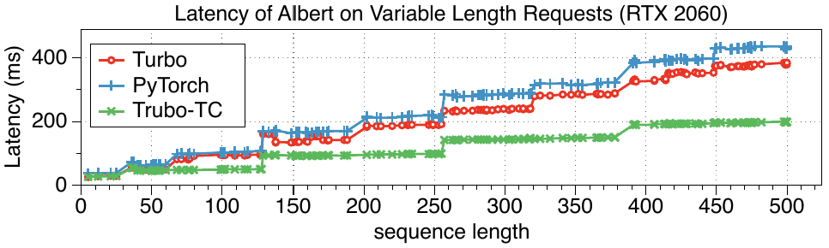
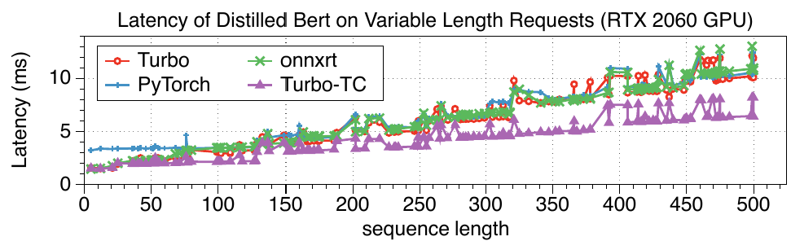
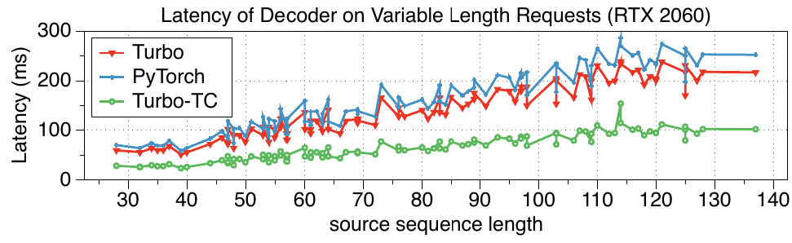
Experimental Results – Speedup of Variable-length input
variable-length input is evaluated by sequential execution of the runtime using requests of different lengths
The task is Chinese-English translation
speedups to PyTorch are ranging from 0.97x-2.44x, on average 1.25x
speedups to PyTorch are ranging from 1.04x-1.45x, on average 1.17x
speedups to PyTorch are ranging from 0.85x-2.24x, on average 1.13x
speedups to PyTorch are ranging from 1.14x-1.20x, on average 1.16x

Slide 22
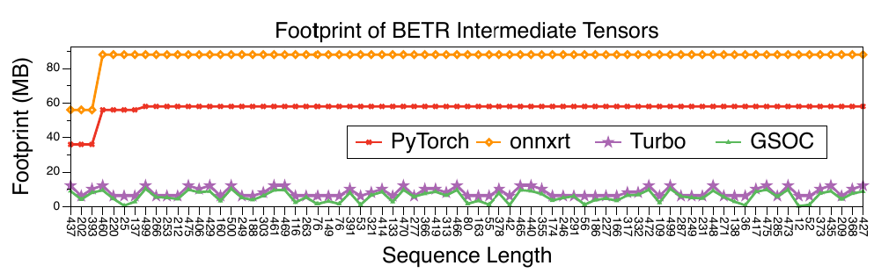
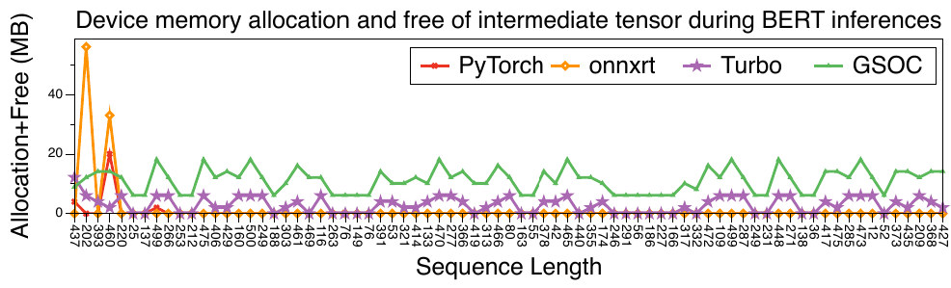
Experimental Results – Memory usage for variable-length inputs
The memory allocated for intermediate tensors in PyTorch and onnxruntime keep increasing during benchmarking
the peak GPU memory used for Turbo is 663 MB while the GPU peak memory used by PyTorch is 1307 MB and 1653 MB for on nxruntime.

Slide 23
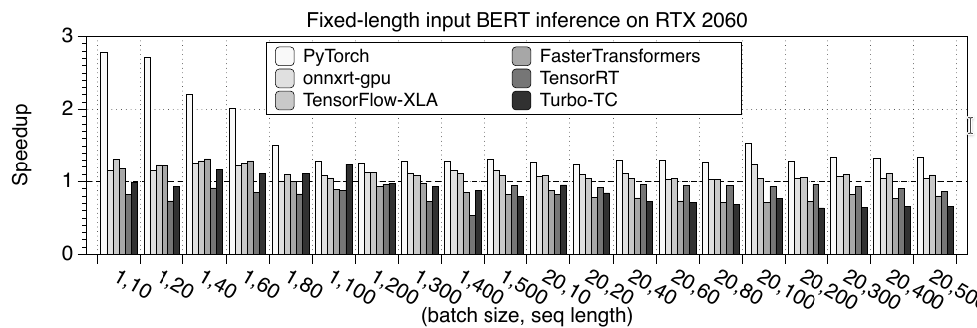
Experimental Results – Speed-up for fixed-length inputs
our runtime does not involve the benefits of these optimizations.

Slide 24
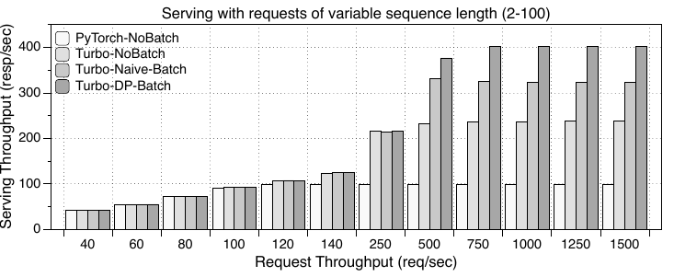
Experimental Results – Performance of serving system
We choose a BERT-based service as our target application, which is used to classify a paragraph of text
Turbo-Naive-Batch is implemented with a naive batch scheduler, which packs the requests currently inside the message queue into a single batch
Other batch modes has been introduced before
The serving throughput of Turbo-NoBatch is saturated at 237 resp/sec (2.39x). Turbo-Naive-Batch improves it to 323 resp/sec (3.26x) and the Turbo-DP-Batch futher improves it to 402 resp/sec (4.06x)

Slide 25
Conclusion
TurboTransformers enhances latency and throughput for deploying transformer-based DL services in GPU data centers.
Addresses challenges posed by transformer models, including unprecedented computation pressure and variable-length input.
Proposes three innovations at computing, memory, and serving levels:
  1. New parallel batch reduction algorithm for Softmax and LayerNorm kernels.
  2. Sequence-length-aware memory allocator.
  3. Sequence-length-aware batch scheduler.
The runtime outperforms PyTorch in variable-length request tests, maintaining a smaller memory footprint.
Achieves comparable speed to onnxruntime in variable-length tests and TensorFlow-XLA, TensorRT, and FasterTransformers in fixed-length request tests.
The serving framework overcomes the inefficiency of conventional batching for variable-length requests, achieving higher throughput with the proposed batch scheduler.

