Slide 1
Cloud Computing in Everyday Life
Transforming How We Work, Learn, and Connect
Name: Muhammad Farhan
Roll no: 25K-0538
Section: K
Program: BCS-1K
Course: ICT Lab
Course Instructor: Miss Syeda Tehreem Gilani

Slide 2
Agenda
Introduction to Cloud Computing
How Cloud Computing Works
Everyday Applications
Benefits of Cloud Computing
Challenges & Concerns
Future of Cloud Computing
Case Study: Netflix
Conclusion

Slide 3
Introduction
Cloud computing delivers computing services (storage, software, processing power) over the internet.
Instead of relying only on local devices, people access resources “in the cloud.”
It has become an essential part of daily life:
Work & Education: Google Drive, Microsoft Teams, Zoom.
Entertainment: Netflix, YouTube, Spotify.
Personal Use: Online backups, file sharing, photo storage.

Slide 4
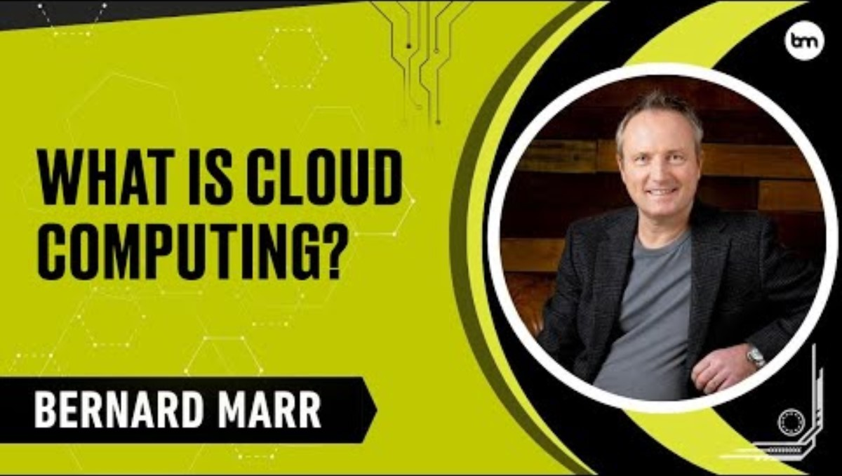
http://www.youtube.com/watch?v=1L55G3GqFhM

Slide 5




How could computing works
User Request → A person connects to the internet.
Cloud Provider Servers → The request is sent to data centers.
Processing → Applications, storage, or services are prepared.
Delivery → Data is sent back to the user’s device.
Access Anytime, Anywhere → Services run smoothly without local storage limits.

Slide 6
Everyday applications of cloud computing
Education:
Online classes, e-learning platforms, collaboration (Google Classroom, Microsoft Teams).
Entertainment:
Streaming services like Netflix, YouTube, Spotify use cloud to deliver content.
Business and Work:
Remote work tools (Zoom, Slack), cloud storage (Dropbox, Google Drive).
Personal Use:
File sharing, photo backups, email services (Gmail, iCloud).

Slide 7
Benefits of Cloud Computing
Accessibility:
Access data and apps anytime, anywhere.
Scalability:
Increase or decrease resources as needed.
Cost Efficiency:
Pay only for what you use, no heavy hardware investment.
Collaboration:
Multiple users can work together in real-time.
Accessibility | Scalability | Cost Efficiency | Collaboration
Anytime Desired | Scale as needed | No Hardware Investment | Multiple users at same time.

Slide 8
Challenges & concerns
Security Risks:
Threat of data breaches and hacking.
Internet Dependency:
Services unavailable without a stable connection.
Privacy Issues:
Concerns about who controls and accesses user data.
Downtime Risks:
Service outages can disrupt work and access.

Slide 9
Future of cloud computing
AI Integration:
Smarter cloud services powered by Artificial Intelligence.
Edge Computing:
Processing closer to users for faster performance.
Hybrid & Multi-Cloud Models:
Combining private and public clouds for flexibility.
Sustainability:
Energy-efficient data centers and green IT practices.
AI-Integration | Edge Computing | Hybrid Models | Sustainability
More effective algorithms | Faster and more efficient performance | Combining multiple models for flexibility | More energy efficient

Slide 10
Case study: netflix
Global Streaming Leader:
Uses cloud servers to deliver movies and shows worldwide.
Scalability:
Handles millions of viewers at the same time.
Personalization:
Cloud-based AI recommends shows and movies for each user.
Cost Efficiency & Reliability:
Avoids building massive data centers by relying on cloud providers.

Slide 11
conclusion
Cloud computing is deeply integrated into daily life — from education to entertainment.
Offers flexibility, scalability, and collaboration benefits.
Challenges like security, privacy, and downtime still exist.
The future points toward AI, edge computing, and sustainable solutions.
Cloud is not just technology — it’s a driver of innovation and connectivity.
Cloud Computing = Flexibility, Connectivity, Possibilities.

Slide 12
references
Amazon Web Services (AWS) – What is Cloud Computing?
Microsoft Azure Documentation – Cloud Services Overview
Google Cloud Blog – Trends in Cloud Computing
IBM Articles – The Future of Cloud Technology
Techopedia – Cloud Computing Explained

