Slide 1
The Importance of AI in Healthcare
Transforming Diagnosis, Treatment, and Patient Care
Name: Muhammad Farhan
Roll no: 25K-0538
Program: BCS-1K
Section: K
Course: ICT Lab
Course Instructor: Miss Syeda Tehreem Gilani

Slide 2
Agenda
Introduction to AI in Healthcare
Applications of AI
Benefits of AI in Healthcare
Challenges & Ethical Issues
Future of AI in Healthcare
Interactive Quiz
Conclusion

Slide 3
Introduction to AI in Healthcare
AI refers to computer systems that can mimic human intelligence.
In healthcare, ai is used for diagnosis, treatment, and administrative support.
Key advantage: faster, more accurate decision-making.
Ai helps reduce human error and improves patient care.

Slide 4
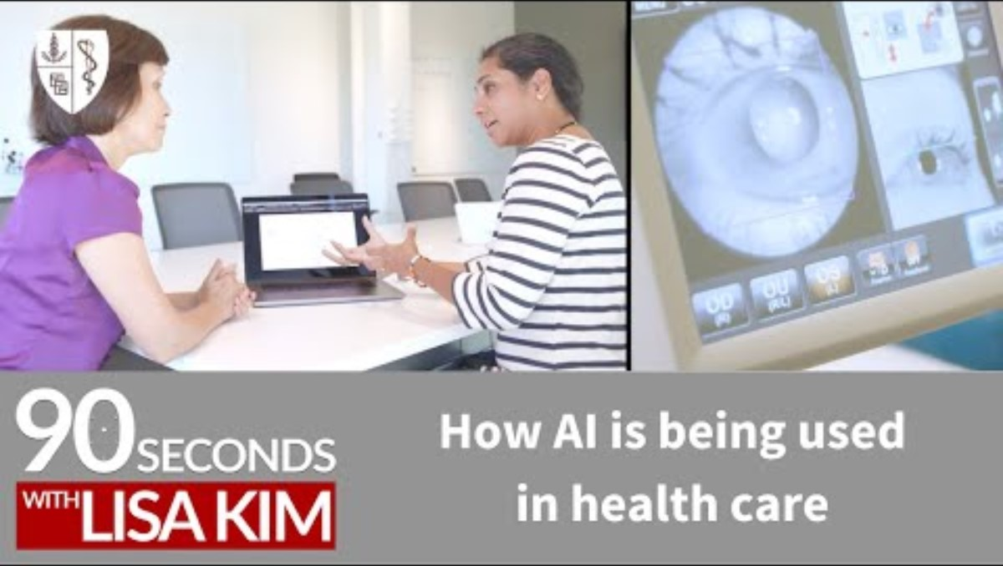
Applications of AI
Medical Imaging & Diagnosis – AI detects diseases like cancer, stroke, and pneumonia earlier and more accurately.
Predictive Analytics – Helps forecast disease outbreaks, patient risks, and hospital resource needs.
Virtual Health Assistants – Chatbots and apps provide reminders, symptom checks, and 24/7 patient support.
Drug Discovery & Development – Speeds up research and testing of new medicines.
Robotic Surgeries – Improves precision, reduces errors, and shortens patient recovery time.
A short video explaining uses of AI In health care by Stanford University.

Slide 5

Benefits of AI in Healthcare
Improved Accuracy – AI reduces errors in diagnosis and treatment.
Personalized Care – Treatment plans tailored to individual patients.
Faster Decisions – Quicker diagnosis and patient management.
Cost Efficiency – Reduces hospital expenses and saves time.
24/7 Support – Virtual assistants help patients anytime.
Doctor using AI-powered holographic display of human body for medical analysis.

Slide 6
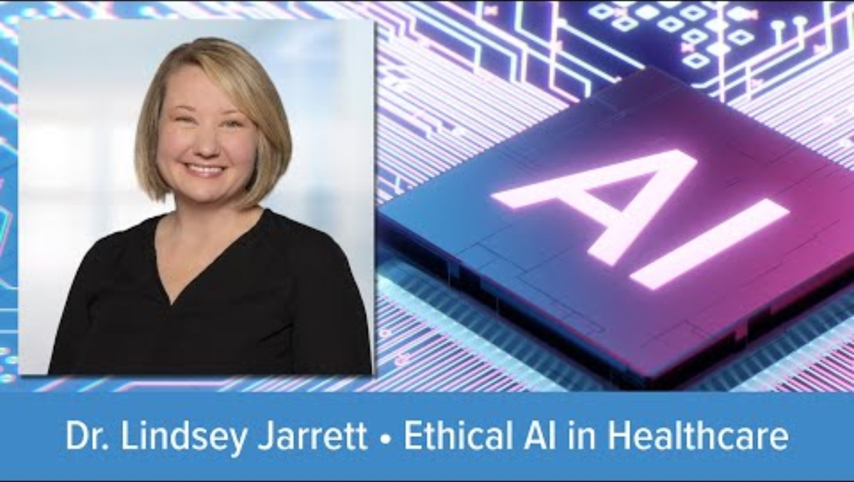
Challenges & Ethical Issues
Data Privacy – Risk of patient information being misused.
Bias in AI – Inaccurate results if training data is limited or unfair.
High Costs – Expensive to implement AI systems in hospitals.
Job Concerns – Fear of AI replacing some healthcare roles.
Accountability – Unclear who is responsible if AI makes a mistake.
A video by Dr. Lindsey Jarrett explaining the Challenges of Ethics in AI.

Slide 7
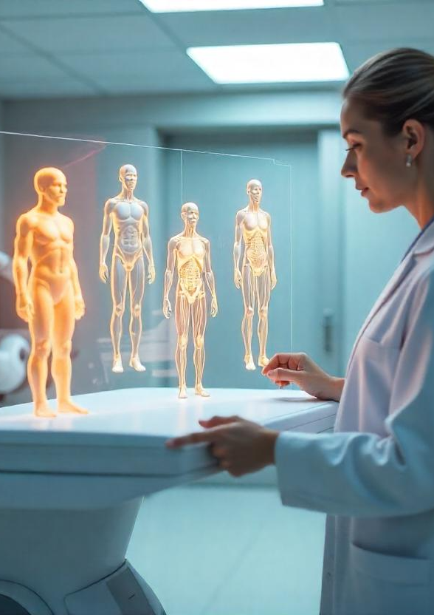
Future of AI in Healthcare
Smart Hospitals – Fully AI-integrated systems for patient care.
Robotic Surgeries – Even more precise and widely available.
Wearable Devices – Real-time health monitoring and alerts.
Mental Health Support – AI chatbots for counseling and therapy.
Global Health Monitoring – AI tracking outbreaks and diseases worldwide.
A doctor using AI with Holograms to check the physical state and data of Patient’s Health.

Slide 8
Interactive Quiz
Question: A hospital is using AI to:
Detect cancer in X-ray images
Predict which patients may develop diabetes
Perform robotic-assisted surgeries
Write patients’ personal stories for novels
Which of these is NOT a real application of AI in healthcare?
A) Detect cancer in X-rays B) Predict diabetes risk C) Robotic surgeries D) Writing patient novels

Slide 9
Correct
Correct!
“Writing patient novels” is not a real application of AI in healthcare.
AI is used for imaging, predictions, and robotic assistance, but not for creating fictional patient biographies as a clinical tool.

Slide 10
Incorrect
Incorrect!
Options A, B, and C are real AI applications in healthcare:
Medical imaging (cancer detection)
Predictive analytics (disease risk)
Robotic-assisted surgery

Slide 11
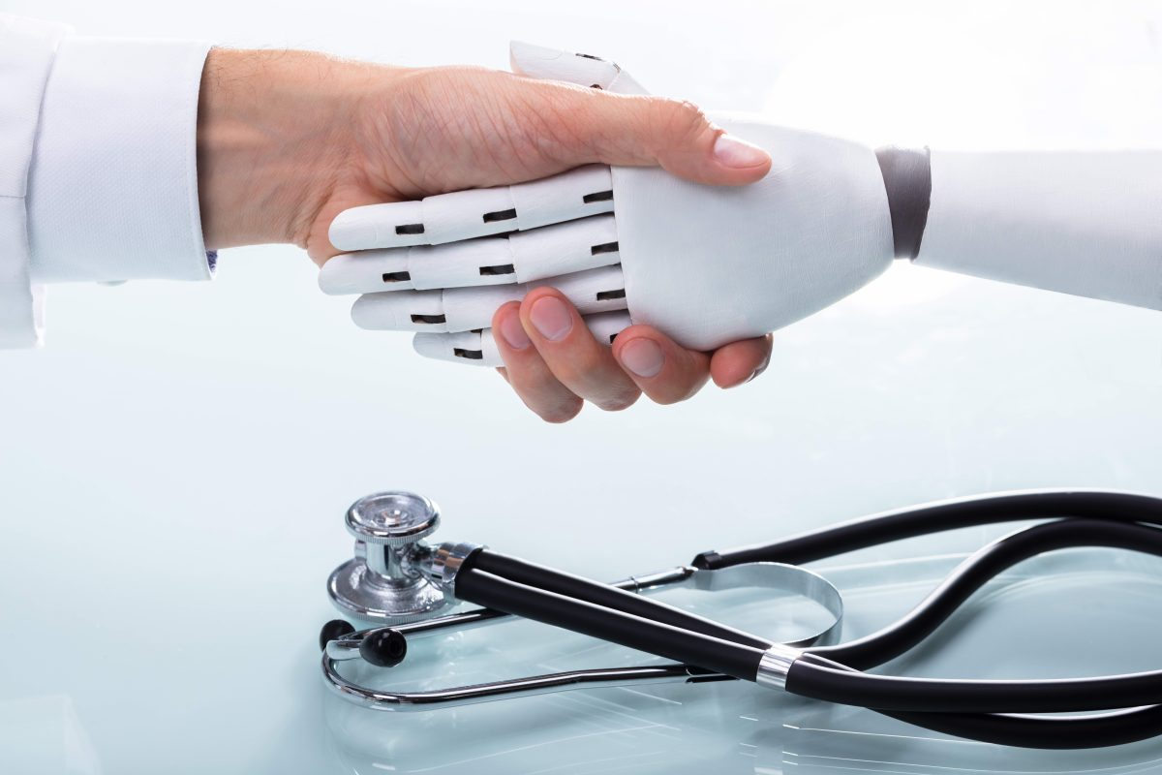
Conclusion
AI is transforming healthcare with speed, accuracy, and personalization.
It brings both benefits and challenges.
Future of medicine = partnership between humans and ai.
"AI won’t replace doctors, but doctors using AI will replace those who don’t."

