Slide 1
Evolution of Computers – From 1st generation to Modern AI
Name: Muhammad Farhan
Roll No: 25K-0538
Class: Bcs-1k
Course: CL1000 – Introduction to Information and Communication Technology
Lab: #2
Assignment#2
Course Instructor: Miss Syeda Tehreem

Slide 2
Timeline of Computer Evolution
Key milestones:
1940s–1950s: 1st Gen — Vacuum tubes (ENIAC, UNIVAC)
1950s–1960s: 2nd Gen — Transistors replace vacuum tubes
1960s–1970s: 3rd Gen — Integrated Circuits (ICs)
1970s–present: 4th Gen — Microprocessors, personal computing
2010s–present: Modern AI era — GPUs, TPUs, deep learning, cloud

Slide 3
Generations of Computers (Overview)
Short summaries:
1st Gen: Used vacuum tubes, very large, slow, and required lots of electricity.
2nd Gen: Used transistors, smaller and more reliable than before.
3rd Gen: Introduced integrated circuits (chips), faster and more affordable.
4th Gen: Microprocessors led to personal computers in homes, schools, and offices.
Modern AI: Computers with smart processors, AI software, and cloud power.

Slide 4
Modern AI and Emerging Trends
Trends shaping modern computing:
Software that learns from data — like AI assistants, chatbots, and image recognition.
Special processors (GPUs/TPUs) handle big tasks like AI training.
Cloud computing and edge devices allow sharing and fast processing everywhere.
Research into quantum computers and brain-like (neuromorphic) chips is ongoing.

Slide 5
Comparison Across Generations
Generation | Technology | Speed | Size | Power Cost | Programming | Examples | Cost
1st Gen | Vacuum Tubes | Slow | Very Large (Room Sized) | Very High | Machine Language | ENIAC, UNIVAC | Extremely Expensive
2nd Gen | Transistors | Better Speed | Smaller than 1st Gen | High | Assembly, Fortran | IBM 1401 | Expensive
3rd Gen | Integrated Circuits | Faster | Medium-Sized | Lower | High Level Languages | IBM 360 | Cheaper
4th Gen | Microprocessors | Fast | PCs and Laptops | Low | C, C++, Java | Personal Computers | Relatively Affordable
Modern AI | AI Processors(GPUs/TPUs) | Very Fast | Phones to Data Centers | Efficient to Very High | Python, JavaScript, C#, AI Tools | AI Systems, Cloud Computing | Varies

Slide 6
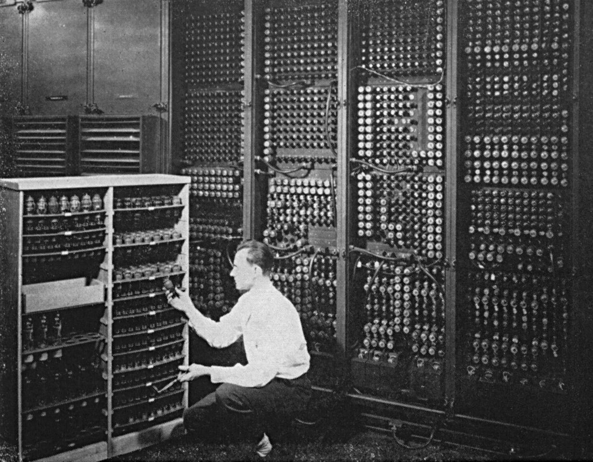
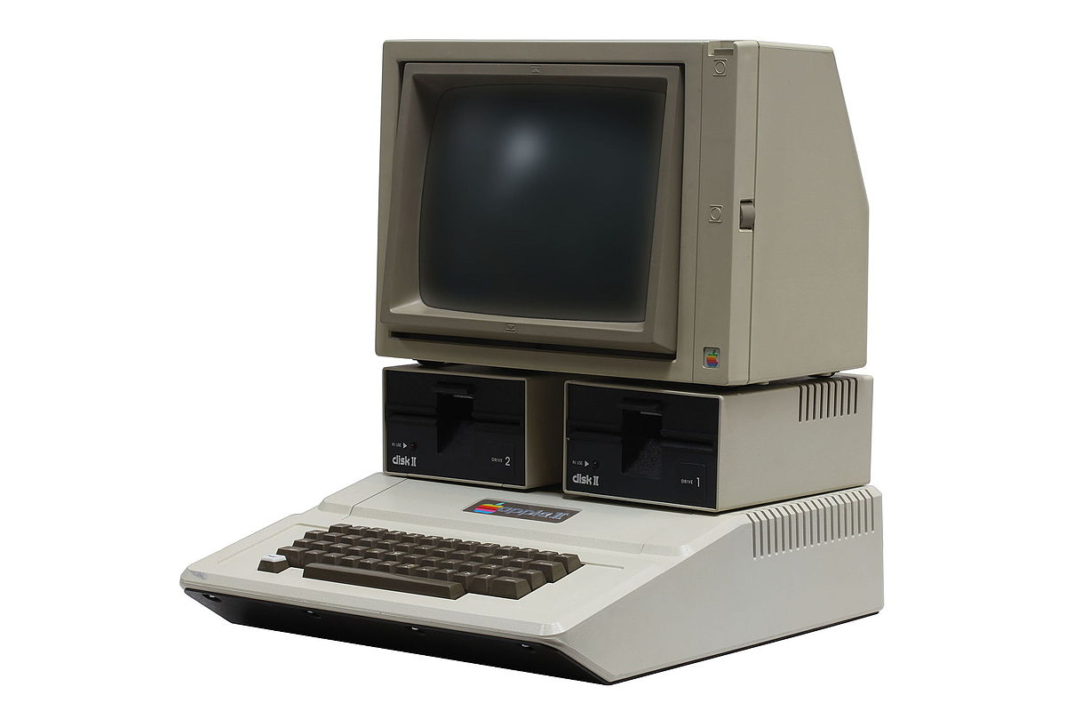
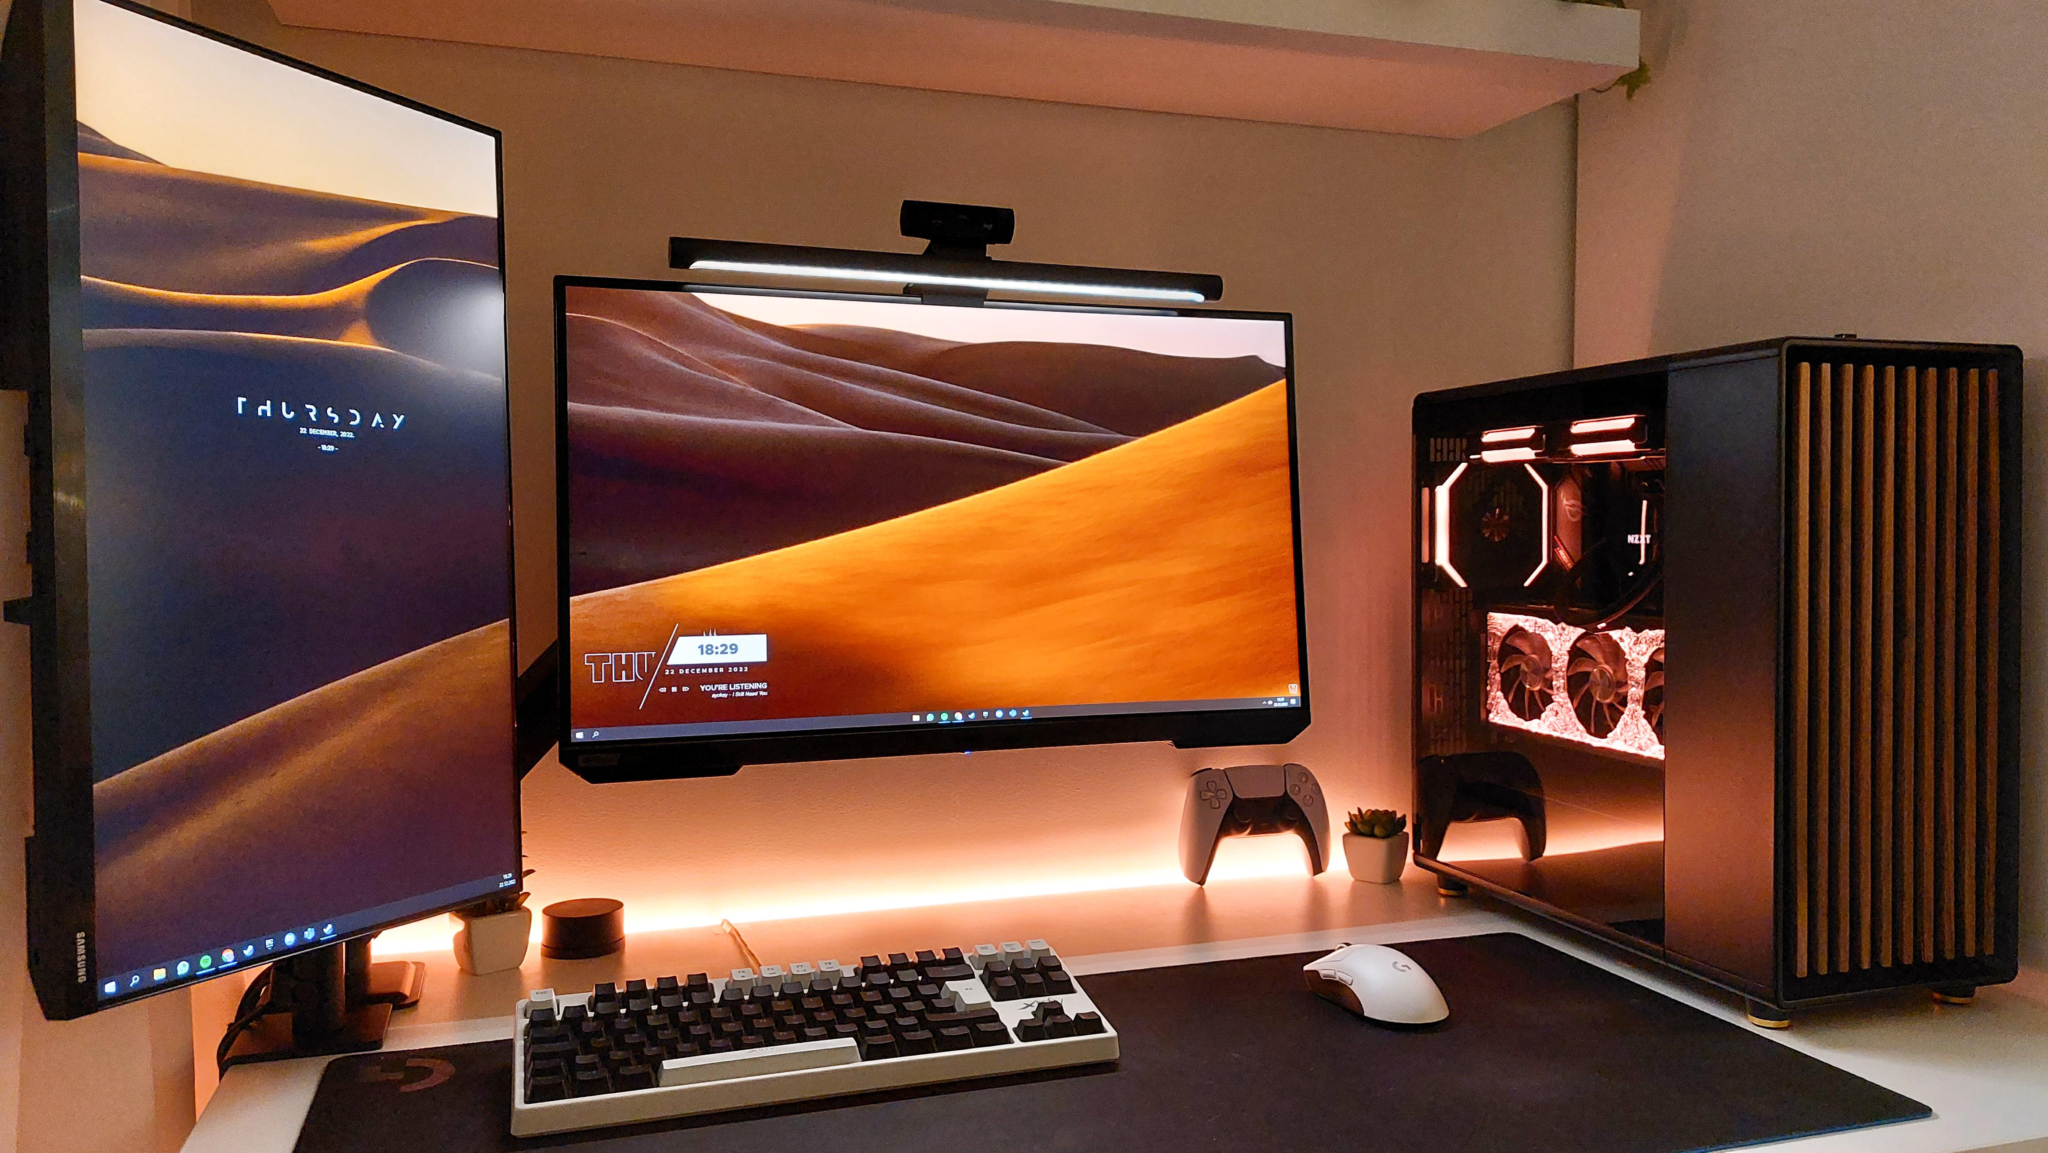
The very first Computer ENIAC.
One of the first widely available Computer, Apple II.
A Modern Desktop Personal Computer.
The very first computer built in 1945 using vacuum tubes. The computer’s size was as big as a room.
Apple II (1977)
The very first widely commercial desktop computer for the ordinary population made by Apple.
Modern Desktop
Modern desktop computers can be custom built to user’s preferences, needs and budget.
ENIAC
Costing $1,298 in 1977 ≈ about $6,200 today (2025)
It costed $500,000 in 1945 ≈ $7–8 million today.
Can cost anywhere from 60$ to thousands of dollars depending on components.

