Slide 1
00
Cybersecurity
Threats
and How to Stay Safe
Cybersecurity Awareness | Digital Safety

Slide 2
01
INTRODUCTION
Cybersecurity:
DID YOU KNOW?
A Digital Battlefield
39s
⚡
Attack every 39 seconds
between each cyberattack worldwide
⚠️
90% breaches → human error
90%
💾
Data = digital currency
of breaches caused by human error
🎯
Everyone is a target
$4.5M
👉 "Who here uses the same password twice?"
average cost of a data breach
Cybersecurity Awareness | Digital Safety

Slide 3
02
PREVENTION
Brute Force
🔑 12+ characters required
Attack
📱 Enable 2FA
🔒 Account lockout policy
HOW IT WORKS
⚡ Automated password guessing
PASSWORD COMPARISON
⚡ Millions of combinations/sec
WEAK ❌
Cracked in: < 1 sec
Ahmed123
THREAT IMPACT
🔓 Account takeover
STRONG ✅
🔓 Data theft
Cracked in: 3,000 yrs
T9#kL!2pQr$8
Cybersecurity Awareness | Brute Force Attacks

Slide 4
03
PREVENTION
Hacking
🔄 Regular updates
Explained
🛡️ Secure configs
🔥 Firewalls
HOW IT HAPPENS
⚡ Software vulnerabilities
REAL WORLD EXAMPLE
⚡ Unpatched systems
VULNERABLE
1
Outdated university portal
THREAT IMPACT
💀 Full system control
EXPLOITED
2
💀 Data leaks
Hacker gains access
3
LEAKED
Student data exposed and leaked
Cybersecurity Awareness | Hacking & System Exploitation

Slide 5
Global Cybersecurity Attacks
04
Number of reported attacks (in millions) | 2020–2024
Sources: IBM Security, Statista, ENISA Threat Landscape Reports

Slide 6





05
PREVENTION
Antivirus software
Virus
Avoid pirated software
(Malware)
Scan files before opening
HOW IT ENTERS
REAL WORLD EXAMPLE
Cracked software
VULNERABLE
1
Downloaded a pirated game online
Email attachment
Infected USB
2
INFECTED
THREAT
Virus activates and spreads
File corruption
System slowdown
DAMAGED
3
Files corrupted, system unusable
Cybersecurity Awareness | Malware & Virus Threats

Slide 7



06
PREVENTION
Backup data regularly
Ransomware
Don't click unknown links
Explained
Keep system updated
HOW IT ENTERS
REAL WORLD EXAMPLE
Phishing link
EXPOSED
1
User clicks phishing email link
Malicious attachment
THREAT
2
ENCRYPTED
Files encrypted & locked
All files locked by ransomware
Payment demanded
RANSOM NOTE
Ask: "Should you ever pay the ransom?"
3
"Pay $300 in Bitcoin to unlock your files."
Cybersecurity Awareness | Ransomware & Encryption Threats

Slide 8
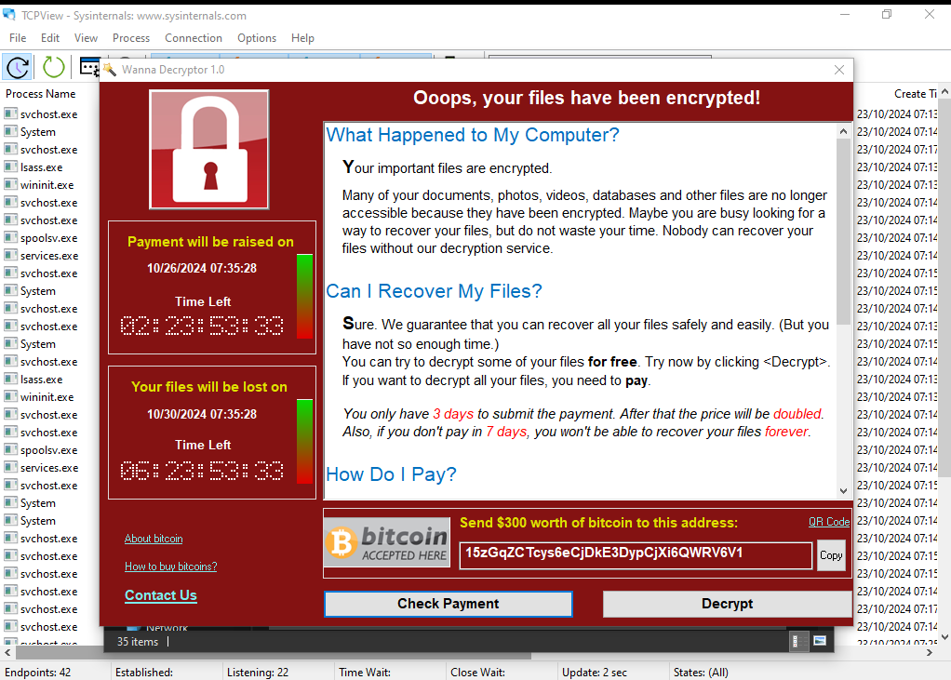
Ransomware
Example
07
Cybersecurity Awareness | Ransomware & Encryption Threats

Slide 9
REAL WORLD ATTACK
08
Phishing
Discord Nitro Phishing
& Modern Tactics
HOW IT HAPPENS
1
TARGETED
⚡ Impersonates trusted orgs & brands
⚡ AI generates perfectly written fake emails
⚡ Attacks via SMS, WhatsApp & social DMs
User receives fake 'Free Nitro'
message via Discord DM
THREAT IMPACT
2
EXPLOITED
💀 Account & identity hijacking
💀 Credential & session token theft
Link steals session token
no password needed
PREVENTION
🛡️ Always verify the sender's address
🛡️ Hover over links before clicking
🛡️ Enable MFA on every account
3
HIJACKED
Full account takeover
Cybersecurity Awareness | Phishing & Modern Tactics

Slide 10



09
PHISHING EXAMPLE
RED FLAGS
Fake Email
micros0f
"0" instead of "o"
Example
Urgency
New Message (URGENT)
"24 hours" designed to panic you
From: security@micros0f-support.com
Subject: URGENT: Account Suspension
Fake link
Dear User,
domain doesn't match Microsoft
Your account will be suspended in 24 hours.
Click here to verify immediately.
http://micros0f-login-security.com
Generic
"Dear User" is not your real name
Ask: "What exposed this as fake?"
Cybersecurity Awareness | Phishing & Fake Email Detection

Slide 11







KEY THREATS & PREVENTION
10
SOCIAL ENGINEERING
Social
Trust Exploited
attacker disguised as legitimate
Engineering
Account
Drained funds transferred instantly
Fake authority
Fear tactics
$1B+
lost to phone scams globally each year
Phone scams
"This is bank security. Share your OTP now."
PREVENTION
Never share OTP, no bank will ask
Verify the caller via official number
Stay calm, urgency is a trap
Cybersecurity Awareness | Social Engineering & Human Manipulation

Slide 12

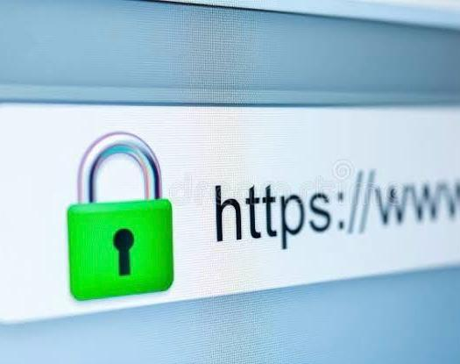
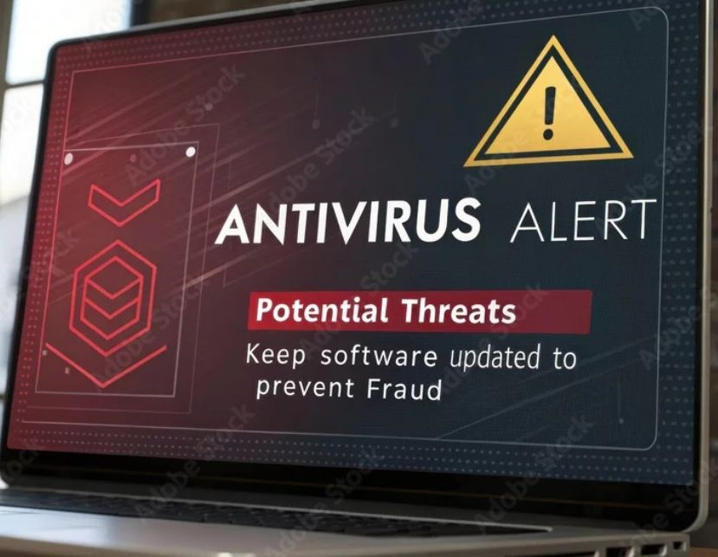
11
Prevention
Your daily security
habits make all the difference.
Best Practices
⚡ KEY PRINCIPLES
🌐 SAFE BROWSING
🛡 ANTIVIRUS & BACKUP
Treat urgency as an instant red flag
Never ignore browser security warnings
Run updated antivirus as your baseline
Download only from verified official sources
Check URL before entering credentials
Back up data offline regularly
Verify unexpected messages, even from friends
Use HTTPS, look for the padlock icon
Keep all software & OS up to date
Cybersecurity Awareness | Prevention & Best Practices

Slide 13
12
Two-Factor Authentication
How a second factor blocks attackers
❌ WITHOUT 2FA
✅ WITH 2FA
🔓
🔒
SCENARIO: Hacker steals your Gmail password via phishing
SCENARIO: Hacker steals your Gmail password via phishing
RESULT
RESULT
VS
Account compromised instantly
Hacker BLOCKED : OTP unreachable
💀 Full account takeover
💀 Emails, contacts & data exposed
💀 Identity theft risk
✅ Password theft alone can't bypass 2FA
✅ Use authenticator app, not SMS
✅ Hardware keys = strongest safety
Cybersecurity Awareness | Two-Factor Authentication

Slide 14
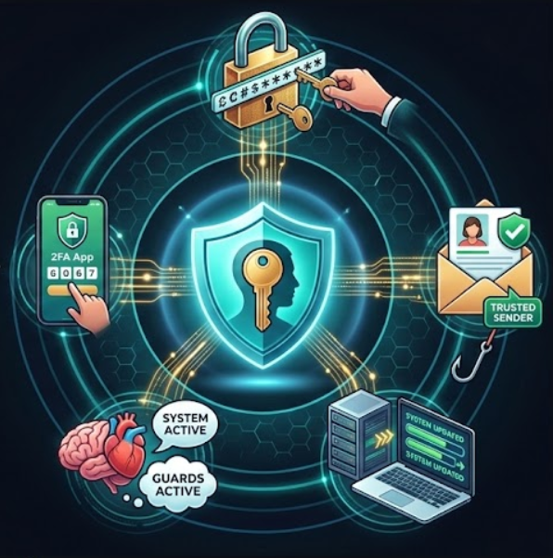
13
CONCLUSION
Stay Vigilant,
Stay Safe
⚡ Think before you click
⚡ Trust your instincts, if it feels wrong, it probably is
👉 “What security habit will you change from today?”
Cybersecurity Awareness | Digital Safety

