Slide 1


Slide 2
Inspiration
Questions we want to answer:
How can we make stock trading less intimidating to the average consumer?
How can we keep the common user informed on stock performance in a way that is easy to visualize and understand?
How do we deliver that stock information in a way that is convenient, fast, and easy to consume?

Slide 3
Solution
Create an app that delivers up-to-date simulations for selected stock performance, and puts that information in the palm of the consumer’s hand via SMS.
Give more insight the possible future prices that the stock will reach, ensuring consumer’s awareness into selected stock’s risk

Slide 4
Data / Analysis
Stock Data from Alpaca:
For our initial version, we only select top 10 S&P 500 stocks to ensure we have enough data for our analysis. Therefore, the data required minimal cleaning.
Stock Analysis:
We use 21-days, 200-days moving averages, and 21-days, 200-days beta to introduce technical analysis for our application. We believe these analysis would help consumer understand the stock projection and risk.
Stock Simulation:
Monte Carlo simulations are use to help explain and relate risk to consumer in more relatable context.

Slide 5
SHOWTIME

Slide 6
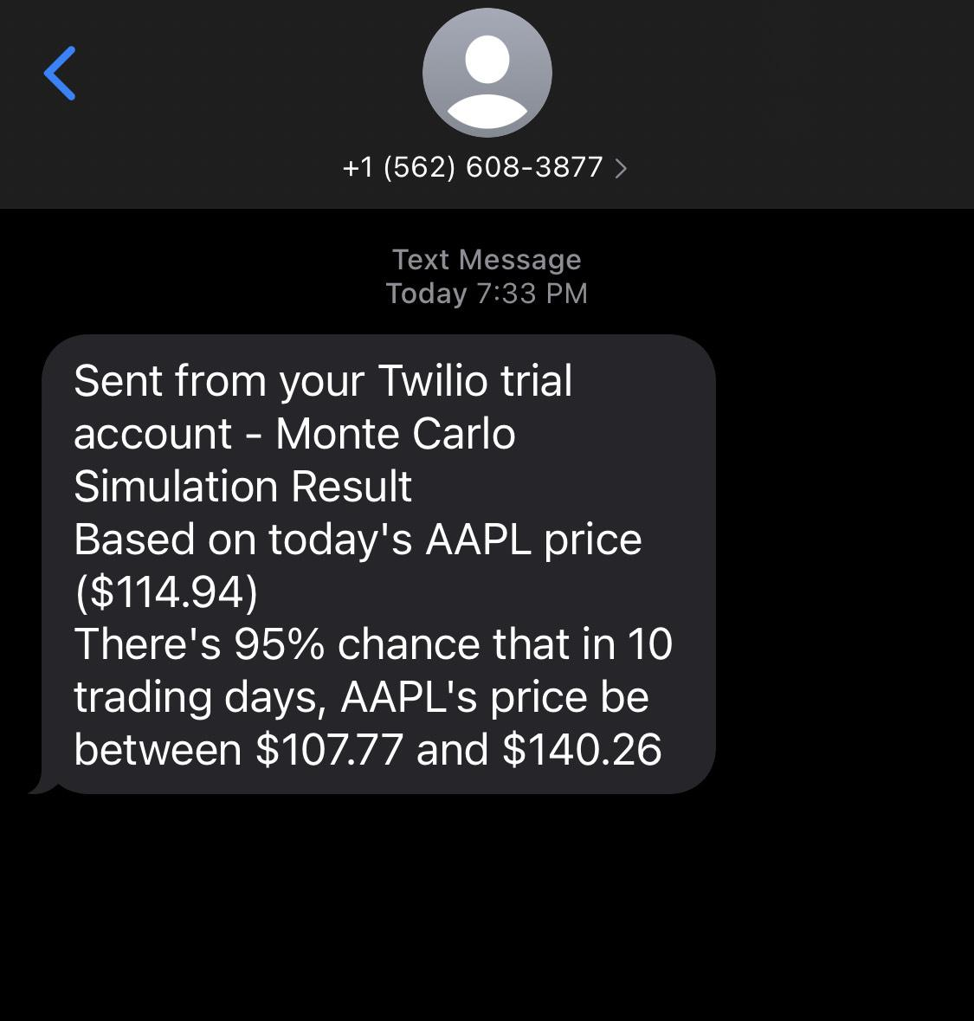
Text from Twilio

Slide 7
Future Possibilities
Allow free selection of stocks
More technical analysis charting options
More # of Monte Carlo simulations
Customizable sms text options
SMS alerts based on custom criterias

