Slide 1
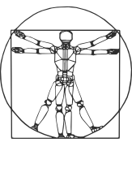
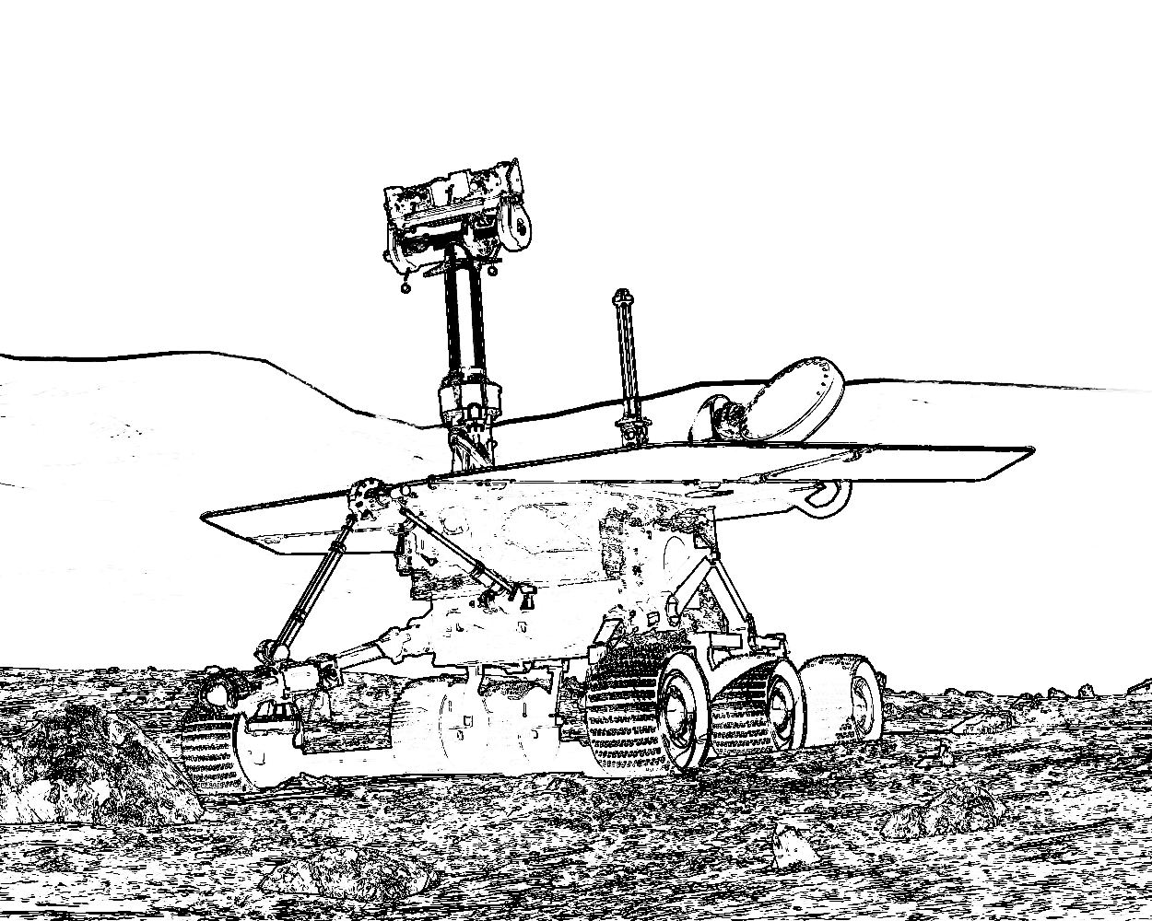


COMP417 Introduction to Robotics and Intelligent Systems Lecture 13: Particle Filters

Slide 2
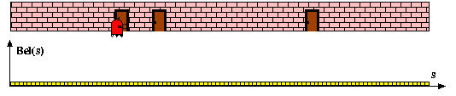
bel(x): when a single Gaussian fails
The robot below has a noisy door sensor
Not a microphone that tells if the door squeaks…

Slide 3
bel(x): when a single Gaussian fails
The robot below has a noisy door sensor
Not a microphone that tells if the door squeaks… rather a camera that says “I’m in front of a door”, but sometimes gets it wrong….

Slide 4
bel(x): when a single Gaussian fails
The robot below has a noisy door sensor
Not a microphone that tells if the door squeaks… rather a camera that says “I’m in front of a door”, but sometimes gets it wrong….
Suppose this robot “wakes up” and has the door sensor read 1:
That means, we’d like our belief to be high everywhere a door exists, and lower everywhere else

Slide 5
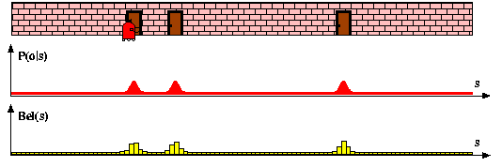
bel(x): when a single Gaussian fails
The robot below has a noisy door sensor
Not a microphone that tells if the door squeaks… rather a camera that says “I’m in front of a door”, but sometimes gets it wrong….
Suppose this robot “wakes up” and has the door sensor read 1:
That means, we’d like our belief to be high everywhere a door exists, and lower everywhere else
Sometime like:

Slide 6
Today 2 different ideas that can track this kind of “multi-modal” belief:
The histogram filter:
Simple and impractical, but good to get the idea
The particle filter:
Another “winning” algorithm in robotics, and competitor to the KF
Widely used and important to know: luckily a bit lighter on math

Slide 7
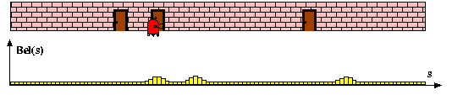
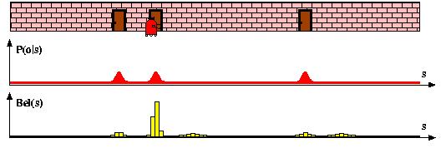
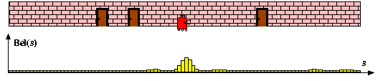
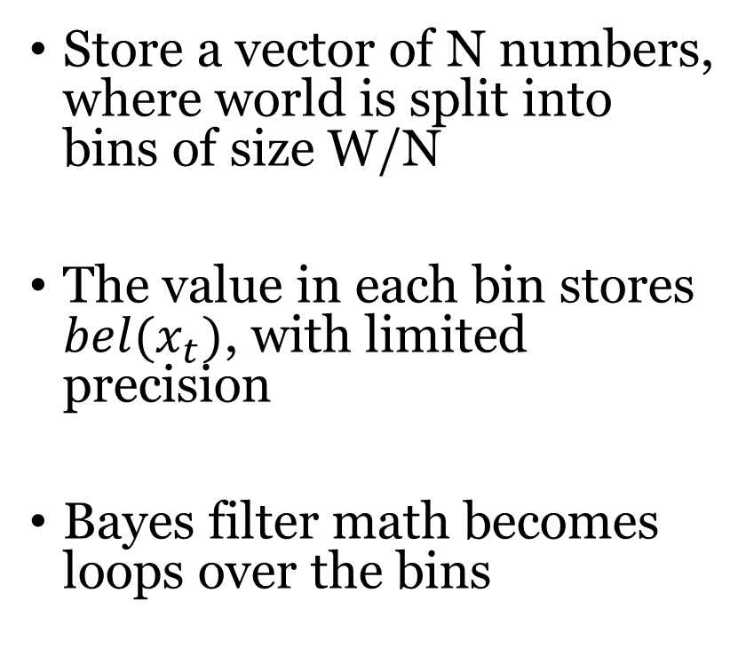
Discrete (aka Histogram) Filter
Store a vector of N numbers, where world is split into bins of size W/N
The value in each bin stores $bel(x_{t})$, with limited precision
Bayes filter math becomes loops over the bins

Slide 8
Discrete Filter
Algorithm Discrete_Bayes_filter( Bel(x),d ):
η=0
If d is a perceptual data item z then
For all x do
For all x do
Else if d is an action data item u then
For all x do
Return Bel’(x)

Slide 9
What is the complexity?
Stare at the “loop over all x”:
Inside this, we compute an update which draws from all other x…

Slide 10
What is the complexity?
Stare at the “loop over all x”:
Inside this, we compute an update which draws from all other x…
Discrete histogram filter is quadratic or worse in the number of states
The number of states needed to uniformly grid an d-dimensional space grows exponentially with d
We almost never use this in practice. But the idea of computing based on discrete locations can be extended!

Slide 11
Recommended reading
Lesson 3 in https://www.udacity.com/course/artificial-intelligence-for-robotics--cs373
Chapters 4.3 and 8.3 in the Probabilistic Robotics textbook

Slide 12
KF vs EKF vs PF
 | Kalman Filter | Extended Kalman Filter | Particle Filter
Dynamics model | Linear | Nonlinear | Nonlinear
Sensor model | Linear | Nonlinear | Nonlinear
Noise | Gaussian (Unimodal) | Gaussian (Unimodal) | Multimodal
One peak
Multiple peaks

Slide 13
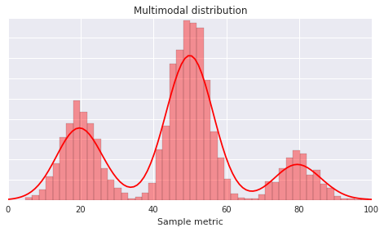
How can we represent multimodal distributions?
Idea #1: Histograms
Advantages: the higher the number of bars the better the approximation is
Disadvantages: exponential dependence on number of dimensions
Note: this approach is called the Histogram Filter. It is useful for low-dimensional systems but we will not study it in this class.
https://www.opsclarity.com

Slide 14
How can we represent multimodal distributions?
Idea #1: Histograms
Advantages: the higher the number of bars the better the approximation is
Disadvantages: exponential dependence on number of dimensions
Note: this approach is called the Histogram Filter. It is useful for low-dimensional systems but we will not study it in this class.
https://www.opsclarity.com
Idea #2: Function Approximation / Fitting
Unclear how to do Bayes’ filter updates and predictions in this case.

Slide 15
How can we represent multimodal distributions?
Idea #1: Histograms
Advantages: the higher the number of bars the better the approximation is
Disadvantages: exponential dependence on number of dimensions
Note: this approach is called the Histogram Filter. It is useful for low-dimensional systems but we will not study it in this class.
https://www.opsclarity.com
Idea #2: Function Approximation
Unclear how to do Bayes’ filter updates and predictions in this case.
Idea #3: Weighted Particles
Advantages: easy to predict/update by treating each particle as a separate hypothesis whose weight is updated.
Disadvantages: need enough particles to “cover” the distribution

Slide 16
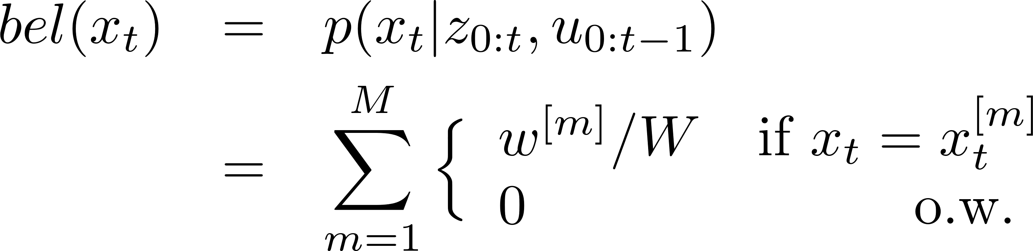
How can we represent multimodal distributions?
Idea #1: Histograms
Advantages: the higher the number of bars the better the approximation is
Disadvantages: exponential dependence on number of dimensions
Note: this approach is called the Histogram Filter. It is useful for low-dimensional systems but we will not study it in this class.
https://www.opsclarity.com
Idea #2: Function Approximation
Unclear how to do Bayes’ filter updates and predictions in this case.
Higher density of
particles means
higher probability
mass
Idea #3: Weighted Particles
Advantages: easy to predict/update by treating each particle as a separate hypothesis whose weight is updated.
Disadvantages: need enough particles to “cover” the distribution
W = sum of all particles’ weights

Slide 17
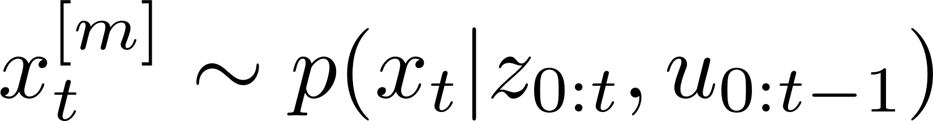
How can we represent multimodal distributions?
Idea #1: Histograms
Advantages: the higher the number of bars the better the approximation is
Disadvantages: exponential dependence on number of dimensions
Note: this approach is called the Histogram Filter. It is useful for low-dimensional systems but we will not study it in this class.
https://www.opsclarity.com
Idea #2: Function Approximation
Unclear how to do Bayes’ filter updates and predictions in this case.
Higher density of
particles means
higher probability
mass
Idea #3: Weighted Particles
Advantages: easy to predict/update by treating each particle as a separate hypothesis whose weight is updated.
Disadvantages: need enough particles to “cover” the distribution
Want particles to be drawn from the belief at time t:

Slide 18
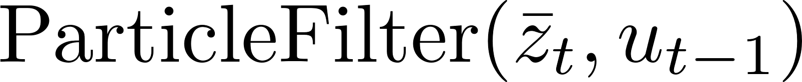
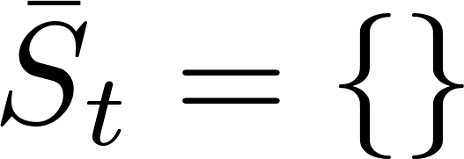
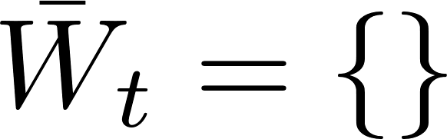
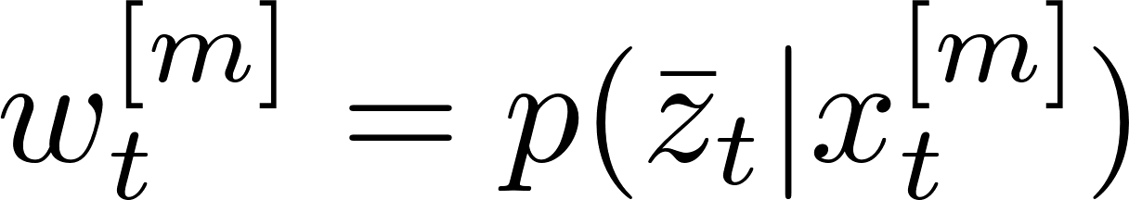
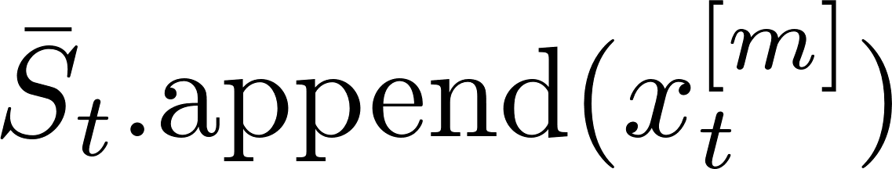
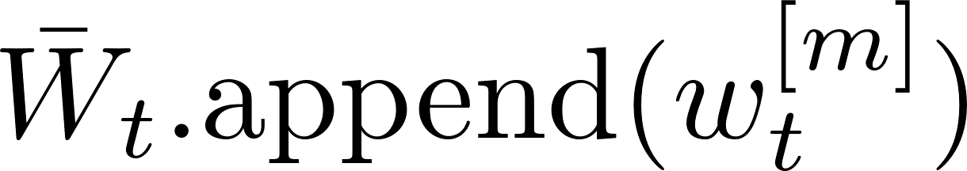

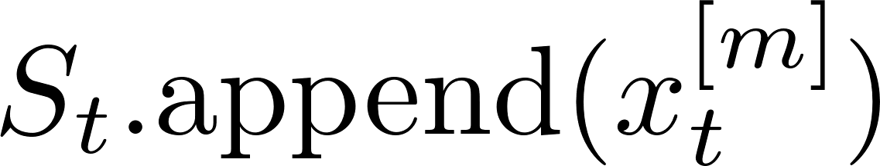
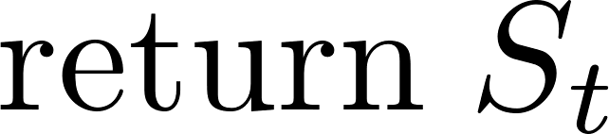
Particle Filter Algorithm
Let’s just get an intuition for the whole process now, and we’ll justify why this is right on the coming slides….

Slide 19
Particle Filter Algorithm
Intuition: use the M particles to “correctly” approx. bel(x)

Slide 20
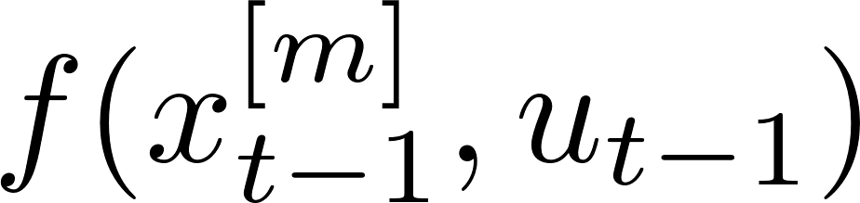

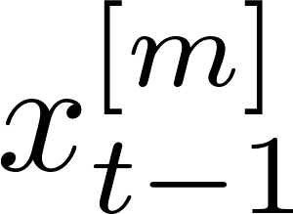
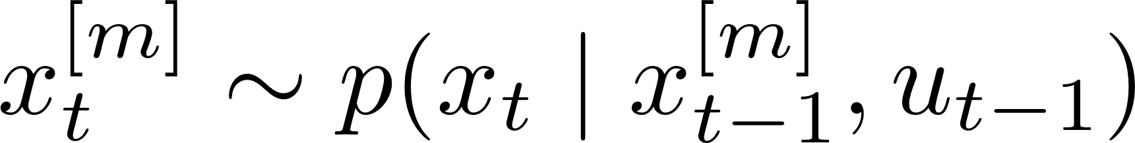
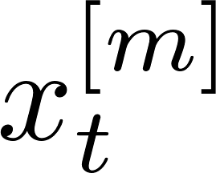
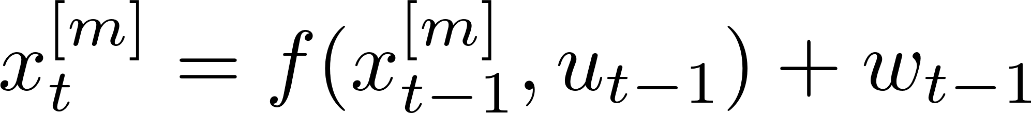
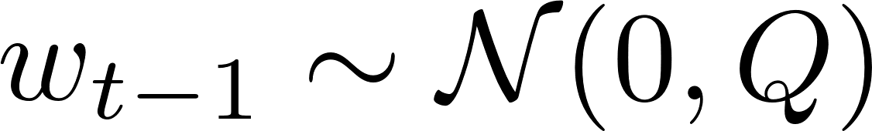
Particle propagation/prediction
Simulate what is going to happen to the particle
at the next time step by drawing a sample from
the next state specified in the dynamics (a.k.a.
one-step simulator)
Usually

Slide 21
Particle Update

Slide 22


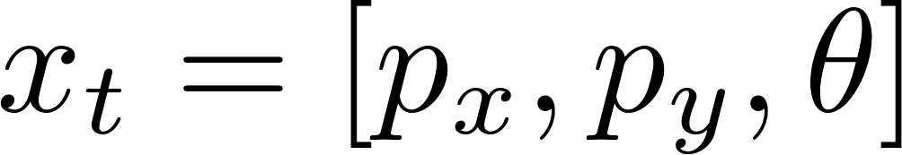
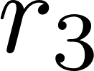

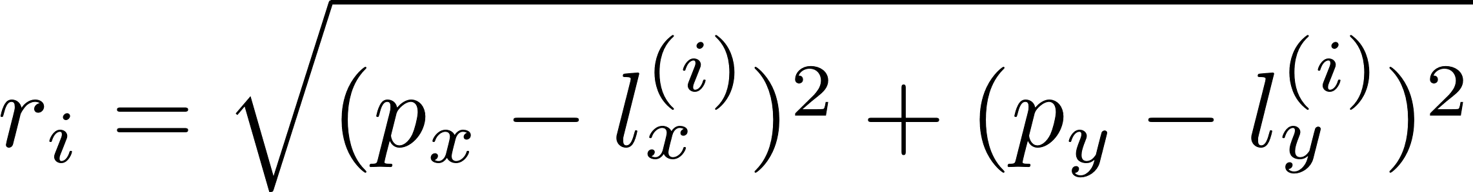
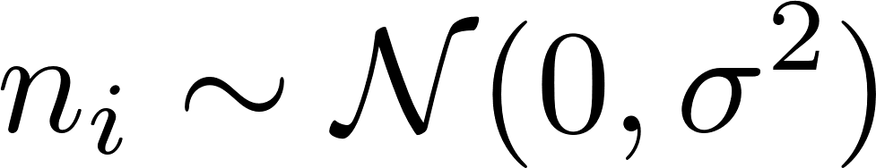
How to update particle weights after an observation
Real state of robot
Measurement model
with and

Slide 23
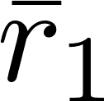
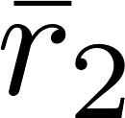
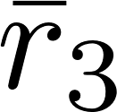
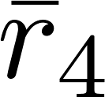
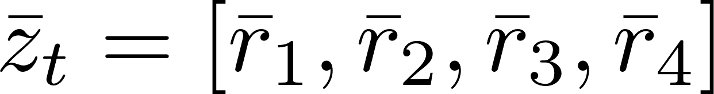
How to update particle weights after an observation
Real state of robot
Actual measurement received:

Slide 24
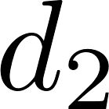
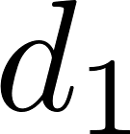
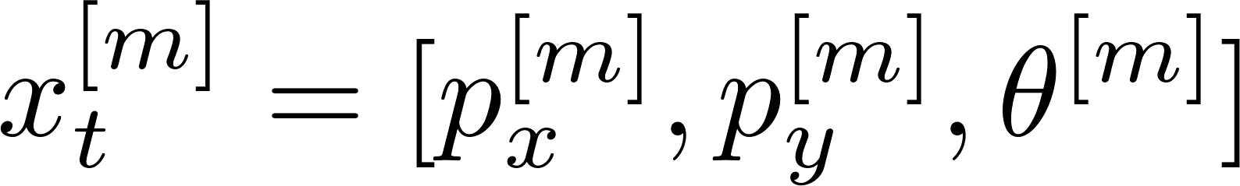
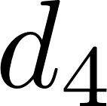
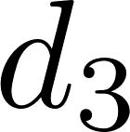
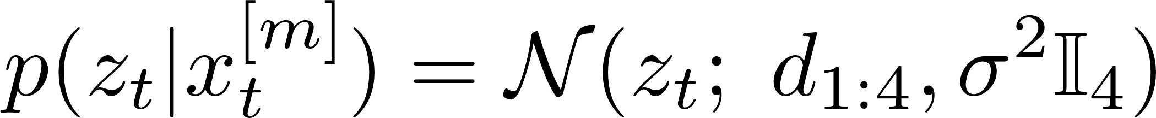
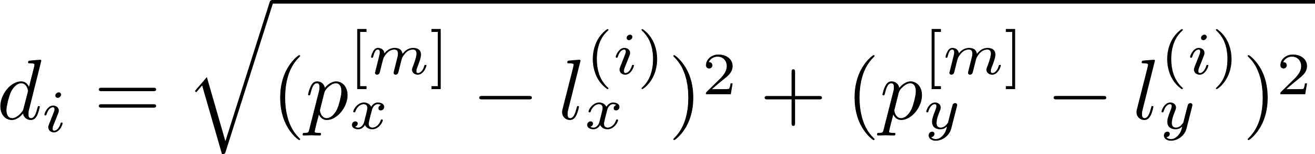
How to update particle weights after an observation
m^{th} particle hypothesis
Measurement model
with and

Slide 25
How to update particle weights after an observation
m^{th} particle hypothesis
Q: What is the probability of the actual measurement given the state hypothesized by the particle?
A:

Slide 26
How to update particle weights after an observation
m^{th} particle hypothesis
Q: What is the probability of the actual measurement given the state hypothesized by the particle?
A:
Assuming range measurements are
conditionally independent given state

Slide 27
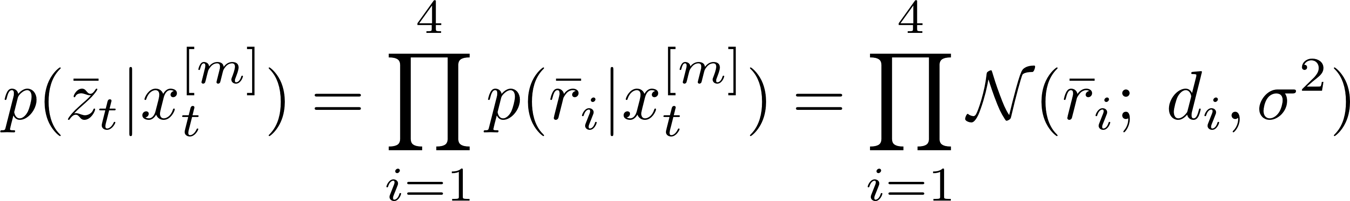
How to update particle weights after an observation
m^{th} particle hypothesis
Q: What is the probability of the actual measurement given the state hypothesized by the particle?
A:
In the figure above this probability would be low
and this particle would be unlikely.

Slide 28
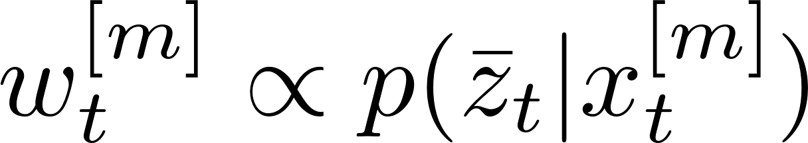
How to update particle weights after an observation
m^{th} particle hypothesis
Particle’s (unnormalized) weight
See Appendix 1 for why
this choice was made
for the weight

Slide 29
The distribution of the particles has not been updated yet. We only updated their weights. To update the distribution of particles we need to do resampling

Slide 30
The distribution of the particles has not been updated yet. We only updated their weights. To update the distribution of particles we need to do resampling
Sample particles with repetition/replacement,
according to their updated weights.

Slide 31
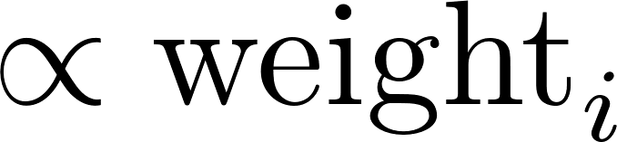
Resampling Particles
Main goal: Get rid of unlikely particles (with too low weights) and focus on most likely particles (a.k.a. survival of the fittest).
Main mechanism: Sample new set of particles from existing set, with replacement (repetition), so that same particle can be sampled more than once.
Sample old particle i with probability
Many possible ways to implement it. Here we present two algorithms.

Slide 32
Resampling Particles: Algorithm #1
new_particles = []
sample u ~ Uniform[0,1]
idx = int( u * (N-1) )
beta = 0
max_w = max(weights)
for each of the N particles:
sample v ~ Uniform[0,1]
beta += v * 2* max_w
while beta > weights[idx]:
beta -= weights[idx]
idx = (idx + 1) % N
p = particles[idx].copy()
new_particles.append(p)

Slide 33
Resampling Particles: Algorithm #2
new_particles = []
sample r ~ Uniform[0, 1/N]
c = weights[0]
idx = 0
for n = 1…N:
u = r + (n-1)/N
while u > c:
idx = idx + 1
c = c + weights[idx]
p = particles[idx].copy()
new_particles.append(p)
w_{n}
w₁
w₂
W_{n-1}
w₃
Stochastic universal sampling
Systematic resampling
Linear time complexity

Slide 34
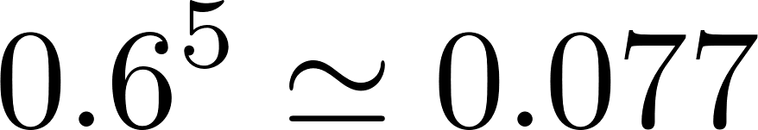
Resampling Particles: Example
Suppose we only have 5 particles:
Particle index | Normalized weight
1 | 0.1
2 | 0.2
3 | 0.4
4 | 0.1
5 | 0.2
Q: What is the probability that after a round of resampling
the highest probability particle (#3) is not sampled?
A:
i.e. there is nonzero probability that we will lose the
highest-probability particle → it will happen eventually

Slide 35
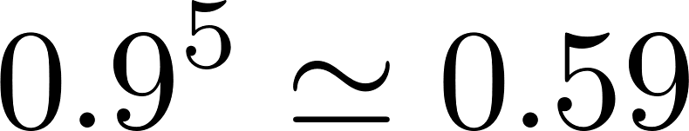
Resampling Particles: Example
Suppose we only have 5 particles:
Particle index | Normalized weight
1 | 0.1
2 | 0.2
3 | 0.4
4 | 0.1
5 | 0.2
Q: What is the probability that after a round of resampling
the highest-probability particle (#3) is not sampled?
A:
Q: What is the probability that after a round of resampling
one of the lowest-probability particles (#1) is not sampled?
A:

Slide 36
Resampling Particles: Consequences
Weak particles very likely do not survive.
Variance among the set of particles decreases, due to mostly sampling strong particles (i.e. loss of particle diversity).
Loss of particle diversity implies increased variance of the approximation error between the particles and the true distribution.
Particle deprivation: there are no particles in the vicinity of the correct state

Slide 37
How to address particle deprivation
Idea #1: don’t resample when only a few particles contribute
Idea #2: inject random particles during resampling
Idea #3: increase the number of particles (may be impractical depending on the computational complexity of the system)

Slide 38
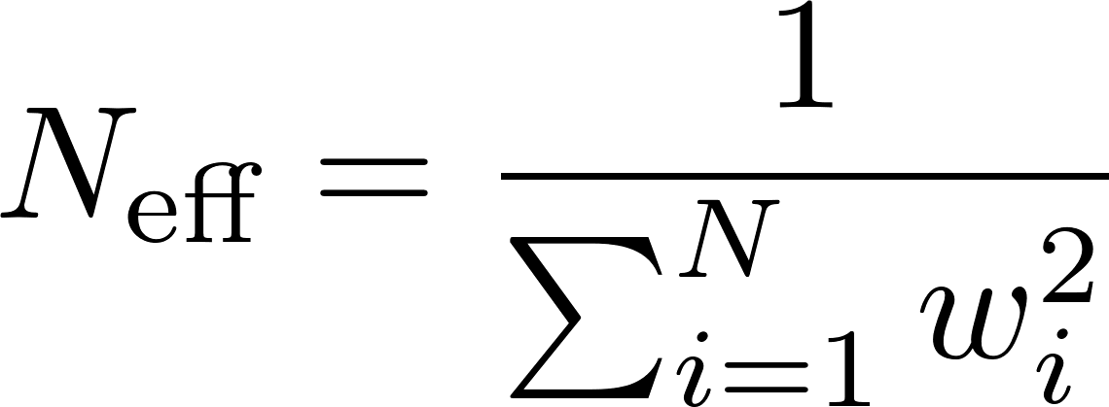

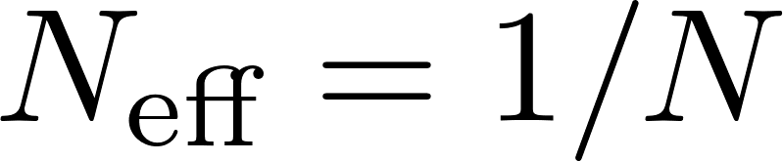

How to address particle deprivation
Idea #1: don’t resample when only a few particles contribute
Effective sample size:
When all particles have equal, normalized weights (1/N) then
When a single particle carries the entire weight then
and we have loss of particle diversity.
Resample only when
Idea #2: inject random particles during resampling
Idea #3: increase the number of particles (may be impractical depending on the computational complexity of the system)

Slide 39
How to address particle deprivation
Idea #1: don’t resample when only a few particles contribute
Idea #2: inject random particles during resampling
A small percentage of the particles’ states should be set randomly
Pro: simple to code, reduces (but does not fix) particle deprivation
Con: incorrect posterior estimation even when there are infinitely many particles
Idea #3: increase the number of particles (may be impractical depending on the computational complexity of the system)

Slide 40
Particle Filter Algorithm
Actual observation and control received

Slide 41
Particle Filter Algorithm
Particle propagation/prediction:
noise needs to be added in order to make
particles differentiate from each other.
If propagation is deterministic then particles
are going to collapse to a single particle after a
few resampling steps.

Slide 42
Particle Filter Algorithm
Weight computation as measurement likelihood.
For each particle we compute the probability of the
actual observation given the state is at that particle.

Slide 43
Particle Filter Algorithm
Resampling step
Note: particle deprivation heuristics are not
shown here

Slide 44
Particle Filter Algorithm
Note: here we work with a fixed number of particles
but in many applications, such as localization, you could work
with a reduced number of particles after the particles have
converged to the true estimate.
Such implementations of particle filters are called adaptive. An
example is the KLD-sampling adaptive particle filter, which is
not going to be covered here.

Slide 45
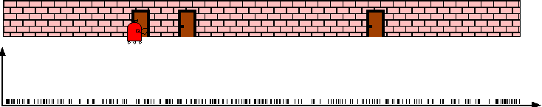
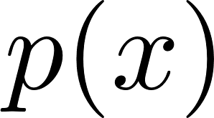




Examples: 1D Localization

Slide 46


Examples: 1D Localization

Slide 47

Examples: Monte Carlo Localization

Slide 48

Examples: Monte Carlo Localization
After incorporating 10 ultrasound scans

Slide 49

Examples: Monte Carlo Localization
After incorporating 65 ultrasound scans

Slide 50


Using Ceiling Maps for Localization
Image of ceiling

Slide 51

Vision-based Localization
P(z|x)
z
h(x)

Slide 52


Under a Light
Measurement z:
P(z|x):

Slide 53


Next to a Light
Measurement z:
P(z|x):

Slide 54


Elsewhere
Measurement z:
P(z|x):

Slide 55

Global Localization Using Vision

Slide 56


Appendix 1
Why did we choose as the importance weight for particle m?
Main trick: importance sampling, i.e. how to estimate properties/statistics of one distribution (f) given samples from another distribution (g)
For example, suppose we want to estimate
the expected value of f given only samples from g.

Slide 57

Appendix 1
Why did we choose as the importance weight for particle m?
Main trick: importance sampling, i.e. how to estimate properties/statistics of one distribution (f) given samples from another distribution (g)
For example, suppose we want to estimate
the expected value of f given only samples from g.

Slide 58
Appendix 1
Why did we choose as the importance weight for particle m?
Main trick: importance sampling, i.e. how to estimate properties/statistics of one distribution (f) given samples from another distribution (g)
For example, suppose we want to estimate
the expected value of f given only samples from g.
Weights describe the mismatch
between the two distributions,
i.e. how to reweigh samples to
obtain statistics of f from
samples of g

Slide 59
Appendix 1
Why did we choose as the importance weight for particle m?
Main trick: importance sampling, i.e. how to estimate properties/statistics of one distribution (f) given samples from another distribution (g)
For example, suppose we want to estimate
the expected value of f given only samples from g.
In the case of particle filters
Weights describe the mismatch
between the two distributions,
i.e. how to reweigh samples to
obtain statistics of f from
samples of g
Posterior belief after update
Belief after propagation, before update

Slide 60

Appendix 1
Why did we choose as the importance weight for particle m?
Main trick: importance sampling, i.e. how to estimate properties/statistics of one distribution (f) given samples from another distribution (g)
In the case of particle filters
Posterior belief after update
Belief after propagation, before update

