Slide 1
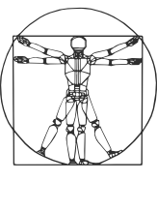
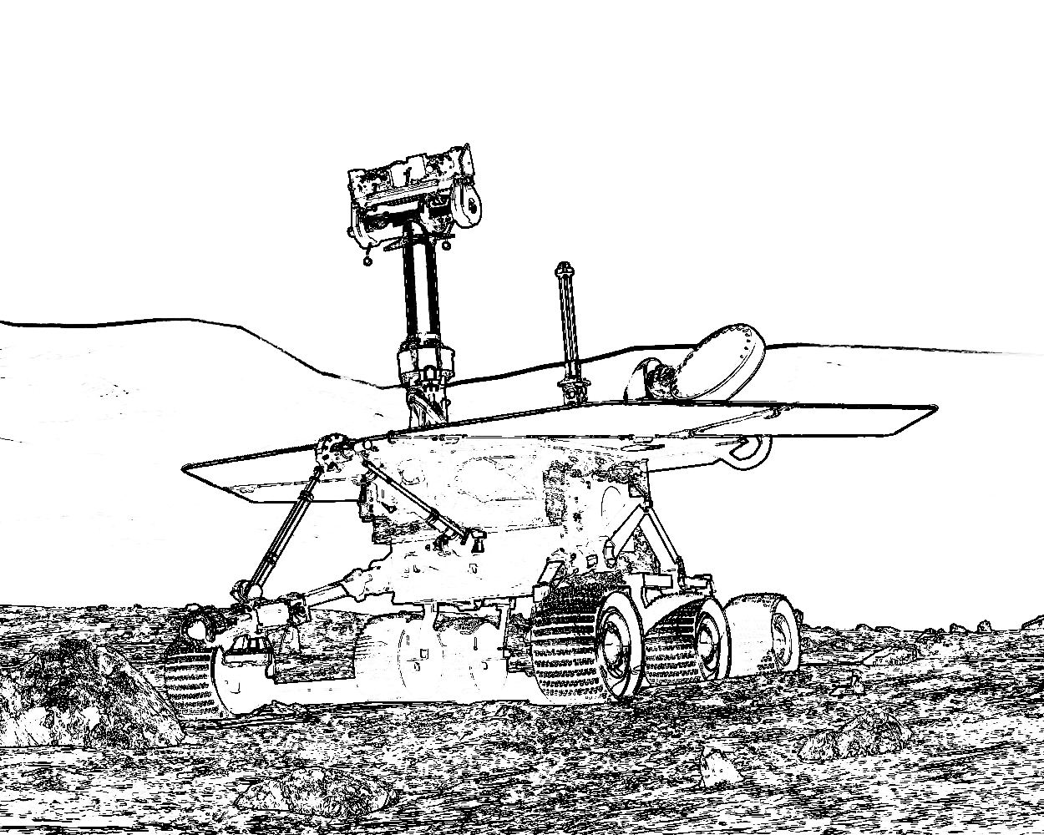


COMP417 Introduction to Robotics and Intelligent Systems Lecture 17: Extended Kalman Filter
Adapted from an earlier version by Florian Shkurti @ U of T

Slide 2
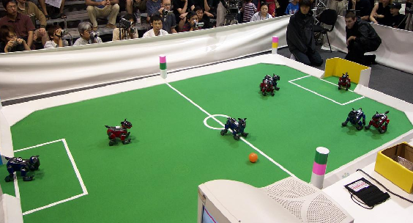
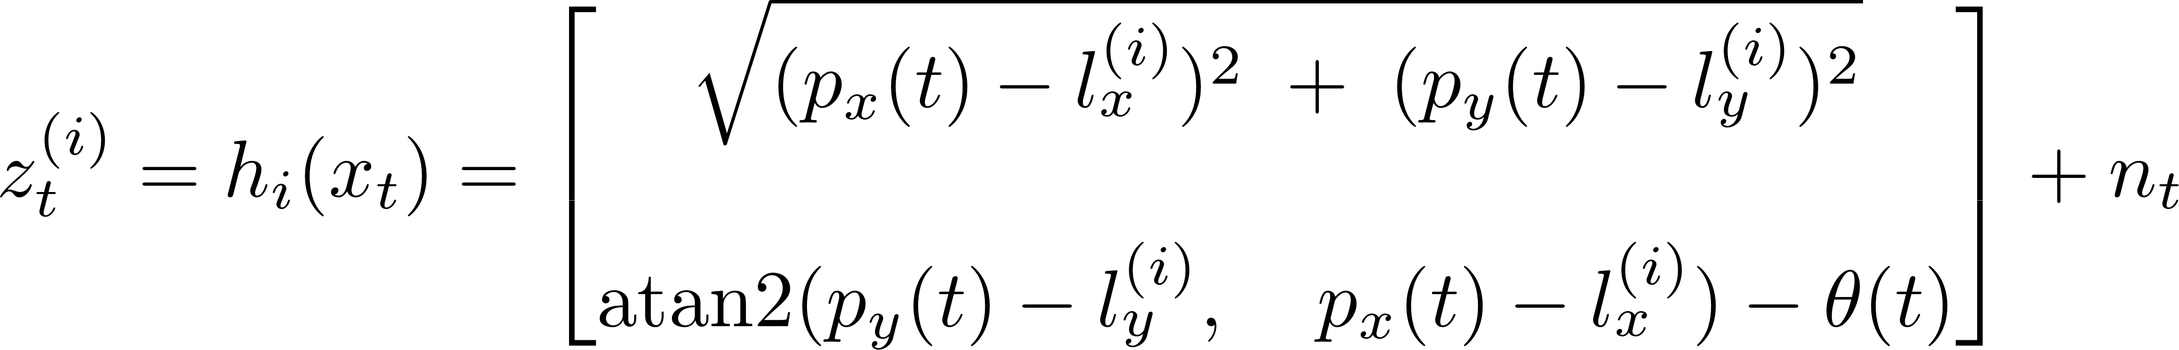
Beyond the KF Assumptions
We used the linear forms of motion and measurement (e.g., z=Hx+noise) at several stages to make the equations easier
But, this was not a good thing in general. Real robots almost all have nonlinear motions and measurements!
E.g., the robots below sense the distance and angle to the landmarks (l) at the edge of the field
To form this equation, need trigonometry
and square root of squares
These are not linear, so are we stuck?

Slide 3
Plan for today
Happily, we are not stuck!
Let’s extend the KF ideas to nonlinear models:
First look at what goes wrong exactly
Then the math to fix it
We’ll end with an algorithm called the Extended Kalman filter, which is the one that is actually used everywhere
Main math ideas come from KF, but extended to practical robots

Slide 4
Recommended reading
Chapter 3.3 in Probabilistic Robotics for EKF
Chapter 7.4 in Probabilistic Robotics for EKF-Localization
Chapter 10.2 in Probabilistic Robotics for EKF-SLAM

Slide 5
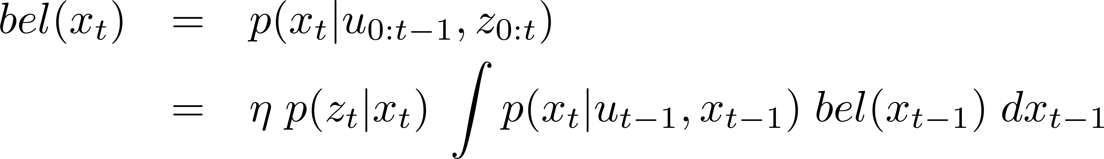
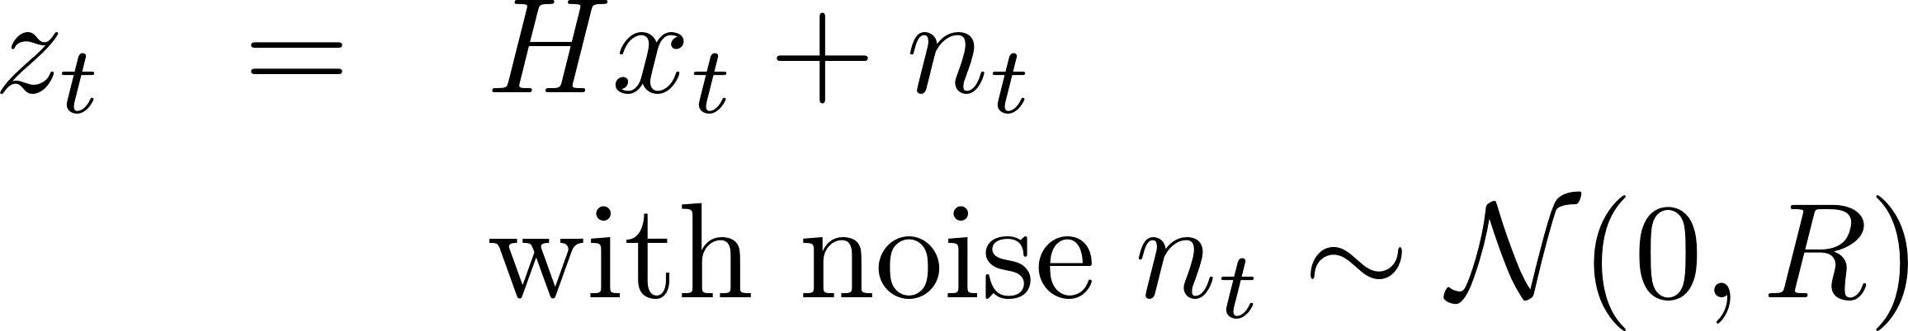
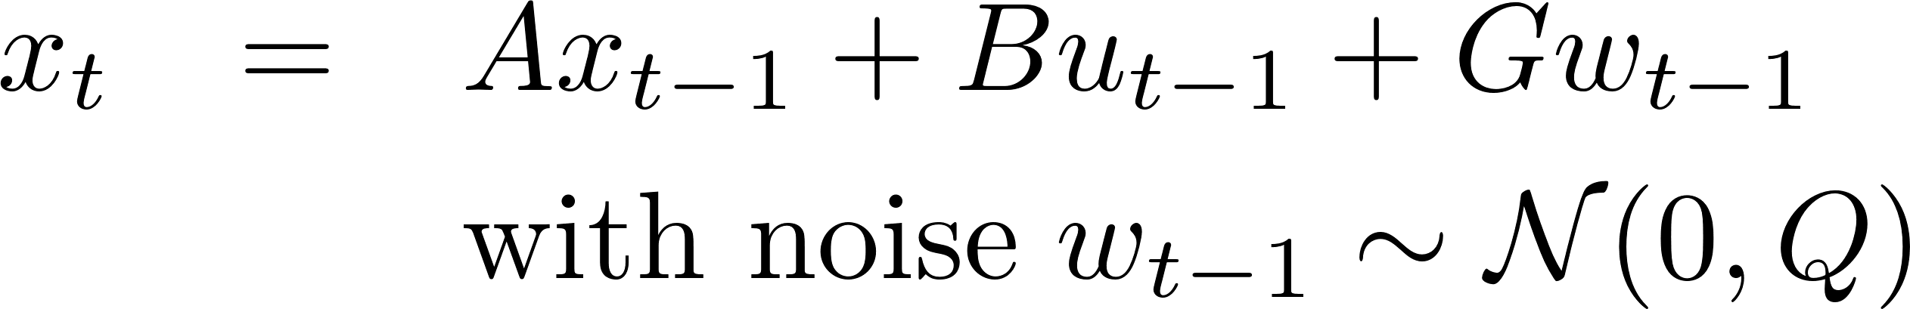
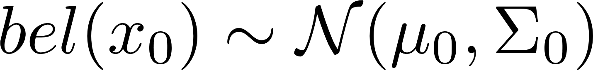
Kalman Filter: an instance of Bayes’ Filter
Assumptions guarantee that if the prior belief before the prediction
step is Gaussian
then the prior belief after the
prediction step will be Gaussian
and the posterior belief
(after the update step)
will be Gaussian.
Linear observations with Gaussian noise
Linear dynamics with Gaussian noise
Initial belief is Gaussian

Slide 6
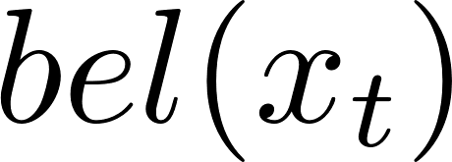
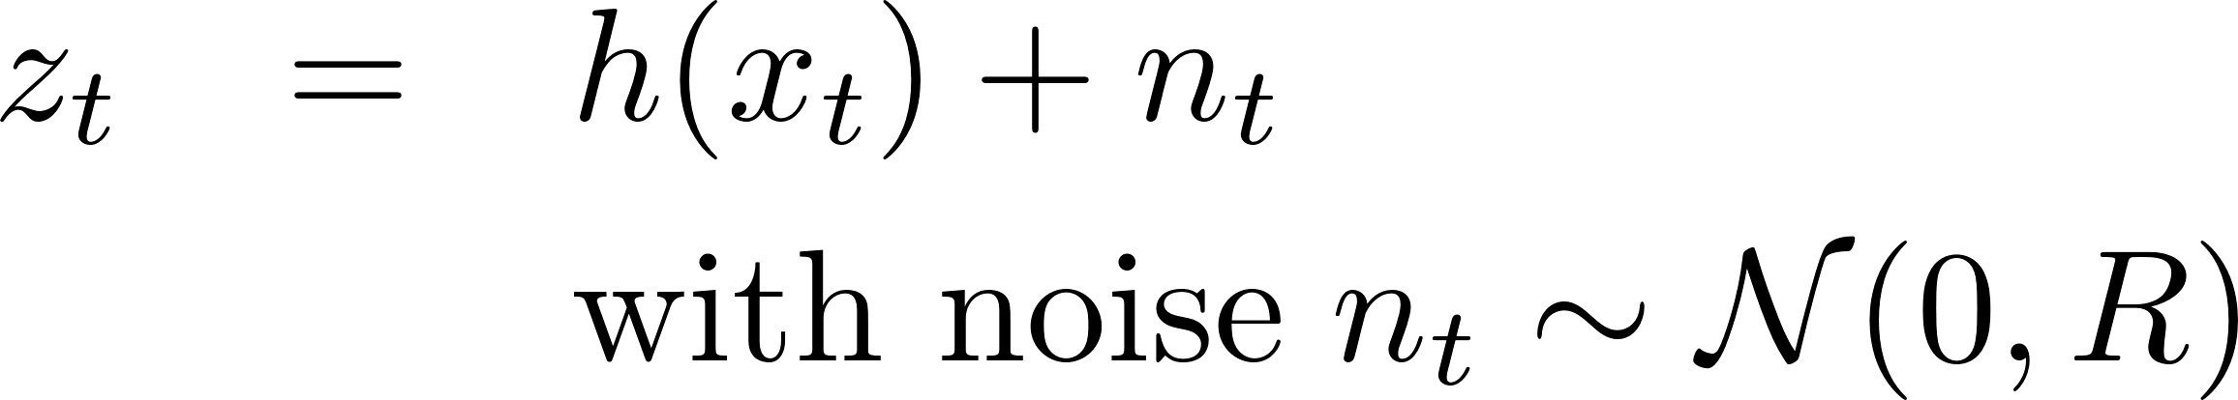
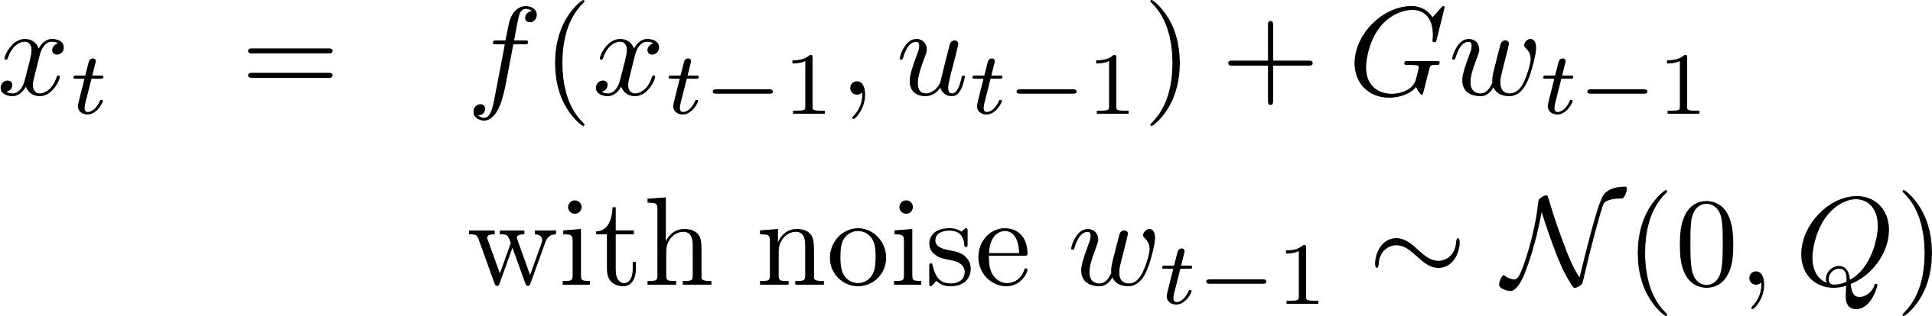
Kalman Filter: an instance of Bayes’ Filter
Assumptions guarantee that if the prior belief before the prediction
step is Gaussian
then the prior belief after the
prediction step will be Gaussian
Suppose you replace
the linear models with
nonlinear models.
Does the posterior remain
Gaussian?
and the posterior belief
(after the update step)
will be Gaussian.
Linear observations with Gaussian noise
Linear dynamics with Gaussian noise
Initial belief is Gaussian

Slide 7
Kalman Filter: an instance of Bayes’ Filter
Assumptions guarantee that if the prior belief before the prediction
step is Gaussian
then the prior belief after the
prediction step will be Gaussian
Suppose you replace
the linear models with
nonlinear models.
Does the posterior remain
Gaussian? NO
and the posterior belief
(after the update step)
will be Gaussian.
Linear observations with Gaussian noise
Linear dynamics with Gaussian noise
Initial belief is Gaussian

Slide 8
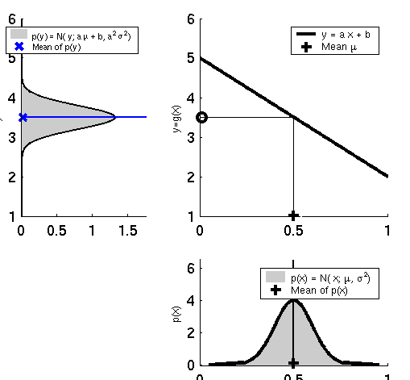
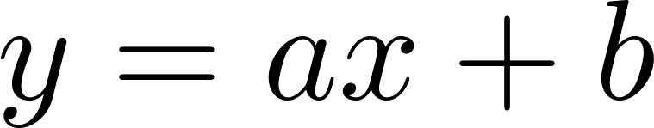
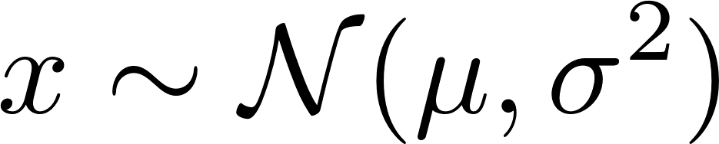
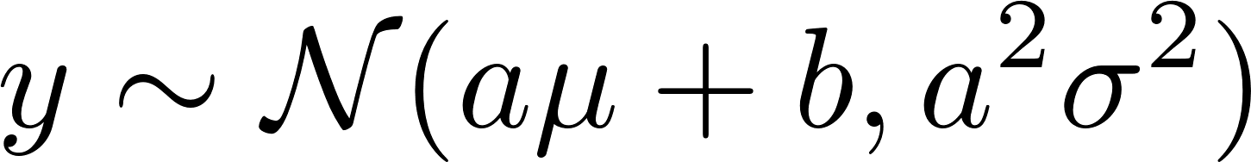
Linearity Assumption Revisited
If
and
then

Slide 9
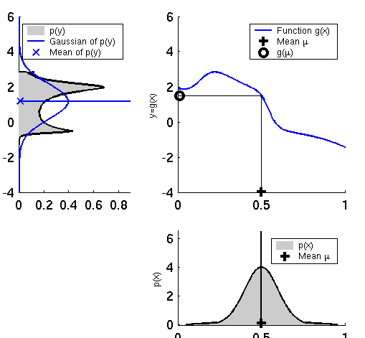
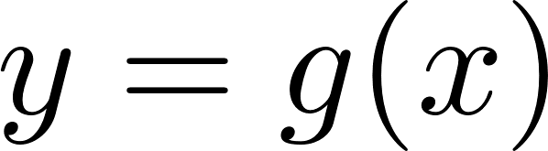
Nonlinear Function
If
and
then y is not necessarily
distributed as a Gaussian.

Slide 10
Nonlinear Function
If
and
then y is not necessarily
distributed as a Gaussian.
How can we approximate p(y) using a single Gaussian, without having a formula for p(y)?
IDEA #1: MONTE CARLO SAMPLING
Draw many (e.g. 10^6) samples xi ~ p(x)
Pass them through the nonlinear function yi = g(xi)
Compute the empirical mean (m) and covariance (S) of the samples yi
Return Normal(m, S)
IDEA #2: LINEARIZE THE NONLINEAR FUNCTIONS f, h
- Then we are in the case y = Gx +c, so p(y) is a Gaussian

Slide 11
Nonlinear Function
If
and
then y is not necessarily
distributed as a Gaussian.
This is how we computed
the Gaussian approximation
of p(y).
How can we approximate p(y) using a single Gaussian, without having a formula for p(y)?
IDEA #1: MONTE CARLO SAMPLING
Draw many (e.g. 10^6) samples xi ~ p(x)
Pass them through the nonlinear function yi = g(xi)
Compute the empirical mean (m) and covariance (S) of the samples yi
Return Normal(m, S)
IDEA #2: LINEARIZE THE NONLINEAR FUNCTIONS f, h
- Then we are in the case y = Gx +c, so p(y) is a Gaussian

Slide 12
Nonlinear Function
If
and
then y is not necessarily
distributed as a Gaussian.
Bad idea to use in Kalman Filter
because we want to approximate
p(y) efficiently.
How can we approximate p(y) using a single Gaussian, without having a formula for p(y)?
IDEA #1: MONTE CARLO SAMPLING
Draw many (e.g. 10^6) samples xi ~ p(x)
Pass them through the nonlinear function yi = g(xi)
Compute the empirical mean (m) and covariance (S) of the samples yi
Return Normal(m, S)
IDEA #2: LINEARIZE THE NONLINEAR FUNCTIONS f, h
- Then we are in the case y = Gx +c, so p(y) is a Gaussian

Slide 13
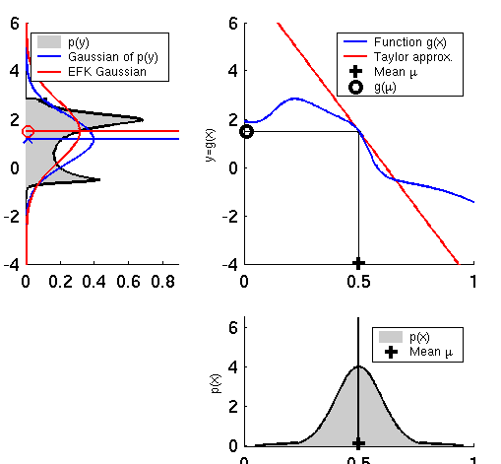
Linearization
Notice how the Linearization
approximation differs from the
Monte Carlo approximation (which
is better, provided sufficiently many
samples).
That said, the Linearization approximation
can be computed efficiently, and can be integrated into the Kalman
Filter estimator → Extended Kalman Filter

Slide 14
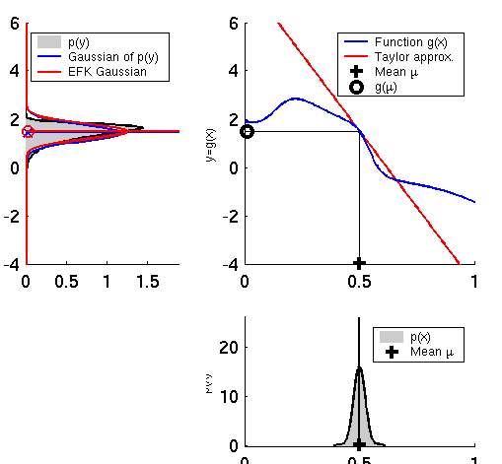
Linearization with low approximation error
The quality of the linearization
approximation depends on the uncertainty
of p(x) but also on the shape of the nonlinearity g(x).
In this example p(x) has small variance so most points will be concentrated around 0.5 and will pass through a very small region of g(x), where g(x) is close to linear.
In this case p(y) is nearly Gaussian,
and the Linearization approximation
matches the Monte Carlo approximation.

Slide 15
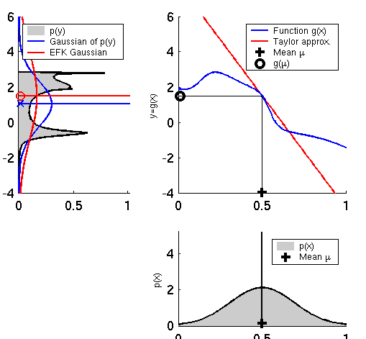
Linearization with high approximation error
The quality of the linearization
approximation depends on the uncertainty
of p(x) but also on the shape of the nonlinearity g(x).
In this example p(x) has high variance so points g(x) will be spread out around g(0.5), where g(x) is not close to linear.
In this case p(y) is multimodal,
and the Linearization approximation
matches the Monte Carlo approximation are both suboptimal approximations. Again Monte Carlo is better, provided sufficient samples.

Slide 16
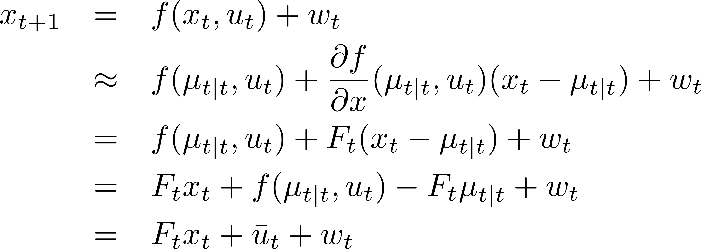
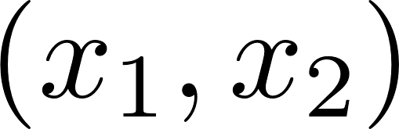
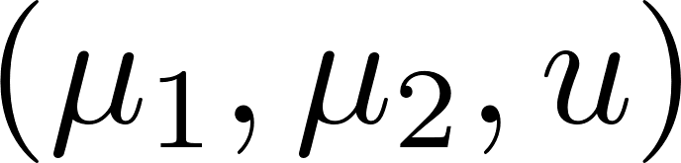
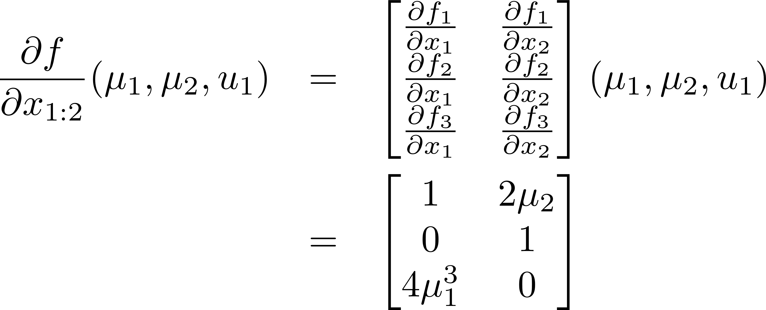
How do we linearize?
Using the first order Taylor expansion around the mean of the previous update step’s state estimate:
Recall how to compute the Jacobian
matrix. For example, if
then the Jacobian of f with respect to
at is
Constant term
with respect to
the state

Slide 17
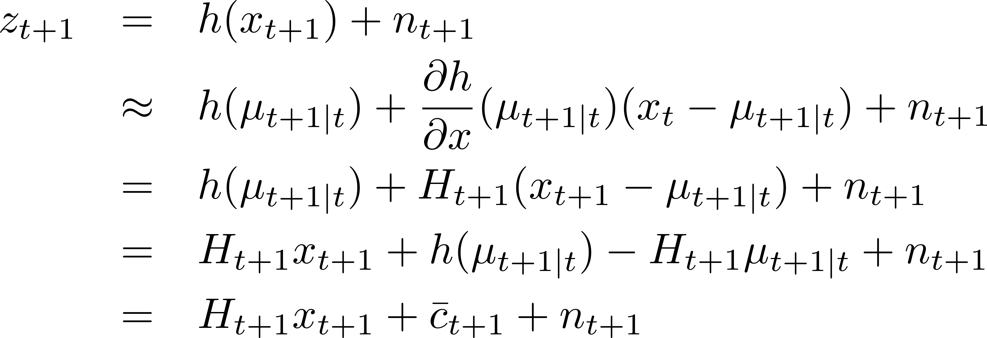
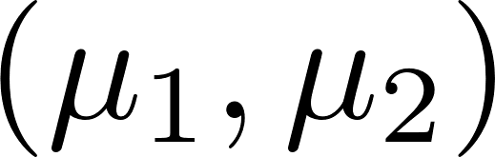
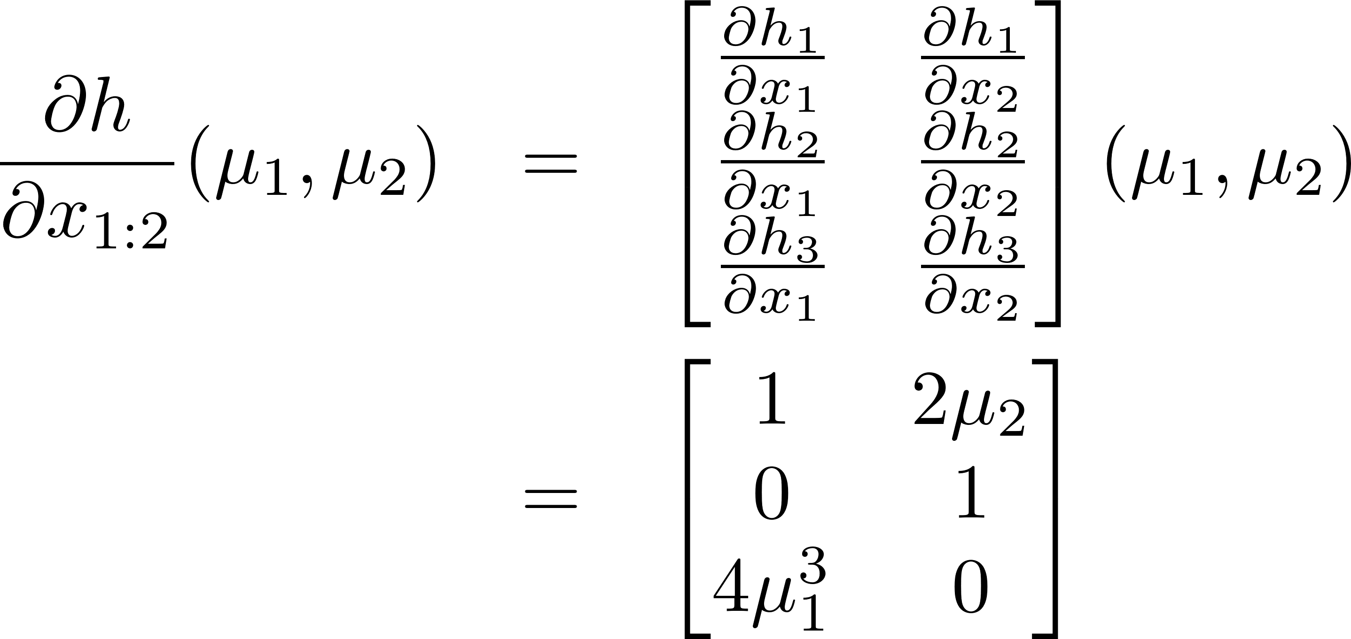
How do we linearize?
Using the first-order Taylor expansion around the mean of the previous prediction step’s state estimate:
Recall how to compute the Jacobian
matrix. For example, if
then the Jacobian of f with respect to
at is
Constant term
with respect to
the state

Slide 18
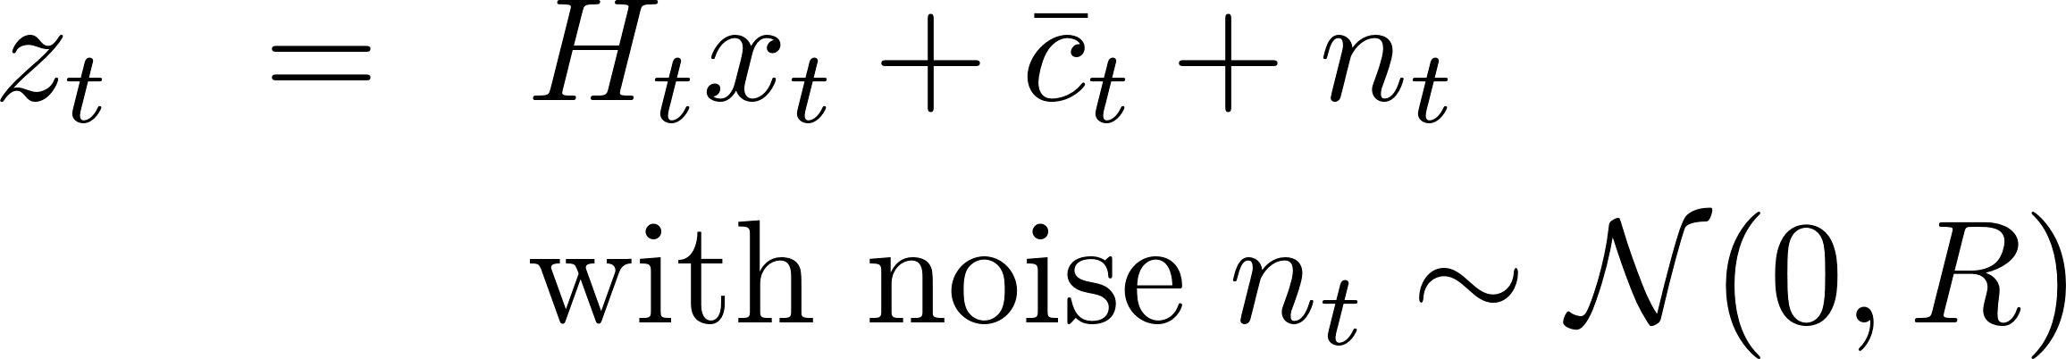
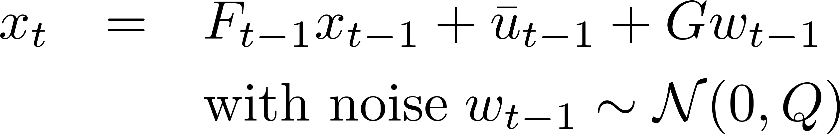
Extended Kalman Filter: an instance of Bayes’ Filter
Assumptions guarantee that if the prior belief before the prediction
step is Gaussian
then the prior belief after the
prediction step will be Gaussian
and the posterior belief
(after the update step)
will be Gaussian.
Linear observations with Gaussian noise
Linear dynamics with Gaussian noise
Initial belief is Gaussian

Slide 19
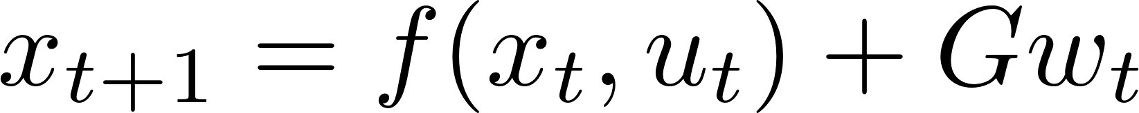
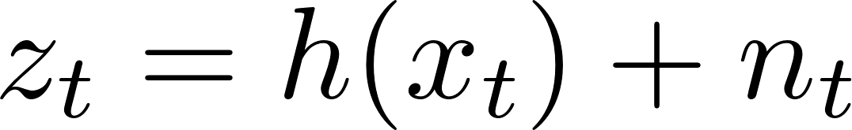
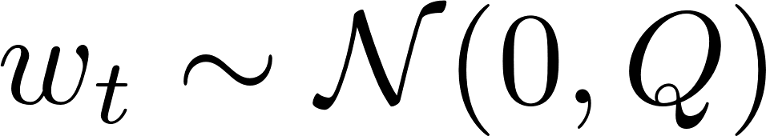
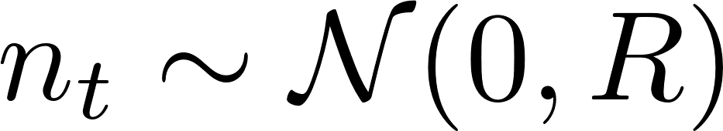
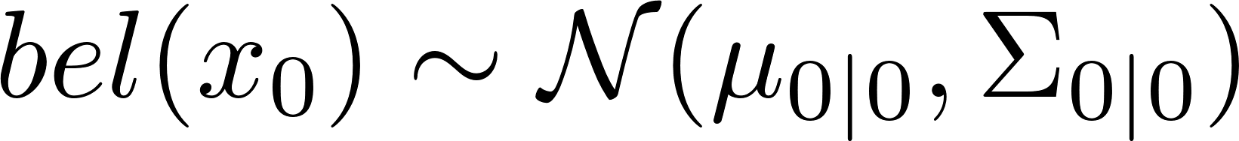
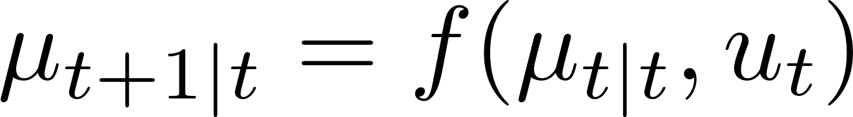
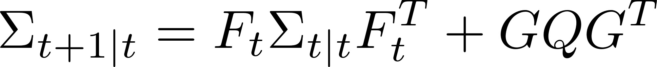
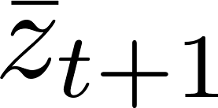
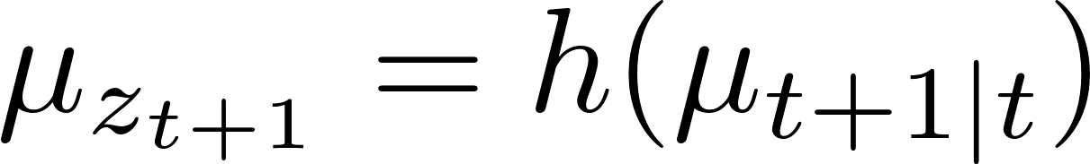
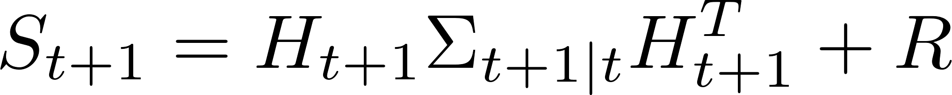
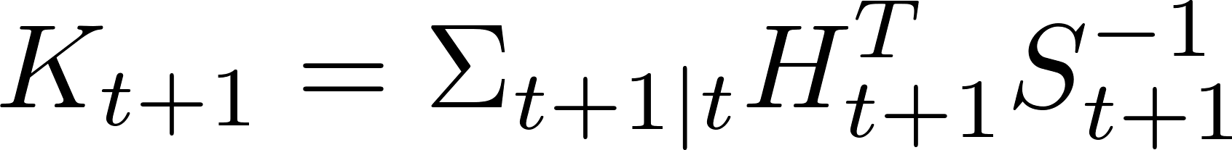
EKF in N dimensions
Dynamics
Measurements
Init
Prediction Step
Update Step
Received measurement but expected to receive
Prediction residual is a Gaussian random variable
where the covariance of the residual is
Kalman Gain (optimal correction factor):

Slide 20
EKF Summary
Efficient: Polynomial in measurement dimensionality k and state dimensionality n: O(k^{2.376} + n²)
Not optimal (unlike the Kalman Filter for linear systems)
Can diverge if nonlinearities are large
Works surprisingly well even when all assumptions are violated
As in KF, inverting
the covariance of the
residual is O(k^2.376)

Slide 21
Example #1: EKF-Localization
“Using sensory information to locate the robot in its environment is the most fundamental problem to providing a mobile robot with autonomous capabilities.” [Cox ’91]
Given
Map of the environment.
Sequence of sensor measurements.
Wanted
Estimate of the robot’s position.
Problem classes
Position tracking
Global localization
Kidnapped robot problem (recovery)

Slide 22
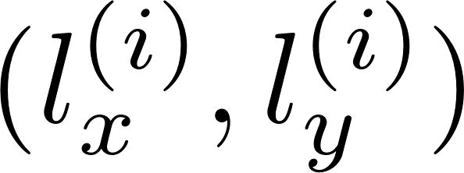
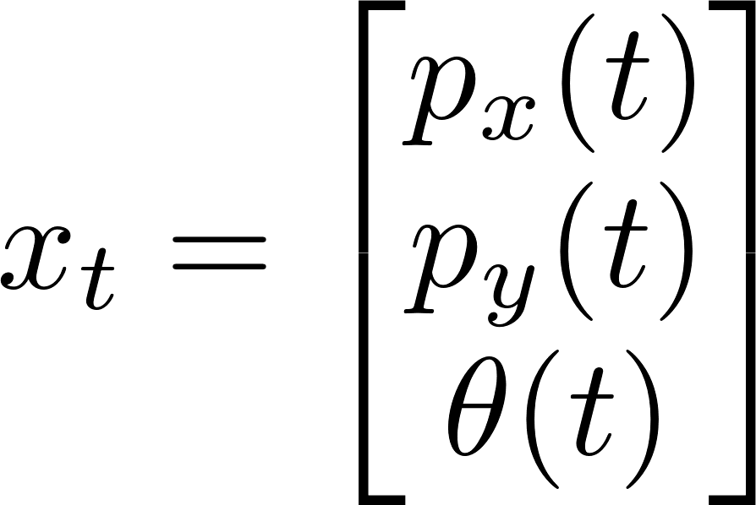
Landmark-based Localization
Landmarks, whose
position
in the world is known.
Each robot measures
its range and bearing
from each landmark
to localize itself.
State of a robot:

Slide 23
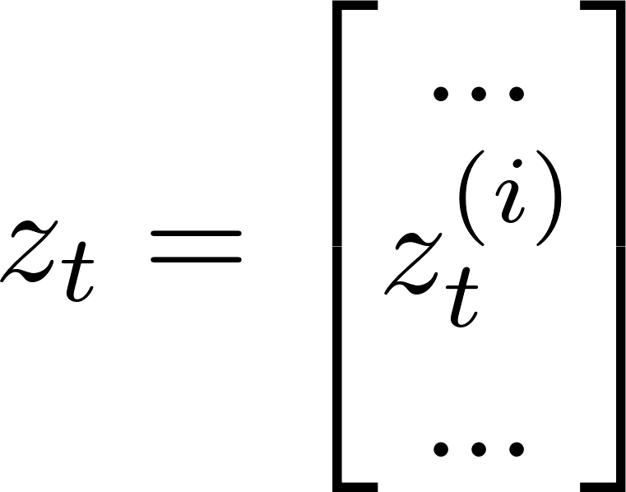
Landmark-based Localization
Measurement at time t,
is a variable-sized
vector, depending on the
landmarks that are
visible at time t.
Each measurement is
a 2D vector, containing
range and bearing from
the robot to a landmark.

Slide 24
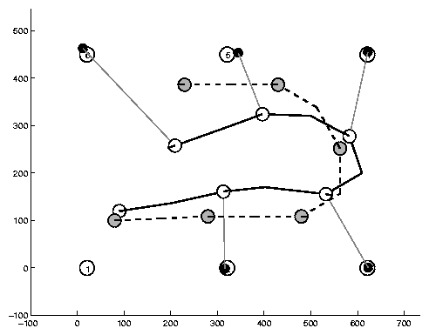
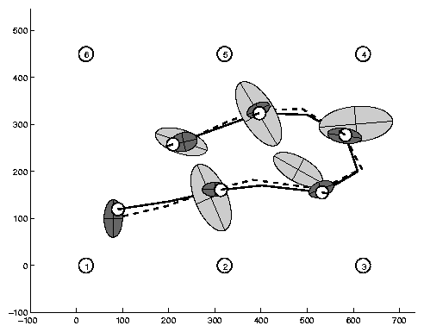
Estimation Sequence (1)

Slide 25
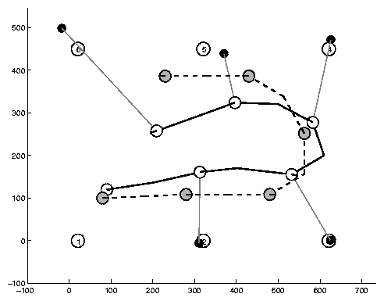
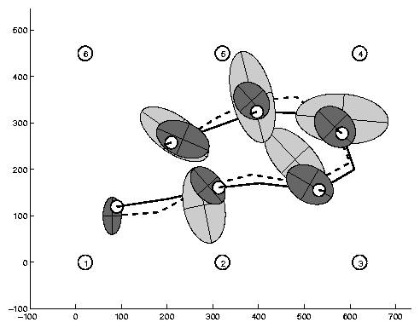
Estimation Sequence (2)

Slide 26
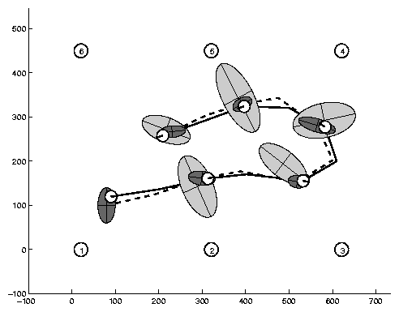
Comparison to true trajectory

Slide 27
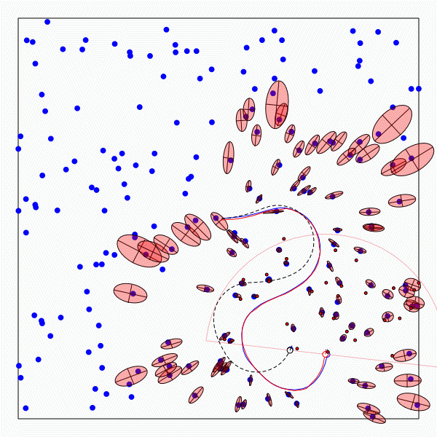
Example #2: EKF-SLAM
A robot is exploring an unknown, static environment.
Given:
The robot’s controls
Observations of nearby features
Estimate:
Map of features
Path of the robot

Slide 28
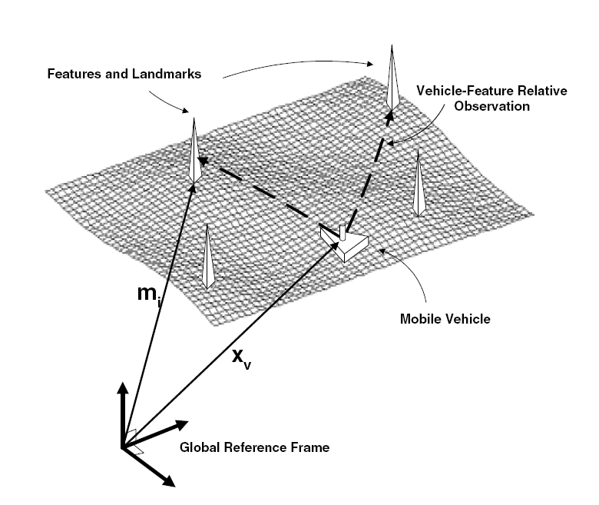
Structure of Landmark-based SLAM

Slide 29
Why is SLAM a hard problem?
SLAM: robot path and map are both unknown
Robot path error correlates errors in the map

Slide 30
Why is SLAM a hard problem?
Robot pose
uncertainty
In the real world, the mapping between observations and landmarks is unknown
Picking wrong data associations can have catastrophic consequences
Pose error correlates data associations

Slide 31
EKF-SLAM
Map with N landmarks: (3+2N)-dimensional Gaussian
Can handle hundreds of dimensions

Slide 32
Appendix

Slide 33

EKF-SLAM
Map Covariance matrix

Slide 34

EKF-SLAM
Map Covariance matrix

Slide 35

EKF-SLAM
Map Covariance matrix

Slide 36
Properties of EKF-SLAM (Linear Case)
[Dissanayake et al., 2001]
Theorem:
The determinant of any sub-matrix of the map covariance matrix decreases monotonically as successive observations are made.
Theorem:
In the limit the landmark estimates become fully correlated

