Slide 1
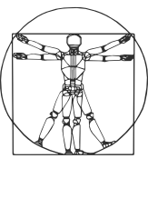
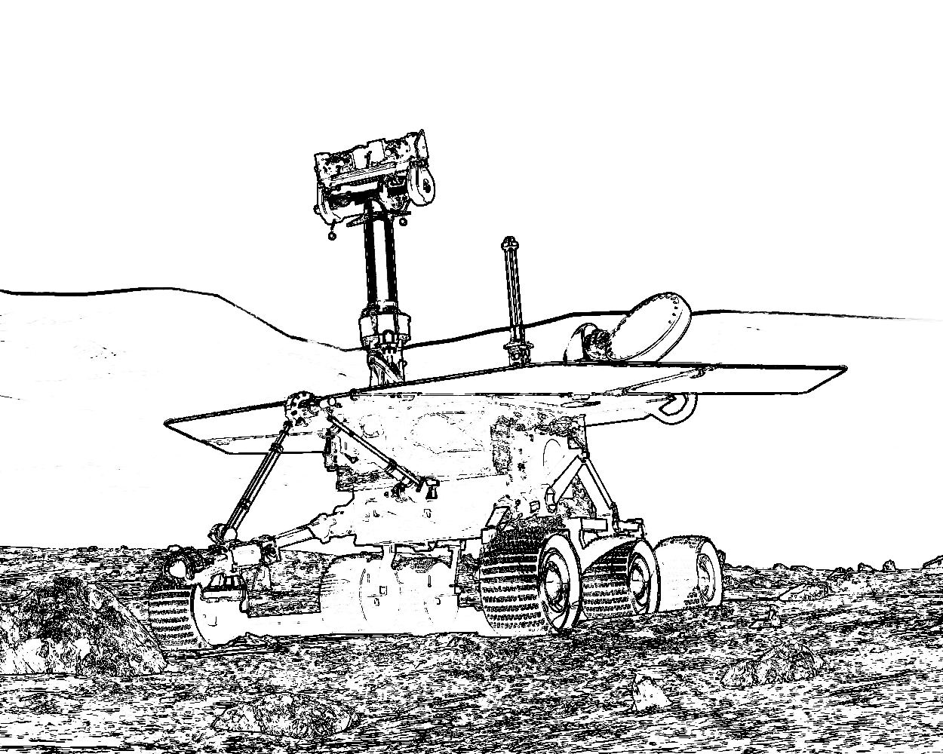


COMP417 Introduction to Robotics and Intelligent Systems Lecture 8: Probabilistic Estimation 3 ways
Based on material by Florian Shkurti @ U of T

Slide 2
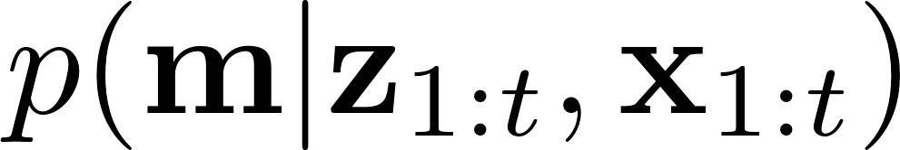


Estimating parameters of probability models
In the occupancy grid mapping problem we wanted to compute over all possible maps.
While we previously treated the map as an occupancy grid, just 0,1 values, there is often more structure in the world that we’d like to capture:
The walls of a building are all straight
Corners appear only at right angles
Any rounded portions are roughly circular
In the map on the right, a few numbers
can very accurately describe large potions

Slide 3
Estimating parameters of probability models
In the occupancy grid mapping problem we wanted to compute over all possible maps.
While we previously treated the map as an occupancy grid, just 0,1 values, there is often more structure in the world that we’d like to capture:
The walls of a building are all straight
Corners appear only at right angles
Any rounded portions are roughly circular
In the map on the right, a few numbers
can very accurately describe large potions
a1, b1, a2, b2, r3… etc, until all basic shapes are covered.
y = a2*x + b2
r3^2 = x^2 + y^2
y = a1*x + b1

Slide 4
Estimating parameters of probability models
Today we will look at several different classes of tools for finding the “parameters” of probability models that let us recover the map efficiently.
There are typically three ways to work with this type of problems:
Maximum Likelihood parameter estimation (MLE)
Least Squares
Maximum A Posteriori (MAP) parameter estimation
Bayesian parameter distribution estimation

Slide 5
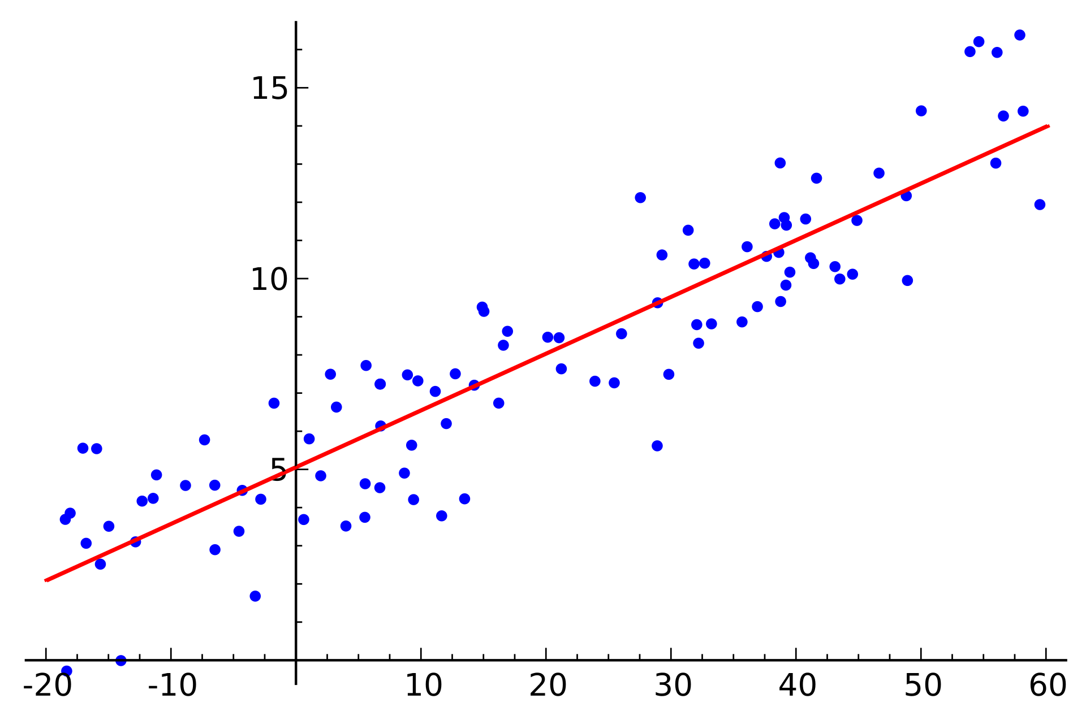
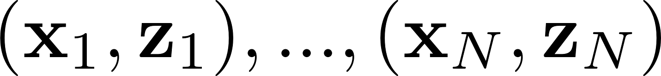
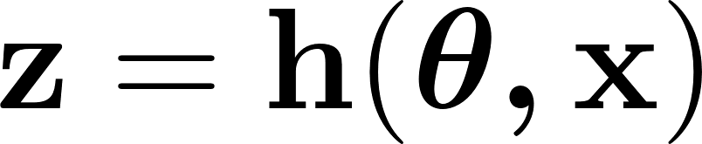
Least Squares Parameter Estimation
We are given data points
We think that the data was generated by a parametric
function

Slide 6


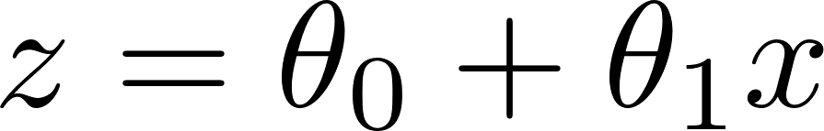
Least Squares Parameter Estimation
We are given data points
We think that the data was generated by a parametric
function
Example: we think that the 2D data was generated
by a line whose parameters we do not
know, and was corrupted by noise.

Slide 7
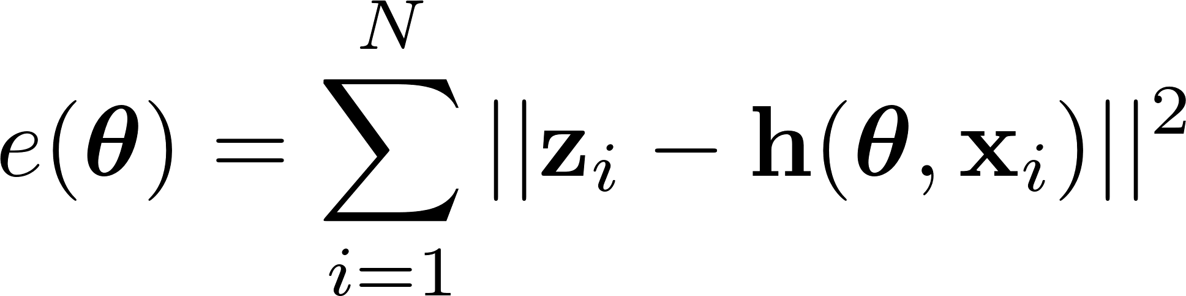
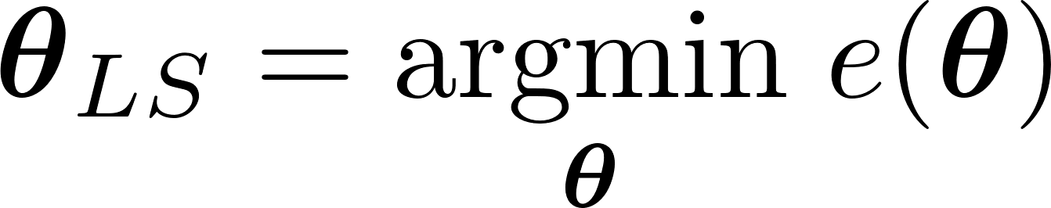
Least Squares Parameter Estimation
We are given data points
We think that the data was generated by a parametric
function
This parametric model will have a fitting error:
The least-squares estimator is:
Example: we think that the 2D data was generated
by a line whose parameters we do not
know.

Slide 8
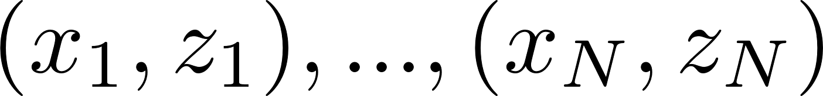
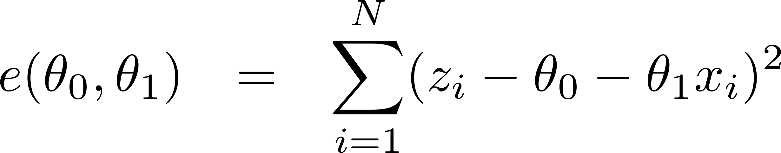

Example #1: Linear Least Squares
Notice we stack $θ_{0}$ and $θ_{1}$ in a vector just to make the math clean.
We are given 2D data points
We think that the data was generated by a linear
parametric function
This parametric model will have a fitting error:
Example: we think that the 2D data was generated
by a line whose parameters we do not
know.

Slide 9
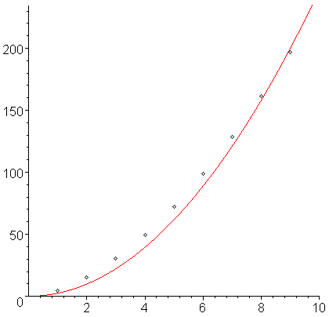
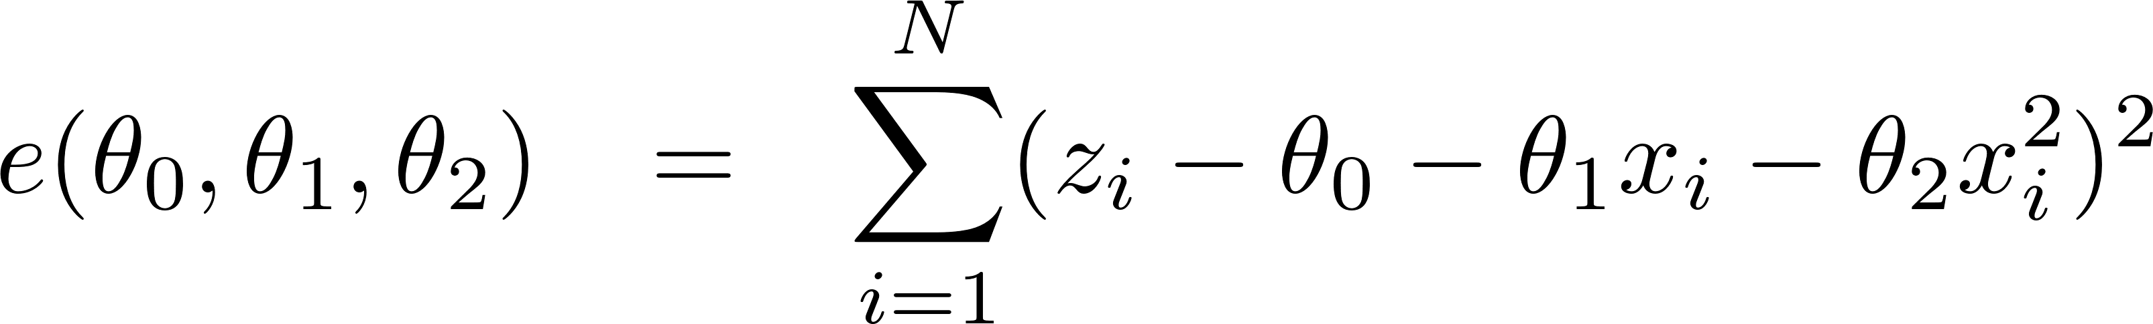
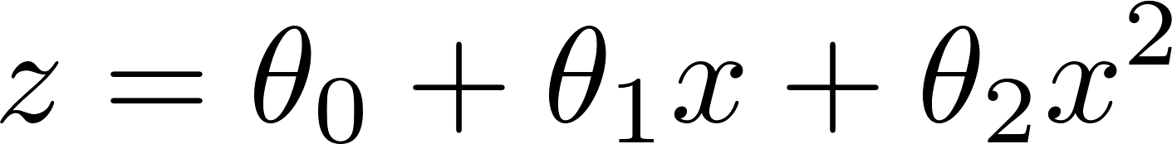
Example #2: Linear Least Squares
We are given 2D data points
We think that the data was generated by a quadratic
function
This parametric model will have a fitting error:
Example: we think that the 2D data was generated by a
quadratic whose parameters
we do not know.

Slide 10
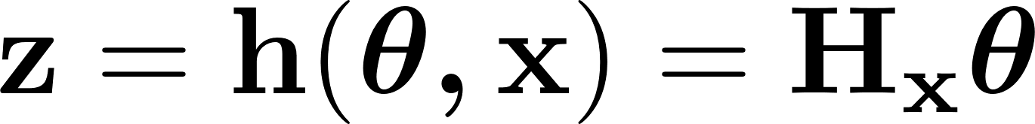
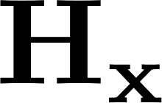

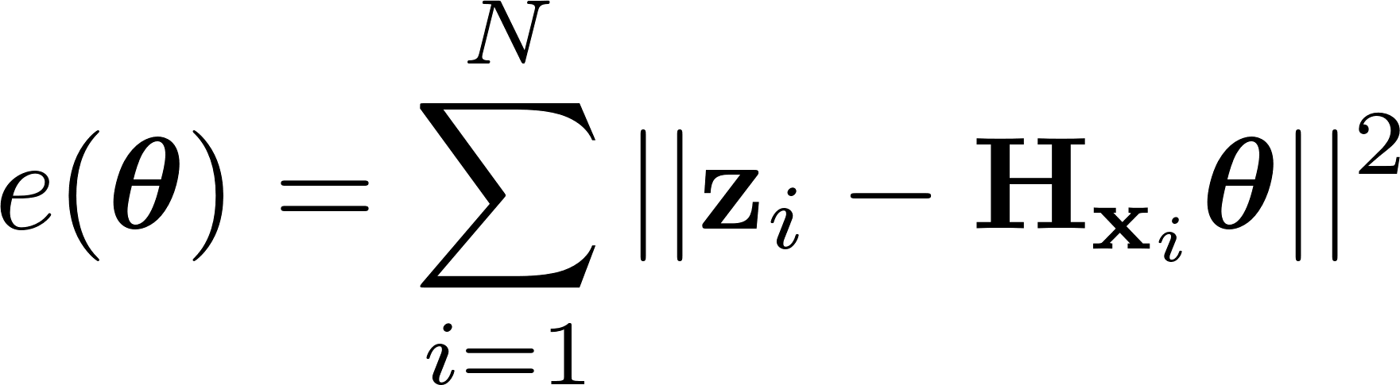
Generalize to all Linear Least Squares Parameter Estimations
We are given data points
We think that the data was generated by a linear
parametric function
where is a matrix whose elements depend on
This parametric model will have a fitting error:
The least-squares estimator is:
Example: we think that the 2D data was generated
by a line whose parameters we do not
know.

Slide 11
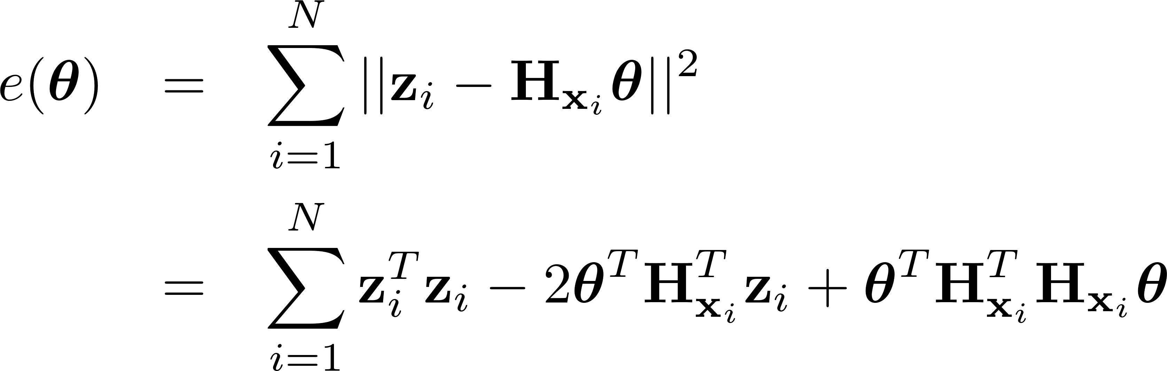
Linear Least Squares Parameter Estimation
We are given data points
We think that the data was generated by a linear
parametric function
This parametric model will have a fitting error:
Example: we think that the 2D data was generated
by a line whose parameters we do not
know.

Slide 12
Linear Least Squares Parameter Estimation
We are given data points
We think that the data was generated by a linear
parametric function
This parametric model will have a fitting error:
The least-squares estimator minimizes the error:
Example: we think that the 2D data was generated
by a line whose parameters we do not
know.

Slide 13
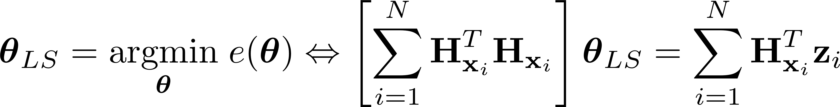
Linear Least Squares Parameter Estimation
We are given data points
We think that the data was generated by a linear
parametric function
This parametric model will have a fitting error:
The least-squares estimator minimizes the error:
Example: we think that the 2D data was generated
by a line whose parameters we do not
know.

Slide 14
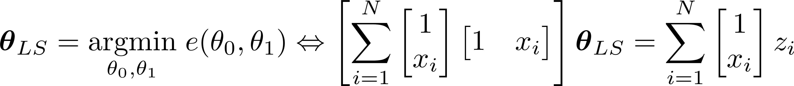
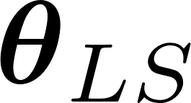
Solution #1: Linear Least Squares
We are given 2D data points
We think that the data was generated by a linear
parametric function
This parametric model will have a fitting error:
The least-squares estimator minimizes the error:
Which is a linear system of 2 equations. If we have at least
two data points we can solve for to define the line.
Example: we think that the 2D data was generated
by a line whose parameters we do not
know.

Slide 15
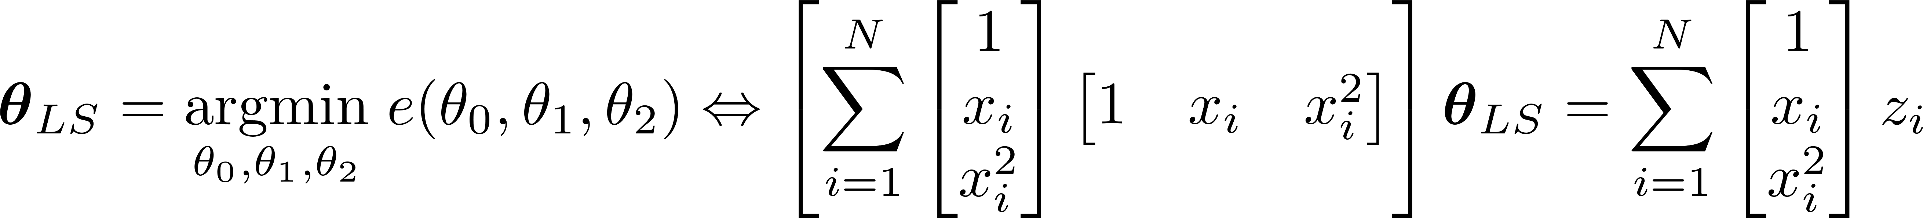
Solution #2: Linear Least Squares
We are given 2D data points
We think that the data was generated by a quadratic
function
This parametric model will have a fitting error:
The least-squares estimator minimizes the error:
Which is a linear system of 3 equations. If we have at least
three data points we can solve for to define the
quadratic.
Example: we think that the 2D data was generated by a
quadratic whose parameters
we do not know.

Slide 16
Estimating parameters of probability models
Today we will look at several different classes of tools for finding the “parameters” of probability models that let us recover the map efficiently.
There are typically three ways to work with this type of problems:
Maximum Likelihood parameter estimation (MLE)
Least Squares
Maximum A Posteriori (MAP) parameter estimation
Bayesian parameter distribution estimation

Slide 17
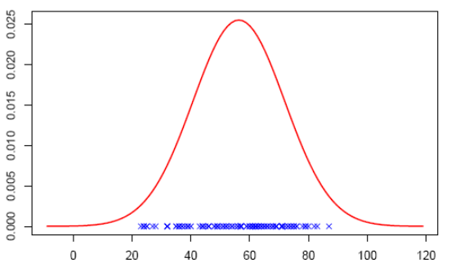

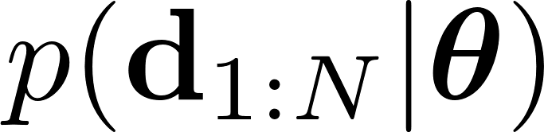
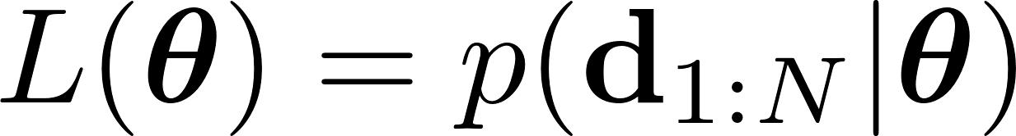
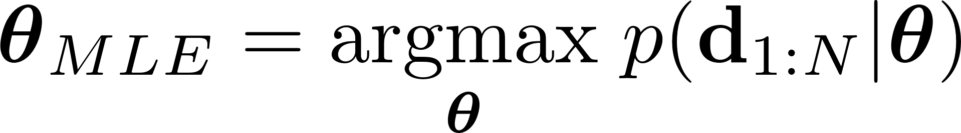
Maximum Likelihood Parameter Estimation
We are given data points
We think the data has been generated from a probability
distribution
We want to find the parameter of the model that maximizes the likelihood function of the data
which is a function of theta, not a probability distribution.

Slide 18
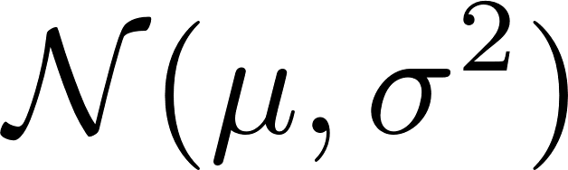
Maximum Likelihood Parameter Estimation
Data points
Find the parameters of the model that maximize
the likelihood function of the data
which is a function of theta, not a probability distribution.
Example: assume we know that 1D data points were generated independently from a Gaussian distribution , but we don’t know the mean and variance. The likelihood function of the data is

Slide 19
Maximum Likelihood Parameter Estimation
Data points
Find the parameters of the model that maximize
the likelihood function of the data
which is a function of theta, not a probability distribution.
Example: assume we know that 1D data points were generated independently from a Gaussian distribution , but we don’t know the mean and variance. The likelihood function of the data is

Slide 20
Maximum Likelihood Parameter Estimation
Data points
Find the parameters of the model that maximize
the likelihood function of the data
which is a function of theta, not a probability distribution.
Example: assume we know that 1D data points were generated independently from a Gaussian distribution , but we don’t know the mean and variance. The likelihood function of the data is
And the maximum-likelihood parameter estimates are

Slide 21
Maximum Likelihood Parameter Estimation
Data points
Find the parameters of the model that maximize
the likelihood function of the data
which is a function of theta, not a probability distribution.
Example: assume we know that 1D data points were generated independently from a Gaussian distribution , but we don’t know the mean and variance. The likelihood function of the data is
And the maximum-likelihood parameter estimates are

Slide 22
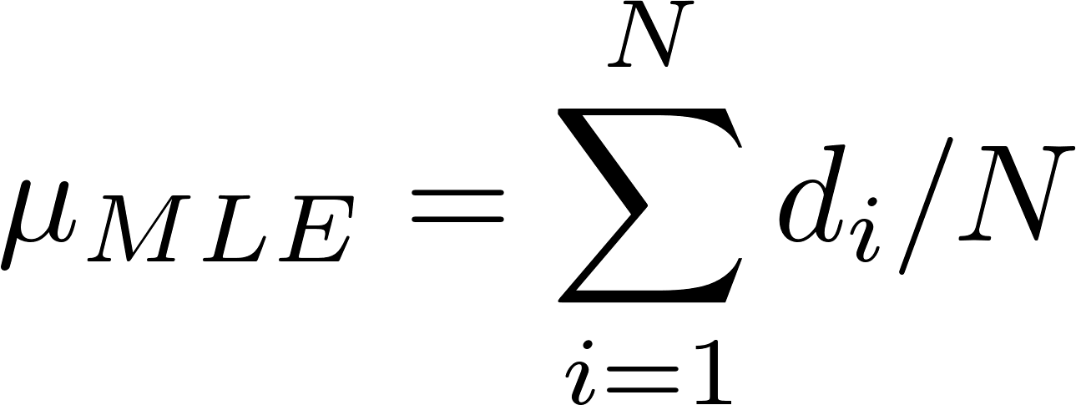


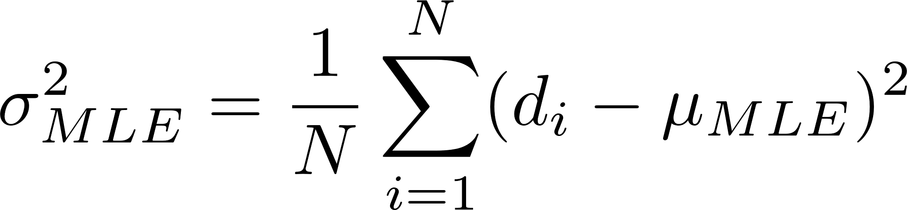
Maximum Likelihood Parameter Estimation
Data points
Find the parameters of the model that maximize
the likelihood function of the data
which is a function of theta, not a probability distribution.
Example: assume we know that 1D data points were generated independently from a Gaussian distribution , but we don’t know the mean and variance. The likelihood function of the data is
And the maximum-likelihood parameter estimates are
Set partial derivatives w.r.t. and to zero

Slide 23
Least Squares as Maximum Likelihood
Find the parameters of the model that maximize
the likelihood function of the data
which is a function of theta, not a probability distribution.
Example: assume we know that 1D data points were generated independently from a Gaussian distribution , but we don’t know the mean and variance. The likelihood function of the data is
And the maximum-likelihood parameter estimates are
Least squares estimation
occurs in maximum likelihood
with Gaussian models of data

Slide 24
Estimating parameters of probability models
In the occupancy grid mapping problem we wanted to compute over all possible maps.
We can see this problem as a specific instance within a category of problems where we are given data (observations) and we want to “explain” or fit the data using a parametric function.
There are typically three ways to work with this type of problems:
Maximum Likelihood parameter estimation (MLE)
Least Squares
Maximum A Posteriori (MAP) parameter estimation
Bayesian parameter distribution estimation

Slide 25
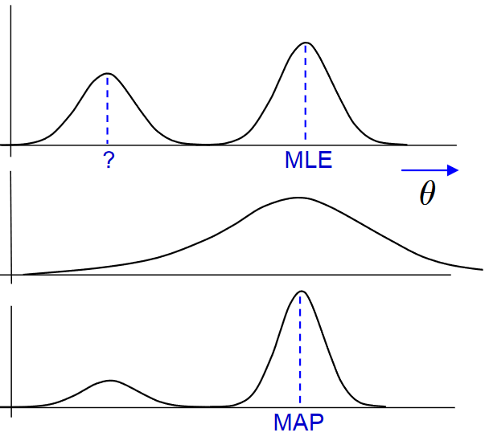
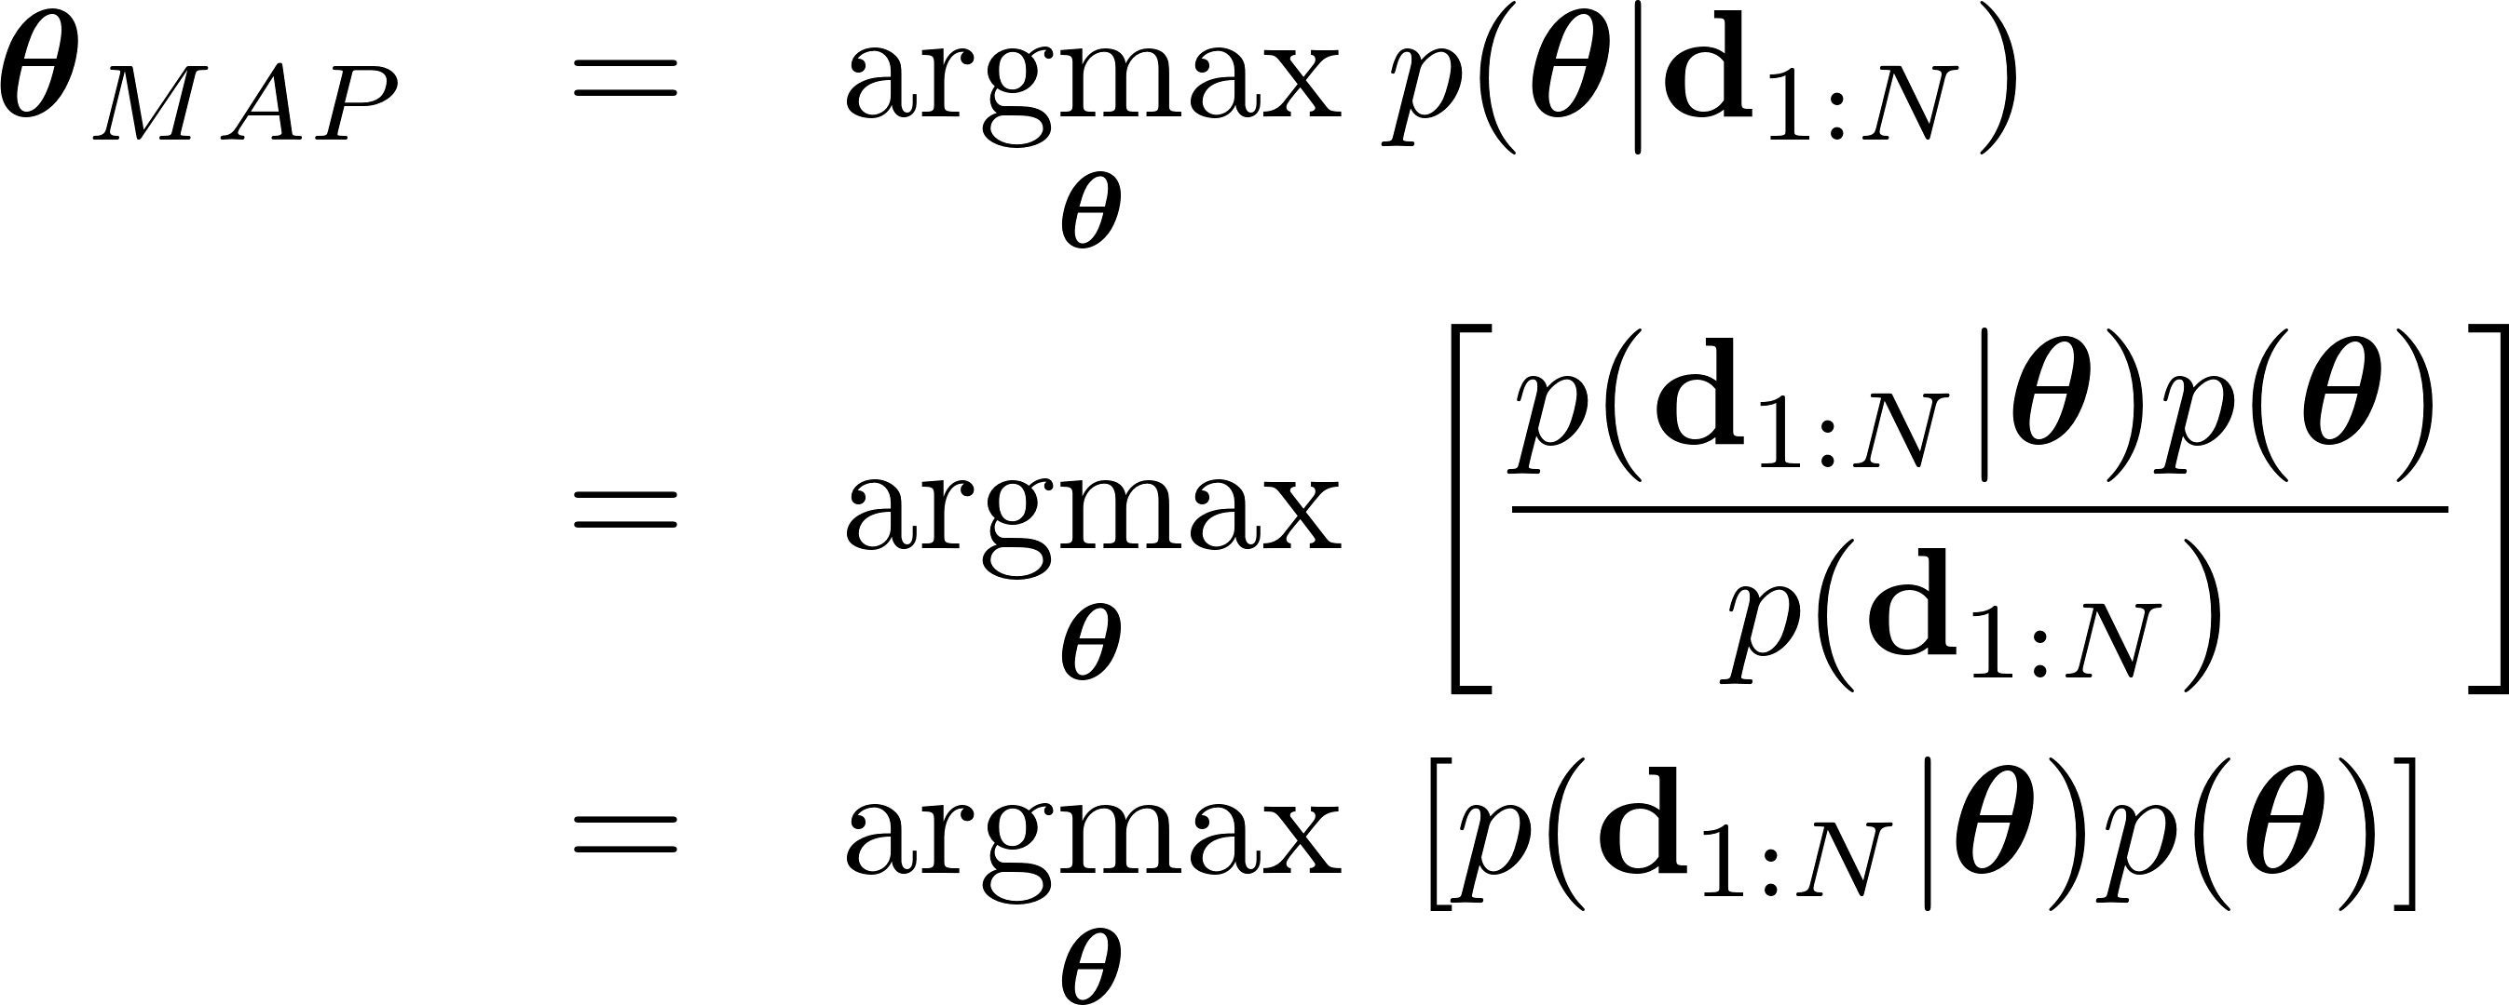
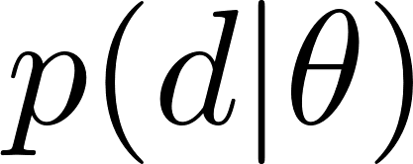
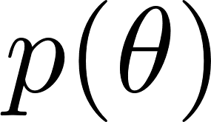
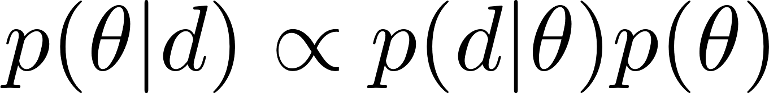
Maximum A Posteriori Parameter Estimation
Likelihood
Prior
Posterior
Note the denominator
does not depend on
the parameters.

Slide 26
Maximum A Posteriori Parameter Estimation
Likelihood
Prior
Posterior
Almost the same as MLE, but
with a prior distribution on
the parameters

Slide 27
Estimating parameters of probability models
In the occupancy grid mapping problem we wanted to compute over all possible maps.
We can see this problem as a specific instance within a category of problems where we are given data (observations) and we want to “explain” or fit the data using a parametric function.
There are typically three ways to work with this type of problems:
Maximum Likelihood parameter estimation (MLE)
Least Squares
Maximum A Posteriori (MAP) parameter estimation
Bayesian parameter distribution estimation

Slide 28
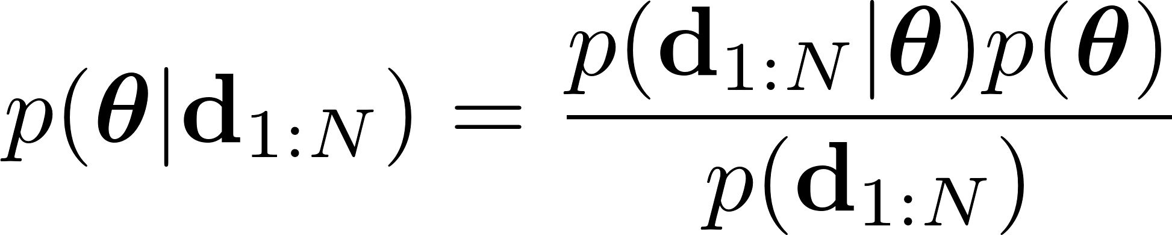
Bayesian parameter estimation
Both MLE and MAP estimators give you a single point estimate.
But there might be many parameters that are compatible with the data.
Instead of point estimates, compute a distribution of estimates that explain the data
Bayesian parameter estimation:
Note, this time we do not write “max”. So, dropping denominator is not trivial.
The probability of the
data is usually hard to
compute. But it does not
depend on the parameter
theta, so it is treated as a
normalizing factor, and we
can still compute how the posterior varies with theta.

Slide 29
Bayesian parameter estimation
Both MLE and MAP estimators give you a single point estimate.
But there might be many parameters that are compatible with the data.
Instead of point estimates, compute a distribution of estimates that explain the data
Bayesian parameter estimation:
This is what we used in occupancy grid mapping, when we approximated

Slide 30
Concluding thoughts: When to use each type of estimation?
The computational complexity increases as we go through MLE, MAP and Bayesian
Our reliability of solution also increases, as long as we have good priors!
Major take-home: maximizing Gaussian likelihood equivalent to least squares solution!

