Slide 1
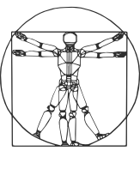
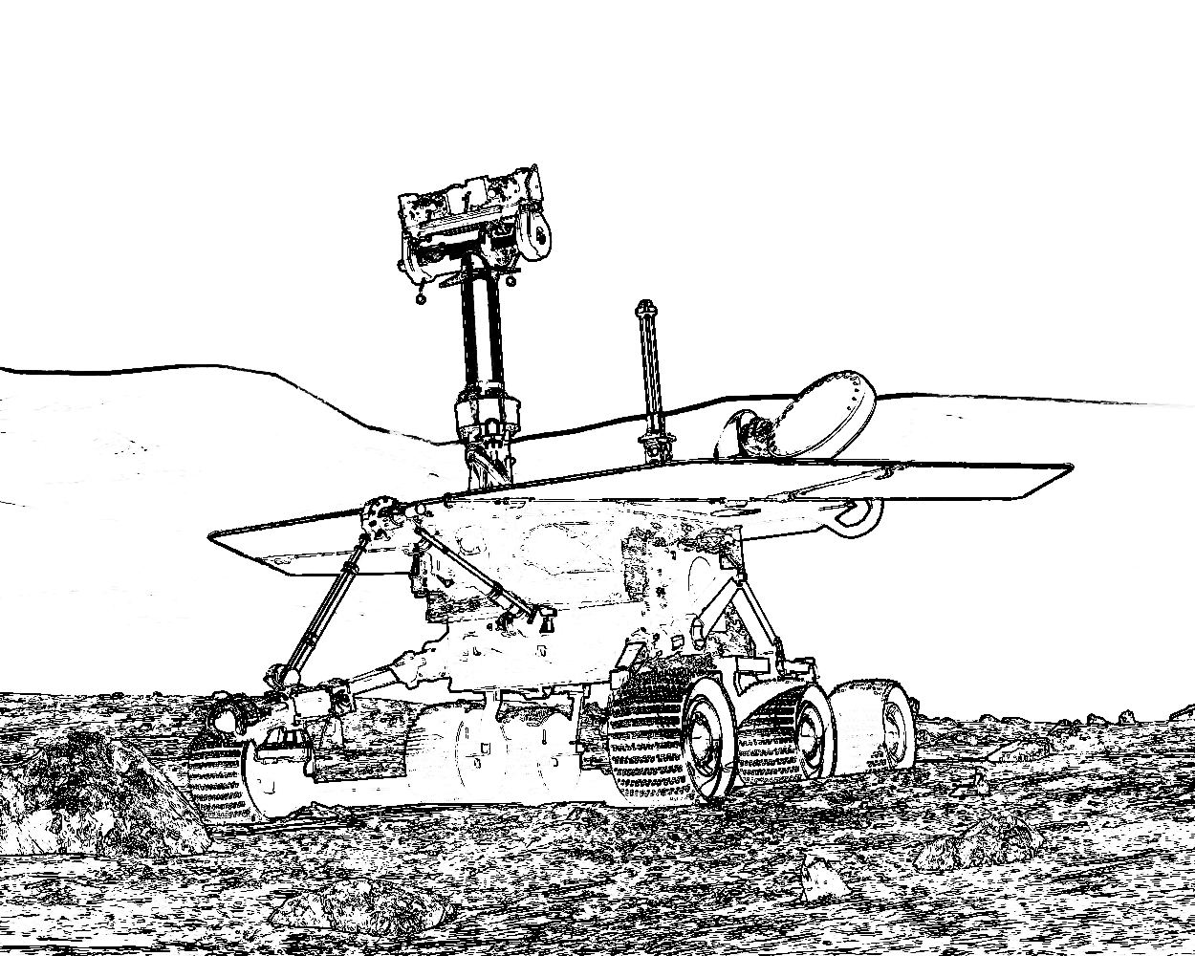


COMP417 - Intro to Robotics
Optimal Control
Fall 2019
David Meger

Slide 2
Intro to Optimal Control
Rather than having a reference trajectory, suppose we have a cost function that tells us just how bad each “wrong” action is
Achieving goal can still be the best (least cost)
Now we can prioritize different mistakes
This allows us to think ahead in time and solve for trajectories that minimize the sum of costs as we formulate their matching control

Slide 3
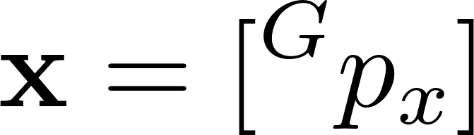
The state of a double integrator (block on ice)
State = [Position along x-axis]
F

Slide 4
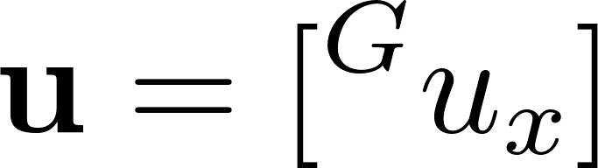
Controls of a double integrator
Controls = [Force along x-axis]
F

Slide 5
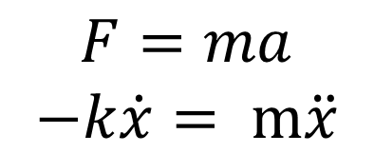
Dynamics of a double integrator
Passive dynamics correspond to taxi sliding on the roads
of Montreal (dirty ice). Where is the car going to end up?
Similar to curling.
$$F=ma$$
$$−k\dot{x}= m\ddot{x}$$
F

Slide 6
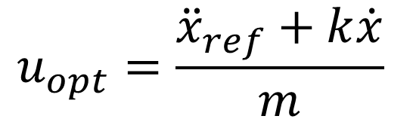


Dynamics of a double integrator
Passive dynamics correspond to taxi sliding on the roads
of Montreal (dirty ice). Where is the car going to end up?
Similar to curling.
$$F=ma$$
$$−k\dot{x}= m\ddot{x}$$
Controlled dynamics:
$$m\ddot{x}=u−k\dot{x}$$
F
What controller achieves ${\ddot{x}}_{ref}$?
$$u_{opt}=\frac{{\ddot{x}}_{ref}+k\dot{x}}{m}$$
If we assume a known
reference acceleration, this is enough.
Let’s add some challenge!

Slide 7
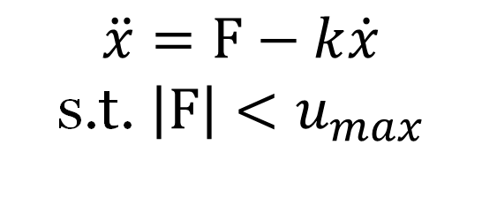
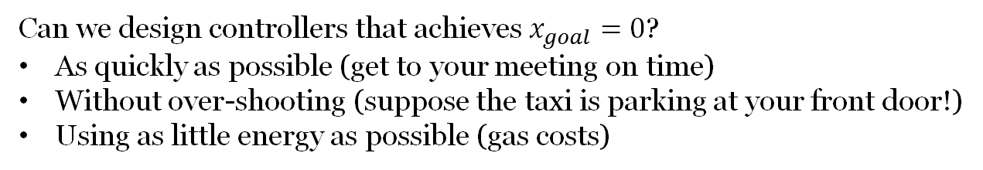
Dynamics of a double integrator
Controlled dynamics interesting when force is limited.
$$\ddot{x}=F−k\dot{x}$$
s.t. $\left|F\right|<u_{max}$
Can we design controllers that achieves $x_{goal}=0$?
As quickly as possible (get to your meeting on time)
Without over-shooting (suppose the taxi is parking at your front door!)
Using as little energy as possible (gas costs)
F

Slide 8
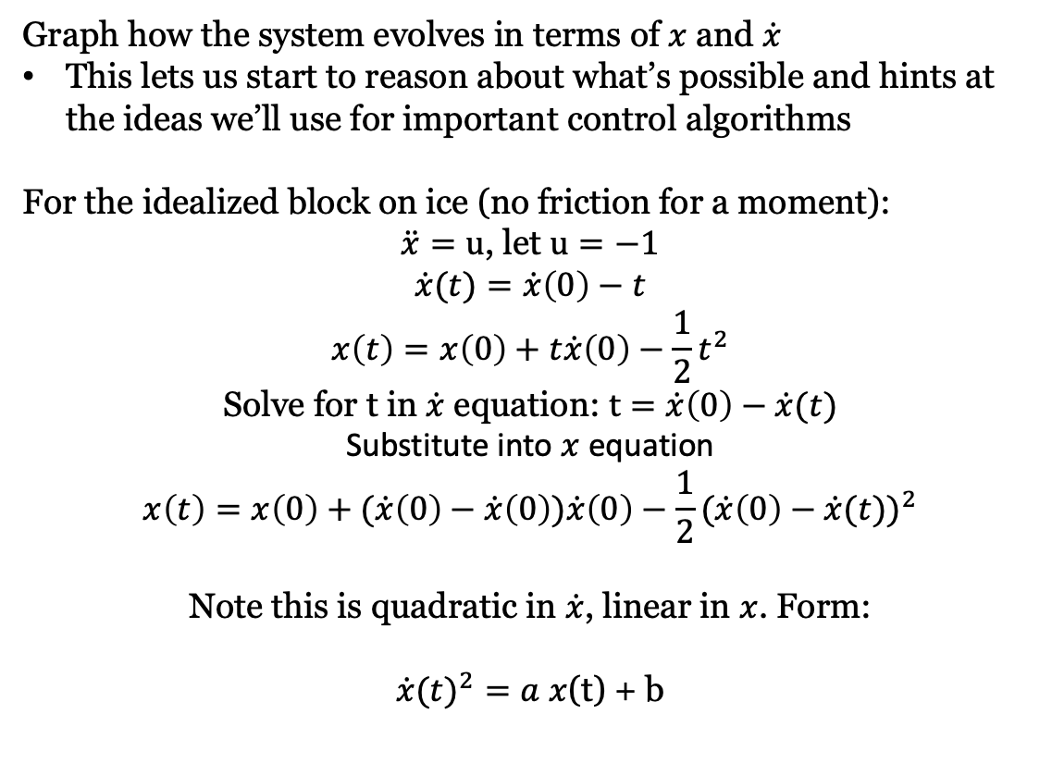


Phase plots: A useful analytical tool
Graph how the system evolves in terms of $x$ and $\dot{x}$
This lets us start to reason about what’s possible and hints at the ideas we’ll use for important control algorithms
For the idealized block on ice (no friction for a moment):
$\ddot{x}=u$, let $u=−1$
$$\dot{x}(t)=\dot{x}\left(0\right)−t$$
$$x\left(t\right)=x\left(0\right)+t\dot{x}\left(0\right)−\frac{1}{2}t^{2}$$
Solve for t in $\dot{x}$ equation: $t=\dot{x}\left(0\right)−\dot{x}(t)$
Substitute into $x$ equation
$$x\left(t\right)=x\left(0\right)+(\dot{x}\left(0\right)−\dot{x}\left(0\right))\dot{x}\left(0\right)−\frac{1}{2}{(\dot{x}\left(0\right)−\dot{x}(t))}^{2}$$
Note this is quadratic in $\dot{x}$, linear in $x$. Form:
${\dot{x}(t)}^{2}=a$ $x$(t) + b
F
$$\dot{x}$$
Slamming on the breaks
looks like this.
$$x$$

Slide 9
Phase Plot: u=0

Slide 10
Phase Plot: u=+1

Slide 11
Phase Plot: u=-1

Slide 12
An Intuitive Result
Claim: Bang-bang controller is optimal for the shortest time problem
Why?

Slide 13
An Intuitive Result
Claim: Bang-bang controller is optimal for the shortest time problem
Why?
Consider any controller that “pushes” less hard at first. Think about its phase portrait. This will, on average, be slower than the bang-bang. Not optimal.

Slide 14
An Intuitive Result
Claim: Bang-bang controller is optimal for the shortest time problem
Why?
Consider any controller that “pushes” less hard at first. Think about its phase portrait. This will, on average, be slower than the bang-bang. Not optimal.
Consider any controller that “brakes” less hard at the critical point. It will overshoot the goal and have to come back around. This will have a faster velocity sometimes, but take longer overall
(harder to prove precisely, but you can do it as an exercise)

Slide 15
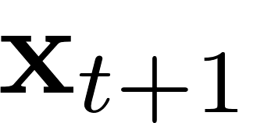

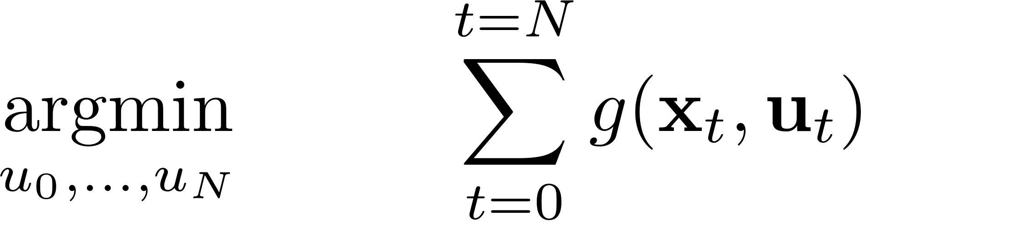
Optimal Control
Formulate control problem as optimization of a cost function given some form of knowledge about the system
Ideal solution for a robot is over continuous x, u, but we could discretize those to make some progress first off…

Slide 16
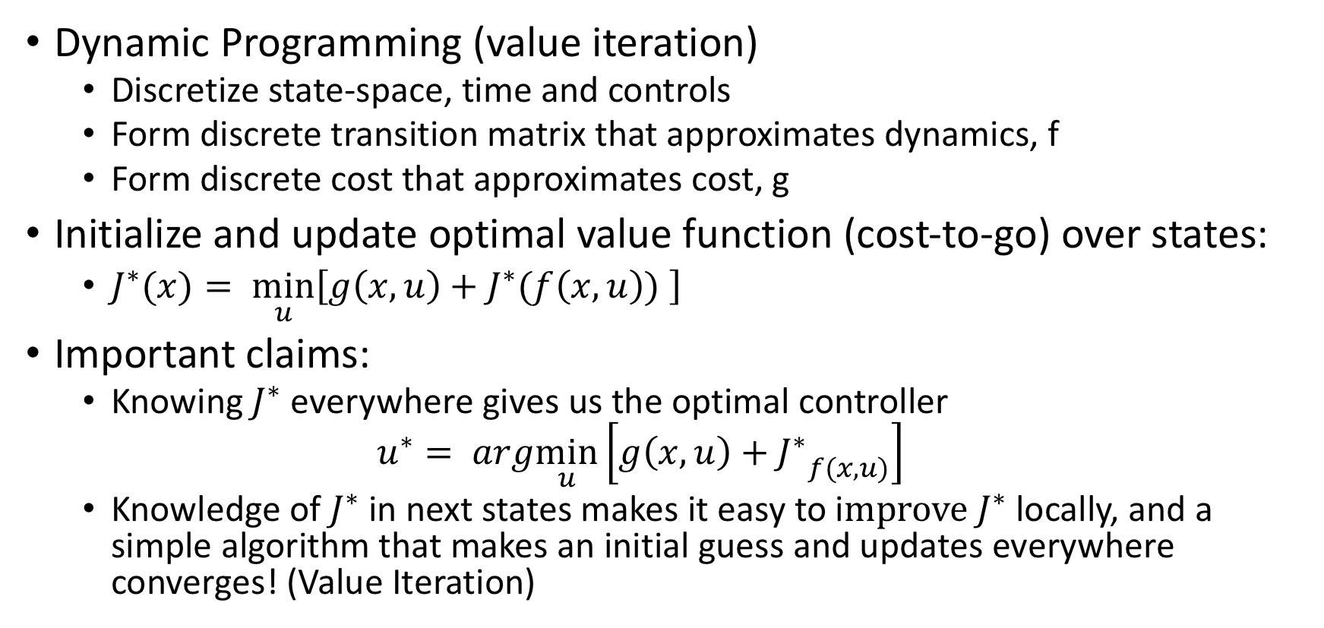
Dynamic Programming for Control
Dynamic Programming (value iteration)
Discretize state-space, time and controls
Form discrete transition matrix that approximates dynamics, f
Form discrete cost that approximates cost, g
Initialize and update optimal value function (cost-to-go) over states:
$J^{∗}(x)= \min_{u}\left[g\left(x,u\right)+J^{∗}(f\left(x,u\right)) \right]$
Important claims:
Knowing $J^{∗}$ everywhere gives us the optimal controller
$$u^{∗}= arg\min_{u}\left[g\left(x,u\right)+{J^{∗}}_{f(x,u)}\right]$$
Knowledge of $J^{∗}$ in next states makes it easy to i$mprove J^{∗}$ locally, and a simple algorithm that makes an initial guess and updates everywhere converges! (Value Iteration)

Slide 17

Double Integrator Example
Goal: arrive at x=0 as soon as possible
Control a(t)=u, limited to |u|<=1
Ideally solve over all x(0), v(0)
Dynamics:
v(t) = v(0) + ut
x(t) = x(0) + v(0)t + 0.5t
Cost (min-time):
g(x,u) = 0 if goal, else 1
What is the intuitive solution?
What does dynamic programming look like?
x
u
2
0

Slide 18
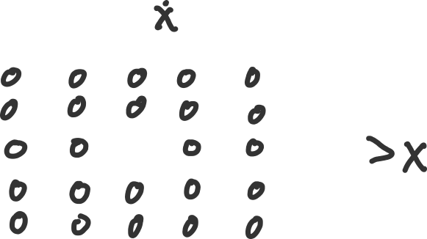
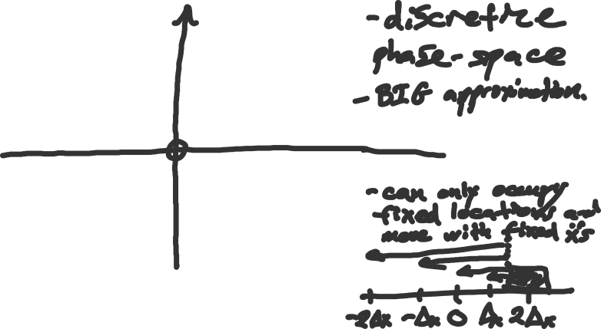
Value Iteration for the Double Integrator

Slide 19
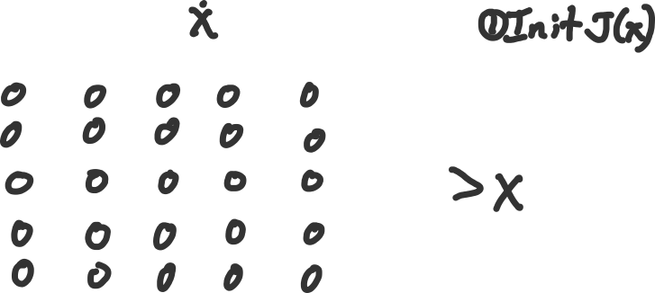

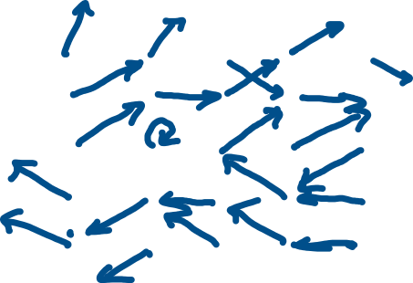
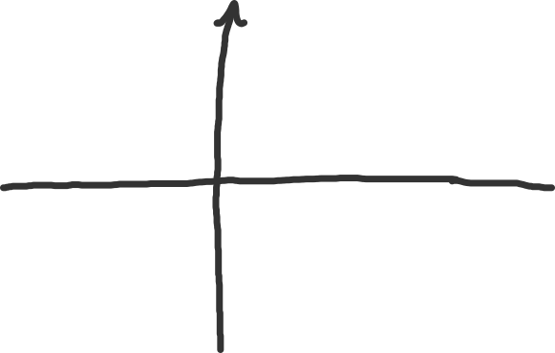

Value Iteration for the Double Integrator

Slide 20


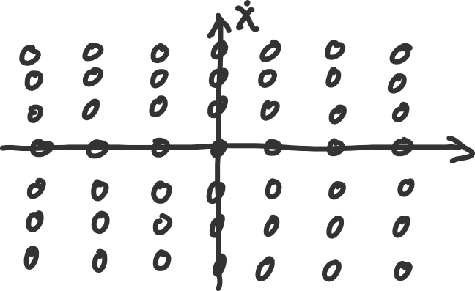
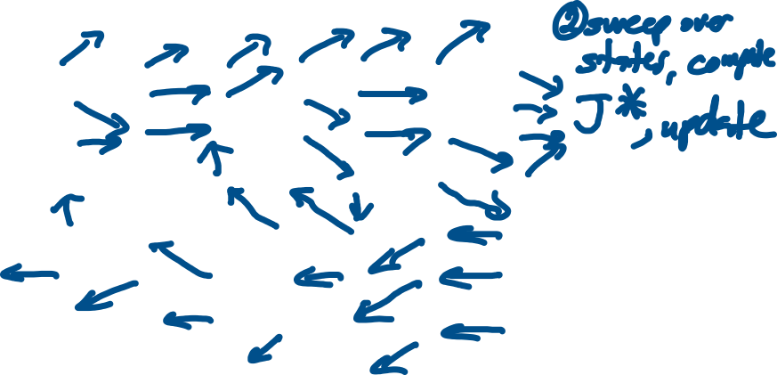
Value Iteration for the Double Integrator

Slide 21


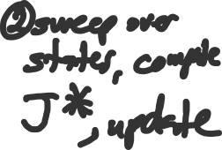
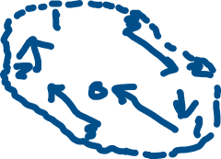




Value Iteration for the Double Integrator

Slide 22
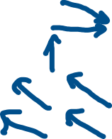
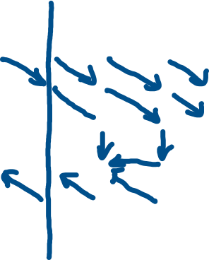
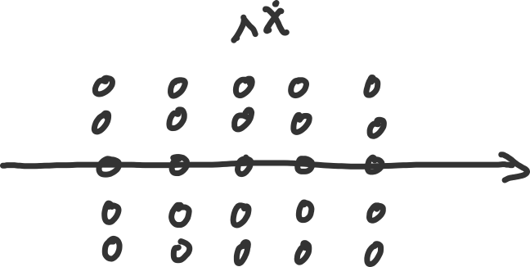
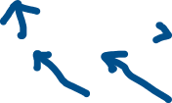
Value Iteration for the Double Integrator

Slide 23
Issues with dynamic programming
Errors in formulation are related to "size" of discretization
Naïve discretization scales exponentially with # of dimensions
Better ways to discretize:
Multi-resolution and adaptive grids
Trajectory-based methods
Improving robustness of solution to local errors:
2nd derivative methods
Line search
Guiding prior information

Slide 24
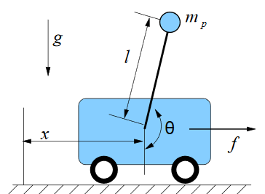
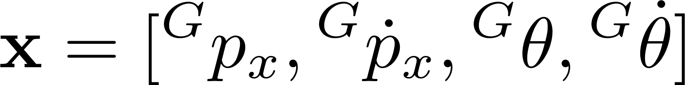

State and control of a cartpole
State = [Position and velocity of cart, orientation
and angular velocity of pole]
Control = [Horizontal force]

Slide 25
Cartpole properties
Theta joint lacks a motor making this system underactuated
We must sometimes sacrifice desirable cart position in order to "catch" the pole and right it
This coupling comes from the dynamics equations
Two canonical tasks:
Swing-up
Balancing

