Slide 1
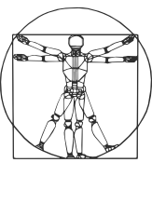
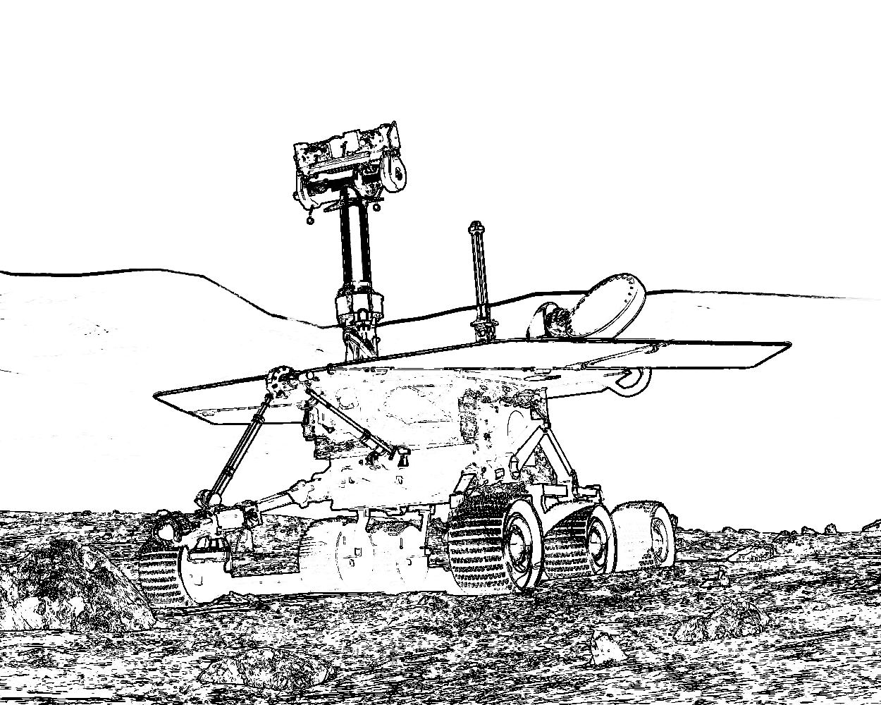


COMP417 Intro to Robotics Lecture 17 - LQR
Fall 2019
David Meger

Slide 2
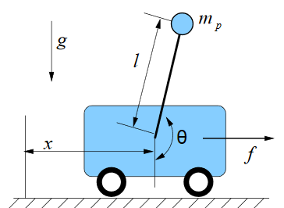
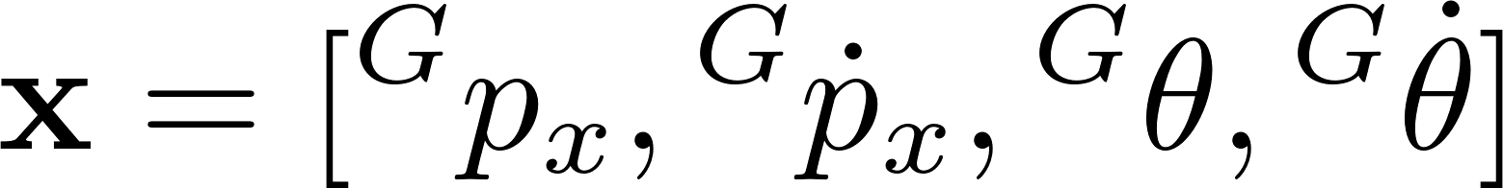

State and control of a cartpole
State = [Position and velocity of cart, orientation
and angular velocity of pole]
Control = [Horizontal force]

Slide 3
Cartpole properties
Theta joint lacks a motor making this system underactuated
We must sometimes sacrifice desirable cart position in order to "catch" the pole and right it
This coupling comes from the dynamics equations
Two canonical tasks:
Swing-up
Balancing

Slide 4
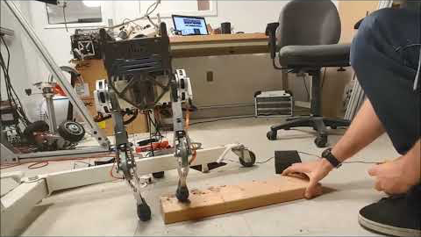

Slide 5
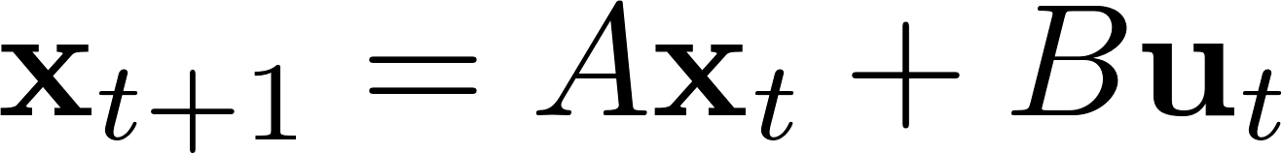

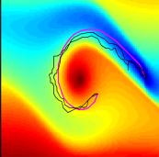
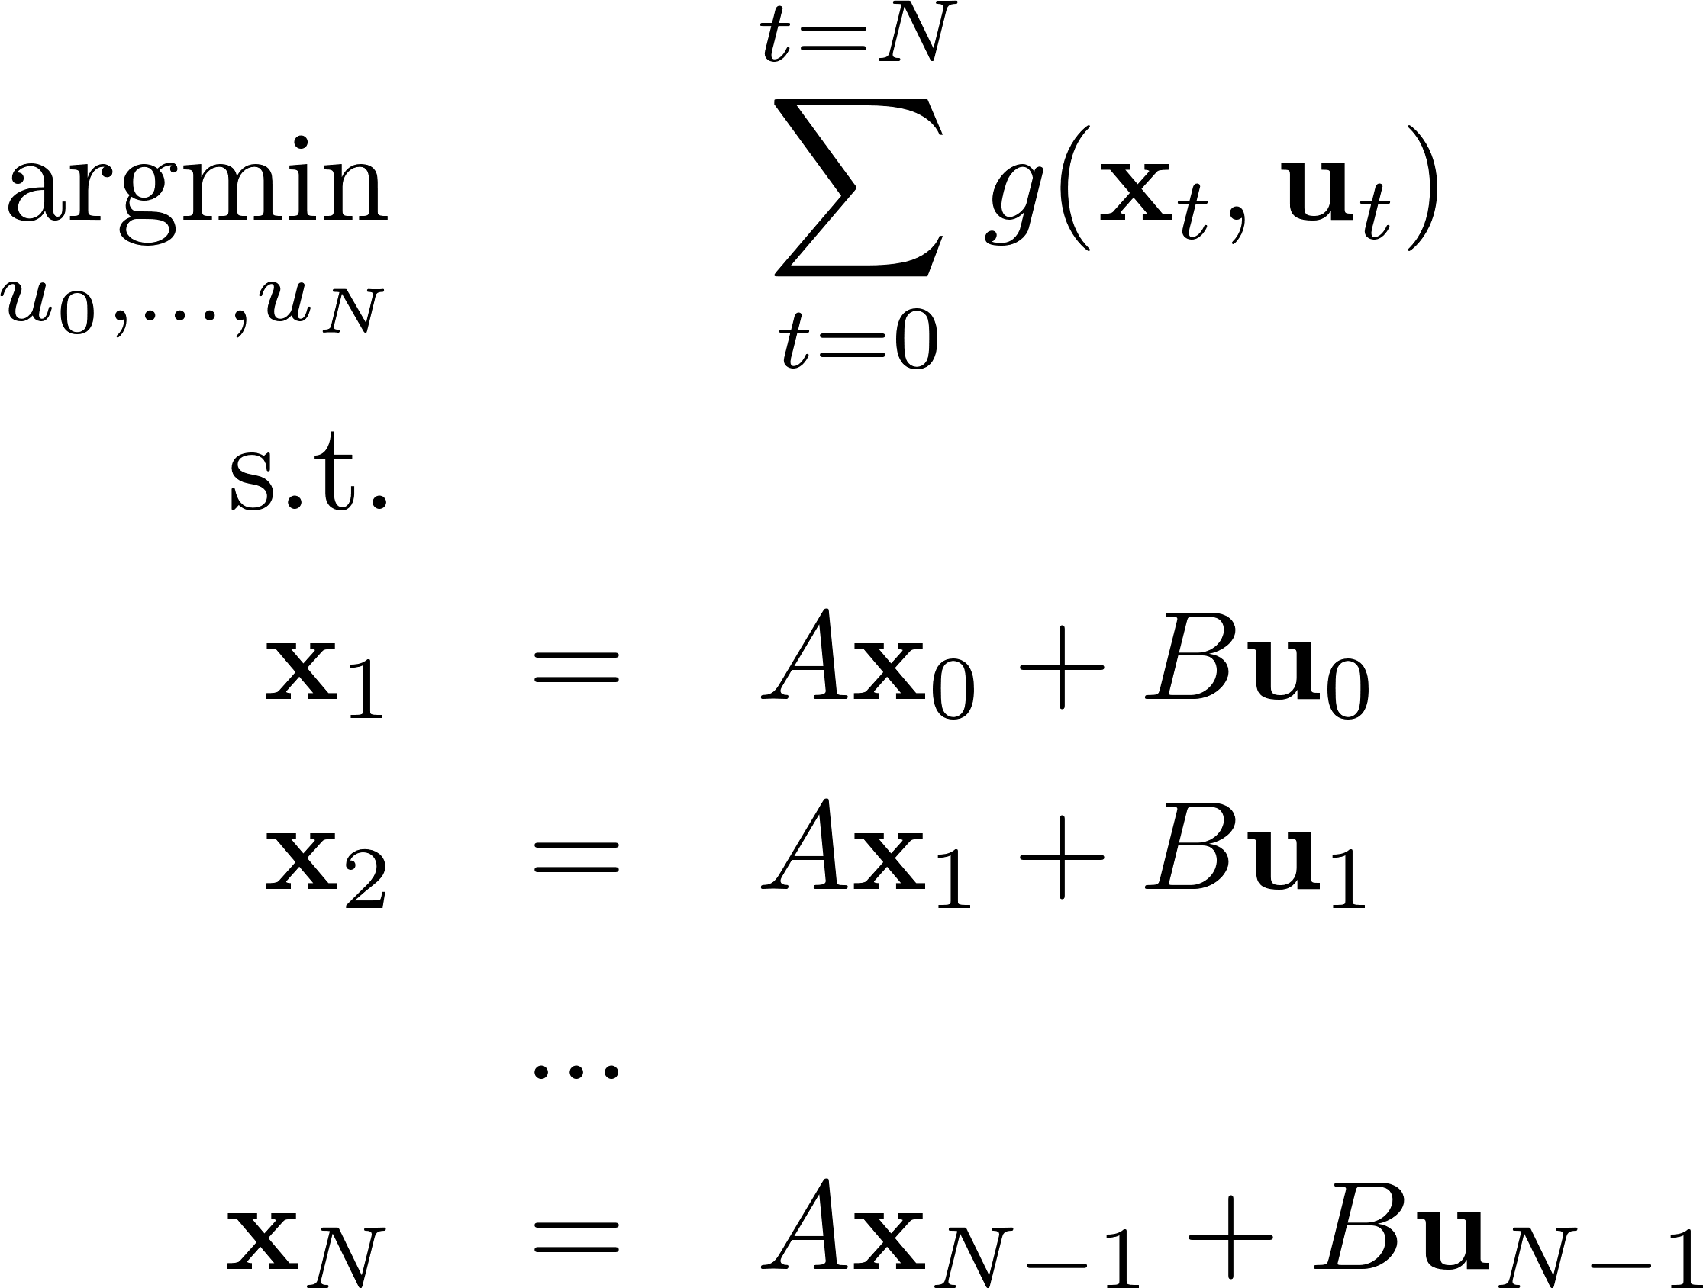
Optimal Control Formulation: Recall
Define: optimal control problem
Optimal u and x gives trajectory with minimum cost
Greedy action often not correct!

Slide 6

Warm-up Example: From Bernoulli
Given two points A and B in a vertical plane, what is the curve traced out by a point acted on only by gravity, which starts at rest at A, is pulled only by gravity, and reaches B in the shortest time.
y
A
B
x

Slide 7
Warm-up Example
Given two points A and B in a vertical plane, what is the curve traced out by a point acted on only by gravity, which starts at A and reaches B in the shortest time.
Solution is called a “cycloid” and can be obtained by integrating constraints of the optimal control form

Slide 8
Solving the Brachistochrone:
Makes us famous!
First known to Leibniz, L'Hospital, Newton, and the two Bernoullis
Has a function f*(x) as its answer
Usual optimization tricks to find x* don’t quite fit
Has an integral over this function as the “cost”:
Physics equation for elapsed time accelerating along the path f(x)
This is the domain of calculus of variations, which underlies much of the material we’ll talk about here. Not testable in COMP 417, but very rich for further reading if interested.

Slide 9
Problem Hierarchy
Time:
Continuous or discrete
Fixed or infinite horizon
State and action spaces:
Continuous or discrete
Motion model:
Linear or non-linear
Known or unknown
Deterministic or stochastic
Cost function:
Quadratic or general non-linear
Known or unknown

Slide 10
Problem Hierarchy
Time:
Continuous or discrete
Fixed or infinite horizon
State and action spaces:
Continuous or discrete
Motion model:
Linear or non-linear
Known or unknown
Deterministic or stochastic
Cost function:
Quadratic or general non-linear
Known or unknown
Reinforcement Learning:
Not testable, we’ll see as bonus material

Slide 11
Problem Hierarchy
Time:
Continuous or discrete
Fixed or infinite horizon
State and action spaces:
Continuous or discrete
Motion model:
Linear or non-linear
Known or unknown
Deterministic or stochastic
Cost function:
Quadratic or general non-linear
Known or unknown
Our next algorithm, LQR

Slide 12
An analytical approach: LQR
Linear quadratic regulator shows an optimal control case that has exact analytical solution, and gives this closed form answer
Idea: if the dynamics model is known and linear and the cost is quadratic, it’s easy to write out the full analytical expression for the next state and its cost-to-go
Square matrices Q and R must be positive definite:
i.e. positive cost for ANY nonzero state or control vector

Slide 13
LQR: preview
This simple case has an exact analytical optimum
The form allows value iteration to be solved exactly in a single pass
The proof gives useful intuition about the problem that is re-used regularly in current research

Slide 14
Finite-Horizon LQR
Idea: finding controls is an optimization problem
Compute the control variables that minimize the cumulative cost

Slide 15
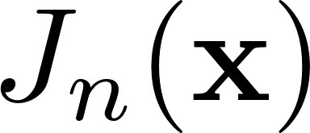
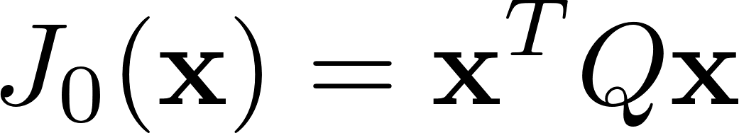
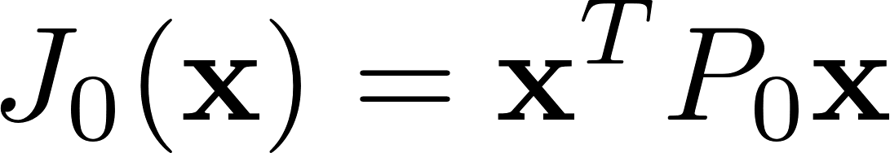
Finding the LQR controller in closed-form by recursion
Let denote the cumulative cost-to-go starting from state x and moving for n time steps.
i.e. cumulative future cost from now till n more steps
is the terminal cost of ending up at state x. Special because no actions left to do. Let’s denote it
Q: What is the optimal cumulative cost-to-go function with 1 time step left?

Slide 16
Finding the LQR controller in closed-form by recursion
Bellman update
(a.k.a. Dynamic Programming)
Expand this using our assumptions!
$$J_{1}\left(x\right)=\min_{u}\left[f\left(x,u\right)+J_{0}(f\left(x,u\right))\right]$$

Slide 17
Finding the LQR controller in closed-form by recursion
$$J_{1}\left(x\right)=\min_{u}\left[f\left(x,u\right)+J_{0}(f\left(x,u\right))\right]$$
Linear motion,
Quadratic cost

Slide 18
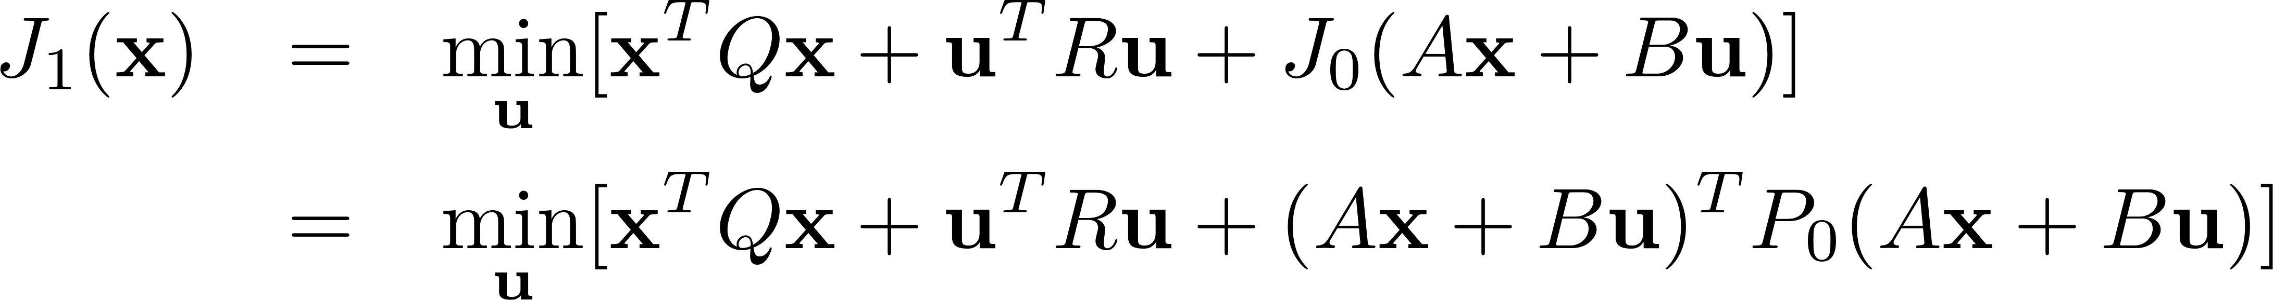
Finding the LQR controller in closed-form by recursion
Begin to expand and factor terms independent of u.

Slide 19
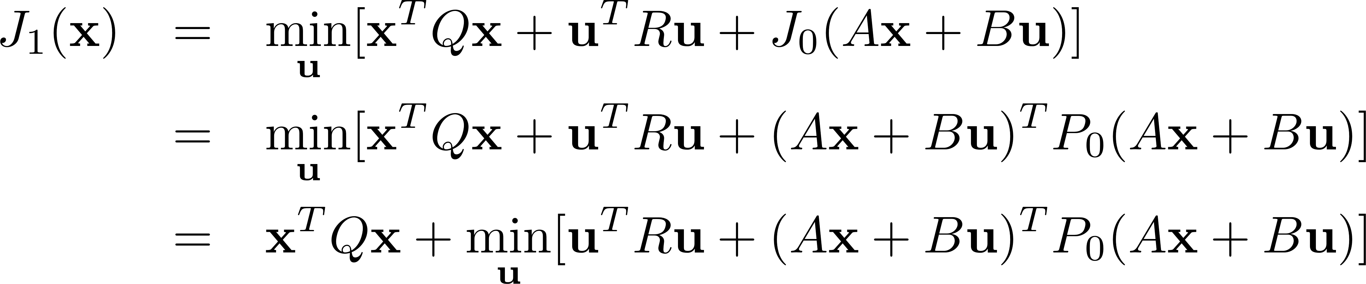
Finding the LQR controller in closed-form by recursion

Slide 20
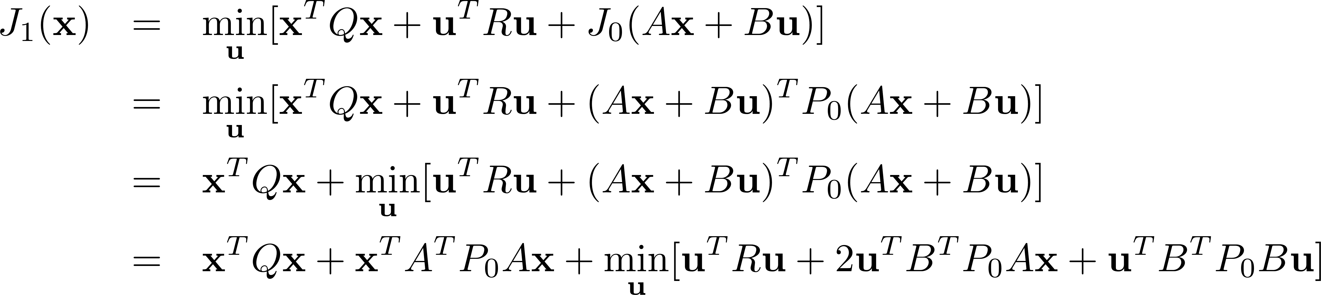
Finding the LQR controller in closed-form by recursion
Q: How do we optimize a multivariable function with respect to some
variables (in our case, the controls)?

Slide 21
Finding the LQR controller in closed-form by recursion
Quadratic
term in u
Linear
term in u
Quadratic
term in u
A: Take the partial derivative w.r.t. controls and set it to zero. That will give you a critical point.

Slide 22
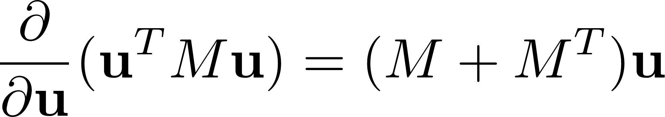
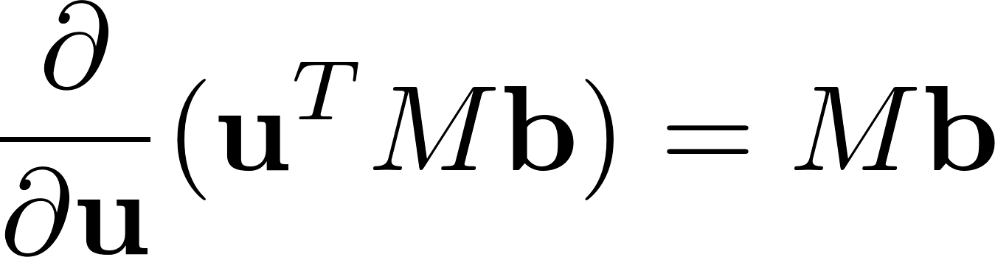
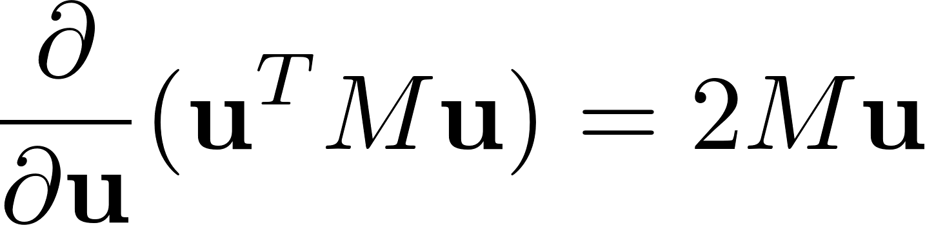
Finding the LQR controller in closed-form by recursion
From calculus/algebra:
The minimum is attained at:
Q: Is this matrix invertible? Recall R, Po are positive definite matrices.
If M is symmetric:

Slide 23
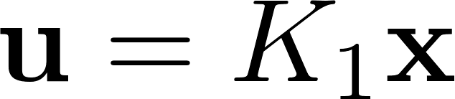
Finding the LQR controller in closed-form by recursion
The minimum is attained at:
So, the optimal control for the last time step is:
Linear controller in terms of the state

Slide 24
Finding the LQR controller in closed-form by recursion
The minimum is attained at:
So, the optimal control for the last time step is:
We computed the location of the minimum.
Now, plug it back in and compute the
minimum value
Linear controller in terms of the state

Slide 25
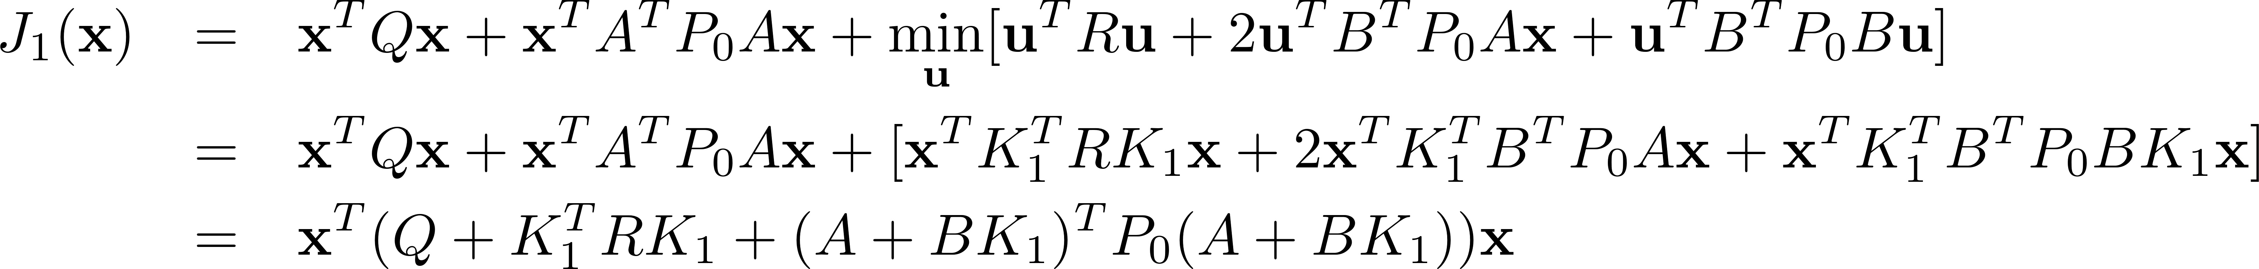
Finding the LQR controller in closed-form by recursion
Substitute solution from previous slide:
Q: Why is this a big deal?
A: The cost-to-go function remains quadratic after the first recursive step!

Slide 26
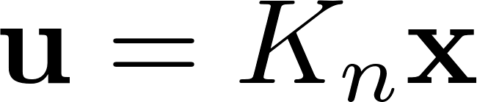
Finding the LQR controller in closed-form by recursion
…
In fact the recursive steps generalize

Slide 27

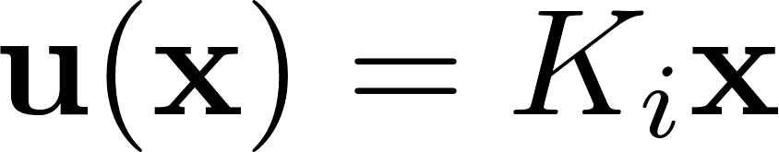
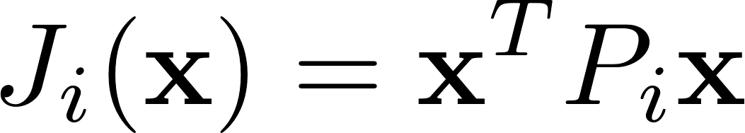
Finite-Horizon LQR: algorithm summary
// n is the # of steps left
for n = 1…N
Optimal controller for i-step horizon is
with cost-to-go

Slide 28
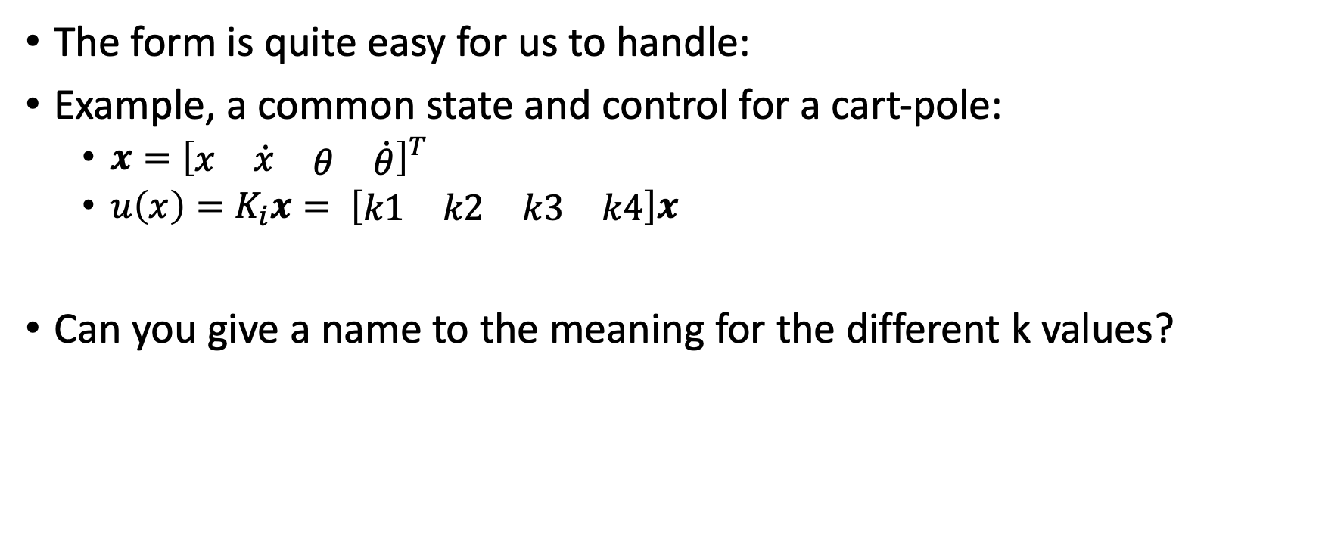
How can we understand the LQR controller?
The form is quite easy for us to handle:
Example, a common state and control for a cart-pole:
$x={\left[\begin{matrix}\begin{matrix}x & \dot{x}\end{matrix} & \begin{matrix}θ & \dot{θ}\end{matrix}\end{matrix}\right]}^{T}$
$u\left(x\right)=K_{i}x= \left[\begin{matrix}\begin{matrix}k1 & k2\end{matrix} & \begin{matrix}k3 & k4\end{matrix}\end{matrix}\right]x$
Can you give a name to the meaning for the different k values?

Slide 29
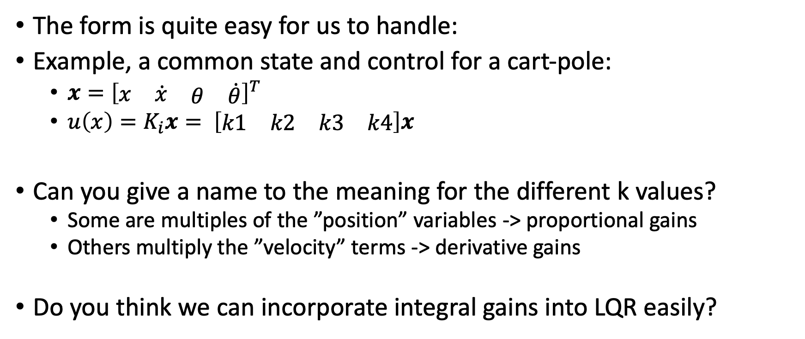
How can we understand the LQR controller?
The form is quite easy for us to handle:
Example, a common state and control for a cart-pole:
$x={\left[\begin{matrix}\begin{matrix}x & \dot{x}\end{matrix} & \begin{matrix}θ & \dot{θ}\end{matrix}\end{matrix}\right]}^{T}$
$u\left(x\right)=K_{i}x= \left[\begin{matrix}\begin{matrix}k1 & k2\end{matrix} & \begin{matrix}k3 & k4\end{matrix}\end{matrix}\right]x$
Can you give a name to the meaning for the different k values?
Some are multiples of the ”position” variables -> proportional gains
Others multiply the ”velocity” terms -> derivative gains
Do you think we can incorporate integral gains into LQR easily?

Slide 30
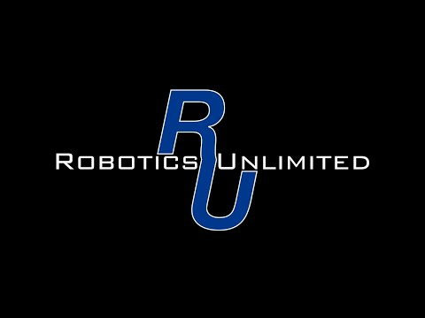

Slide 31
Infinite Horizon LQR
Fixed horizon is natural for some problems, e.g. get to goal quickly
In other cases, we want to behave well forever, e.g. pendulum balancing
We saw J(x) is a quadratic function for finite horizons. This never stops being true:

Slide 32
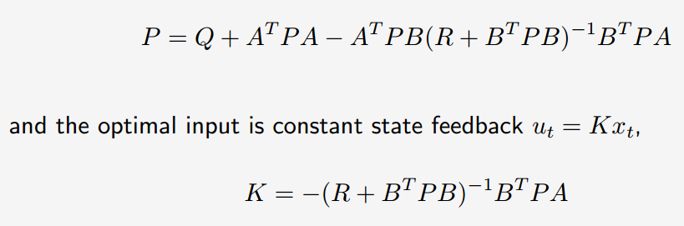
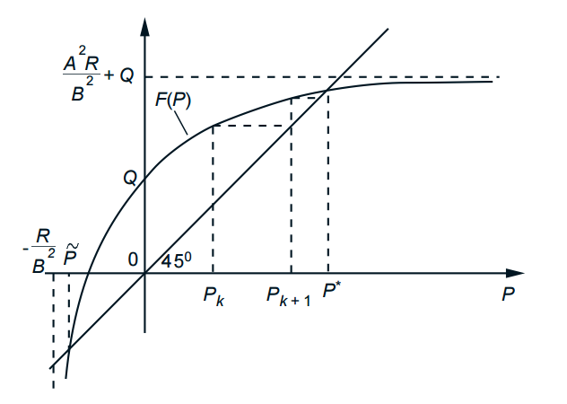
Consider limiting behavior
If P(n) = P(n-1), this defines the limiting behavior
Under correct assumptions, it will exist. Here is the geometry:
Steady-state equation easy to write:
This is known as an Algebraic Riccati Equation (ARE)
Standard solution methods exist

Slide 33
LQR in practice
Solving for K and P accurately is not trivial (matrix inversion or ARE)
How about with error in knowledge of A, B?
Linear system model is almost never true of real robots
Some good fixes for this next
Requirement of precise knowledge of system model is more limiting, we are still working on this in active research (Learning to control)

Slide 34
Non-linear Extensions
Trajectory optimization: solve locally about a path, which is jointly improved:
Dynamic programming with local linearization
Constrained optimization: cost is objective, dynamics are constraints
"Direct" methods that search in the space of policies
Approximate the value function with learning approaches
This slide ends the “testable” material on LQR. You should be aware that it can only handle linear problems and why, but don’t need to know the math for the non-linear solutions that follow here…

Slide 35
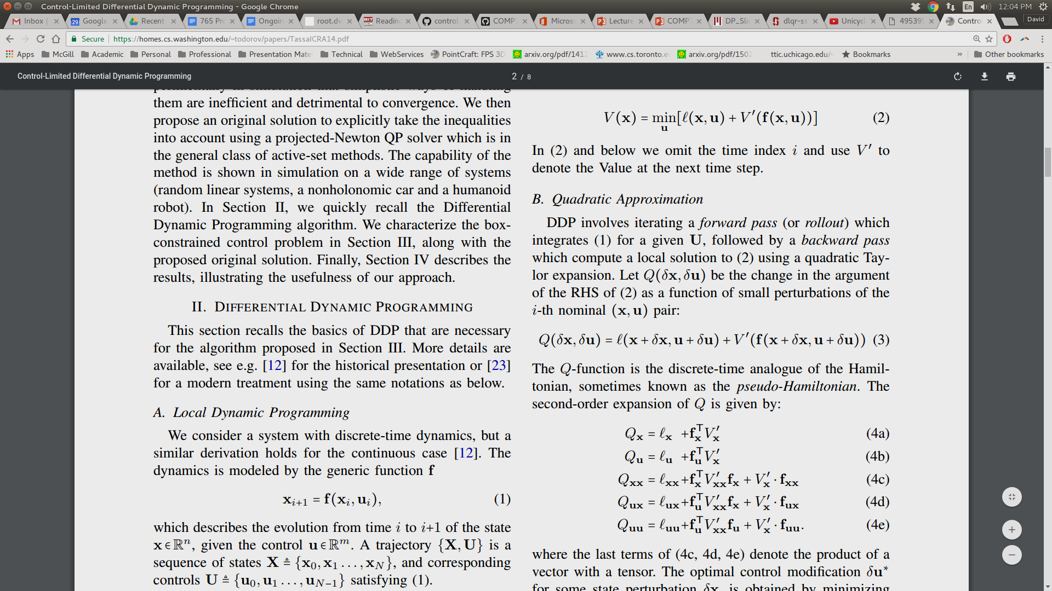
Differential Dynamic Programming
A "shooting" local trajectory optimization method that build upon LQR ideas
Approximate the familiar value function with a 2nd order approximation:
Computed around a reference trajectory from a forward pass integrating current policy
Delta x and u are deviations from that, where we can assume linearity

Slide 36
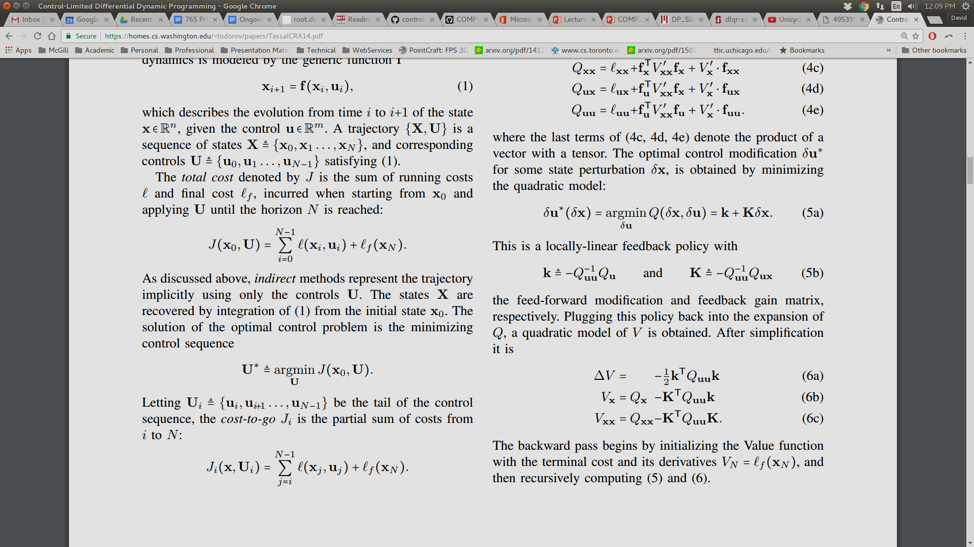
DDP Backwards Pass
Solving for optimizing control relative to current forward "rollout" is called a backwards pass
The math follows the LQR pattern:
Expand
Take derivative w.r.t. u
Compute control and best value
Iterate

Slide 37
DDP analysis
What can DDP do?
Swing up pendulums from rest (rapidly!)
Grasping motions for robot arms
Full-body motions for humanoid robots (and animated humans)
What are the limitations?
No guarantees about global solution quality (computation only around trajectory)
Sensitive to starting controller
Model knowledge is still needed
Used widely as a sub-step in research :
"Probabilistic Differential Dynamic Programming” (we will read)
"Control-Limited Differential Dynamic Programming” (Yuval Tassa – DeepMind)
"Guided Policy Search" (Sergey Levine – UC Berkeley uses iLQR, almost equivalent)

Slide 38
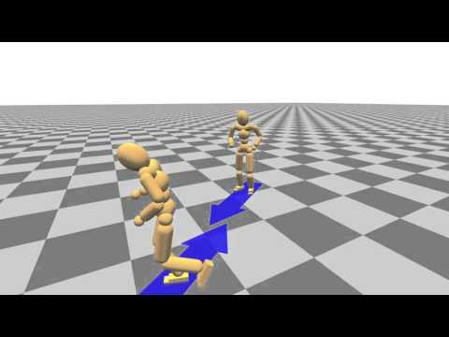

Slide 39
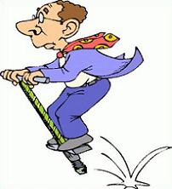
What doesn’t work yet: pogo-stick dynamics
Two different phases with drastically different properties
Relevant because this is a simple model of one leg of a walking robot
Concepts:
What is the correct time-scale for control?
With what fidelity must we model ground contact forces?
Energetics are crucial

Slide 40
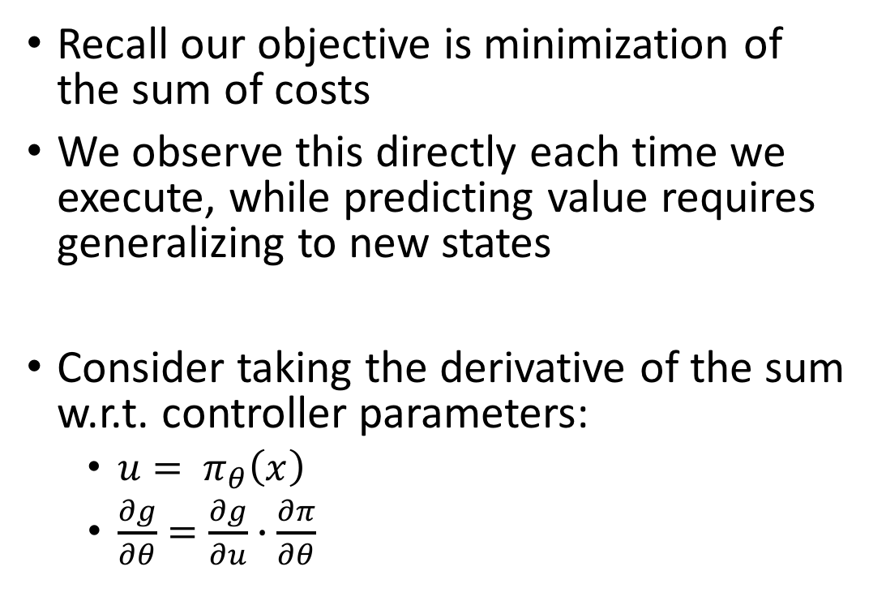
Another idea: direct policy search
Recall our objective is minimization of the sum of costs
We observe this directly each time we execute, while predicting value requires generalizing to new states
Consider taking the derivative of the sum w.r.t. controller parameters:
$u= π_{θ}\left(x\right)$
$\frac{∂g}{∂θ}=\frac{∂g}{∂u}∙\frac{∂π}{∂θ}$

Slide 41
Model-free RL Methods
Utilize returns along a policy to estimate J(x) for visited states
Can operate without knowledge (or even an estimate) of f(x,u)
Search for policies that maximize learned value. Examples:
Q-learning
DQN
DDPG
PPO
TRPO
TD3
SAC

