Slide 1

COMP 417 – Tutorial 3
October 4, 2019
Linear Algebra Tutorial

Slide 2
Outline
Basic matrix and vector operations review
Coordinate transforms
Optimization: Least Squares, Total Least Squares, relation to SVD and eigendecomposition
Optional ROS coordinate transform exercise

Slide 3
Basic Matrix and Vector Operations

Slide 4
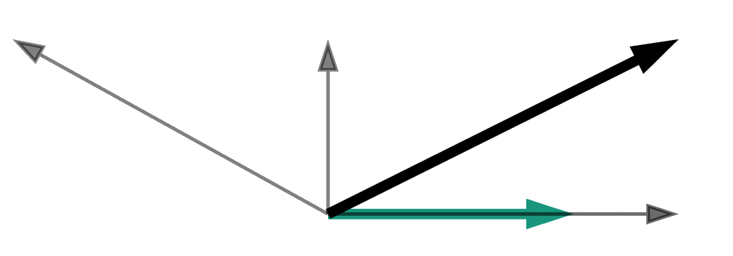



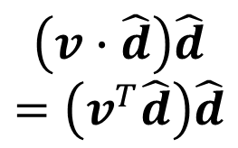


Vector Directional Components
Given $v$ and directional unit vector $\hat{d}$, can decompose $v$:
$$v−\left(v^{T}\hat{d}\right)\hat{d}$$
$$v$$
$$v−2\left(v^{T}\hat{d}\right)\hat{d}$$
$$\hat{d}$$
$$\left(v∙\hat{d}\right)\hat{d}$$
$$=\left(v^{T}\hat{d}\right)\hat{d}$$

Slide 5
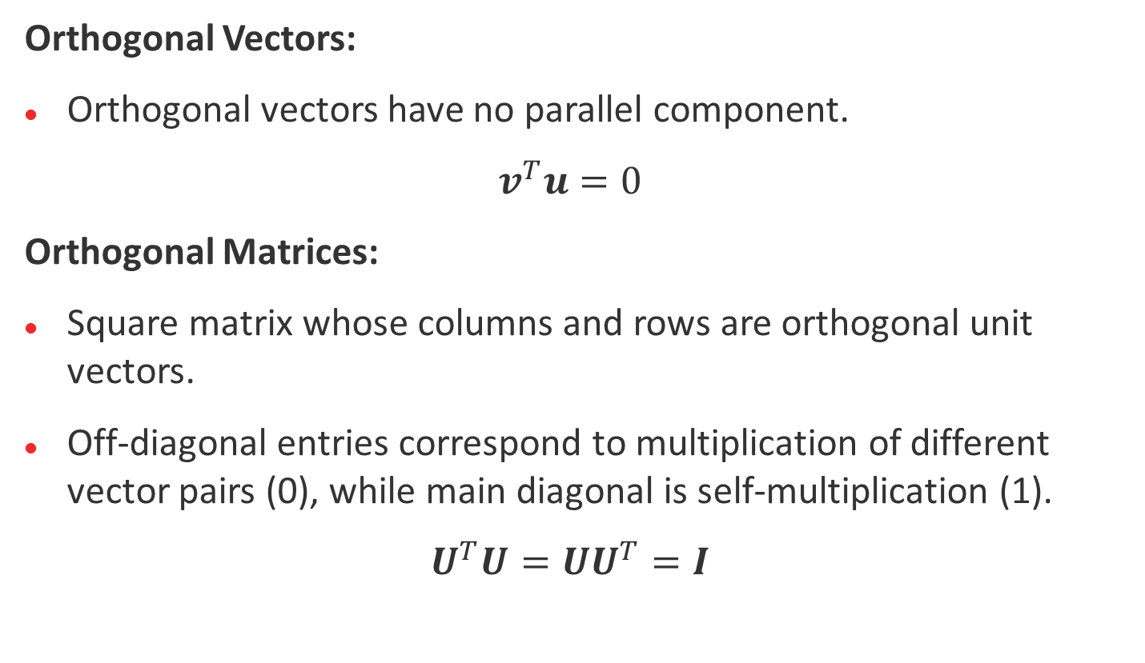
Orthogonal Vectors and Matrices
Orthogonal Vectors:
Orthogonal vectors have no parallel component.
$$v^{T}u=0$$
Orthogonal Matrices:
Square matrix whose columns and rows are orthogonal unit vectors.
Off-diagonal entries correspond to multiplication of different vector pairs (0), while main diagonal is self-multiplication (1).
$$U^{T}U=UU^{T}=I$$

Slide 6
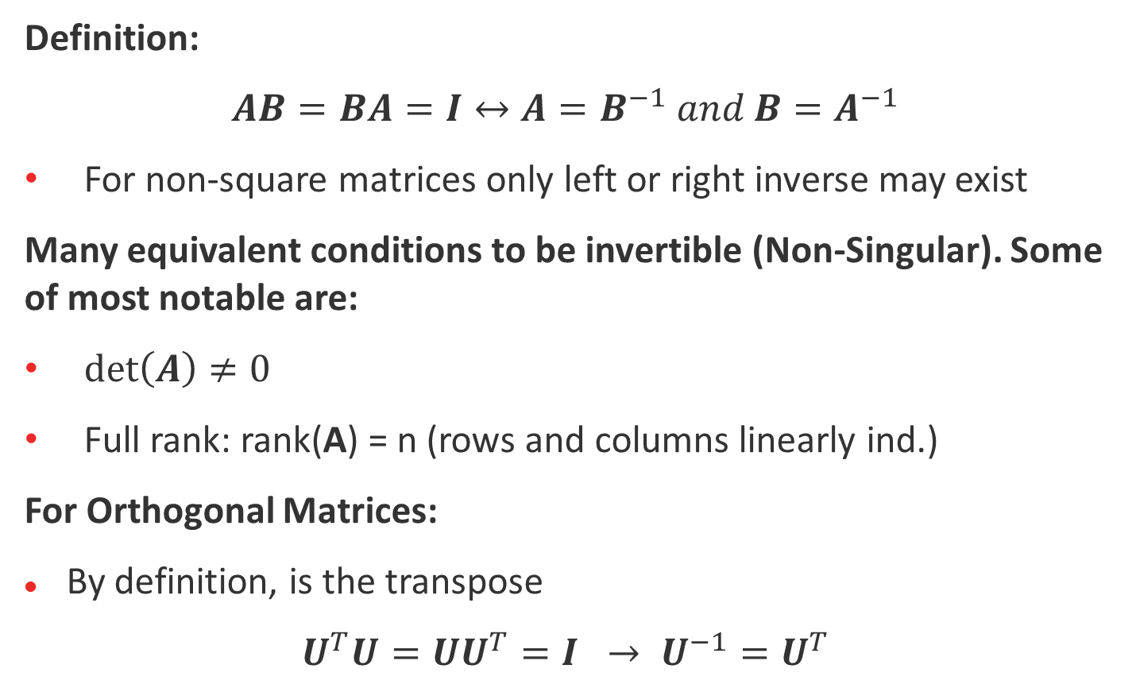
Matrix Inverse
Definition:
$$AB=BA=I↔A=B^{−1} and B=A^{−1}$$
For non-square matrices only left or right inverse may exist
Many equivalent conditions to be invertible (Non-Singular). Some of most notable are:
$\det\left(A\right)≠0$
Full rank: rank(A) = n (rows and columns linearly ind.)
For Orthogonal Matrices:
By definition, is the transpose
$${U^{T}U=UU^{T}=I → U}^{−1}=U^{T}$$

Slide 7
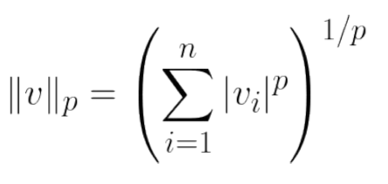
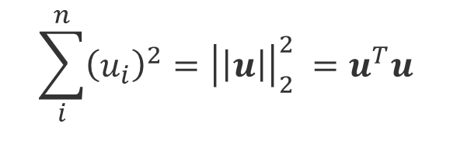
Vector Norms
Norm Function: Assigns a positive length to a vector
Length value depends on norm variant
P-norm general equation:
L1 Norm: | Sum of absolute values
L2 Norm: | Euclidian Distance
Infinity Norm: | Magnitude of largest element
L2 Norm Squared: Also frequently used. Several equivalent representations:
$$\sum_{i}^{n}{{\left(u_{i}\right)}^{2}}={\left|\left|u\right|\right|}_{2}^{2} =u^{T}u$$

Slide 8
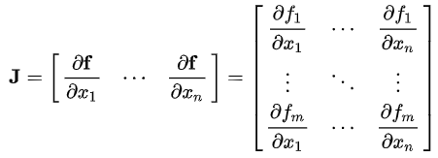

Gradient and Jacobian
Gradient: Partial derivative of a multivariable function w.r.t. a vector
Jacobian: Partial derivative of a vector of functions w.r.t. a vector
$$∇_{x}f\left(x\right)=\left[\begin{matrix}\frac{∂}{∂x_{1}}f(x) \\ ⋮ \\ \frac{∂}{∂x_{n}}f(x)\end{matrix}\right]$$

Slide 9
Coordinate Transforms

Slide 10
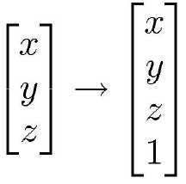
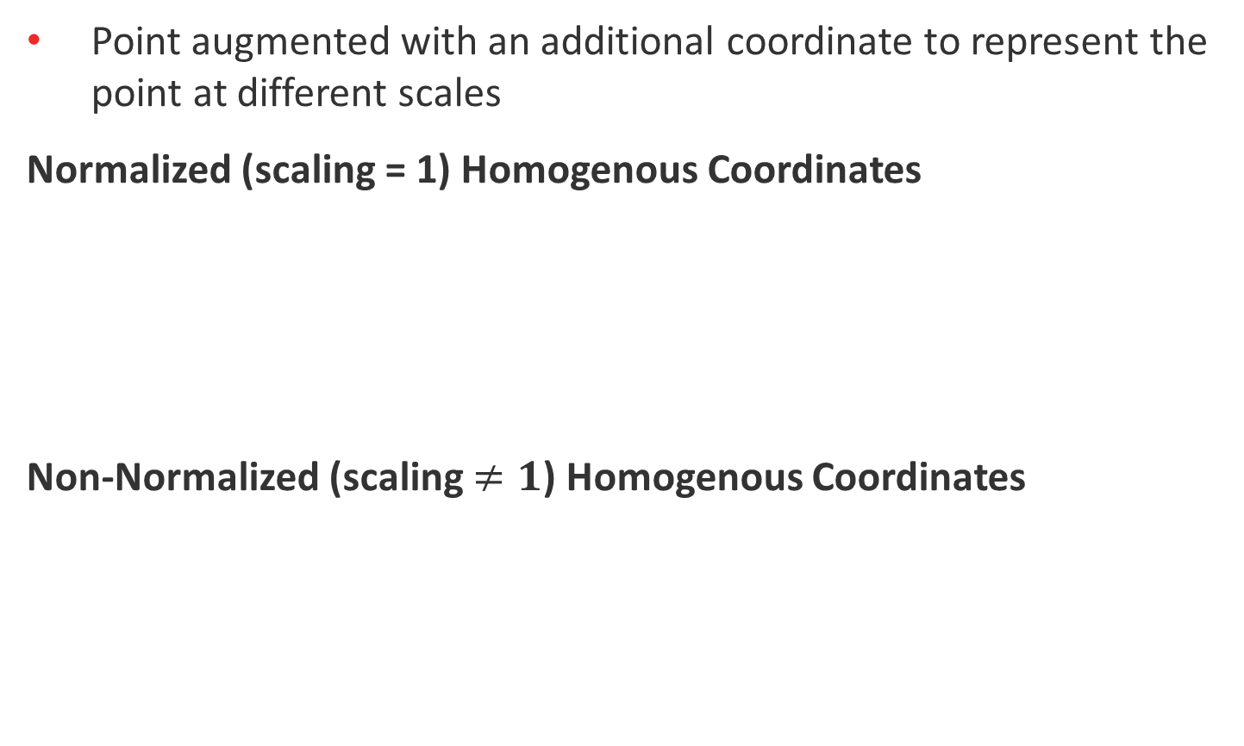


Homogenous Coordinates
Point augmented with an additional coordinate to represent the point at different scales
Normalized (scaling = 1) Homogenous Coordinates
Non-Normalized (scaling $≠1$) Homogenous Coordinates
$$p=\left[\begin{matrix}x \\ y \\ \begin{matrix}z \\ 1\end{matrix}\end{matrix}\right]→\tilde{p}=\left[\begin{matrix}wx \\ wy \\ \begin{matrix}wz \\ w\end{matrix}\end{matrix}\right]$$
$$p=\tilde{\frac{p}{w}}$$

Slide 11


Homogenous Coordinates Applications – Point at Infinity
Set $w=0$
Normative division causes resulting point to possess values at infinity.
$$\tilde{p}=\left[\begin{matrix}x \\ y \\ \begin{matrix}z \\ w=0\end{matrix}\end{matrix}\right]$$
$$p=\frac{\tilde{p}}{w}$$

Slide 12
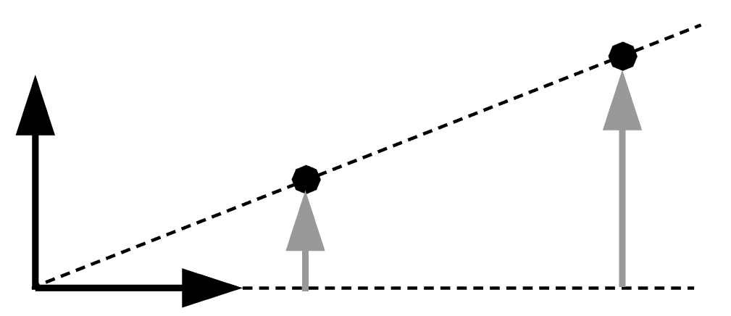


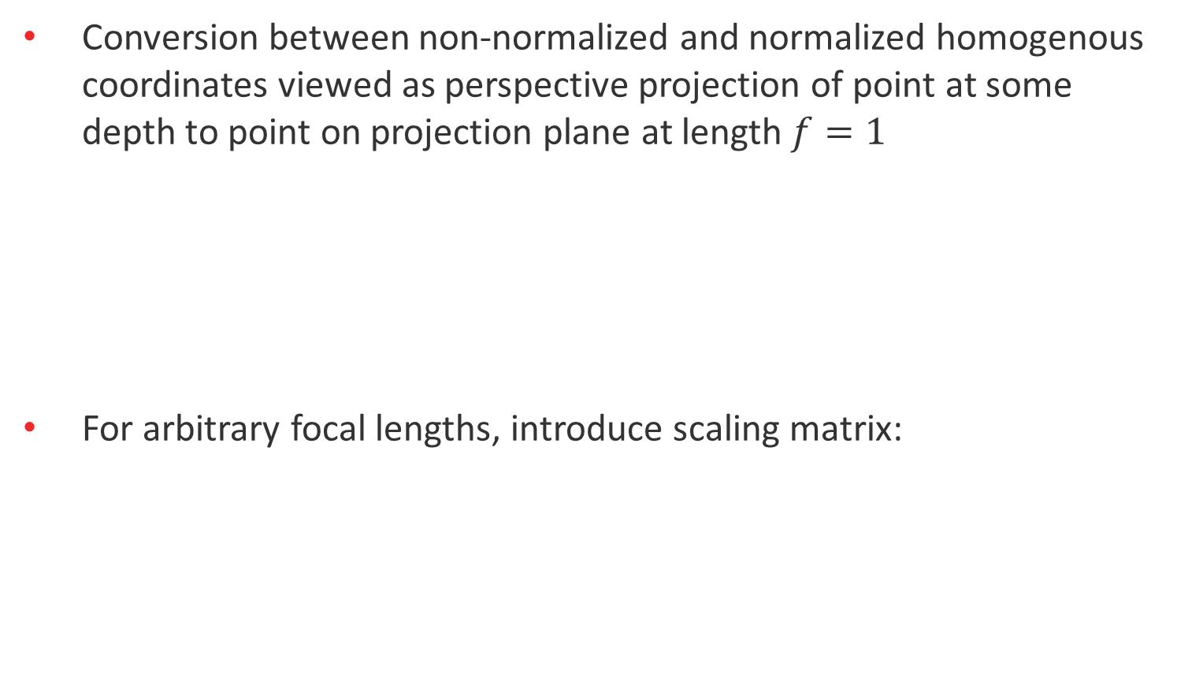





Homogenous Coordinates Applications – Perspective Projection
Conversion between non-normalized and normalized homogenous coordinates viewed as perspective projection of point at some depth to point on projection plane at length $f=1$
For arbitrary focal lengths, introduce scaling matrix:
$$y^{′}=f\frac{y}{z}$$
$$y$$
$$\hat{y}$$
$$\hat{z}$$
$$f$$
$$z$$
$$\left[\begin{matrix}f\frac{x}{z} \\ f\frac{y}{z} \\ 1\end{matrix}\right]=\left[\begin{matrix}f & 0 & 0 \\ 0 & f & 0 \\ 0 & 0 & 1\end{matrix}\right]\left[\begin{matrix}x \\ y \\ z\end{matrix}\right]$$

Slide 13

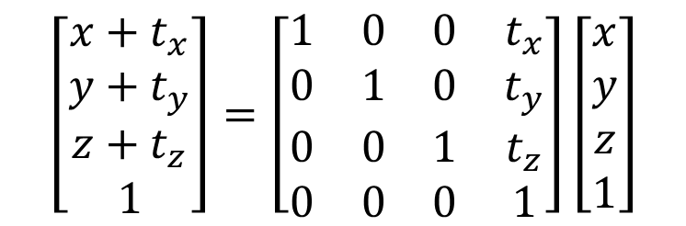
Homogenous Coordinates Applications – Translation Operation
Can represent translation as a matrix multiplication with homogenous coordinates.
$$p^{′}=Tp$$
$$\left[\begin{matrix}x+t_{x} \\ y+t_{y} \\ z+t_{z} \\ 1\end{matrix}\right]=\left[\begin{matrix}1 & 0 & 0 & t_{x} \\ 0 & 1 & 0 & t_{y} \\ 0 & 0 & 1 & t_{z} \\ 0 & 0 & 0 & 1\end{matrix}\right]\left[\begin{matrix}x \\ y \\ z \\ 1\end{matrix}\right]$$

Slide 14



Matrix Transformations (1/2)
Matrix Transformations
Apply matrix transformation $F$ to transform a point:
Translation:
See previous slide
Scaling:
$p^{′}=Fp→\left[\begin{matrix}x′ \\ y′ \\ z′ \\ 1\end{matrix}\right]$= $F\left[\begin{matrix}x \\ y \\ z \\ 1\end{matrix}\right]$
$$\left[\begin{matrix}s_{x}x \\ s_{y}y \\ s_{z}z \\ 1\end{matrix}\right]=\left[\begin{matrix}s_{x} & 0 & 0 & 0 \\ 0 & s_{y} & 0 & 0 \\ 0 & 0 & s_{z} & 0 \\ 0 & 0 & 0 & 1\end{matrix}\right]\left[\begin{matrix}x \\ y \\ z \\ 1\end{matrix}\right]$$

Slide 15
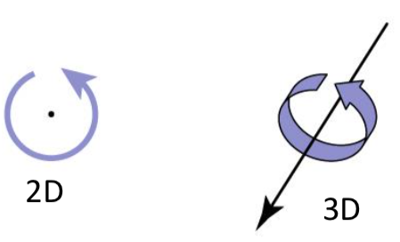
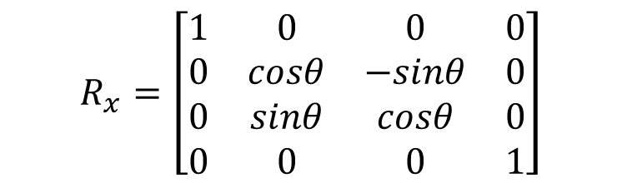
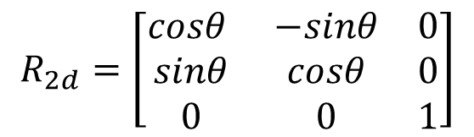

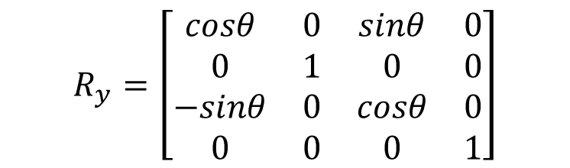
Matrix Transformations (2/2)
3d rotation about z / 2d rotation
3d rotation about x
3d rotation about y
$$R_{z}=\left[\begin{matrix}cosθ & −sinθ & 0 & 0 \\ sinθ & cosθ & 0 & 0 \\ 0 & 0 & 1 & 0 \\ 0 & 0 & 0 & 1\end{matrix}\right]$$
$$R_{2d}=\left[\begin{matrix}cosθ & −sinθ & 0 \\ sinθ & cosθ & 0 \\ 0 & 0 & 1\end{matrix}\right]$$
$$R_{x}=\left[\begin{matrix}1 & 0 & 0 & 0 \\ 0 & cosθ & −sinθ & 0 \\ 0 & sinθ & cosθ & 0 \\ 0 & 0 & 0 & 1\end{matrix}\right]$$
$$R_{y}=\left[\begin{matrix}cosθ & 0 & sinθ & 0 \\ 0 & 1 & 0 & 0 \\ −sinθ & 0 & cosθ & 0 \\ 0 & 0 & 0 & 1\end{matrix}\right]$$

Slide 16
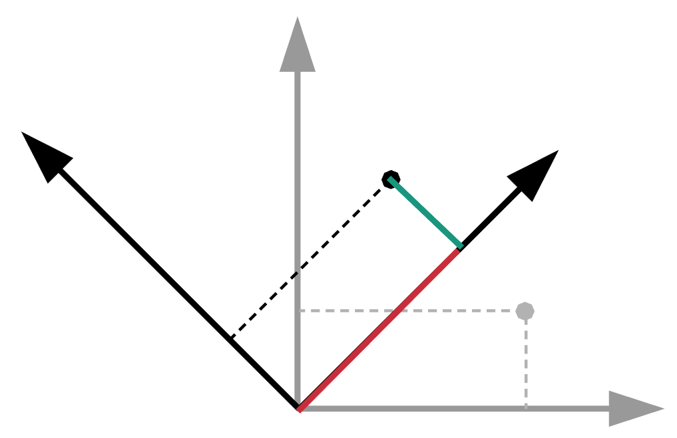


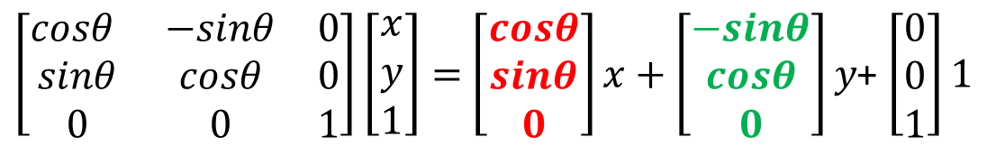






Rotation Matrix Equation Intuition
Derived by doing vector addition along coordinate frame
made by rotation
$\left[\begin{matrix}cosθ & −sinθ & 0 \\ sinθ & cosθ & 0 \\ 0 & 0 & 1\end{matrix}\right]\left[\begin{matrix}x \\ y \\ 1\end{matrix}\right]=$ $\left[\begin{matrix}cosθ \\ sinθ \\ 0\end{matrix}\right]x+\left[\begin{matrix}−sinθ \\ cosθ \\ 0\end{matrix}\right]y$+ $\left[\begin{matrix}0 \\ 0 \\ 1\end{matrix}\right]1$
$$y(−sinθ, cosθ)$$
$$(−sinθ, cosθ)$$
$$(x′,y′)$$
$$(cosθ, sinθ)$$
$$x(cosθ, sinθ)$$
$$(x,y)$$
$$θ$$
$$θ$$

Slide 17


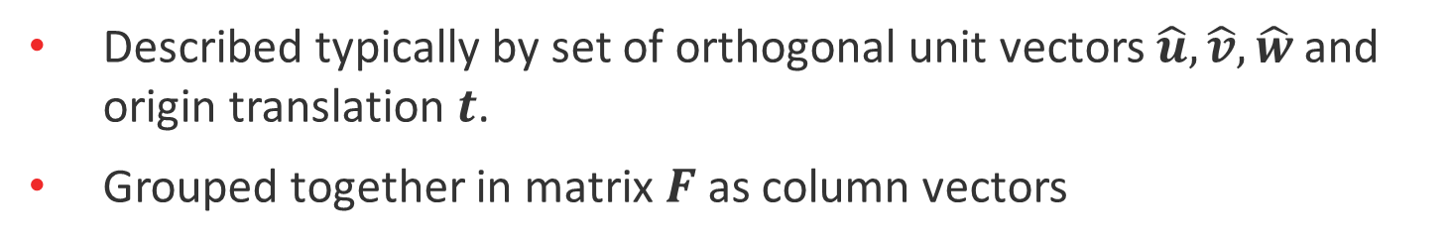







Coordinate Frames
Described typically by set of orthogonal unit vectors $\hat{u}, \hat{v}, \hat{w}$ and origin translation $t$.
Grouped together in matrix $F$ as column vectors
$$F=\left[\begin{matrix}| & | & | & | \\ \hat{u} & \hat{v} & \hat{w} & t \\ | & | & | & |\end{matrix}\right]$$
$$\hat{w}$$
$$\hat{v}$$
$$t$$
$$\hat{u}$$
$$\hat{z}$$
$$\hat{y}$$
$$\hat{x}$$

Slide 18

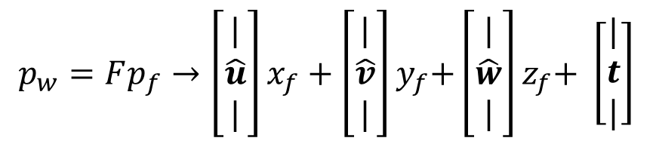

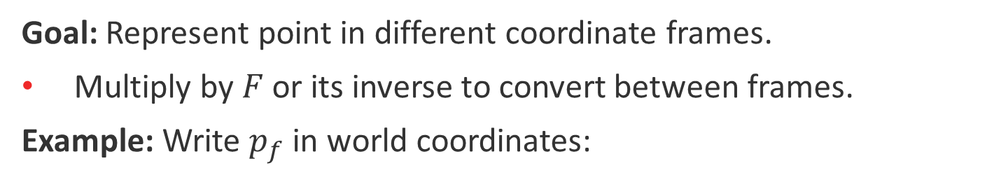



Coordinate Frame Transformations (1/2)
Goal: Represent point in different coordinate frames.
Multiply by $F$ or its inverse to convert between frames.
Example: Write $p_{f}$ in world coordinates:
$$p_{w}=Fp_{f}→\left[\begin{matrix}| \\ \hat{u} \\ |\end{matrix}\right]x_{f}+\left[\begin{matrix}| \\ \hat{v} \\ |\end{matrix}\right]y_{f}\text{+}\left[\begin{matrix}| \\ \hat{w} \\ |\end{matrix}\right]z_{f}\text{+} \left[\begin{matrix}| \\ t \\ |\end{matrix}\right]$$
$$p_{f}$$
other frame
$$z_{f}\hat{w}$$
$$t$$
$$x_{f}\hat{u}$$
$$y_{f}\hat{v}$$
world frame

Slide 19
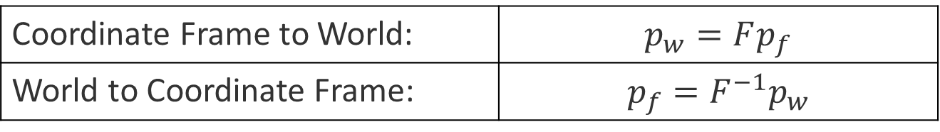
Coordinate Frame Transformations (2/2)
Summary:
Coordinate Frame to World: | $$p_{w}=Fp_{f}$$
World to Coordinate Frame: | $$p_{f}=F^{−1}p_{w}$$
Relation to Matrix Transformations:
Example: Rotation matrix can be viewed as rotated coordinate frame with 0 origin translation.
Any orthogonal coordinate frame is considered a rotation.
Example: Translation can be viewed as coordinate frame with no rotation but offset origin.

Slide 20
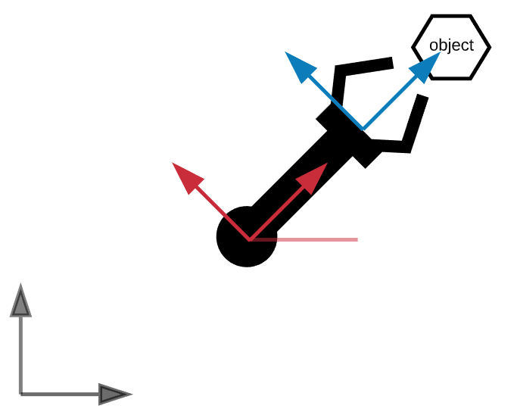

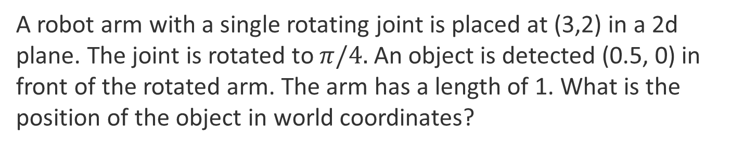




Coordinate Transform Example (1/2)
A robot arm with a single rotating joint is placed at (3,2) in a 2d plane. The joint is rotated to $π/4.$ An object is detected (0.5, 0) in front of the rotated arm. The arm has a length of 1. What is the position of the object in world coordinates?
$$1$$
$$0.5$$
$$θ$$
$$(3,2)$$
$$(0,0)$$

Slide 21
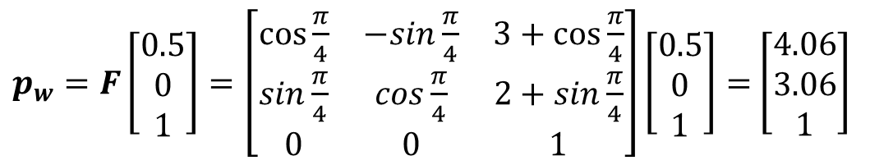
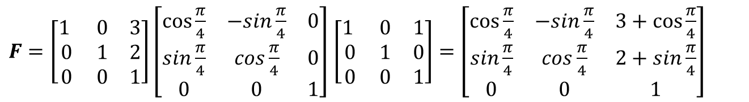
Coordinate Transform Example (2/2)
Robot Arm End-Effector Coordinate frame:
Arm Frame to World Coordinates:
Note that point represented in homogenous coordinates
$F=\left[\begin{matrix}1 & 0 & 3 \\ 0 & 1 & 2 \\ 0 & 0 & 1\end{matrix}\right]\left[\begin{matrix}cos⁡\frac{π}{4} & −sin\frac{π}{4} & 0 \\ sin\frac{π}{4} & cos\frac{π}{4} & 0 \\ 0 & 0 & 1\end{matrix}\right]$ $\left[\begin{matrix}1 & 0 & 1 \\ 0 & 1 & 0 \\ 0 & 0 & 1\end{matrix}\right]=\left[\begin{matrix}cos⁡\frac{π}{4} & −sin\frac{π}{4} & 3+cos\frac{π}{4} \\ sin\frac{π}{4} & cos\frac{π}{4} & 2+sin\frac{π}{4} \\ 0 & 0 & 1\end{matrix}\right]$
$p_{w}=F\left[\begin{matrix}0.5 \\ 0 \\ 1\end{matrix}\right]=\left[\begin{matrix}cos⁡\frac{π}{4} & −sin\frac{π}{4} & 3+cos⁡\frac{π}{4} \\ sin\frac{π}{4} & cos\frac{π}{4} & 2+sin\frac{π}{4} \\ 0 & 0 & 1\end{matrix}\right]\left[\begin{matrix}0.5 \\ 0 \\ 1\end{matrix}\right]=$ $\left[\begin{matrix}4.06 \\ 3.06 \\ 1\end{matrix}\right]$

Slide 22
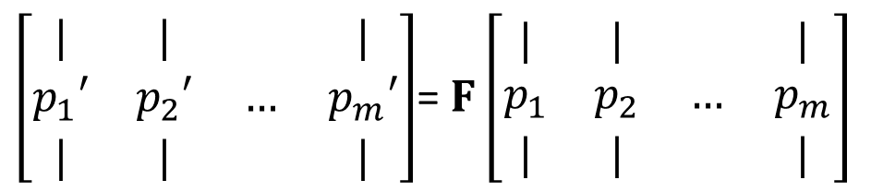
Matrix Transformations Applied to Multiple Points
Multiple points can be stacked column-wise:
$\left[\begin{matrix}| & | & & | \\ p_{1}′ & p_{2}′ & … & p_{m}′ \\ | & | & & |\end{matrix}\right]$= $F\left[\begin{matrix}| & | & & | \\ p_{1} & p_{2} & … & p_{m} \\ | & | & & |\end{matrix}\right]$

Slide 23
Optimization and Decomposition Methods

Slide 24
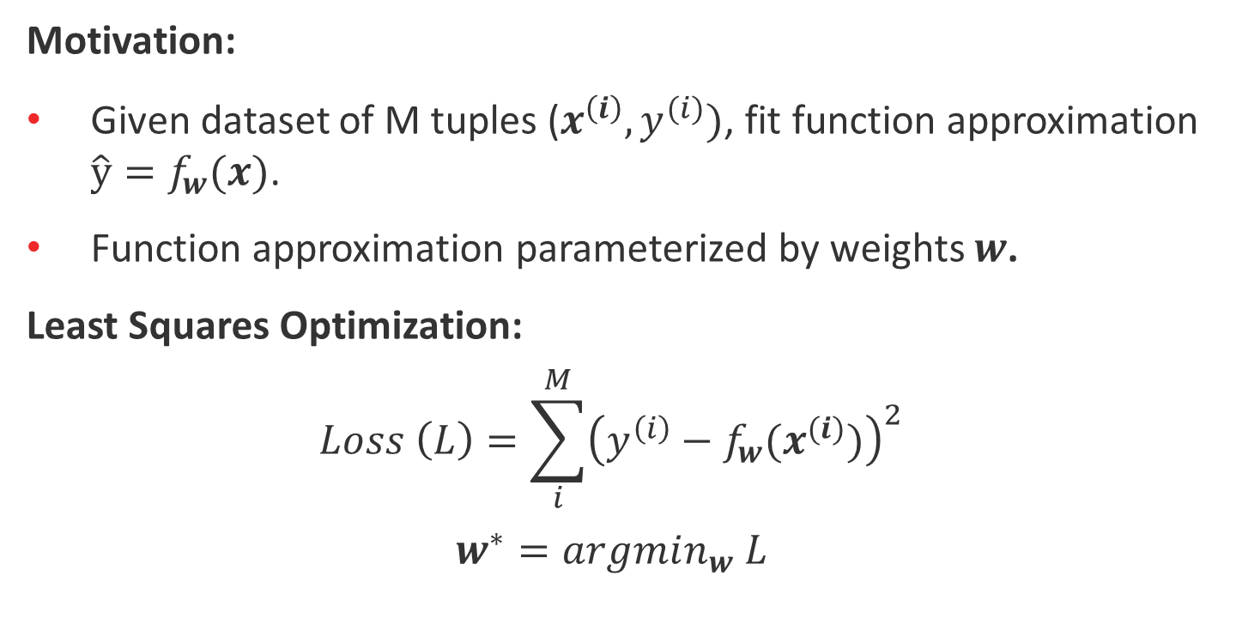
Least Squares Optimization
Motivation:
Given dataset of M tuples ($x^{\left(i\right)},y^{(i)})$, fit function approximation $\hat{y}=f_{w}(x)$.
Function approximation parameterized by weights $w$.
Least Squares Optimization:
$$Loss \left(L\right)=\sum_{i}^{M}{{\left(y^{\left(i\right)}−f_{w}(x^{(i)})\right)}^{2}}$$
$$w^{∗}=argmin_{w} L$$

Slide 25
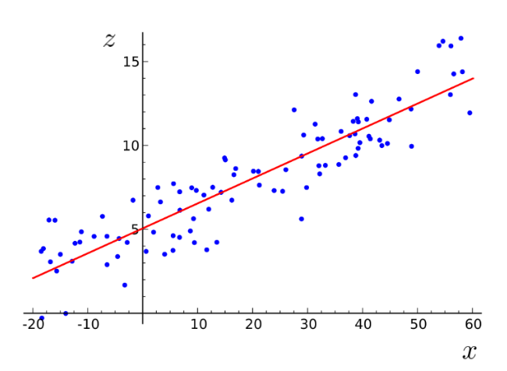
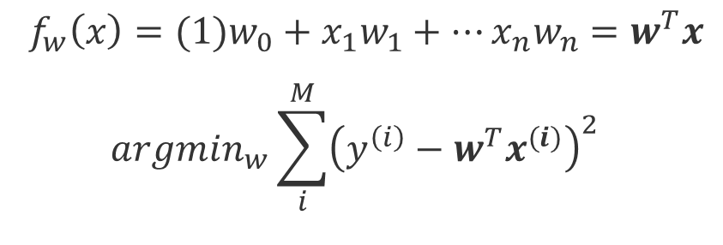

Linear Regression
Motivation:
A specific instance of Least Squares Optimization
Function approximator written as linear combination of weights:
$$f_{w}\left(x\right)=(1)w_{0}+x_{1}w_{1}+…x_{n}w_{n}=w^{T}x$$
$$argmin_{w}\sum_{i}^{M}{{\left(y^{\left(i\right)}−w^{T}x^{(i)}\right)}^{2}}$$
$$|y^{\left(i\right)}−w^{T}x|$$

Slide 26
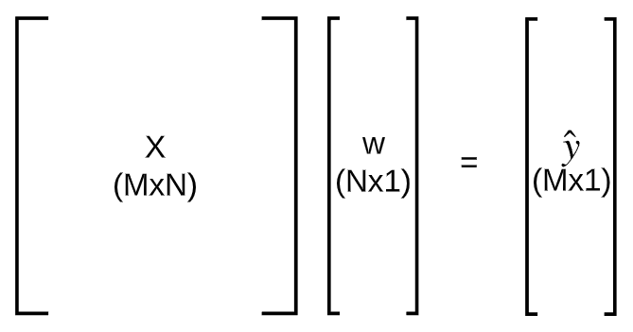

Linear Regression Matrix Format
Can represent linear regression in purely matrix form since ${\sum_{i}^{M}{{\left(u_{i}\right)}^{2}}=\left|\left|u\right|\right|}^{2}=u^{T}u$
$argmin_{w}{\left(y−Xw\right)}^{T}(y−Xw$)

Slide 27
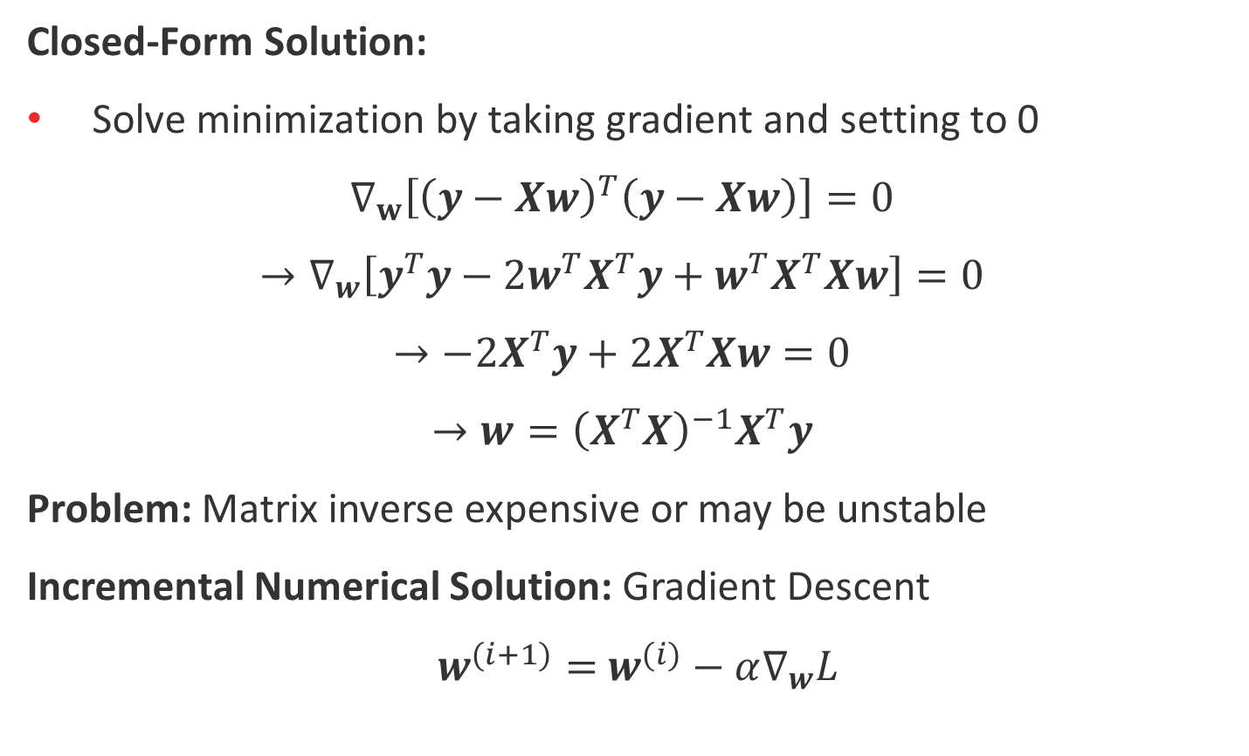
Linear Regression Solution
Closed-Form Solution:
Solve minimization by taking gradient and setting to 0
$$∇_{w}\left[{\left(y−Xw\right)}^{T}\left(y−Xw\right)\right]=0$$
$$→∇_{w}\left[y^{T}y−2w^{T}X^{T}y+w^{T}X^{T}Xw\right]=0$$
$$→−2X^{T}y+2X^{T}Xw=0$$
$$→w={\left(X^{T}X\right)}^{−1}X^{T}y$$
Problem: Matrix inverse expensive or may be unstable
Incremental Numerical Solution: Gradient Descent
$w^{(i+1)}=$ $w^{(i)}−α∇_{w}L$

Slide 28
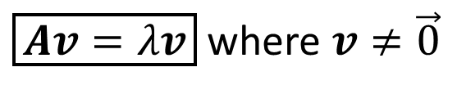
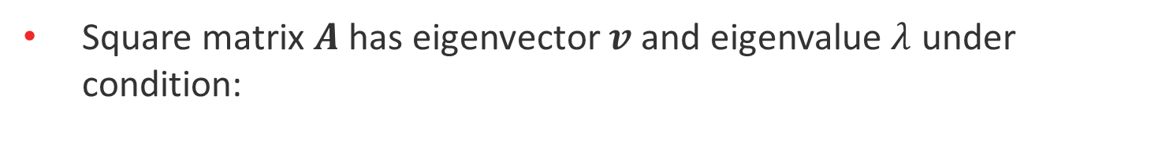

Eigenvalues and Eigenvectors
Square matrix $A$ has eigenvector $v$ and eigenvalue $λ$ under condition:
$\boxed{Av=λv}$ where $v≠\vec{0}$
Interpretation:
Describes case where transformation $A$ on $v$ equivalent to applying scaling factor $λ$

Slide 29
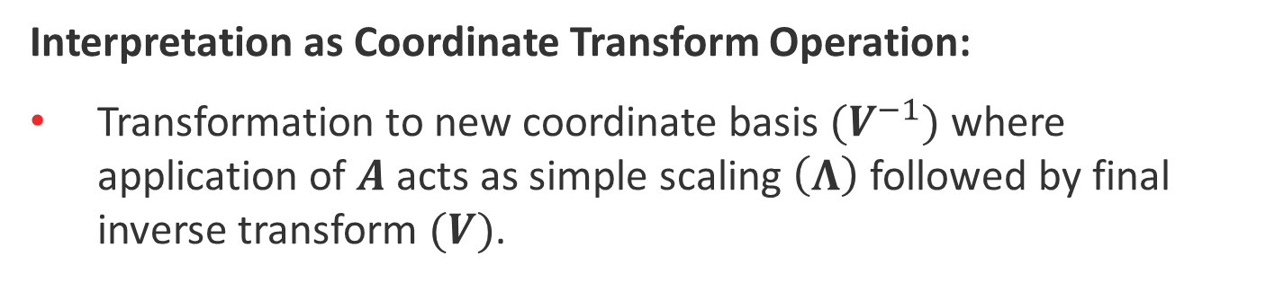

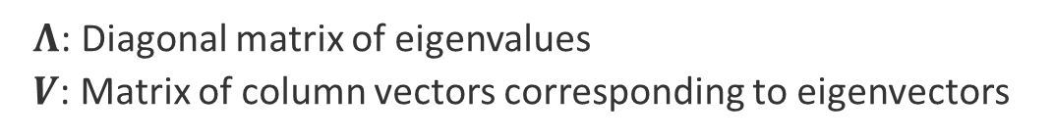

Eigendecomposition
Previous equation described single eigenvalue/vector pair
Square, diagonalizable A has N eigenvectors:
$$AV=VΛ→\boxed{A=VΛV^{−1}}$$
$Λ$: Diagonal matrix of eigenvalues
$V$: Matrix of column vectors corresponding to eigenvectors
For symmetric matrix, ensured orthogonal eigenvectors:
$$A=VΛV^{−1}→\boxed{A= VΛV^{T}}$$
Interpretation as Coordinate Transform Operation:
Transformation to new coordinate basis $(V^{−1})$ where application of $A$ acts as simple scaling $\left(Λ\right)$ followed by final inverse transform $(V)$.

Slide 30
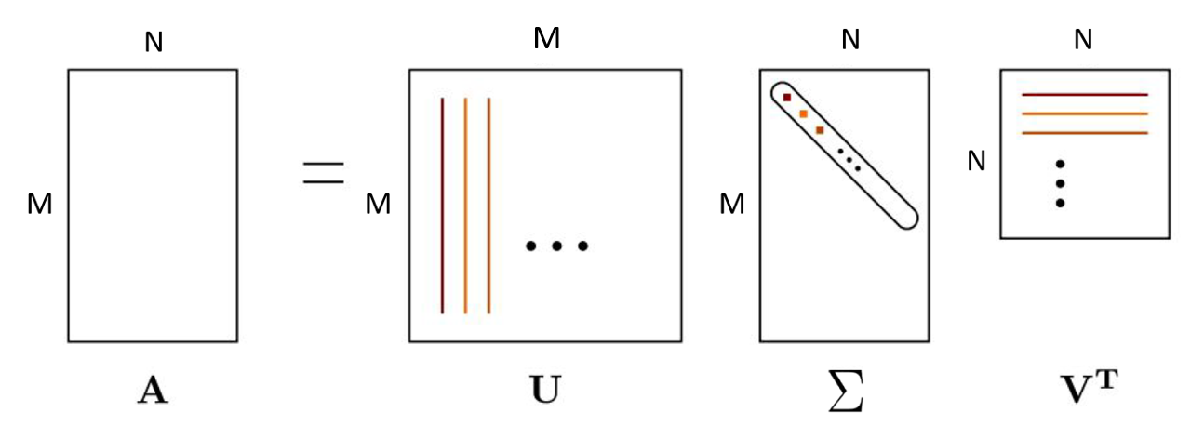
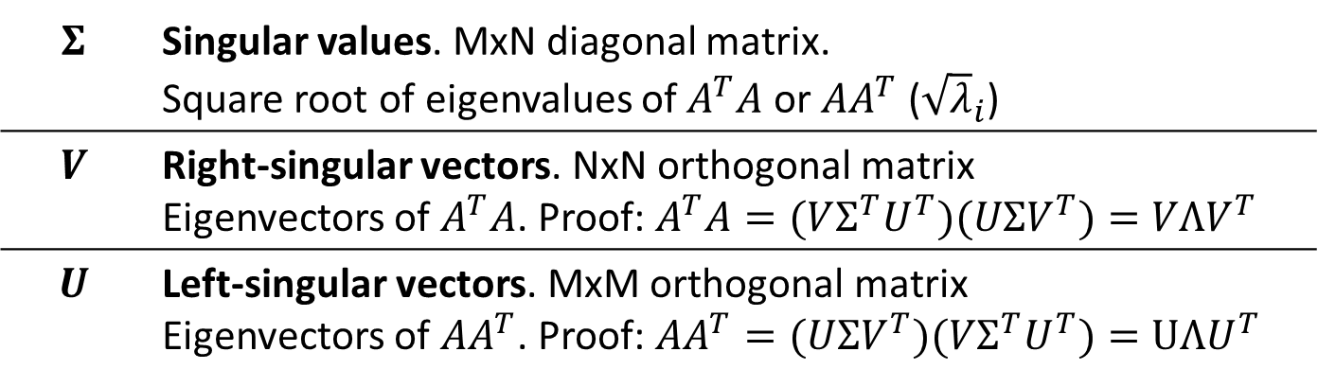

Singular Value Decomposition (SVD)
Decomposes $MxN$ matrix $A$ into:
$$\boxed{A=UΣV^{T}}$$
$$Σ$$ | Singular values. MxN diagonal matrix. Square root of eigenvalues of $A^{T}A$ or $AA^{T}$ (${\sqrt{λ}}_{i}$)
$$V$$ | Right-singular vectors. NxN orthogonal matrix Eigenvectors of $A^{T}A$. Proof: $A^{T}A=(VΣ^{T}U^{T})(UΣV^{T})=VΛV^{T}$
$$U$$ | Left-singular vectors. MxM orthogonal matrix Eigenvectors of $AA^{T}$. Proof: $AA^{T}=(UΣV^{T})(VΣ^{T}U^{T})=UΛU^{T}$

Slide 31



SVD Interpretation
Rotation to new coordinate system defined by $V$
Scaling by $Σ$
Final opposing rotation defined by $U$
$$A$$

Slide 32

Application: Total Least Squares
Problem Statement:
$$argmin_{w}{\left|\left|Xw\right|\right|}^{2} with constraint \left|\left|w\right|\right|=1$$
Solution:
Eigenvector $w$ of $X^{T}X$ corresponding to smallest eigenvalue. Solve by taking SVD of $X$ and taking eigenvector in $V$.
Reasoning:
$${\left|\left|Xw_{min}\right|\right|}^{2}=w_{min}^{T}X^{T}Xw_{min}=some min value=λ$$
Same result obtained by starting with eigenvector/value relation:
$$X^{T}Xw_{min}=λw_{min}→{w_{min}^{T}X}^{T}Xw_{min}=λ$$
Therefore eigenvector $w_{min}$ satisfies minimization.

Slide 33

Application: Pseudo-Inverse
If SVD decomposition is known, computation of pseudo-inverse is trivial
$A=UΣV^{T}→A^{+}=VΣ^{+}U^{T}$
($(VΣ^{+}U^{T})(UΣV^{T})=I$ and $Σ^{+}$ is reciprocal transpose of $Σ$)
Above pseudo-inverse can be used in place of left pseudo-inverse in Least Squares linear regression equation:
$$w={\left(X^{T}X\right)}^{−1}X^{T}y→VΣ^{+}U^{T}y$$
Recall in case where inverse exists, pseudo-inverse is same
(where X = A)

Slide 34



SVD and Eigendecomposition Equivalency
Requirements on matrix $A$:
Symmetric $(A^{T}=A)$
Positive semi-definite $z^{T}Az≥0$ for any $z$
Total Least Squares Example: $A=X^{T}X$
Symmetric: ${\left(X^{T}X\right)}^{T}=X^{T}X$
Positive semi-definite: $z^{T}X^{T}Xz={\left(Xz\right)}^{T}\left(Xz\right)={\left|\left|Xz\right|\right|}^{2}≥0$
Eigendecomposition
SVD
$$X^{T}X=VΣ^{T}U^{T}UΣV^{T}$$
$$=VΣ^{T}ΣV^{T}$$
$$=VΛV^{T}$$
$$X^{T}X=A=VΛV^{T}$$

Slide 35
Optional ROS Coordinate Frame Exercise
There is a short exercise involving coordinate transforms and ROS found here:
https://github.com/comp417-fall2019-tutorials/linear_algebra_tutorial
See the README.md file for instructions

