Slide 1



CYBERSECURITY
INFORMATION SECURITY
FINAL PROJECT
A Group Project — Two Cybersecurity Tools
Secure Password Generator
File Integrity Monitoring
Tool 01
Tool 02
PRESENTED BY
Mohammad Farid Hassani • Sami Jaberi

Slide 2




Introduction
About this project
PROJECT OVERVIEW
Course Project
Two Tools, One Mission
Built for our Information Security class
We built two practical cybersecurity tools as part of our Information Security course. The goal is simple: improve system security and help protect important information using ideas we learned in class.
Two Cybersecurity Tools
Password generator and integrity checker
Real-World Goal
Python 3
SHA-256
Cryptography
Improve security and protect important data
Information Security Final Project
2 / 15

Slide 3






Security Problems We Face
Why cybersecurity matters
Weak Passwords
Unauthorized Edits
Data Loss
Common Threats
Easy to guess or crack
Files changed by attackers
Important info disappears
Modern systems face many risks every day. These are the problems our project tries to address.
Security Risks
Unauthorized Access
Vulnerabilities in systems
Strangers reach private data
Information Security Final Project
3 / 15

Slide 4




Project Goals
What we want to achieve
01
Generate Strong Passwords
02
Improve Authentication Security
03
Monitor Important Files
Our Mission
04
Detect File Tampering
Five clear goals shape our two security tools.
05
Generate Security Logs
Information Security Final Project
4 / 15

Slide 5


TOOL 01
Secure Password Generator
Strong, random passwords for better authentication
KEY FEATURES
Strong Generation
Complexity Levels
Cryptographically random
Easy, Medium, Hard
Strength Evaluation
Symbol Support
Strong by Design
Rates each password
Special characters included
Uses Python's secrets module for true cryptographic randomness — not predictable like the random module.
Save to File
Bulk Generation
Export passwords safely
Multiple at once
Information Security Final Project
5 / 15

Slide 6



Password Generator — Technologies
What we used to build it
LANGUAGE
LIBRARIES
SECURITY CONCEPT
Python 3
Built-in Modules
Secure Random Generation
secrets
secure randomness
Cross-platform, beginner-friendly, with a strong standard library for security tasks.
argparse
CLI arguments
Uses cryptographically secure random number generation. The secrets module is designed for passwords, tokens, and security keys.
string
char sets
pathlib
file paths
v3.x
Cryptographic
Information Security Final Project
6 / 15

Slide 7

TOOL 02
File Integrity Monitoring System
Detect any file changes using SHA-256 hashing
SHA-256 Hashing
Integrity Verification
Tampering Detection
Deleted File Alert
Industry-standard algorithm
Match files against baseline
Spot unauthorized changes
Find missing files
New File Detection
Security Logging
JSON Hash Database
Catch added files
Record every event
Lightweight storage
Information Security Final Project
7 / 15

Slide 8


How SHA-256 Monitoring Works
Step-by-step workflow
1
2
3
4
5
Scan Files
Generate Hashes
Save Database
Re-scan Later
Detect Changes
Read all watched files
Compute SHA-256 hash
Store hashes in JSON
Hash files again
Compare and alert
Why SHA-256?
Even a single byte change in a file produces a completely different hash — making tampering impossible to hide.
Information Security Final Project
8 / 15

Slide 9
Integrity Monitor — Technologies
What we used to build it
LANGUAGE
LIBRARIES
SECURITY CONCEPT
Python 3
Built-in Modules
SHA-256 Integrity Check
hashlib
SHA-256 hashing
Same language as our other tool, so we can share knowledge and keep things simple.
json
data storage
Each file gets a unique 256-bit fingerprint. If even one bit changes, the hash changes, so we know the file was modified.
os
file operations
pathlib
file paths
v3.x
datetime
timestamps
256-bit Hash
Information Security Final Project
9 / 15

Slide 10
Project Architecture
How the project is organized
Folder Structure
project-structure
A clean, simple layout. Each part of the project lives in its own folder for easy navigation.
📁 information-security-final-project/
├── 📁 password-generator/
│ ├── main.py
Source code folders
│ └── README.md
├── 📁 file-integrity-checker/
Resources & docs
│ ├── main.py
Project root file
│ ├── hashes.json
│ └── security.log
├── 📁 screenshots/
├── 📁 presentation/
└── 📄 README.md
Information Security Final Project
10 / 15

Slide 11
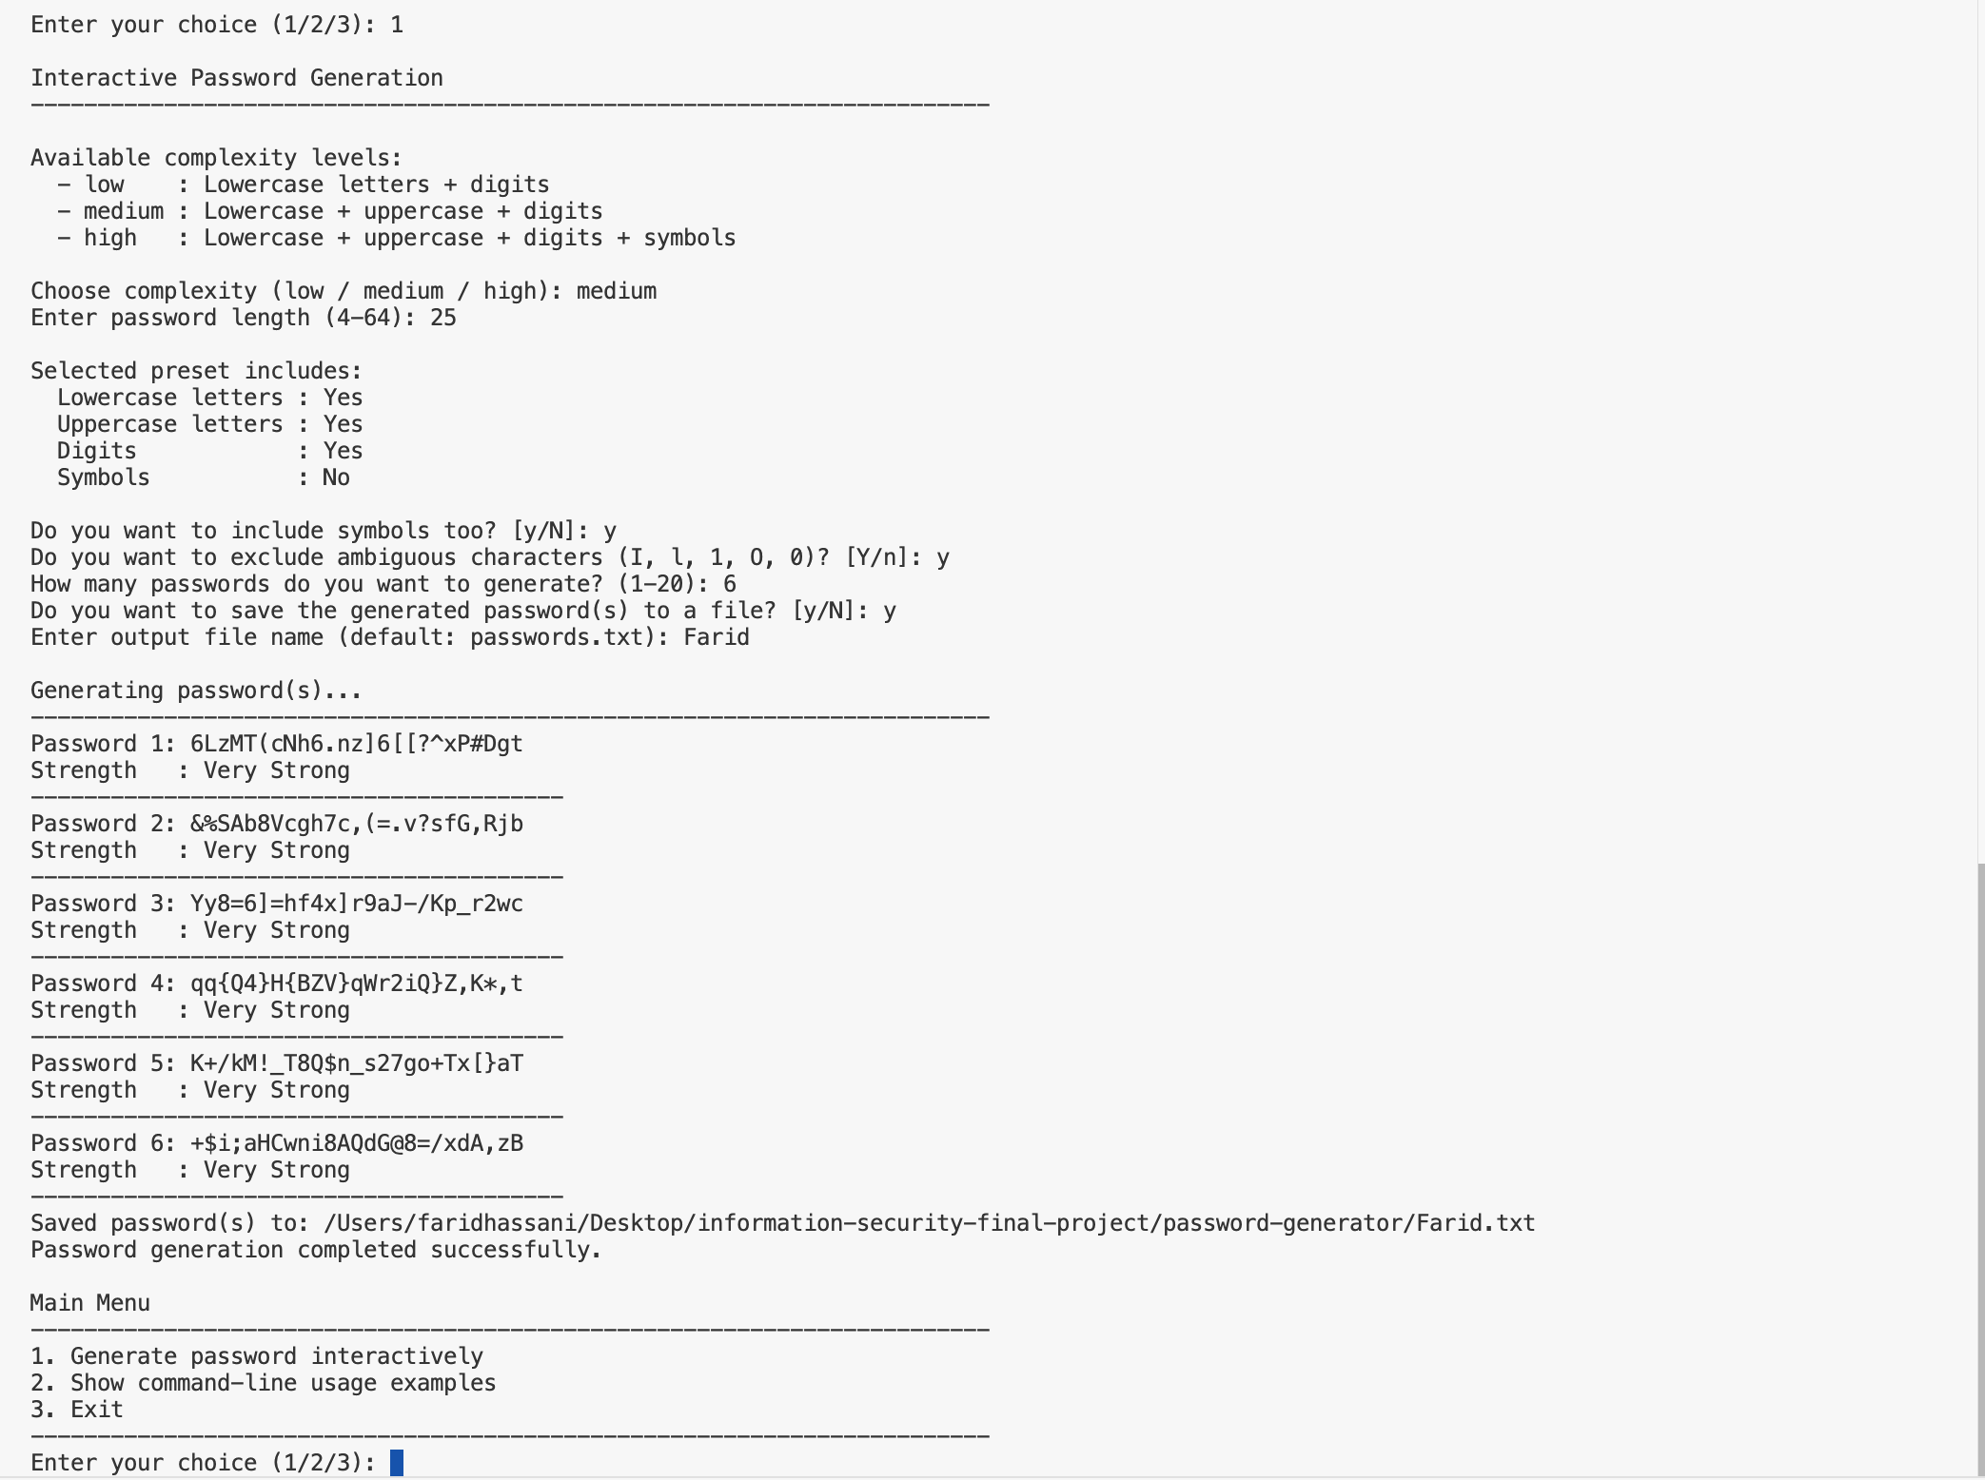


Password Generator — Demo Results
What we tested and confirmed
TEST RESULTS
All Tests Passed
Generated strong passwords successfully
Strength evaluation worked correctly
SCREENSHOT
password-strength-results.png
Multiple passwords generated at once
Insert screenshot here showing password strength evaluation output.
Passwords saved to file successfully
Information Security Final Project
11 / 15

Slide 12
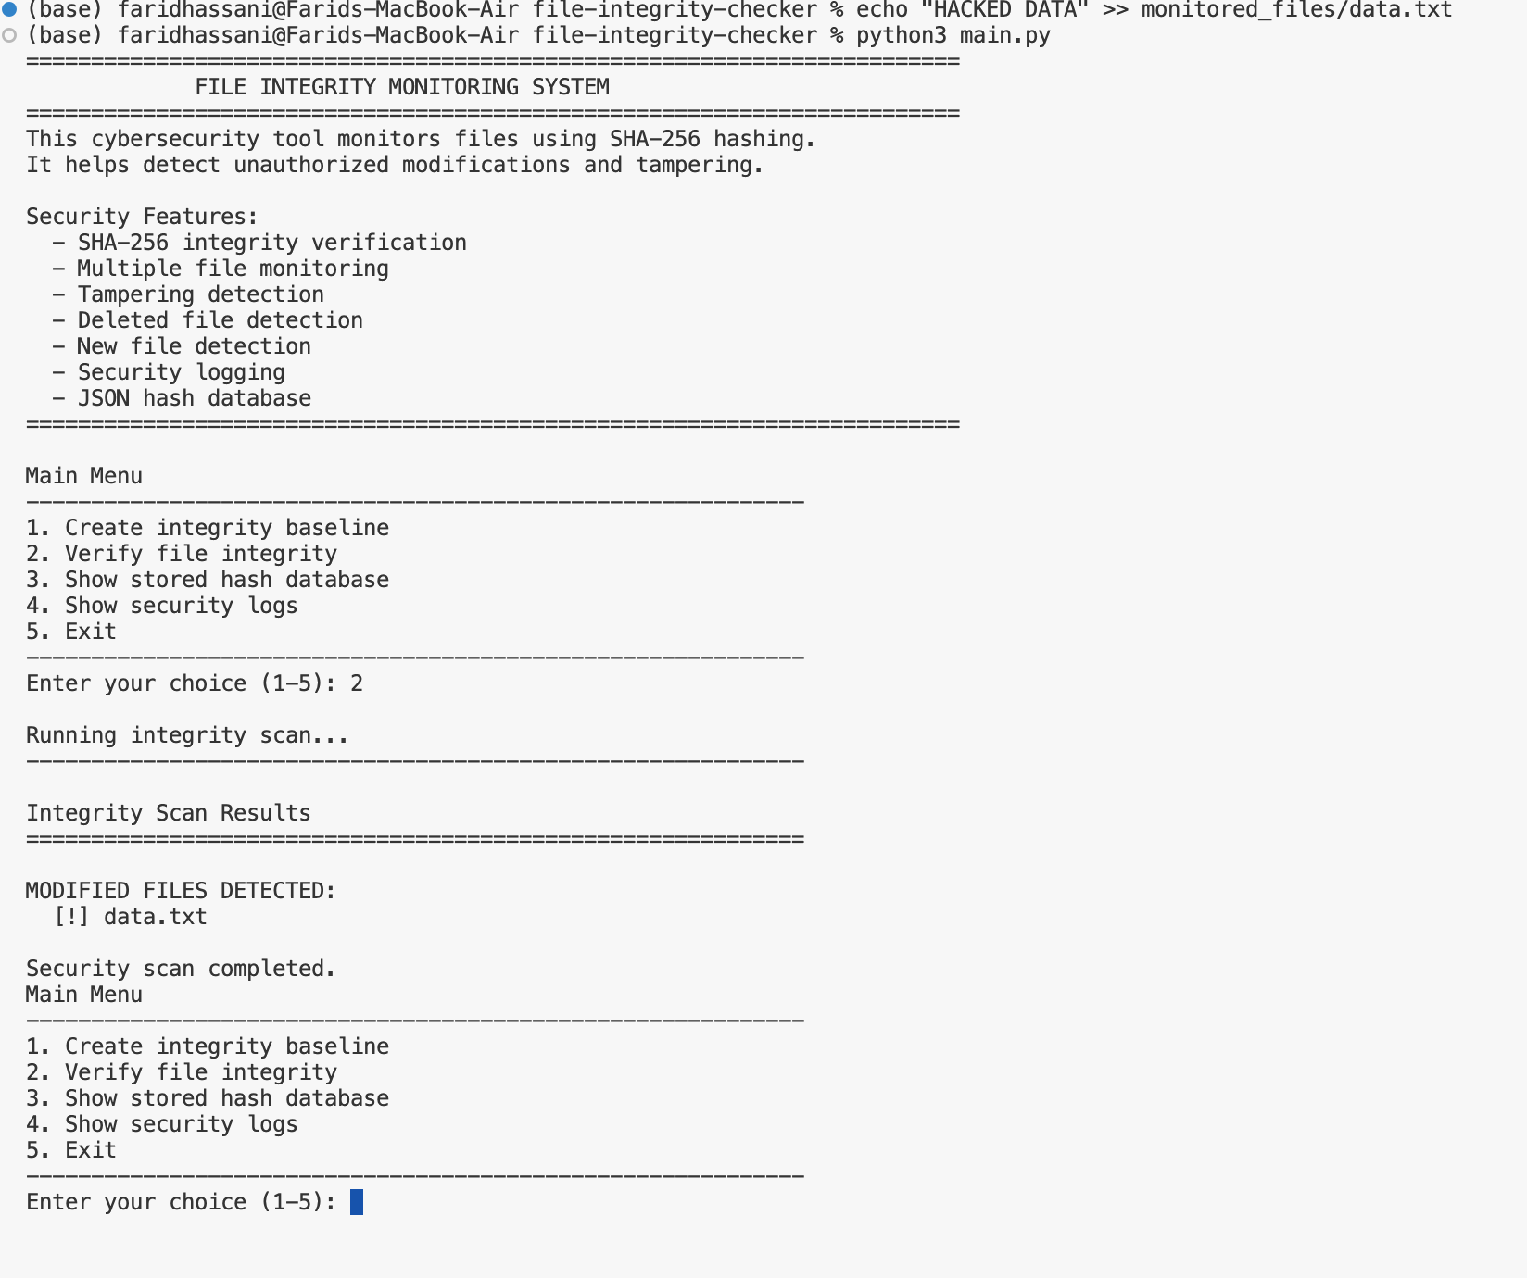
Integrity Monitor — Demo Results
What we tested and confirmed
TEST RESULTS
All Tests Passed
Integrity baseline created successfully
Modified files detected correctly
SCREENSHOT
tampering-detection.png
Security logs generated as expected
Insert screenshot here showing detected file tampering and security log output.
Tampering attempts caught reliably
Information Security Final Project
12 / 15

Slide 13
Information Security Concepts
Key ideas behind our project
Password Security
Authentication Protection
File Integrity
Strong, random passwords
Verify user identity safely
Confirm files are unchanged
CORE CONCEPT
CORE CONCEPT
CORE CONCEPT
SHA-256 Hashing
Tampering Detection
Security Monitoring
Cryptographic fingerprint
Catch unauthorized changes
Watch systems continuously
CORE CONCEPT
CORE CONCEPT
CORE CONCEPT
Information Security Final Project
13 / 15

Slide 14





Future Improvements
What we want to add next
Graphical User Interface
Easy point-and-click for non-technical users
Real-time Monitoring
Watch files continuously, not just on demand
Email Alerts
What's Next?
Send notifications when changes are detected
Ideas for v2.0 to make our tools even better.
Multi-directory Support
Monitor several folders at the same time
Encryption Support
Encrypt the password file and hash database
Information Security Final Project
14 / 15

Slide 15
CONCLUSION
Wrapping Up
Concepts Demonstrated
Better Authentication
File Protection
Real Impact
Project shows important Information Security ideas in action
Password Generator improves login and account security
Integrity Monitor protects files using SHA-256 hashing
Both tools help protect systems and sensitive information
Thank you!
Questions?
Mohammad Farid Hassani • Sami Jaberi— Information Security Course

