Slide 1



Al Imam Mohammad Ibn Saud Islamic University
College of Computer and Information Sciences
Computer Science Department
Second Semester- 2023/2024
Dr. Ibrahem Abdulmajed
LangExpand
SWE2 Aim
Vision
Features
Presented By:
Suliman Abdulhamid Alhamidi (443015062)
Abdullah Abdulaziz Almutairi (442018911)
Ali Saleh Al-Suhibani (444009753)
Mohammed Zaid Almogherah (443018531)
Abdullah Hamad Al Askar (443017652)
Game
Introduction
Diagrams

Slide 2
Outline
Introduction
Target Audience
Vision
Our Clients
Game
layer architecture
Diagrams
Features
SWE2 Aim
SWE2 Aim
Vision
Features
Game
Introduction
Diagrams

Slide 3
Introduction
In the last few years, the usage of smart devices has increased significantly, this increase comes with many threats to the young generation such as lack of concentration and mental distraction,
Our game solves this problem, it has multiple levels each level represents a word, you will have to guess a word that start with that letter, the second level will start with the last letter of the previous level.
Features
Vision
SWE2 Aim
Game
Introduction
Diagrams

Slide 4
Target Audience
The game targets children, and people who want to develop a strong vocabulary base to help memorize different words.
Target Audience
Features
SWE2 Aim
Game
Introduction
Diagrams

Slide 5
Vision
Our aim is to create a game that improves the overall vocabulary of individuals and enhances the cognitive ability of our users to help them expand their knowledge while using our app, therefore we have created this app-like game.
Features
Solution
SWE2 Aim
Game
Vision
Diagrams
Introduction

Slide 6
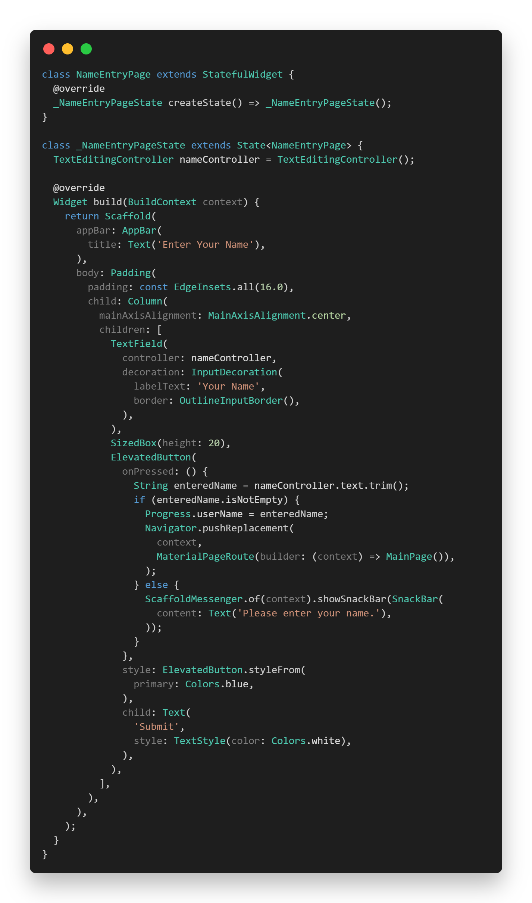
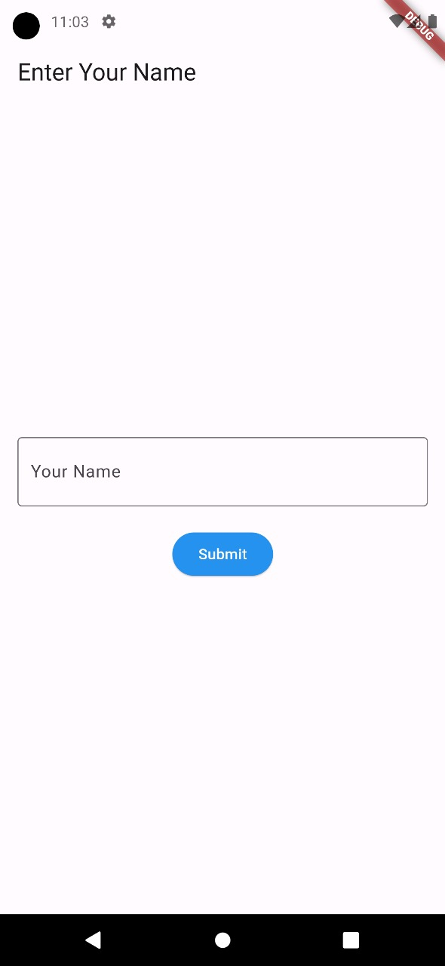
Game
SWE2 Aim
Vision
Features
Introduction
Diagrams
Game

Slide 7
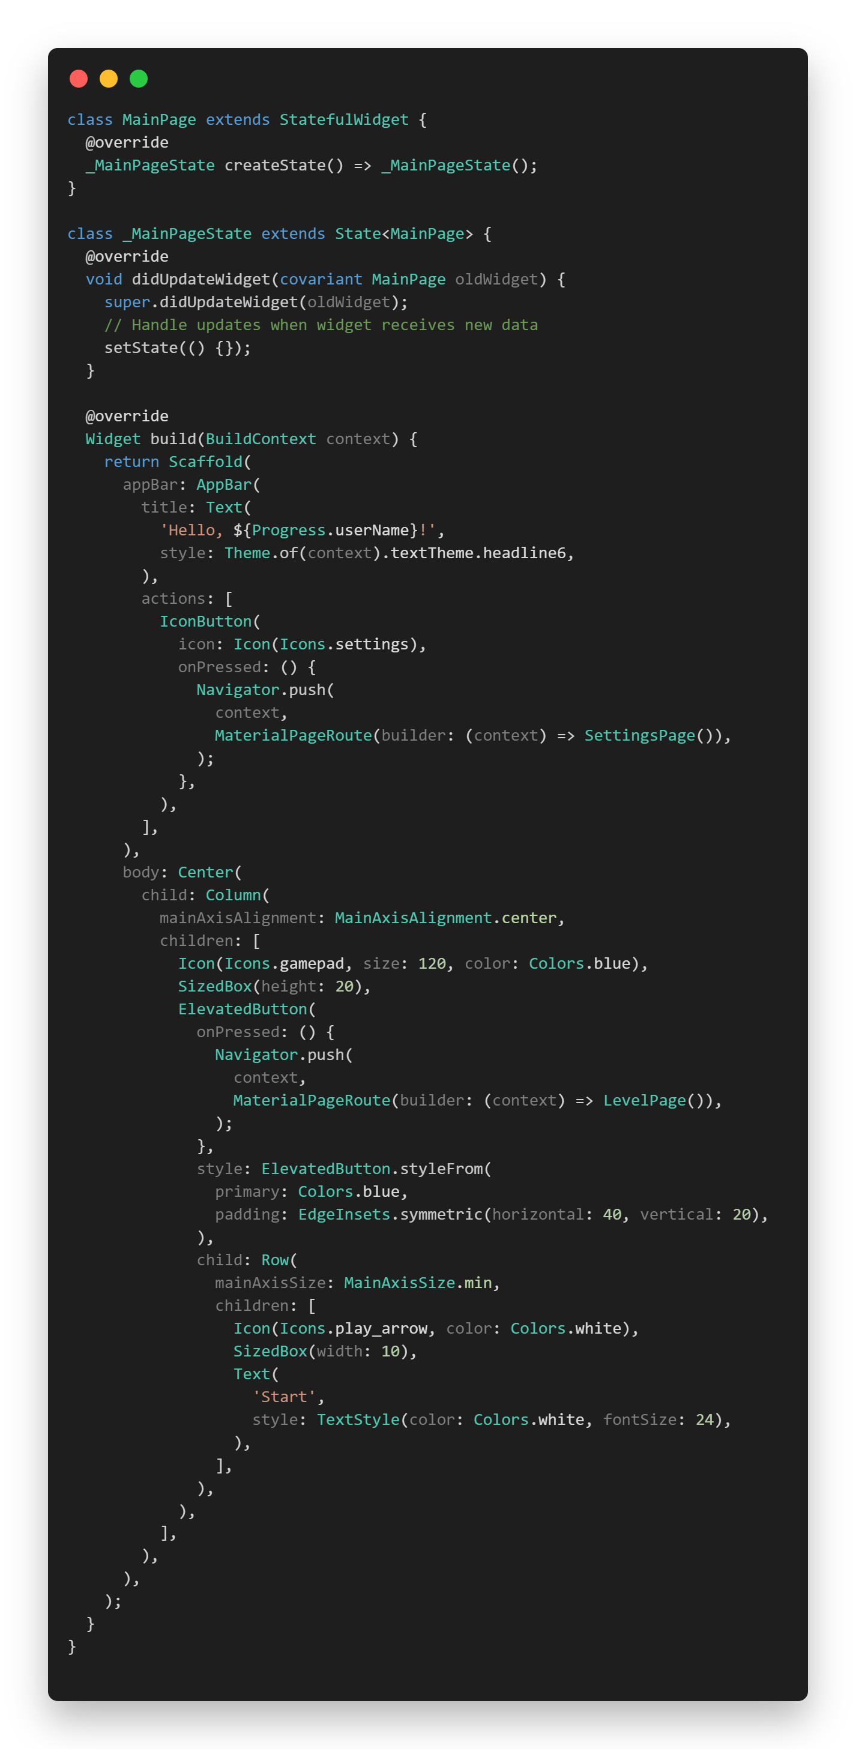
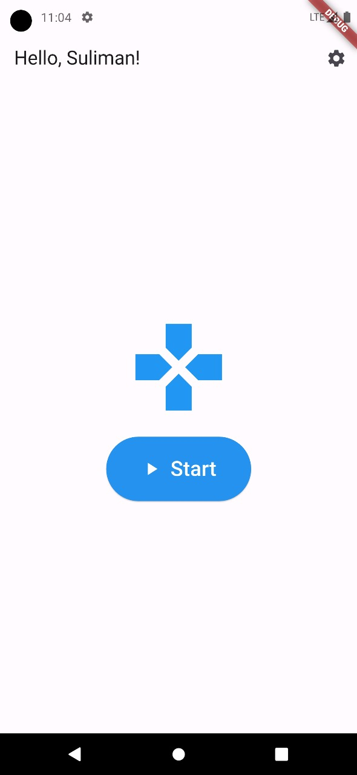
Game
SWE2 Aim
Vision
Features
Introduction
Diagrams
Game

Slide 8
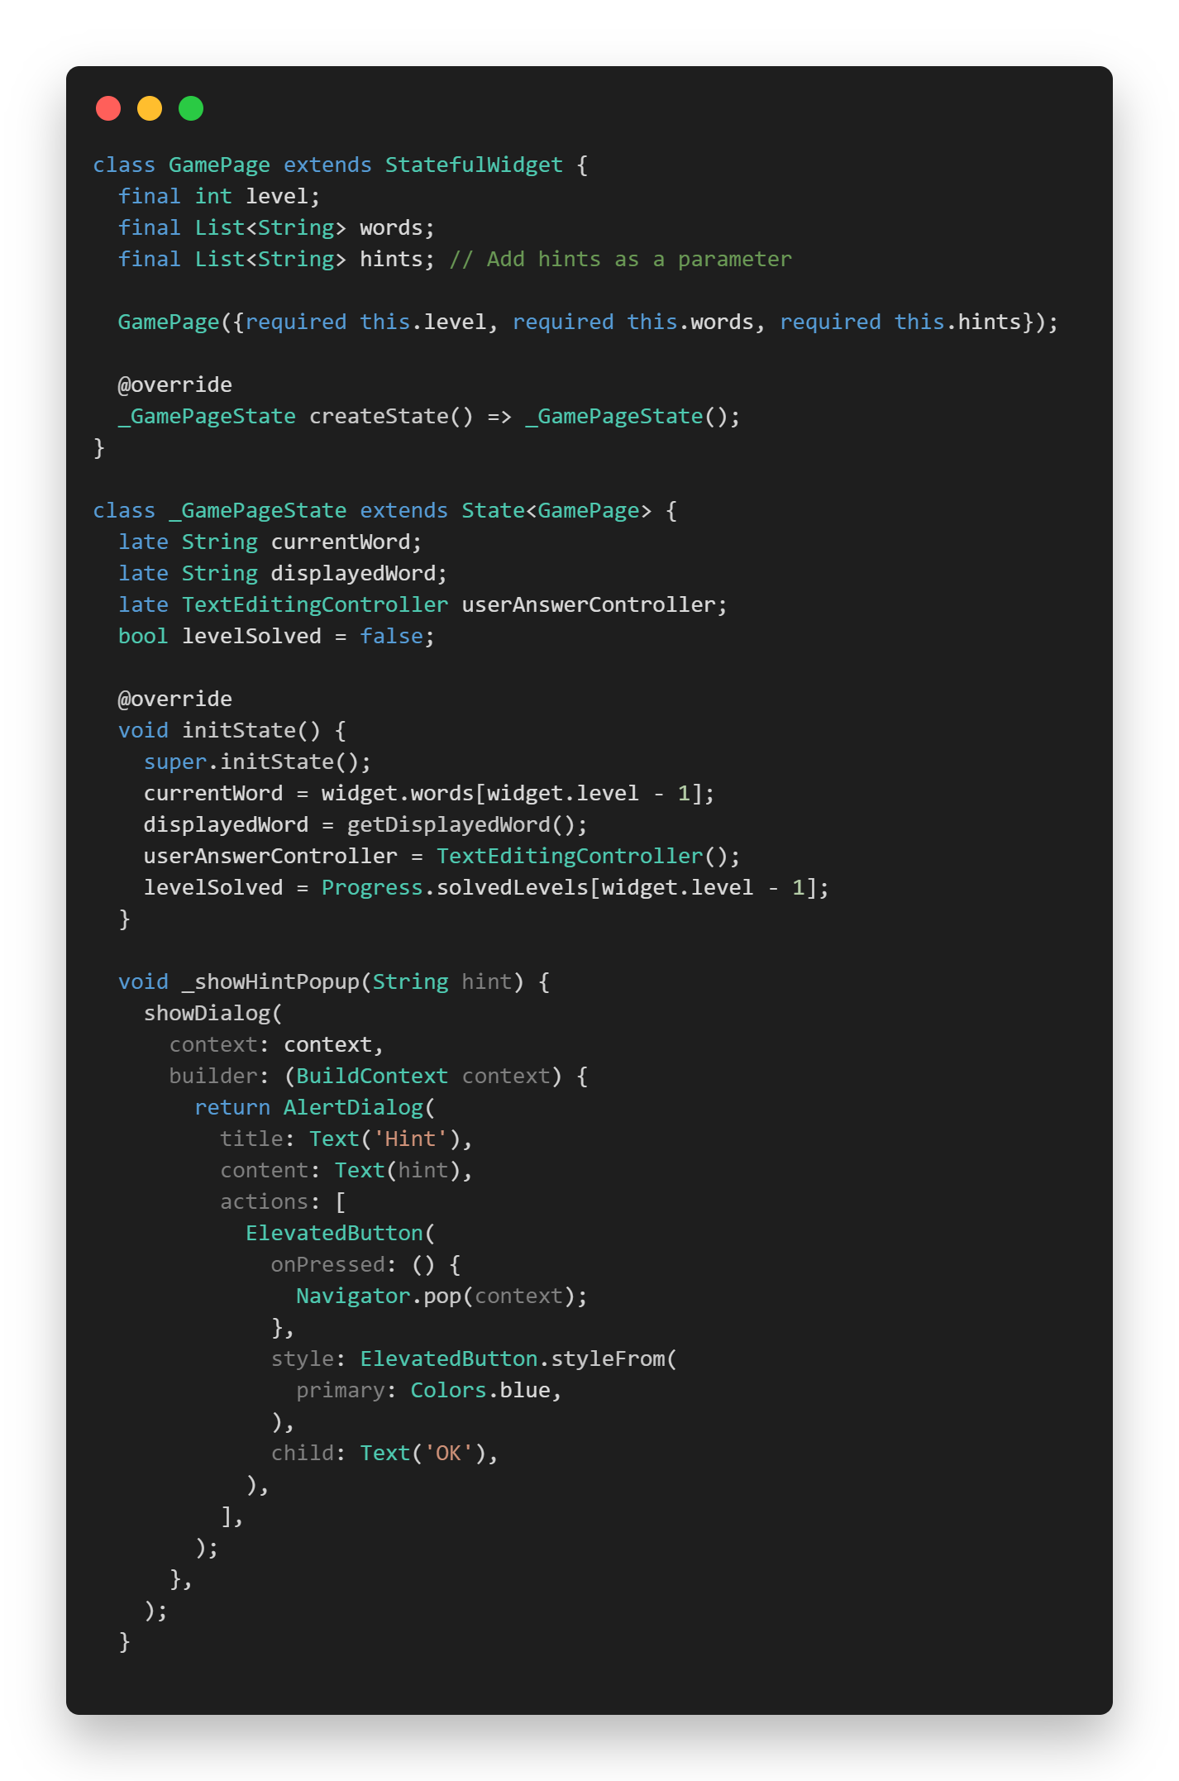
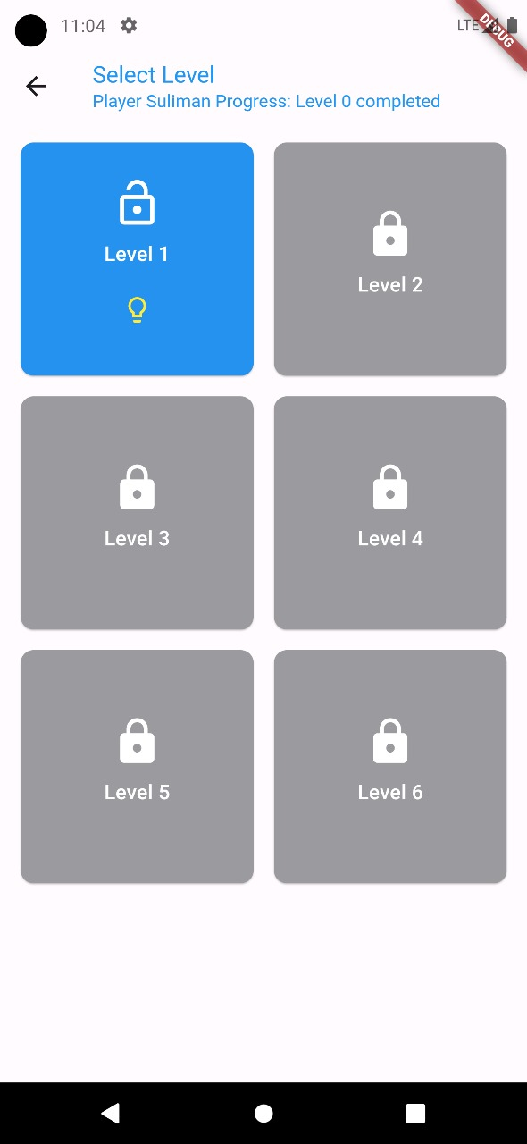
Game
SWE2 Aim
Vision
Features
Introduction
Diagrams
Game

Slide 9
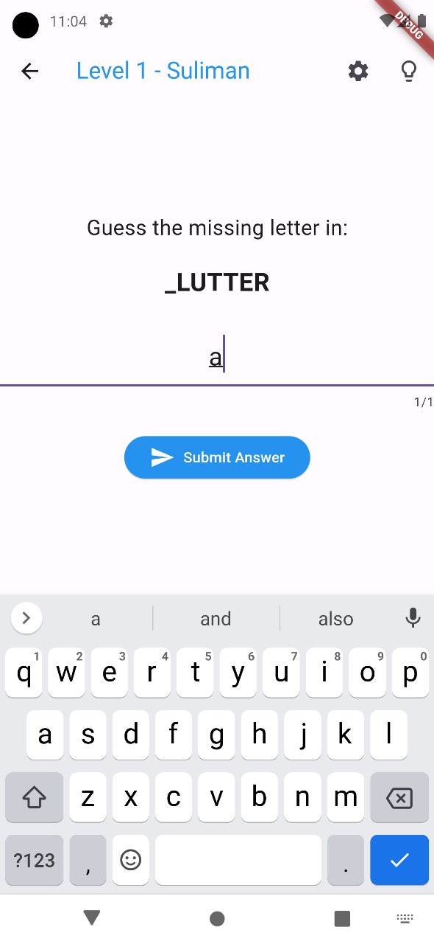
Game
SWE2 Aim
Vision
Features
Introduction
Diagrams
Game

Slide 10
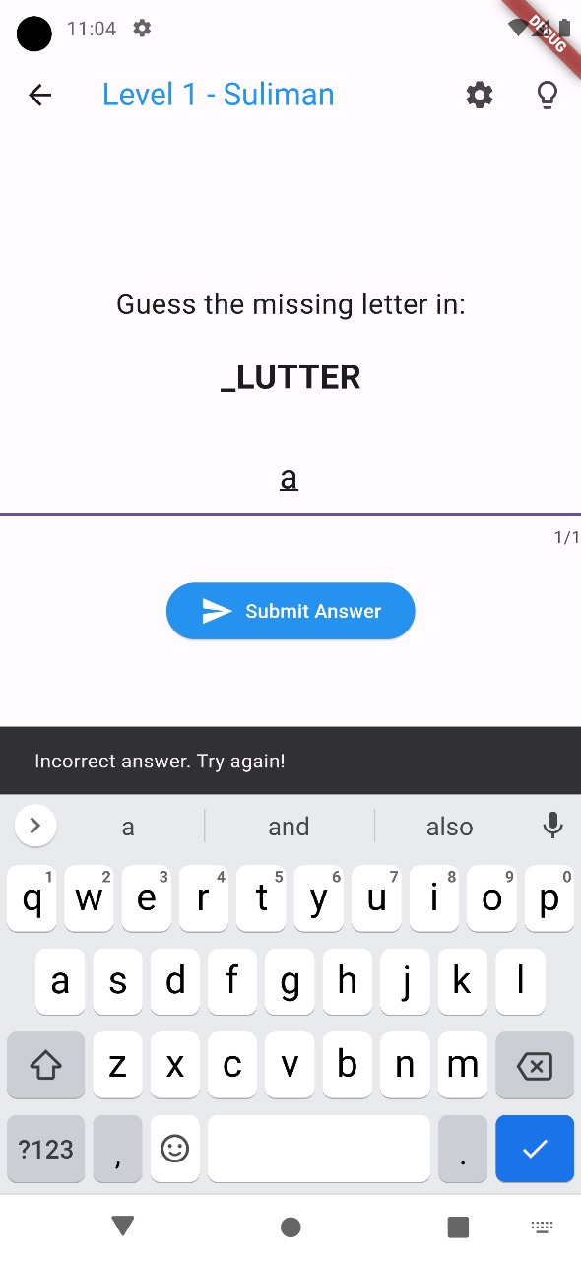
Game
SWE2 Aim
Vision
Features
Introduction
Diagrams
Game

Slide 11
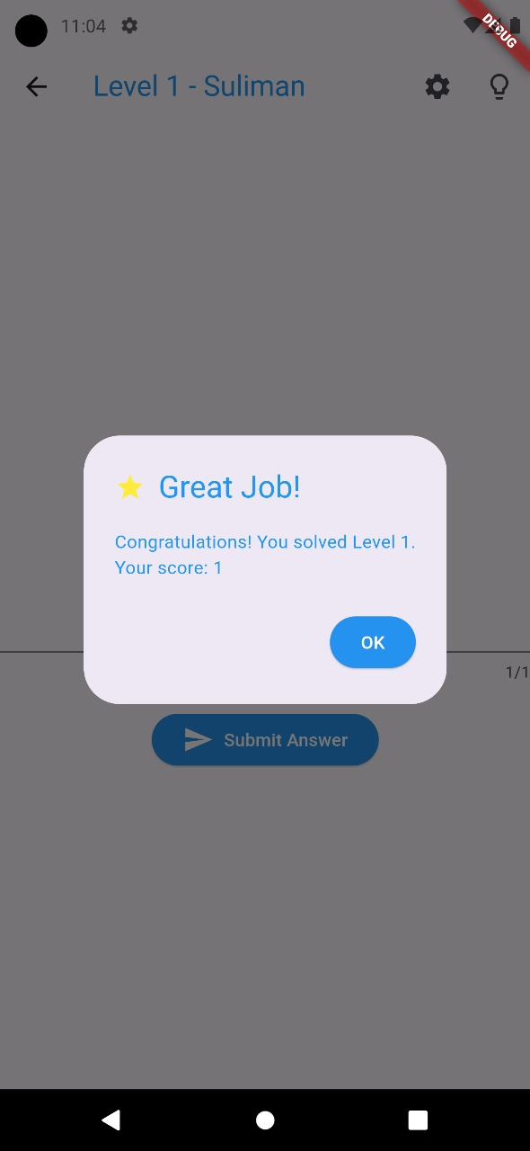
Game
SWE2 Aim
Vision
Features
Introduction
Diagrams
Game

Slide 12
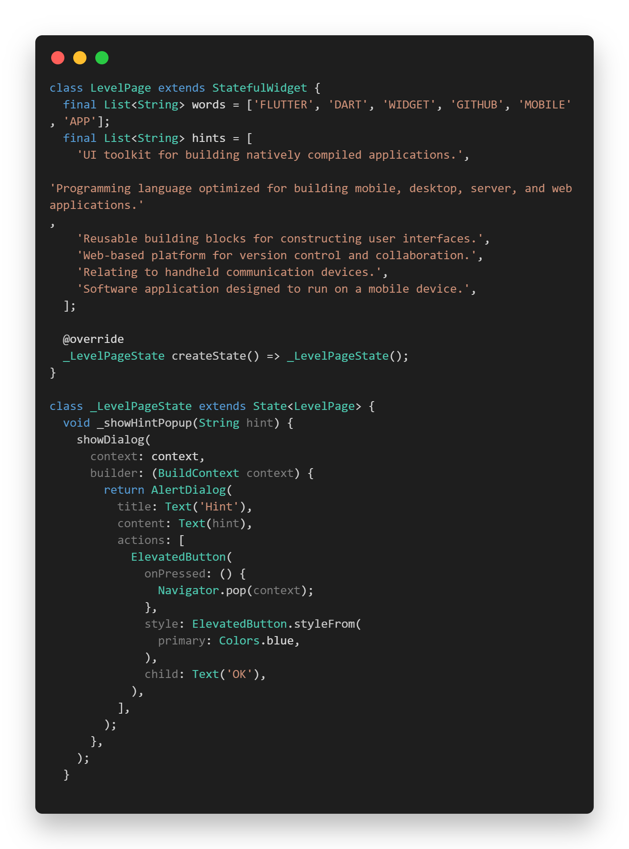
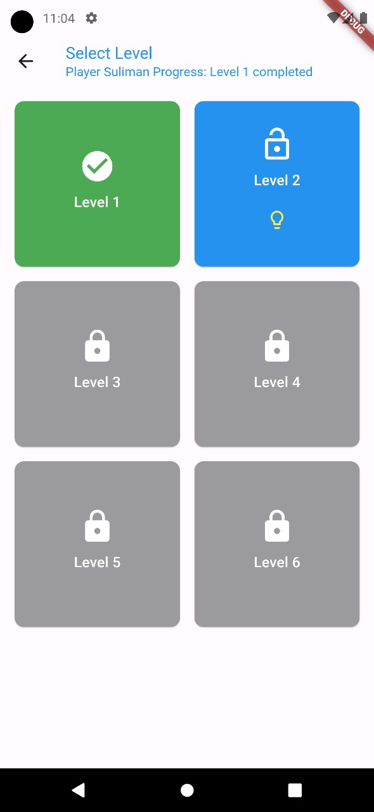
Game
SWE2 Aim
Vision
Features
Introduction
Diagrams
Game

Slide 13
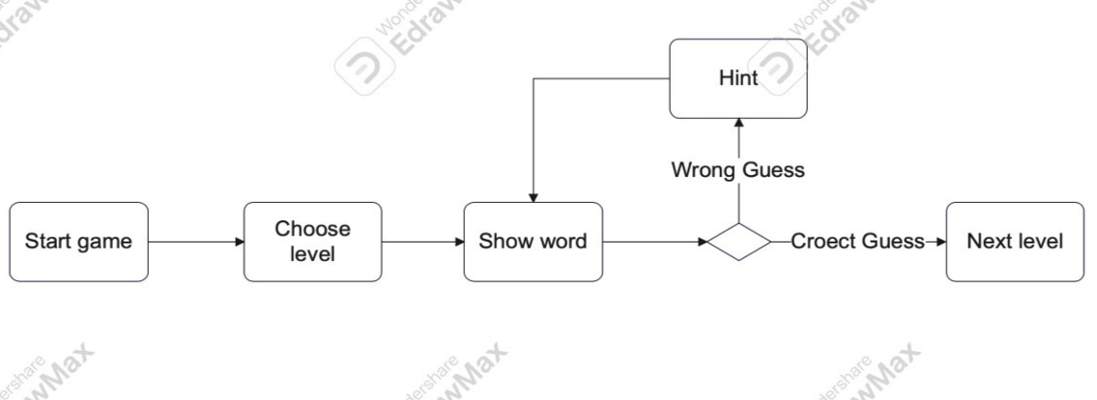
Activity Diagrams
SWE2 Aim
Features
Vision
Introduction
Game
Diagrams

Slide 14
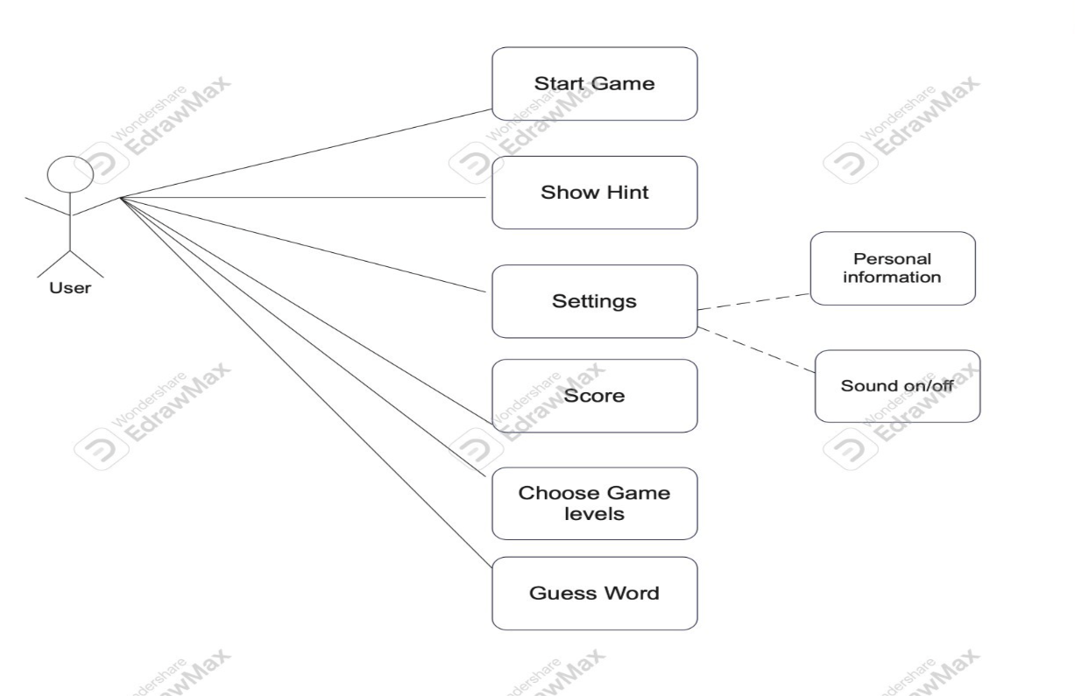
Use Case Diagram
SWE2 Aim
Features
Vision
Introduction
Game
Diagrams

Slide 15
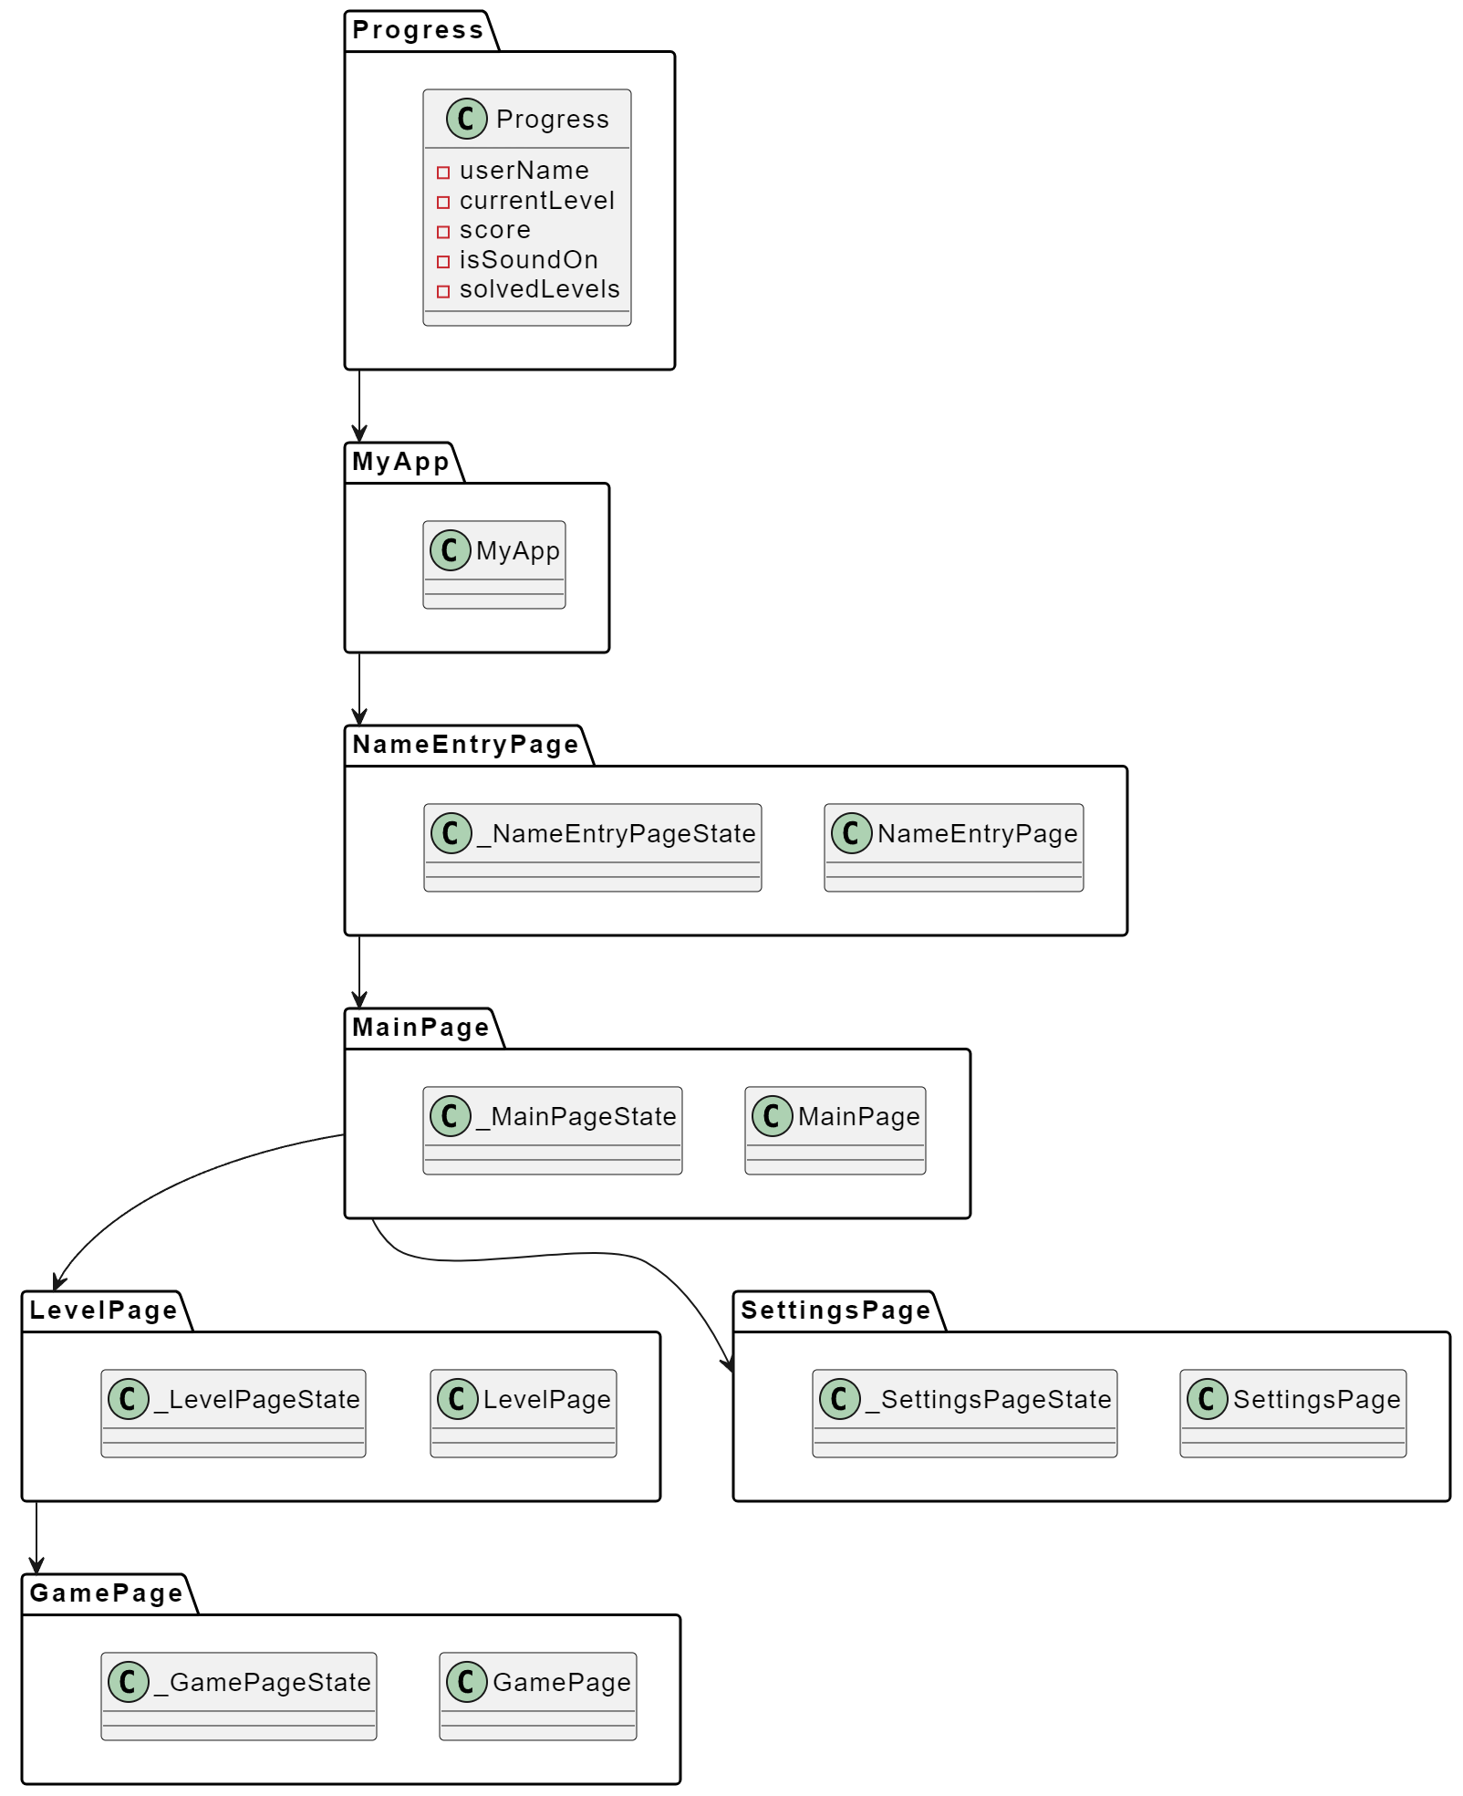
layer architecture
SWE2 Aim
Features
Vision
Introduction
Game
Diagrams

Slide 16
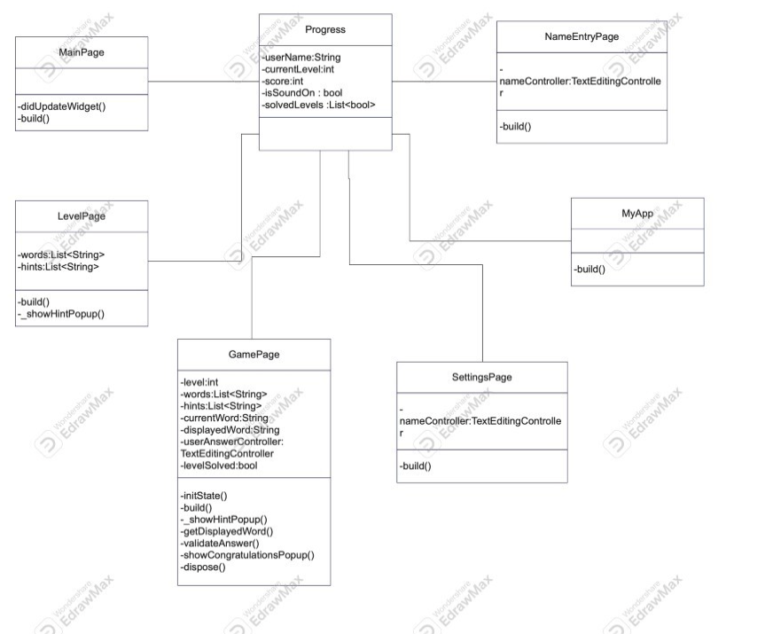
Class Diagram
SWE2 Aim
Features
Vision
Introduction
Game
Diagrams

Slide 17
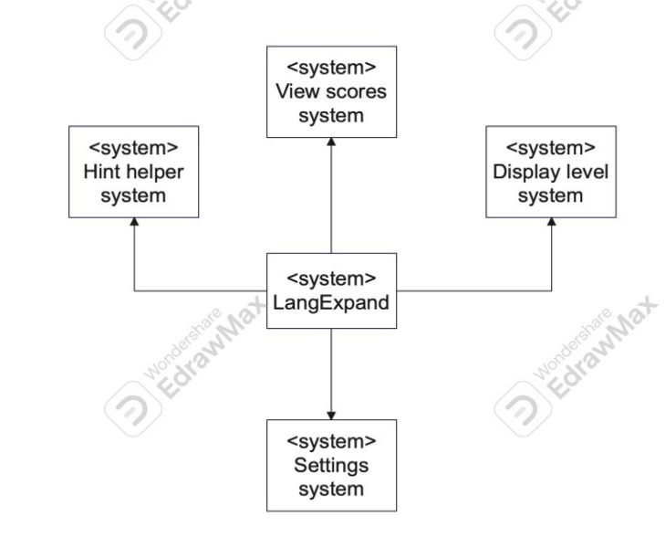
Context Diagram
SWE2 Aim
Features
Vision
Introduction
Game
Diagrams

Slide 18
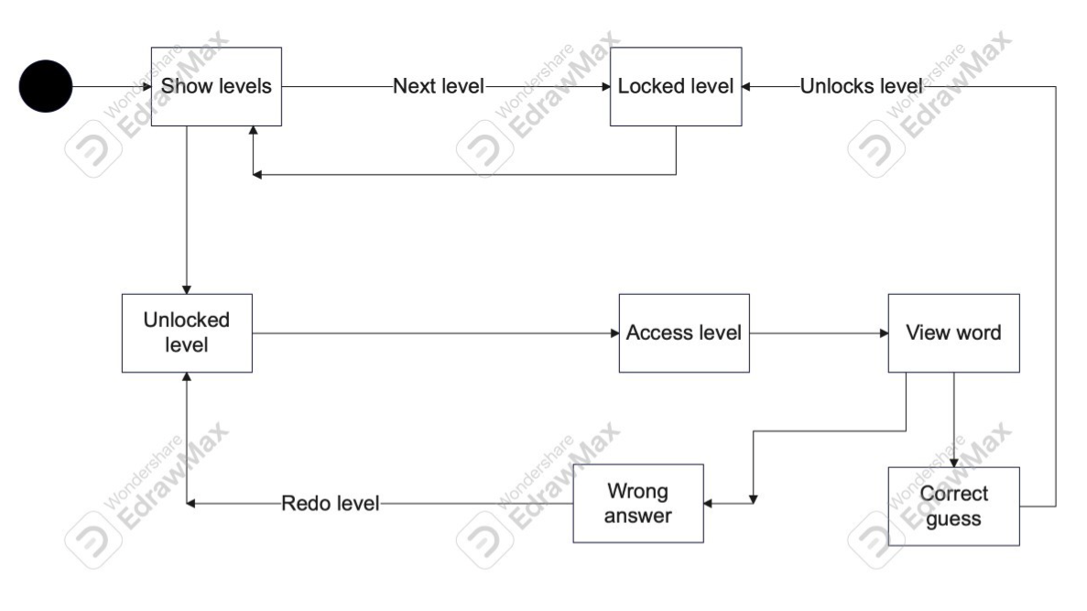
State Diagram
SWE2 Aim
Features
Vision
Introduction
Game
Diagrams

Slide 19
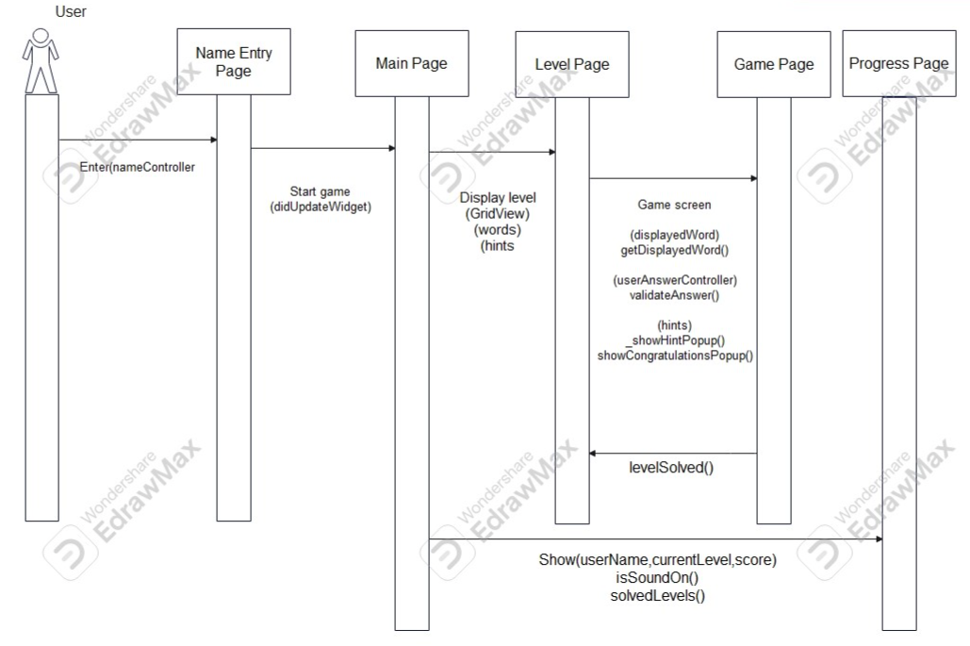
Sequence Diagram
SWE2 Aim
Features
Vision
Introduction
Game
Diagrams

Slide 20
Features
User-friendly
Free-to-play
No Wi-fi required
Sound effects
Educative
No in game advertisement
Menu bar with options
Colored background
SWE2 Aim
Vision
Features
Introduction
Game
Diagrams

Slide 21
Our aims in SWE 2
Our aim in SWE2 is to keep on updating LangExpand and make sure it attracts and gain feedback from users of our app
SWE2 Aim
Vision
Features
Introduction
Game
Diagrams

Slide 22

Thank You For listening!
Any Questions?
Features
SWE2 Aim
Vision
Introduction
Game
Diagrams

