Slide 1

Reconocimiento de Patrones
Domingo Mery
Departamento de Ciencia de la Computación
Escuela de Ingeniería
Universidad Católica de Chile
Toy Example: FR with LBP + SFS + KNN
[ Capítulo 2 ]

Slide 2


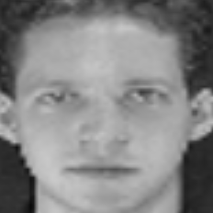
Example: Face Recognition for 3 people
Subject 0 Subject 1 Subject 2
10 images per subject: images 1… 9 for training, image 10 for testing

Slide 3

Feature Extraction
4 x 59 = 236 features
1
3
LBP
. . .
1 2 4
2
4
Sample | Z₁ | Z₂ | … | Z₂₃₆
1
2
:
9
10
11
12
:
19
20
21
22
:
29
30
Subject 0
Training
Testing
Subject 1
Training
Testing
Subject 2
Training
Testing

Slide 4
Splitting Training/Testing
Training
Testing
Sample | Z₁ | Z₂ | … | Z₂₃₆
1
2
:
9
11
12
:
19
21
22
:
29
Sample | Z₁ | Z₂ | … | Z₂₃₆
10
20
30

Slide 5
Normalization
Xtrain_new, a, b = minmax(Xtrain)
Xtest_new = Xtest * a + b
Training
Testing
Sample | Z₁ | Z₂ | … | Z₂₃₆
1
2
:
9
11
12
:
19
21
22
:
29
Sample | Z₁ | Z₂ | … | Z₂₃₆
10
20
30
0) Original columns
xtrain, xtest
1) Parameters (a,b from xtrain!!!)
xmin = min(xtrain), xmax = max(xtrain)
d = xmax – xmin, a = 1/d, b = -xmin/d
2) Scaling
xtrain_new = a*xtrain + b
xtest_new = a*xtest + b
Pseudo Code

Slide 6
Feature Selection (SELECTION OF TWO FEATURES)
Copy of two columns
Training
Selection
Sample | Z₁ | Z₂ | … | Z₂₃₆
1
2
:
9
11
12
:
19
21
22
:
29
Sample | Z₄₀ | Z₉₇
1
2
:
9
11
12
:
19
21
22
:
29
2
SFS

Slide 7
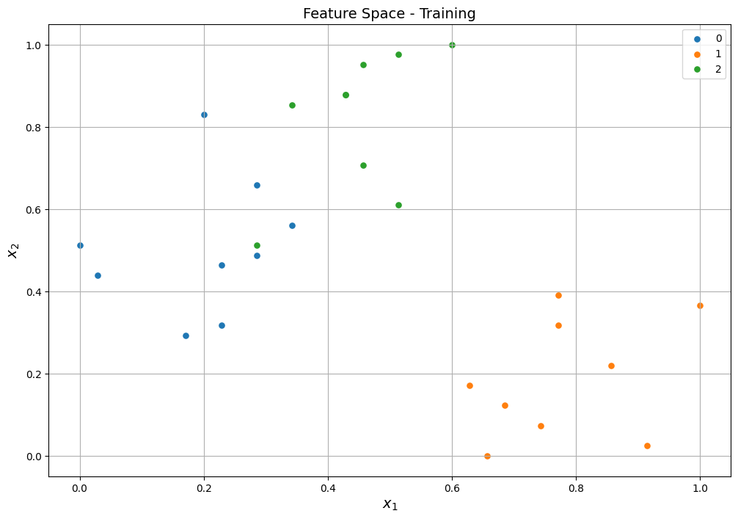
Feature Space
Selection of Training
Sample | X₁ = Z₄₀ | X₂ = Z₉₇ | GT
1 |  |  | 0
2 |  |  | 0
: |  |  | :
9 |  |  | 0
11 |  |  | 1
12 |  |  | 1
: |  |  | :
19 |  |  | 1
21 |  |  | 2
22 |  |  | 2
: |  |  | :
29 |  |  | 2
GT: Ground Truth
9 x 3 = 27 points, one for each sample

Slide 8









Feature Space
Selection of Training
Sample | X₁ = Z₄₀ | X₂ = Z₉₇ | GT
1 |  |  | 0
2 |  |  | 0
: |  |  | :
9 |  |  | 0
11 |  |  | 1
12 |  |  | 1
: |  |  | :
19 |  |  | 1
21 |  |  | 2
22 |  |  | 2
: |  |  | :
29 |  |  | 2
GT: Ground Truth
9 x 3 = 27 points, one for each sample

Slide 9
Feature Space
Selection of Training
Sample | X₁ = Z₄₀ | X₂ = Z₉₇ | GT
1 |  |  | 0
2 |  |  | 0
: |  |  | :
9 |  |  | 0
11 |  |  | 1
12 |  |  | 1
: |  |  | :
19 |  |  | 1
21 |  |  | 2
22 |  |  | 2
: |  |  | :
29 |  |  | 2
GT: Ground Truth
9 x 3 = 27 points, one for each sample

Slide 10









Feature Space
Selection of Training
Sample | X₁ = Z₄₀ | X₂ = Z₉₇ | GT
1 |  |  | 0
2 |  |  | 0
: |  |  | :
9 |  |  | 0
11 |  |  | 1
12 |  |  | 1
: |  |  | :
19 |  |  | 1
21 |  |  | 2
22 |  |  | 2
: |  |  | :
29 |  |  | 2
GT: Ground Truth
9 x 3 = 27 points, one for each sample

Slide 11
Feature Space
Selection of Training
Sample | X₁ = Z₄₀ | X₂ = Z₉₇ | GT
1 |  |  | 0
2 |  |  | 0
: |  |  | :
9 |  |  | 0
11 |  |  | 1
12 |  |  | 1
: |  |  | :
19 |  |  | 1
21 |  |  | 2
22 |  |  | 2
: |  |  | :
29 |  |  | 2
GT: Ground Truth
9 x 3 = 27 points, one for each sample

Slide 12









Feature Space
Selection of Training
Sample | X₁ = Z₄₀ | X₂ = Z₉₇ | GT
1 |  |  | 0
2 |  |  | 0
: |  |  | :
9 |  |  | 0
11 |  |  | 1
12 |  |  | 1
: |  |  | :
19 |  |  | 1
21 |  |  | 2
22 |  |  | 2
: |  |  | :
29 |  |  | 2
GT: Ground Truth
9 x 3 = 27 points, one for each sample

Slide 13
Feature Space
Selection of Training
Sample | X₁ = Z₄₀ | X₂ = Z₉₇ | GT
1 |  |  | 0
2 |  |  | 0
: |  |  | :
9 |  |  | 0
11 |  |  | 1
12 |  |  | 1
: |  |  | :
19 |  |  | 1
21 |  |  | 2
22 |  |  | 2
: |  |  | :
29 |  |  | 2
GT: Ground Truth
9 x 3 = 27 points, one for each sample

Slide 14
Testing
Selection of Testing
Sample | X₁ | X₂ | GT
10 | 0.14 | 0.61 | 0
20 | 0.43 | 0.17 | 1
30 | 0.49 | 0.78 | 2
9 x 3 = 27 points, one for each sample

Slide 15
Testing
Selection of Testing
Sample | X₁ | X₂ | GT | PRED
10 | 0.14 | 0.61 | 0 | 0
20 | 0.43 | 0.17 | 1 | 1
30 | 0.49 | 0.78 | 2 | 2
9 x 3 = 27 points, one for each sample

Slide 16


Testing
Selection of Testing
Sample | X₁ | X₂ | GT | PRED
10 | 0.14 | 0.61 | 0 | 0
20 | 0.43 | 0.17 | 1 | 1
30 | 0.49 | 0.78 | 2 | 2
9 x 3 = 27 points, one for each sample
9 x 3 = 27 points, one for each sample

Slide 17
Evaluation: Confusion Matrix
Selection of Testing
Sample | X₁ | X₂ | GT | PRED
10 | 0.14 | 0.61 | 0 | 0
20 | 0.43 | 0.17 | 1 | 1
30 | 0.49 | 0.78 | 2 | 2
Confusion Matrix
GT/PRED | 0 | 1 | 2
0 | 1 | 0 | 0
1 | 0 | 1 | 0
2 | 0 | 0 | 1
9 x 3 = 27 points, one for each sample

Slide 18
Evaluation: Accuracy
Selection of Testing
Sample | X₁ | X₂ | GT | PRED
10 | 0.14 | 0.61 | 0 | 0
20 | 0.43 | 0.17 | 1 | 1
30 | 0.49 | 0.78 | 2 | 2
Confusion Matrix
GT/PRED | 0 | 1 | 2
0 | 1 | 0 | 0
1 | 0 | 1 | 0
2 | 0 | 0 | 1
Accuracy = 3/3 = 100%
9 x 3 = 27 points, one for each sample

