Slide 1

Reconocimiento de Patrones
Domingo Mery
Departmento de Ciencia de la Computación
Escuela de Ingeniería
Universidad Católica de Chile
LDA
[ Capítulo 4 ]

Slide 2

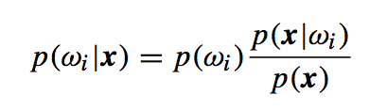
Bayes’ Classifier: x is classified as class j if
Using Bayes’ Rule

Slide 3
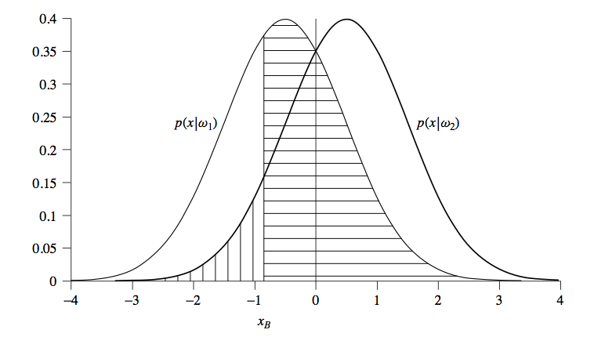

Slide 4
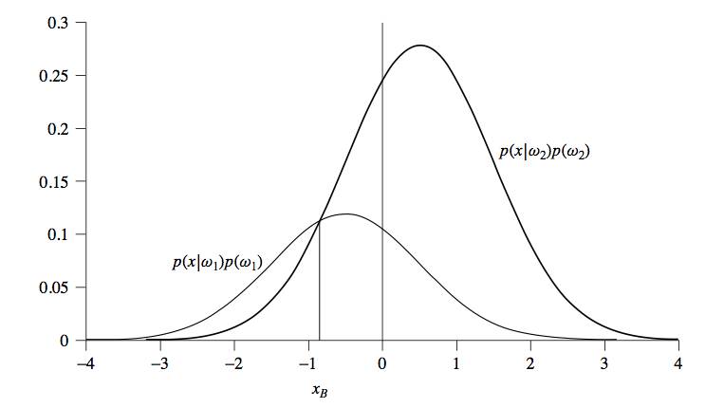

Slide 5
How to estimate the probability density functions?
PAT04_EstimationPDF.m

Slide 6
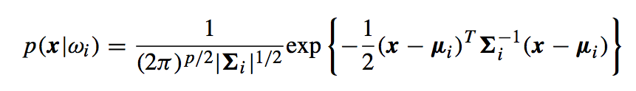
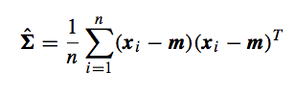






For Gaussian Distributions
Estimator of Covariance Matrix:
Examples of Σ and μ in 2D:
.
.
.

Slide 7


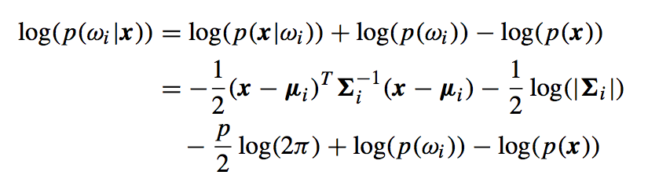


Bayes’ Classifier
log{ }
log{ }
For Gaussian Distributions:

Slide 8
log{ }
log{ }
This term is constant, it can be removed from the inequality.

Slide 9
LDA
log{ }
log{ }
In LDA (Linear Discriminant Analysis) it is assumed that Σ_{i} = Σ (it is constant).
Σ is computed from training data. A good estimation is the average of the individual covariance matrices: Σ = (Σ₁+Σ₂)/2

Slide 10
LDA
X: training data
d: labels of X
Xt: testing data
dt: labels of Xt
Example for LDA in Matlab:
op.p = [0.5 0.5]; % prior probability for each class
cl = Bcl_lda(X,d,op); % training
ds = Bcl_lda(Xt,cl); % testing
p = Bev_performance(ds,dt) % performance on test data
Example for LDA in Python:
clf = LinearDiscriminantAnalysis() # definition of classifier
clf.fit(X, d) # training
ds = clf.predict(Xt) # testing
Acc = accuracy_score(ds,dt) # accuracy

Slide 11
MAHALANOBIS
log{ }
log{ }
In Mahalanobis Classifier it is assumed that Σ_{i} = Σ and p(w_{i}) = p.

Slide 12
QDA
log{ }
log{ }
In QDA (Quadratic Discriminant Analysis) it is assumed that Σ_{i} and p(w_{i})
are different.

Slide 13
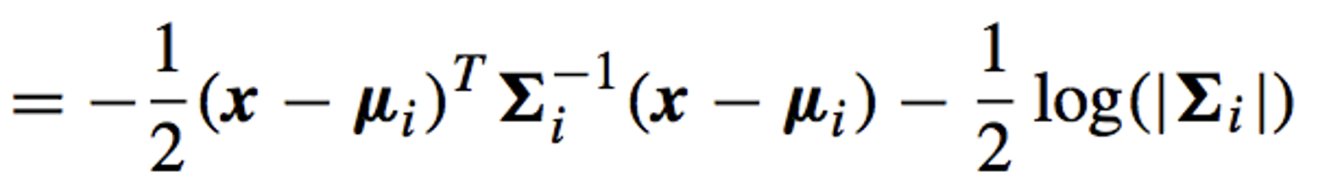
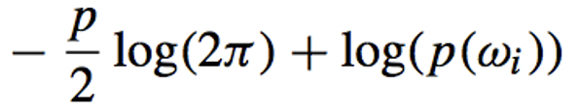
Σ_{i} = Σ = cte
cte
LDA
Σ_{i} = Σ = cte
cte
p(w_{i}) = cte
Mahalanobis
cte
QDA

