Slide 1
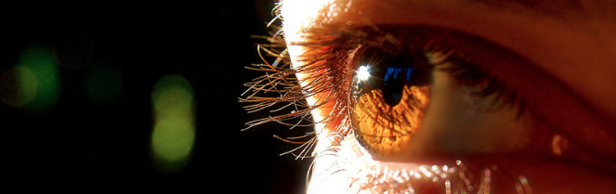
Reconocimiento de Patrones
Domingo Mery
Departmento de Ciencia de la Computación
Escuela de Ingeniería
Universidad Católica de Chile
Confusion Matrix
[ Capítulo 5 ]

Slide 2
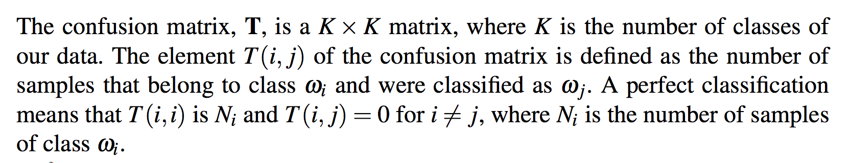
[ CONFUSION MATRIX ]
PAT05_ConfisionMatrix.pptx

Slide 3
[ CONFUSION MATRIX ]
predicted
 |  |  |  | ...
:
actual
PAT05_ConfisionMatrix.pptx

Slide 4
[ CONFUSION MATRIX ]
predicted
 |  |  |  | ...
 | 1230 | 90 | 78 |  | 9
 | 66 | 890 | 120 |  | 5
 | 59 | 95 | 1527 |  | 90
:
 | 40 | 67 | 129 |  | 912
actual
Example: there are 78 samples of class 1 that have been classified as class 3.
PAT05_ConfisionMatrix.pptx

Slide 5
[ CONFUSION MATRIX: TWO CLASSES ]
predicted
actual
PAT05_ConfisionMatrix.pptx

Slide 6
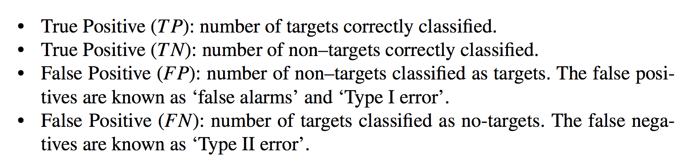
[ CONFUSION MATRIX: TWO CLASSES ]
TARGET DETECTION
Target No-Target
predicted
 | TP | FN
 | FP | TN
actual
Negative (FN):
PAT05_ConfisionMatrix.pptx

Slide 7
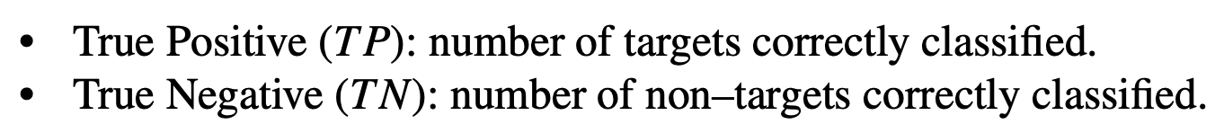
[ CONFUSION MATRIX: TWO CLASSES ]
predicted
 | TP | FN
 | FP | TN
P = TP+FN (positive instances)
actual
N = FP+TN (negative instances)
D = TP+FP (detections)
Negative (FN):
PAT05_ConfisionMatrix.pptx

Slide 8
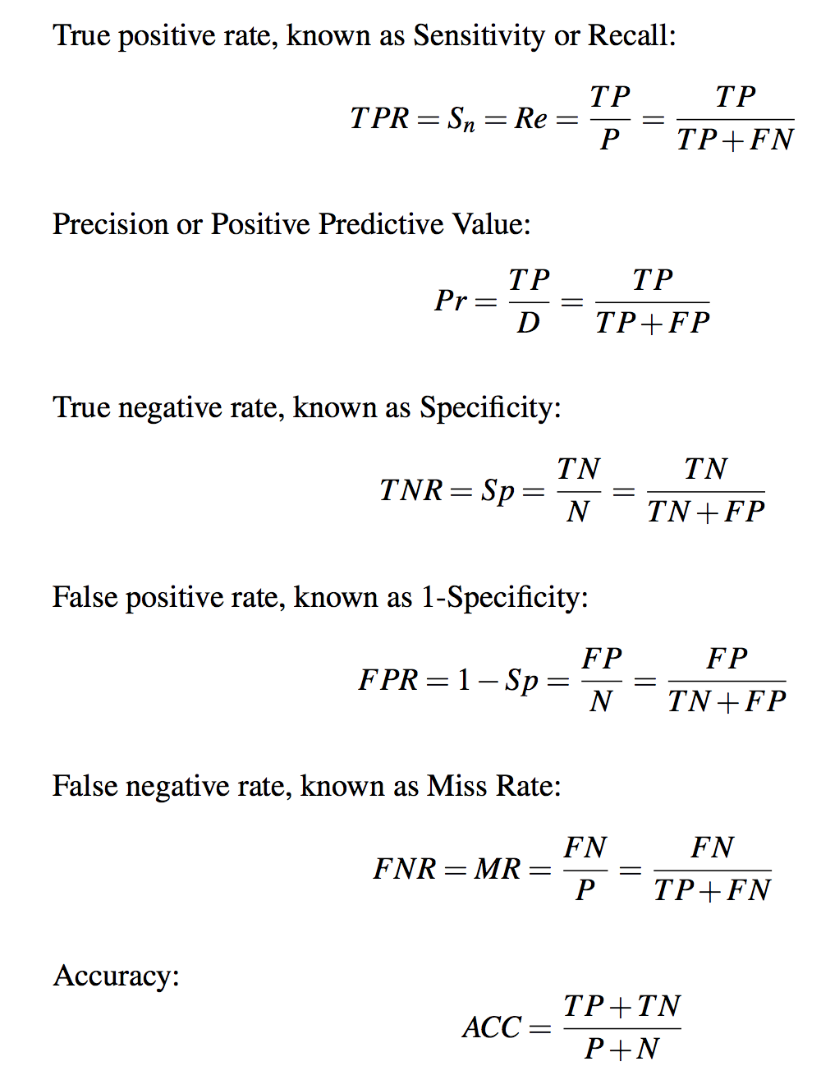
[ DEFINITIONS ]
PAT05_ConfisionMatrix.pptx

Slide 9
[ EXAMPLE ]
o
o
o
x₂
o
o
*
*
o
*
*
o : class 0
*
*
*
*
*
*
*
*
* : class 1
*
*
o
o
*
*
*
*
*
*
*
o
*
*
*
*
*
o
*
*
*
*
*
*
*
*
*
o
*
*
*
*
*
o
*
*
o
o
o
o
o
o
x₁
PAT05_ConfisionMatrix.pptx

Slide 10
[ EXAMPLE ]
x₂
* : class 1
x₁
PAT05_ConfisionMatrix.pptx

Slide 11
[ EXAMPLE ]
Red pixels: Positive instances (P)
White pixels: Negative instances (N)
Ground Truth
Target
PAT05_ConfisionMatrix.pptx

Slide 12
[ EXAMPLE ]
Detection (D)
Ground Truth
Detection using a classifier
PAT05_ConfisionMatrix.pptx

Slide 13
[ EXAMPLE ]
Detection (D)
Ground Truth
Detection using a classifier
PAT05_ConfisionMatrix.pptx

Slide 14
Magenta pixels: True positives (TP)
Blue pixels: False positives (FP)
Red pixels: False negatives (FN)
White pixels: True negatives (TN)
[ EXAMPLE ]
Detection (D)
Ground Truth
PAT05_ConfisionMatrix.pptx

Slide 15
Magenta pixels: True positives (TP)
Blue pixels: False positives (FP)
Red pixels: False negatives (FN)
White pixels: True negatives (TN)
[ EXAMPLE ]
Detection (D)
FN
Ground Truth
TP
FP
TN
PAT05_ConfisionMatrix.pptx

Slide 16
IDEAL
TPR = 100%
FPR = 0%
Magenta pixels: True positives (TP)
Blue pixels: False positives (FP)
Red pixels: False negatives (FN)
White pixels: True negatives (TN)
Extreme
Extreme
All positive samples
are detected
No false positive
No false alarm
Reality:
Trade-off between
FPR and TPR
All targets detected
PAT05_ConfisionMatrix.pptx

Slide 17
Curve
Precision – Recall
PAT05_ConfisionMatrix.pptx

Slide 18
Magenta pixels: True positives (TP)
Blue pixels: False positives (FP)
Red pixels: False negatives (FN)
White pixels: True negatives (TN)
[ EXAMPLE ]
Observe that:
TP+FN = Ground Truth
TP+FP = Detection
FN
TP
FP
TN
PAT05_ConfisionMatrix.pptx

Slide 19
Magenta pixels: True positives (TP)
Blue pixels: False positives (FP)
Red pixels: False negatives (FN)
White pixels: True negatives (TN)
[ EXAMPLE ]
Pr
Pr = TP/(TP+FP)
Re = TP/(TP+FN)
Observe that:
TP+FN = Ground Truth
TP+FP = Detection
1
Re
FN
0
1
TP
Precision-Recall curve
FP
TN
PAT05_ConfisionMatrix.pptx

Slide 20
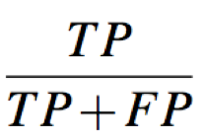
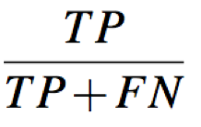
Precision = =
Recall = =
+
+
1
AREA UNDER CURVE:
mPA
(mean Precision Average)
Precision
0 1
Recall
PAT05_ConfisionMatrix.pptx

Slide 21
Curve
ROC
(Receiver Operation Characteristic)
PAT05_ConfisionMatrix.pptx

Slide 22
Magenta pixels: True positives (TP)
Blue pixels: False positives (FP)
Red pixels: False negatives (FN)
White pixels: True negatives (TN)
[ EXAMPLE ]
Pr
Pr = TP/(TP+FP)
Re = TP/(TP+FN)
TPR = TP/(TP+FN)
FPR = FP/(TN+FP)
1
Re
FN
0
1
TP
Precision-Recall curve
FP
TPR
1
TN
FPR
0
1
ROC curve
PAT05_ConfisionMatrix.pptx

Slide 23
Magenta pixels: True positives (TP)
Blue pixels: False positives (FP)
Red pixels: False negatives (FN)
White pixels: True negatives (TN)
[ EXAMPLE ]
Pr
Pr = TP/(TP+FP)
Re = TP/(TP+FN)
TPR = TP/(TP+FN)
FPR = FP/(TN+FP)
Sensitivity = TPR
Specificity = 1-FPR
Re
FN
Precision-Recall curve
TP
FP
TPR
TN
FPR
ROC curve
PAT05_ConfisionMatrix.pptx

Slide 24
[ ROC curve – Example ]
PAT05_ConfisionMatrix.pptx

Slide 25
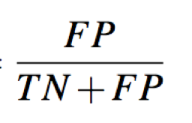
TPR = =
FPR = =
+
+
1
AREA UNDER CURVE:
Az
(AUC)
TPR
0 1
FPR
PAT05_ConfisionMatrix.pptx

Slide 26
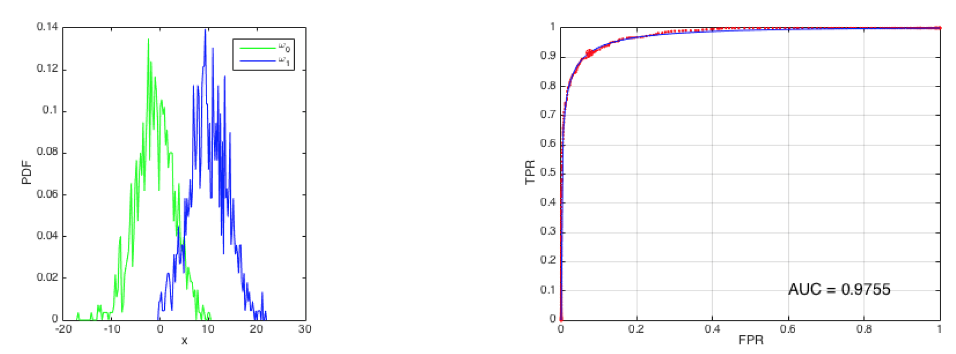
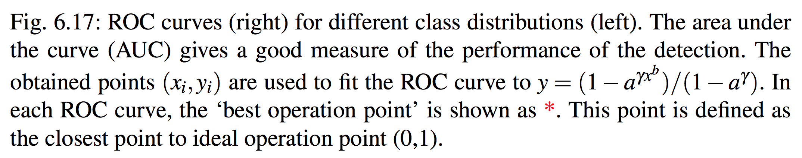
[ ROC curve – Example ]
PAT05_ConfisionMatrix.pptx

Slide 27
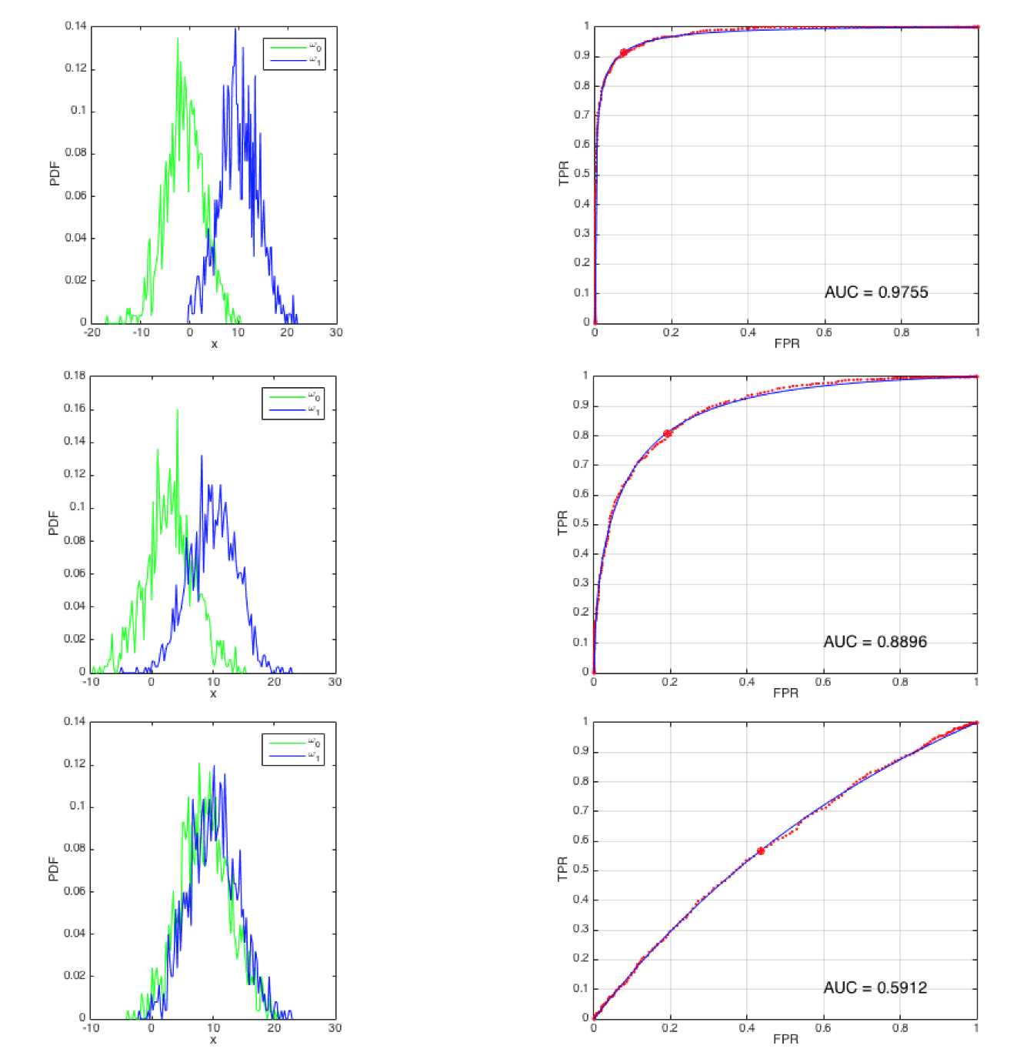
[ ROC curve – Example ]
PAT05_ConfisionMatrix.pptx

