Slide 1
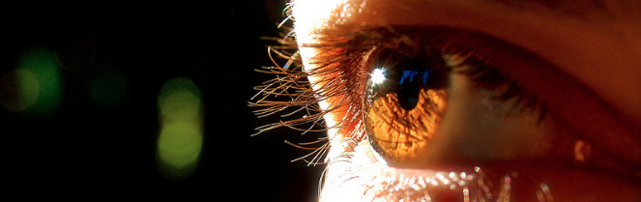
Reconocimiento de Patrones
Domingo Mery
Departamento de Ciencia de la Computación
Escuela de Ingeniería
Universidad Católica de Chile
Carácterísticas Geométricas
[ Capítulo 2 ]

Slide 2
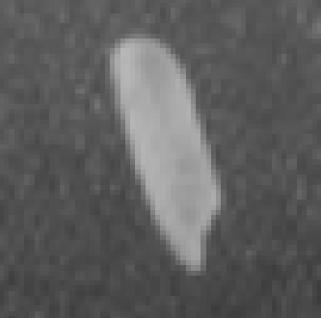

a) Grayscale image b) Segmentation c) 3D representation of a)
There are two categories of features: Geometric Features and
Intensity Features
Geometric Features give information about location, orientation, shape and size.
Intensity Features give information about how are the grayvalues.

Slide 3
Geometric Features

Slide 4



Area and Perimeter
A = # of gray pixels
L = # of white pixels
Height and width of
Roundness
Center of Mass
(i_{m}, j_{m})

Slide 5
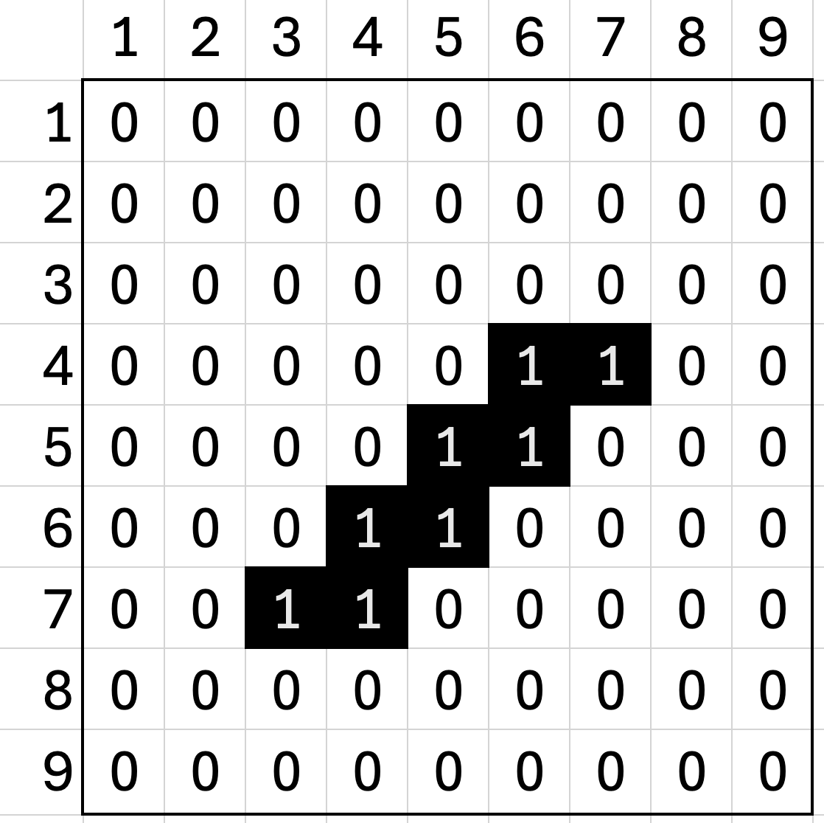
Example: 9x9 binary image - Basic
In region R:

Slide 6
Ellipses

Slide 7
Ellipses
Major axis (a)
Minor axis (b)
Orientation (Θ)
Center x₀, y₀
Area A
Perimeter L
Eccentricity E = b/a
A
b
y₀
L
a
Θ
x₀

Slide 8
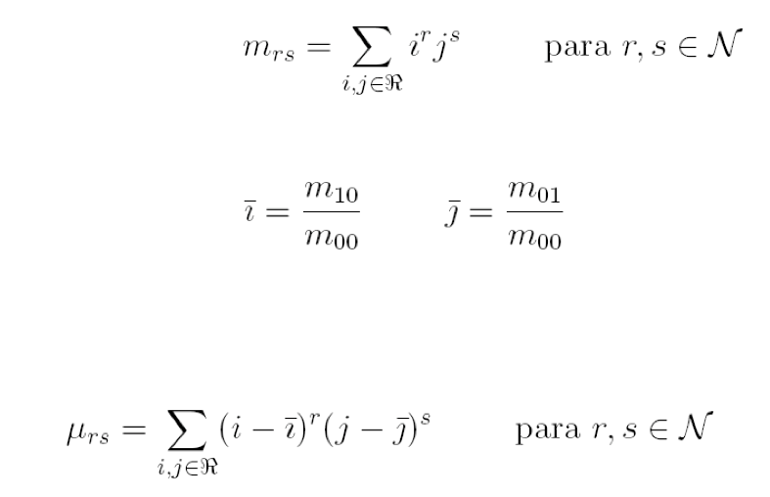
Moments
for r, s
for r, s

Slide 9
Example: 9x9 binary image - Moments
In region R:

Slide 10
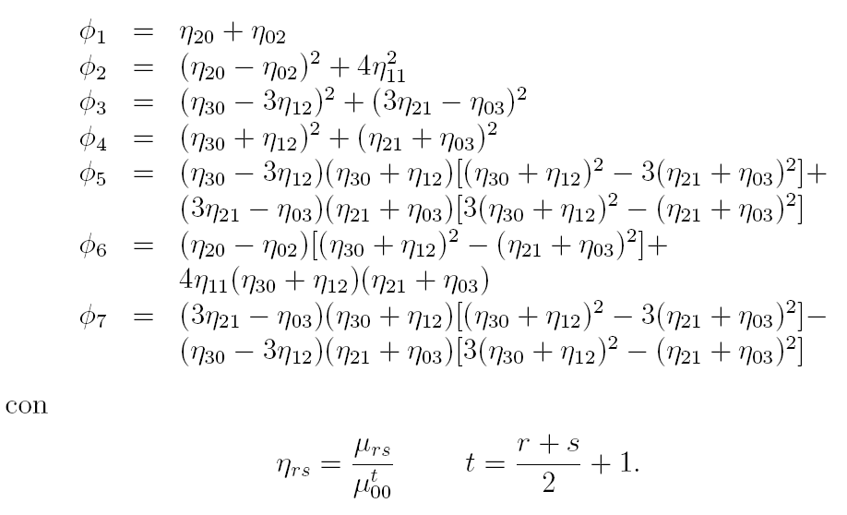
They are invariant against:
scale,
rotation and
location
Hu - Moments
with
Hu, M.K. (1962): Visual Pattern Recognition by moment invariants. IRE Trans. On Information Theory, 8(2): 179-187.

Slide 11
Example: 9x9 binary image - Hu
In region R:

Slide 12
They are invariant against:
scale,
rotation and
location
Hu - Moments
They have similar Φ₁, Φ₂, … Φ₇.

Slide 13
They are invariant against:
scale,
rotation and
location
Hu - Moments
They have similar Φ₁, Φ₂, … Φ₇.

Slide 14
Hu - Moments
2
3
1
They have different Φ₁, Φ₂, … Φ₇.
4
5
6

Slide 15
2
3
1
4
5
6

Slide 16
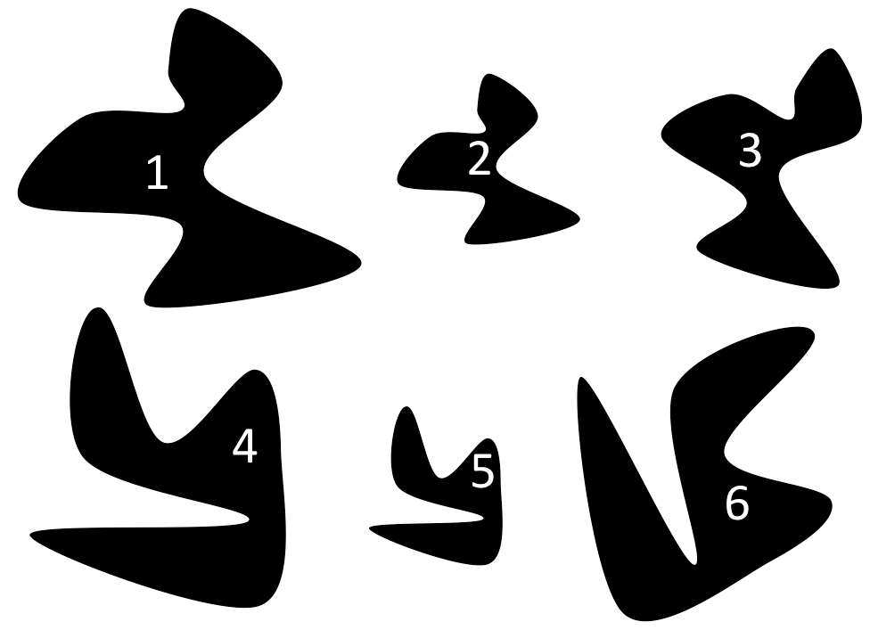
Difference between Φ₁ of region i and Φ₁ of region j
1 2 3 4 5 6
1
2
3
4
5
6
j
i

Slide 17
Φ₁ Φ₂ Φ₃ Φ₄
Φ₅ Φ₆ Φ₇

Slide 18
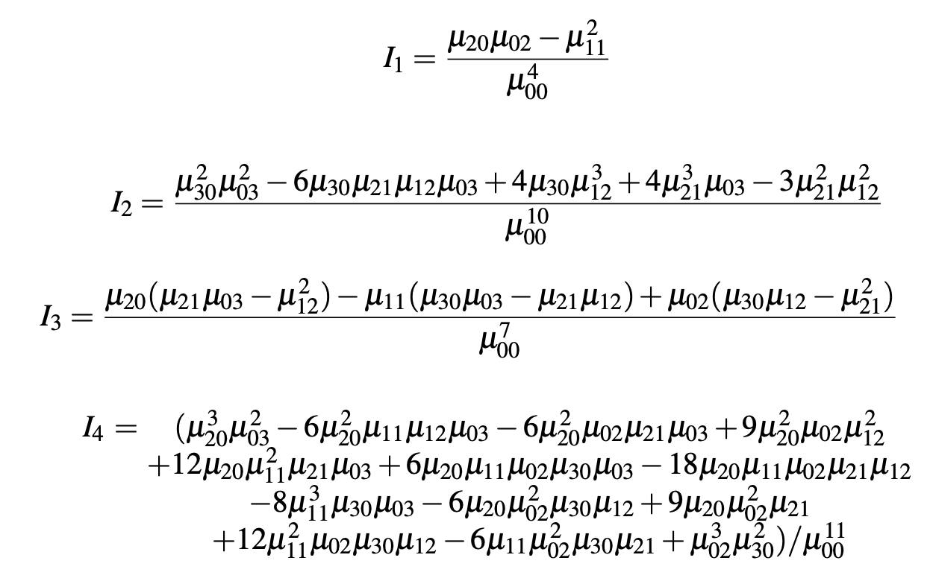
Flusser Moments
Invariante a la transformada afín: líneas paralelas se transforman como líneas paralelas
Flusser, J., & Suk, T. (1993). Pattern recognition by affine moment invariants. Pattern recognition, 26(1), 167-174.

