Slide 1
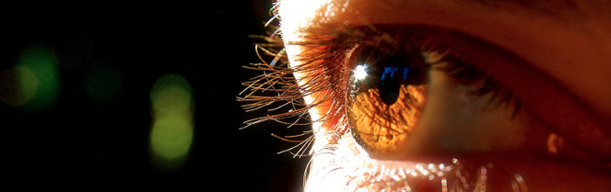
Reconocimiento de Patrones
Domingo Mery
Departmento de Ciencia de la Computación
Escuela de Ingeniería
Universidad Católica de Chile
Genuine - Impostor
[ Capítulo 5 ]

Slide 2
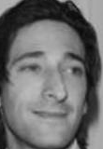
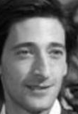
Face Verification Schema
Image A
Feature
Extraction
Vectors of n
elements
(1 x n)
Image B
Feature
Extraction
If image-A and image-B are from the same person
score s is high
Similarity using
cos - similarity
If image-A and image-B are from different persons
score s is low

Slide 3
Set of Images A
Set of Images B
Face
1
Face
1
Face i of set A and Face i of Set B are from the same person.
Face i of set A and Face j of set B for i=j are from different persons.
Face
2
Face
2
:
:
:
:
Face
m
Face
m
:
:
m x n elements
m x n elements

Slide 4
m x m elements
Similarity between Face-i of set A and Face-j of set B
d⁺: Diagonal : positive pairs (genuines)
d⁻: Non-Diagonal: negative pairs (impostors)

Slide 5
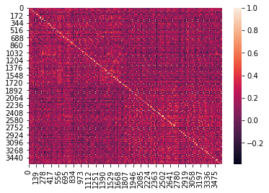
m x m elements
Similarity between Face-i of set A and Face-j of set B
d⁺: Diagonal : positive pairs (genuines)
d⁻: Non-Diagonal: negative pairs (impostors)

Slide 6
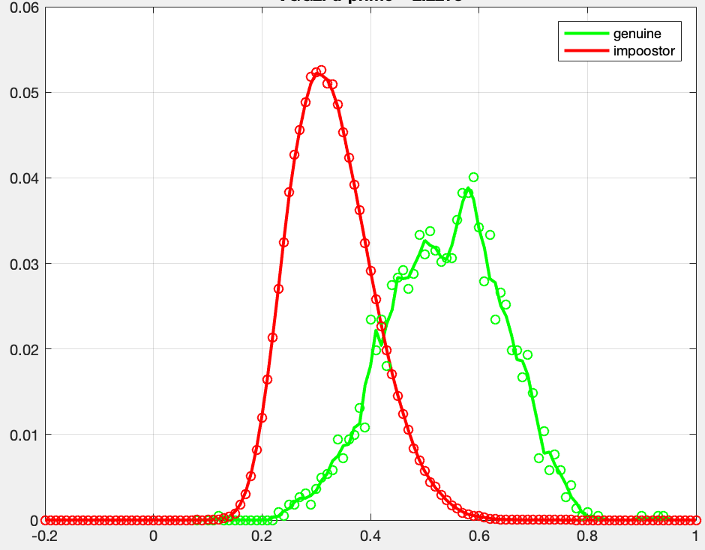
Probability density frequency
S
FNMR
False Non-Match Rate
FMR
False Match Rate

Slide 7
Probability density frequency
S
FNMR
False Non-Match Rate
FMR
False Match Rate

Slide 8
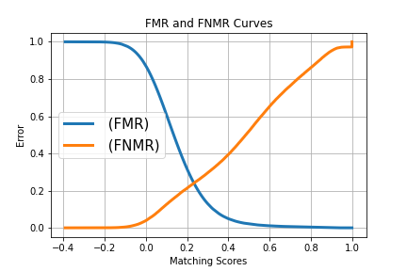

Slide 9
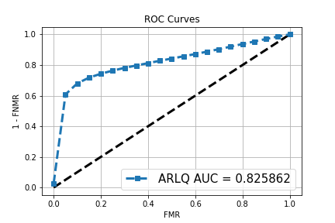

Slide 10
Distribution of d-
Distribution of d+
Probability density frequency
S
Performance:
Area of each distribution = 1

Slide 11
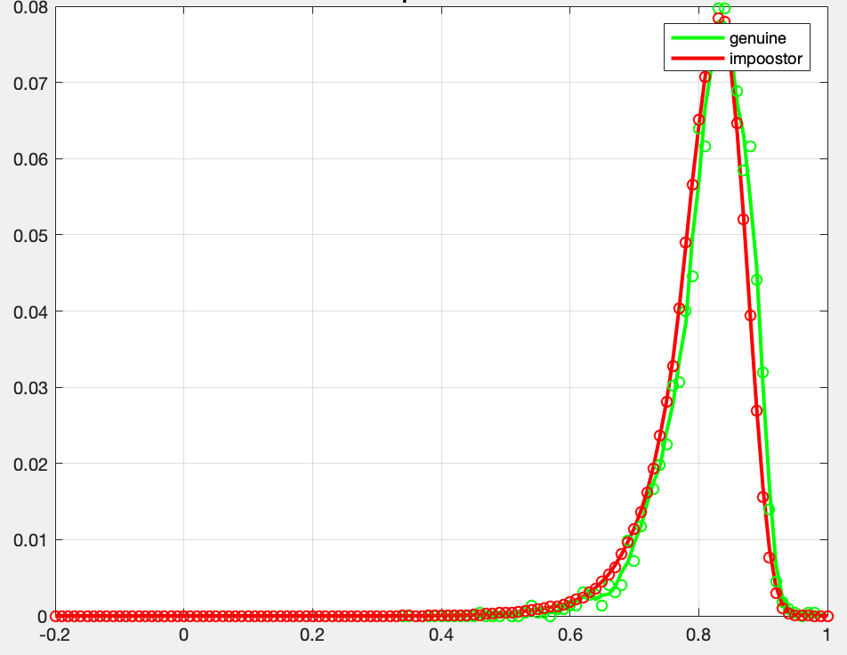
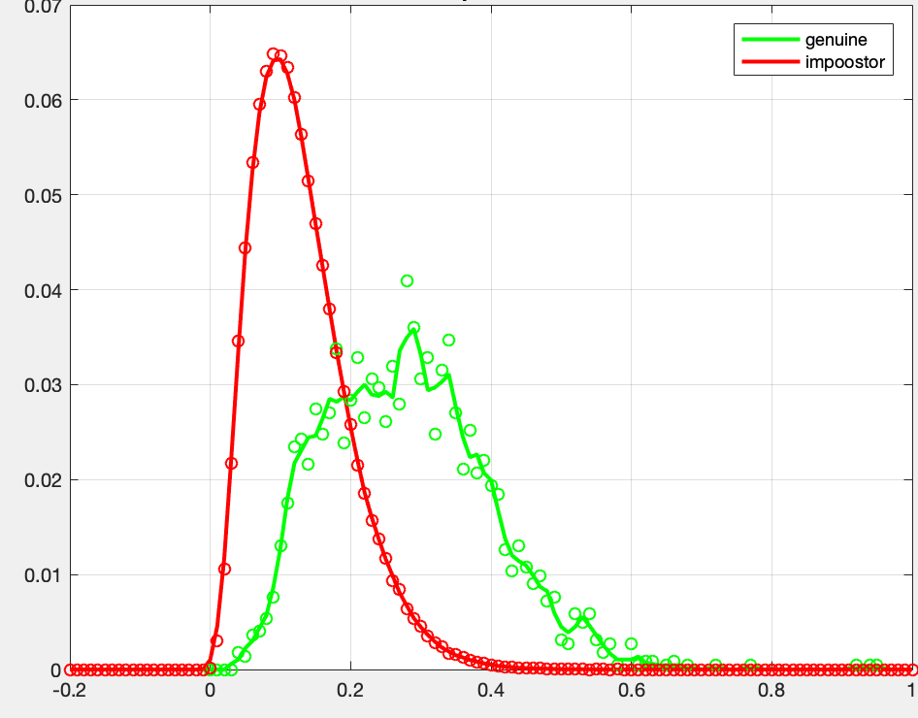
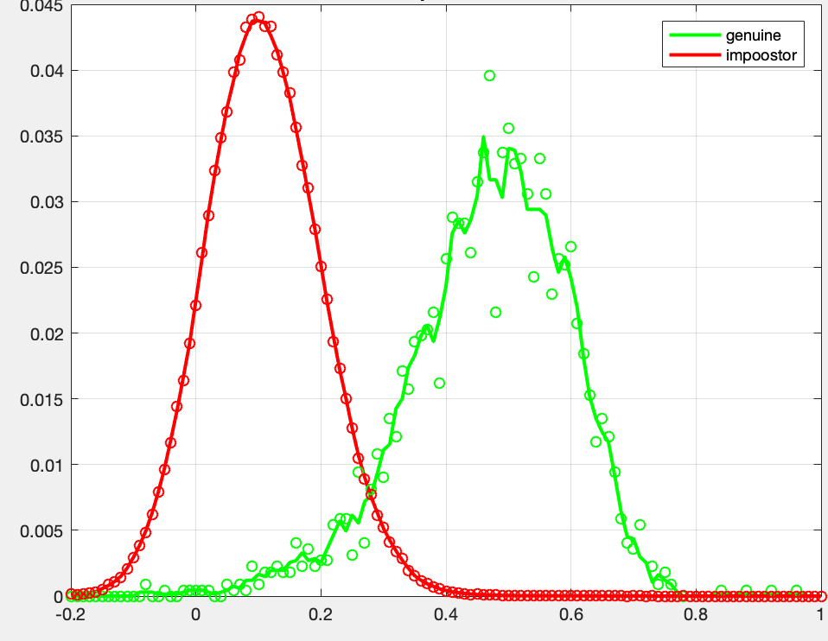
Examples of d’
for different algorithms
d’ = 0.20
d’ = 1.59
d’ = 2.22
d’ = 3.23
The best one

Slide 12
Other metrics
For Euclidean distance:
For other metrics, matrix is learned from negative and positive pairs
If image-A and image-B are from the same person the distance is low
If image-A and image-B are from different persons the distance is high
Genuine distribution is at the left side
Impostor distribution is at the right side

Slide 13
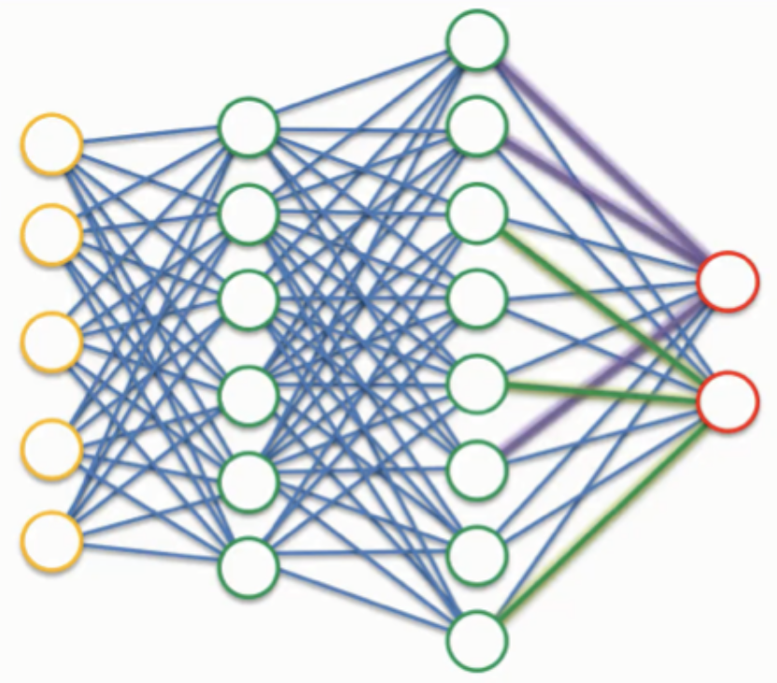
Other metrics
Sometimes the metric is obtained from the output of a classifier (for example SVM or neural network). In this case, there are two classes, ‘1’ for genuine (same person) and ‘0’ for impostor (different persons). Typically, the classifier has a score at the output that is compared with a threshold. If the score is greater than the threshold the classification is ‘1’, otherwise is ‘0’. The score can be used in this case as a similarity metric.
score
A
same: 0.95
different: 0.05
B
If image-A and image-B are from the same person the score s is high.
If image-A and image-B are from different persons the score s is low

