Slide 1

Reconocimiento de Patrones
Domingo Mery
Departmento de Ciencia de la Computación
Escuela de Ingeniería
Universidad Católica de Chile
Feature Selection
SFS – Sequential Forward Selection
[ Capítulo 3 ]

Slide 2
Example:
From 9 features, select 3

Slide 3
Extracted features Selected features
m features
labels
p features
x₁ | x₂ | x₃ | x₄ | x₅ | x₆ | x₇ | x₈ | x₉
d
z₁ | z₂ | z₃
N samples
N samples

Slide 4
J_{max} = 0
1
2
3
4
5
6
7
8
9
score
J
0.75
J > J_{max} ?
yes

Slide 5
J_{max} = 0.75
1
2
3
4
5
6
7
8
9
score
J
0.75
J > J_{max} ?
yes

Slide 6
J_{max} = 0.75
1
2
3
4
5
6
7
8
9
score
J
0.51
J > J_{max} ?
yes

Slide 7
J_{max} = 0.75
1
2
3
4
5
6
7
8
9
score
J
0.24
J > J_{max} ?
yes

Slide 8
J_{max} = 0.75
1
2
3
4
5
6
7
8
9
score
J
0.64
J > J_{max} ?
yes

Slide 9
J_{max} = 0.93
1
2
3
4
5
6
7
8
9
score
J
0.93
J > J_{max} ?
yes

Slide 10
J_{max} = 0.93
1
2
3
4
5
6
7
8
9
score
J
0.62
J > J_{max} ?
yes

Slide 11
J_{max} = 1.47
1
2
3
4
5
6
7
8
9
score
J
1.47
J > J_{max} ?
yes

Slide 12
J_{max} = 1.47
1
2
3
4
5
6
7
8
9
score
J
0.27
J > J_{max} ?
yes

Slide 13
J_{max} = 1.47
1
2
3
4
5
6
7
8
9
score
J
0.13
J > J_{max} ?
yes

Slide 14
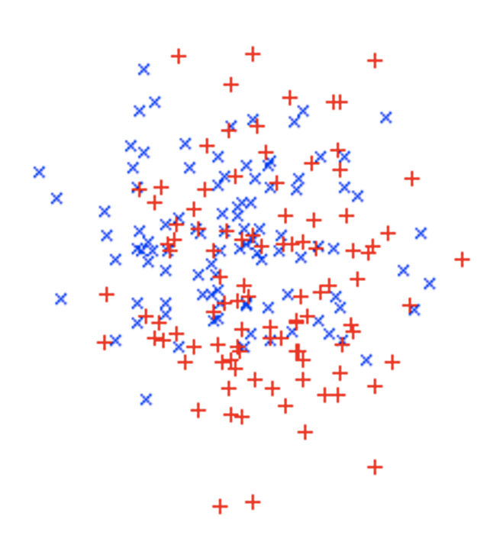
J_{max} = 1.47
1
2
3
4
5
6
7
8
9
score
J
1.53
J > J_{max} ?

Slide 15
7
J_{max} = 1.53
1
2
3
4
5
6
8
9
score
J
1.53
J > J_{max} ?
yes

Slide 16
7
J_{max} = 1.53
1
2
3
4
5
6
8
9
score
J
1.51
J > J_{max} ?
yes

Slide 17
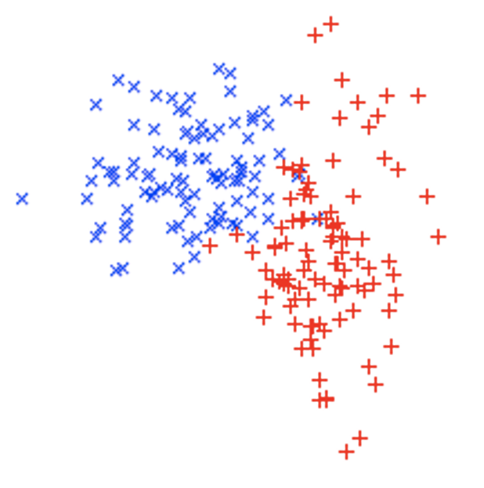
7
J_{max} = 2.31
1
2
3
4
5
6
8
9
score
J
2.31
J > J_{max} ?
yes

Slide 18
7
J_{max} = 2.31
1
2
3
4
5
6
8
9
score
J
2.27
J > J_{max} ?
yes

Slide 19
7
J_{max} = 2.31
1
2
3
4
5
6
8
9
score
J
2.17
J > J_{max} ?
yes

Slide 20
7
J_{max} = 2.31
1
2
3
4
5
6
8
9
score
J
1.93
J > J_{max} ?
yes

Slide 21
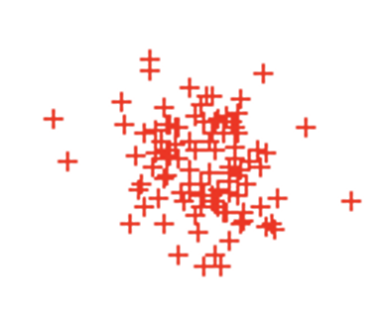
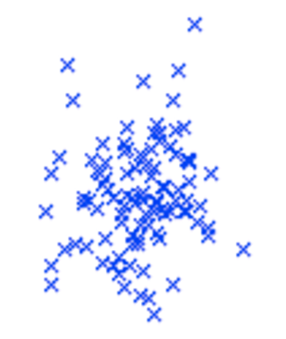
7
J_{max} = 3.63
1
2
3
4
5
6
8
9
score
J
3.63
J > J_{max} ?
yes

Slide 22
7
J_{max} = 3.63
1
2
3
4
5
6
8
9
score
J
1.55
J > J_{max} ?
yes

Slide 23
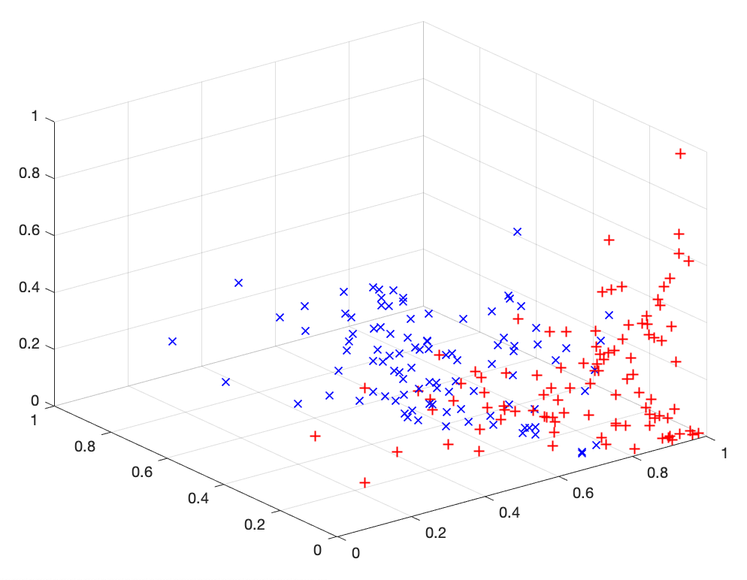
7
J_{max} = 3.63
1
2
3
4
5
6
8
9
score
J
3.65
J > J_{max} ?

Slide 24
8
7
J_{max} = 3.65
1
2
3
4
5
6
9
score
J
3.65
J > J_{max} ?
yes

Slide 25
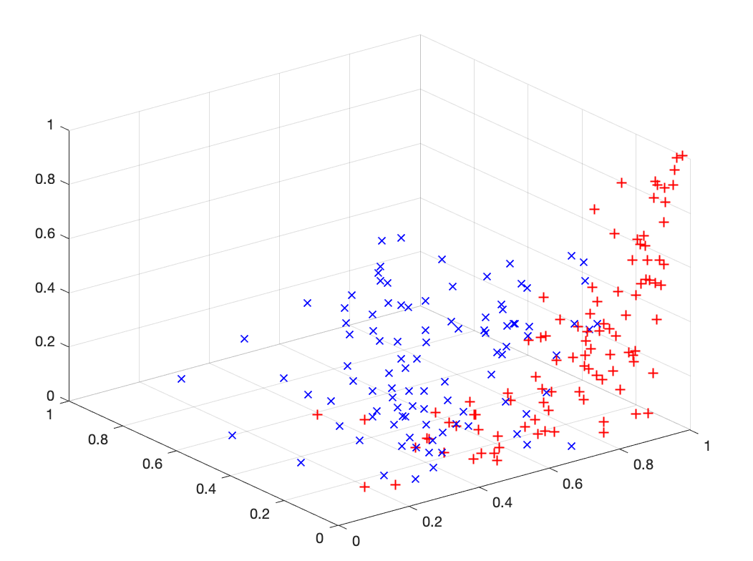
8
7
J_{max} = 3.82
1
2
3
4
5
6
9
score
J
3.82
J > J_{max} ?
yes

Slide 26
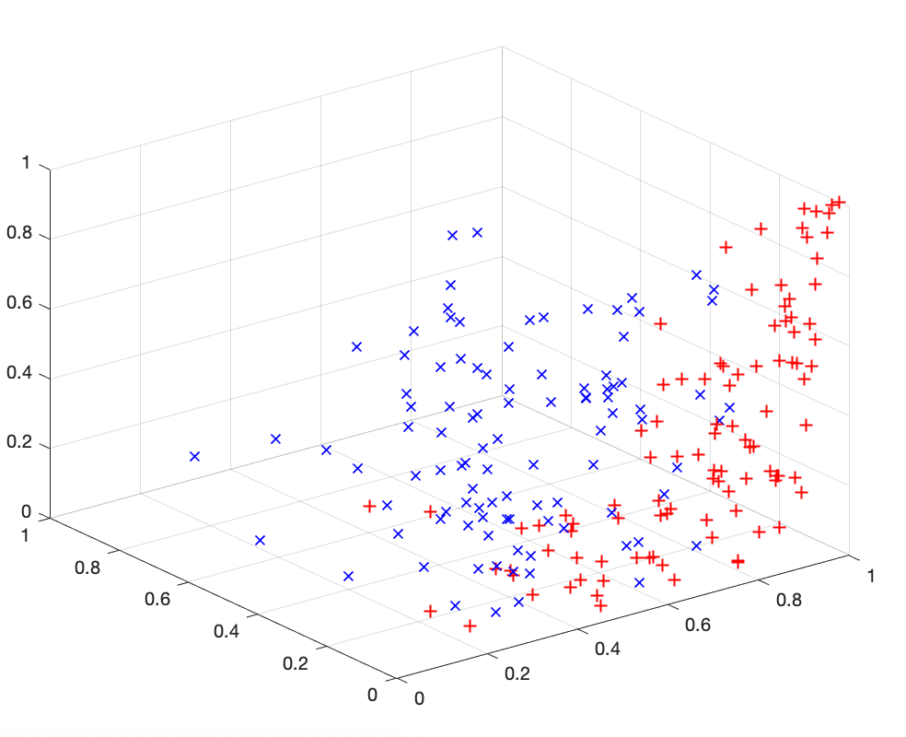
8
7
J_{max} = 3.82
1
2
3
4
5
6
9
score
J
3.70
J > J_{max} ?
yes

Slide 27
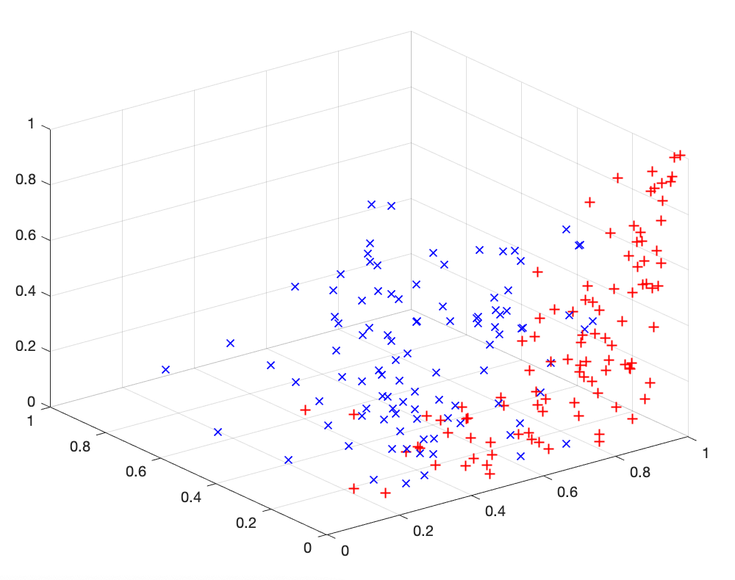
8
7
J_{max} = 3.82
1
2
3
4
5
6
9
score
J
3.70
J > J_{max} ?
yes

Slide 28
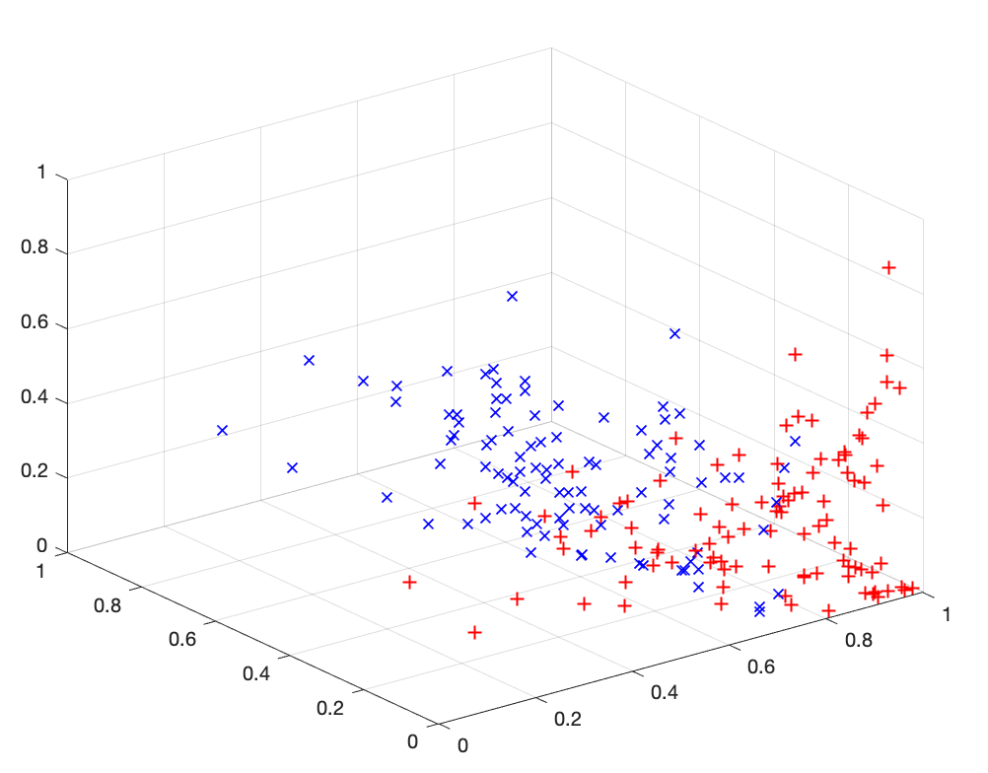
8
7
J_{max} = 3.94
1
2
3
4
5
6
9
score
J
3.94
J > J_{max} ?
yes

Slide 29
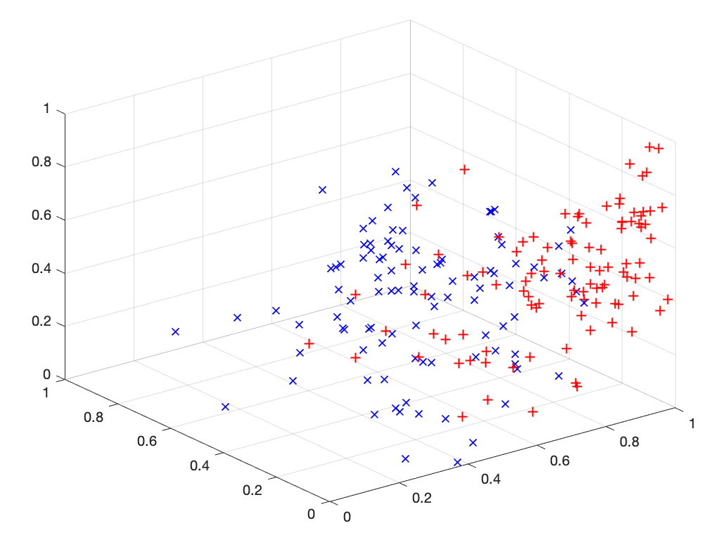
8
7
J_{max} = 3.94
1
2
3
4
5
6
9
score
J
3.64
J > J_{max} ?
yes

Slide 30
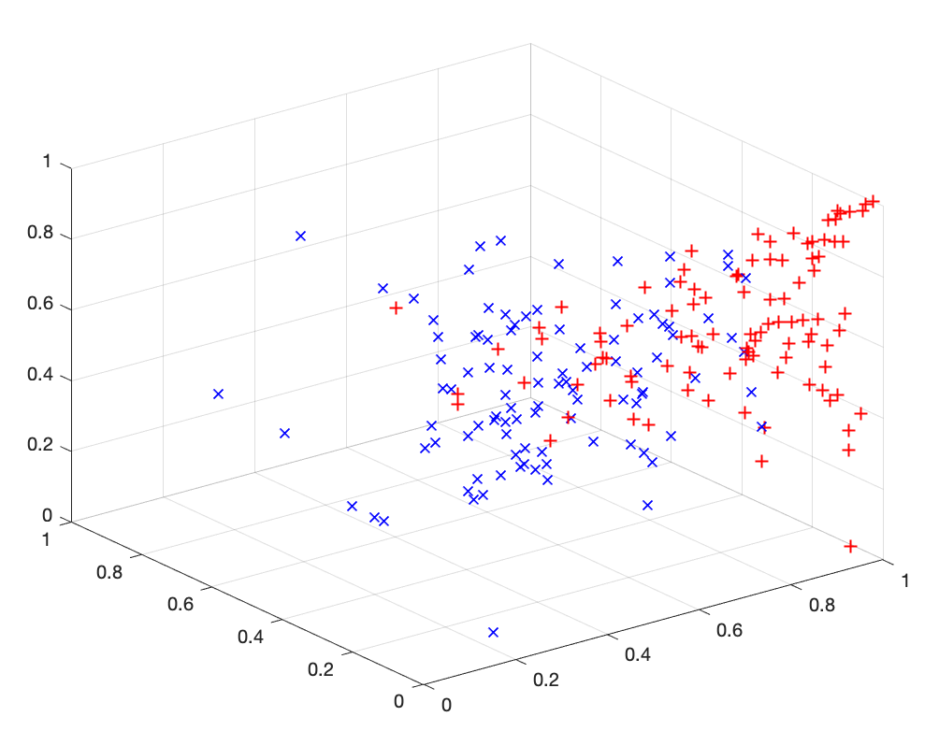
8
7
J_{max} = 3.94
1
2
3
4
5
6
9
score
J
3.72
J > J_{max} ?
yes

Slide 31
8
7
J_{max} = 3.94
1
2
3
4
5
6
9
3.94
J
3.63
1.47
Selected Features

Slide 32
SFS Algorithm
s = [ ] # selected features
a = ones(m,1) # available features
Jmax = 0 # initialization
for j = 1 to p # p features to be selected
for k = 1 to m # X has m features
if a(k) == 1 # is feature k available
st = [s, k] # columns of X
J = score(X(st)) # evaluation of the score
if J>Jmax
kmax = k
Jmax = J # update maximum
end
end
end
a(kmax) = 0 # selected features in no available
s = [s, kmax] # update selected features
end

