Slide 1
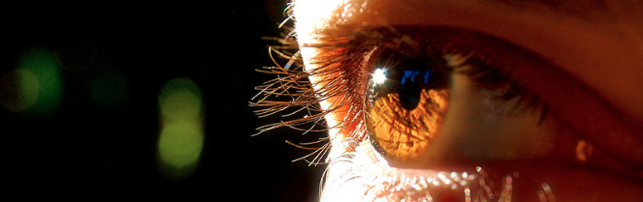
Reconocimiento de Patrones
Domingo Mery
Departmento de Ciencia de la Computación
Escuela de Ingeniería
Universidad Católica de Chile
Clustering: K-means
[ Capítulo 6 ]

Slide 2
Algorithm:
Input Data X = {x₁, x₂, ... x_{N}} and number of clusters K
Centroids {c₁, c₂, ... c_{K}} = random K points of X
For each data point x_{i}
Compute distance d_{ij} = d(x_{i},c_{j}) i=1,...,N, j=1,...K
Assign x_{i} to the nearest centroid: y_{i} = argmin_{j}{d_{ij}}
Compute the new centroids of each cluster
c*_{j} = mean(x_{i}) for y_{i} = j
if c*_{j} c_{j} then c_{j} = c*_{j} go to step 3
Output: {c*₁, c*₂, ... c*_{K}} and y_{i} for i=1,...,N
PAT06_KMeans.pptx

Slide 3
PAT06_KMeans.pptx

Slide 4
Choose random K=2 points (centroids)
PAT06_KMeans.pptx

Slide 5
Assign to the nearest centroid
PAT06_KMeans.pptx

Slide 6
Assign to the nearest centroid
PAT06_KMeans.pptx

Slide 7
Assign to the nearest centroid
PAT06_KMeans.pptx

Slide 8
PAT06_KMeans.pptx

Slide 9
Compute new centroids
PAT06_KMeans.pptx

Slide 10
Assign to the nearest centroid
PAT06_KMeans.pptx

Slide 11
Assign to the nearest centroid
PAT06_KMeans.pptx

Slide 12
Repeat until convergence
PAT06_KMeans.pptx

Slide 13
Algorithm:
Input Data X = {x₁, x₂, ... x_{N}} and number of clusters K
Centroids {c₁, c₂, ... c_{K}} = random K points of X
For each data point x_{i}
Compute distance d_{ij} = d(x_{i},c_{j}) i=1,...,N, j=1,...K
Assign x_{i} to the nearest centroid: y_{i} = argmin_{j}{d_{ij}}
Compute the new centroids of each cluster
c*_{j} = mean(x_{i}) for y_{i} = j
if c*_{j} c_{j} then c_{j} = c*_{j} go to step 3
Output: {c*₁, c*₂, ... c*_{K}} and y_{i} for i=1,...,N
PAT06_KMeans.pptx

Slide 14
Example: Two Clouds of Points

Slide 15
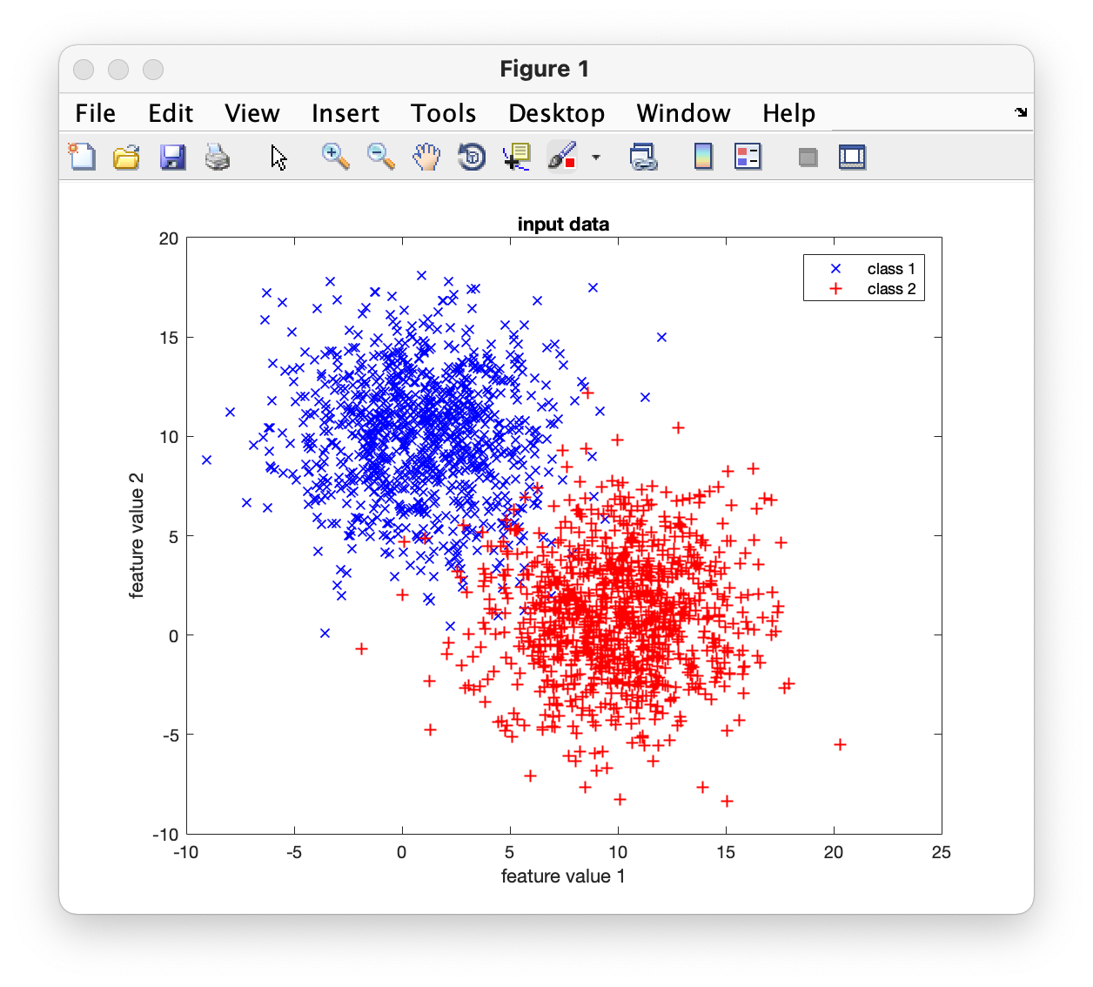
Input Data

Slide 16
Iteration 0:

Slide 17
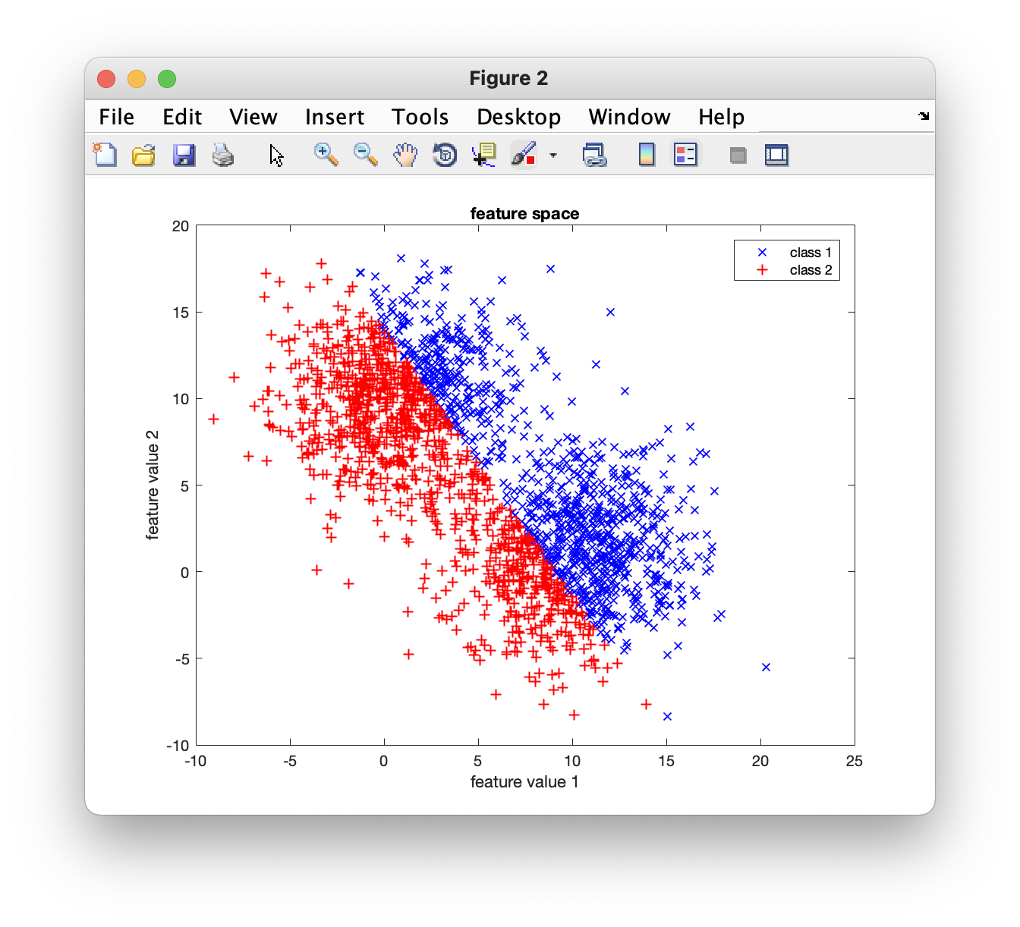
Iteration 1:
Random
points
Separation
line

Slide 18
Iteration 1:

Slide 19
Iteration 2:
Centroids
Separation
line

Slide 20
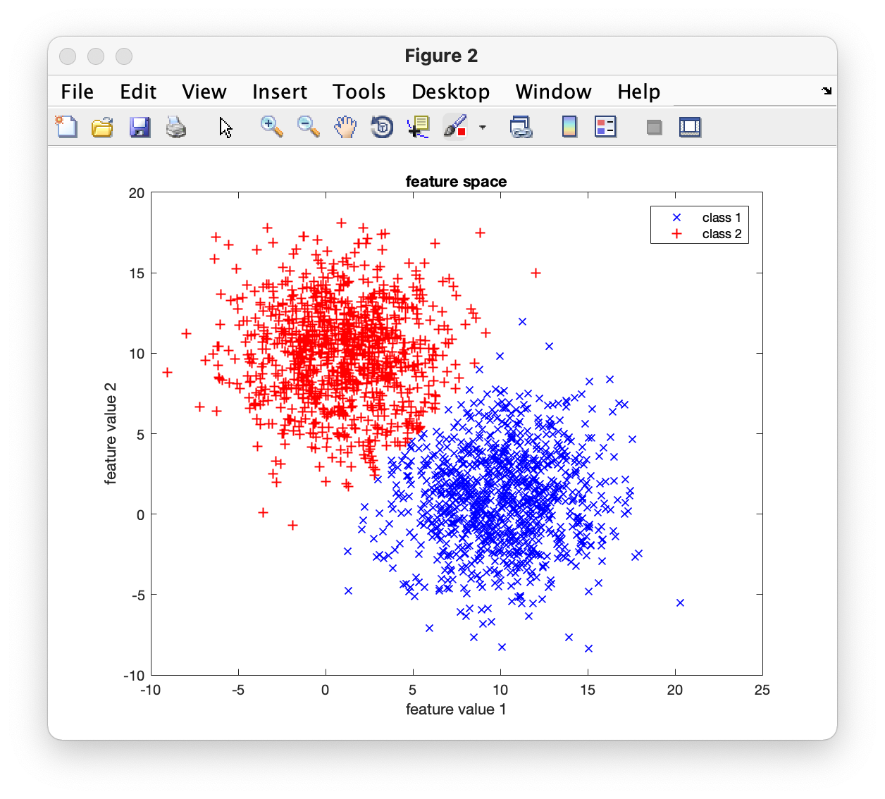
Iteration 3:

Slide 21

Iteration 4:

Slide 22

Iteration 5:

Slide 23
Found Clusters

Slide 24
Input Data

Slide 25
Example: Color Segmentation

Slide 26


Slide 27
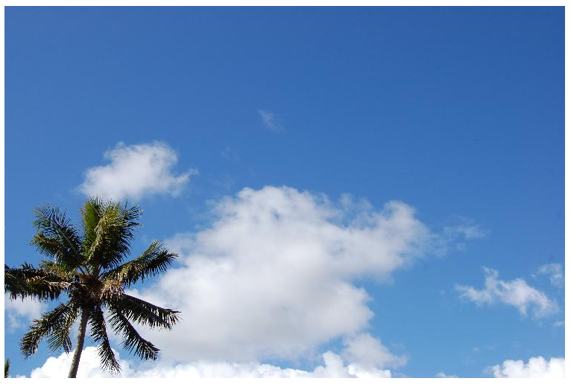
Segmentación por Clustering
B
(47,97,168)
G
(192,201,216)
R

Slide 28
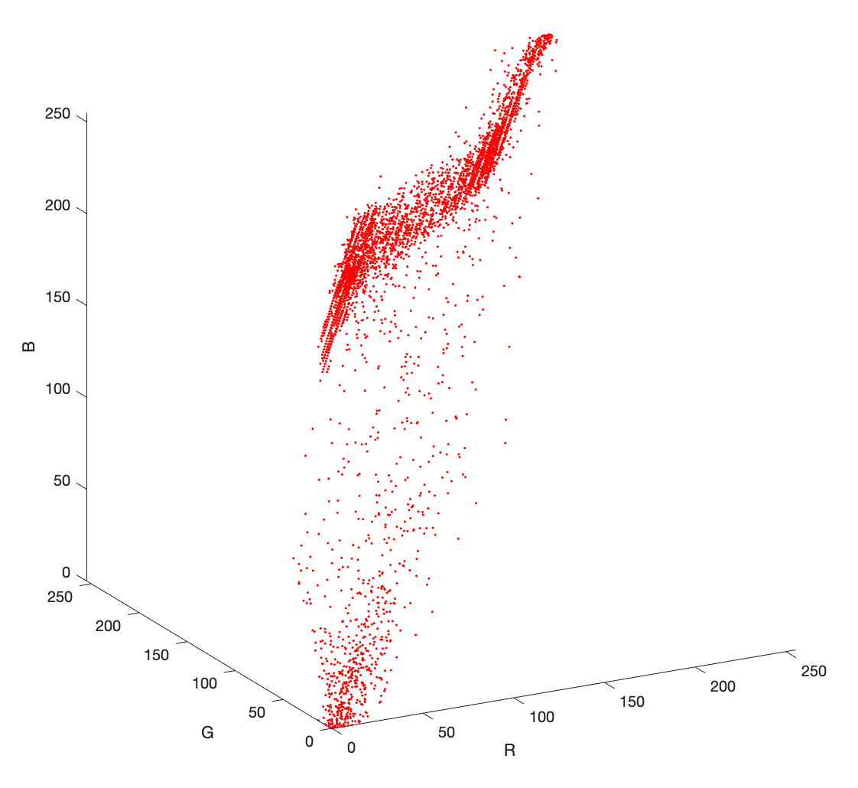
Segmentación por Clustering
B
G
R

Slide 29
Segmentación por Clustering

Slide 30
Segmentación por Clustering
cielo
nubes
palmera

Slide 31
Descomposición de Colores
Algoritmo
INPUT
R G B
Clustering
Clusters
OUTPUT

Slide 32
Clustering usando k-means

Slide 33
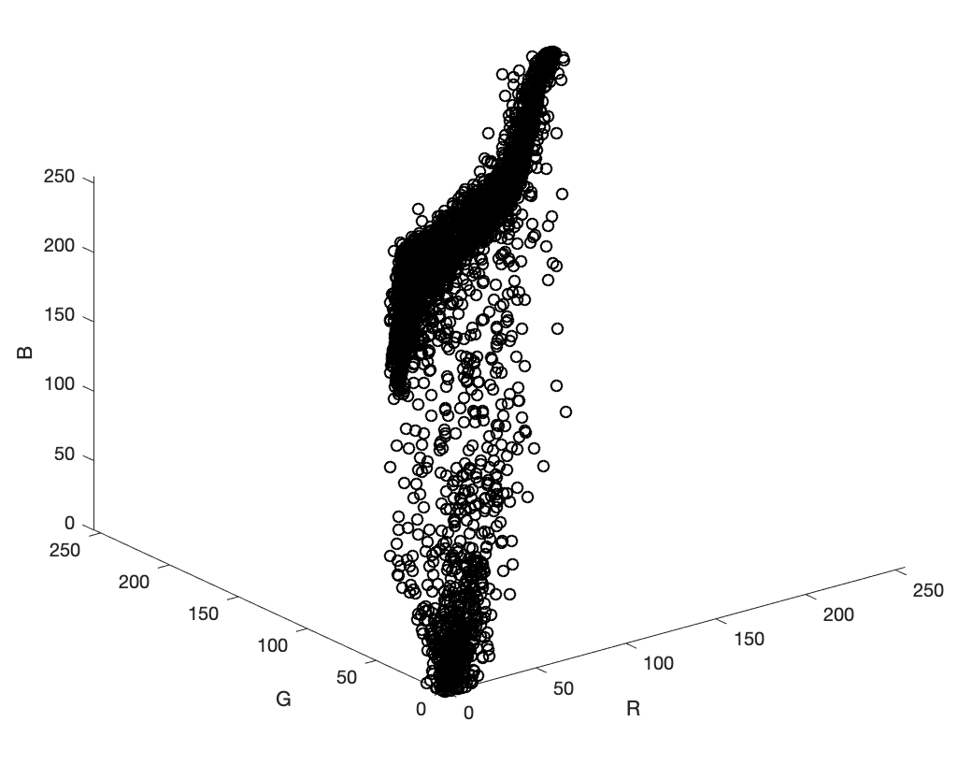

Slide 34
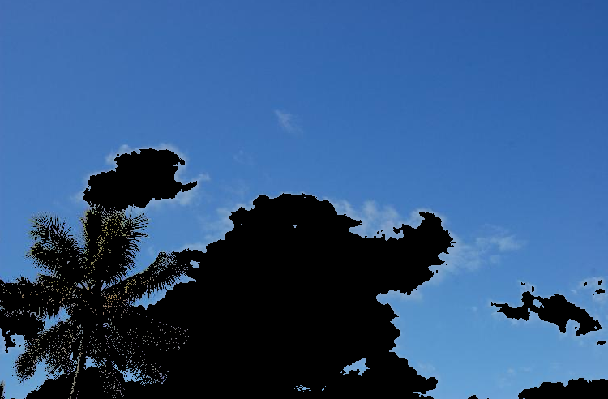
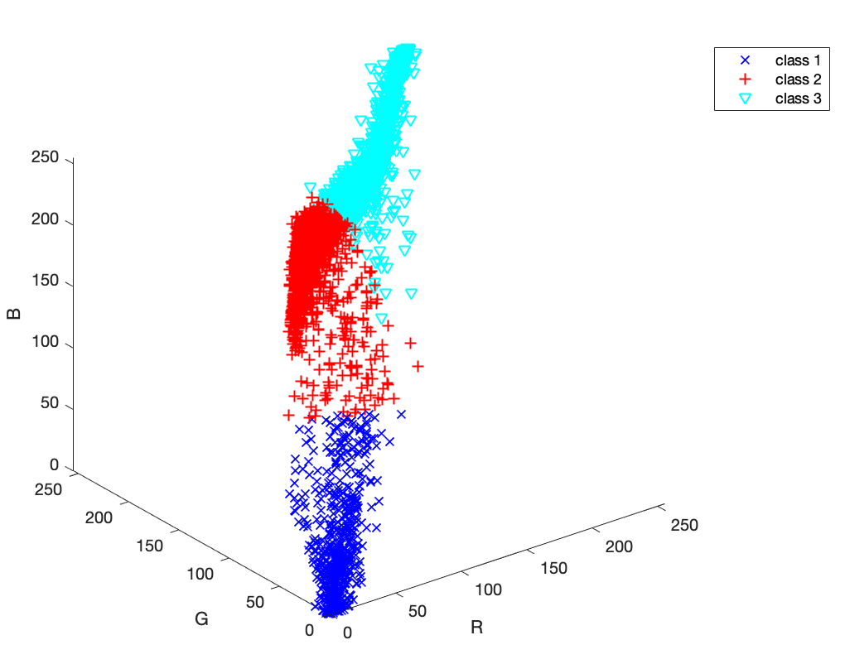

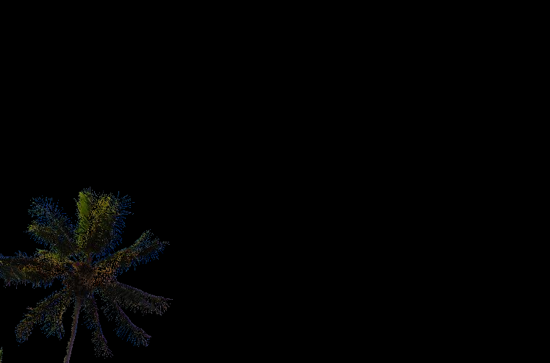

Slide 35
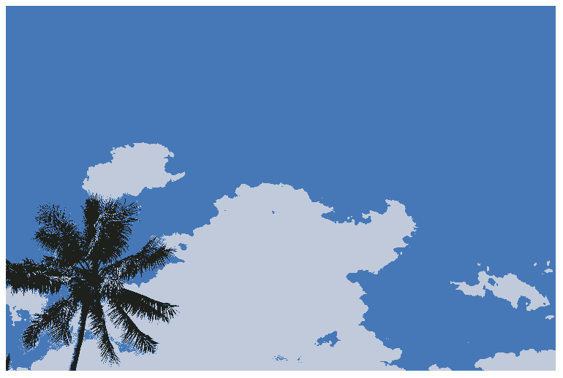
INPUT
OUTPUT

Slide 36
INPUT

Slide 37
OUTPUT

