Slide 1

Reconocimiento de Patrones
Domingo Mery
Departamento de Ciencia de la Computación
Escuela de Ingeniería
Universidad Católica de Chile
KNN
[ Capítulo 4 ]

Slide 2
KNN: k nearest neighbors

Slide 3
KNN: k nearest neighbors (two classes)
Training data

Slide 4
KNN: k nearest neighbors (two classes)
Testing data
?
Training data

Slide 5
KNN: k nearest neighbors (two classes)
KNN Algorithm
Testing data

Slide 6
KNN: k nearest neighbors (two classes)
KNN Algorithm
Distances
Testing data
0.3655
0.7015
0.6712
0.7474
0.4313
0.2880
0.0115
0.9202
0.5304
0.9362
0.5989
0.9447
0.0569
0.3264
0.6811
0.1332
0.0226
0.2435
0.0705
0.4839
0.3631
0.1090
0.6296
0.0508
0.7660
0.9544
0.6487
0.1519
0.7936
0.9525

Slide 7
KNN: k nearest neighbors (two classes)
KNN Algorithm
Distances
Sort
Testing data
0.3655
0.7015
0.6712
0.7474
0.4313
0.2880
0.0115
0.9202
0.5304
0.9362
0.5989
0.9447
0.0569
0.3264
0.6811
0.1332
0.0226
0.2435
0.0705
0.4839
0.3631
0.1090
0.6296
0.0508
0.7660
0.9544
0.6487
0.1519
0.7936
0.9525
0.0115
0.0226
0.0508
0.0569
0.0705
0.1090
0.1332
0.1519
0.2435
0.2880
0.3264
0.3631
0.3655
0.4313
0.4839
0.5304
0.5989
0.6296
0.6487
0.6712
0.6811
0.7015
0.7474
0.7660
0.7936
0.9202
0.9362
0.9447
0.9525
0.9544

Slide 8
KNN: k nearest neighbors (two classes)
KNN Algorithm
Distances
Sort
Take the k nearest
(example k=7)
Testing data
0.0115
0.0226
0.0508
0.0569
0.0705
0.1090
0.1332
0.1519
0.2435
0.2880
0.3264
0.3631
0.3655
0.4313
0.4839
0.5304
0.5989
0.6296
0.6487
0.6712
0.6811
0.7015
0.7474
0.7660
0.7936
0.9202
0.9362
0.9447
0.9525
0.9544

Slide 9
KNN: k nearest neighbors (two classes)
KNN Algorithm
Distances
Sort
Take the k nearest
(example k=7)
Majority vote
Testing data
0.0115
0.0226
0.0508
0.0569
0.0705
0.1090
0.1332
0.1519
0.2435
0.2880
0.3264
0.3631
0.3655
0.4313
0.4839
0.5304
0.5989
0.6296
0.6487
0.6712
0.6811
0.7015
0.7474
0.7660
0.7936
0.9202
0.9362
0.9447
0.9525
0.9544
2 blue
5 red
Testing sample is red

Slide 10
KNN: k nearest neighbors (two classes)
KNN Algorithm
Distances
Sort
Take the k nearest
(example k=7)
Majority vote
Testing data
2 blue
5 red
Testing sample is red

Slide 11
KNN: k nearest neighbors (two classes)
KNN Algorithm
Distances
Sort
Take the k nearest
(example k=7)
Majority vote
Testing data

Slide 12
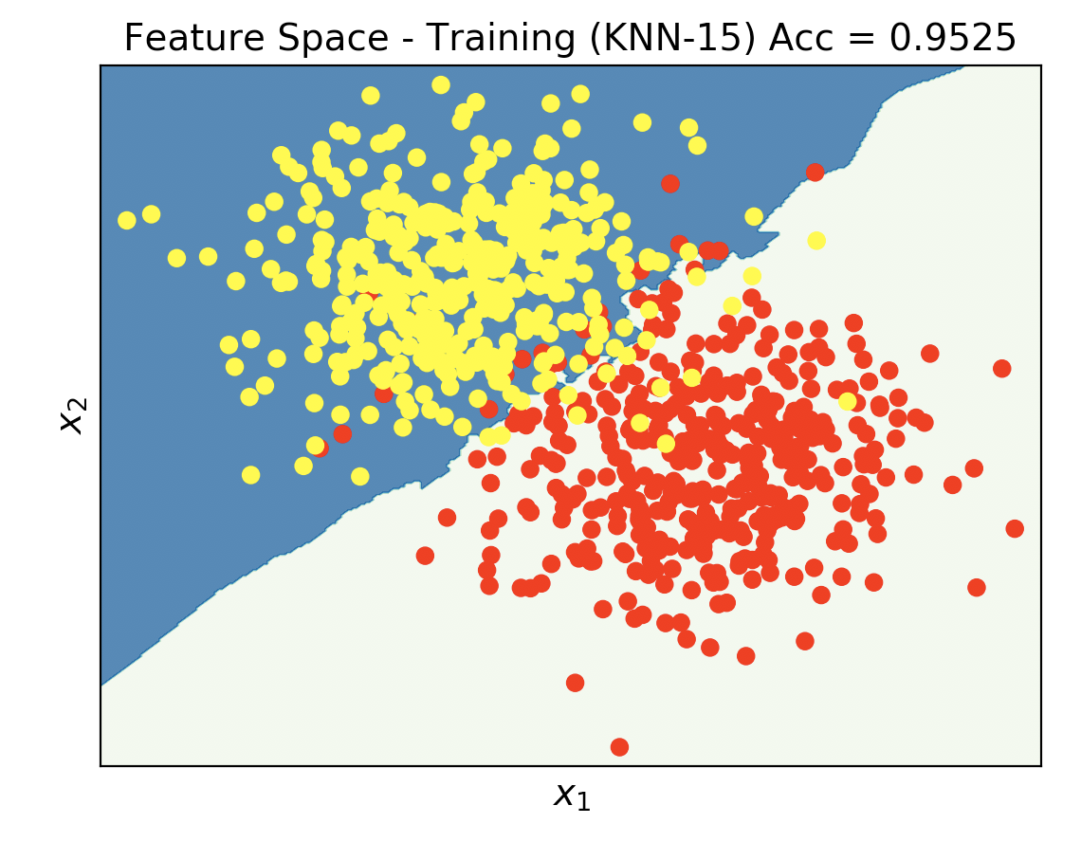
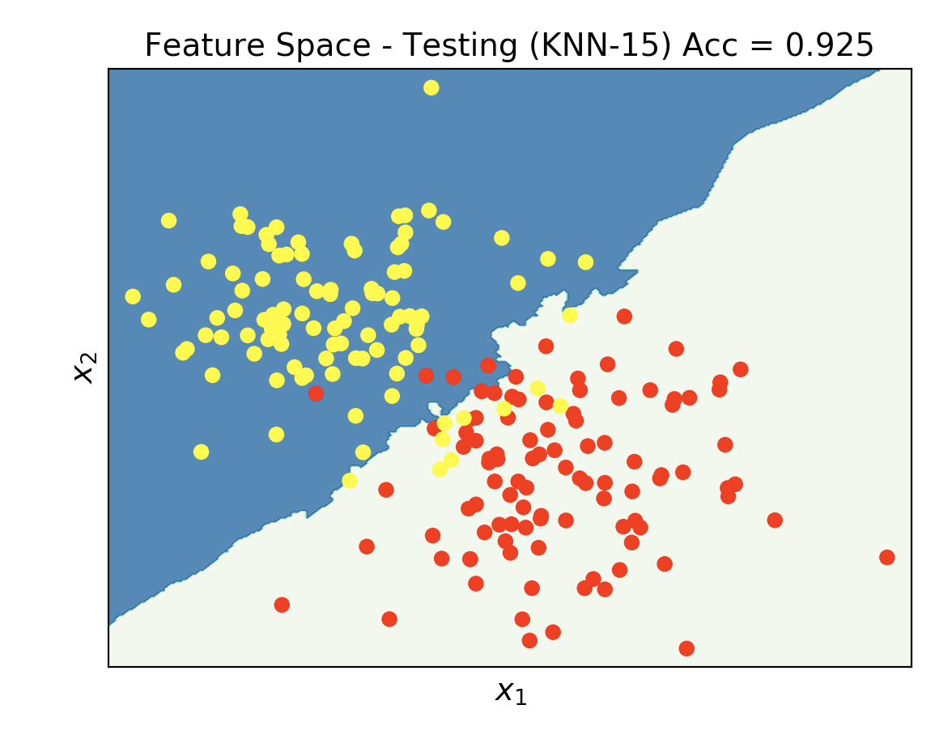
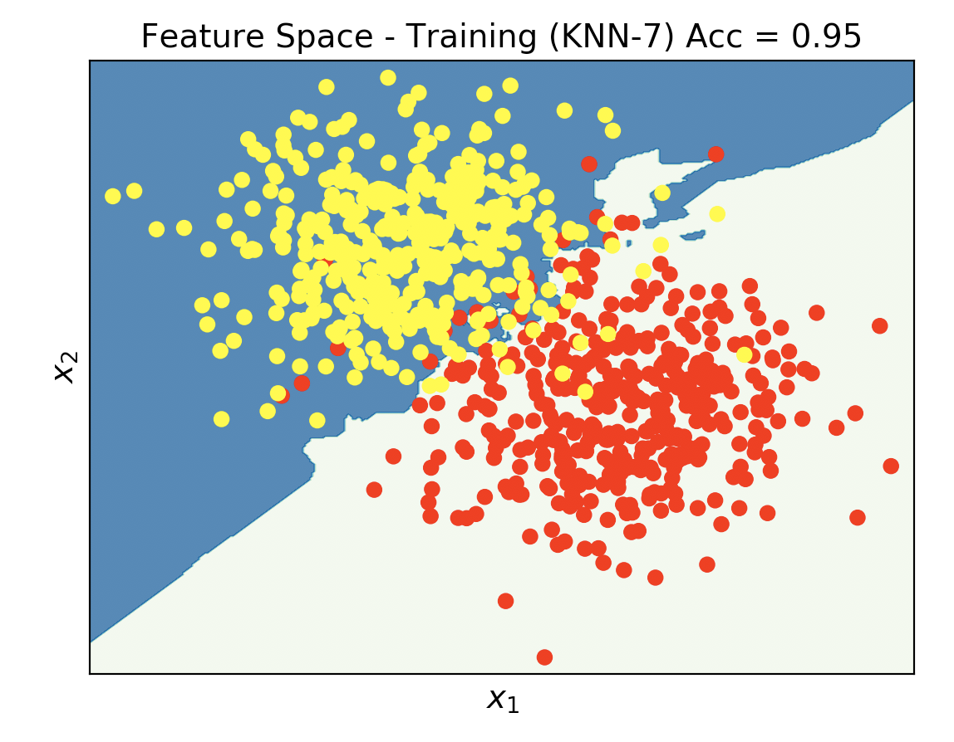
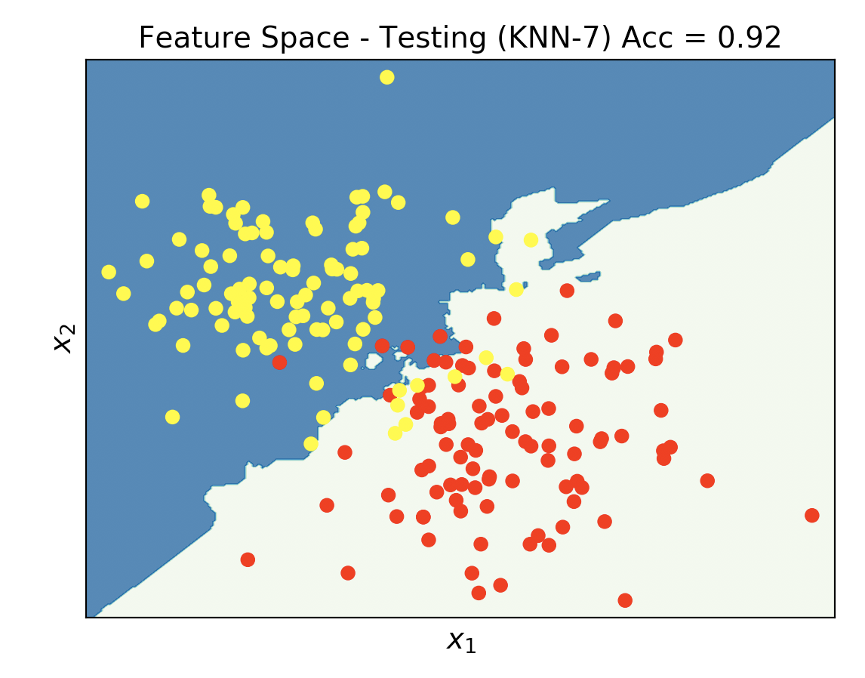
TRAINING
TESTING
k = 15
k = 7

Slide 13
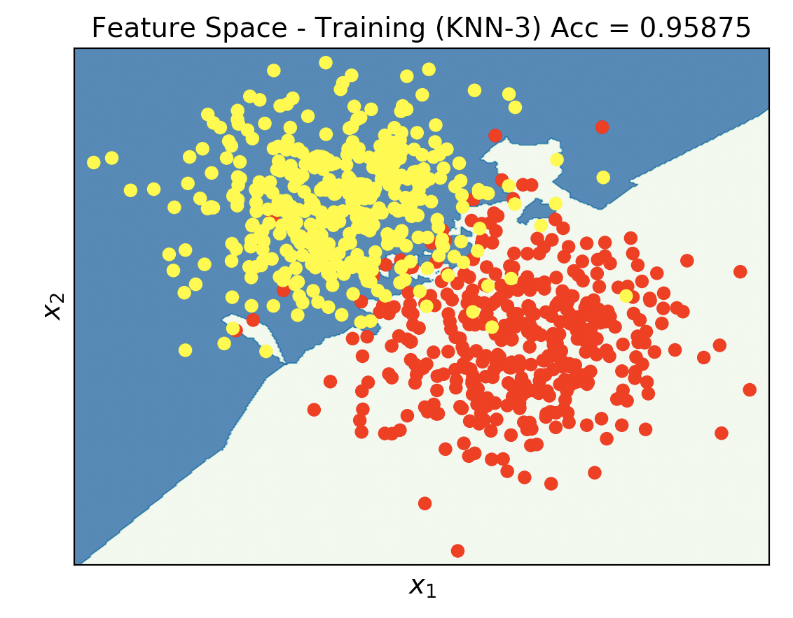
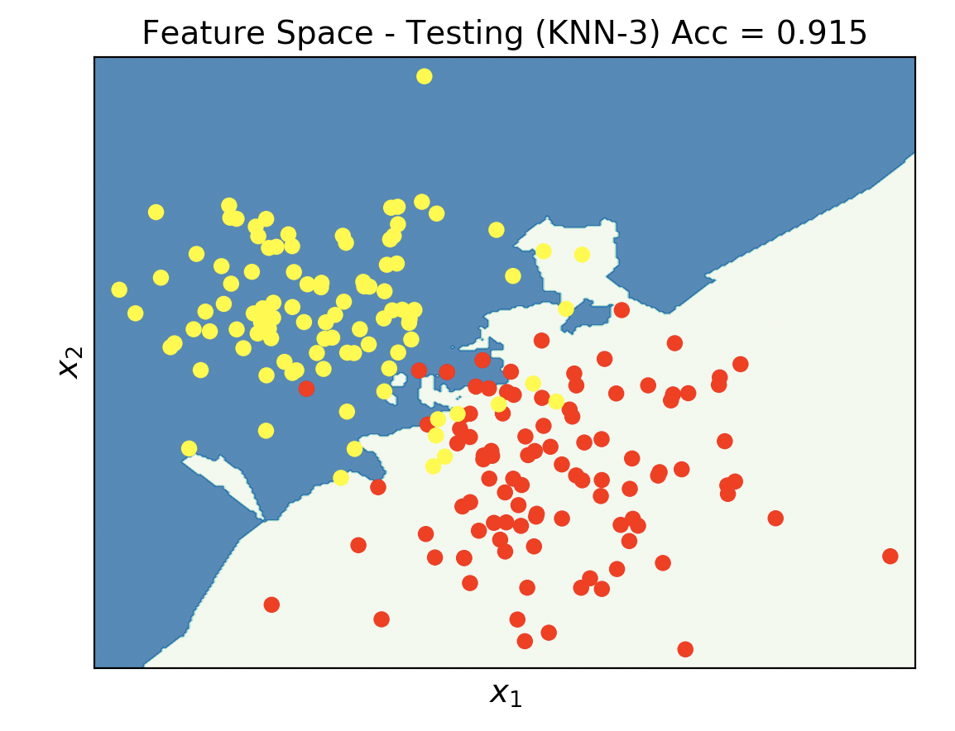
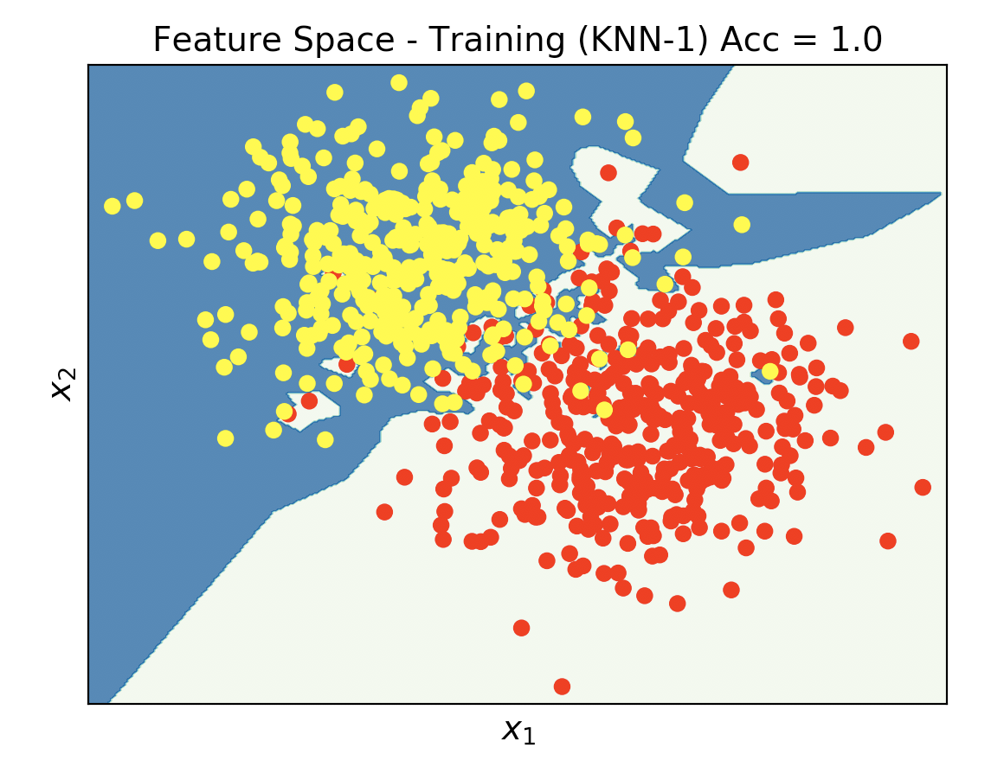
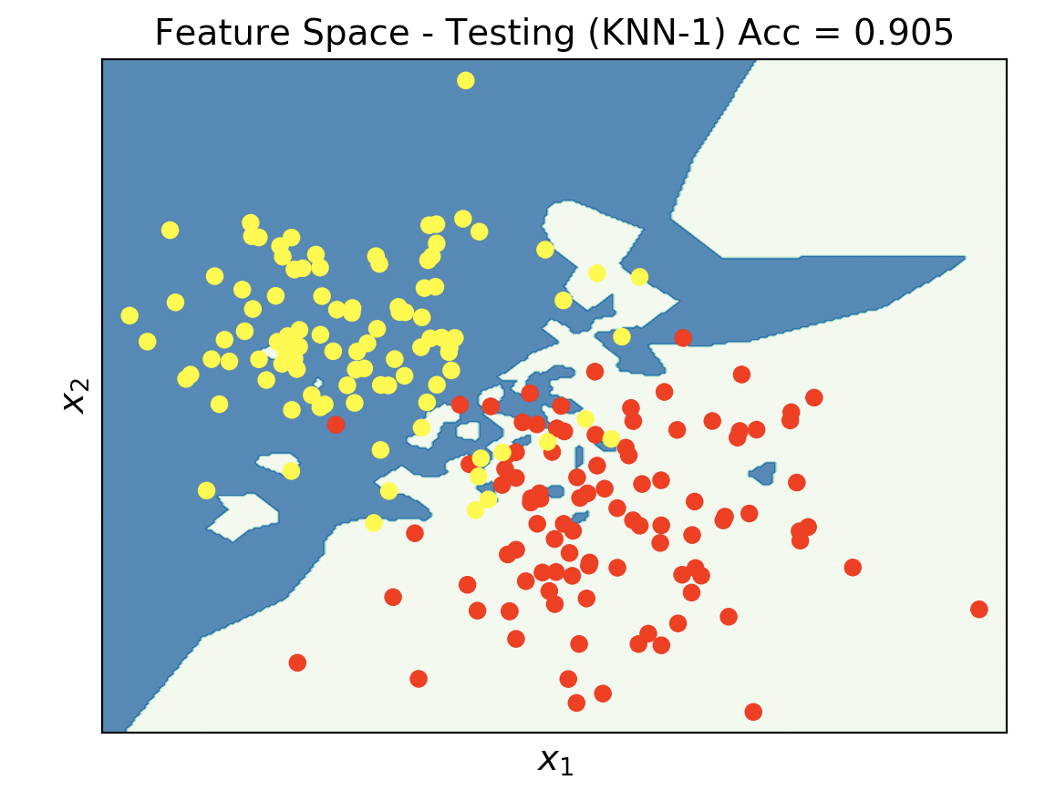
TRAINING
TESTING
k = 3
k = 1

Slide 14
Example with 80 million images

Slide 15
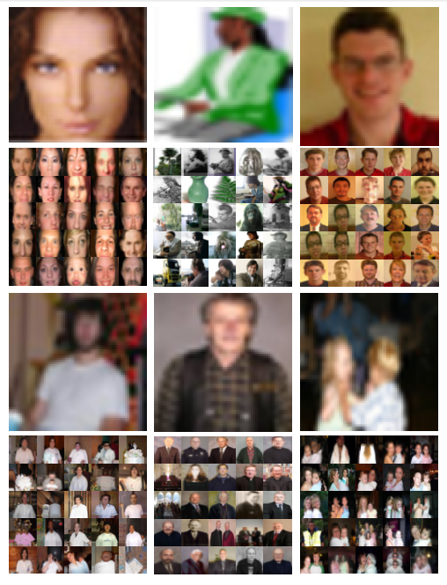

Slide 16
