Slide 1
Parser and Scanner for Complex Number Expressions
Group:
Mohammed Alqadda, 202002837
Kanaan Abukhadra, 202101747

Slide 2
Project Objective:
Implement a Scanner/Parser for a simple language for expressions involving complex numbers using FLEX (Fast Lexical Analyzer Generator) and Bison (parser generator).
FLEX: A tool for generating scanners (lexical analyzers).
Bison: A tool for generating parsers.

Slide 3
What our Language do?
Our Language supports all four basic arithmetic operations between complex numbers,
Arithmetic operations: +, -, *, /
Complex numbers: (a ± bi), where a and b are integers.
Numbers that are missing either the real component (a) or the imaginary component (bi) are considered valid.
Parentheses for grouping.

Slide 4
How it Works:
User Input
Lexer (FLEX),
Tokens
Parser (Bison)
Output

Slide 5
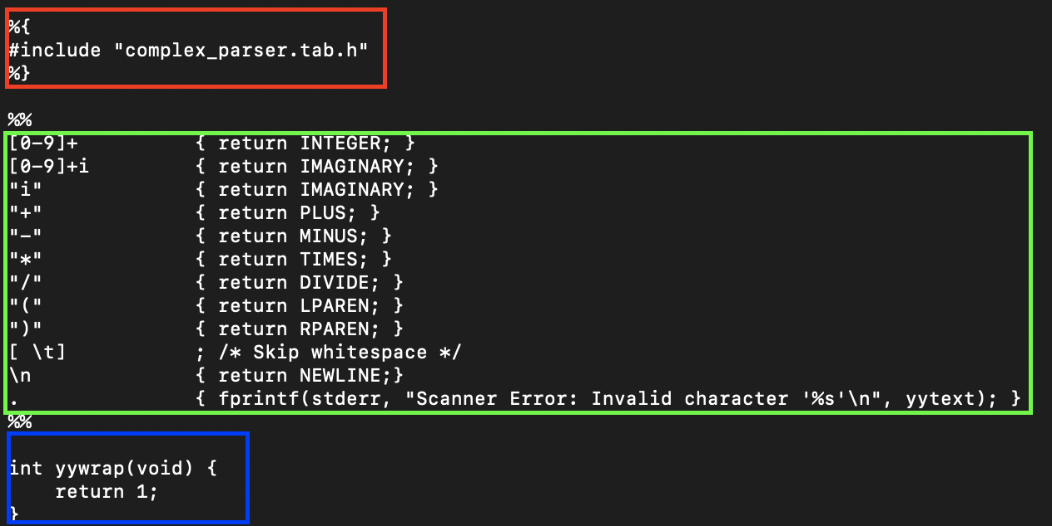
A Look at Our Flex File (Scanner)
Definitions Section
Rules Section
User Code Section
Notes:
#include "complex_parser.tab.h" This is for ensuring proper communication and type compatibility between the lexer and parser.
yywrap() is a Flex function called when the lexer reaches the end of input. Returning 1 tells Flex to stop scanning.

Slide 6
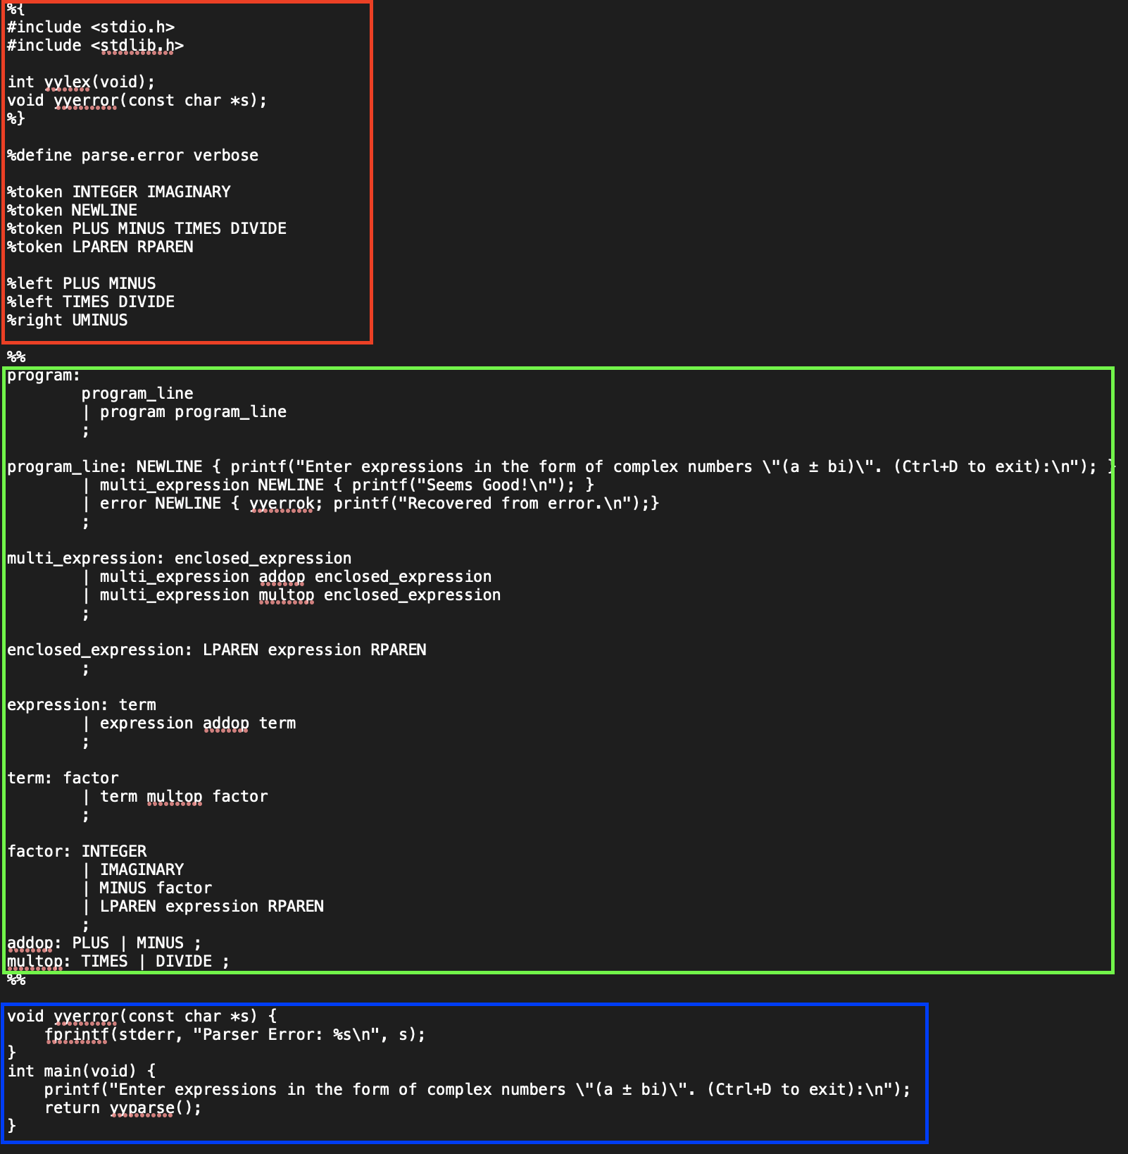
A Look at Our Bison File (Parser)
Definitions Section
Rules Section
User Code Section
Notes:
in factor rule, it is fixed to have MINUS factor %prec UMINUS; instead of MINUS factor

Slide 7
After We are Finished with Flex and Bison Files We Run these Commands
bison -d filename.y
To generate the parser code.
Which gives,
filename.tab.c: The C source file implementing the parser.
filename.tab.h: A header file containing token definitions for use in the scanner (Flex).
flex filenme.l
to generate the scanner code.
Which gives,
lex.yy.c
gcc lex.yy.c filename.tab.c -o programname
To get an executable program.
Which gives,
Programname
The final executable, To run, ./Programname

Slide 8
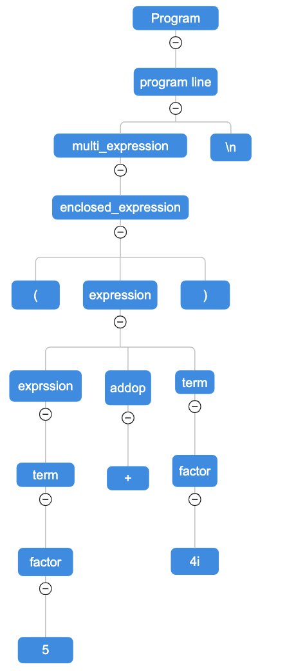
Parse Tree Showing A Valid Complex Number, (5+4i)\n

Slide 9
Valid Complex Number Examples
(3 + 4i), (3), and (4i)
(3 + 4i) + (5 - 2i) and (2i) * (-3i)
(0 + 0i), (3 - -2i), and (((1 + i)))
(5 – 2i) - (-2 + 3i)*(-5i) + (7)

Slide 10
Invalid Complex Number Examples
3 +4i, 3, and 4i
(3 + 4i , and 3 + 4i)
( + 4i) and (3 - )
(3 + 4i) + * (5 - 2i)
(3 + 4j), and (3 + 4#)

