Slide 1
Lab 6: LLM on Raspberry Pi 5

Slide 2
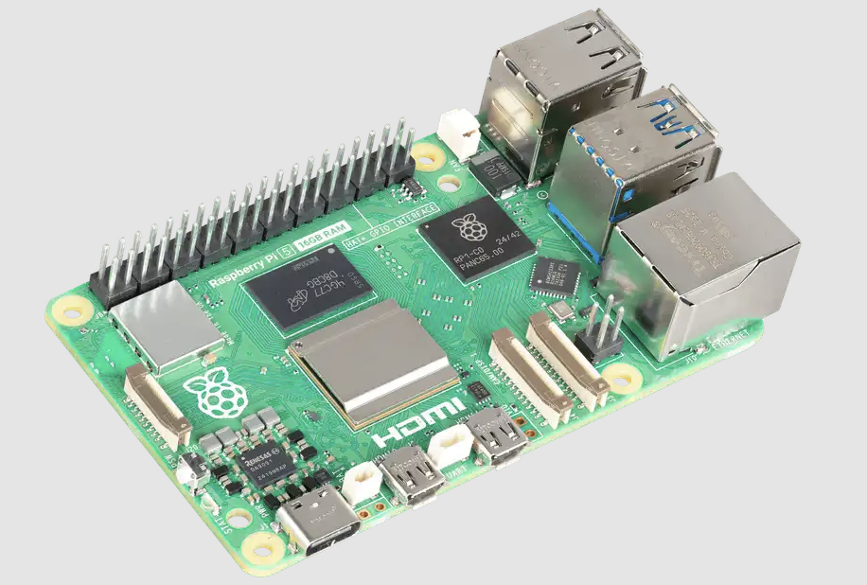
Raspberry Pi 5
The Raspberry Pi 5 is a powerful, affordable single-board computer featuring a quad-core Arm CPU.

Slide 3
SSH into device
ssh <user name>@<IP address>
password: <password>

Slide 4
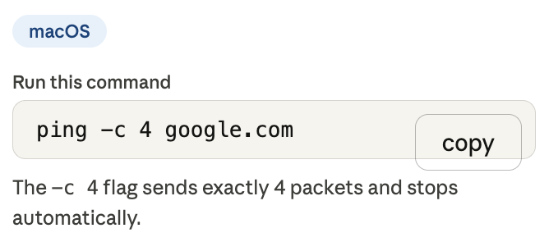
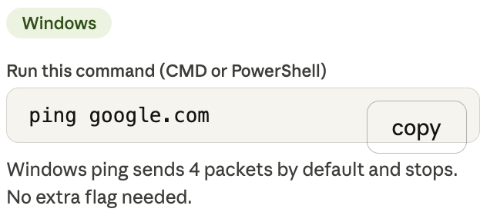
SSH into device Preliminaries
Open the terminal in your laptop
You should have 4 successful packets transmission

Slide 5
SSH into device Preliminaries
Now connect to:
SSID: TP-Link_BC8C
Password: default0000
After connecting to TP-Link_BC8C, open the terminal in your laptop
You should have 4 FAILED packets transmission

Slide 6
SSH into device Preliminaries
After connecting to TP-Link_BC8C, open the terminal in your laptop
Replace ‘google.com’ with ‘192.168.0.165’
You should have 4 successful packets transmission
Congratulations! You are in the raspberry pi local network!

