Slide 1
Demo
Accessing Raspberry Pi 5

Slide 2
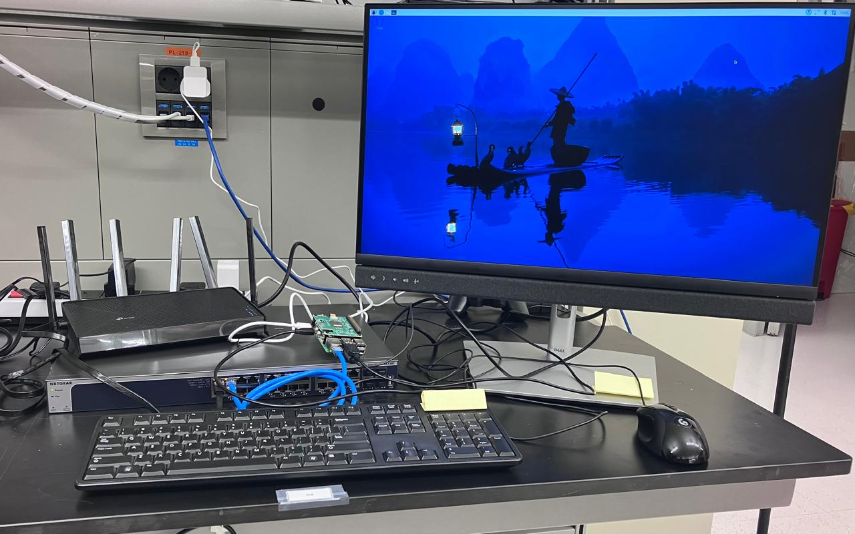
Setup
Wifi router
Rpi-5
Switch

Slide 3
A first time run
A first time run might need a User Interface (UI)
Using an HDMI with a keyboard and a mouse.
VNCTiger is used instead of directly using HDMi.

Slide 4
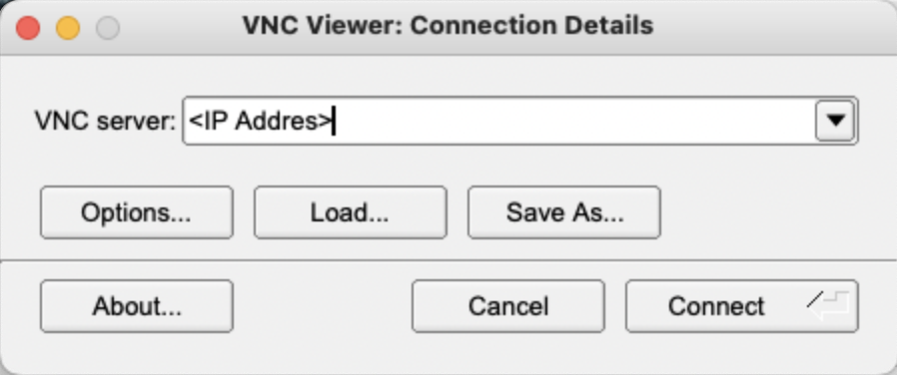
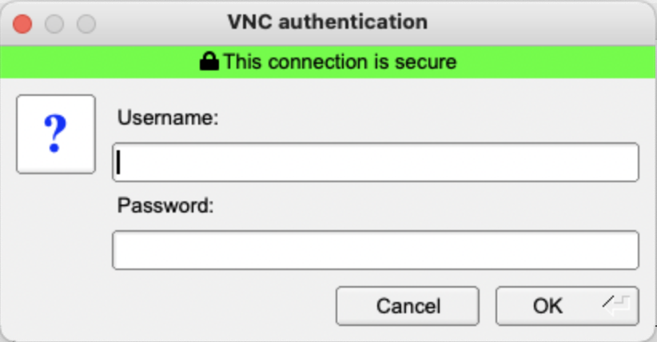
A first time run: Using VNC
Insert the RPi-5 IP address then ’connect’.
Insert your credentials

Slide 5
A practical Deployment scenario
Take the scenario where many devices are connected to a switch and you need to access them.
A solution is to connect to them using ‘SSH’

Slide 6
A practical Deployment scenario How to use ssh
Open the terminal
Find the device IP:
Use ifconfig
Ping (i.e., send packets) to the device to confirm connectivity.
ping -c 5 <IP>
If succeeded, connect using ssh:
ssh <user_name>@<IP>

Slide 7
A practical Deployment scenario Use the device via ssh
pwd to check you current directory
ls to check the content
cd to navigate through the directories
Example:
cd Documents/MoI
mkdir live_demo
cd live_demo
nano hello_demo.py
Create and edit a new file named ‘hello_demo.py’
Write a hello world python script, exit and save.
Run the script using python hello_demo.py

