Slide 1


Deploying TensorFlow Lite
on ESP32-C3
From Offline Training to On-Device Inference
MNIST Handwritten Digit Recognition • A Step-by-Step Guide
CCSL Lab • KAUST

Slide 2
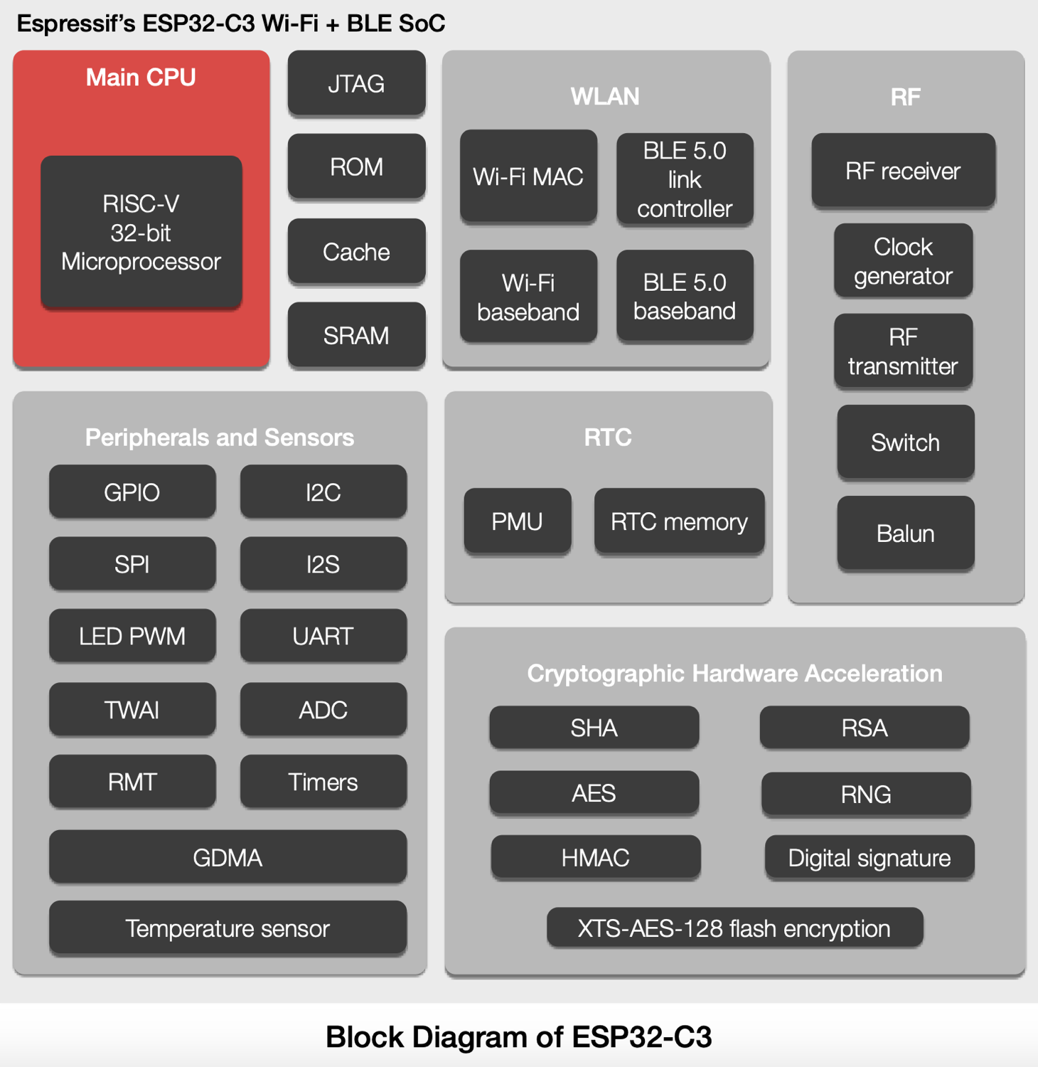
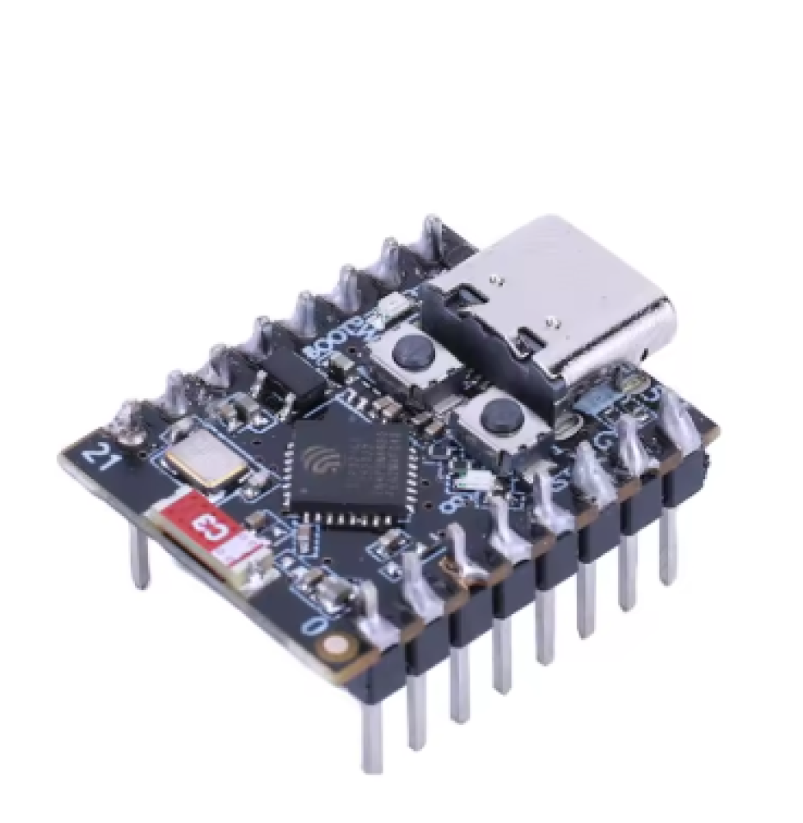
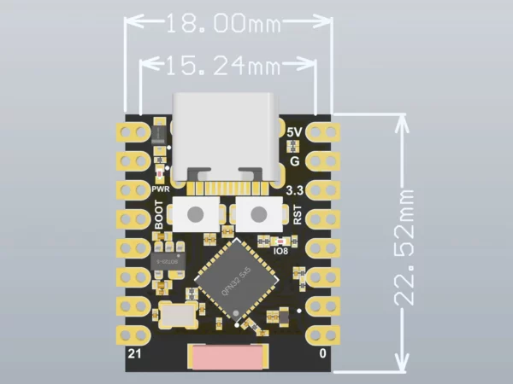

The Big Picture: Our Workflow
We train a neural network on a PC, shrink it, then run it on a tiny chip
Key Idea: The ESP32-C3 is too small to train a model. We train on a powerful PC, then transfer only the trained weights to the microcontroller for inference (prediction only).
2 / 16

Slide 3




The Big Picture: Our Workflow
We train a neural network on a PC, shrink it, then run it on a tiny chip
1. Train
2. Evaluate
3. Convert
4. Deploy
Build & train a neural network on PC using TensorFlow + MNIST data
Check accuracy & loss to make sure the model works well
Convert the model to TF Lite format (.tflite) — tiny & optimized
Export as C header file, flash to ESP32-C3, run inference on-device
Key Idea: The ESP32-C3 is too small to train a model. We train on a powerful PC, then transfer only the trained weights to the microcontroller for inference (prediction only).
2 / 16

Slide 4



Key Concepts
TensorFlow
TensorFlow Lite (TF Lite)
An open-source library by Google for building and training machine learning models. We use it on a PC (Google Colab) to create our digit-recognition model.
A lightweight version of TensorFlow designed for microcontrollers and mobile devices. It takes a trained model and converts it to a tiny, efficient format.
ESP32-C3
MNIST Dataset
A low-cost, low-power microcontroller with Wi-Fi & Bluetooth. It has limited memory (~400 KB RAM) — perfect for running small TF Lite models at the edge.
A classic dataset of 70,000 handwritten digit images (0-9), each 28×28 pixels in grayscale. It's the "Hello World" of machine learning.
Inference vs Training
C Header File (.h)
Training = teaching the model (heavy, done on PC). Inference = using the trained model to make predictions (light, done on ESP32-C3).
The TF Lite model is converted into a C array stored in a .h file. This lets us include the model directly in our ESP32 firmware code.
3 / 16

Slide 5
Step 1
Load the MNIST Dataset
Import libraries and download 60,000 training + 10,000 test images
import keras
import tensorflow as tf
import matplotlib.pyplot as plt
from keras.models import Sequential
from keras.layers import Dense
from keras.optimizers import SGD
# Download MNIST (auto from internet)
(X_train, y_train), (X_valid, y_valid) = \
tf.keras.datasets.mnist.load_data()
What is happening?
We import TensorFlow and Keras (a friendly API for TF). Then we download the MNIST dataset which automatically splits into training set (60K images) and test/validation set (10K images).
Key Libraries
• keras — builds neural networks easily
• tensorflow — the engine behind keras
• matplotlib — for plotting graphs
• Sequential — a stack of layers
• Dense — a fully-connected layer
💡 Run this in Google Colab — it's free and has TensorFlow pre-installed!
4 / 16

Slide 6

Step 2
Visualize the Data
Always look at your data before training!
# Show 12 sample images in a 3x4 grid
plt.figure(figsize=(5, 5))
for k in range(12):
plt.subplot(3, 4, k+1)
plt.imshow(X_train[k], cmap='Greys')
plt.axis('off')
plt.tight_layout()
plt.show()
Why Visualize?
Before building a model, it's important to see what the data looks like. Each image is 28×28 pixels showing a handwritten digit from 0 to 9.
What You'll See
A grid of grayscale handwritten digits. Each pixel is a value from 0 (black) to 255 (white). The label tells us which digit it is.
28 × 28
pixels
Label: 5
5 / 16

Slide 7
Step 3
Preprocess the Data
Reshape images to 1D vectors and normalize pixel values to 0-1
# Flatten 28x28 images to 784-element vectors
X_train = X_train.reshape(60000, 784)
.astype('float32') / 255
X_valid = X_valid.reshape(10000, 784)
.astype('float32') / 255
Reshape — Why?
A Dense (fully-connected) neural network expects a 1D input. So we flatten each 28×28 image into a single row of 784 numbers.
Normalize — Why?
28 × 28
2D Image
Pixel values go from 0 to 255. Dividing by 255 scales them to 0.0–1.0. This helps the network learn faster and more stably.
784 values
1D Vector
float32
We convert integers to 32-bit floats because neural networks do math with decimal numbers, not whole numbers.
6 / 16

Slide 8
Step 4
One-Hot Encode the Labels
Convert digit labels into vectors the network can understand
n_classes = 10
y_train = keras.utils.to_categorical(
y_train, n_classes)
y_valid = keras.utils.to_categorical(
y_valid, n_classes)
What is One-Hot Encoding?
Instead of label "3", we create a vector of 10 zeros with a 1 at position 3. This way the network outputs a probability for each digit (0-9).
Example: Label "3"
3
[0, 0, 0, 1, 0, 0, 0, 0, 0, 0]
0 1 2 3 4 5 6 7 8 9
Why 10 classes?
Digits 0 through 9 = 10 possible categories. The output layer will have 10 neurons — one per digit.
7 / 16

Slide 9
Step 5
Build the Neural Network
A simple 3-layer fully-connected (Dense) model
model = Sequential()
model.add(Dense(64, activation='relu',
input_shape=(784,)))
model.add(Dense(64, activation='relu'))
model.add(Dense(10, activation='softmax'))
Sequential
Layers stacked one after another — the simplest way to build a neural network in Keras.
ReLU Activation
ReLU(x) = max(0, x). Introduces non-linearity so the model can learn complex patterns.
Input
784
Dense
64 (ReLU)
Dense
64 (ReLU)
Output
10 (Softmax)
Softmax
Converts raw outputs into probabilities that sum to 1.0. Highest probability = predicted digit.
Why 64 neurons?
Small enough for ESP32-C3's limited RAM (~400KB), but big enough to learn digit patterns.
8 / 16

Slide 10
Step 6
Compile & Train the Model
Set the loss function, optimizer, then train for 20 epochs
model.compile(
loss='categorical_crossentropy',
optimizer=SGD(learning_rate=0.1),
metrics=['accuracy']
)
categorical_crossentropy
The loss function for multi-class classification. Measures how far the predicted probabilities are from the true labels.
SGD Optimizer
history = model.fit(
X_train, y_train,
batch_size=128,
epochs=20,
verbose=1,
validation_data=(X_valid, y_valid)
)
Stochastic Gradient Descent — updates weights step by step to minimize the loss. Learning rate = 0.1 controls the step size.
Epochs & Batches
Epoch = one full pass through all 60K images. Batch = 128 images processed at once. 20 epochs means the model sees each image 20 times.
✅ Result: ~97.5% validation accuracy after 20 epochs
9 / 16

Slide 11

Step 7
Plot Training Results
Visualize training vs validation loss to check for overfitting
loss = history.history['loss']
val_loss = history.history['val_loss']
epochs = range(1, len(loss) + 1)
plt.plot(epochs, loss, 'r.', label='Training loss')
plt.plot(epochs, val_loss, 'b', label='Validation loss')
plt.title('Training and validation loss')
plt.xlabel('Epochs')
plt.ylabel('Loss')
plt.legend()
plt.show()
What to Look For
Both curves should decrease. If training loss keeps going down but validation loss goes up, the model is overfitting (memorizing, not learning).
Good Result ✓
In our training: both losses decrease smoothly and converge. Final validation loss ≈ 0.08. This means the model generalizes well to unseen data.
Training loss: 0.78 → 0.03 📉
Validation loss: 0.24 → 0.08 📉
10 / 16

Slide 12
Step 8
Test a Prediction
Verify the model works on a single image before converting
idx = 6
plt.imshow(ORI_X_valid[idx], cmap='Greys')
prediction = model.predict(
X_valid[idx : (idx + 1)]
)[0]
ans = argmax(prediction)
print("ANS:", ans)
What This Does
1. Pick image #6 from the test set
2. Show it on screen
3. Feed it to the model
4. model.predict() returns 10 probabilities
5. argmax picks the highest one = predicted digit
Image
28×28
model.predict()
→ [0.0, 0.0, ...,
0.98, 0.0]
argmax()
= 8
✅ Correct!
Digit = 8
11 / 16

Slide 13
Step 9
Convert to TensorFlow Lite
Shrink the model from full TensorFlow to a tiny .tflite file
# Create output folder
!mkdir output
# Convert Keras model → TF Lite
converter = tf.lite.TFLiteConverter\
.from_keras_model(model)
tflite_model = converter.convert()
# Save the .tflite binary file
open("output/mnist_model.tflite", "wb")\
.write(tflite_model)
What is TF Lite Conversion?
TFLiteConverter takes your trained Keras model and:
• Strips training-only operations
• Flattens the computation graph
• Optimizes for inference speed
• Produces a single compact .tflite file
Why Convert?
Full TensorFlow is way too large for a microcontroller. TF Lite models are typically 10-100× smaller, using only the minimum operations needed for inference.
Full TF Model: ~MBs → TF Lite: ~KBs
Small enough to fit in ESP32-C3 flash memory!
12 / 16

Slide 14
Step 10
Export Model as C Header File
Convert the .tflite binary into a C array for the ESP32 firmware
with open("mnist_model.tflite", "rb") as f:
data = f.read()
# Convert each byte to hex: 0x3a, 0x7b, ...
c_array = ", ".join(
f"0x{b:02x}" for b in data
)
header_content = f"""
#ifndef MNIST_MODEL_H
#define MNIST_MODEL_H
#include <stdint.h>
const unsigned char mnist_model[] = {{
{c_array}
}};
const unsigned int mnist_model_len = {len(data)};
#endif
"""
with open("mnist_model.h", "w") as f:
f.write(header_content)
Why a C Header?
The ESP32-C3 is programmed in C/C++. By converting the .tflite file into a C byte array, we can #include it directly in the firmware source code.
What's Inside?
The .h file contains:
• A const byte array with every byte of the .tflite model in hex format
• A length variable so TF Lite Micro knows the model size
Alternative: xxd
You can also use the Linux tool xxd:
!xxd -i model.tflite > model.h
Both methods produce the same result.
13 / 16

Slide 15

Step 11
Export Test Images as C Header
Embed sample MNIST images in the ESP32 firmware for testing
num_images = 10
selected_images = train_images[:num_images]\
.astype(np.uint8)
# Flatten 28x28 → 784 per image
flattened = selected_images.reshape(
num_images, -1
)
# Build C header with hex pixel values
header = f"""
#define NUM_IMAGES {num_images}
#define IMAGE_SIZE 28*28
const uint8_t image_data[NUM_IMAGES]
[IMAGE_SIZE] = {{
"""
for img in flattened:
hex_vals = ", ".join(
f"0x{p:02x}" for p in img
)
header += f" {{{hex_vals}}},\n"
header += "};\n"
with open("image_data.h", "w") as f:
f.write(header)
Why Embed Images?
The ESP32-C3 has no camera or file system. By embedding test images directly in the code, we can test inference without external hardware.
What's in image_data.h?
A 2D C array: 10 images × 784 pixels each. Each pixel is stored as uint8_t (0-255). The ESP32 code will normalize these to 0.0-1.0 before feeding to the model.
For Real Use
In a real application, you would replace these embedded images with live sensor data — for example from an ADC, camera module, or data received via BLE/HBC.
14 / 16

Slide 16
Step 12
Deploy to ESP32-C3
Flash the firmware with the model and run inference on-device
A
Set Up ESP-IDF / Arduino
// ESP32-C3 Inference (simplified)
#include "mnist_model.h"
#include "image_data.h"
#include <TensorFlowLite_ESP32.h>
// 1. Load model
const tflite::Model* model =
tflite::GetModel(mnist_model);
// 2. Create interpreter
tflite::MicroInterpreter interpreter(
model, resolver, arena, arena_size);
interpreter.AllocateTensors();
// 3. Copy image → input tensor
float* input = interpreter
.input(0)->data.f;
for(int i=0; i<784; i++)
input[i] = image_data[0][i]/255.0f;
// 4. Run inference
interpreter.Invoke();
// 5. Get result
float* output = interpreter
.output(0)->data.f;
int predicted = argmax(output, 10);
Install the ESP32-C3 toolchain. Add TF Lite Micro library to your project.
B
Include Header Files
#include "mnist_model.h"
#include "image_data.h"
This embeds the model + test images in flash.
C
Initialize TF Lite Interpreter
Load the model, allocate tensors, and set up the TF Lite Micro interpreter in your setup() function.
D
Run Inference
Copy image data to input tensor, invoke the interpreter, read the output tensor to get the predicted digit.
E
Flash & Test
Compile, flash via USB, open Serial Monitor. The ESP32 prints the predicted digit for each test image.
15 / 16

Slide 17


Summary & Recap
Load Data
Preprocess
Build Model
Train
Convert
Export .h
Deploy
MNIST 60K train / 10K test
Flatten 784 + normalize /255
Dense 784→64→64→10
20 epochs, SGD, ~97.5% acc
TFLiteConverter → .tflite
C arrays for model + images
Flash to ESP32-C3, infer!
Key Takeaways
Offline Training
On-Device Inference
TF Lite is the Bridge
Use a powerful PC (Google Colab) for all the heavy training work
The ESP32-C3 only runs predictions — fast and low-power
Converts big models to micro-sized formats for embedded systems
CCSL Lab • KAUST • TinyML on ESP32-C3
16 / 16

