Slide 1
Lab 7b: LLM on Raspberry Pi 5

Slide 2
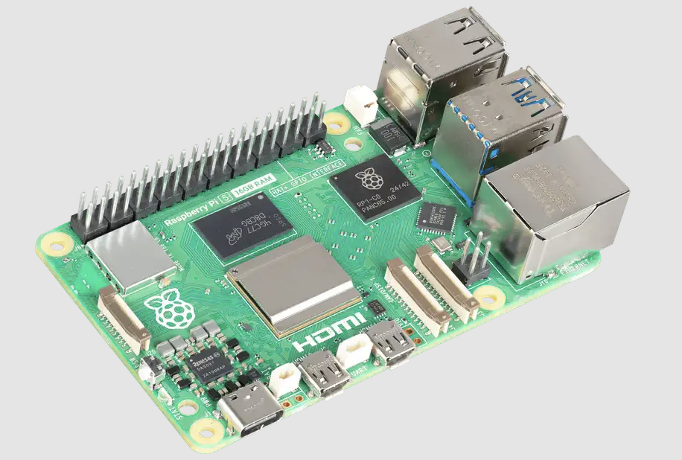
Raspberry Pi 5
The Raspberry Pi 5 is a powerful, affordable single-board computer featuring a quad-core Arm CPU.

Slide 3
SSH into device
ssh raspberrypi@10.100.202.xx
password: raspberrypi

Slide 4


What is ollama and LLaMA
ollama: opensource LLM inference framework
LLaMA = Large Language Model Meta AI
Notes:
Ollama 是一个轻量级本地推理框架，主要功能是：
让你在自己电脑上本地运行大语言模型（LLMs），比如 Llama3、Mistral、Gemma、Phi-2 等，不依赖外部云服务。
内置了高效的推理引擎，优化了在普通CPU、GPU上的推理性能，甚至能在 MacBook M1/M2 或 树莓派5 这种设备上跑小模型。
1B 和 3B 模型从 Llama 8B 模型中剪枝

Slide 5
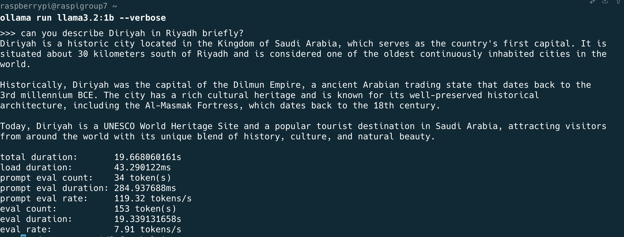
Run ollama llama3.2:1b
ollama run llama3.2:1b --verbose

Slide 6
Metric
Metric | Meaning | Description
Total Duration (2.620s) | Full execution time | The total time from starting the command to completing the response, including model loading, input processing, and output generation.
Load Duration (39.95ms) | Model loading time | The time taken to load the model or necessary components into memory. A small value suggests the model was already loaded or required minimal setup.
Prompt Eval Count (32 tokens) | Number of input tokens | The number of tokens (words or subwords) the model evaluated from the input prompt.
Prompt Eval Duration (1.645s) | Input processing time | The time the model spent understanding and analyzing the input prompt, often the most time-consuming phase.
Prompt Eval Rate (19.46 tokens/s) | Input processing speed | The speed at which the model processes tokens during prompt evaluation. Higher values indicate faster comprehension.
Notes:
Total Duration (2.620s)
从命令开始到响应完成的总耗时
包括加载模型、处理输入、生成响应的全部时间
Load Duration (39.95ms)
模型或组件加载进内存的时间
如果很短，通常表示模型已预加载或仅进行轻量初始化
Prompt Eval Count (32 tokens)
输入提示词（Prompt）的Token数
包括所有单词或子词，影响理解复杂度
Prompt Eval Duration (1.645s)
输入提示词处理时间
模型花在理解输入上的时间，通常是耗时最大的部分
Prompt Eval Rate (19.46 tokens/s)
输入处理速率
表示每秒处理多少个Token，反映理解效率

Slide 7
Metric
Metric | Meaning | Description
Eval Count (8 tokens) | Number of output tokens | The number of tokens generated in the response (e.g., “The capital of France is Paris.” yields 8 tokens).
Eval Duration (889.94ms) | Output generation time | The time required to generate the model’s response after evaluating the input.
Eval Rate (8.99 tokens/s) | Output generation speed | The rate at which the model generates tokens during response generation. Higher values indicate faster output production.
Notes:
指标名称
含义
说明
Eval Count (8 tokens)
模型输出的Token数
比如回答”The capital of France is Paris.”，总共8个Token
Eval Duration (889.94ms)
生成输出的时间
从模型开始生成回复到完成所花的时间
Eval Rate (8.99 tokens/s)
输出生成速率
每秒生成多少个Token，体现推理阶段的生成效率

Slide 8
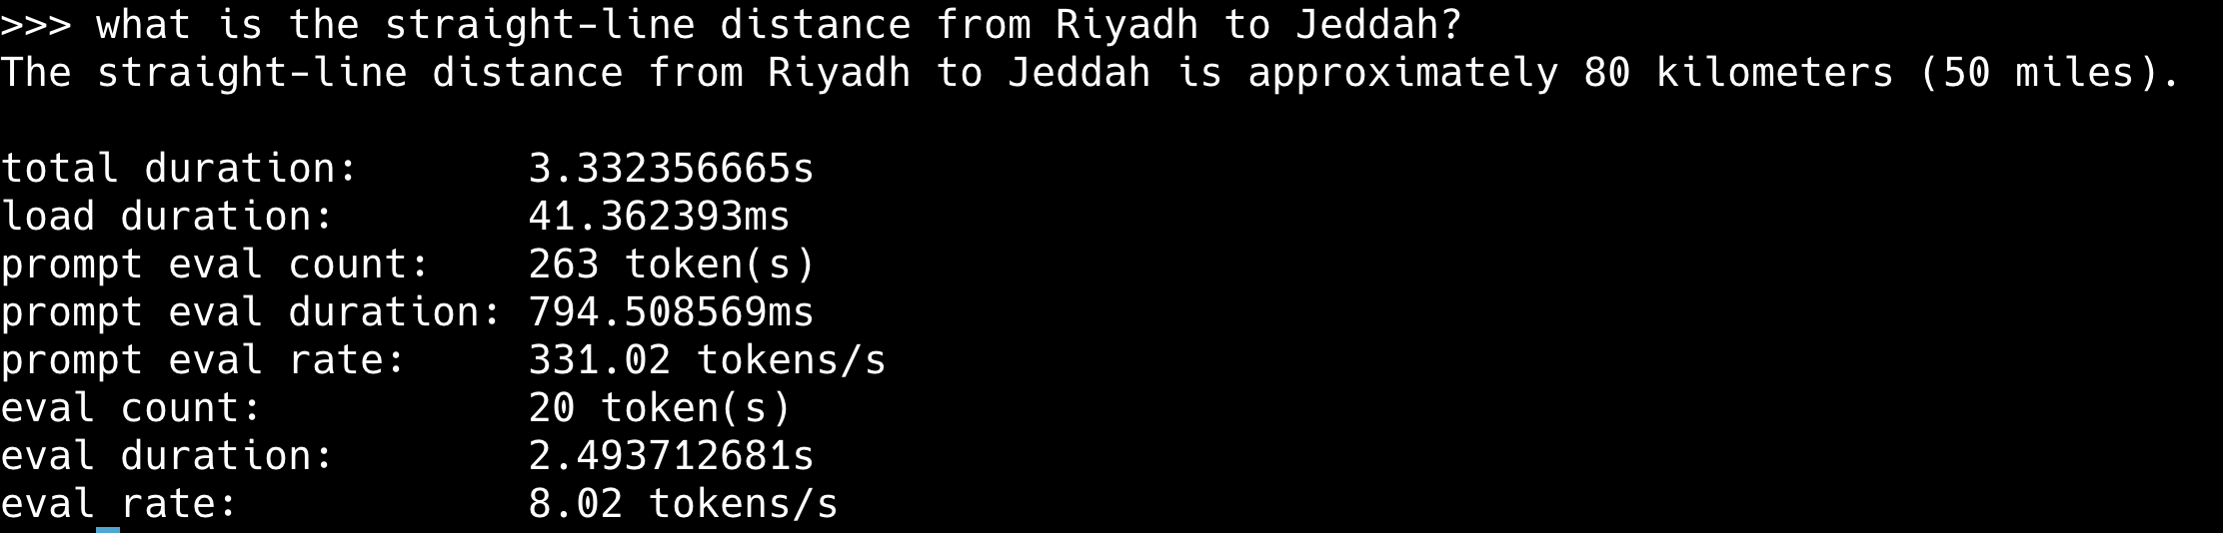
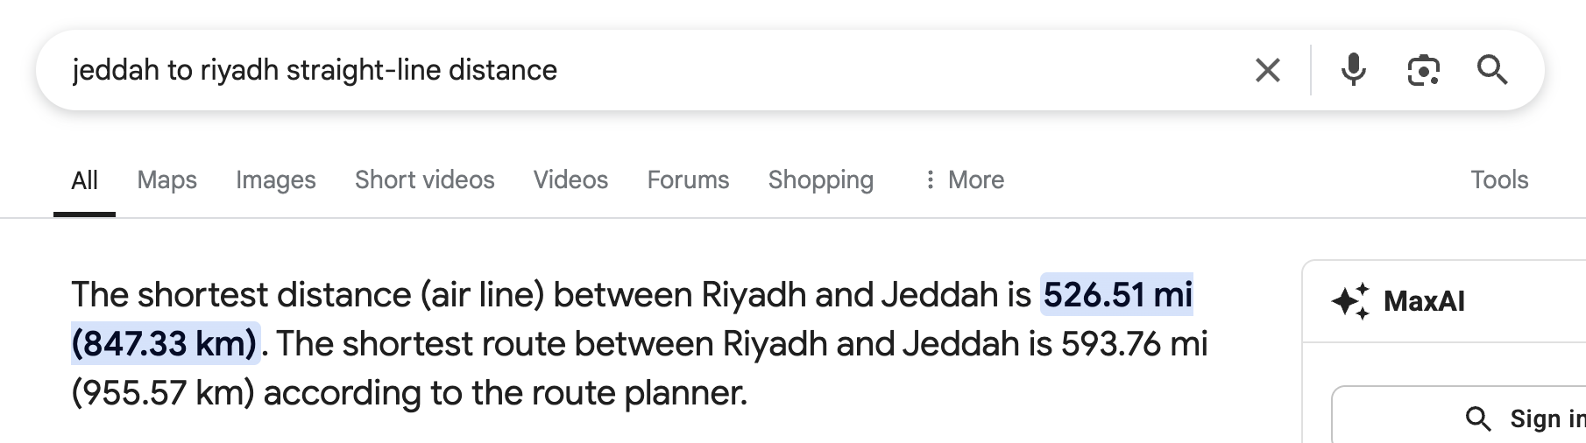
LLM can make errors

Slide 9
IP Pool
10.100.202.126
10.100.202.217
10.100.202.115
10.100.202.119
10.100.202.120
10.100.202.116
10.100.202.114
10.100.202.121
10.100.202.62
10.100.202.68
10.100.202.130
10.100.202.131
10.100.202.124
10.100.202.90
10.100.202.137
10.100.202.142
10.100.202.75
10.100.202.139
10.100.202.113
10.100.202.126
10.100.202.115

