Slide 1
Lab 5: Arithmetic and Number Representations

Slide 2
Floating-Point Number
Example: 32-bit floating-point number in IEEE 754
₂3 ₂2 ₂1 ₂0 ₂-1 ₂-2 ₂-3 ₂-4
Sign 8 bit Exponent
23 bit Fraction (significant / mantissa)
(-1)^{sign} × (1 + Fraction) × 2^{Exponent-127}
Exponent Bias = 127 = 2⁸⁻¹-1
How to represent 0.265625?
0.265625 = 1.0625 × 2⁻² = (1 + 0.0625) × 2¹²⁵⁻¹²⁷
0 | 0 | 1 | 1 | 1 | 1 | 1 | 0 | 1 | 0 | 0 | 0 | 1 | 0 | 0 | 0 | 0 | 0 | 0 | 0 | 0 | 0 | 0 | 0 | 0 | 0 | 0 | 0 | 0 | 0 | 0 | 0
125
0.0625

Slide 3

Floating-Point Number
Example: 32-bit floating-point number in IEEE 754
Sign 8 bit Exponent
23 bit Fraction
(-1)^{sign} × (1 + Fraction) × 2^{Exponent-127}
Normal Numbers, Exponent≠0
(-1)^{sign} × Fraction × 2¹⁻¹²⁷
Subnormal Numbers, Exponent=0
0 | 1 | 1 | 1 | 1 | 1 | 1 | 1 | 1 | 0 | 0 | 0 | 0 | 0 | 0 | 0 | 0 | 0 | 0 | 0 | 0 | 0 | 0 | 0 | 0 | 0 | 0 | 0 | 0 | 0 | 0 | 0
- | 1 | 1 | 1 | 1 | 1 | 1 | 1 | 1 | - | - | - | - | - | - | - | - | - | - | - | - | - | - | - | - | - | - | - | - | - | - | -
+∞ (positive infinity)
NaN (Not a Number)
1 | 1 | 1 | 1 | 1 | 1 | 1 | 1 | 1 | 0 | 0 | 0 | 0 | 0 | 0 | 0 | 0 | 0 | 0 | 0 | 0 | 0 | 0 | 0 | 0 | 0 | 0 | 0 | 0 | 0 | 0 | 0
-∞ (negative infinity)
much waste. revisit in fp8.

Slide 4
Floating-Point Number
Example: 32-bit floating-point number in IEEE 754
Sign 8 bit Exponent
23 bit Fraction
Exponent | Fraction=0 | Fraction≠0 | Equation
00H = 0 | ±0 | subnormal | (-1)^{sign} × Fraction × 2¹⁻¹²⁷
01H … FEH = 1 … 254 | normal |  | (-1)^{sign} × (1 + Fraction) × 2^{Exponent-127}
FFH = 255 | ±INF | NaN
subnormal values
…
normal values
_{±0 2}-149 ₍₁₋₂-23₎ ₂-126
₂-126
(1+1-2⁻²³)×2¹²⁷

Slide 5
Numeric Data Types
Question: What is the following IEEE half precision (IEEE FP16) number in decimal?
Exponent Bias = 1510
1 | 1 | 0 | 0 | 0 | 1 | 1 | 1 | 0 | 0 | 0 | 0 | 0 | 0 | 0 | 0
•
•
•
•
Sign 5 bit Exponent 10 bit Fraction
Sign: -
Exponent: 100012 - 1510 = 1710 - 1510 = 210
Fraction: 11000000002 = 0.7510
Decimal Answer = - (1 + 0.75) × 2² = -1.75 × 2² = -7.010

Slide 6
Numeric Data Types
Question: What is the decimal 2.5 in Brain Float (BF16)?
2.510 = 1.2510 × 2¹
Exponent Bias = 12710
•
•
•
•
Sign: +
Exponent Binary: 110 + 12710 = 12810 = 100000002
Fraction Binary: 0.2510 = 01000002 Binary Answer
0 | 1 | 0 | 0 | 0 | 0 | 0 | 0 | 0 | 0 | 1 | 0 | 0 | 0 | 0 | 0
Sign
8 bit Exponent
7 bit Fraction

Slide 7
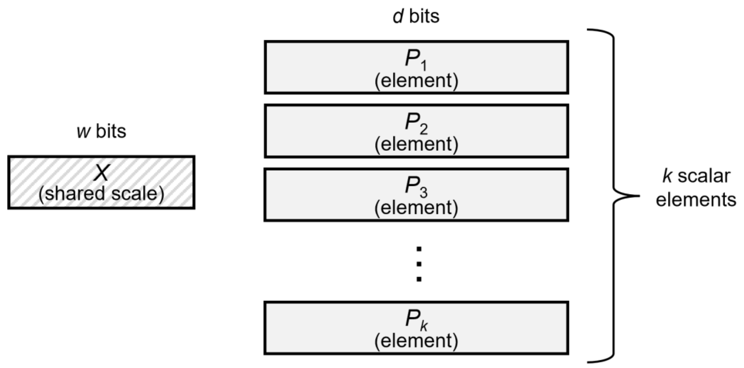
Numeric Data Types (Microscaling)
An MX-compliant format is characterized by three components:
• Scale (𝑋) data type / encoding
• Private elements (𝑃𝑖) data type / encoding
• Scaling block size (𝑘)
The bit widths are represented by the following symbols:
• w: number of bits used to encode the shared scale 𝑋
• d: number of bits used to represent each element 𝑃𝑖
Notes:
All 𝑘 elements (𝑃𝑖) have the same data type and, therefore, the same bit-width. The scale factor
𝑋 is shared across all k elements. The data types of the elements and scale are chosen
independently. In this sense, MX can be seen as a mechanism to build a vector data type from
scalar data types.
The bit widths are represented by the following symbols:
• w: number of bits used to encode the shared scale 𝑋
• d: number of bits used to represent each element 𝑃𝑖

Slide 8
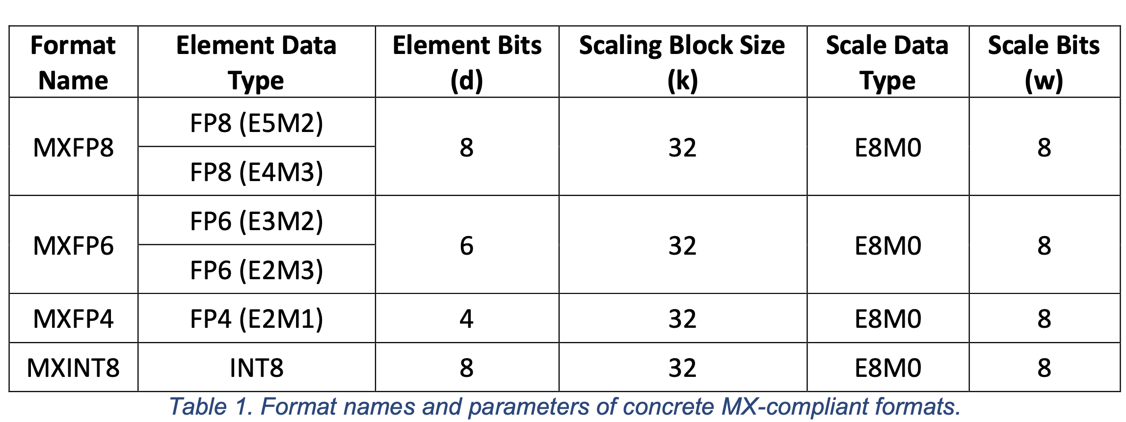
Microscaling
Notes:
All 𝑘 elements (𝑃𝑖) have the same data type and, therefore, the same bit-width. The scale factor
𝑋 is shared across all k elements. The data types of the elements and scale are chosen
independently. In this sense, MX can be seen as a mechanism to build a vector data type from
scalar data types.
The bit widths are represented by the following symbols:
• w: number of bits used to encode the shared scale 𝑋
• d: number of bits used to represent each element 𝑃𝑖

Slide 9
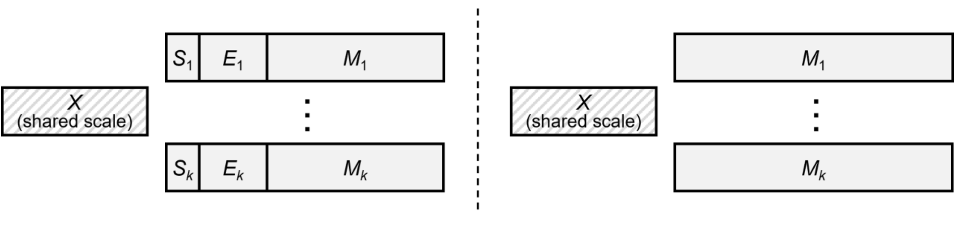
Microscaling
Element Data Types
- 𝑆, 𝐸, and 𝑀 are the values of the Sign, Exponent, and Mantissa fields, respectively.
- 𝑏𝑖𝑎𝑠 is the exponent bias.
- 𝑚 is the number of mantissa bits
MX_FP
MX_INT
Notes:
All 𝑘 elements (𝑃𝑖) have the same data type and, therefore, the same bit-width. The scale factor
𝑋 is shared across all k elements. The data types of the elements and scale are chosen
independently. In this sense, MX can be seen as a mechanism to build a vector data type from
scalar data types.
The bit widths are represented by the following symbols:
• w: number of bits used to encode the shared scale 𝑋
• d: number of bits used to represent each element 𝑃𝑖

Slide 10
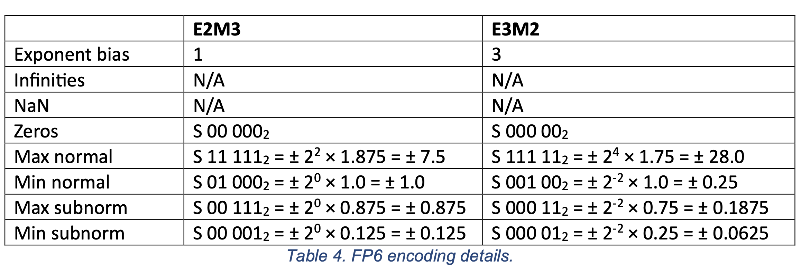
Microscaling
FP6
Notes:
All 𝑘 elements (𝑃𝑖) have the same data type and, therefore, the same bit-width. The scale factor
𝑋 is shared across all k elements. The data types of the elements and scale are chosen
independently. In this sense, MX can be seen as a mechanism to build a vector data type from
scalar data types.
The bit widths are represented by the following symbols:
• w: number of bits used to encode the shared scale 𝑋
• d: number of bits used to represent each element 𝑃𝑖

Slide 11
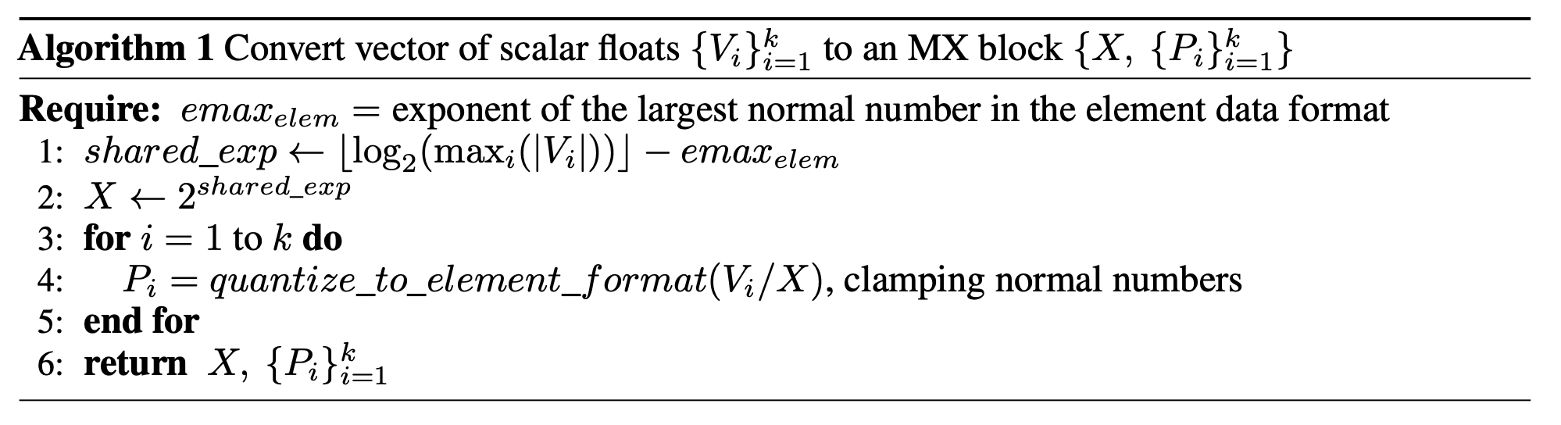
Microscaling
Notes:
All 𝑘 elements (𝑃𝑖) have the same data type and, therefore, the same bit-width. The scale factor
𝑋 is shared across all k elements. The data types of the elements and scale are chosen
independently. In this sense, MX can be seen as a mechanism to build a vector data type from
scalar data types.
The bit widths are represented by the following symbols:
• w: number of bits used to encode the shared scale 𝑋
• d: number of bits used to represent each element 𝑃𝑖

Slide 12
Microscaling
step 1:
V = [4.2, -3.1]
shared_exp = log₂4-2=0
emax_{elem}
Notes:
shared_exp contains an offset of emax_elem to map the max input exponent to the largest binade in the element data format

Slide 13
Microscaling
step 2:
X=2^0=1
emax_{elem}
Notes:
shared_exp contains an offset of emax_elem to map the max input exponent to the largest binade in the element data format

Slide 14
Microscaling
Element Data Types
step 3:
bias=2^(2-1)-1=1
V = [4.2/1, -3.1/1]= [4.2, -3.1]
step 4: FP6_E2M3: 4.2
4.2=(-1)^0 * 2^(E-1) * (1 + 2⁻³ * M) = 2² * ( 1 + 2⁻³ * 0.4)
S=0
E=3 -> 11
M=0.4 -> 000
4.2 -> 0 11 000 -3.1 -> 1 10 100
Notes:
shared_exp contains an offset of emax_elem to map the max input exponent to the largest binade in the element data format

Slide 15
Microscaling
step 5:
X=1 E8M0
bias = 2⁸⁻¹-1=127
1 = 2^{E-127} * (1+2⁰ * M) -> E=127, M=0
X->01111111
Notes:
shared_exp contains an offset of emax_elem to map the max input exponent to the largest binade in the element data format

Slide 16
Numeric Data Types (Microscaling)
V = [4.2, -3.1]
Sign
Exponent
Fraction
0 11 000
01111111
1 10 100

Slide 17
Microscaling
4.2 -> 0 11 000
-3.1 -> 1 10 100
2³⁻¹ * (1 + 2⁻³ * 0)=4
-1 * 2²⁻¹ * (1+2⁻³*4)= -3
Notes:
shared_exp contains an offset of emax_elem to map the max input exponent to the largest binade in the element data format

