Slide 1
Fish Distribution Editing Tool:
Web-based Tools for Complex Spatial Data
Bill Daigle
Montana Fish, Wildlife & Parks

Slide 2
A brief history of time…
1960s - Fisheries Bureau started centralizing data
1980s - Data computerized
NW Power Act ->
Montana Rivers Study->
Montana Rivers Information System ->
StreamNet
1988 – 2,056 stream miles recommended by Montana be protected for fish and/or wildlife values
1999 - Data became available on the web
Montana Fisheries Information system

Slide 3
Data managment
Raw sample data
Over 80 fish species
14,118 streams and rivers
5162 lakes and reservoirs
Variety of data types and sample methods
Stored centrally and managed via web editor.

Slide 4
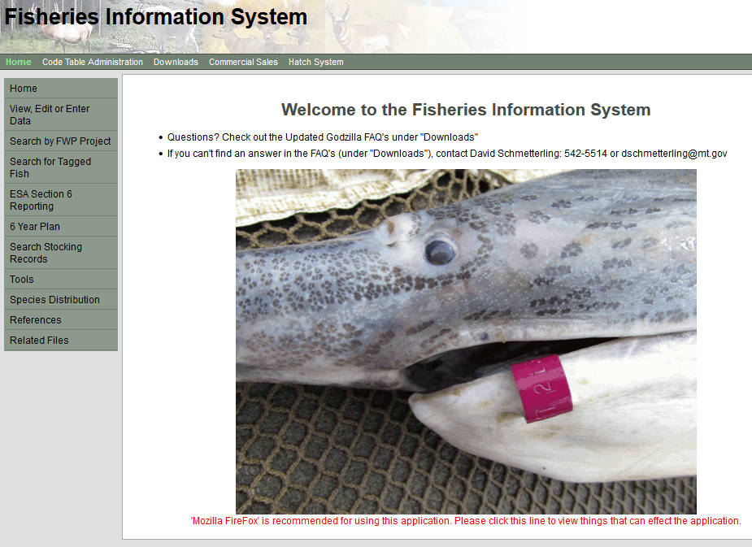

Slide 5
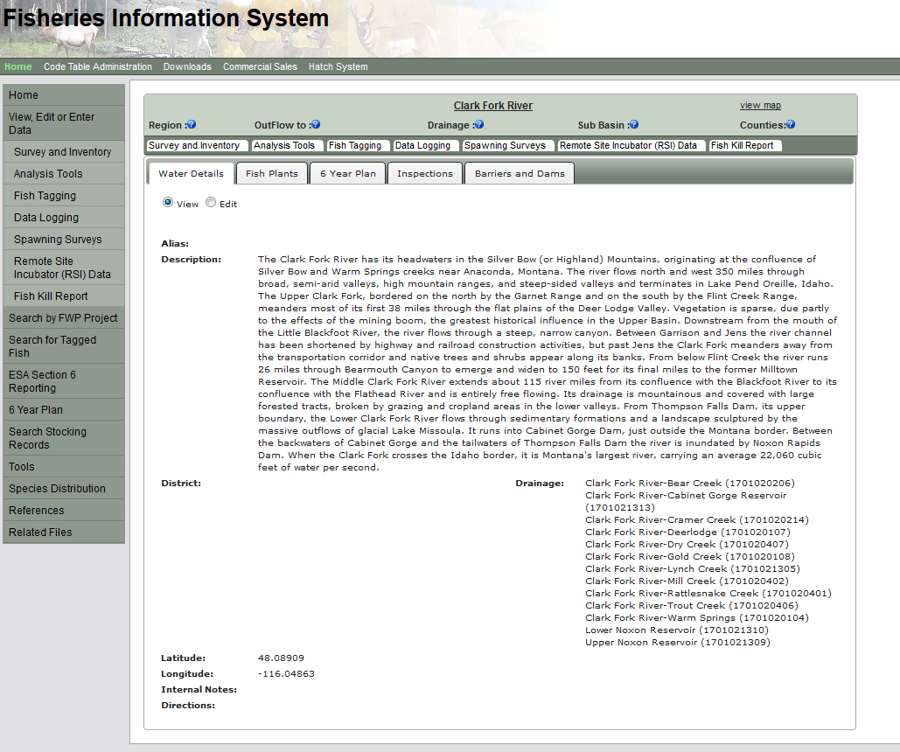

Slide 6
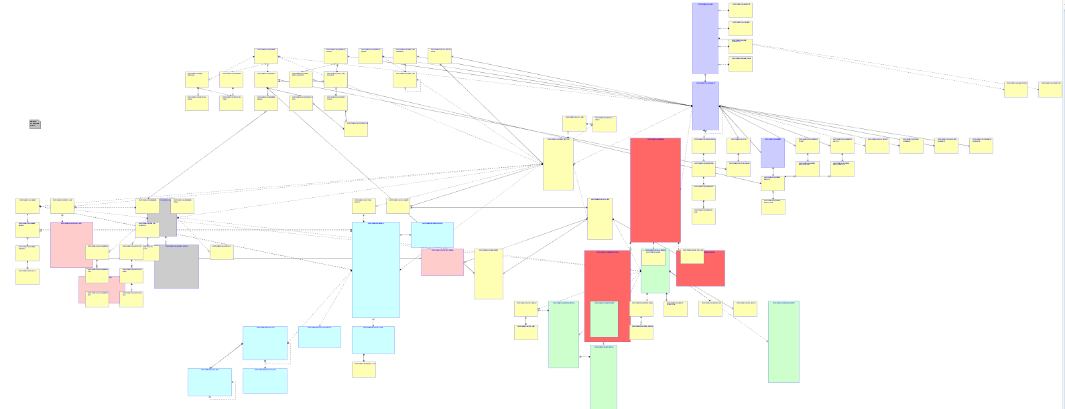
Data types

Slide 7
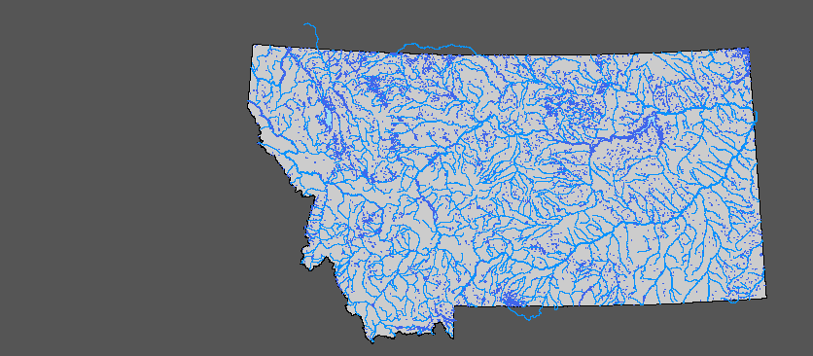
Data types

Slide 8
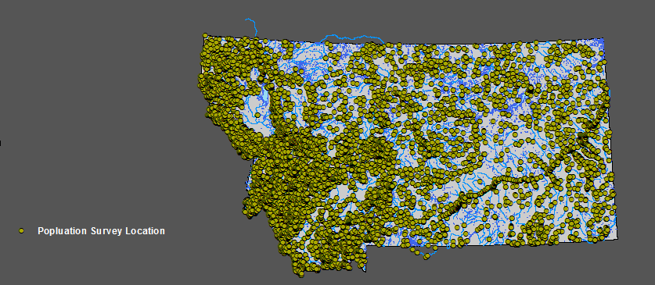
Data types

Slide 9
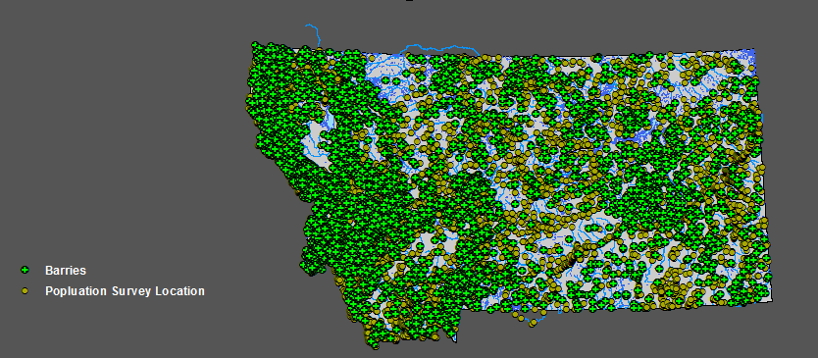
Data types

Slide 10
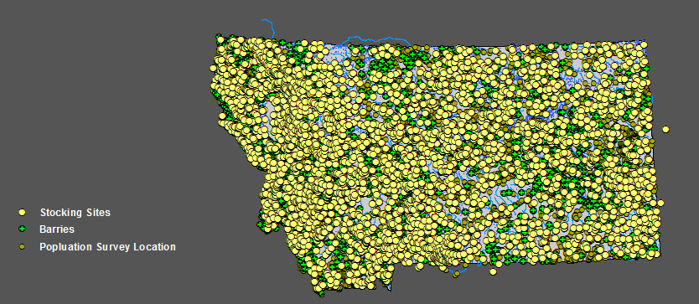
Data types

Slide 11
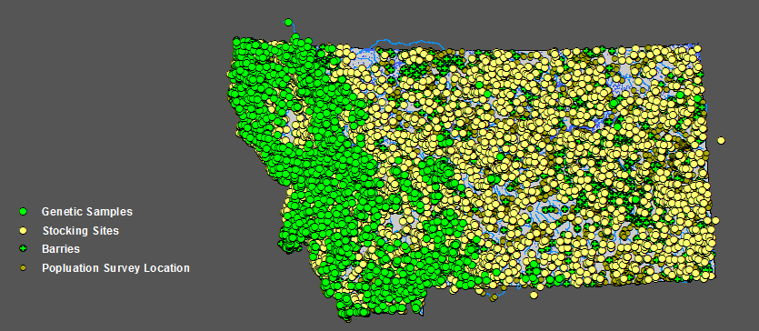
Data types

Slide 12
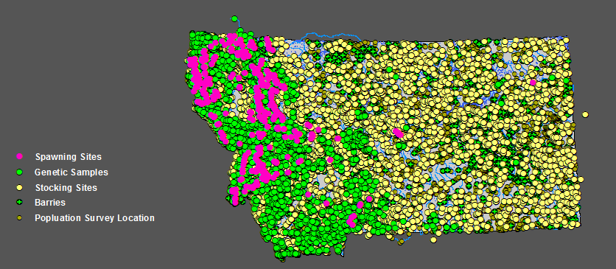
Data types

Slide 13

Data types

Slide 14
Fish distribution – management and use
Distillation of hard data and professional opinion
Generalized and extrapolated
Uses:
QA/QC of field data
Map production
Public download
Statewide and region-wide assessment
Challenge to maintain:
80 species X 5 attributes 25 biologists = 10,000 combinations

Slide 15

Old Process
Manual: lots of intervention from data services staff

Slide 16
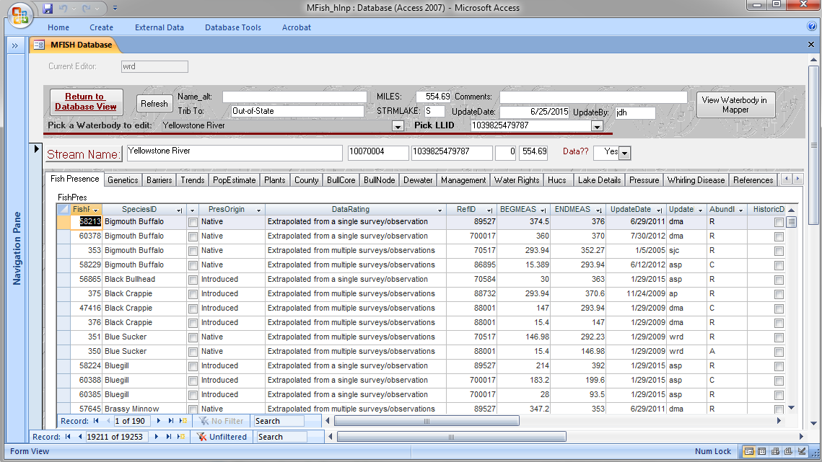
Old Process
Manual: lots of intervention from data services staff

Slide 17
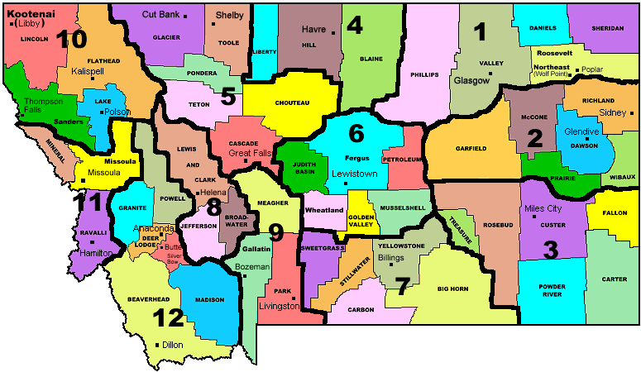
Old Process
Route Features
Manual: lots of intervention from data services staff

Slide 18

Old Process
Repeat
Review
Route Features
Manual: lots of intervention from data services staff

Slide 19



Old Process
Repeat
Review
Route Features
Distribute
Manual: lots of intervention from data services staff

Slide 20
Web-based waterbody location editor
Decrease to time/energy to update layers
Enable the data owners
Decrease dependency on GIS staff
Designed around editing fish distributions
Extends to other data types:
Fishing regulations
Boating regulation
Waterbody classifications

Slide 21
Requirements
Easy to use
Map based
Dynamic
Responsive
Accommodate existing data

Slide 22
Old Process
Repeat
Review
Route Features
Distribute
Manual: lots of intervention from data services staff

Slide 23
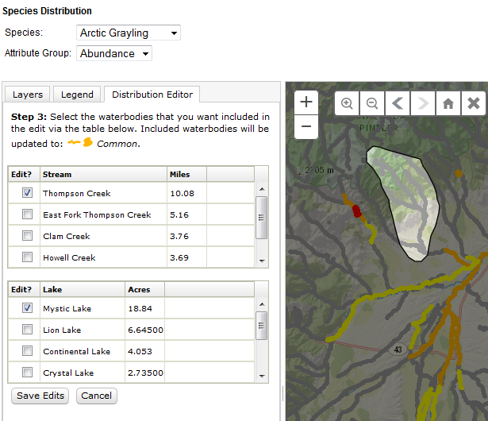
New Process
Distribute
Puts the responsibility in the hands of the biologist

Slide 24
Demo

Slide 25
Table structure
Old
New
Flat file
All attributes as fields
Spatial “snap shots”
Normalized
Attributes as records
Live views
FISHPRES Species
FISHPRES Attributes
Attributes->
FISHPRES
Species
x Attribute
WB_LOC_Lakes
WB_LOC_
MASTER
WB_LOC_Streams_Whole
WB_LOC_Streams_Segment

Slide 26
Producing spatial layers
The Old Way (static “snap shots”)
Attributes->
FISHPRES
Streams Feature Class
Lakes Feature Class
Routed
Joined
Stream DistributionFeature Class
Lake DistributionFeature Class

Slide 27
Producing spatial layers
The New Way (dynamic views)
FISHPRES Species
FISHPRES Attributes
Species
x Attribute
WB_LOC_Lakes
WB_LOC_
MASTER
WB_LOC_Stream_Segment
WB_LOC_Stream_Whole

Slide 28
Producing spatial layers
The New Way (dynamic views)
FISHPRES Species
FISHPRES Attributes
Species
x Attribute
Lakes Feature Class
WB_LOC_Lakes
WB_LOC_
MASTER
WB_LOC_Stream_Segment
WB_LOC_Stream_Whole
Streams Feature Class

Slide 29
Producing spatial layers
The New Way (dynamic views)
FISHPRES Species
FISHPRES Attributes
Species
x Attribute
Lakes Feature Class
WB_LOC_
Lakes Spatial View
Join
WB_LOC_Lakes
WB_LOC_
MASTER
WB_LOC_Stream_Segment
WB_LOC_Stream_Whole
WB_LOC_
Streams Spatial View
Join
Streams Feature Class

Slide 30
ArcGIS Server Components
Versioned geodatabase
One Map Service
With dynamic workspaces enable
One Geoprocessing Service
Fetches data about record ID’s and symbology
Performs geometry clips and returns the clipped geometry
Applies edits and ensures data integrity

Slide 31
Web Server Components
Map application
Used existing map components
Fish distribution specific form elements
Waterbody location display widget
Interacts with the Map Service
Can be used outside of edit application
Waterbody location editor widget
Interacts with the geoprocessing service

Slide 32
Yet to come…
Interface improvements:
Edit multiple attributes with a single edit
Additional map layers
Make more informed decisions
Better integration with other data entry screens
Triggers to validate when new species is surveyed
Integrate into other data entry systems
Regulations, Survey locations, waterbody classifications

Slide 33
“Git it” on GitHub
https://github.com/MFWP-GIS/waterbodyLocationEditor
Presentation
Sample code available soon
Questions? bdaigle@mt.gov

