Slide 1
Social Network Analysis of Our Class
孟繁续 18S151514

Slide 2
Table of contents
INTRODUCTION
METHODS AND TOOLS
MODELING AND ANALYSIS
CONCLUSION

Slide 3
INTRODUCTION
A social network is a set of people (or organizations or other social entities) connected by a set of social relationships.
Data:
knowing someone’s name
knowing someone’s hometown
knowing someone’s dialect
Target:
perform computer simulations
analyze the network properties and dynamical behaviors

Slide 4
METHODS AND TOOLS
anaconda: https://www.anaconda.com/download/#windows
NumPy: http://numpy.scipy.org/.
MatplotLib: http://matplotlib.sourceforge.net.
xlrd: https://pypi.python.org/pypi/xlrd.
xlwt: https://pypi.python.org/pypi/xlwt/.
NetworkX: http://networkx.lanl.gov/.
Tkinter: https://wiki.python.org/moin/TkInter

Slide 5
METHODS AND TOOLS
There are three way to run this program:
The simplest is run GUI.py with python platform.Chose which data (name, hometown, dialect) you want to read. Then click the button you interest.

Slide 6
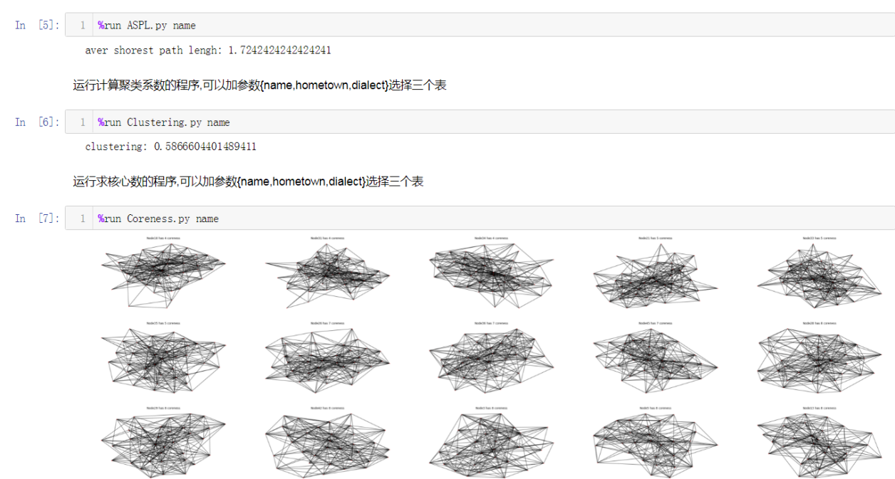
METHODS AND TOOLS
There are three way to run this program:
The second way is run readme.ipynb, use shift+enter to run every cell

Slide 7
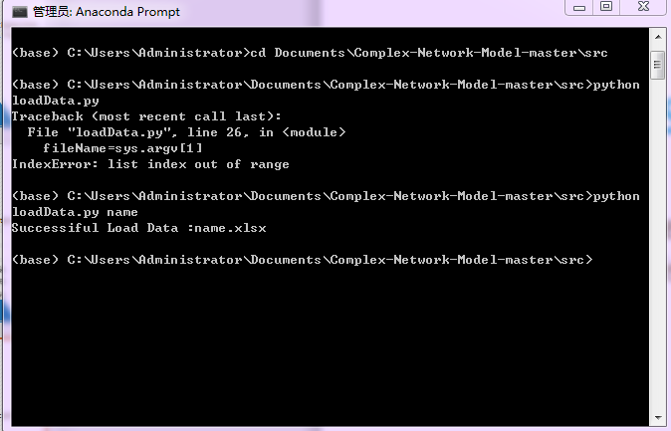
METHODS AND TOOLS
There are three way to run this program:
The third way is run *.py file on pycharm or input command in termal.

Slide 8
MODELING AND ANALYSIS

Slide 9
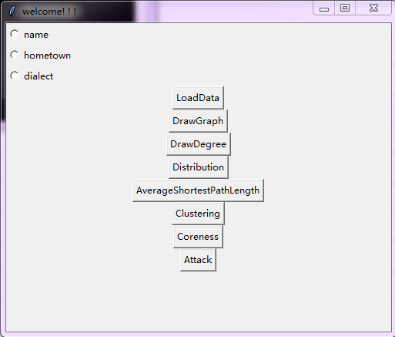
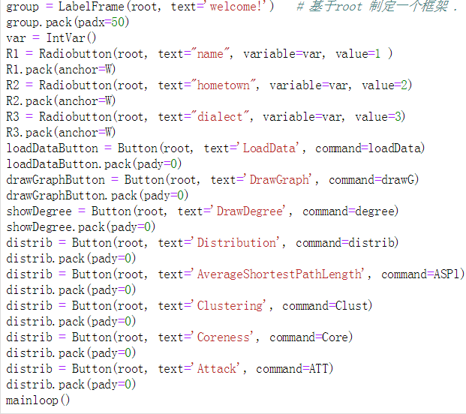
Graphical User Interface

Slide 10
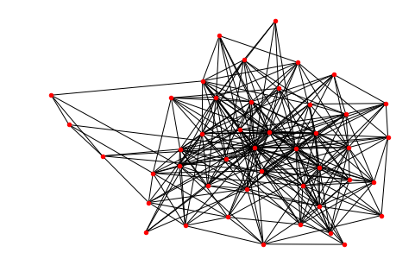
Knowing someone’s name
Build the graph base on the Knowing someone’s name table

Slide 11
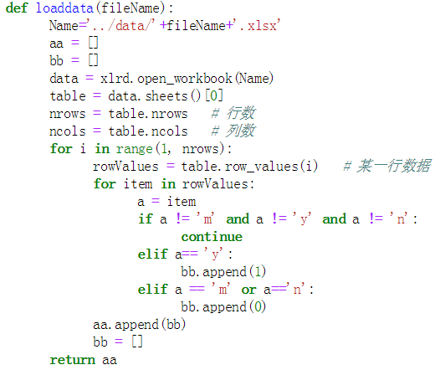
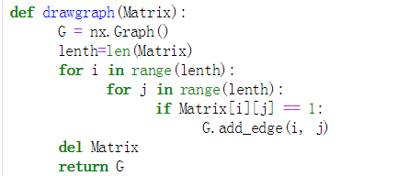
Knowing someone’s name

Slide 12
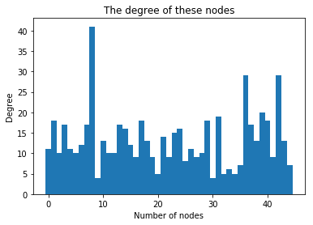
Degree

Slide 13
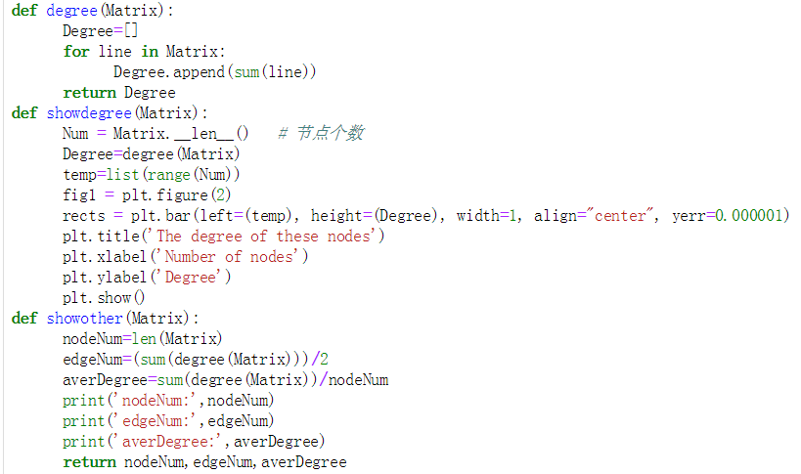
Degree

Slide 14
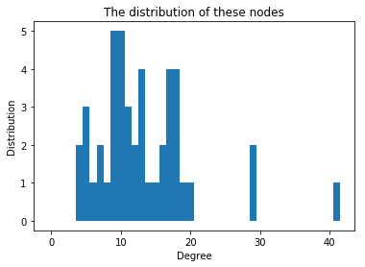
Degree Distribution
Top ten students who has largest degree:
[No.8, No.42, No.36, No.39, No.31, No.29, No.1, No.40, No.17, No.13]

Slide 15
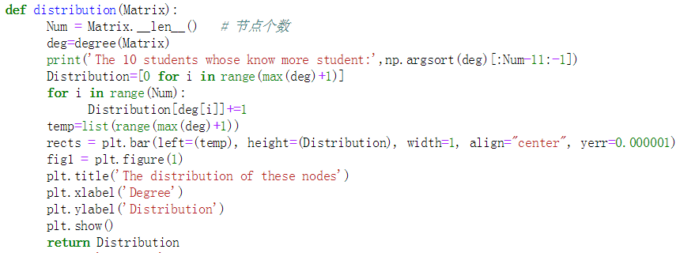
Degree Distribution

Slide 16
Basic information of the network
Network | type | total nodes | total edges | average degree | average path length | clustering coefficient
Knowing someone’s name | undirected | 45 | 203 | 13.2 | 1.72424 | 0.58666

Slide 17
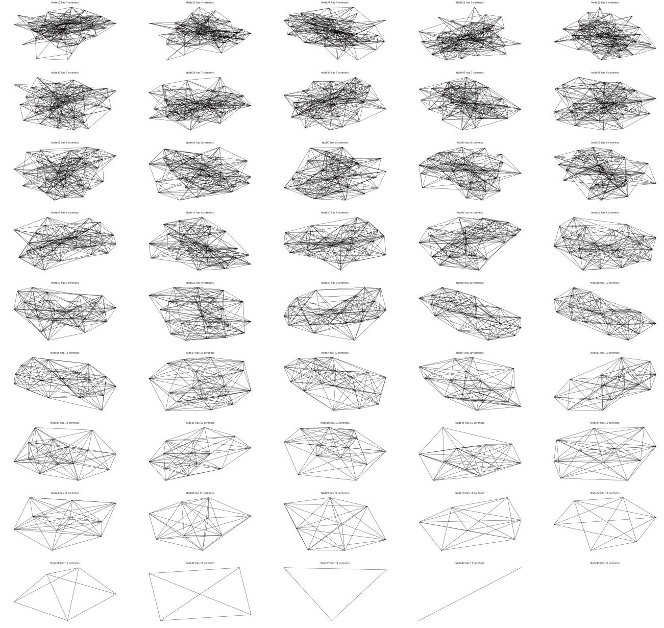
Coreness
The Coreness of each node is:
[9, 10, 8, 11, 8, 10, 10, 11, 11, 4, 10, 9, 8, 10, 10, 10, 8, 11, 9, 8, 5, 9, 8, 11, 10, 7, 10, 8, 8, 11, 4, 11, 5, 4, 5, 7, 11, 10, 9, 11, 10, 8, 11, 10, 7]
The Coreness of the network is 11.

Slide 18
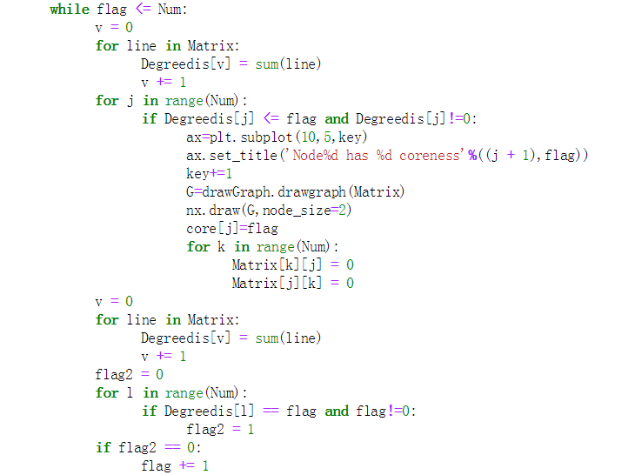
Coreness

Slide 19
Robustness
Test the robustness network with some attacks,there are two kinds of attacks:
One is removing the nodes with larger degree, which is an intentional attack.
And the other is randomly removing the nodes, which is a random attack.

Slide 20
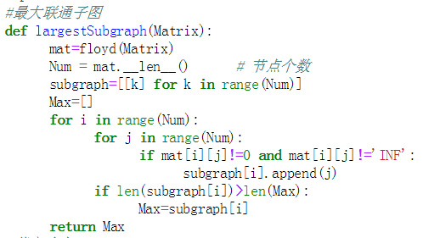
Robustness

Slide 21
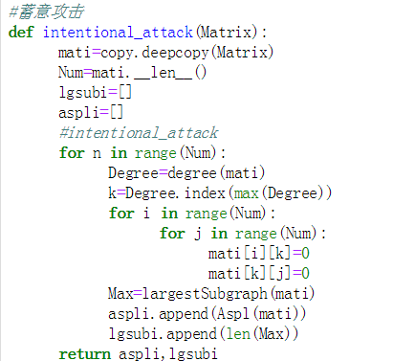
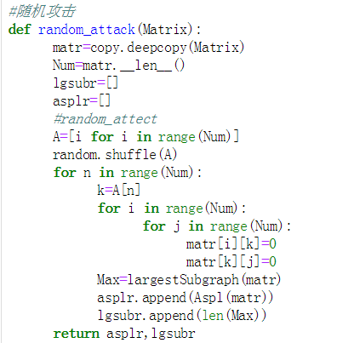
Robustness

Slide 22
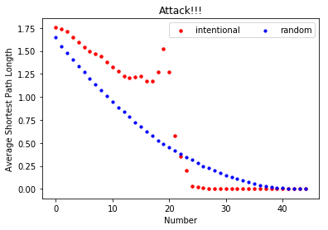
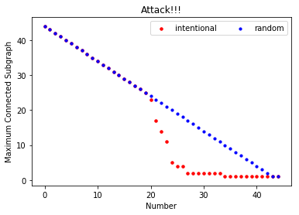
Robustness and fragility of the network
The network seems to have good robustness, but have better robustness under a random attack. It indicates the importance of the nodes with large degree.

Slide 23
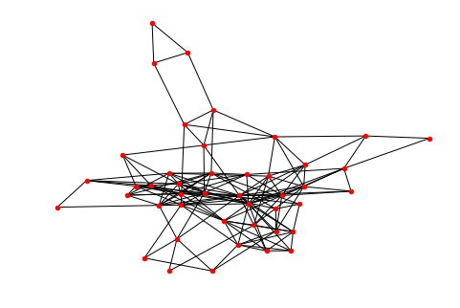
Knowing someone’s hometown
Build the graph base on the Knowing someone’s hometown table

Slide 24
Knowing someone’s name
From the figure we can find it’s more thin than the first figure, because it’s difficult for us to know each other’s hometown.

Slide 25
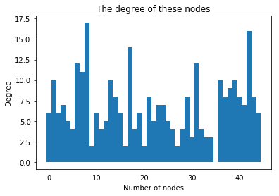
Degree
Degree base on the Knowing someone’s hometown table

Slide 26
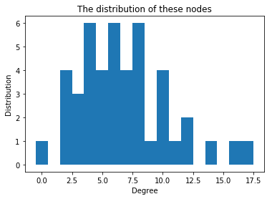
Degree Distribution
top ten students who have largest degree:
[No.8, No.42, No.17, No.6, No.31, No.7, No.13, No.39, No.36, No.1]

Slide 27
Degree Distribution
top ten students who know more name:
[No.8, No.42, No.17, No.6, No.31, No.7, No.13, No.39, No.36, No.1]
Top ten students who know more hometown:
[No.8, No.42, No.36, No.39, No.31, No.29, No.1, No.40, No.17, No.13]

Slide 28
Basic information of the network
Network | type | total nodes | total edges | average degree | average path length | clustering coefficient
Knowing someone’s hometown | undirected | 45 | 152 | 6.7555 | 2.28889 | 0.43268
Knowing someone’s name | undirected | 45 | 203 | 13.2 | 1.72424 | 0.58666

Slide 29
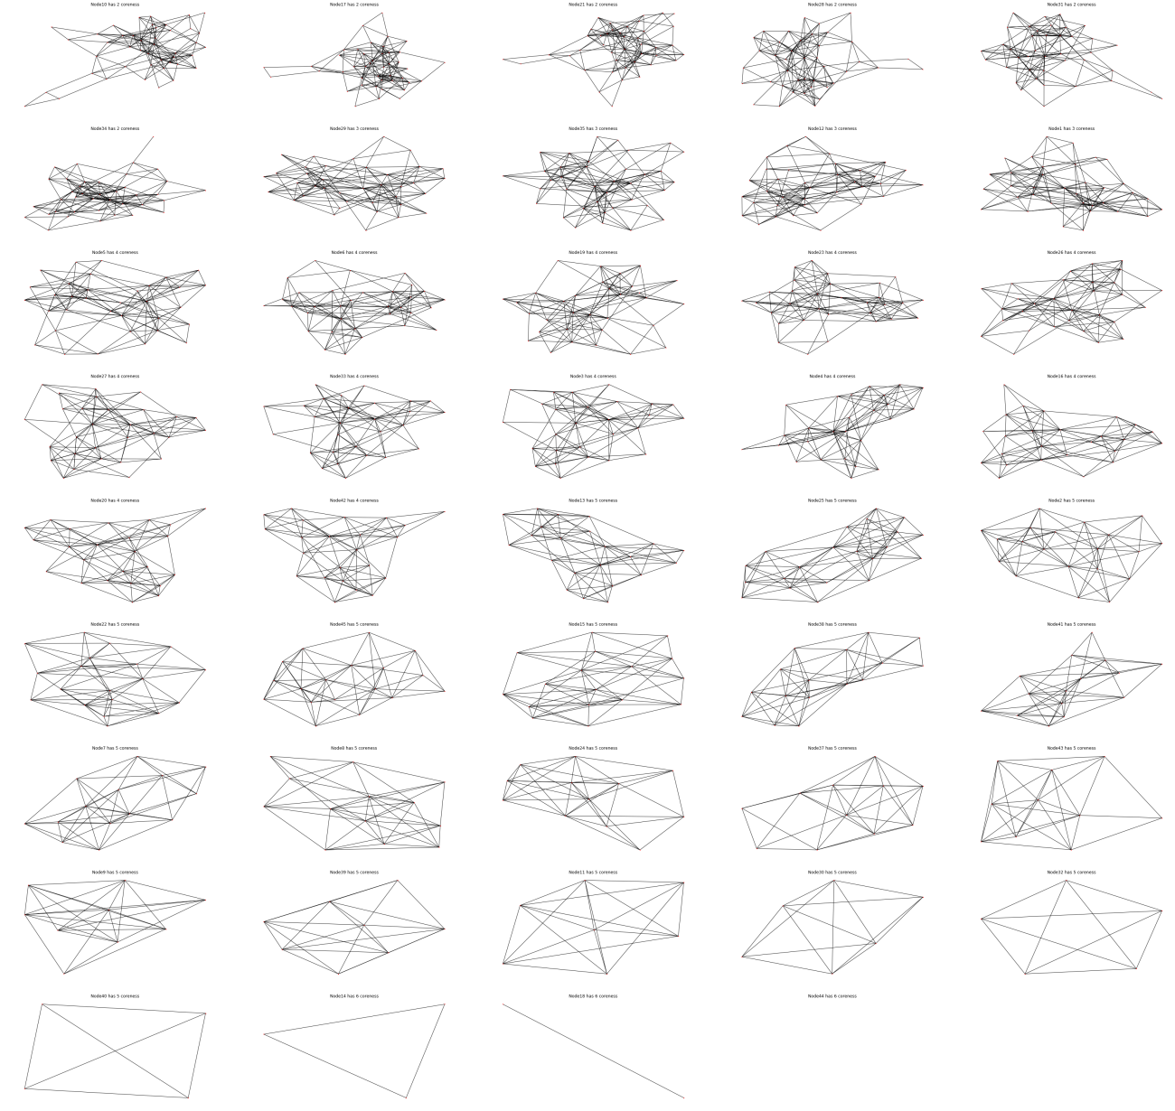
Coreness
The Coreness of each node is:
[3, 5, 4, 4, 4, 4, 5, 5, 5, 2, 5, 3, 5, 6, 5, 4, 2, 6, 4, 4, 2, 5, 4, 5, 5, 4, 4, 2, 3, 5, 2, 5, 4, 2, 3, 0, 5, 5, 5, 5, 5, 4, 5, 6, 5]
The Coreness of the network is 6.

Slide 30
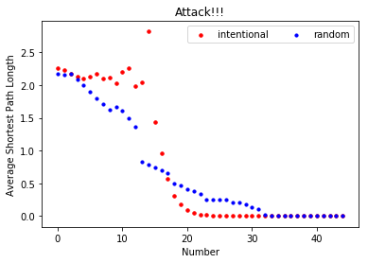
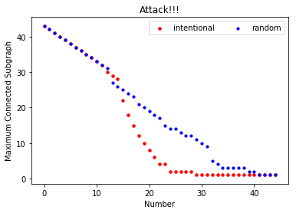
Robustness and fragility of the network
The robustness of this network is worse than the first network .

Slide 31
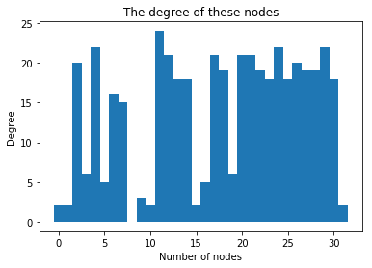
Degree

Slide 32
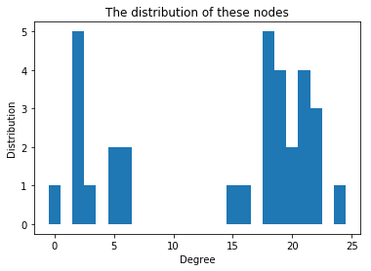
Degree Distribution
top ten students who have largest degree:
[No.11, No.4, No.24, No.29, No.12, No.20, No.21, No.17, No.2, No.26]

Slide 33
Basic information of the network
Network | type | total nodes | total edges | average degree | average path length | clustering coefficient
Knowing someone’s hometown | undirected | 32 | 233 | 13.9375 | 1.451613 | 0.8035957
Knowing someone’s hometown | undirected | 45 | 152 | 6.7555 | 2.28889 | 0.43268
Knowing someone’s name | undirected | 45 | 203 | 13.2 | 1.72424 | 0.58666

Slide 34
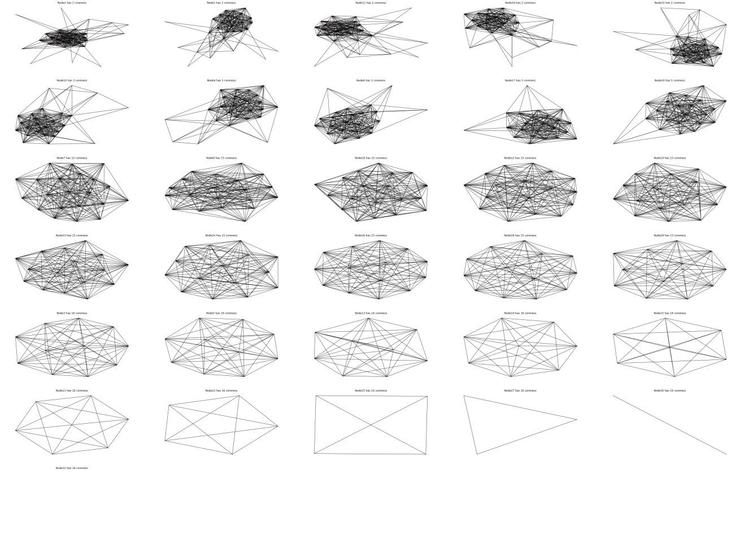
Coreness
The Coreness of each node is:
[2, 2, 16, 5, 16, 5, 15, 15, 0, 3, 2, 15, 16, 16, 16, 2, 5, 15, 15, 5, 16, 16, 15, 15, 16, 15, 16, 15, 15, 16, 16, 2]
The Coreness of the network is 16.

Slide 35
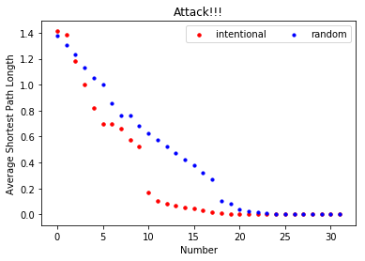
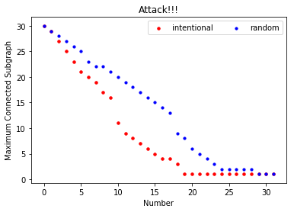
Robustness and fragility of the network

Slide 36
CONCLUSION
A few people control the power in the first network. That is, they are very popular among the students and play an important role to transmit information.
The second network seems to be sparser with fewer edges, that means people don’t know each other’s hometown very much unless friends.
Third network shows plenty of dialects are easy to recognize, but some are difficult to recognize.

Slide 37


Thank you!

