Slide 1
Simulation of Proton Beam Passing Through Different materials
Presented by:
Muhammad Farooq (2714BE)
Supervisor:
Dr. Talib Hussain
Panel:
Dr. Ibrar Zafar Ahmad
Dr. Maqsood
Dr. Rasheed Ahmad

Slide 2
Contents
Introduction
Flexibility of GEant4
Physics in Geant4
Purpose of Uses
Advantages
Applications
Installation of G4
Installation requirements
DATA requirement
PATH Setting
Examples in Geant4
Basic Examples
Example B1
Example B2
Example B3
Example B4

Slide 3
Contents
Extended Examples
Novice Example
Example N01
Example N02
Example N03
Example N04
Example N05
Example N06
Example N07
Advanced Example
Introduction to Geant4 Visualization Driver
Purposes of G4 Visualization
Visualization Driver
OpenGL
HepRep/ WIRED
RayTracer
ASCIITree
DAWN

Slide 4
Contents
Installation of Geant4 Visualization Driver
Basic concepts and Kernel structure of Geant4 Kernel
Run in Geant4
Event in Geant4
Track in Geant4
Unit System in Geant4
Material and Geometry in Geant4
Construction of Detector in Geant4
Defining the Materials
Solid and shape
Geometry of the Detector
G4LogicalVolume
Visualization Attributes
Physical Volume
Magnetic Field

Slide 5
Contents
Application Development in Geant4
Geant4 setup is studying the Proton beam passing through the varied materials
B4DetectorConstrction.cc
B4aEventAction.cc
B4PrimaryGeneratorAction.cc
B4RunAction.cc
B4aSteppingAction.cc
Results
References

Slide 6
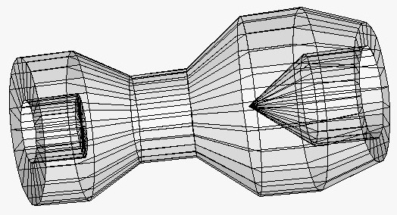
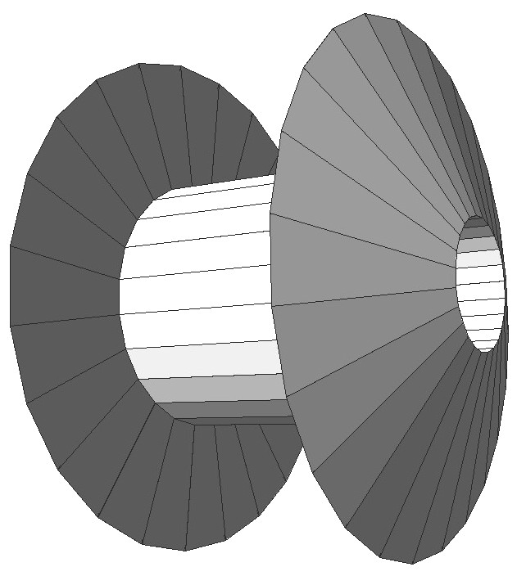
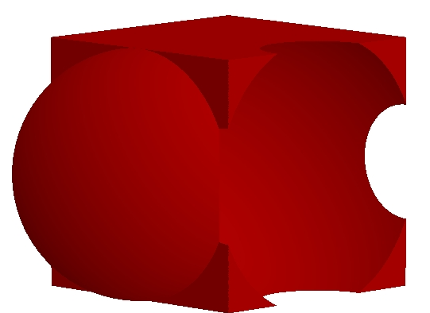
Introduction to Geant4
Geant4 is the successor of Geant3, the world-standard toolkit for the simulations for HEP detector simulations. It is used for the tracking and geometry for the detectors and experiments. It was prepared by CERN (The European Organization for Nuclear Research). It is used the platform of C++.
Flexibility of Geant4:
Geant4 provides a wide variety of the functionality and flexibility:
It provides a wide variety of geometrical descriptions which are most complicated and realistic geometries
CSG, BREP, Boolean
Placement, replica,
Choice of physics processes / model
Choice of GUI / Visualization / Histogramming technologies
Physics in Geant4:
There are following physics process and models:
EM processes
Hadronic processes
Photon / Lepton-hadron processes
Optical photon processes
Decay processes.

Slide 7
Introduction to Geant4
Purpose of Uses:
It is used for the simulation of passage of particles from the matter. It provides us to the complete set of tools for the study of simulation:
Geometry and Tracking
Physics Processes and models
Graphics and User Interfaces
Propagation in the relevant fields
G4 physics processes describe electromagnetic and nuclear interactions of particles with matter, at energies from eV to TeV
Advantages
- Simulation of the Geometry of complex setups with efficiently
- Provide configuration of physical process for application areas
- Provide the facility for Data Analysis
Applications
High energy and nuclear physics detectors
Accelerator and shield in Medicine Radiotherapy
Simulation of Scanners
Space Environment
cosmic ray cut-offs
Astronauts

Slide 8
Installation of G4
For the installation of G4 we can use the following operating systems:
-Unix/Linux on PC with g++\\
-Mac with g++\\
-Windows with Visual Studio with c++ compiler
Installation requirements
-Visual Studio 2008, 2009, 2010 (With c++ compiler). We used the Visual Studio 2010.
-CMAKE version 2.8 (cmake gui) or another latest version like 3.11. We used the both CMAKE version 2.8 and 3.11. Either you can use CMAKE versions or dependent own your choice.
-Operating systems: Windows 7, Windows 8, Windows 10. We used the Windows 10 Operating system.
-Geant4 source code is: Geant4.9.5. p01
Installation Process
There are following steps for the installation of the Geant4.
Step1
Install the visual studio 2010 in the windows operating system Windows 10. You can download the Visual Studio from internet, which is easily available on the internet.
Step2
Install the cmake version 2.8 on the windows.
Step3
Now place the source code of Geant4.9.5 in the desired location or drive.

Slide 9
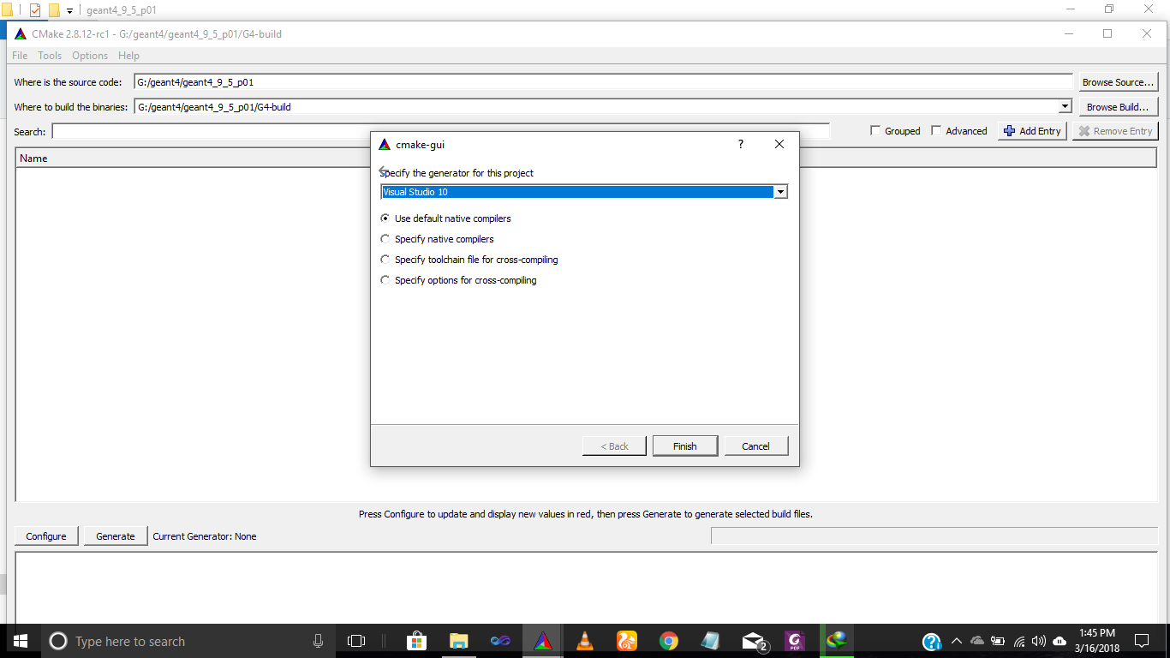
Installation of G4
Note
Place your source code Geant4.9.5 in other drive rather than Drive C, sometimes there is error occur like administrator errors. So, to avoid this please you can choose another location for your Geant4 source code.
Here the source code 4.9.5 is an older version so, it’s not available on the CERN website you can download this older version from the following link:
https://www.jlab.org/12gev_phys/packages/sources/geant4/?C=D;O=A
The CMAKE version 2.8 is also note available on their official website, either you can download this version from the following link or you can download the latest version of CMAKE 3.11 from the official website:
https://cmake.org/files/v2.8
After downloading the Geant4.9.5 source code which is in zip file
, now unpack or extract this zip file in your desired directory or drive.
Now, copy the link following for the build data for Geant4.
G:\geant4\geant4_9_5_p01
G:\geant4\geant4_9_5_p01\G4-build
In the above windows “specify the generator for this project”,
select the Visual Studio 2010 then ‘Finish’ this window.
After finishing the windows, again the windows
will open and to paste the address in the
“CMAKE_INSTALL-PREFIX” tab. The address is:
G:\geant4\geant4_9_5_p01\G4-install

Slide 10
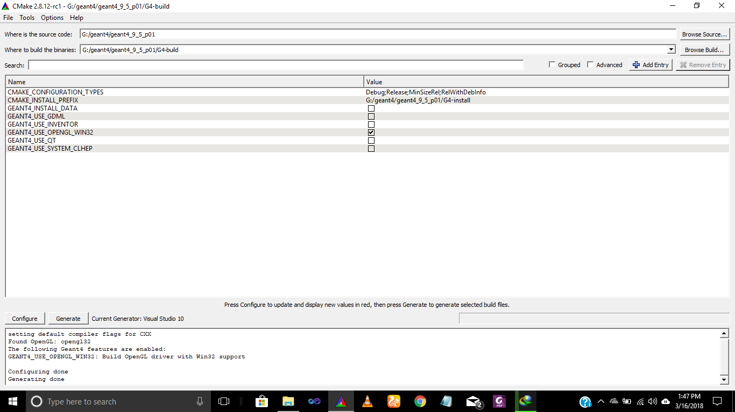
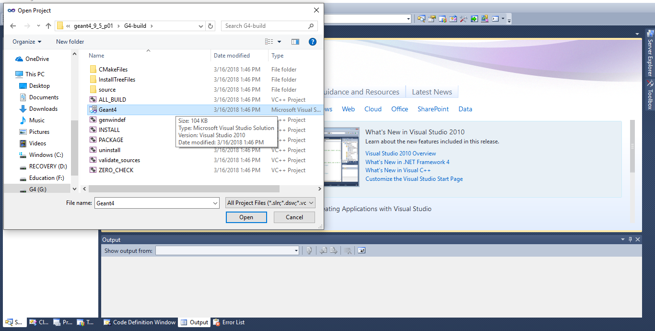
Installation of G4
Select (Tick) the tab “GEANT4_USE_OPENGL-WIN32”.
Click the button of ‘configure’ as well as to select the button
of ‘generate’. After doing this process, there will display a
message like ‘Configuring done’ and ‘Generating done’. The fig is:
After completing this process. Open the ‘Visual Studio 2010’,
click the ‘File’ tab and open the Project/solution or just press
the (Ctrl+Shift+O). There will show windows and click the file
After completing this process. Open the ‘Visual Studio 2010’,
click the ‘File’ tab and open the Project/solution or just press
the (Ctrl+Shift+O). There will show windows and click the file
Geant4.sln (sln it’s data types) and open it, like this:
There will show a “Solution Explorer” and scroll down the
“Solution Explorer”. And again there will show a tab like
“INSTALL” and right click on the “INSTALL” tab. There will
show windows and click on the “Build” tab like below:

Slide 11
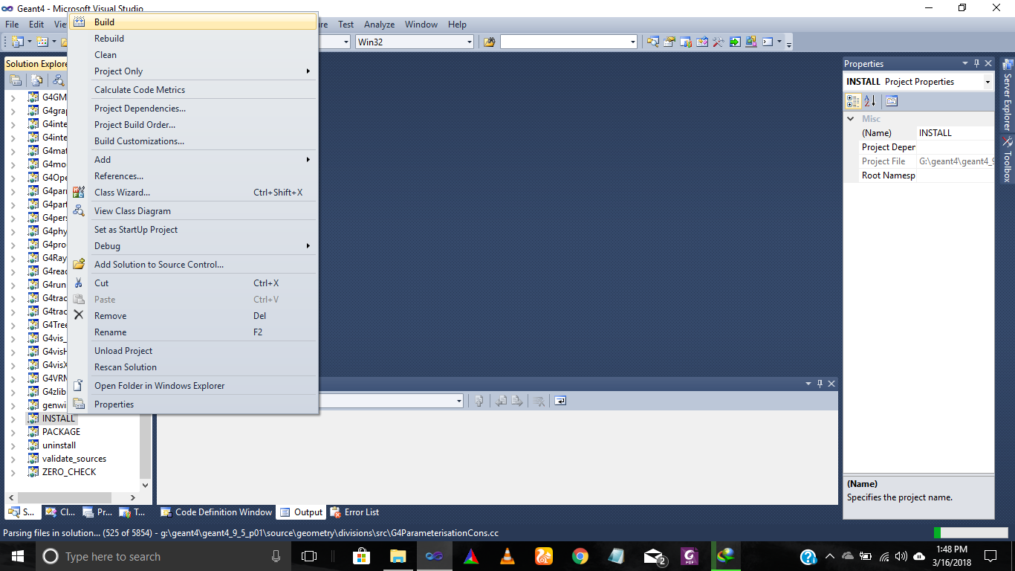
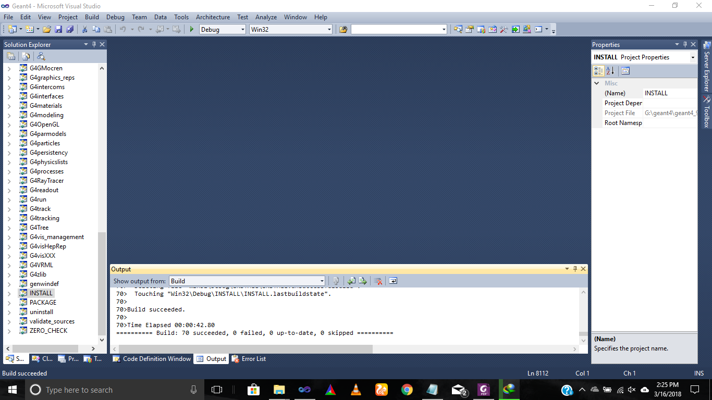
Installation of G4
There will show a message the given bellow:
******Build: 70 Succeeded, 0 failed, 0 up-to-date, 0 skipped******
Exit the ‘Visual Studio 2010’.

Slide 12
DATA requirement
Now download the DATA required for this:
Note: The Geant4.9.5 DATA is not available again in the CERN website, you can download this from the following link:
http://distfiles.macports.org/geant4/
After downloading the DATA, unpack it in the following link directory:
G:\geant4\geant4_9_5_p01\G4-install\share\Geant4-9.5.1\Data
2.3 PATH Setting
After unpacking this data and set the PATH as Environment variables. For this purpose, we set the Variable Name and Variable Values like as that is used this link:
Control Panel\System and Security\System
Here open the “Advanced System Settings”, click on the “Environmental Variables” and use the tabs of ‘User Variables’. Click on the ‘New’, write the “Variable Name” as PATH and write the “Variable Value”
G:\geant4\geant4_9_5_p01\G4-install\bin
I will write some of them like below:
Variable Name:
G4ABLADATA
Variable Value:
G:\geant4\geant4_9_5_p01\G4-install\share\Geant4-9.5.1\Data\G4ABLA3.0
Variable Name:
G4ENSDFSTATE
Variable Value:
G:\geant4\geant4_9_5_p01\G4-install\share\Geant4-9.5.1\Data\G4ENSDFSTATE1.2.3
Variable Name:
G4LEDATA
Variable Value:
G:\geant4\geant4_9_5_p01\G4-install\share\Geant4-9.5.1\Data\G4EMLOW6.23
The installation process has been completed.

Slide 13
Examples in Geant4
Example B1
Example B2
Simple geometry with few solids like boxes, cones and trapezoids
Geometry with simple placement
For generating the particles, use particle gun
There are user action classes
Simplify the tracker geometry with applied uniform magnetic field
Geometry is simple placement and parameterization
Scoring within a tracker via sensitive detector and hits
Example B3
Example B4
Schematic Positron Emission Tomography system
Geometry with simple rotation placements (G4PVPlacement)
Radioactive Source
The example B4 designed for the Calorimeter with two materials
The geometry with (G4 Replica)
There are Scoring in four ways:(a) via User Action, (b) Via user own object, (c) Via G4 Sensitive detector and hits, (d) Via Scorers
The UI commands used by G4GenericMessenger
Extended Examples: The extended example used for the Analysis, Electromagnetic, Error Propagation,
, Magnetic Field, Geometry, Hadronic, Medical, Optical, Parametrization, Radioactive decay, Run and Event, and Visualization.

Slide 14
Novice Examples
Example N01
Example N02
Simple example to demonstrate how the GEANT4 basic framework works. No physics involved, only tracking on a simple geometry.
Simulation of a simplified fixed target experiment.
It includes a simple parameterized geometry. It defines a transverse uniform magnetic field. It includes standard EM physics for gammas, charged leptons and charged hadrons. It includes visualization and detector response.
Example N03
Example N04
Simulation of a simple sample Calorimeter setup. It shows the usage of 'replicated' volumes in the geometry.
It defines user commands for primaries generation (isotropic random distribution). It defines a transverse uniform magnetic field. It includes detector response and statistics on the relevant quantities. It includes a tutorial for visualization, exercising different and visualization drivers.
It defines a simplified collider detector setup. It defines all ordinary physics processes for leptons and hadrons.
It includes a tutorial for visualization, exercising different and visualization drivers.
Example N05
Example N06
It implements a setup for fast-parameterization. It provides a simple shower parameterization for e+/e-/gamma in an EM calorimeter parameterization. It implements the parameterized detector response.
The simulation of optical photons generation and transport, define optical surfaces and exercises on optical physics processes (Cerenkov, Scintillation, Absorption...).

Slide 15
Examples in Geant4
Example N07:
It implements three simplified sandwich calorimeters. It shows how to modify the part of the geometry setup at run-time. It includes detector description parameterization by materials. It demonstrates sharing of a sensitive detector by definition of different sub-detectors.
Advanced Examples:
Geant4 provides the advanced examples with realistic applications in experimental environment. The advanced examples are:
Air shower, AMS Ecal, Brachy Therapy, Composite Calorimeter, DNA Physics, Gamma Ray Telescope,
Hadron Therapy, Iort Therapy, IAr-Calorimeter, Medical Linac, Micro beam, Micro dosimetry, Nano beam,
Purging Magnet, Radio Protection, Underground Physics, X-ray Fluorescence, X-ray Telescope.

Slide 16
Introduction to Geant4 Visualization Driver
Purposes of G4 Visualization
For quick response to geometries, trajectories and hits.
High quality outputs for publications
To zoom, rotate the geometries of detectors
Flexible camera control to debug the complex geometries
Interactive picking to get more information about the visualization drivers
Visualization Driver
There are many visualization drivers in G4:
OpenGL
Ray-Tracer
HepRep/WIRED
DAWN

Slide 17
Introduction to Geant4 Visualization Driver
OpenGL
HepRep/ WIRED
Create a file in the .exe file by typing /vis/open OGLIX. It has the following features:
View directly from G4.
Zoom and rotate the detector geometries.
It gives fast response.
Limited printing ability (pixel graphics, not vector graphics)
Create a file in the .exe file by typing /vis/open HepRepFile. It has the following features:
Create a file to view in the WIRED3 HepRep Browser
Wireframe or simple area fills (not photorealistic)
There are many interactive features about this Driver:
Zoom, rotate, translate, reset
Click to show attributes like (momentum, kinetic energy, material, state, PID, density etc.)
Special projections like (Fish Eye, Z-Phi, perspective, parallel etc.).
Special orientation like (Auto Fly, Wobble, Beam view, Auto Rotate etc.).
Export too many vector graphic formats like (Postscript, PDF, gif, raw, bmp, jpg, jpeg etc.)
RayTracer
Create a file in the .exe file by typing /vis/open RayTracer. It has the following features:
Create a jpeg file.
It is used to show geometries not show trajectories
It also supports shadow, transparency, and mirrored surfaces.

Slide 18
Introduction to Geant4 Visualization Driver
DAWN:
Create a file in the .exe file by typing /vis/open DAWNFILE. It has the following features:
Create a file to view in the DAWN
Runs on Linux/Unix and windows
No interactive features
Highest quality technical rendering, and camera focusing
Installation of Geant4 Visualization Driver
The installation of WIRED Visualization driver is given in the following link:
http://conferences.fnal.gov/g4tutorial/g4cd/Documentation/Visualization/G4WIREDTutorial/G4WIREDTutorial.html
The installation of HepRApp Visualization driver is given in the following link:
http://www.slac.stanford.edu/~perl/HepRApp/
The installation of DAWN Visualization driver is given in the following link:
http://geant4.slac.stanford.edu/Presentations/vis/G4DAWNTutorial/G4DAWNTutorial.html

Slide 19
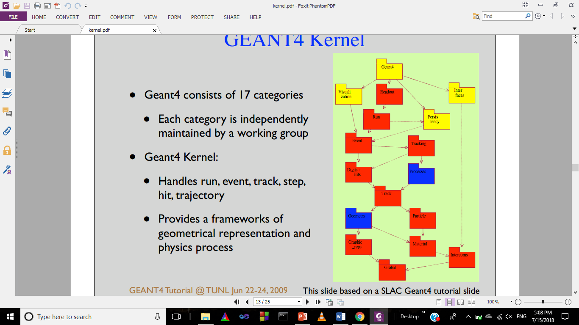
Basic concepts and Kernel structure of Geant4 Kernel:
Run in Geant4:
A run of Geant4 starts when “BeamOn”, we execute the file of .exe by typing /run/beamOn 10. There are a following characteristics of Run in Geant4.
Within a run we cannot change the geometry of the detector and physical process
A run is a collection of events which share the same detector conditions.
At the beginning of the run we can navigate the geometry of detector, cross-section tables and cut-off values.
G4RunManager class manages processing of run, a run is represented by the G4Run class.
G4UserRunAction is the optional user hook.
Event in Geant4:
At the beginning of the processing, an event contains the primary particles. These particles are pushed into stack. When the stack becomes empty, processing of event becomes over.
G4EventManager class manages the processing of event.
G4Event class represent an event, and it contains the following processes at the end of event.
List of particles
Hits collections
Trajectory collections
Digits collections
G4UserEventAction is an optional user hook.

Slide 20
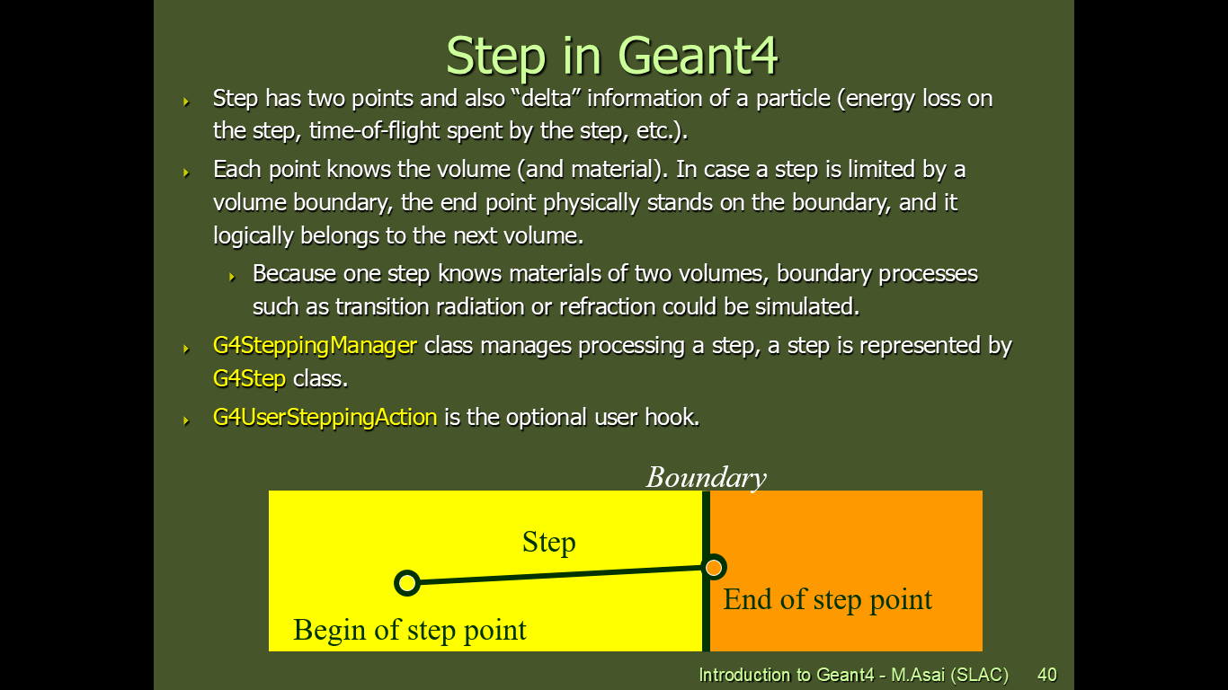
Basic concepts and Kernel structure of Geant4 Kernel:
Track in Geant4:
Track is a snapshot of a particle. It contains only the position and physical quantities of current instance.
Step is a delta information of the track.
Track is not the collection of steps.
Track is deleted when:
It goes out of the world volume
It disappears (e.g. decay)
It goes down to zero kinetic energy
The user decided to kill it
No track object persists at the end of event
G4TrackingManager manages the process of a track, the G4Track represent the track.
G4UserTrackingAction is the optional user hook.
Step in Geant4:
Step has two points and it’s contain the “delta” information about the particle (like energy of the particle and the time of flight etc.).
In which of these points each point knows the volume and material. In this case a step is limited to the volume boundary, at the volume boundary, it means the next volume.
Because one step knows the information of the material of two volumes, boundary process means the transition radiation or refraction could be simulated.
G4SteppingActionManager class manages process of step, the G4Step represents the step.
G4UserSteppingAction is the optional user hook.

Slide 21
Material and Geometry in Geant4
Unit System in Geant4:
Geant4 provides the facility for the unit system which is hard coded to implement in the simulation, we just multiply the proper unit like below:
Length=10.0*cm
kineticEnergy=1.0*GeV or 13.0*TeV
For getting the number we just divide this by unit like below:
G4cout<<Length/cm<<”[cm]”<<G4endl;
G4cout are o-stream objects defined by Geant4. G4endl is also provided.
Construction of Detector in Geant4:
Describe the detector class from the concrete or base class G4VUserDetectorConstruction, it has the following features:
Construct all the necessary materials
Define the solid/shapes for the geometry
Construction and placement of volumes for detector
Instantiate the sensitive detectors and set them for the corresponding volumes (optional)
Set the magnetic field to detector (optional)
Set the visualization attributes for the detector (optional)
4.6.2 Defining the Materials:
We can define the material of the detector there are following methods:
Isotopes, elements, compound, mixtures and molecules.
Here we use only one method, which are very simple like below:
G4NistManager* nist = G4NistManager::Instance();
G4Material* env_mat = nist->FindOrBuildMaterial("G4_WATER");

Slide 22
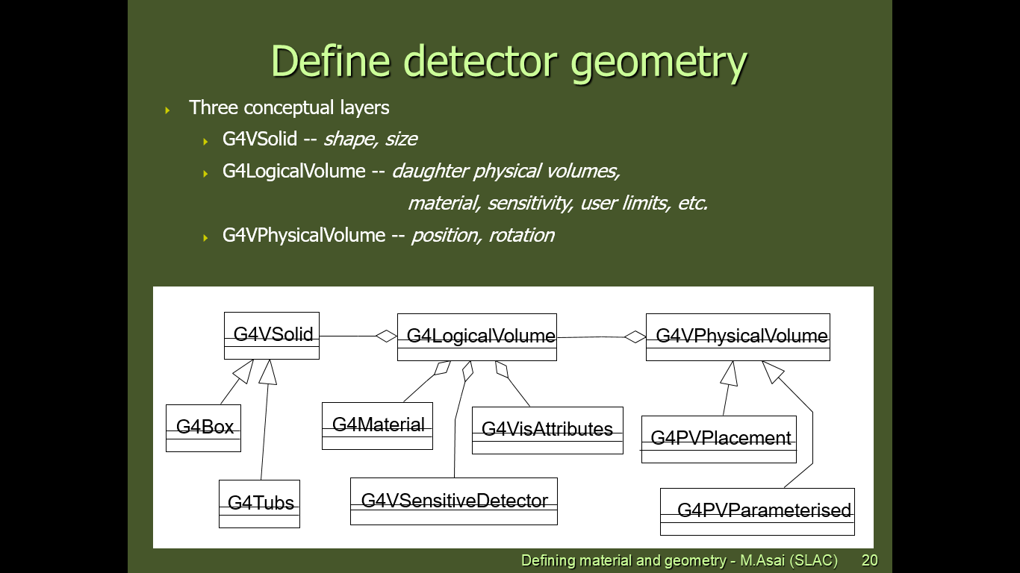
Material and Geometry in Geant4
Solid and shape:
All the shapes of the detectors are abstracted from the G4VSolid class, from this class we can derive the other type of solid classes like (G4Tubs, G4Cons etc.)
Solids can be defined in Geant4 by:
CSG (Constructed Solid Geometry) solids like G4Box, G4Tubs, and G4Cons etc.
BREP (Boundary REPresented) solids like G4BREPSolidPolycone, G4BSplineSurface etc.
Boolean Solid like G4UnionSolid, G4SubtractionSolid etc.
Geometry of the Detector:
There are following layers which are used to define the detector geometry:
A physical volume contains the physical area which must exist and contains the other element like the World Volume.

Slide 23
Material and Geometry in Geant4
G4LogicalVolume:
It’s contains the followings information except of the position and rotation:
Shapes and dimensions (G4VSolid)
Material, sensitivity, visualization attributes
Position of the daughter volumes
Magnetic field
Visualization Attributes:
Each logical volume can be associated to visualization attributes by using the class G4VisAttributes object, which contains the following properties:
Visibility of the daughter volumes
Invisibility of the daughter volumes
Physical Volume:
There are five types of physical volumes, but we use only three which are given below:
G4PVPlacement in which 1 Placement = One Volume
G4PVParameterised in which 1 Parameterized = many volumes
Which are implemented through the concrete class G4VPVParameterisation.
G4PVReplica in which 1 Replica = many Volumes
Mother volumes is filled by the daughter volumes of the same shape

Slide 24
Application Development in Geant4:
Geant4 setup is studying the Proton beam passing through the varied materials:
In this simulation code, we described the Calorimeter of which detector construction, beam generating, energy of beam and material and shape of Calorimeter and the number of layers which is our target.
In our simulation, we choose the “Proton Beam” and “15 MeV” energy and the particle like “Proton”.
In our simulation code there are seven “src” files with “.cc” data type and eight “include” files with “.hh” header files. We used the “Basic Example B4a”.
Now, we will explain the “src” files briefly.
B4DetectorConstrction.cc:
In this class, we will explain the detector geometries, materials, placements of solids and visual attributes for the solids etc. We will just discuss the functions/commands to do so. We can define the material as the given below:
G4NistManager* nist = G4NistManager::Instance();
G4Material* env_mat = nist->FindOrBuildMaterial("G4_WATER");
We used the G4Box constructor which is derived from the G4VSolid class to design the Calorimeter. The constructor of this solid is:
It’s for the World volume:
G4VSolid* worldS = new G4Box("World", // its name
worldSizeXY/2, worldSizeXY/2, worldSizeZ/2); // its size
It’s for the Calorimeter volume:
G4VSolid* calorimeterS = new G4Box("Calorimeter", // its name
calorSizeXY/2, calorSizeXY/2, calorThickness/2); // its size
After this one more constructor is G4PVPlacement is defined as:
G4LogicalVolume* worldLV= new G4LogicalVolume(
worldS, // its solid
wor_mat, // its material
"World"); // its name

Slide 25
B4DetectorConstrction.cc
G4VPhysicalVolume* worldPV= new G4PVPlacement(0,// no rotation G4ThreeVector(), // at (0,0,0) worldLV, // its logical volume
"World", // its name 0, // its mother volume false, // no boolean operation 0, // copy number
fCheckOverlaps); // checking overlaps
After this one more constructor is G4PVReplica is defined as:
G4LogicalVolume* layerLV= new G4LogicalVolume(layerS, // its solid lar_mat, // its material
"Layer"); // its name
new G4PVReplica(
"Layer", // its name
layerLV, // its logical volume
calorLV, // its mother
kZAxis, // axis of replication
nofLayers, // number of replica
layerThickness); // witdth of replica
After this one more is Visualization Attributes is defined as:
G4VisAttributes*VisAtt=new G4VisAttributes( G4Colour::Red());
G4VisAttributes*VisAtt1=new G4VisAttributes( G4Colour::Yellow ());
G4VisAttributes*VisAtt2=new G4VisAttributes( G4Colour::White());
calorLV->SetVisAttributes(VisAtt);
worldLV->SetVisAttributes(VisAtt1);

Slide 26
B4DetectorConstrction.cc
After this one more is Magnetic field is defined as:
G4FieldManager* fieldManager
= G4TransportationManager::GetTransportationManager()->GetFieldManager();
// Delete the existing magnetic field
if ( fMagField ) delete fMagField;
if ( fieldValue != 0. ) {
// create a new one if not null
fMagField
= new G4UniformMagField(G4ThreeVector(fieldValue, 0., 0.));
fieldManager->SetDetectorField(fMagField);
fieldManager->CreateChordFinder(fMagField);
}
else {
fMagField = 0;
fieldManager->SetDetectorField(fMagField);
}

Slide 27
B4aEventAction.cc
In this class two Virtual Void functions are implemented BeginOfEventAction(const G4Event* evt) and EndOfEventAction(const G4Event*evt). Here we will discuss the second functions. In this function, we will fill the Histograms like below:
G4AnalysisManager* analysisManager = G4AnalysisManager::Instance();
// fill histograms
analysisManager->FillH1(1, fEnergyAbs);
analysisManager->FillH1(2, fEnergyGap);
analysisManager->FillH1(3, fTrackLAbs);
analysisManager->FillH1(4, fTrackLGap);
// fill ntuple
analysisManager->FillNtupleDColumn(0, fEnergyAbs);
analysisManager->FillNtupleDColumn(1, fEnergyGap);
analysisManager->FillNtupleDColumn(2, fTrackLAbs);
analysisManager->FillNtupleDColumn(3, fTrackLGap);
analysisManager->AddNtupleRow();
And then print per event of this quantity:
G4int eventID = evt->GetEventID();
if ( eventID % fPrintModulo == 0) {
G4cout << "---> End of event: " << eventID << G4endl;
G4cout
<< " Absorber: total energy: " << std::setw(7)
<< G4BestUnit(fEnergyAbs,"Energy")
<< " total track length: " << std::setw(7)
<< G4BestUnit(fTrackLAbs,"Length")
<< G4endl
<< " Gap: total energy: " << std::setw(7)
<< G4BestUnit(fEnergyGap,"Energy")
<< " total track length: " << std::setw(7)
<< G4BestUnit(fTrackLGap,"Length")
<< G4endl;
}

Slide 28
B4aEventAction.cc
Here, in the EndOfEventAction(const G4Event*evt), we can also find the momentum and position of the particle like below:
//Momentum
G4ThreeVector momentum=B4aSteppingAction::Instance()->GetMomentum();
fmomentum +=momentum;
//G4cout<<"Momentum"<<momentum<<G4endl;
G4cout << " Momentum " << momentum/keV << " [keV] " <<G4endl
//Position
G4ThreeVector position=B4aSteppingAction::Instance()->GetPosition();
fposition +=position;
// G4cout<<"Position"<<position<<G4endl;
G4cout << " Position " << position/cm << " [cm] " <<G4endl;

Slide 29
B4PrimaryGeneratorAction.cc
This class is very important which is used for the initialization of particles by using the particle gun and set the particle and its energy, and position of the particle gun, like below:
G4int nofParticles = 1;
fParticleGun = new G4ParticleGun(nofParticles);
// default particle kinematic
G4ParticleDefinition* particleDefinition
= G4ParticleTable::GetParticleTable()->FindParticle("e+");
fParticleGun->SetParticleDefinition(particleDefinition);
fParticleGun->SetParticleMomentumDirection(G4ThreeVector(0.,0.,1.));
fParticleGun->SetParticleEnergy(15.*MeV);
Now here set the position of the particle gun on the world volume:
G4double worldZHalfLength = 0;
G4LogicalVolume* worlLV
= G4LogicalVolumeStore::GetInstance()->GetVolume("World");
G4Box* worldBox = 0;
if ( worlLV) worldBox = dynamic_cast< G4Box*>(worlLV->GetSolid());
if ( worldBox ) {
worldZHalfLength = worldBox->GetZHalfLength();
}
else {
G4cerr << "World volume of box not found." << G4endl;
G4cerr << "Perhaps you have changed geometry." << G4endl;
G4cerr << "The gun will be place in the center." << G4endl;
}
// Set gun position
fParticleGun
->SetParticlePosition(G4ThreeVector(0., 0., -worldZHalfLength));
fParticleGun->GeneratePrimaryVertex(anEvent);

Slide 30
B4RunAction.cc
In this class, two void virtual functions are implemented, which are:
BeginOfRunAction(const G4Run* run) & EndOfRunAction(const G4Run* aRun)
In the BeginOfRunAction(const G4Run* run), we will create the Histograms and ntuples like below:
G4AnalysisManager* analysisManager = G4AnalysisManager::Instance();
// Open an output file
G4String fileName = "B4";
analysisManager->OpenFile(fileName);
analysisManager->SetFirstHistoId(1);
// Creating histograms
analysisManager->CreateH1("1","Edep in absorber", 100, 0., 800*MeV);
analysisManager->CreateH1("2","Edep in gap", 100, 0., 100*MeV);
analysisManager->CreateH1("3","trackL in absorber", 100, 0., 1*m);
analysisManager->CreateH1("4","trackL in gap", 100, 0., 50*cm);
// Creating ntuple
analysisManager->CreateNtuple("B4", "Edep and TrackL");
analysisManager->CreateNtupleDColumn("Eabs");
analysisManager->CreateNtupleDColumn("Egap");
analysisManager->CreateNtupleDColumn("Labs");
analysisManager->CreateNtupleDColumn("Lgap");
analysisManager->FinishNtuple();
In the EndOfRunAction(const G4Run* aRun), we will print the Histograms and ntuples like below:
G4int nofEvents = aRun->GetNumberOfEvent();
if ( nofEvents == 0 ) return;
// print histogram statistics
G4AnalysisManager* analysisManager = G4AnalysisManager::Instance();
if ( analysisManager->GetH1(1) ) {
G4cout << "\n ----> print histograms statistic \n" << G4endl;

Slide 31
B4RunAction.cc
G4cout
<< " EAbs : mean = " << G4BestUnit(analysisManager->GetH1(1)->mean(), "Energy")
<< " rms = " << G4BestUnit(analysisManager->GetH1(1)->rms(), "Energy") << G4endl;
G4cout
<< " EGap : mean = " << G4BestUnit(analysisManager->GetH1(2)->mean(), "Energy")
<< " rms = " << G4BestUnit(analysisManager->GetH1(2)->rms(), "Energy") << G4endl;
G4cout
<< " LAbs : mean = " << G4BestUnit(analysisManager->GetH1(3)->mean(), "Length")
<< " rms = " << G4BestUnit(analysisManager->GetH1(3)->rms(), "Length") << G4endl;
G4cout
<< " LGap : mean = " << G4BestUnit(analysisManager->GetH1(4)->mean(), "Length")
<< " rms = " << G4BestUnit(analysisManager->GetH1(4)->rms(), "Length")
<< G4endl;
}
// save histograms
analysisManager->Write();
analysisManager->CloseFile();
// complete cleanup
delete G4AnalysisManager::Instance();

Slide 32
B4aSteppingAction.cc
In this class, there is one main constructor, which is given below:
Here we can collect energy and track length step by step like below:
// get volume of the current step
G4VPhysicalVolume* volume
= step->GetPreStepPoint()->GetTouchableHandle()->GetVolume();
// energy deposit
G4double edep = step->GetTotalEnergyDeposit();
// step length
G4double stepLength = 0.;
if ( step->GetTrack()->GetDefinition()->GetPDGCharge() != 0. ) {
stepLength = step->GetStepLength();
}
if ( volume == fDetConstruction->GetAbsorberPV() ) {
fEventAction->AddAbs(edep,stepLength);
}
if ( volume == fDetConstruction->GetGapPV() ) {
fEventAction->AddGap(edep,stepLength);
}
Here we will find the momentum and position of the particle by taking GetTrack from the step from the UserSteppingAction:
G4Track* track = step->GetTrack();
G4ThreeVector momentum = track->GetMomentum();
fmomentum +=momentum;
G4ThreeVector position = track->GetPosition();
fposition +=position;

Slide 33
exampleB4a.cc
G4RunManager:
The first thing in main is G4RunManager class, which controls the flow of programs and manages the event loops within the run, which is in a G4 Kernel.
when the G4RunManager is created other manager classes are created and when it deleted other manager classes are also created, which responsible for the detector construction, physics process etc.
We initialize the managers classes by G4RunManager. There are two types of managers classes:
1) User initialization classes
2) User action classes

Slide 34
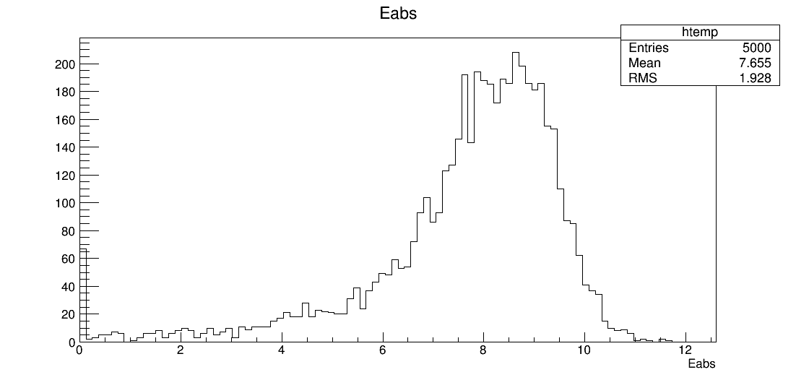
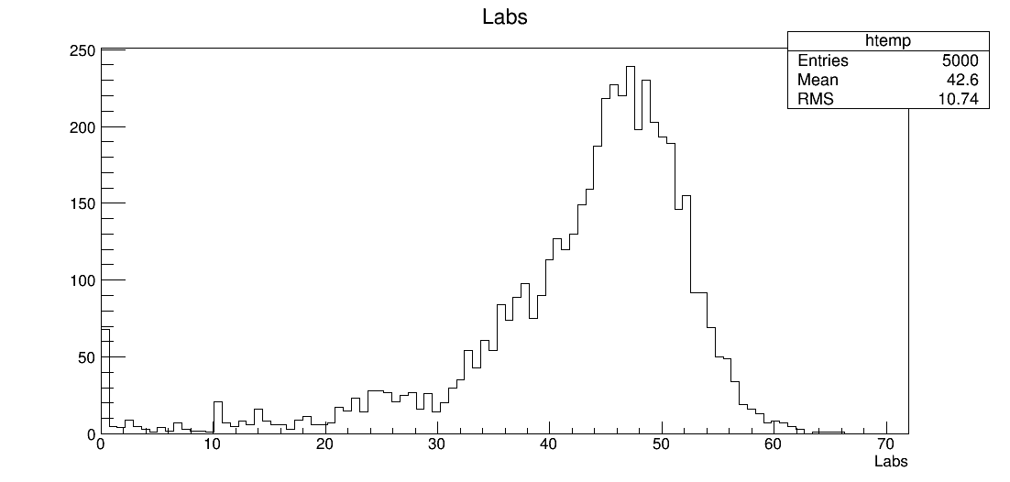
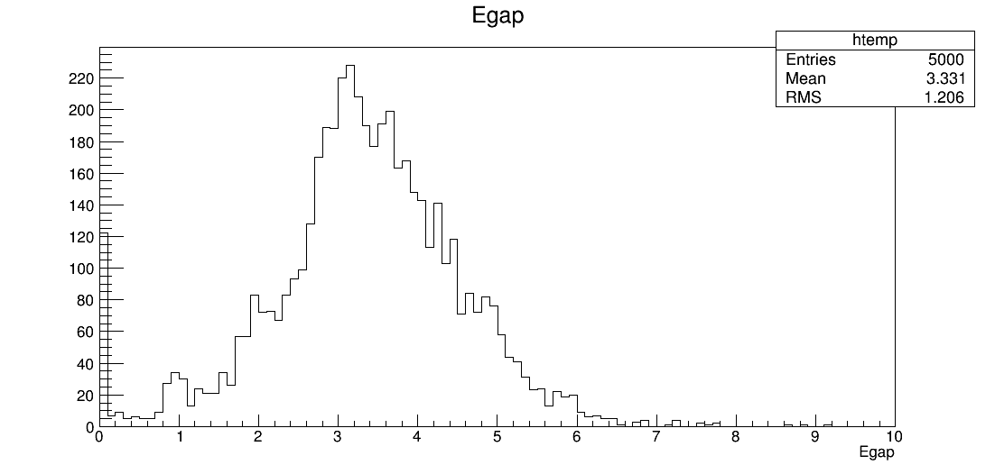
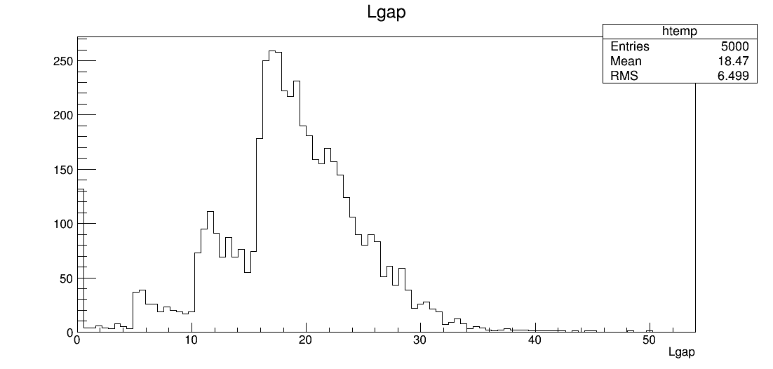
Results
When the protons pass through the water material it losses the energy, the histograms it’s related are given below:
Histogram 1 is related to energy absorption through the water material:
Histogram 3 is related to track absorption through the water material
Histogram 2 is related to energy gap through the water material:
Histogram 4 is related to track gap through the water material:

Slide 35
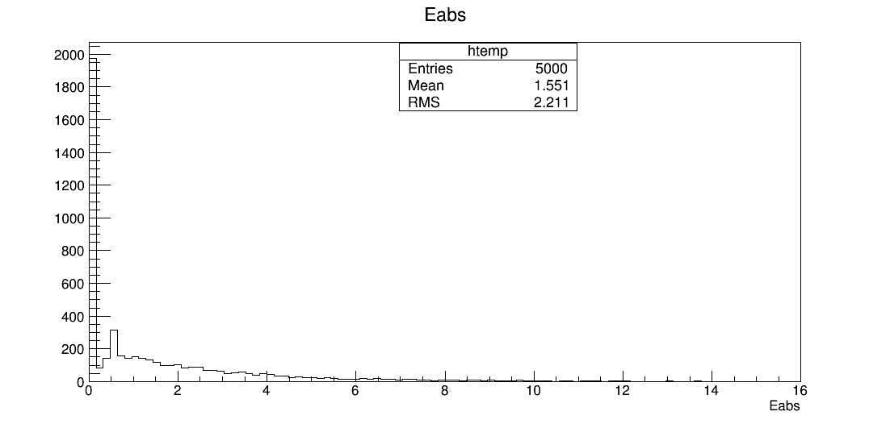
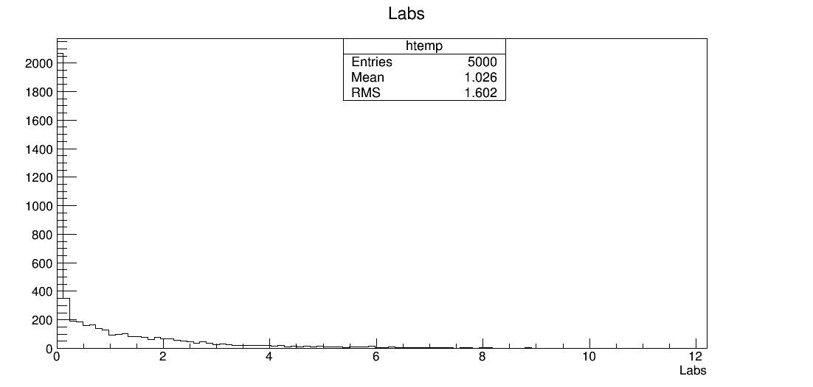
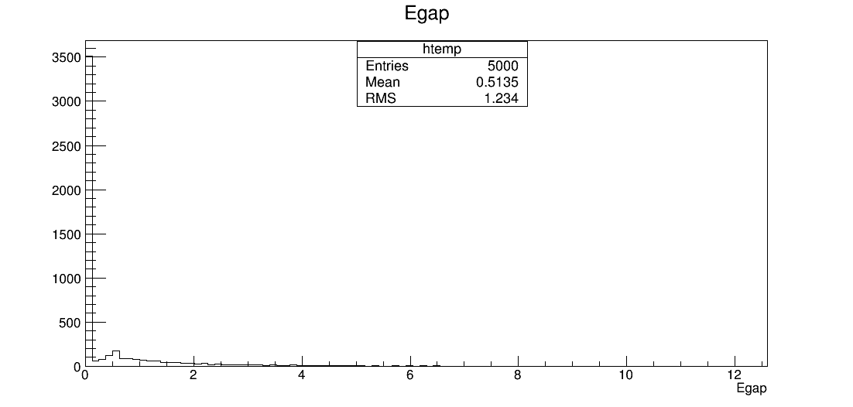
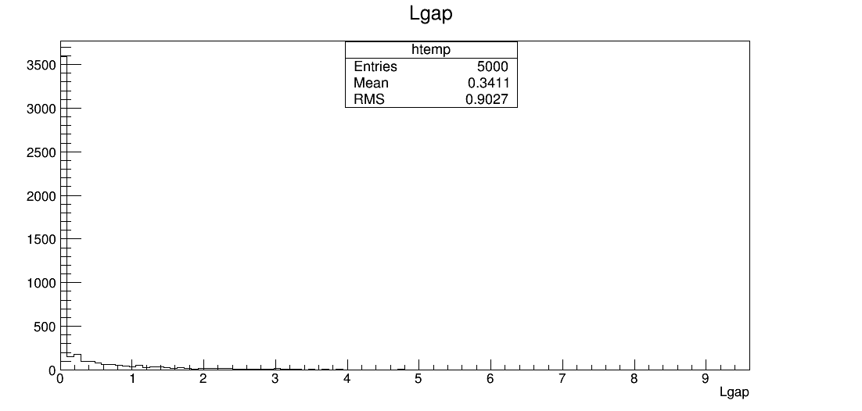
Results: When the protons pass through the lead (Pb) material it losses the energy, the histograms it’s related are given below:
Histogram 1 is related to energy absorption through the lead material:
Histogram 3 is related to track absorption through the lead material:
Histogram 2 is related to energy gap through the lead material:
Histogram 4 is related to track gap through the lead material

Slide 36
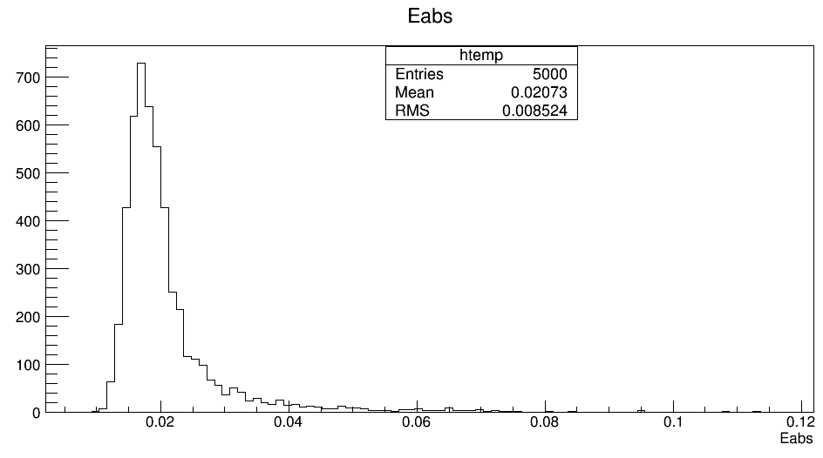
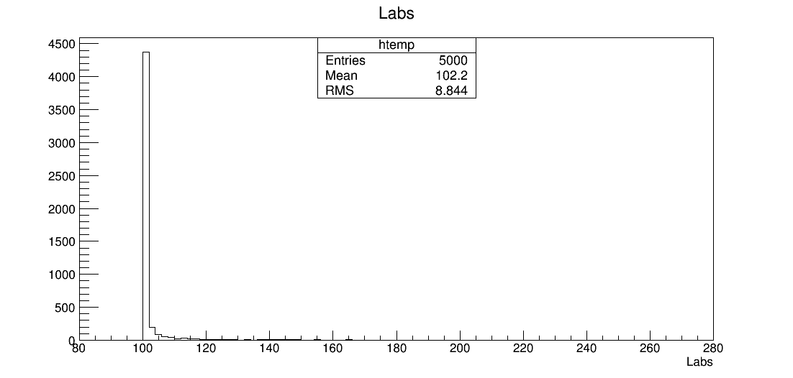
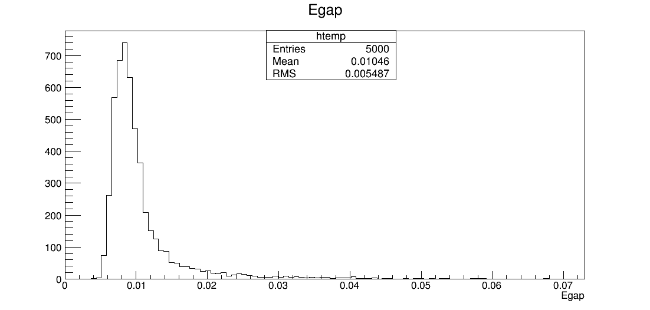
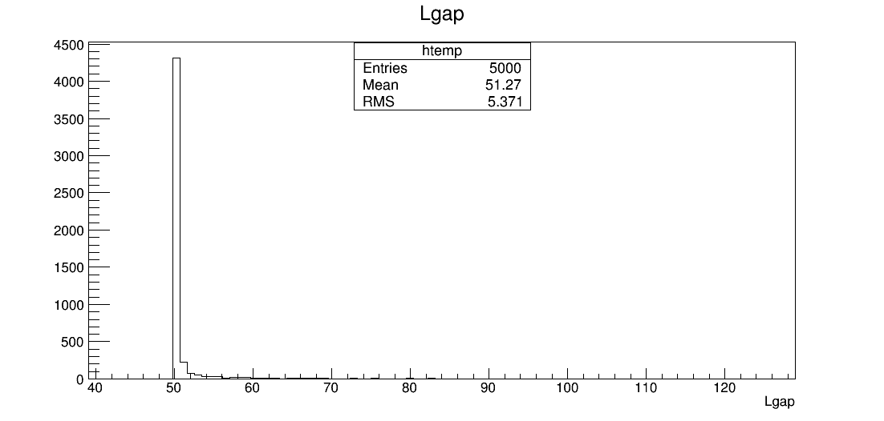
Results: When the protons pass through the air material it losses the energy, the histograms it’s related are given below:
Histogram 1 is related to energy absorption through the air material:
Histogram 3 is related to track absorption through the air material:
Histogram 2 is related to energy gap through the air material:
Histogram 4 is related to track gap through the air material

Slide 37
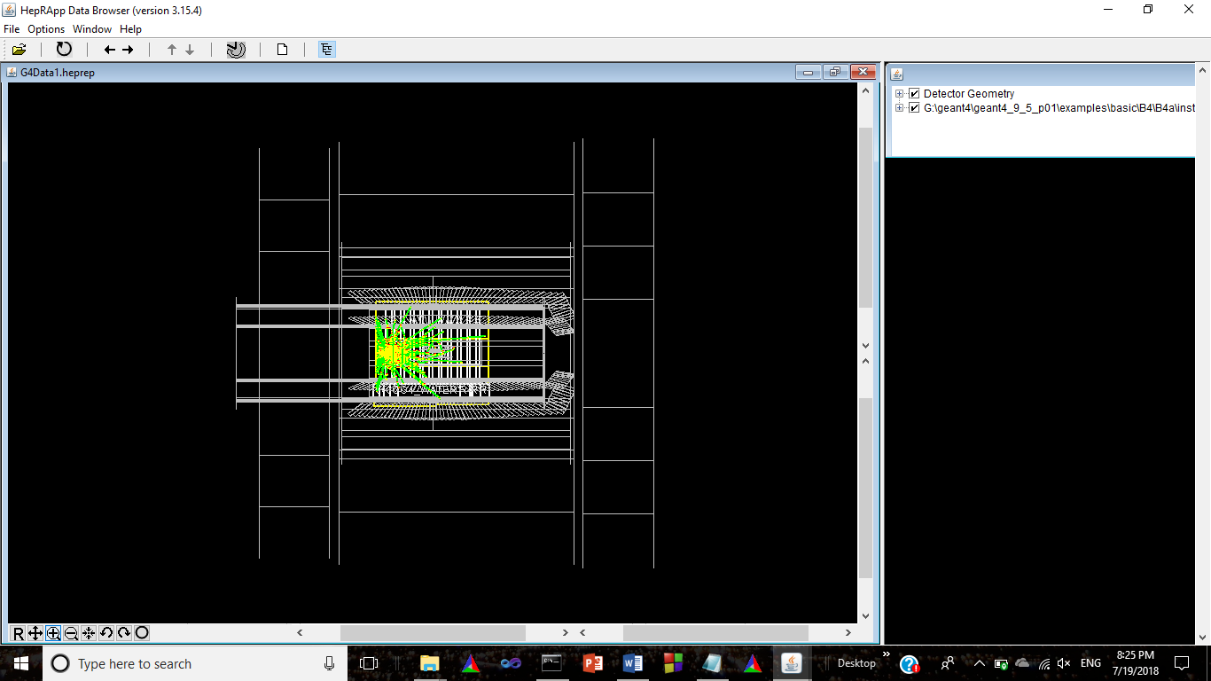

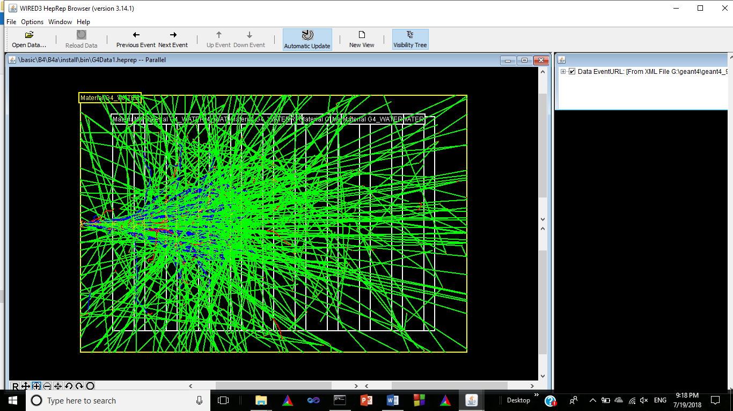
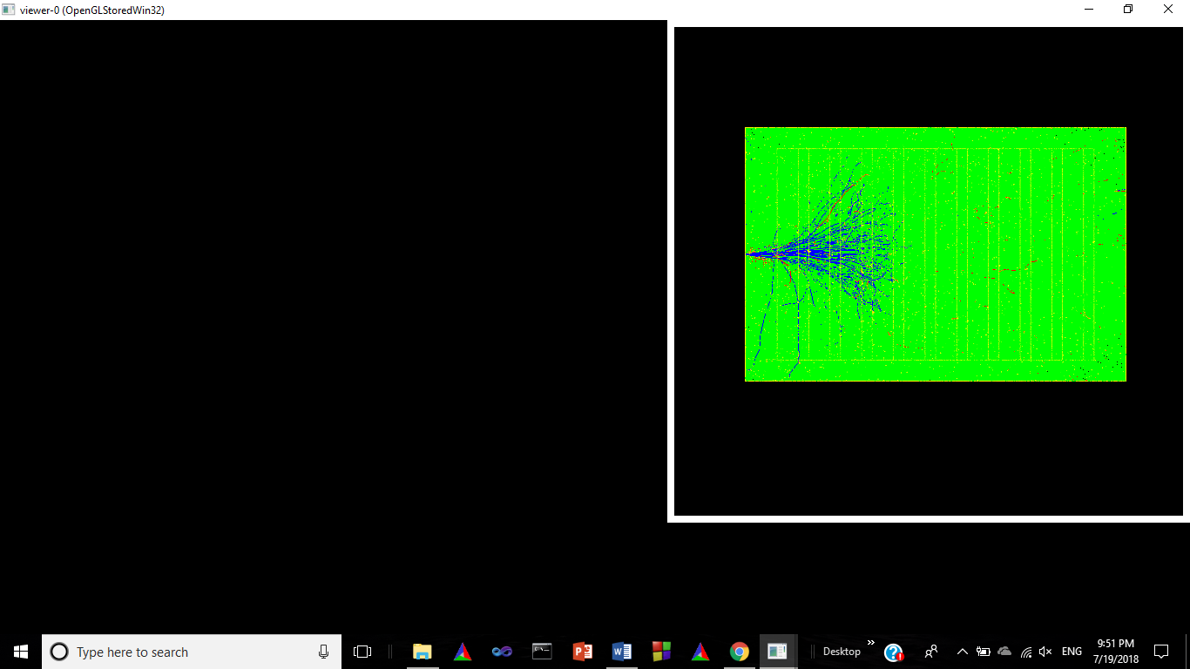
Detector view from the HepRApp Data Visualization Browser:
Babar Detector view from visualization Browser:
Detector view from the RayTracer Visulization:
Detector view from the WIRED3 HepRep Visualization Browser
Detector view from the OpenGL Visualization:

Slide 38
[1] Geant4 collaboration, Geant4 Installation Guide Version: Geant4.9.5, (2011).
[2] Geant4 collaboration, Geant4 User’s Guide for Application Developer’s Version: Geant4.9.5, (2011).
[3] Geant4 collaboration, Physics Reference Manual Version: Geant4.9.5, (2011).
[4] Geant4 Source Code Version: Geant4.9.5.p01:
[5] https://www.jlab.org/12gev_phys/packages/sources/geant4/?C=D;O=A
retrieved on 6 June, 2018.
[6] Cmake Version: 2.8.7:
[7] https://cmake.org/files/v2.8
retrieved on 6 June, 2018.
[8] http://distfiles.macports.org/geant4/
retrieved on 8 June, 2018.
[9]http://geant4.web.cern.ch/geant4/UserDocumentation/UserGuides/IntroductionToGeant4/html/index.html retrieved on 8 June, 2018.
[10]http://conferences.fnal.gov/g4tutorial/g4cd/Documentation/Visualization/G4WIREDTutorial/G4WIREDTutorial.html
[11] http://www.slac.stanford.edu/~perl/HepRApp/
[12]http://geant4.slac.stanford.edu/Presentations/vis/G4DAWNTutorial/G4DAWNTutorial.html

