Slide 1

Presented by: Abdelmoneim, Mostafa, Noha, Reem

Slide 2

Outline
Introduction
Problem
Features
Demonstration
Value for Money
Future plans
Questions

Slide 3

Introduction
Health Domain
One system joining pharmacies all over Egypt
Questions answered with a click of a button

Slide 4
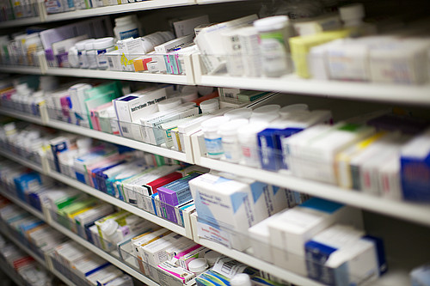
Problem
A rise in missing medications in Egypt
Resort to social media and other means
Lack of inventory management systems
Statistics:
84.4% faced problems finding meds
79.6% asked friends and family abroad, 19.4% resorted to
social media and other methods
60% were sometimes able to find these medications
Miscommunication between pharmacies and clients

Slide 5




Features
Client can search for medications
By pharmacy
By medicine
Client can search and view close pharmacies on a map
Client can place an order
Pharmacies’ enhanced inventory management

Slide 6
Demonstration
https://medsondemandtest.mybluemix.net

Slide 7

Value for Money
Pharmacies
Relatively low costs
Pharmacies improved inventory management impacts sales
Demographic correlations
Demand & Supply
Clients
Find what they seek easily
No longer resort to unconventional means
Free of charge service

Slide 8



Future Plan
Client
Individual
Retrieve search results by location
Insurance
Add medical information
Clinics
Extend MedsOnDemand to include clinics
Pharmacy
Add new medicine
Preview analytics
Gentlemen agreement inaugurated
ANALYTICS

Slide 9
Questions ?

