Slide 1
Simulation Concepts
Shen Cheng
ECP8506 Clinical Trial Simulation
10/18/2024

Slide 2
Outline
Simulation Nomenclature
Types of Simulations
General Modeling Process
General Simulation Process

Slide 3
Simulation Nomenclature
Population parameter
Fixed effects (θ_{n}): parameters describing structural/covariate model
Random effects: parameters describing variability
Inter-individual/occasion variability (IIV/IOV, ⍵_{n}²): Ω matrix (⍵₁²… ⍵_{n}²)
Residual variability (RV, σ_{n}²): Σ matrix (σ₁²… σ_{n}²)
Individual IIV/IOV
Empirical Bayes estimates (EBEs): η_{n,i} ~ N(0, ⍵_{n}²)
Individual RV: ε_{n,ij} ~ N(0, σ_{n}²)
Parameter uncertainty/precision
How confident/precise in estimating the population parameters
Relevant to both fixed effects & random effects
Covariate: Patient characteristics (e.g., weight_{i}, height_{i}, age_{i}, etc)
Replicate: A single set of simulation incorporate all trial components
Annotations:
n: index of a parameter (e.g., the n^{th} parameter).
i: index of an individual (e.g., the i^{th} individual).
j: index of an observation (e.g., the observation collected at j^{th} time point).

Slide 4
Types of Simulations
Deterministic vs. Stochastic
Patient-level vs Population-level
Drug Property vs Clinical Trial
Mike Heathman, Simulation Concepts, ACoP 2019

Slide 5
Deterministic vs. Stochastic Simulation
Deterministic
Produce a typical response for a patient/population.
Do not need random number generator for Monte Carlo sampling.
Stochastic (Monte Carlo)
Produce a distribution of response for a patient/population.
Require random number generator for Monte Carlo sampling in single or multiple levels:
Inter-individual / occasion variability
Parameter uncertainty
Mike Heathman, Simulation Concepts, ACoP 2019

Slide 6
Patient-level vs Population-level
Patient-level
Each simulation replicate correspond to a (typical) patient
Population-level
Each simulation replicate correspond to a population (e.g., a trial patient population, a study arm, etc)
Mike Heathman, Simulation Concepts, ACoP 2019

Slide 7
Drug Property vs Clinical Trial
Drug Property
To understand the property of a drug
Independent of study design
Example: what is the probability to achieve X response in a typical patient given Y dosing regimen of drug Z?
Clinical Trial
To understand the performance of a trial design
Dependent on trial design (e.g., number or characteristics of subjects, duration of study, study arms/doses)
Example: what is the power of the X trial given Y design?
Mike Heathman, Simulation Concepts, ACoP 2019

Slide 8
Outline
Simulation Nomenclature
Types of Simulations
General Modeling Process
General Simulation Process

Slide 9
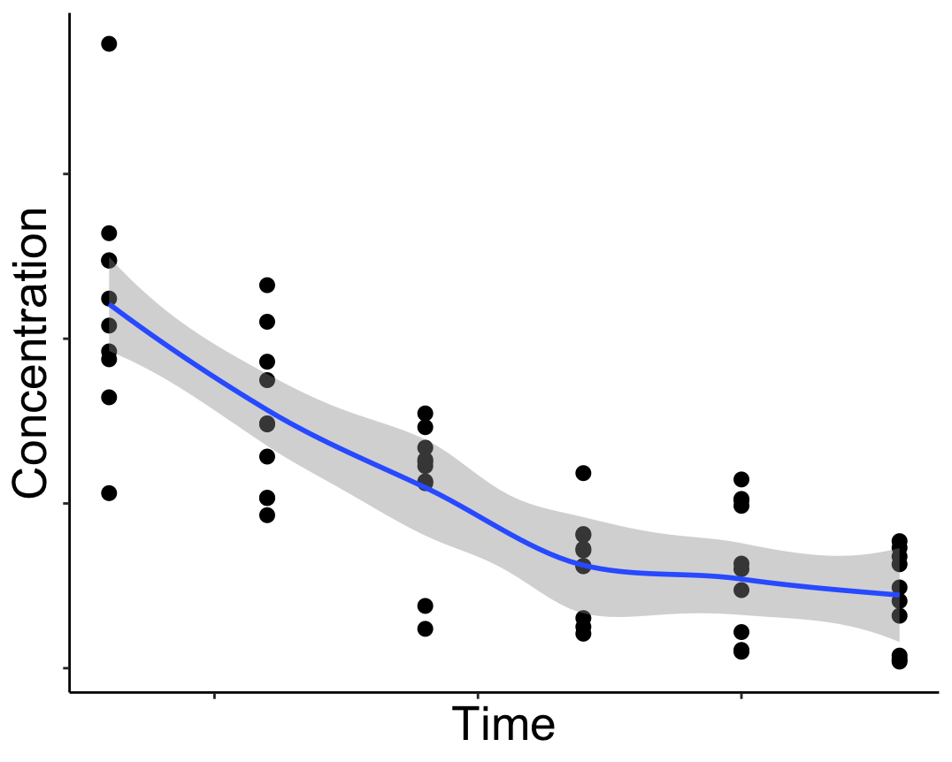
Model Development
ID | TIME | DV | AMT | CMT | EVID | WT | AGE
1 | 0 | 0 | 100 | 1 | 1 | 65 | 31
1 | 0.69 | 48.1 | 0 | 2 | 0 | 65 | 31
1 | 1.98 | 12.5 | 0 | 2 | 0 | 65 | 31
2 | 0 | 0 | 100 | 1 | 1 | 77 | 25
2 | 0.52 | 69.7 | 0 | 2 | 0 | 77 | 25
2 | 2.56 | 15.3 | 0 | 2 | 0 | 77 | 25
WT | AGE | SEX | …
65 | 31 | F | …
77 | 25 | M | …
102 | 36 | M | …
… | … | … | …

Slide 10
Model Development
Dose
F_{i}
DEPOT
K_{a,i}
CENT
WT | AGE | SEX | …
65 | 31 | F | …
77 | 25 | M | …
102 | 36 | M | …
… | … | … | …
V_{i}
CL_{i}

Slide 11

Model Development
Dose
F_{i}
DEPOT
K_{a,i}
CENT
V_{i}
CL_{i}
$${CL}_{i}=θ_{1}×{\frac{WT_{i}}{70kg}}^{θ_{2}}×e^{η_{1},i}$$
$$η_{1,i}\sim N(0, ω_{1,1}^{2})$$
…
$$IPRED_{ij}=\frac{F_{i}×Dose ×K_{a,i}}{V_{i}×(K_{a,i}−\frac{CL_{i}}{V_{i}})}×\left(e^{−\frac{CL_{i}}{V_{i}}×t_{ij}}−e^{−K_{a,i}×t_{ij}}\right)$$
$$OBS_{ij}=IPRED_{ij}+ε_{1,ij}$$
$$ε_{1,ij}\sim N(0, σ_{1,1}^{2})$$
…
WT | AGE | SEX | …
65 | 31 | F | …
77 | 25 | M | …
102 | 36 | M | …
… | … | … | …

Slide 12


Population parameters (.ext)
1. Fixed-effect
$$θ_{1}{,θ}_{2} …$$
2. Random-effect
2.1 Ω matrix
$$\left(\begin{matrix}ω_{1,1}^{2} & ⋯ & ω_{n,1}^{2} \\ ⋮ & ⋱ & ⋮ \\ ω_{1,n}^{2} & ⋯ & ω_{n,n}^{2}\end{matrix}\right)$$
2.2 Σ matrix
$$\left(\begin{matrix}σ_{1,1}^{2} & ⋯ & σ_{n,1}^{2} \\ ⋮ & ⋱ & ⋮ \\ σ_{1,n}^{2} & ⋯ & σ_{n,n}^{2}\end{matrix}\right)$$
Model Development
Dose
F_{i}
DEPOT
K_{a,i}
CENT
V_{i}
CL_{i}
$${CL}_{i}=θ_{1}×{\frac{WT_{i}}{70kg}}^{θ_{2}}×e^{η_{1},i}$$
$$η_{1,i}\sim N(0, ω_{1,1}^{2})$$
…
$$IPRED_{ij}=\frac{F_{i}×Dose ×K_{a,i}}{V_{i}×(K_{a,i}−\frac{CL_{i}}{V_{i}})}×\left(e^{−\frac{CL_{i}}{V_{i}}×t_{ij}}−e^{−K_{a,i}×t_{ij}}\right)$$
$$OBS_{ij}=IPRED_{ij}+ε_{1,ij}$$
$$ε_{1,ij}\sim N(0, σ_{1,1}^{2})$$
…
WT | AGE | SEX | …
65 | 31 | F | …
77 | 25 | M | …
102 | 36 | M | …
… | … | … | …

Slide 13



Population parameters (.ext)
1. Fixed-effect
$$θ_{1}{,θ}_{2} …$$
2. Random-effect
2.1 Ω matrix
2.2 Σ matrix
Model Development
Dose
F_{i}
DEPOT
K_{a,i}
CENT
$$ω_{1,1}^{2}$$
V_{i}
CL_{i}
$${CL}_{i}=θ_{1}×{\frac{WT_{i}}{70kg}}^{θ_{2}}×e^{η_{1},i}$$
$$η_{1,i}\sim N(0, ω_{1,1}^{2})$$
…
$$IPRED_{ij}=\frac{F_{i}×Dose ×K_{a,i}}{V_{i}×(K_{a,i}−\frac{CL_{i}}{V_{i}})}×\left(e^{−\frac{CL_{i}}{V_{i}}×t_{ij}}−e^{−K_{a,i}×t_{ij}}\right)$$
$$OBS_{ij}=IPRED_{ij}+ε_{1,ij}$$
$$ε_{1,ij}\sim N(0, σ_{1,1}^{2})$$
…
$$σ_{1,1}^{2}$$
WT | AGE | SEX | …
65 | 31 | F | …
77 | 25 | M | …
102 | 36 | M | …
… | … | … | …

Slide 14
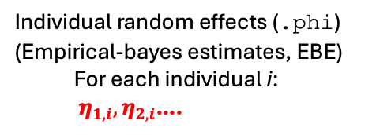




Population parameters (.ext)
1. Fixed-effect
$$θ_{1}{,θ}_{2} …$$
2. Random-effect
2.1 Ω matrix
2.2 Σ matrix
Model Development
Dose
F_{i}
DEPOT
K_{a,i}
CENT
$$ω_{1,1}^{2}$$
V_{i}
CL_{i}
$${CL}_{i}=θ_{1}×{\frac{WT_{i}}{70kg}}^{θ_{2}}×e^{η_{1},i}$$
$$η_{1,i}\sim N(0, ω_{1,1}^{2})$$
…
$$IPRED_{ij}=\frac{F_{i}×Dose ×K_{a,i}}{V_{i}×(K_{a,i}−\frac{CL_{i}}{V_{i}})}×\left(e^{−\frac{CL_{i}}{V_{i}}×t_{ij}}−e^{−K_{a,i}×t_{ij}}\right)$$
$$OBS_{ij}=IPRED_{ij}+ε_{1,ij}$$
$$ε_{1,ij}\sim N(0, σ_{1,1}^{2})$$
…
$$σ_{1,1}^{2}$$
Individual random effects (.phi)
(Empirical-bayes estimates, EBE)
For each individual i:
$η_{1,i}, η_{2,i}$….
WT | AGE | SEX | …
65 | 31 | F | …
77 | 25 | M | …
102 | 36 | M | …
… | … | … | …

Slide 15

Population parameters (.ext)
1. Fixed-effect
$$θ_{1}{,θ}_{2} …$$
2. Random-effect
2.1 Ω matrix
2.2 Σ matrix
Model Development
Dose
F_{i}
DEPOT
K_{a,i}
CENT
$$ω_{1,1}^{2}$$
V_{i}
CL_{i}
$${CL}_{i}=θ_{1}×{\frac{WT_{i}}{70kg}}^{θ_{2}}×e^{η_{1},i}$$
$$η_{1,i}\sim N(0, ω_{1,1}^{2})$$
…
$$IPRED_{ij}=\frac{F_{i}×Dose ×K_{a,i}}{V_{i}×(K_{a,i}−\frac{CL_{i}}{V_{i}})}×\left(e^{−\frac{CL_{i}}{V_{i}}×t_{ij}}−e^{−K_{a,i}×t_{ij}}\right)$$
$$OBS_{ij}=IPRED_{ij}+ε_{1,ij}$$
$$ε_{1,ij}\sim N(0, σ_{1,1}^{2})$$
…
$$σ_{1,1}^{2}$$
Individual random effects (.phi)
(Empirical-bayes estimates, EBE)
WT | AGE | SEX | …
65 | 31 | F | …
77 | 25 | M | …
102 | 36 | M | …
… | … | … | …
$$η_{1,i}$$

Slide 16




Parameter precision (.cov)
(Variance-Covariance Matrix)
$$\left(\begin{matrix}VAR(θ_{1}) & ⋯ & COV(σ_{n,n}^{2}, θ_{1}) \\ ⋮ & ⋱ & ⋮ \\ COV(θ_{1}, σ_{n,n}^{2}) & ⋯ & VAR(σ_{n,n}^{2})\end{matrix}\right)$$
Population parameters (.ext)
1. Fixed-effect
$$θ_{1}{,θ}_{2} …$$
2. Random-effect
2.1 Ω matrix
2.2 Σ matrix
Model Development
Dose
$$ω_{1,1}^{2}$$
F_{i}
DEPOT
K_{a,i}
CENT
V_{i}
CL_{i}
$$σ_{1,1}^{2}$$
$${CL}_{i}=θ_{1}×{\frac{WT_{i}}{70kg}}^{θ_{2}}×e^{η_{1},i}$$
$$η_{1,i}\sim N(0, ω_{1,1}^{2})$$
…
$$IPRED_{ij}=\frac{F_{i}×Dose ×K_{a,i}}{V_{i}×(K_{a,i}−\frac{CL_{i}}{V_{i}})}×\left(e^{−\frac{CL_{i}}{V_{i}}×t_{ij}}−e^{−K_{a,i}×t_{ij}}\right)$$
$$OBS_{ij}=IPRED_{ij}+ε_{1,ij}$$
$$ε_{1,ij}\sim N(0, σ_{1,1}^{2})$$
…
Individual random effects (.phi)
(Empirical-bayes estimates, EBE)
$$η_{1,i}$$
WT | AGE | SEX | …
65 | 31 | F | …
77 | 25 | M | …
102 | 36 | M | …
… | … | … | …
$$ω_{1,1}^{2}$$

Slide 17


Parameter precision (.cov)
(Variance-Covariance Matrix)
Population parameters (.ext)
1. Fixed-effect
$$θ_{1}{,θ}_{2} …$$
2. Random-effect
2.1 Ω matrix
2.2 Σ matrix
Model Development
$$VAR(θ_{1})$$
Dose
$$ω_{1,1}^{2}$$
F_{i}
DEPOT
K_{a,i}
CENT
V_{i}
CL_{i}
$$σ_{1,1}^{2}$$
$${CL}_{i}=θ_{1}×{\frac{WT_{i}}{70kg}}^{θ_{2}}×e^{η_{1},i}$$
$$η_{1,i}\sim N(0, ω_{1,1}^{2})$$
…
$$IPRED_{ij}=\frac{F_{i}×Dose ×K_{a,i}}{V_{i}×(K_{a,i}−\frac{CL_{i}}{V_{i}})}×\left(e^{−\frac{CL_{i}}{V_{i}}×t_{ij}}−e^{−K_{a,i}×t_{ij}}\right)$$
$$OBS_{ij}=IPRED_{ij}+ε_{1,ij}$$
$$ε_{1,ij}\sim N(0, σ_{1,1}^{2})$$
…
Individual random effects (.phi)
(Empirical-bayes estimates, EBE)
$$η_{1,i}$$
WT | AGE | SEX | …
65 | 31 | F | …
77 | 25 | M | …
102 | 36 | M | …
… | … | … | …
$$ω_{1,1}^{2}$$

Slide 18
Outline
Simulation Nomenclature
Types of Simulations
General Modeling Process
General Simulation Process

Slide 19

Parameter precision (.cov)
(Variance-Covariance Matrix)
Population parameters (.ext)
1. Fixed-effect
$$θ_{1}{,θ}_{2} …$$
2. Random-effect
2.1 Ω matrix
2.2 Σ matrix
Simulation
$$VAR(θ_{1})$$
Dose
$$ω_{1,1}^{2}$$
F_{i}
DEPOT
K_{a,i}
CENT
V_{i}
CL_{i}
$$σ_{1,1}^{2}$$
$${CL}_{i}=θ_{1}×{\frac{WT_{i}}{70kg}}^{θ_{2}}×e^{η_{1},i}$$
$$η_{1,i}\sim N(0, ω_{1,1}^{2})$$
…
$$IPRED_{ij}=\frac{F_{i}×Dose ×K_{a,i}}{V_{i}×(K_{a,i}−\frac{CL_{i}}{V_{i}})}×\left(e^{−\frac{CL_{i}}{V_{i}}×t_{ij}}−e^{−K_{a,i}×t_{ij}}\right)$$
$$OBS_{ij}=IPRED_{ij}+ε_{1,ij}$$
$$ε_{1,ij}\sim N(0, σ_{1,1}^{2})$$
…
Individual random effects (.phi)
(Empirical-bayes estimates, EBE)
$$η_{1,i}$$
WT | AGE | SEX | …
65 | 31 | F | …
77 | 25 | M | …
102 | 36 | M | …
… | … | … | …
$$ω_{1,1}^{2}$$

Slide 20
Parameter precision (.cov)
(Variance-Covariance Matrix)
Population parameters (.ext)
1. Fixed-effect
$$θ_{1}{,θ}_{2} …$$
2. Random-effect
2.1 Ω matrix
2.2 Σ matrix
Simulation
$$VAR(θ_{1})$$
Dose
$$ω_{1,1}^{2}$$
F_{i}
DEPOT
K_{a,i}
CENT
V_{i}
CL_{i}
$$σ_{1,1}^{2}$$
$${CL}_{i}=θ_{1}×{\frac{WT_{i}}{70kg}}^{θ_{2}}×e^{η_{1},i}$$
$$η_{1,i}\sim N(0, ω_{1,1}^{2})$$
…
$$IPRED_{ij}=\frac{F_{i}×Dose ×K_{a,i}}{V_{i}×(K_{a,i}−\frac{CL_{i}}{V_{i}})}×\left(e^{−\frac{CL_{i}}{V_{i}}×t_{ij}}−e^{−K_{a,i}×t_{ij}}\right)$$
$$OBS_{ij}=IPRED_{ij}+ε_{1,ij}$$
$$ε_{1,ij}\sim N(0, σ_{1,1}^{2})$$
…
Individual random effects (.phi)
(Empirical-bayes estimates, EBE)
$$η_{1,i}$$
WT | AGE | SEX | …
65 | 31 | F | …
77 | 25 | M | …
102 | 36 | M | …
… | … | … | …
$$ω_{1,1}^{2}$$

Slide 21
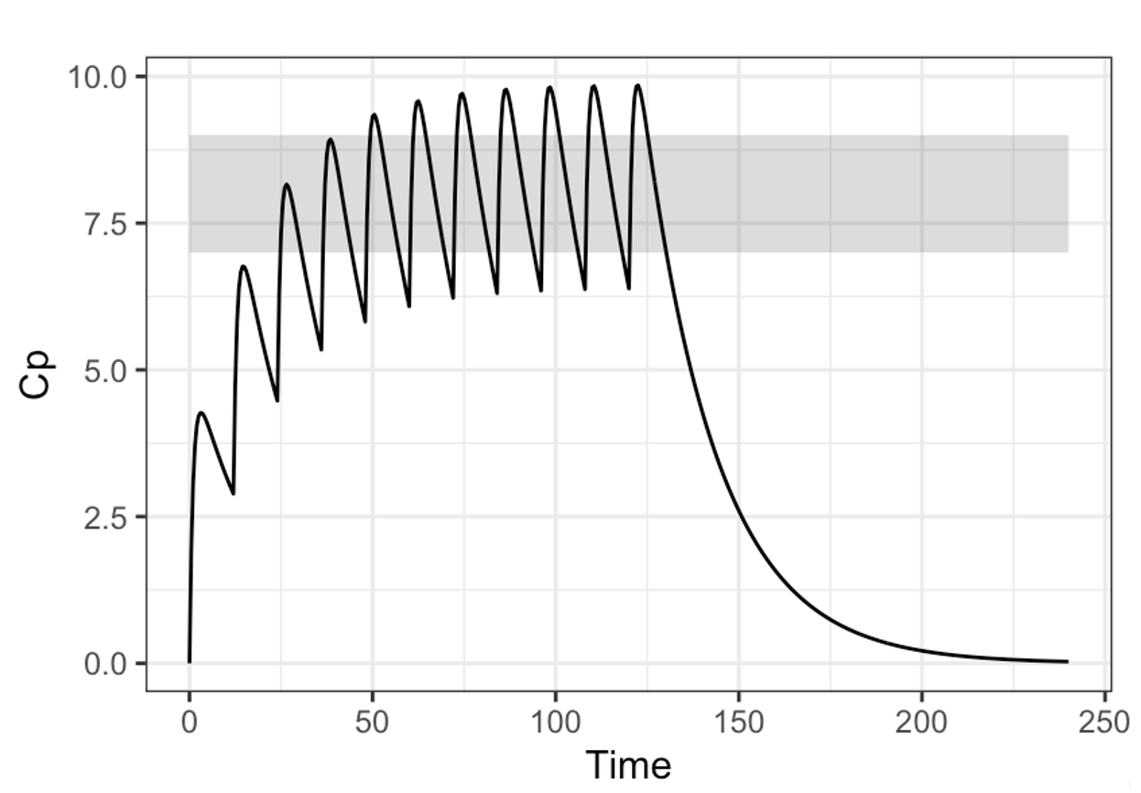
Parameter precision (.cov)
(Variance-Covariance Matrix)
?
Population parameters (.ext)
1. Fixed-effect
$$θ_{1}{,θ}_{2} …$$
2. Random-effect
2.1 Ω matrix
2.2 Σ matrix
Simulation
Simulation design:
Treatment regimen
Study duration
Sampling schedule
$$VAR(θ_{1})$$
Dose
$$ω_{1,1}^{2}$$
F_{i}
?
DEPOT
K_{a,i}
CENT
The incorporation of simulation components depend on the type of simulation and the question to be answered
V_{i}
CL_{i}
$$σ_{1,1}^{2}$$
$${CL}_{i}=θ_{1}×{\frac{WT_{i}}{70kg}}^{θ_{2}}×e^{η_{1},i}$$
$$η_{1,i}\sim N(0, ω_{1,1}^{2})$$
…
$$IPRED_{ij}=\frac{F_{i}×Dose ×K_{a,i}}{V_{i}×(K_{a,i}−\frac{CL_{i}}{V_{i}})}×\left(e^{−\frac{CL_{i}}{V_{i}}×t_{ij}}−e^{−K_{a,i}×t_{ij}}\right)$$
$$OBS_{ij}=IPRED_{ij}+ε_{1,ij}$$
$$ε_{1,ij}\sim N(0, σ_{1,1}^{2})$$
…
Individual random effects (.phi)
(Empirical-bayes estimates, EBE)
?
$$η_{1,i}$$
WT | AGE | SEX | …
65 | 31 | F | …
77 | 25 | M | …
102 | 36 | M | …
… | … | … | …
$$ω_{1,1}^{2}$$
?

Slide 22

Population parameters (.ext)
1. Fixed-effect
$$θ_{1}{,θ}_{2} …$$
2. Random-effect
2.1 Ω matrix
2.2 Σ matrix
Deterministic Simulation-Typical Value Simulation
Simulation design:
Treatment regimen
Study duration
Sampling schedule
Dose
$$ω_{1,1}^{2}$$
F_{i}
DEPOT
K_{a,i}
CENT
V_{i}
CL_{i}
$$σ_{1,1}^{2}$$
$${CL}_{i}=θ_{1}×{\frac{WT_{i}}{70kg}}^{θ_{2}}×e^{η_{1},i}$$
$$η_{1,i}=0$$
…
$$IPRED_{ij}=\frac{F_{i}×Dose ×K_{a,i}}{V_{i}×(K_{a,i}−\frac{CL_{i}}{V_{i}})}×\left(e^{−\frac{CL_{i}}{V_{i}}×t_{ij}}−e^{−K_{a,i}×t_{ij}}\right)$$
$$OBS_{ij}=IPRED_{ij}+ε_{1,ij}$$
$$ε_{1,ij}=0$$
…
WT | AGE | SEX | …
65 | 31 | F | …
77 | 25 | M | …
102 | 36 | M | …
… | … | … | …

Slide 23
Typical Workflow When Perform Typical Value Simulations
For i=1, …, nsub
Fix η_{i}=0 for subject i
Fix ε_{ij}=0 for subject i at time j
Derive θ_{i} = f(θ,cov_{i})for subject i
Calculate response Y_{ij} = f(θ_{i},η_{i}=0,ε_{ij}=0)
End
nsub: number of subjects
cov_{i:} covariates (e.g., body weight, age, etc) in subject i
Adapted from Hu C. J Pharmacokinet Pharmacodyn. 2022 PMID: 35927373.

Slide 24

Population parameters (.ext)
1. Fixed-effect
$$θ_{1}{,θ}_{2} …$$
2. Random-effect
2.1 Ω matrix
2.2 Σ matrix
Deterministic Simulation-EBE simulation
Simulation design:
Treatment regimen
Study duration
Sampling schedule
Dose
$$ω_{1,1}^{2}$$
F_{i}
DEPOT
K_{a,i}
CENT
V_{i}
CL_{i}
$$σ_{1,1}^{2}$$
$${CL}_{i}=θ_{1}×{\frac{WT_{i}}{70kg}}^{θ_{2}}×e^{η_{1},i}$$
$$η_{1,i}\sim N(0, ω_{1,1}^{2})$$
…
$$IPRED_{ij}=\frac{F_{i}×Dose ×K_{a,i}}{V_{i}×(K_{a,i}−\frac{CL_{i}}{V_{i}})}×\left(e^{−\frac{CL_{i}}{V_{i}}×t_{ij}}−e^{−K_{a,i}×t_{ij}}\right)$$
$$OBS_{ij}=IPRED_{ij}+ε_{1,ij}$$
$$ε_{1,ij}\sim N(0, σ_{1,1}^{2})$$
…
Individual random effects (.phi)
(Empirical-bayes estimates, EBE)
$$η_{1,i}$$
WT | AGE | SEX | …
65 | 31 | F | …
77 | 25 | M | …
102 | 36 | M | …
… | … | … | …
$$ω_{1,1}^{2}$$

Slide 25
Typical Workflow When Perform EBE Simulations
For i=1, …, nsub
Fix η_{i}=η_{i} in model output for subject i
Fix ε_{ij}=0 for subject i at time j
Derive EBE_{i}= f(θ, cov_{i}, η_{i}) for subject i
Calculate response Y_{ij} = f(EBE_{i},ε_{ij}=0)
End
nsub: number of subjects
cov_{i:} covariates (e.g., body weight, age, etc) in subject i
EBE_{i}: empirical Bayes estimates in subject i
Adapted from Hu C. J Pharmacokinet Pharmacodyn. 2022 PMID: 35927373.

Slide 26

Population parameters (.ext)
1. Fixed-effect
$$θ_{1}{,θ}_{2} …$$
2. Random-effect
2.1 Ω matrix
2.2 Σ matrix
Stochastic Simulation
Simulation design:
Treatment regimen
Study duration
Sampling schedule
Dose
$$ω_{1,1}^{2}$$
F_{i}
DEPOT
K_{a,i}
CENT
V_{i}
CL_{i}
$$σ_{1,1}^{2}$$
$${CL}_{i}=θ_{1}×{\frac{WT_{i}}{70kg}}^{θ_{2}}×e^{η_{1},i}$$
$$η_{1,i}\sim N(0, ω_{1,1}^{2})$$
…
$$IPRED_{ij}=\frac{F_{i}×Dose ×K_{a,i}}{V_{i}×(K_{a,i}−\frac{CL_{i}}{V_{i}})}×\left(e^{−\frac{CL_{i}}{V_{i}}×t_{ij}}−e^{−K_{a,i}×t_{ij}}\right)$$
$$OBS_{ij}=IPRED_{ij}+ε_{1,ij}$$
$$ε_{1,ij}\sim N(0, σ_{1,1}^{2})$$
…
WT | AGE | SEX | …
65 | 31 | F | …
77 | 25 | M | …
102 | 36 | M | …
… | … | … | …

Slide 27
Typical Workflow When Perform Stochastic Simulations
For i=1, …, nsub
Draw sample η_{i} for subject i using Ω matrix
*Draw sample ε_{ij} for subject i at time j using Σ matrix/Fix ε_{ij}=0
Derive θ_{i} = f(θ,cov_{i})
Calculate response Y_{ij} = f(θ_{i},η_{i},ε_{ij})
End
nsub: number of subjects
cov_{i:} covariates (e.g., body weight, age, etc) in subject i
*: this step may or may not be needed
Adapted from Hu C. J Pharmacokinet Pharmacodyn. 2022 PMID: 35927373.

Slide 28

Population parameters (.ext)
1. Fixed-effect
$$θ_{1}{,θ}_{2} …$$
2. Random-effect
2.1 Ω matrix
2.2 Σ matrix
Covariate (Virtual Patient) Simulations
Simulation design:
Treatment regimen
Study duration
Sampling schedule
Dose
$$ω_{1,1}^{2}$$
F_{i}
DEPOT
K_{a,i}
CENT
V_{i}
CL_{i}
$$σ_{1,1}^{2}$$
$${CL}_{i}=θ_{1}×{\frac{WT_{i}}{70kg}}^{θ_{2}}×e^{η_{1},i}$$
$$η_{1,i}\sim N(0, ω_{1,1}^{2})$$
…
$$IPRED_{ij}=\frac{F_{i}×Dose ×K_{a,i}}{V_{i}×(K_{a,i}−\frac{CL_{i}}{V_{i}})}×\left(e^{−\frac{CL_{i}}{V_{i}}×t_{ij}}−e^{−K_{a,i}×t_{ij}}\right)$$
$$OBS_{ij}=IPRED_{ij}+ε_{1,ij}$$
$$ε_{1,ij}\sim N(0, σ_{1,1}^{2})$$
…
WT | AGE | SEX | …
45 | 12 | M | …
57 | 15 | F | …
33 | 6 | F | …
… | … | … | …

Slide 29
Typical Workflow When Perform Stochastic Simulations
For i=1, …, nsub
Draw sample η_{i} for subject i using Ω matrix
*Draw sample ε_{ij} for subject i at time j using Σ matrix/Fix ε_{ij}=0
Derive θ_{i} = f(θ,cov_{i})
Calculate response Y_{ij} = f(θ_{i},η_{i},ε_{ij})
End
nsub: number of subjects
cov_{i:} covariates (e.g., body weight, age, etc) in subject i
*: this step may or may not be needed
Adapted from Hu C. J Pharmacokinet Pharmacodyn. 2022 PMID: 35927373.

Slide 30
The Importance of Realistic Covariates/Virtual Patients
mean_WT <- mean(test1$WT)
sd_WT <- sd(test1$WT)
mean_HT <- mean(test1$HT)
sd_HT <- sd(test1$HT)
withr::with_seed(1234,
test2 <- data.frame(ID=1:1000,
WT=rnorm(1000,mean=mean_WT,sd=sd_WT),
HT=rnorm(1000,mean=mean_HT,sd=sd_HT)
)
)

Slide 31
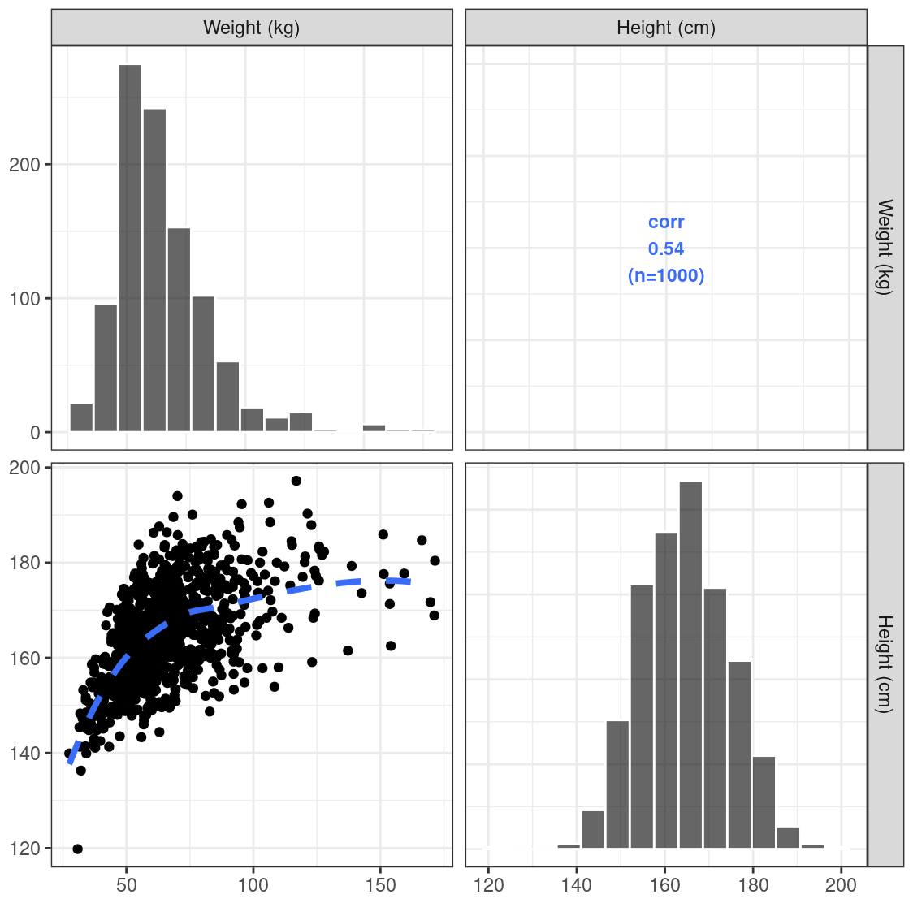
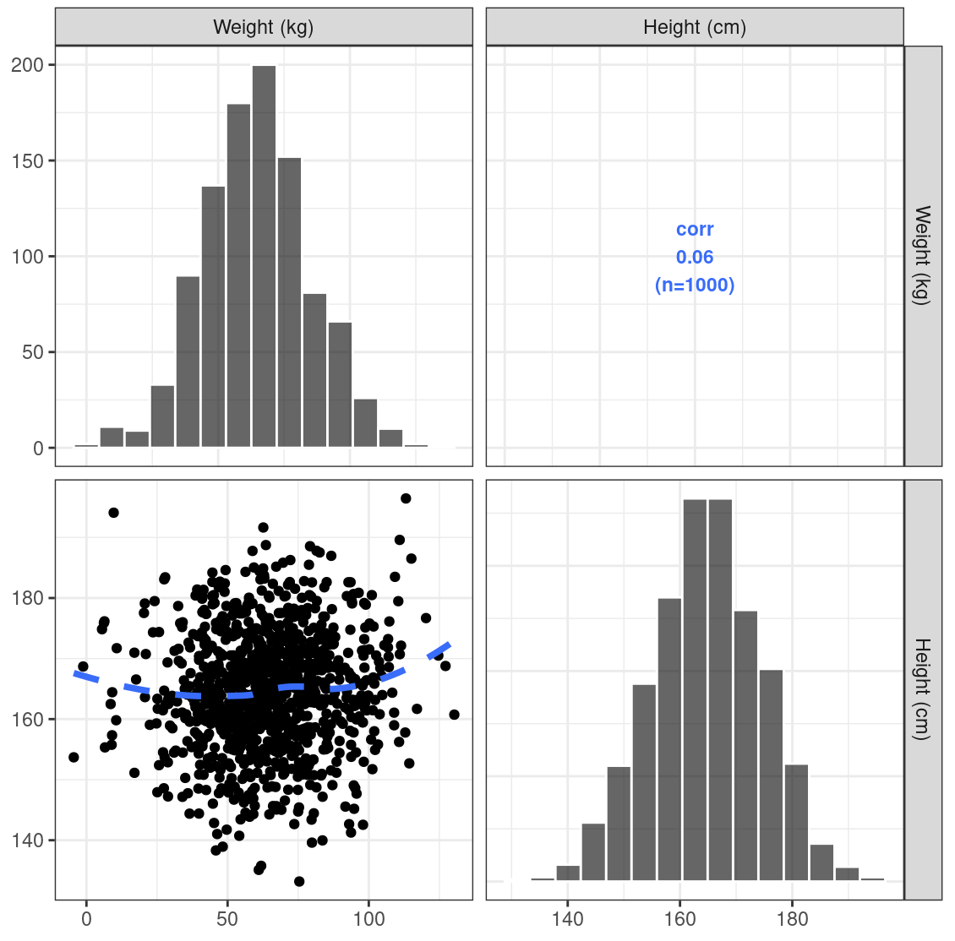
The Importance of Realistic Covariates/Virtual Patients

Slide 32
Population parameters (.ext)
1. Fixed-effect
$$θ_{1}{,θ}_{2} …$$
2. Random-effect
2.1 Ω matrix
2.2 Σ matrix
Stochastic Simulation-Multiple Replicates
Simulation design:
Treatment regimen
Study duration
Sampling schedule
Dose
$$ω_{1,1}^{2}$$
F_{i}
DEPOT
K_{a,i}
CENT
V_{i}
CL_{i}
$$σ_{1,1}^{2}$$
$${CL}_{i}=θ_{1}×{\frac{WT_{i}}{70kg}}^{θ_{2}}×e^{η_{1},i}$$
$$η_{1,i}\sim N(0, ω_{1,1}^{2})$$
…
$$IPRED_{ij}=\frac{F_{i}×Dose ×K_{a,i}}{V_{i}×(K_{a,i}−\frac{CL_{i}}{V_{i}})}×\left(e^{−\frac{CL_{i}}{V_{i}}×t_{ij}}−e^{−K_{a,i}×t_{ij}}\right)$$
$$OBS_{ij}=IPRED_{ij}+ε_{1,ij}$$
$$ε_{1,ij}\sim N(0, σ_{1,1}^{2})$$
…
WT | AGE | SEX | …
65 | 31 | F | …
77 | 25 | M | …
102 | 36 | M | …
… | … | … | …
n simulation replicates…
e.g., Visual Predictive Check (VPC)

Slide 33
Typical Workflow When Perform Stochastic Simulations with Replicates
For n=1, …, nrep
Fixed population parameters (θ_{n},Ω_{n},Σ_{n})
For i=1, …, nsub
Draw sample η_{ni} for subject i using Ω_{n} matrix
*Draw sample ε_{nij} for subject i at time j using Σ_{n} matrix
Derive θ_{ni} = f(θ_{n},cov_{i})
Calculate response Y_{nij} = f(θ_{ni},η_{ni},ε_{nij})
End
End
nrep: number of replicates
nsub: number of subjects
cov_{i:} covariates (e.g., body weight, age, etc) in subject i
*: this step may or may not be needed
Adapted from Hu C. J Pharmacokinet Pharmacodyn. 2022 PMID: 35927373.

Slide 34



Simulations with Parameter Uncertainty
Parameter precision (.cov)
(Variance-Covariance Matrix)
Population parameters (.ext)
1. Fixed-effect
$$θ_{1}{,θ}_{2} …$$
2. Random-effect
2.1 Ω matrix
2.2 Σ matrix
Simulation design:
Treatment regimen
Study duration
Sampling schedule
$$VAR(θ_{1})$$
Dose
$$ω_{1,1}^{2}$$
F_{i}
DEPOT
K_{a,i}
CENT
V_{i}
CL_{i}
$$σ_{1,1}^{2}$$
$${CL}_{i}=θ_{1}×{\frac{WT_{i}}{70kg}}^{θ_{2}}×e^{η_{1},i}$$
$$η_{1,i}\sim N(0, ω_{1,1}^{2})$$
…
$$IPRED_{ij}=\frac{F_{i}×Dose ×K_{a,i}}{V_{i}×(K_{a,i}−\frac{CL_{i}}{V_{i}})}×\left(e^{−\frac{CL_{i}}{V_{i}}×t_{ij}}−e^{−K_{a,i}×t_{ij}}\right)$$
$$OBS_{ij}=IPRED_{ij}+ε_{1,ij}$$
$$ε_{1,ij}\sim N(0, σ_{1,1}^{2})$$
…
WT | AGE | SEX | …
65 | 31 | F | …
77 | 25 | M | …
102 | 36 | M | …
… | … | … | …
n simulation replicates
n = number of (parameter vector) samples from uncertainty/precision distributions

Slide 35
Parameter uncertainty
Parametric
Variance-Covariance matrix
Multivariate normal distribution (MVN) for fixed effects (θ)
Inverse wishart distribution for random effects (⍵², σ²)
Non-parametric
Non-parametric bootstrap (BS)
Sampling-importance resampling (SIR)
Bayesian posterior distribution

Slide 36
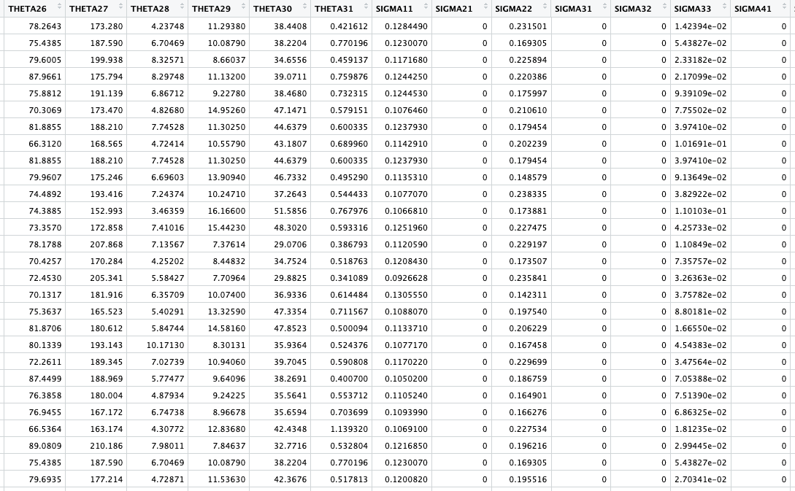
Example-parameter uncertainty distribution
1 row = 1 parameter vector =1 simulation replicate

Slide 37
Typical Workflow When Perform Simulations with Parameter Uncertainty
For n=1, …, nrep
Draw a set of parameters (θ_{n},Ω_{n},Σ_{n}) from the uncertainty distribution
For i=1, …, nsub
Draw sample η_{ni} for subject i using Ω_{n} matrix
*Draw sample ε_{nij} for subject i at time j using Σ_{n} matrix
Derive θ_{ni} = f(θ_{n},cov_{i})
Calculate response Y_{nij} = f(θ_{ni},η_{ni},ε_{nij})
End
End
nrep: number of replicates
nsub: number of subjects
cov_{i:} covariates (e.g., body weight, age, etc) in subject i
*: this step may or may not be needed
Adapted from Hu C. J Pharmacokinet Pharmacodyn. 2022 PMID: 35927373.

Slide 38
The end

