Slide 1


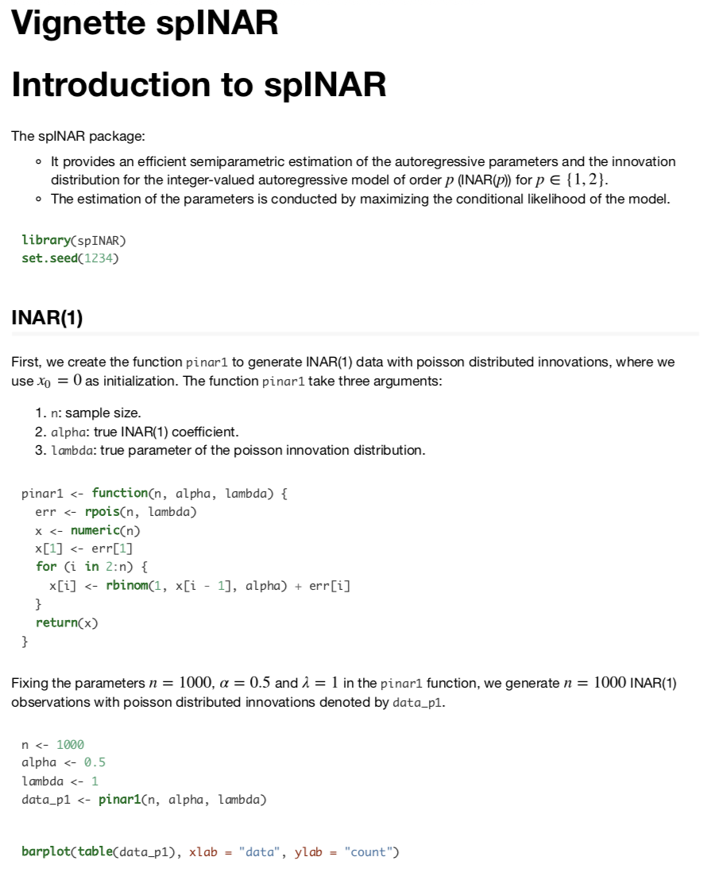
spINAR: : CHEAT SHEET
Installation
Main Functions
Sintaxis
Development version
devtools::install_github(“Mfaymon/spINAR”)
library(spINAR)
Simulation INAR(p)
spinar_sim() simulate INAR data given n, p, alpha and pmf output: simulated INAR data
spinar_sim(n, p, alpha, pmf, prerun)
What is spINAR?
Estimation INAR(p)
spinar_est() estimates semi-parametrically an INAR model of given x and p output: estimated parameters alpha and pmf
spinar_est(x, p)
The spINAR package was generated to work with count data for Autoregressive Integer Models.
Boostrap INAR(p)
spinar_boot() performs the semiparametric INAR bootstrap procedure given x, p and for a given number of replications (B) output: boostrap estimated parameters, alpha and pmf
inar_sp_boot(x, p, B)
Vignettes
Fully parametric estimation of INAR(p)
spinar_est_param() estimates parametrically (moment based for now and maximum likelihood later) an INAR model, for a given x, p, a estimation type (type) a parametric family of distribution (distr). output: estimated parameters: alpha, parameters of input distribution
spinar_est_param(x, p, type, distr)
tutorial for spINAR
estimation type
Poison
Geometric
Neg. Binomial
help(package = “spINAR”)
Arguments
Penalized semiparametric estimation of INAR(p)
n : simple size
p : model order
alpha : INAR coefficient(s)
pmf: probability mass function of the
x : data
spinar_penal() estimates semiparametrically and penalized an INAR model of given order p on x and for a given penalization parameters (penal1, penal2) output: estimated parameters (alpha, pmf)
spinar_penal(x, p, penal1, penal2)
spinar_penal_val() estimates semiparametrically and penalized an INAR model for a given p, x, and allows for validation of both or only one penalization parameter, which can be adjusted by the number of folds and init1 init2. output: estimated parameters( (alpha, pmf) and validated penalization parameter(s)
spinar_penal_val(x, p, valid, penal1, penal2,
over,folds,
init1, init2)
initial values for the penalized parameters
COPYRIGHT
Additional functions
Each cheatsheet should be licensed under the creative commons license.
To license the sheet as creative commons, put CC'd by <your name> in the small print at the bottom of each page and link it to http://creativecommons.org/licenses/by/4.0/
R script | description
helper | Contains the functions constrmat and .constrvec
llspinar | Contains a list of the two semiparametric log-likelihood functions
llspinar-penal | Contains a list of the two penalized semiparametric log likelihood functions

