Slide 1
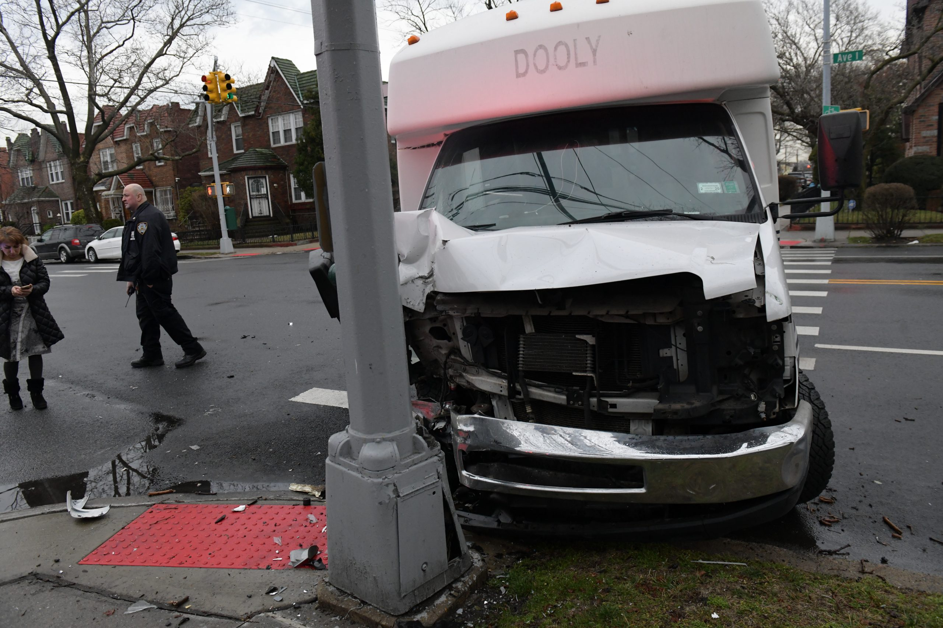
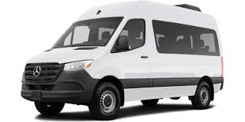
The Rebirth of the Dollar Van
Matthew Fein
The Data Incubator
Wednesday 5.13.2020

Slide 2
Dollar Van Revolution
How Do Tourists Navigate NYC?
Options
Public Transportation (subway, bus, etc.)
Taxi/Rideshare
Walk/Bike
Why not dollar vans?

Slide 3
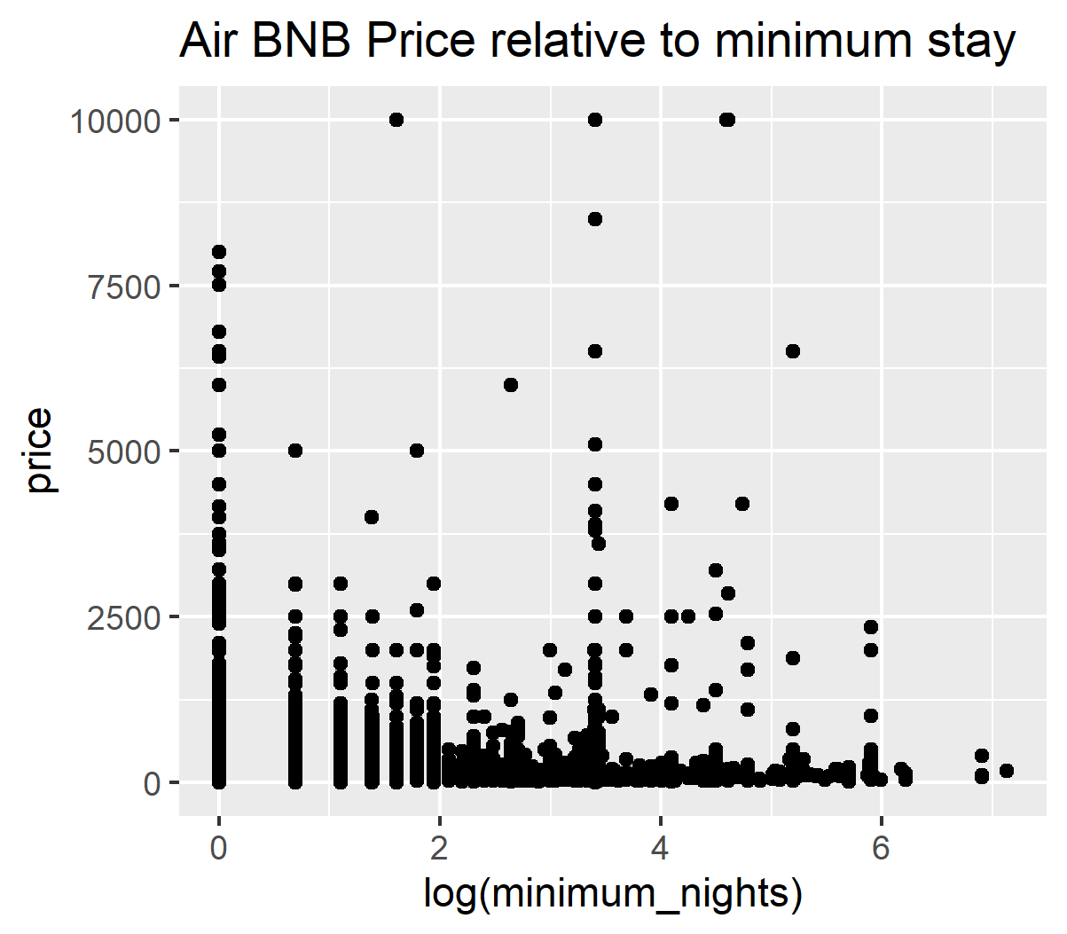
How Long Are Tourists Visiting?
Long Enough to Need a Reliable and
Cmfortable mode of Transportation
Many units require one night
Beyond this most require a range of 3-6 nights
Average Price is $150-$300/night

Slide 4
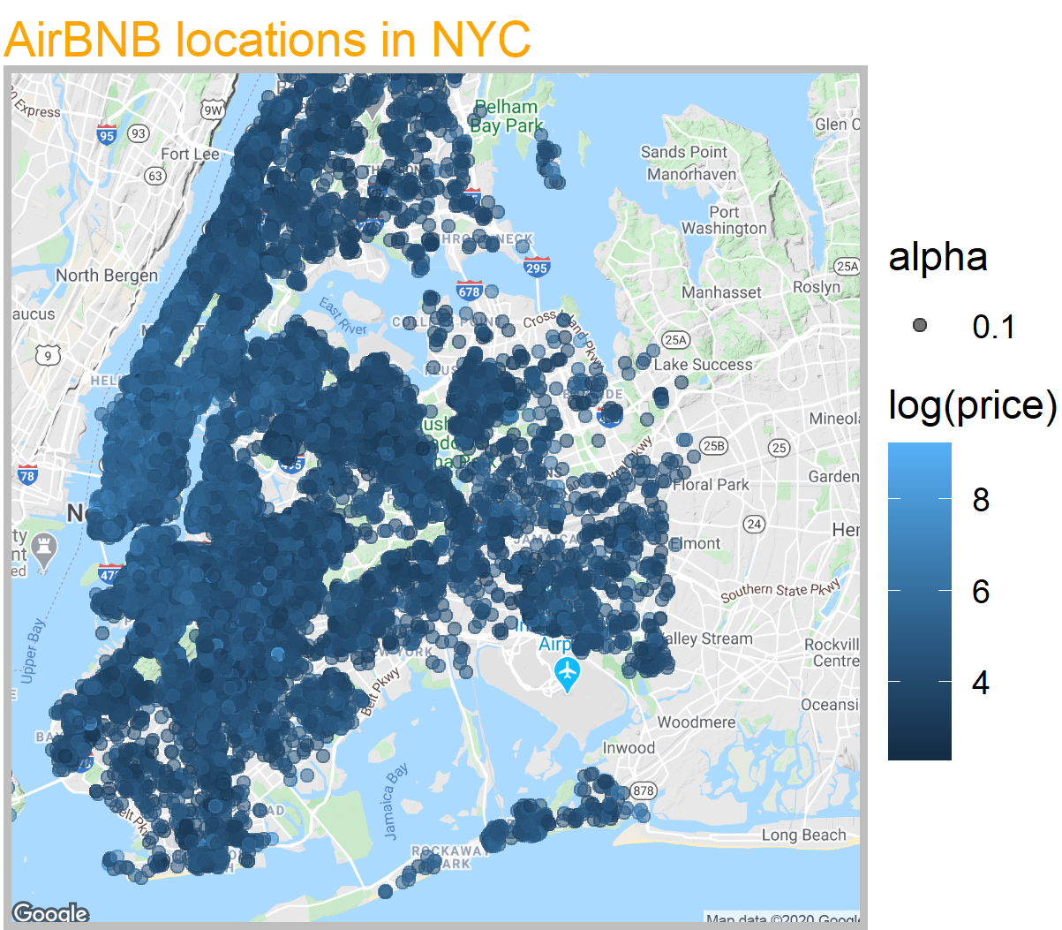
Where Are They Staying?
Pockets of Outer Boroughs seen in Brooklyn and Queens
Areas which cater to travelers on more of a budget
Public Transportation is more sparsely organized
Rideshare over longer distances is prohibitively expensive

Slide 5
Future Directions
Incorporate More Data into Analysis
Collect MTA, Rideshare, and more basic information about locations identified (i.e. ACS, Census, etc.)
Employ PCA or or dimensionality reduction techniqueto aid with feature selection
Logistic Regression to estimate likelihood of vivitors using proposed service

