Slide 1

Notes:
Change mathias pict

Slide 2
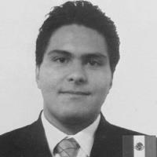


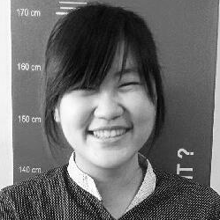

Our Team
Iker
Sanchez
Max
Doerr
Marie
Mangilier
Melinda
Palit
Matthias
Floru
Notes:
Change mathias pict

Slide 3










Our advances
Total: 60 references

Slide 4
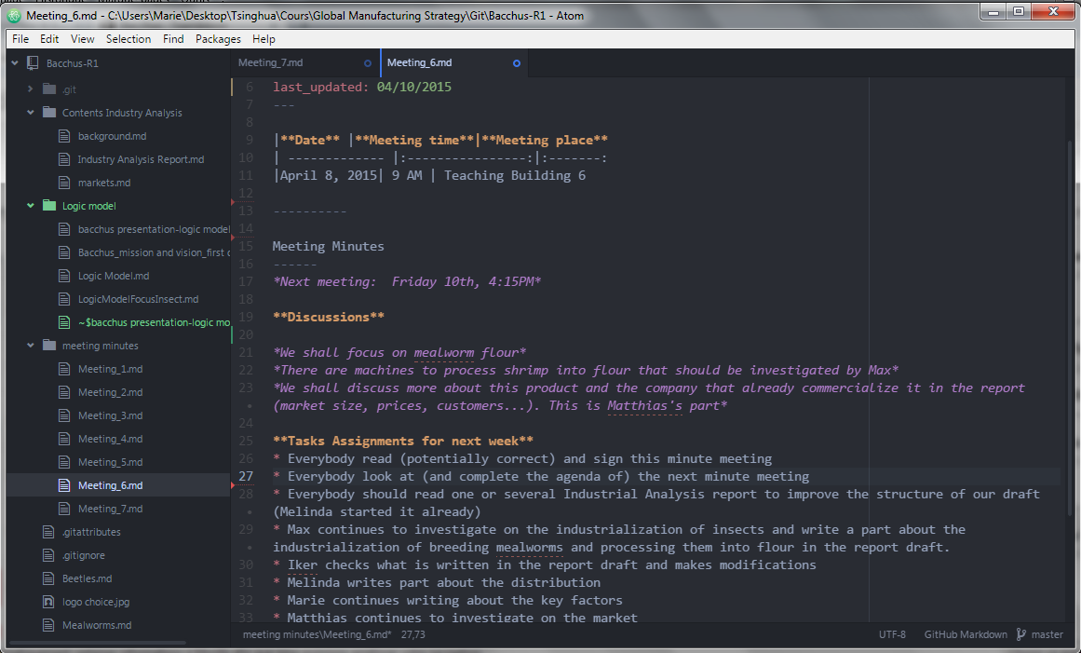
Our Progress
What we do every week
XX
Literature review
XX
Report
XX
Contacts
Notes:
Change the “XX” with number, and also the “literature review” and “report” if necessary. This slide shows what we have so far
Maybe a git screenshot would be nice to see our constant progress

Slide 5
Our goal
What we want to achieve
Goal
Problem statement
Why Insect?
Logic Model
To provide society with healthy, sustainable and delicious source of food
Industrialization of insect as food
Healthy
Ecological friendly
People
Inputs
Outputs
Outcomes

Slide 6
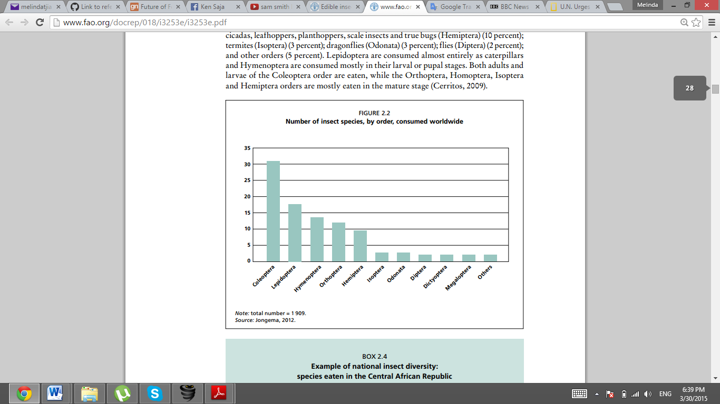



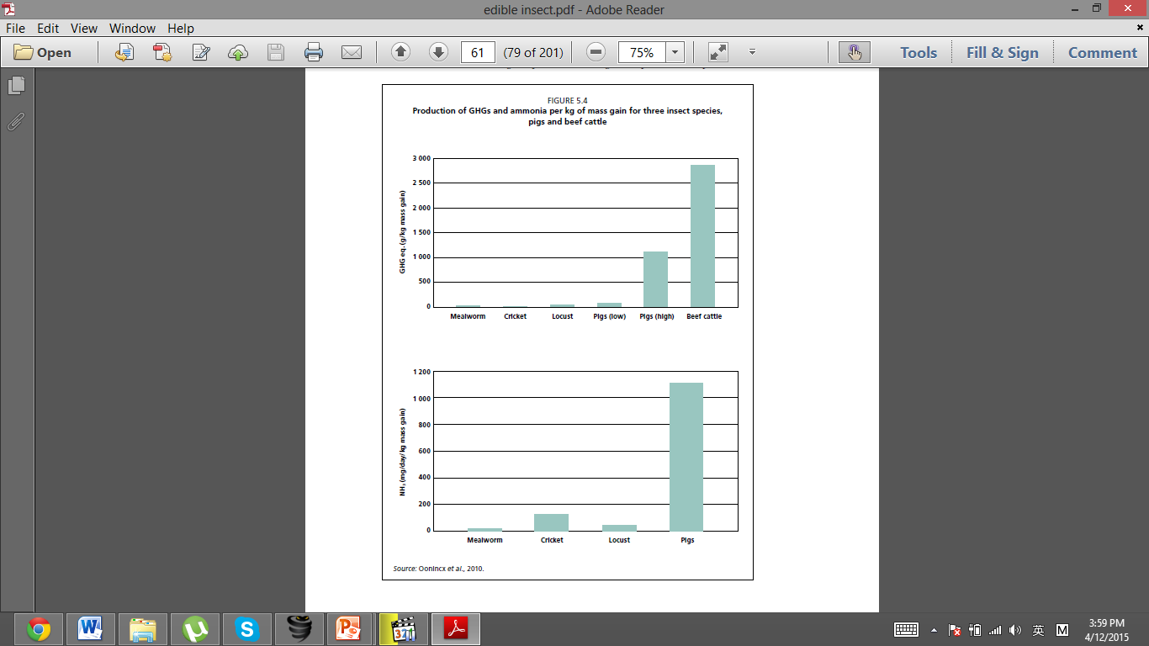




Mealworm VS Cricket
Why mealworm rocks!
Production of GHGs and Ammonia / kg of mass gain for three insect species, pigs and beef cattle
31%
13%
Amount consumed
46 - 66%
8 - 25%
Protein Content
Less GHGs and ammonia
More GHGs and ammonia
Environment Friendliness
Notes:
Play the animation to see how it works

Slide 7








Market Size
Our scope
In 2013 the market size for meat substitute is $3.2 billion. 80% of it is soy based
In 2007 BBC forecasted that the total market size would be $91.8 billion in 2013.
Sport Supplement
Meat Substitute
A market size between $60 & $70 billion for exotic pet that eat insect, and can still be enlarged for fish food, poultry food, and other animal
Substitute Flour
Pet Food
Notes:
To explain about this market size, read mathias post about market to seize in github

Slide 8
Logic model
Identifying all the data needed
Input | Output (activities) | Outcomes
 |  | Short | Medium | Long
5 team members | Information compiled | Provide stakeholders with the overview of the industry | Growth of insect industry | Environmental gain, lower waste of resource (land, water, oil)
Knowledge, time and information collecting and analyzing capacities of team | Impact assessment of industry | Advance knowledge in processing insect | Processed insects available in wide variety and amount | Health gain: improve the diet of humans
People
Team members
Classmates

Slide 9
Weekly classes & meetings | Assessment of operational improvements needed to achieve impact | Promotion of information sharing in insect industry | Low cost insect producing | Social economic gain: access to a cheap protein source
Cooperation platforms: Github & Teambition | Establishment of an industrial process needed in the supply chain of processes insects |  | Establishing insect as a widespread meat replacement | Global food security
Experimental setup of industrial process. place: RISE greenhouse, budget: 50-500$ | Published IA report on website, github, traditional media, specialized media | Deeper understanding about how to process mealworm
Mentors: professor Ben Koo, TA Echo, Zimmer, Kuba
Insect community, researchers, scholar, startups, farmers
Team members
Team members

