Slide 1
Radial Level Planarity
Testing and Embedding in Linear Time
Christian Bachmaier
bachmaier@fmi.uni-passau.de
Franz J. Brandenburg
brandenb@fmi.uni-passau.de
Michael Forster
forster@fmi.uni-passau.de
University of Passau, Germany
Notes:
Hello, welcome to my talk. My name is Christian Bachmaier and I'd like to tell you something about radial level planarity testing and embedding in linear time.
This is a joined work with Franz Brandenburg and Mike Forster.

Slide 2
Idea
1
0
3
4
2
1
4
3
2
1
3
2
3
4
1
0
4
5
2
Every planar graph has a
concentric representation
Opposite view
  Is a graph with vertices fixed to concentric levels planar?
5
Notes:
From the Sugiyama algorithm we are used to draw graphs having their vertices fixed to horizontal level lines with as few edge crossings as possible. The best would be without any crossing.
The idea behind our work is to draw a graph having its vertices fixed to concentric circles not to horizontal lines planar.
It is well known that every planar graph has a concentric representation which can be computed via breadth first search.
Here we take the opposite view whether a graph having its vertices fixed to concentric circles can be drawn planar.

Slide 3
Overview
Level planarity
  Definition
  Level planar graphs
  Level planarity testing and embedding
Radial level planarity
  Definition
  Concepts
Radial level planarity testing
  PQR-tree data structure
  Merge of PQR-trees
Summary
Notes:
At the beginning I will give a short overview over level planarity.
Afterwards I'll point out some characteristics of radial level planar graphs.
Then I present our algorithm for detection of radial level planar graphs. Therefore we can't follow the demand "Stop Minding Your P's and Q's" made in the talk on Monday morning. Things get even worse, we also need R's!
At the end I'll make a short summary.

Slide 4
1. Level Planarity
Definition, Example, Previous Work
Notes:
What is level planarity?

Slide 5
Level Graph
G = (V¹ ∪ V² ∪ … ∪ V^{k}, E) is a k-level graph
  No horizontal edges
G is proper
  Each edge between adjacent levels
1
0
x
2
1
2
3
3
4
5
6
4
7
Notes:
To answer this question we first should have a look on what is a level graph.
A k-level graph G is a graph with a levelling of its vertices on k disjoint levels. If I talk of directions of edges I always mean the implicit direction of edges from the lower to the higher level. There are no inner level edges.
G is called proper if there are only edges between adjacent levels.
If edge (2, 7) in the example was not there, the graph would be proper. However for our purposes it does not matter whether the graph is proper.

Slide 6
Level Planar Graph
G is k-level planar
  k-level graph
  Edges drawn strictly downwards
  Planar
1
0
2
1
2
3
3
4
5
6
4
7
x
Notes:
A graph G is k-level planar if it is a k-level graph and all edges can be drawn strictly downwards. The routing like the edge (1, 6) shows is prohibited. Of course, there must not be any crossing.

Slide 7
Time Line
Planarity
  Lempel, Even, Cederbaum (1966)
  Booth, Lueker (1976)
    O(n) running time
    PQ-trees
  Chiba, Nishizeki, Abe, Ozawa (1985)
    Embedding
Alternative methods
  Hopcroft, Tarjan (1974)
  …
  Boyer, Cortese, Patrignani,
  Di Battista (last Monday)
Level planarity
  Di Battista, Nardelli (1988)
    Edges are not allowed to span more than one level
    All source vertices must lie on the first level
  Heath, Pemmaraju (1995)
    Extension to arbitrary level graphs (merge of PQ-trees)
  Jünger, Leipert, Mutzel (1998/1999)
    Adjustments and improvements
    Embedding
Notes:
This slide compares the advances made in planarity testing and level planarity testing.
As you know there is a linear time planarity testing algorithm of Lempel, Even, and Cederbaum which is due to Chiba and others also capable of computing a planar embedding.
There are of course many alternative methods.
Linear time level planarity testing started with an algorithm of Di Battista and Nardelli for proper hierarchies. A hierarchy is a graph where all vertices lie on the first level.
Heath and Pemmaraju extend this test to arbitrary level graphs.
Jünger, Leipert, and Mutzel have developed some adjustments and an embedding variant.
Because this is the one on which our radial algorithm is based I'll give a short overview over that for the test part.

Slide 8
Level Planarity
Similar to planarity test
(vertex addition method, LEC)
"Sweep line"
  Traversing the graph level by level
  Storing "admissible" edge permutations
  For each vertex: REDUCE
    Test on planarity
    Update of permutations
  For each vertex: REPLACE
    Insertion of new edges
  Next level
Running time: O(n)
Data structure: PQ-trees
  Merges
level planar
untreated
Notes:
Linear time level planarity testing is similar to the vertex addition method of Lempel, Even, and Cederbaum.
It is a level by level sweep from 1 to k. Thus we have a level planar and an not yet treated part of the graph. The admissible orders of the edges from the upper part to the lower must be saved.
The operation REDUCE ensures that edges to the same vertex can be routed side by side and thus do not violate planarity. Therefore it updates the admissible edge permutations. This is done vertex by vertex from left to right.
Afterwards the new edges discovered are inserted in the permutations by the REPLACE operation again from left to right.
Then the sweep treats to the next level.
For saving the permutations a PQ-tree data structure is used on which the necessary but here not shown merges must be implemented for treating arbitrary level graphs.

Slide 9
Storing the Permutations
PQ-trees [Booth and Lueker 1976]
  Leaves represent edges ("virtual nodes")
  P-nodes:
    Correspond to cut vertices
    Arbitrary permutations of its children
  Q-nodes:
    Correspond biconnected components
    Only reversion
D
A
B
C
B
D
E
F
I
G
H
J
K
Notes:
A PQ-tree represents permutations of a finite set where members of specified subsets of this set occur consecutively.
PQ-leaves represent the edges and their untreated end vertices, respectively.
Permutations of its leaves are encoded by combination of the two types of inner nodes, P-nodes and Q-nodes. P-nodes coresspond to cut vertices which allow arbitrary permutation of their children.
Q-nodes represent biconnected components, and thus only allow reversion of their ordered children list.

Slide 10
PQ-trees: Operations
REDUCE
  Restricts permutation set
    Leaves of a set S must lie side by side
  Traversing tree from leaves to the root
    Templates: P0-P6 and Q0-Q3
  Failure ⇔ graph not (level) planar
REPLACE
  Replaces consecutive leaves
Notes:
The operation REDUCE restricts the permutation set such that the leaves of a set S lie side by side in any case.
This is achieved by a bottom up traversal of the relevant parts of the tree which applies the templates P0 to P6 and Q0 to Q3 to realise local changes in the tree. If REDUCE fails, the graph under test is not planar.
The other main operation on PQ-trees, REPLACE, replaces the consecutive leaves with new ones.

Slide 11
Complexity
Theorem (JLM)
  There is an O(n) time algorithm for
    level planarity testing
    level planar embedding
Notes:
There is a linear time algorithm for testing level planarity and computing a level planar embedding.

Slide 12
2. Radial Level Planarity
Definition, Example, Differences, Concepts
Notes:
Before I present our radial algorithm we have to enhance the definition of level planarity and to have a look on the major differences in the radial case.

Slide 13
Radial Level Planar Graphs
Generalisation of level planar graphs
G is radial k-level planar if it can be drawn such that
  Vertices of each level lie on a concentric circle
  Edges drawn strictly outwards
  Planar
Notes:
Radial level planar graphs are a superset of level planar ones.
A level graph G is radial k-level planar if it can be drawn that its vertices of a level j lie on a concentric circle. Further the edges are drawn as strictly monotonic curve from the centre outwards and thus we obtain an outwards drawing. Again, of course, there are no crossings.

Slide 14
Transformation
4-level graph
Not level planar
Radial 4-level planar
1
0
2
1
2
3
3
4
5
6
4
7
Notes:
This example graph is not 4-level planar because of the edge (1, 6). But as we well see it is radial 4-level planar.

Slide 15
Transformation
4-level graph
Not level planar
Radial 4-level planar
Bend level lines to circles
Planar possibility to route edge (1, 6)
Ray through connection points
Cut edges
Level planar ⇔ no cut edges
Test?
4
3
2
1
0
1
3
2
4
6
5
7
Notes:
Now the levels are bent to radial levels by connecting their fronts and their backs.
In this scenario we have a possibility to route the edge (1, 6) without a crossing as we will see here.
Through this meeting points we lay a ray.
We call (1, 6) a cut edge, because it crosses this ray. Obviously a radial level planar graph is level planar if there are no cut edges.
Now we are at a point were the question arises how a graph can be tested whether it is radial level planar or not.

Slide 16
Radial Level Planarity Testing
[Dujmović, Fellows, Hallet, Kitching, Liotta, McCartin, Nishimura, Ragde, Rosamond, Suderman, Whitesides, Wood 01]:
  Detection of radial level planarity is fixed parameter tractable
  k ∈ O(1) ⇒ O(n) running time
  Large constants
Our algorithm
  O(n) running time for any k
  Practical constants, same as in JLM
Notes:
Dujmović and others mentioned in their ESA 2001 paper that radial level planarity is fixed parameter tractable. Their approach has linear running time if the number of levels k is a constant. We have already heard yesterday that this algorithm involves large constants. This results in high running times.
We present a more practical algorithm which has a linear running time for any k. The running time is similar to the one of JLM.

Slide 17
Concepts
Differences: level vs. radial
  Level planar ⇔ each component level planar
  Not for radial level planarity
2
1
Notes:
What are the main differences between level planarity and radial level planarity?
For level planarity of a graph it suffices to test each component on level planarity. For the radial case this is obviously no more true.
The example shows a non-radial planar graph consisting of two radial planar connected components.
Obviously we have to consider those components which are radial planar but not level planar.

Slide 18
Rings
Ring:
  Biconnected component
  of a level graph
  Radial planar
  Not level planar
  Depends on levelling
23
15
16
8
Not level planar
17
9
14
2
7
18
3
10
0
1
5
4
3
2
1
14
19
13
4
6
5
12
22
24
11
20
21
25
Notes:
We call such a component a ring. A ring is a biconnected component of a level graph which is radial planar but not level planar.
Here we have an example graph consiting of four biconnected components. One of them is a ring. Additionally this picture shows that it may be necessary to nest componentes within others. Moreover it shows that rings are not related to cycles. In fact every biconnected component with at least three vertices contains a cycle. Whether a component is a ring depends rather on the levelling, e.g. if vertex 14 was on level 1 this graph would not contain a ring because there are no cut edges with a ray like this and each component could be placed side by side.
The picture two slides ago showed two minimum examples of rings.

Slide 19
Nesting of Rings
Ring extremes
  Minimum level
  Inner radius
  Outer radius
  Maximum level
1
3
2
6
7
5
4
1
Level graph G
with two rings R and S
Lemma
  G is radial level planar ⇔
  R and S are radial planar and R fits in centre face of S or vice versa
2
9
3
4
8
5
6
Notes:
Because rings can be nested we have to define four characteristic values of a ring, the ring extremes.
The first is the lowest level the ring has vertices on.
The second is the so called inner radius. Inner radius means here how many levels are covered by the centre face.
The third one is the outer radius which is the minimum level of the outer face.
And the fourth is the maximum level the ring has vertices on.
Two radial planar rings R and S can be nested without violating planarity if and only if either S has enough space in its centre face to contain R or vice versa. That means that the rings are well nested.

Slide 20
Level Optimality
Depend on embedding
  Inner radius
  Outer radius
For leaving maximum space
  Maximise inner radius
  Minimise outer radius
Level optimal embeddings
  Existence?
  Our algorithm computes level optimal embeddings
Notes:
Contrary to the outer bounds of a ring, the inner and the outer radius depend on the embedding.
In order to leave maximum space for embedding other components the inner radius must be maximised and the outer radius minimised.
We call an embedding with such properties level optimal.
A priori it is not clear that there is a level optimal embedding for every ring in a graph but they exist because our algorithm computes such embeddings.

Slide 21
3. Radial Level Planarity Testing
PQR-trees, Algorithm
Notes:
Now we are ready to talk about the radial planarity testing algorithm.

Slide 22
R-Nodes
Wavefront sweep
New R-nodes in PQ-trees to represent rings
R-nodes similar to Q-nodes
  Represent a biconnected component
  Reverse children
...
...
...
New
  Rotate children
...
...
  Only at the root
Notes:
The top down sweep becomes now a wavefront sweep from the centre outwards.
Further we introduce a new R-node type in PQ-trees to represent rings.
These R-nodes are similar to Q-nodes because they represent a biconnected component and allow reversion of the children order.
The additional feature of an R-node is that it allows a cyclic rotation of its children. That's moving children from front to back and vice versa while maintaining their relative order. Please note, this happens implicitly if the children of the R-node are stored as a circular list. R-nodes only occur at the root of a tree.

Slide 23
New Templates
PQR-trees
Additional templates for PQR-trees which treat R-nodes
  P-templates: P7 – P9
  Q-templates: Q4 – Q7
  R-templates: R0 – R4
Notes:
Consequently, we call PQ-trees optionally containing an R-node PQR-trees. Please do not confuse PQR-trees with SPQR-trees used in online planarity testing.
For the maintenance of PQR-trees, especially for the operation REDUCE, we need twelve new templates. Presenting all of them would exceed the time limit. Thus I'll only show one typical representatives of them.

Slide 24
New Templates…
Template Q6
  Grey shading: pertinent leaves or pertinent sequence
  Grey parts must be made consecutive
  Applicable to the Q-root of a PQR-tree
...
...
...
...
...
...
...
...
...
...
Boundary partial Q-nodes admissible
  Root is/becomes an R-node during this reduction step
  Impossible with PQ-tree templates
Templates which can only be applied to the root
Notes:
A typical example is template Q6. The grey shading indicates pertinent leaves or pertinent sequences, respectively. The goal of every template is to make the grey parts locally consecutive. Q6 is only applicable if the upper Q-node X of the source pattern is the root of a PQR-tree. X has in exception to full children exactly one boundary partial Q-child. Boundary partial because it is partial, that means it has full and empty children and boundary because the full ones occur only on its boundaries.
Boundary partial Q-nodes are admissible in radial case if the root of the PQR-tree becomes an R-node during this reduction step and afterwards a rotation is possible. In planarity testing this pattern is forbidden, there the grey parts always must form a consecutive sequence.
Please note that we have templates which can only be applied to the root of the tree.

Slide 25
Merge Operations on PQR-trees
Differences when merging two PQR-trees
  Additional merge operations C^{R} and D^{R}
  Treating admissible merges into PQR-trees at an R-root
Example C^{R}:
T₁
T₂
T₁
X
X
X₁
...
X_{i-1}
X'
X_{i+1}
...
X_{t}
X₁
...
X_{i-1}
Y
X_{i+1}
...
X_{t}
v
v
X'
v
v
Notes:
Merging two PQR-trees stays the same as described by JLM for PQ-trees except the case that the host PQR-tree can have an R-root. Therefore we introduce two new merge conditions C^{R} and D^{R} which are slight modifications of the original conditions C and D.
For example consider merge condition C^{R}.
Here we see a merge according to a vertex v which is found in at least unitl now disconnected components. Whether the root of the host PQR-tree is an Q-node like in merge condition C or a R-node like here makes no furhter difference.
By the way, the guest PQR-tree, here T₂, must never have an R-root, because every component represented by an R-node contains the centre of the concentric levels and thus this would violate planarity.

Slide 26
Merge of Processed Non-Rings
Presence of ring R
  Placing components side by side impossible
  Other processed components must fit in some face of R
Check whenever an inner face is closed
Storing minimum level over all processed components
Same mechanism as JLM use for v-singular forms
Notes:
This slide shows merging no of processed components which contain no ring. A completely processed component is a component of the graph having no vertex on the current or on a higher level.
It is not possible to lie components side by side if the graph contains at least one ring.
Therefore we have to check whenever an inner face is closed by REDUCE if it is big enough to contain these components.
Therefore we store the minimum level where one of this components has a vertex on.
With this information we use the same mechanism as JLM use for embedding v-singular forms. A component is v-singular if all virtual vertices of its corresponding PQ-tree have the same label v.

Slide 27
Merge of Processed Rings
A processed component may contain a ring
It must fit in centre face of an outer ring
  Highest jag
Checked whenever a ring is closed
Invariant
  At most one PQR-tree with an R-root
Notes:
One of the processed component may contain a ring.
Thus this component must fit into the centre face of an outer ring, not in an arbitrary face. Therefore the highest jag of the outer ring must fit between two children of the R-node of the inner ring.
This situation is checked whenever a ring is closed.
The invariant we get is that at one time there is at most one PQR-tree with an R-root.

Slide 28
Radial Level Planarity
Radial level planarity ⇔
  No REDUCE operation failed
  No merge operation failed
  All remaining components fit in outer face
Notes:
If no REDUCE operation and no MERGE failed during the sweep and all remaining components fit at the end in the outer face, the graph is radial level planar.

Slide 29
Summary
Past and Future Work
Notes:
Now we slightly come to an end.

Slide 30
Results
Theorem
  There is an O(n) time algorithm for radial level planarity testing
Theorem
  There is an O(n) time algorithm for radial level planar embedding
Prototypic implementation in C++ using GTL
Future work
  Detection of forbidden subgraphs for (radial) level planarity
  Drawings
Notes:
We have presented a linear time algorithm for the detection and the embedding of radial planar graphs.
Further we have extended this algorithm so that it is also capable of computing a radial level planar embedding. The explanation of that would go to far now.
We have realised a prototype of it in C++ using our Graph Template Library GTL.
As future work it was desirable not only to have an embedding in the planar case but also to obtain forbidden subgraphs. This forbidden subgraphs are the counterparts of the Kuratowski graphs in standard planarity testing. Their detection was very helpful for debugging purposes, because this level planarity algorithms (at least the linear ones) are non trivial algorithms and thus it is not unlikely that an implementation gets faulty.
Another future topic was coordinates assignement.

Slide 31
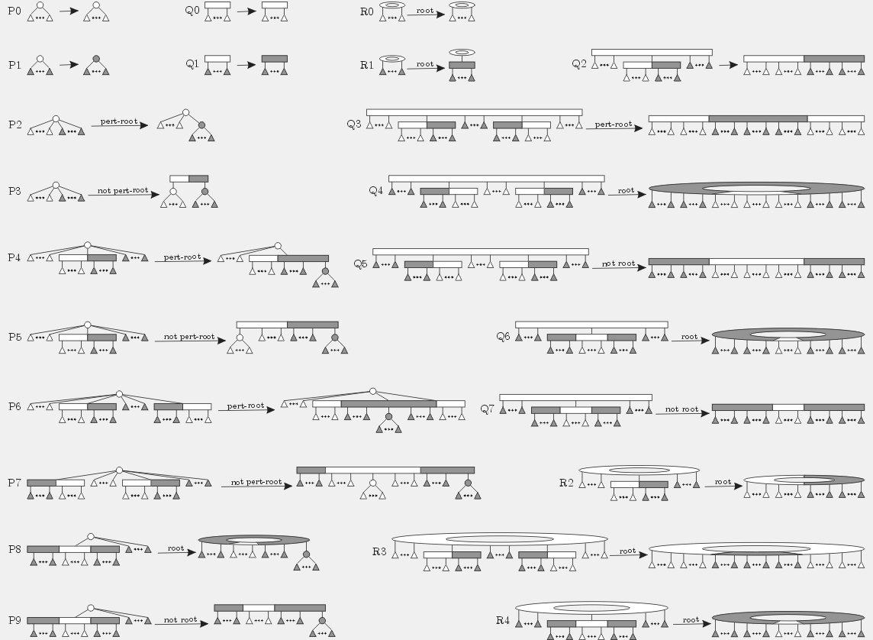
Notes:
This "wallpaper" showing all PQR-tree templates closes my talk.
Thank you very much for your attention.
Are there any questions?

