Slide 1
Clustered Level Planarity
Michael Forster, Christian Bachmaier
University of Passau

Slide 2
UML Diagrams
java
Vertices
  Classes
  Interfaces
Directed edges
  Inheritance
  Association
Recursive clustering
  Packages
  Arbitrary depth
lang
io
CharSequence
Comparable
Object
Serializable
Clonable
String
File
util
Collection
List
AbstractCollection
AbstractList
AbstractSequentialList
LinkedList

Slide 3
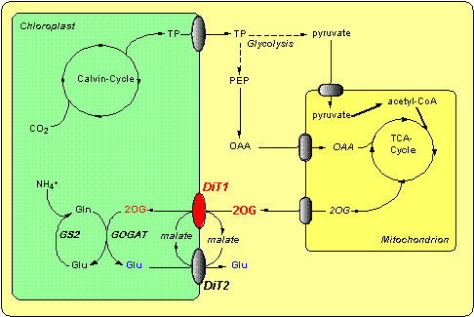
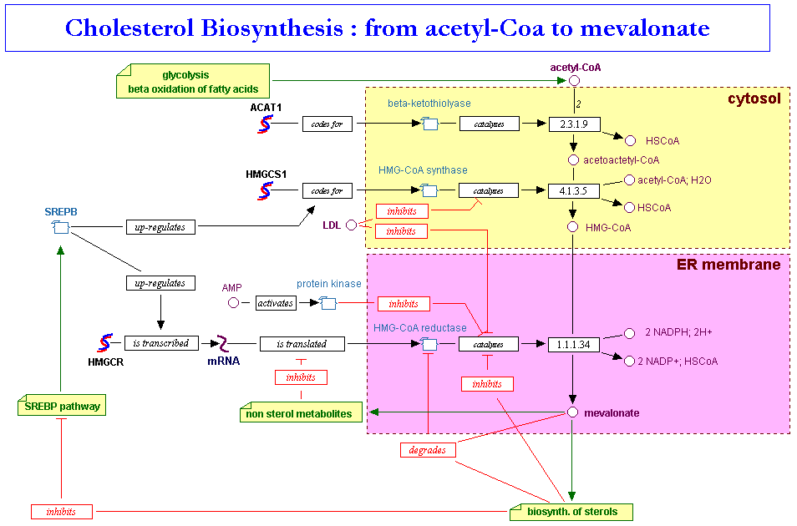
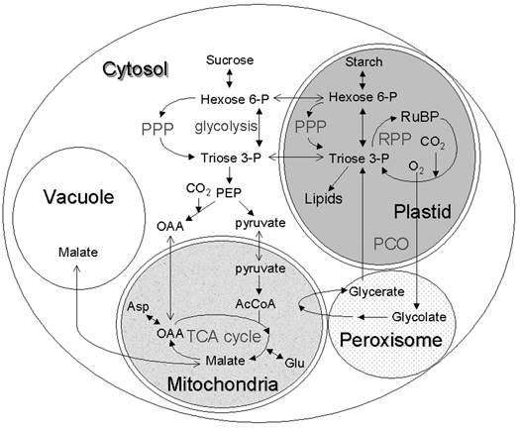
Biochemical Pathways
Reaction networks
  Substances / reactions
  Directed (hyper) graphs
Compartments
  Separate cell regions
  Nested

Slide 4
Overview
Introduction
Definition and concepts
Level planarity testing
  Algorithm of Jünger, Leipert, Mutzel (1998)
  PQ-trees
Clustered level planarity testing
  Differences to level planarity
  Extension of the algorithm
Summary

Slide 5
Definitions and Concepts
Clustered (Level) Graphs
Clustered (Level) Planarity

Slide 6
Clustered Graphs
Clustered graph: G = (V, E, C, I)
Vertices: V
Clusters: C
  Contain vertices
  Or other clusters
Inclusion relation: I
  T = (V ∪ C, I) is a tree
  No cluster overlap
  Single root cluster
Edges: E ⊆ VV
  Connect vertices
  But not clusters
4
6
7
1
8
E
2
3
5
C, I
1
2
3
4
5
6
7
8
V

Slide 7
Clustered Planarity (c-Planarity)
Is G planar?
Can G be drawn without
  edge crossings
  edge/clusters crossings?
Complexity
  O(|V|) for c-connected graphs [Feng, Cohen, Eades, 1995]
  Open in the general case
4
6
7
1
8
2
3
5
One of the TOP 10 open problems
in graph drawing!

Slide 8
Clustered Level Graphs
Clustered level graph:
G=(V₁  V₂  ...  V_{k}, E, C, I)
  Clustered graph: (V, E, C, I)
  Leveling: V = V₁  V₂  ...  V_{k}
Drawing conventions
  Clusters
    Connected regions
    No overlaps
    Recursively nested
    Simple: convex polygons, rectangles
  Levels
    Horizontal lines
  Edges
    Strictly downwards
    Horizontal edges: see previous talk
Question: is G planar?
4
6
7
V₁
1
8
V₂
2
3
5
V₃
1
2
3
4
5
6
7
8

Slide 9
Overview
 | Class of graphs | Complexity
Clustered Planarity | arbitrary | open
 | c-connected | Θ(|V|)
Level Planarity | arbitrary | Θ(|V|)
Clustered Level Planarity | arbitrary | open
 | level connected proper single source | O(k ∙ |V|)

Slide 10
Level Planarity Testing
Algorithm of Jünger, Leipert, Mutzel (1998)

Slide 11
Level Planarity Testing
Similar to planarity testing
(vertex addition method, LEC)
“Sweep-line”
  Traverse the graph
  level by level
  Store the “admissible”
  edge permutations
  For each vertex: REDUCE
    Check planarity
    Update permutation set
  For each vertex: REPLACE
    Insert outgoing edges
  Next level
Precondition: proper, single source
Running time: O(|V|)
Data structure: PQ-trees
level planar
unvisited

Slide 12
Storing the permutations
PQ-trees [Booth, Lueker, 1976]
  Leaves represent edges (“virtual vertices”)
  P-nodes:
    Represent cut vertices
    Arbitrary permutations of children
  Q-nodes:
    Represent biconnected components
    Only “reversion”
D
A
B
C
B
D
E
F
I
G
H
J
K

Slide 13
PQ-trees: Operations
REDUCE(T, S):
  Restricts the permutation set:
  Leaves S must be consecutive
  Failure is possible → graph is not planar
  Traverse tree bottom-up
    At each node: local updates
    Apply one of 11 “Templates”
  Afterwards: Reduced leaves correspond to a subtree of T
REPLACE(T, S, S'):
  Substitute leaves S with leaves S'
  Leaves S must already be consecutive

Slide 14
Clustered Level Planarity Testing
Needed Extensions

Slide 15
Clustered Level Planarity Restrictions
Edge/Edge-Restriction
Edge/Cluster-Restriction
Property of the graph: level connectivity
  At least one edge between consecutive levels
  Weak form of cluster connectivity
  Similar to cluster planarity
Cluster/Level-Restriction
Cluster/Cluster-Restriction

Slide 16
Clustered Level Planarity: Algorithm
“Sweep-line”
  Traverse the graph level by level
  Store the “admissible” edge permutations
  For each vertex: REDUCE
    Check planarity
    Update permutation set
  For each vertex: REPLACE
    Insert outgoing edges
  Next level
level planar
  REDUCE-CLUSTERS
unvisited

Slide 17
REDUCE-CLUSTERS
Given: PQ-tree containing admissible permutations
Wanted: Restricted permutation set
  Contents of a cluster must be consecutive
  Invalid permutations are removed
Idea
  Semantics of the PQ-tree operation REDUCE are the same
  Reuse REDUCE
Naive Algorithm
  For each cluster c on the current level
    REDUCE(T, {vertices contained in c})
  Running time: O(|V| ∙ |C|)
Improvement
  Single traversal of the PQ-tree
  Running time: O(|V|)

Slide 18
REDUCE-CLUSTERS
Compare clusters and PQ-tree
  Every cluster corresponds to a subtree of the PQ-tree
  This is only true after the reduction
Nested clusters
  Child in the inclusion tree
  Corresponding PQ-subtrees are nested
Idea
  Reuse the inner PQ-subtree for the outer PQ-subtree
  Simultaneously traverse trees bottom up
PQ-tree
Inclusion tree
Complexity
  Both trees are traversed once per level
  Both are of size O(|V|)
  Overall running time O(k ∙ |V|)

Slide 19
Summary
Future Work
Results and Open Problems

Slide 20
Summary / Future Work
Cluster-Level-Planarity
  Test and Embedding
    O(k ∙ |V|) running time
    Restricted graph class
  Combinable with other advanced level planarity concepts
Open
  Test for arbitrary clustered level graphs
  Linear time algorithm
Similar situation as with c-planarity

Slide 21
Questions?
Thank you for your attention!

