Slide 1
BioPath
Visualization of Biochemical Pathways
Franz J. Brandenburg,
Michael Forster, Andreas Pick,
Marcus Raitner, Falk Schreiber

Slide 2
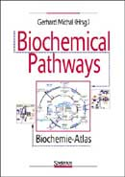

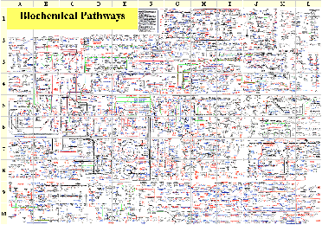
BioPath Project
Electronic version
BioPath
Project partners: University of Erlangen
  University of Mannheim
  University of Passau
  Spektrum Verlag Heidelberg
Notes:
Poster zeigen

Slide 3
Overview
Visualization of Pathways
  Static vs. dynamic visualization
  Requirements
  Solutions: Modeling & Algorithms
  Results
BioPath Prototype
  System architecture
  Screenshots
Perspectives

Slide 4
State of the Art
Static visualization
Manually produced drawings
  Produced once
  Used many times
  Not changeable
Used in
  Biochemistry books
  Boehringer Poster “Biochemical Pathways”
  Electronic systems (KEGG, ExPASy, PUMA)

Slide 5
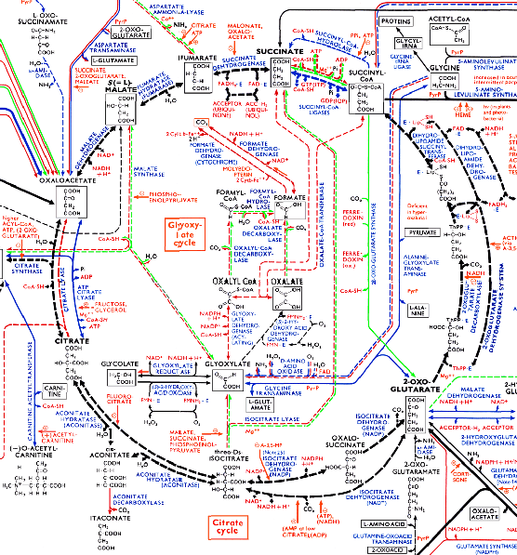
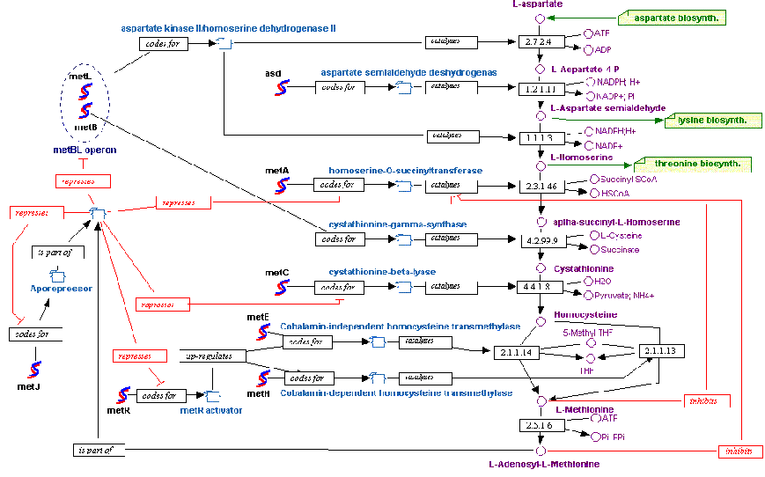
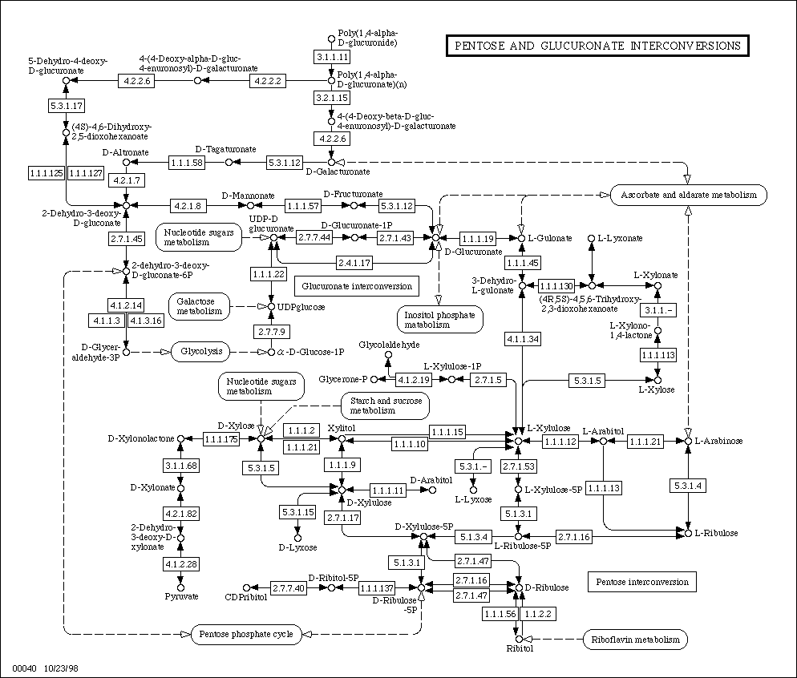
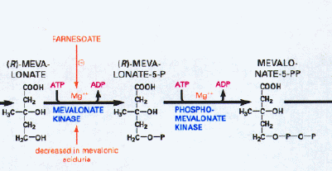
Static Visualization Examples

Slide 6
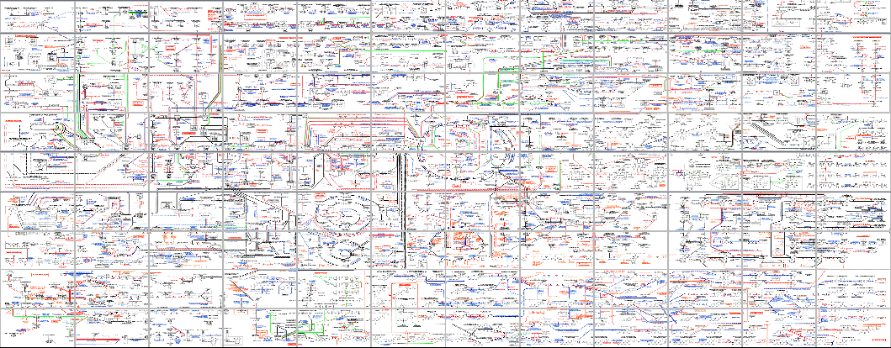
Static Visualization Problems
Very complex
  Information overflow
  Hard to find information (even with an index)
  Not suited for answering specific questions
  Only one view on the data
Expensive
  Creation of Boehringer Poster took > 1 year
  Updates are difficult
Find pathway from isovaleryl-CoA to acetyl-CoA
→ Dynamic visualization

Slide 7
Wishes
Interactive Navigation
Arbitrary views on the data
  Part of the network
  Part of the available information
  Different levels of detail

Slide 8
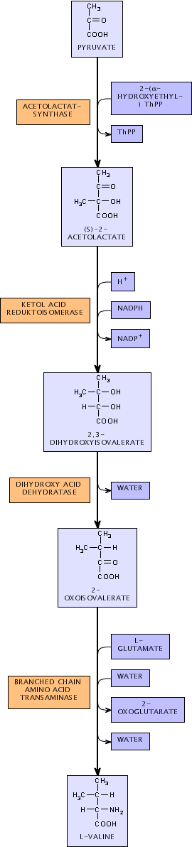
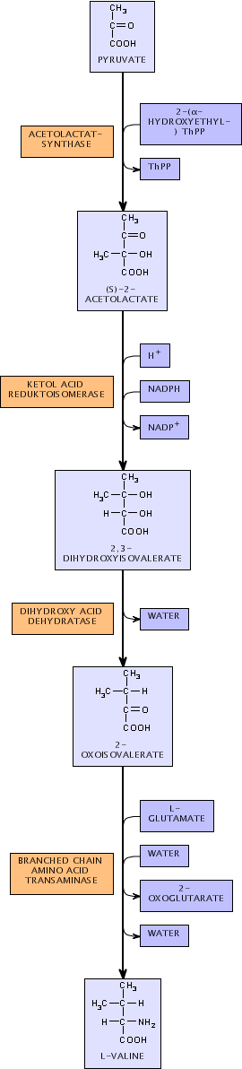
Pathway Hierarchy

Slide 9
Pathway Hierarchy
Metabolism
Pathways
Reactions
Reaction mechanisms

Slide 10
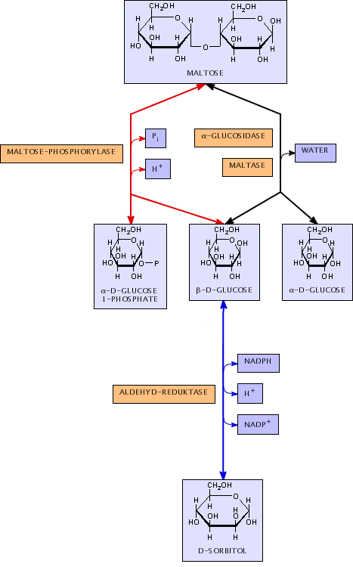
Visualization Requirements
Substances, co-substances, enzymes
  Text and/or images
Reactions
  Substances: start/end of reaction arrow
  Enzymes: along reaction arrow
  Co-substances: along reaction arrow, according to chemical order
Reaction networks
  Distinct Direction
  Predefined layout of special pathway structures

Slide 11
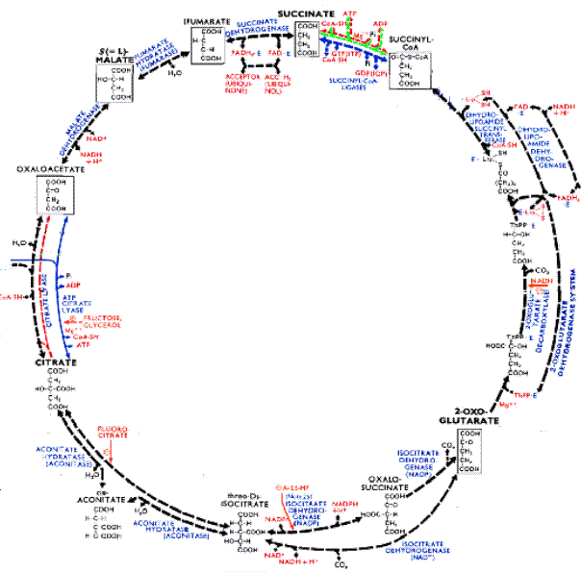
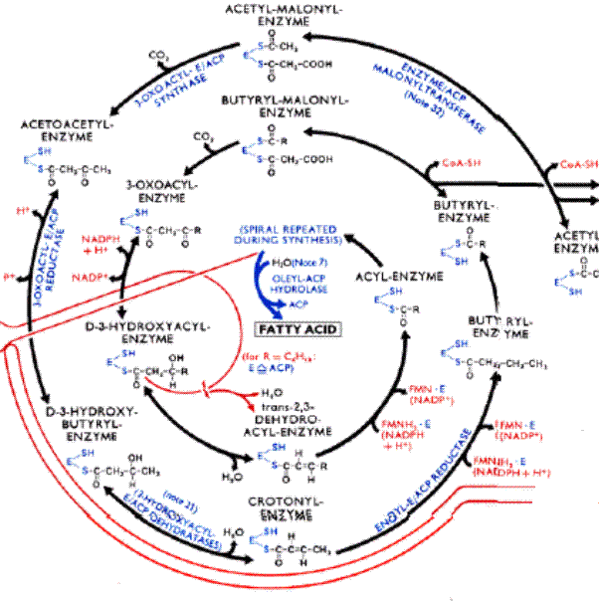
Special Pathway Structures
Closed Cycles
  Sequence of related reactions
  Product is equal to educt
Open Cycles
  Sequence of related reactions
  Product is similar to educt

Slide 12
Drawing Conventions
Substances, co-substances, enzymes
  Text and/or images
Reactions
  Substances: start/end of reaction arrow
  Enzymes: along reaction arrow
  Co-substances: along reaction arrow, according to chemical order
Reaction networks
  Distinct Direction
  Predefined structures of special pathway structures (e. g. citrate cycle)
Sequences of networks
  Context-preserving layouts

Slide 13
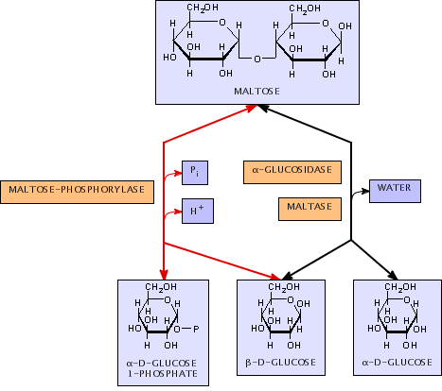
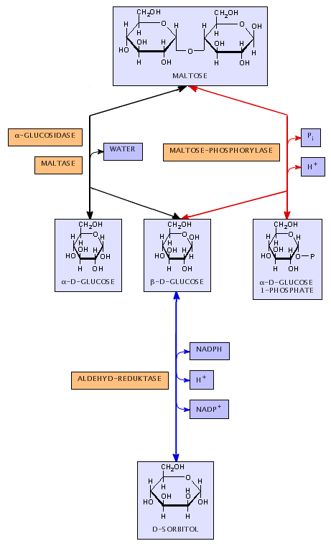
Context Preservation
Not context-preserving

Slide 14
Context Preservation
Context-preserving

Slide 15


Modeling of Reactions
PYRUVATE
2-(α-HYDROXYETHYL-)
THPP
ACETOLACETATE
SYNTHASE
THPP
(S)-2-ACETOLACTATE

Slide 16
Graph Drawing
Given: Graph
Wanted: “Nice” Drawing
  Node positions
  Edge routing
Several standard algorithms
  Force directed (Spring Embedder)
  Hierarchical (Sugiyama)
  Specialized Algorithms for
    Trees
    Planar Graphs
    Other special classes of graphs

Slide 17
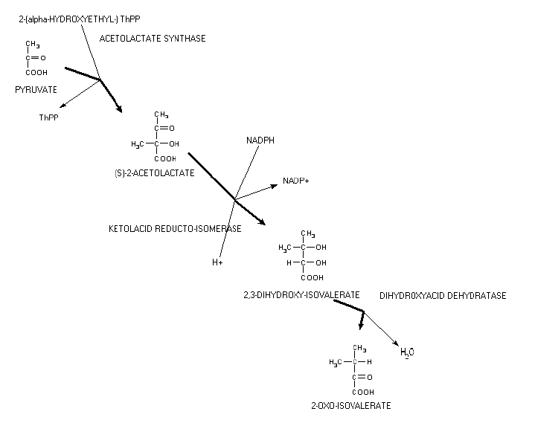
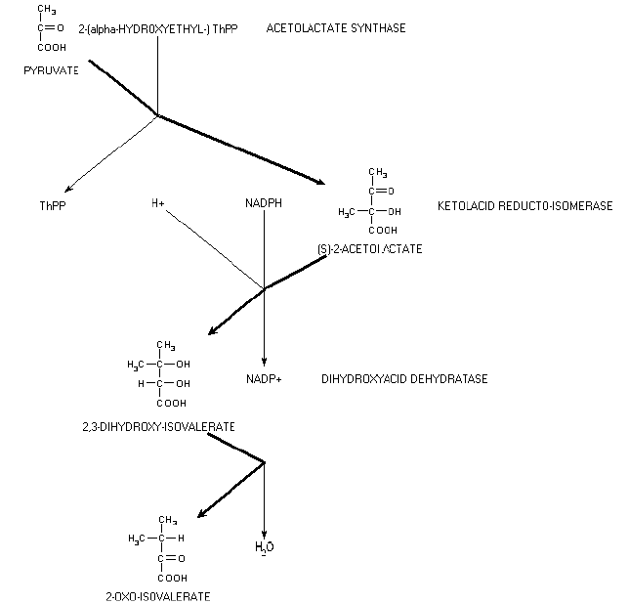
Standard Algorithms
Spring Embedder Sugiyama

Slide 18
New Algorithm
Too technical for presentation here
  Several problems proven to be NP-hard
  Efficient heuristics
Extension of Sugiyama algorithm
  Arbitrary node sizes
  Layout constraints
    Special pathway structures
    Context preservation

Slide 19
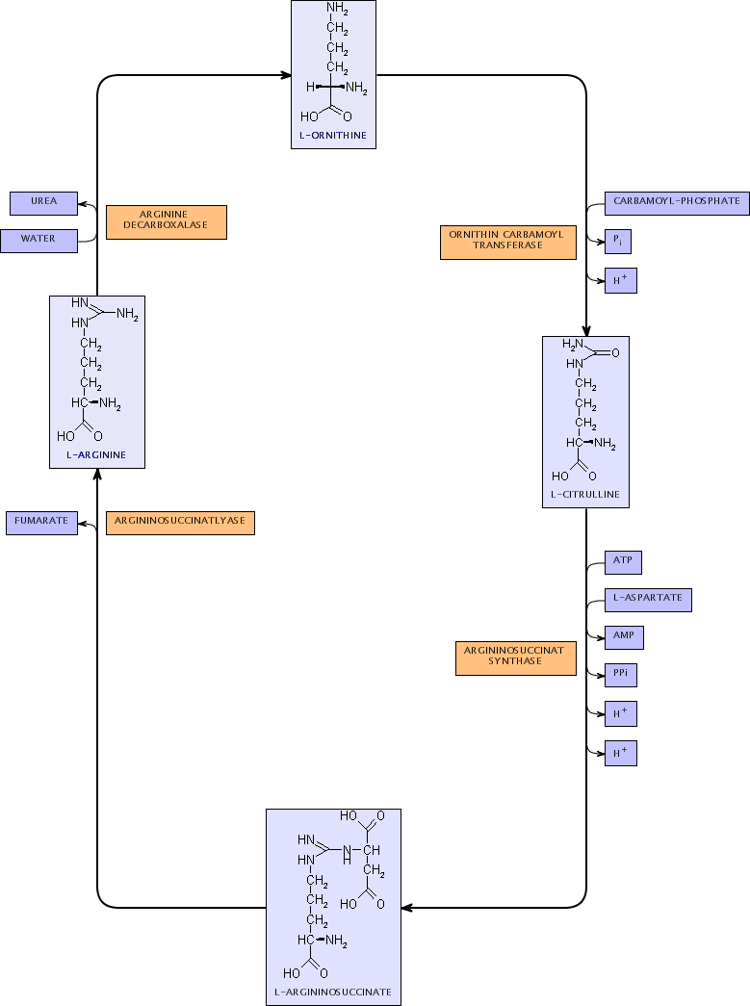
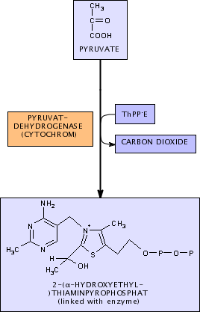
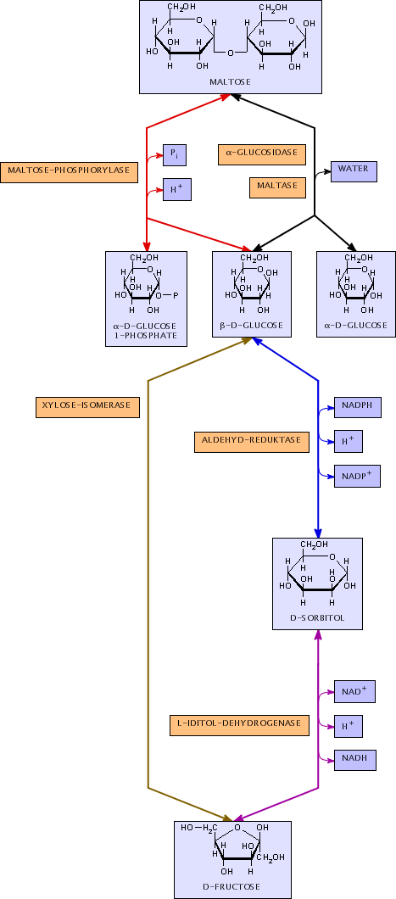
Results
Reactions
Reaction networks
  closed cycles
  open cycles

Slide 20
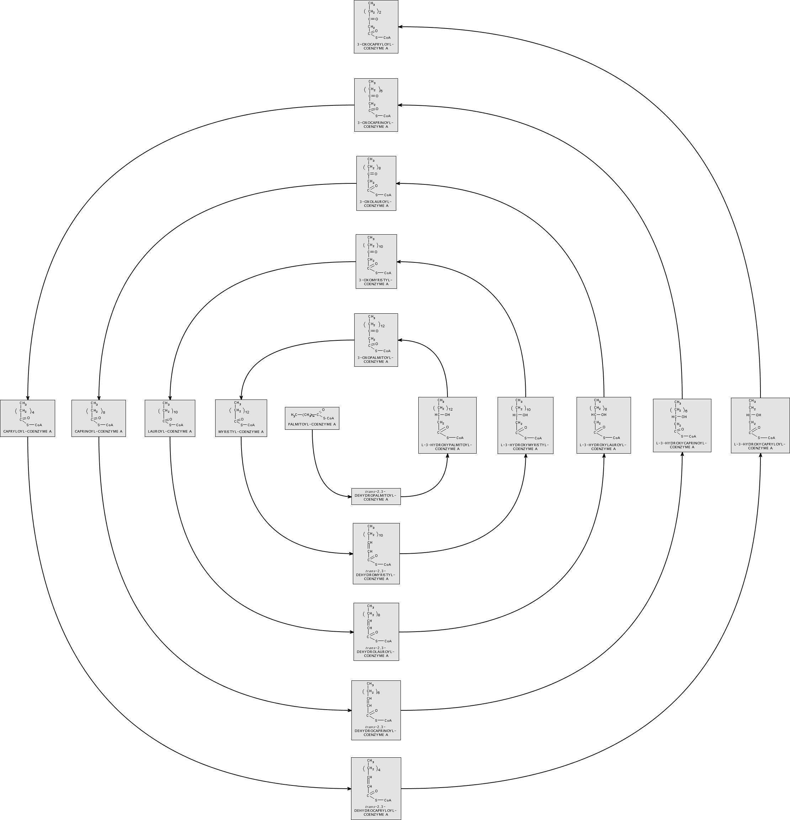
Results - Open Cycles

Slide 21
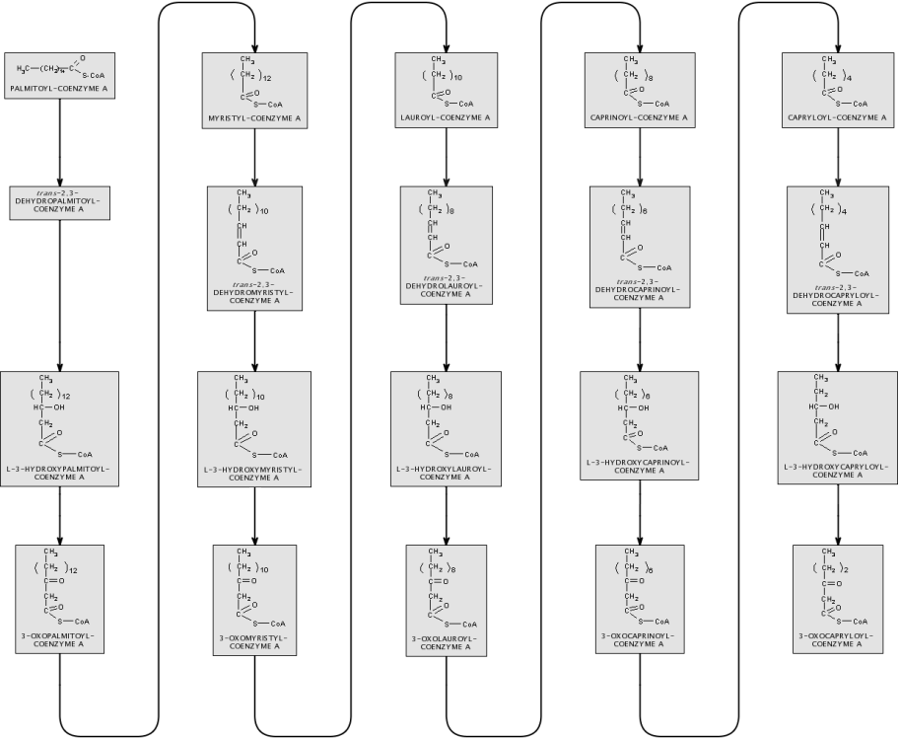
Results - Open Cycles

Slide 22
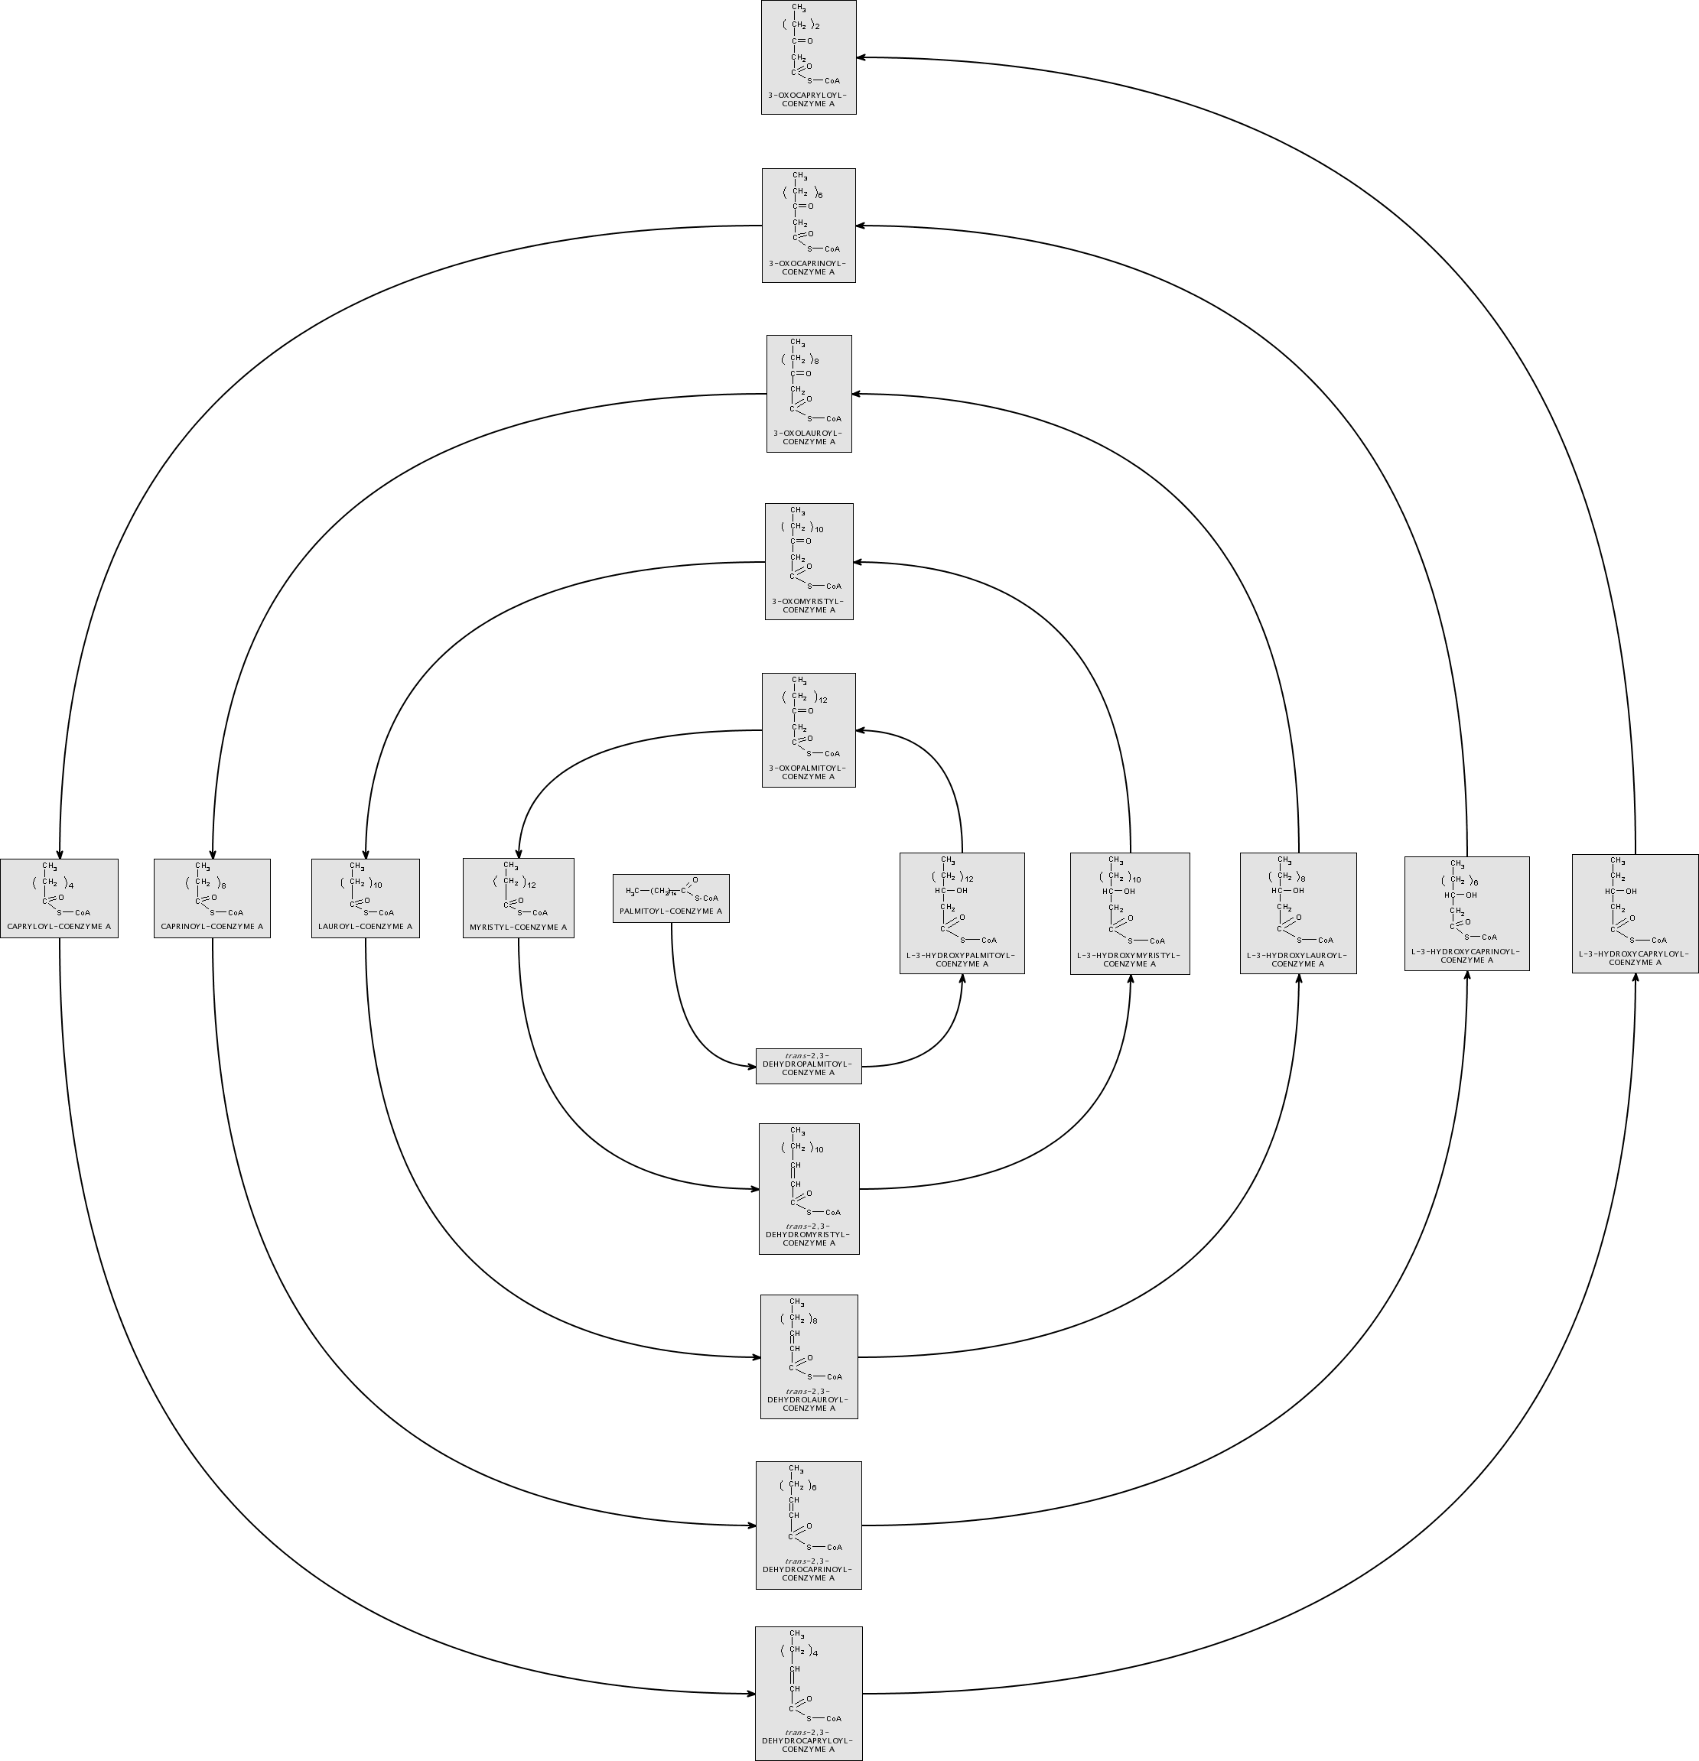
Results - Open Cycles

Slide 23
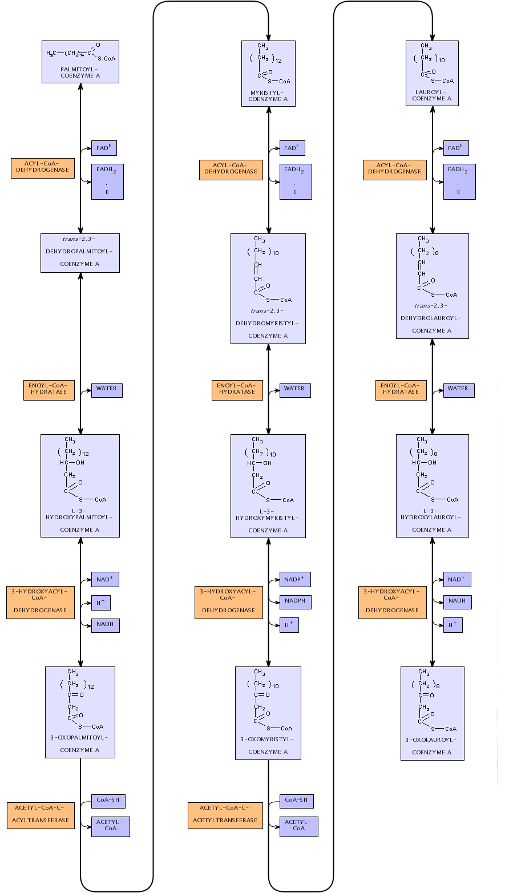
Results
Reactions
Reaction networks
  closed cycles
  open cycles

Slide 24
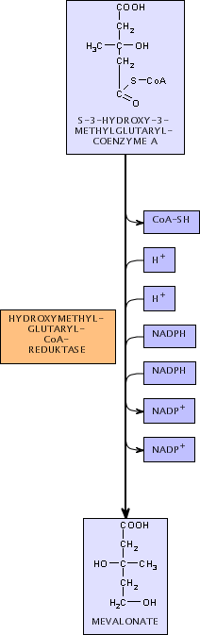
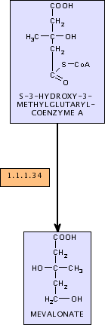
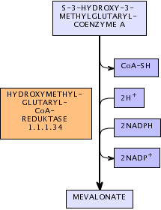
Results
Reactions
Reaction networks
  closed cycles
  open cycles
Different views

Slide 25

Results
Reactions
Reaction networks
  closed cycles
  open cycles
Different views
Different levels of detail

Slide 26
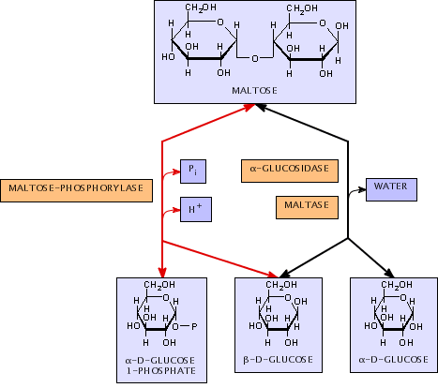
Results
Reactions
Reaction networks
  closed cycles
  open cycles
Different views
Different levels of detail
Preserving the context

Slide 27
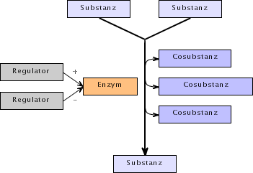
Results
Reactions
Reaction networks
  closed cycles
  open cycles
Different views
Different levels of detail
Preserving the context
Extensible
  new information

Slide 28
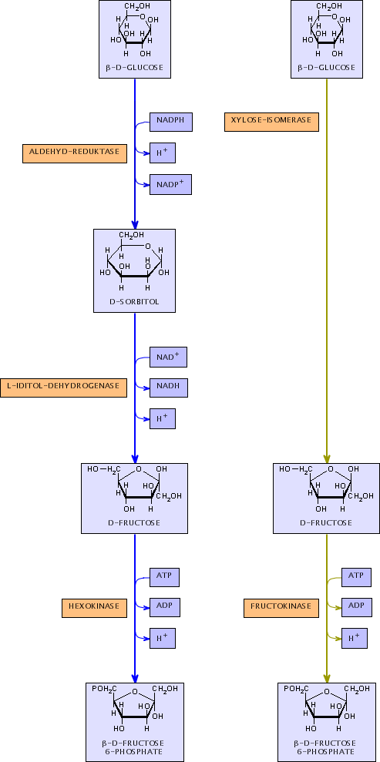
Results
Reactions
Reaction networks
  closed cycles
  open cycles
Different views
Different levels of detail
Preserving the context
Extensible
  new information
  new applications

Slide 29
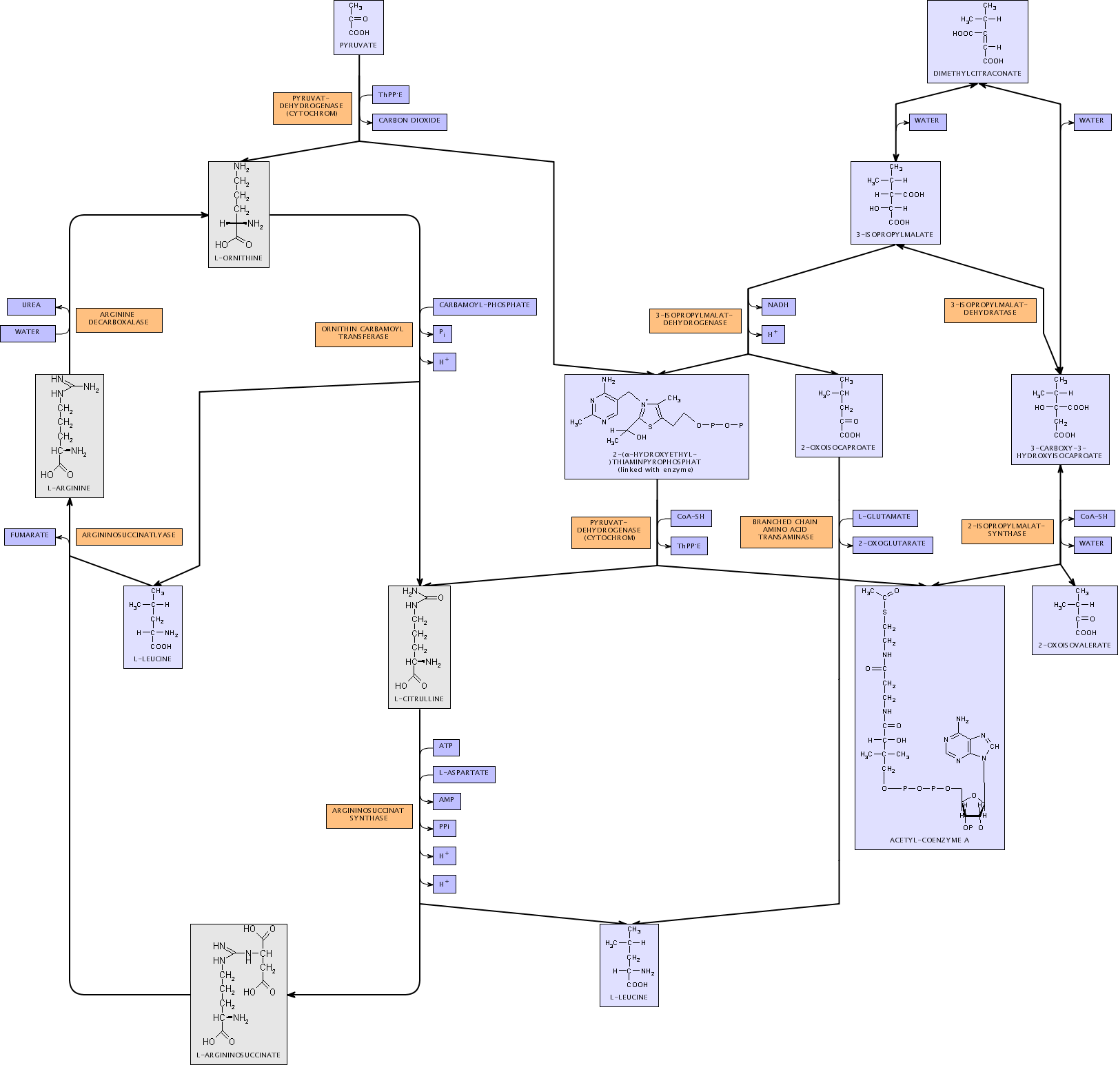

Slide 30
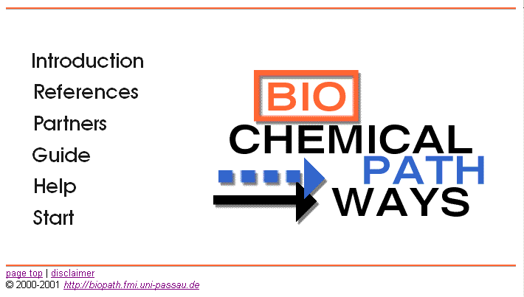
BioPath Prototype
http://biopath.fmi.uni-passau.de/

Slide 31
System Architecture
Web Browser
Client Tier
Application Server
Web Interface
Application Tier
Query Engine
Graphlet
Database Interface
BioPath
Database
(IBM DB2)
Data Storage Tier

Slide 32
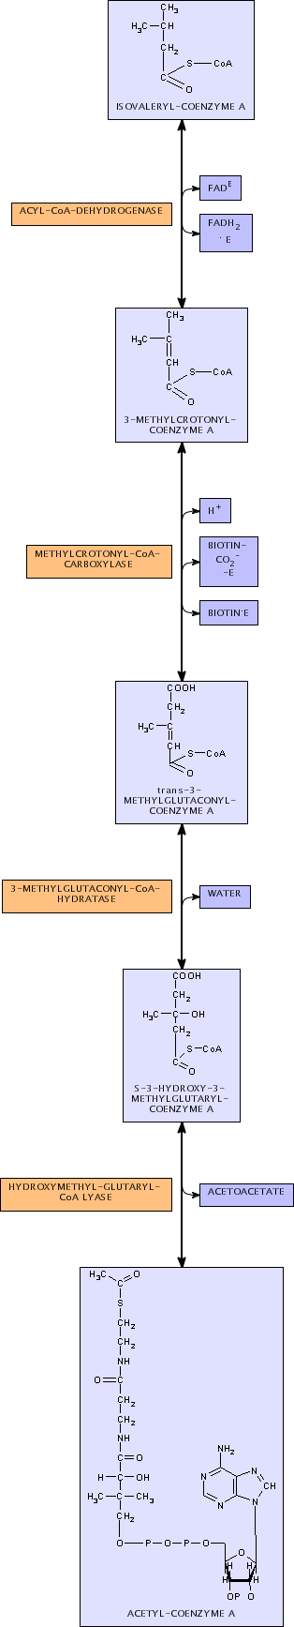
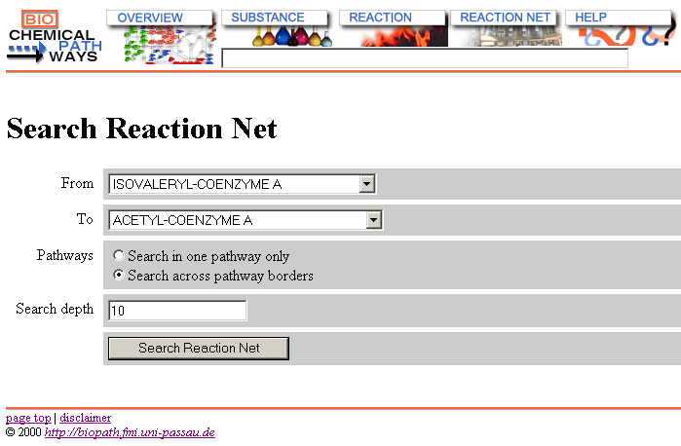
BioPath Prototype

Slide 33
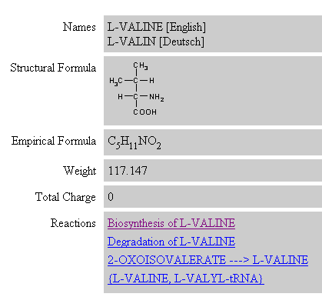
BioPath - Substances

Slide 34
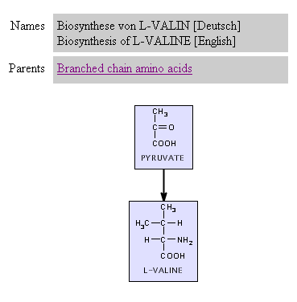
BioPath - Reactions
Navigation

Slide 35
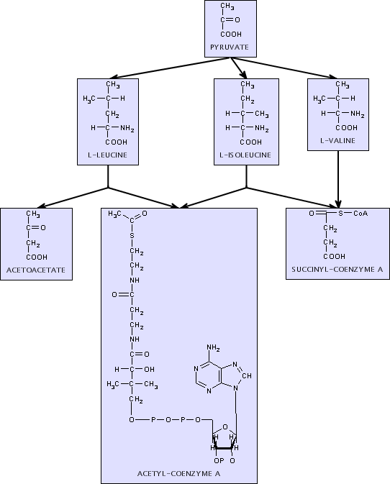
BioPath - Reactions
Navigation

Slide 36
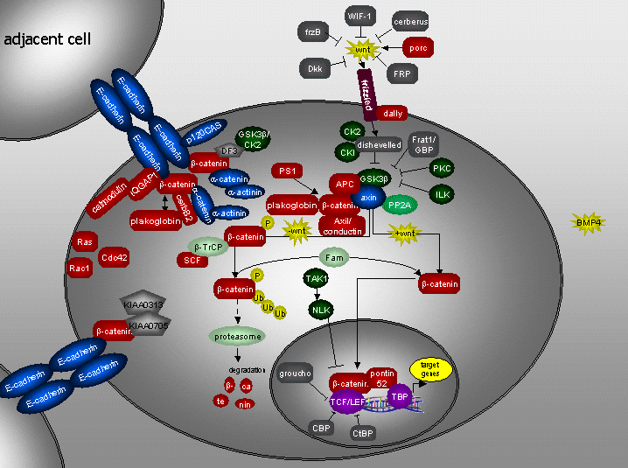
Perspective
Signal pathways
Static visualization example (TRANSPATH database)

