Slide 1
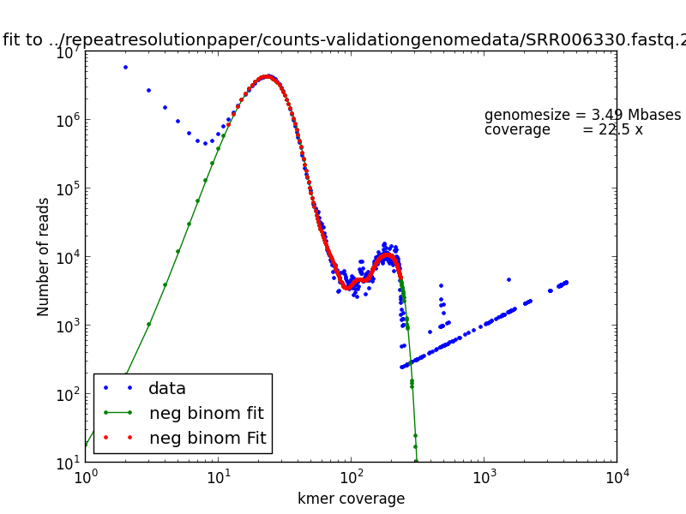
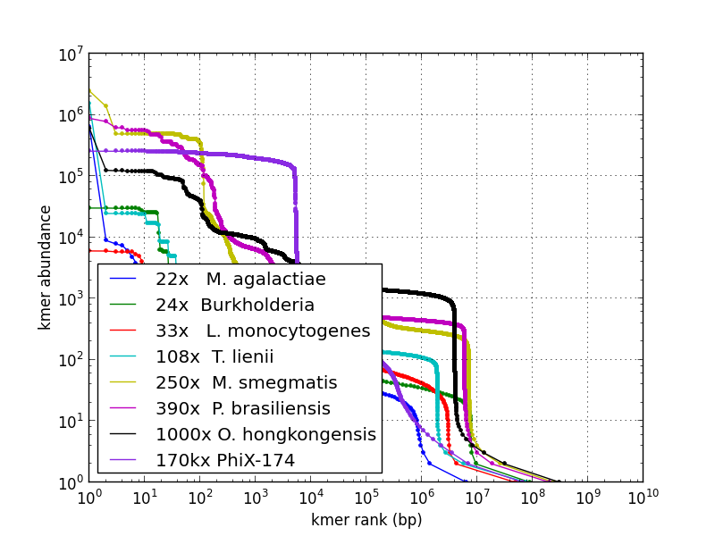
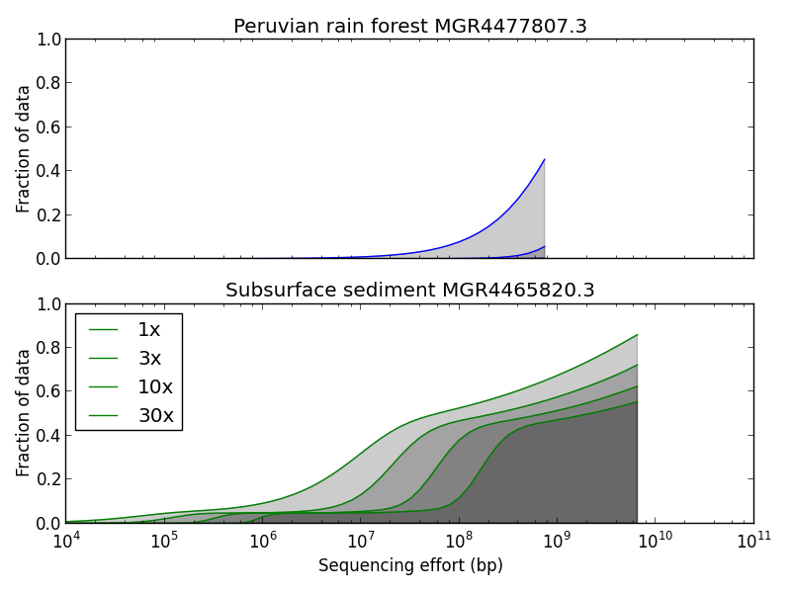
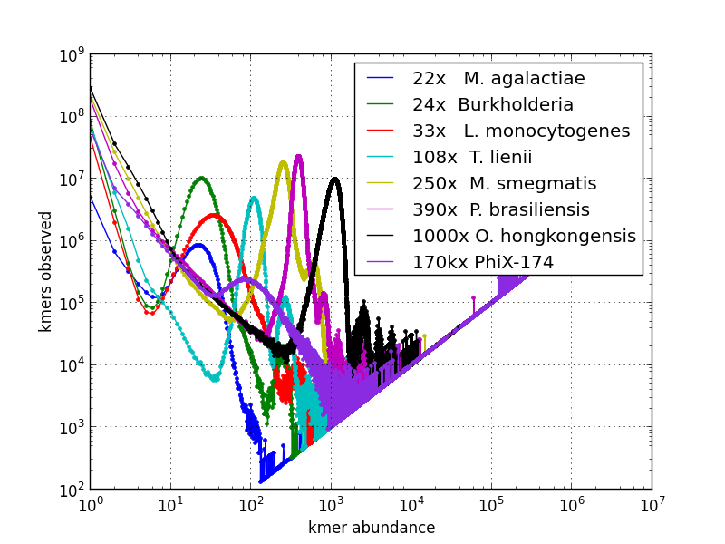
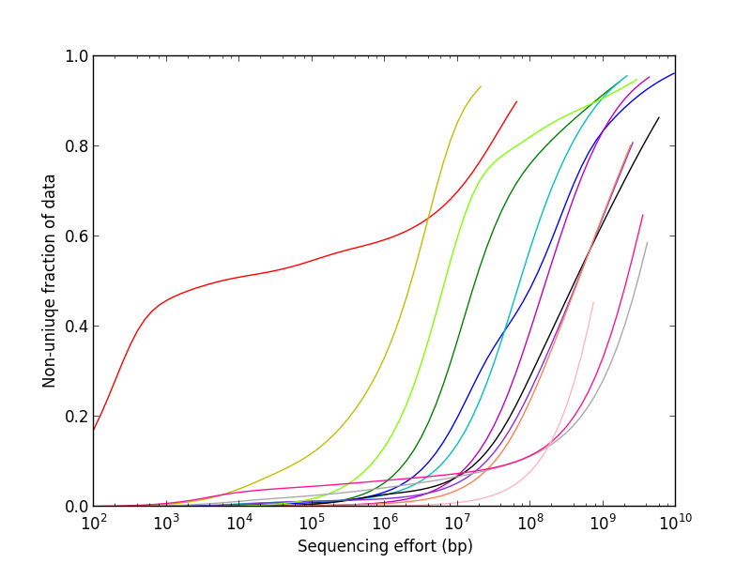
Input sequence data
fasta/fastq
MG-RAST
countkmer21
plotkmer-
spectrum
k-mer spectrum
kmerspectrum-
analyzer
plotkmer-
spectrum
nonpareilk
Poisson
mixture fits
kmer spectrum
graphs
Rarefaction
plots

