Slide 2
Growth on Imperfect Crystal Faces
Monte-Carlo Method
A. Franke, M.W. Glorie, J. Sangers
Computational Physics - AP3082
June 8 2022

Slide 3
Table of content
Motivation
Theoretical Background
Implementation
Results
Discussion
Conclusion & Outlook
Short video

Slide 4
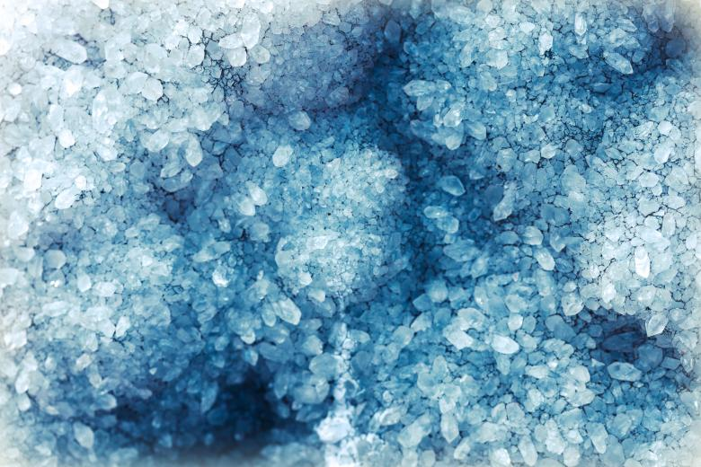
Motivation
Crystal growth: -Atomic bonding
-Atom mobility
-Surface impurities
Monte-Carlo computer simulations ideal

Slide 5


2. Theoretical Background
Interface interactions:
Evaporation:
Impingement:
Surface migration

Slide 6


2. Theoretical Background
Interface interactions:
Evaporation:
Impingement:
Surface migration

Slide 7
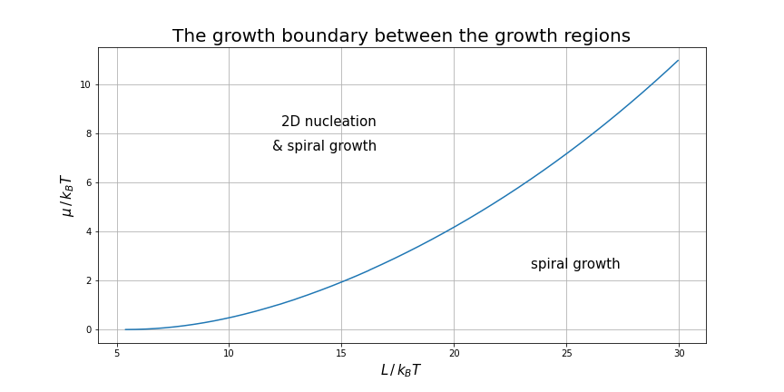
2. Theoretical Background

Slide 8
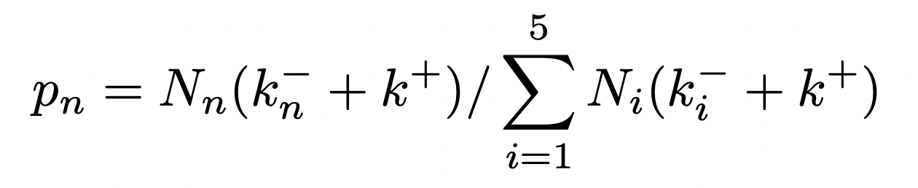
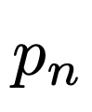
3. Implementation
Divide the surface atoms in subsets based on the number of neighbours of each atom
Select a subset with probability
Choose a lattice point from the subset
Choose from of interaction with a probability proportional to their interaction rate

Slide 9
3. Implementation
0 | 0 | 0 | 2 | 0
0 | 0 | 0 | 2 | 0
0 | 0 | 0 | 2 | 0
0 | 0 | 0 | 0 | 0
0 | 0 | 0 | 0 | 0
Dislocation
Simulate dislocation by introducing scanning matrices
At the boundaries periodic boundary conditions were applied
Forward scanning matrix
1 | 1 | 1 | 1 | 1
1 | 1 | 1 | 1 | 1
1 | 1 | 1 | 1 | 1
1 | 1 | 1 | 1 | 1
1 | 1 | 1 | 1 | 1
0 | 0 | -2 | 0 | 0
0 | 0 | -2 | 0 | 0
0 | 0 | -2 | 0 | 0
0 | 0 | 0 | 0 | 0
0 | 0 | 0 | 0 | 0
Backward scanning matrix
Surface matrix

Slide 10
3. Implementation
Interaction site
Optimize neighbour scanning by updating the number of neighbours of the lattice sites affected by evaporation, impingement or migration
Neighbour

Slide 11
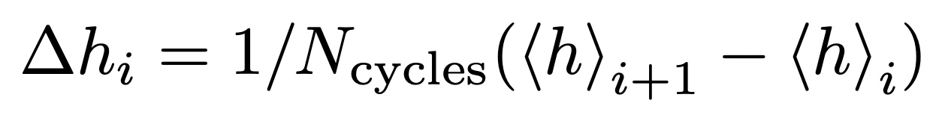
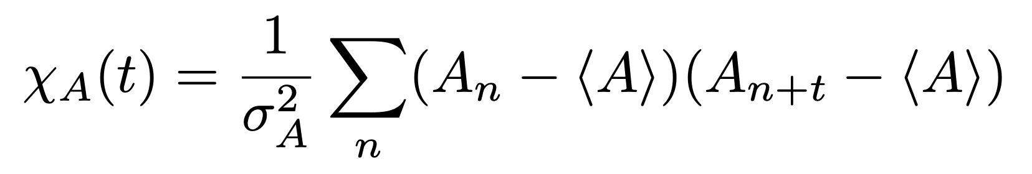
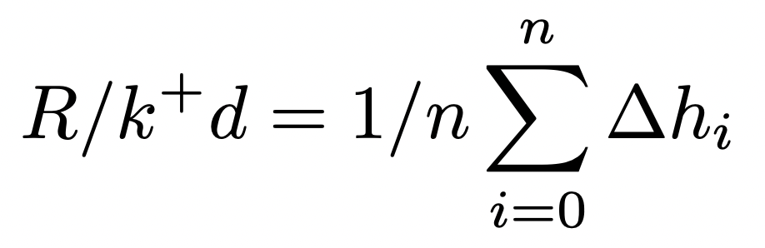
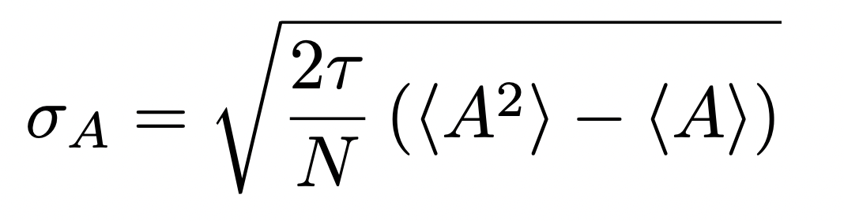
3. Implementation
The growth rate:
Every the crystal surface is stored
Growth rate error:
Growth rate is determined from one simulation - thus the data is correlated
The error is determined using the autocorrelation function

Slide 12
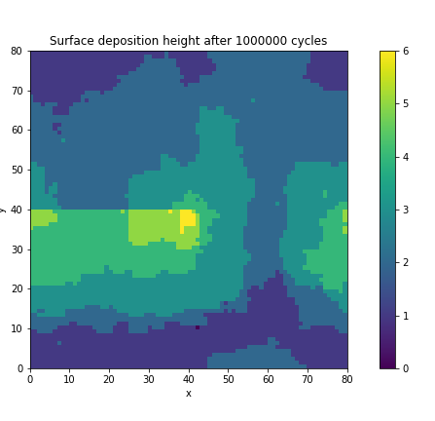
4. Results
Spiral growth:
when does a spiral grow
what effect does it have

Slide 13
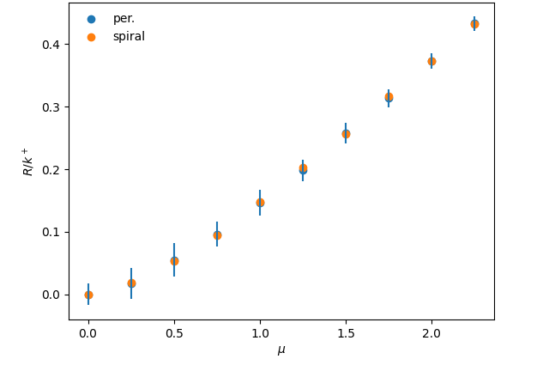
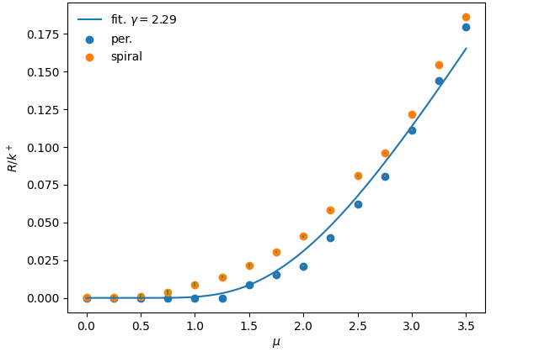
4. Results
Only in a small range of T do we see the contribution of spiral growth
T=2
T=4

Slide 14
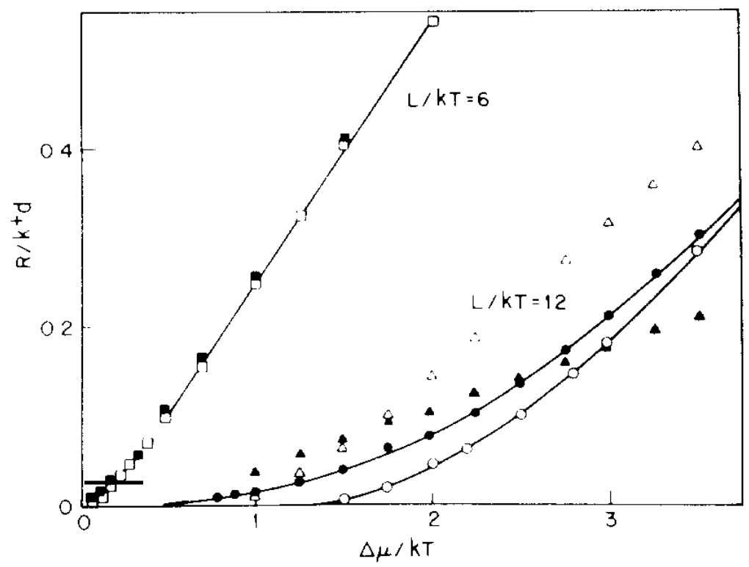
5. Discussion
[1]

Slide 15
6. Conclusion & Outlook
The results in the paper were replicated
Spiral growth contributes to growth rate in a small window of temperatures.
With more time…
…we would like to have simulated with surface migrations and analysed these results

Slide 16
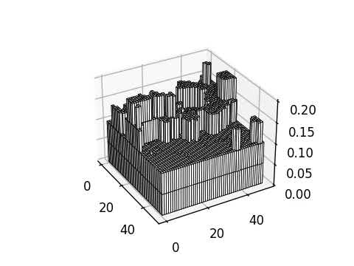
7. Short video
dims = [50,50]
T = 6.5
mu = 6
N = 1e5 #attempts
defect introduced at
[0,25]->[15,25]
Can see:
Periodic BC
Plateaus of growth
Clumps of critical size stay
spirals can’t be seen due to small simulation space

Slide 17
Thank you for your attention
Source:
[1] G.H. Gilmer, Growth on imperfect crystal faces: I. Monte-Carlo growth rates, Journal of Crystal Growth, Volume 36, Issue 1 (1976), Pages 15-28,
A. Franke, M.W. Glorie, J. Sangers

