Slide 1
Sales Performance Review
Board Presentation
Findings and Recommendations
24 Apr 2026 - 30 Apr 2026
Magdalena Bronowska

Slide 2
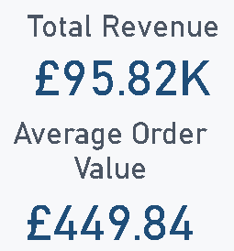
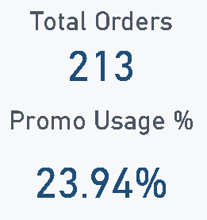
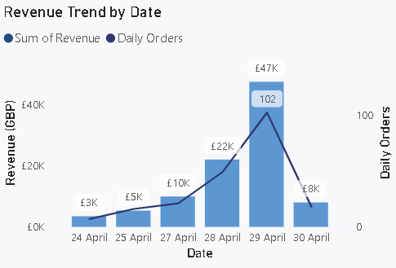
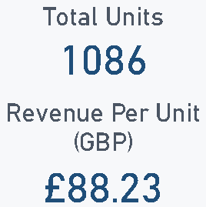
Executive Snapshot
Paste Screenshot: Executive KPI Dashboard
Notes:
Executive Snapshot
In the last 7 days, the business processed 213 orders, generating £95.82K in revenue and selling 1,086 units. The average order value was £449.84, and roughly 1 in 4 orders used a promotion.
One day stands out - 29 April alone accounted for 102 orders and £47K, nearly half the week's total. That could be a bulk order, a campaign, or end-of-month buying. It needs to be looked into before we treat it as a normal trading day.
Overall the business is generating solid volume in a short window, with promotions used selectively rather than across the universally.
Takeaway: stable topline performance, with promotions as a targeted lever — not a dependency.
213 orders | GBP 95.82K revenue | 1,086 units sold
Average Order Value: GBP 449.84
Promotion Usage: 23.94% (51 of 213 orders)
Revenue per Unit: GBP 88.23
Peak day: 29 Apr — £47K revenue, 102 orders (49% of weekly total in one day)

Slide 3
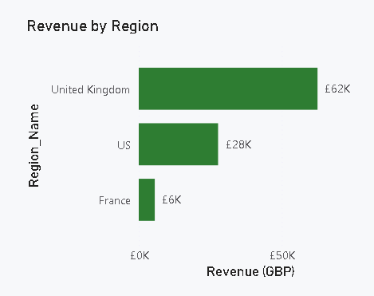
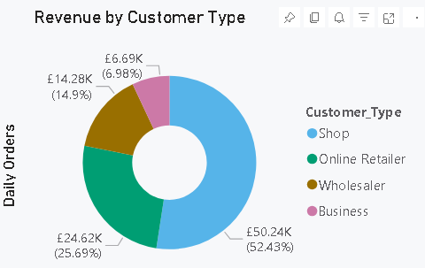
Revenue Concentration
Paste Screenshot: Revenue by Region + Revenue by Customer Type
- Revenue is concentrated in UK and US
- Customer mix is led by Shops, then Online Retailers
Recommendation: protect the strong segments (UK and Shops), and grow smaller segments with targeted offers.
Notes:
Revenue is concentrated in United Kingdom and US
Customer mix is led by Shops, then Online Retailers
Recommendation: protect the strong segments (UK and Shops), and grow smaller segments with targeted offers.

Slide 4
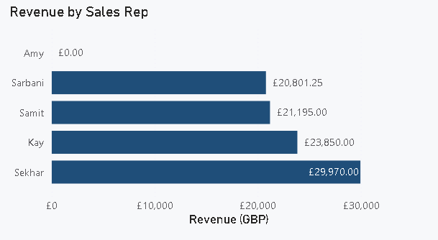
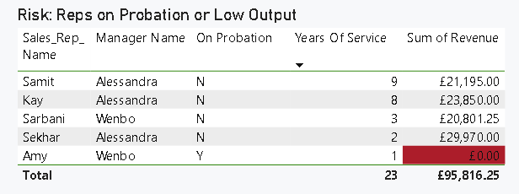
Sales Rep Performance
Paste Screenshot: Sales Rep Performance Page
- Performance is uneven across reps
- Top performers drive a large share of revenue
- One probationary rep has zero output in period Recommendations:
- Copy what top reps do well.
- Put probation and low-performing reps on a recovery plan. - Track each rep with simple KPIs.
Notes:
Recommendations:
Ask managers to copy what top reps do well (pipeline discipline, better deal quality, strong account routines).
Put probation and low-performing reps on a 30-day recovery plan with weekly check-ins.
Track each rep with simple KPIs: Orders, Revenue, Average Order Value, and Promo Revenue.

Slide 5
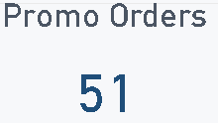
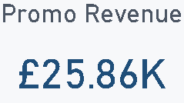
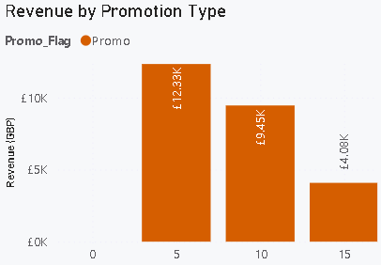
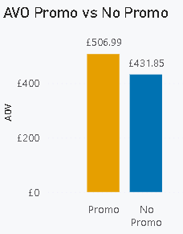
Promotion Effectiveness
- 5% and 10% discount tiers outperform 15% on value
- Promotions support volume but need discount discipline Recommendations:
- Prioritize 5% and 10% tiers; restrict 15% to clear strategic cases.
Add approval guardrails for higher discounts.
Notes:
Recommendations:
Prioritize 5% and 10% tiers; restrict 15% to clear strategic cases.
Add approval guardrails for higher discounts.
Run controlled tests by rep/region to optimize discount vs volume response.

Slide 6
Decision Summary
Defend and expand core revenue pools (UK, Shop/Online)
Improve rep consistency through manager-led coaching
Optimize promo mix toward lower discount tiers
Expected outcome: sustain growth while improving revenue quality
Notes:
My recommendation is a three-part plan:
Defend and grow core revenue pools in the UK and Shop/Online segments.
Improve rep consistency through manager-led coaching and a weekly performance cadence.
Optimize promotions toward lower discount tiers, with tighter controls on higher discounts.

Slide 7
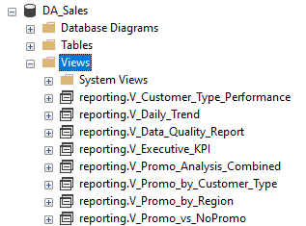
Approach Overview
1. Reviewed raw data and checked the main fields.
2. Cleaned data in SQL and created reporting views.
3. Used views in Power BI to build dashboard.
4. Used outputs to build short business narrative.

Slide 8
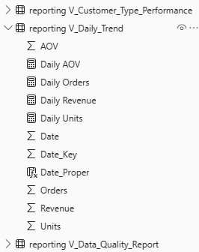
Build Choices and Why
1. Keep most of the transformation work in SQL and keep Power BI focused on visuals and lightweight measures.
2. Used reporting views as a semantic layer

Slide 9
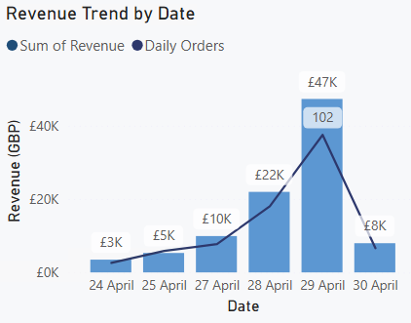
Key Assumptions
1. Data as a valid short-term snapshot of data activity.
2. Revenue is the main performance measure.
3. Promotion effectiveness could be assessed through revenue, order volume, average order value, and revenue per unit.

Slide 10
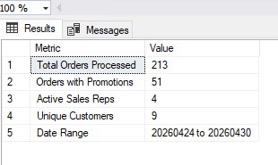
Data Challenges and Limitations
1. Proper date format.
2. Model design.
3. Business interpretation.
4. Short time window.

Slide 11
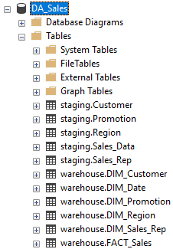
What I Would Do Next
1. Load longer history.
2. Add cost and margin promotion data.
3. Fact and Dimensions table in Power BI.
4. Automate a weekly performance.

