Slide 1



MarketingDashboard
View in Power BI
Last data refresh:
09/03/2026 09:44:03 UTC
Downloaded at:
09/03/2026 10:38:57 UTC

Slide 2
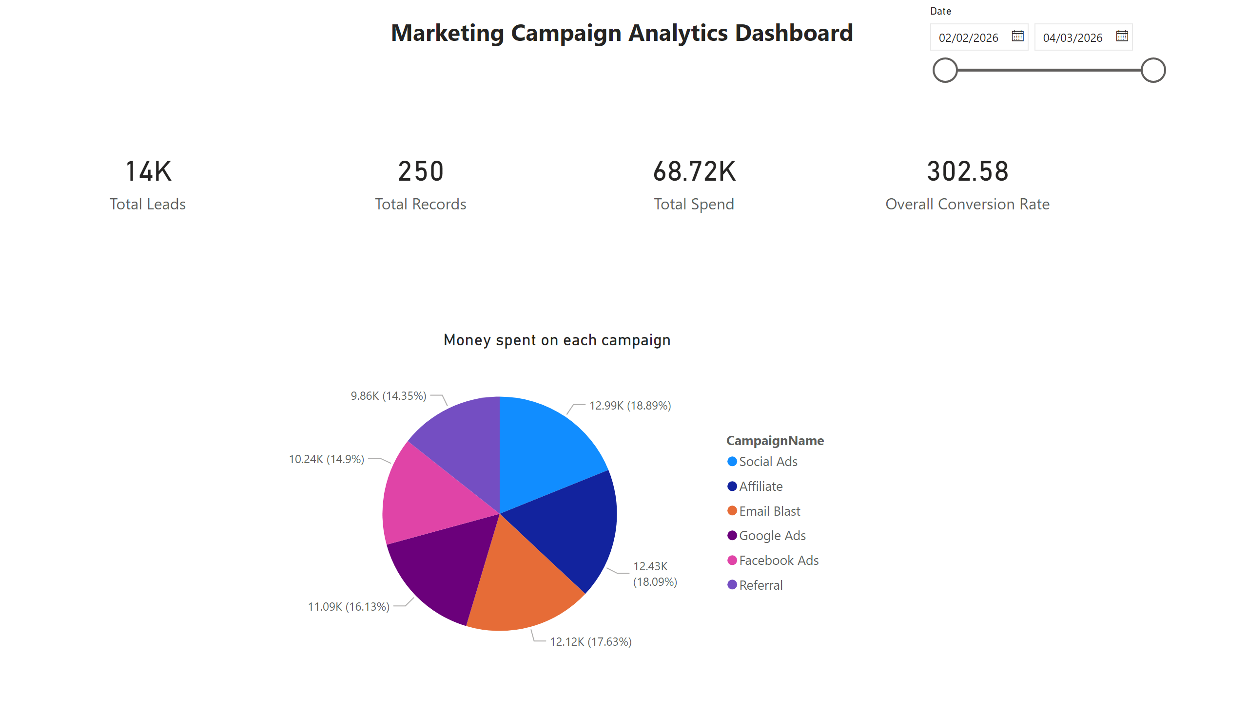
cards
Notes:
card
No alt text provided
card
No alt text provided
card
No alt text provided
card
No alt text provided
Money spent on each campaign
No alt text provided
slicer
No alt text provided
textbox
No alt text provided

Slide 3
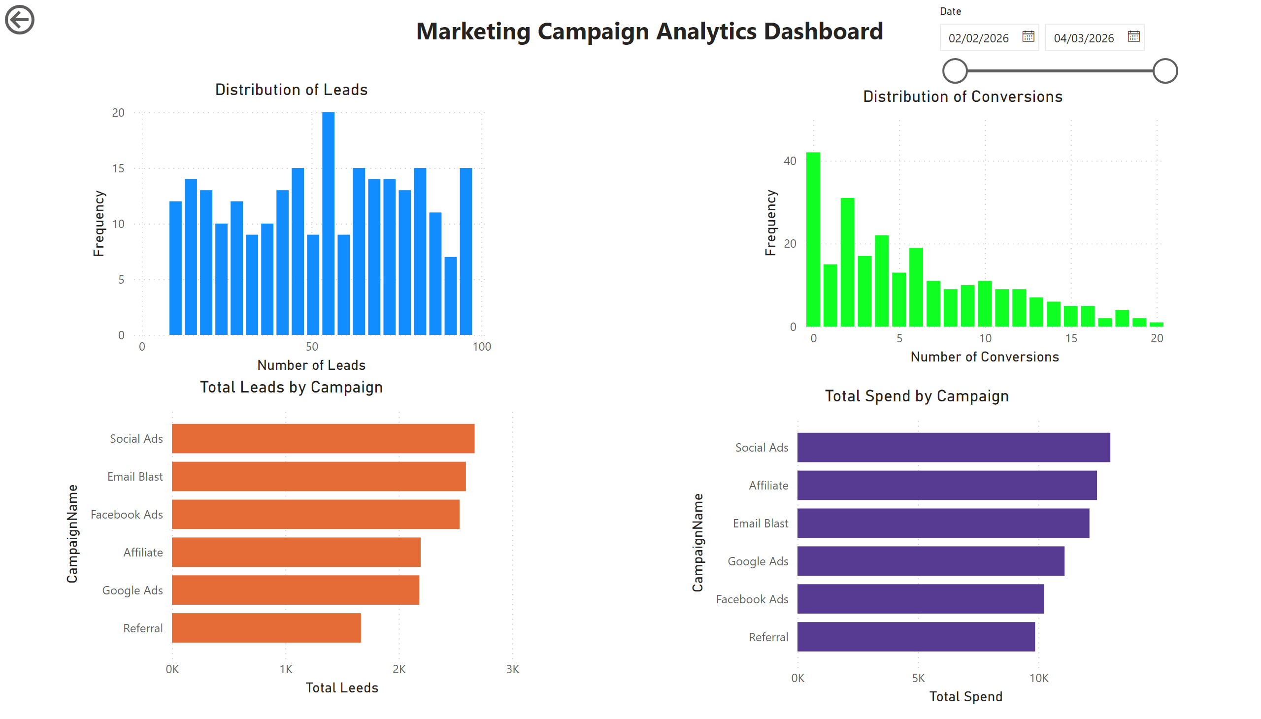
bar_chart
Notes:
Distribution of Leads
No alt text provided
Distribution of Conversions
No alt text provided
Total Leads by Campaign
No alt text provided
Total Spend by Campaign
No alt text provided
textbox
No alt text provided
slicer
No alt text provided
actionButton
No alt text provided

