Slide 1

REU Application
Dr.M.S.Sheshgiri College of Engineering & Technology
Belagavi Campus
Name : Chaitra Manjunath Gunaga
USN : 2KL20CS022
Department : Computer Science and Engineering
REU Topic : Mobile application to detect sugarcane damaged billets
Guide Name: Dr. Manisha Tapale

Slide 2
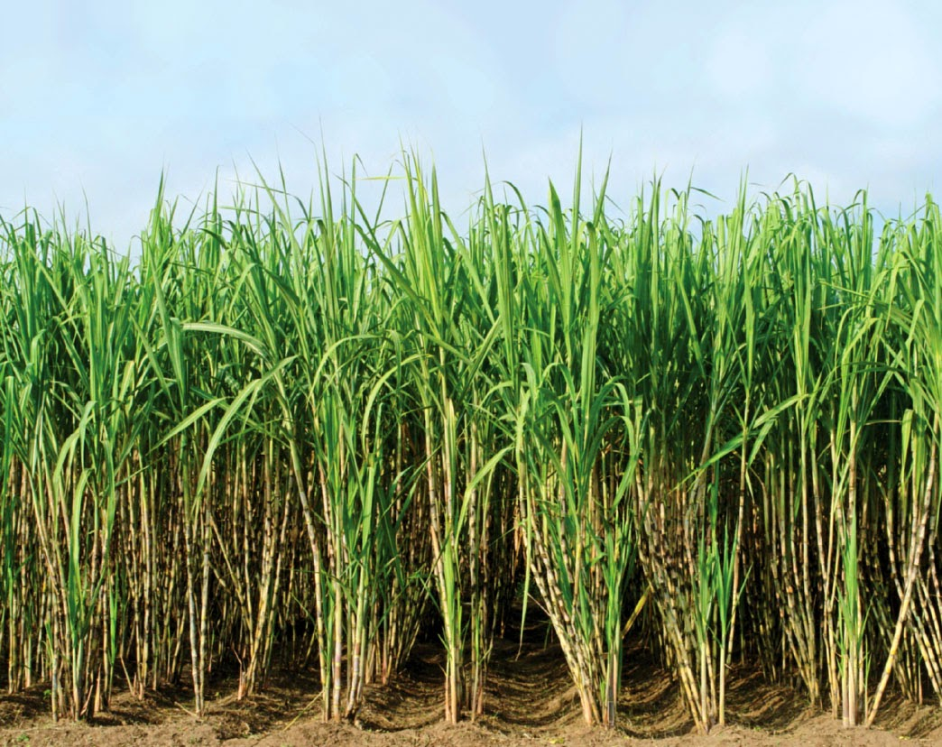
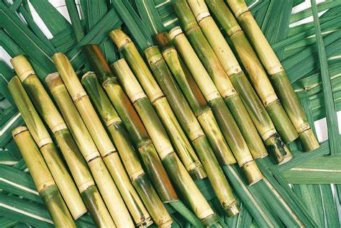
Sugarcane (Saccharum officinarum)
Sugarcane is one of the most harvested crop in India because it has profit in it’s crop as well as in waste .
Sugarcanes are used as: 1. major product in Sugar production 2. Sugarcane juice 3. Production of Jaggery 4. Ethanol ,that is substitute of petrol(non-renewable source).
Billets:
The growing part of sugar cane is stem. for planting the new sugarcane, we have to use a bud from cane which is mentioned as eye. Eye located at rings along the length of the cane.
Harvester cuts the stalk into shorter segments known as billets.
Problem Definition:
While making billets seed cane can be damaged because of cut and cracks. These problem can introduce diseases. Eventually overall yield gets affected.

Slide 3
STRENGTH AND CAPABILITIES:
Having basic knowledge on sugarcane, types of billet damages and it’s cultivation method.
Basic knowledge on Image processing.
Android Application Development basic knowledge( using java).
Python programming.
Additional knowledge to be learnt:
Deep Learning/ Machine Learning.
Application Development.
Study of Algorithms: (FC: Fractional Calculus, DHOA: Deer Hunting Optimization Algorithm)
Study of net (PSP: Pyramid Scene Parsing , DMN: Deep Maxout Network)

Slide 4
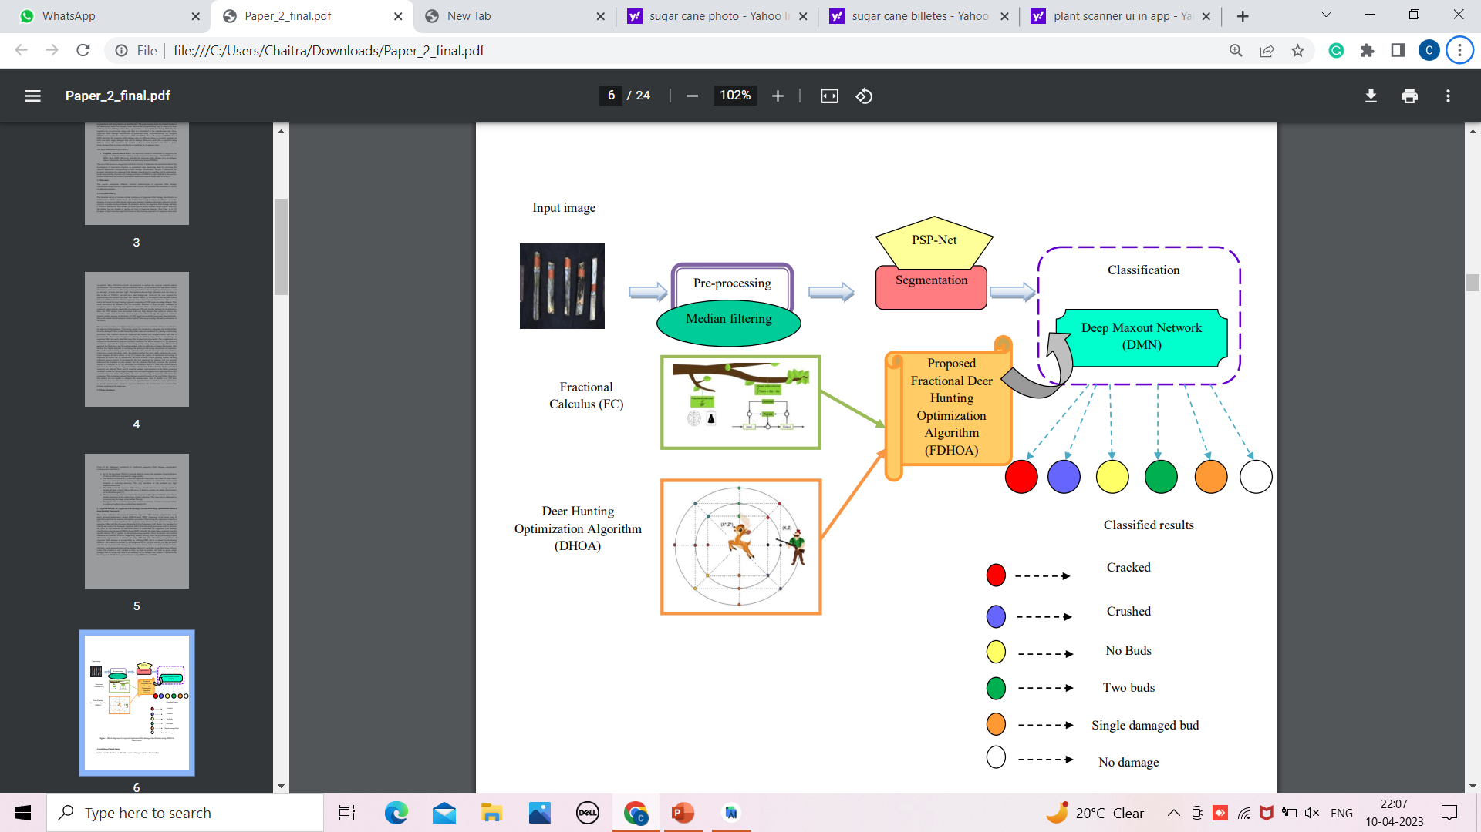
Methodology:
This process mainly involves three steps, namely 1.pre-processing, 2.segmentation, and 3.categorization
1.pre-processing: Median filtering
2.Segmentation: PSP-Net
3.Classification: DMN
(trained by FDHOA, that is FC+DHOA)

Slide 5
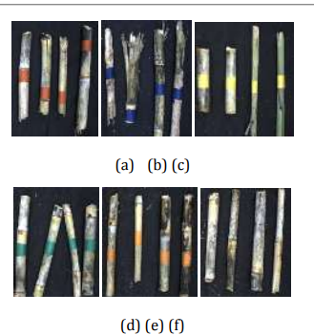
Dataset classification:
a. Cracked: natural growth cracks caused by machine.
b. Crushed: during harvesting end or center portion of the billets are crushed.
c. No buds: billets were cut such that no buds are included.
d. Two buds: billet has two buds with one is healthy and other one is damaged.
e. Single damaged buds: billet has one bud and that is damaged.
f. No damage: billet had no visual evidence that it has damage.

Slide 6
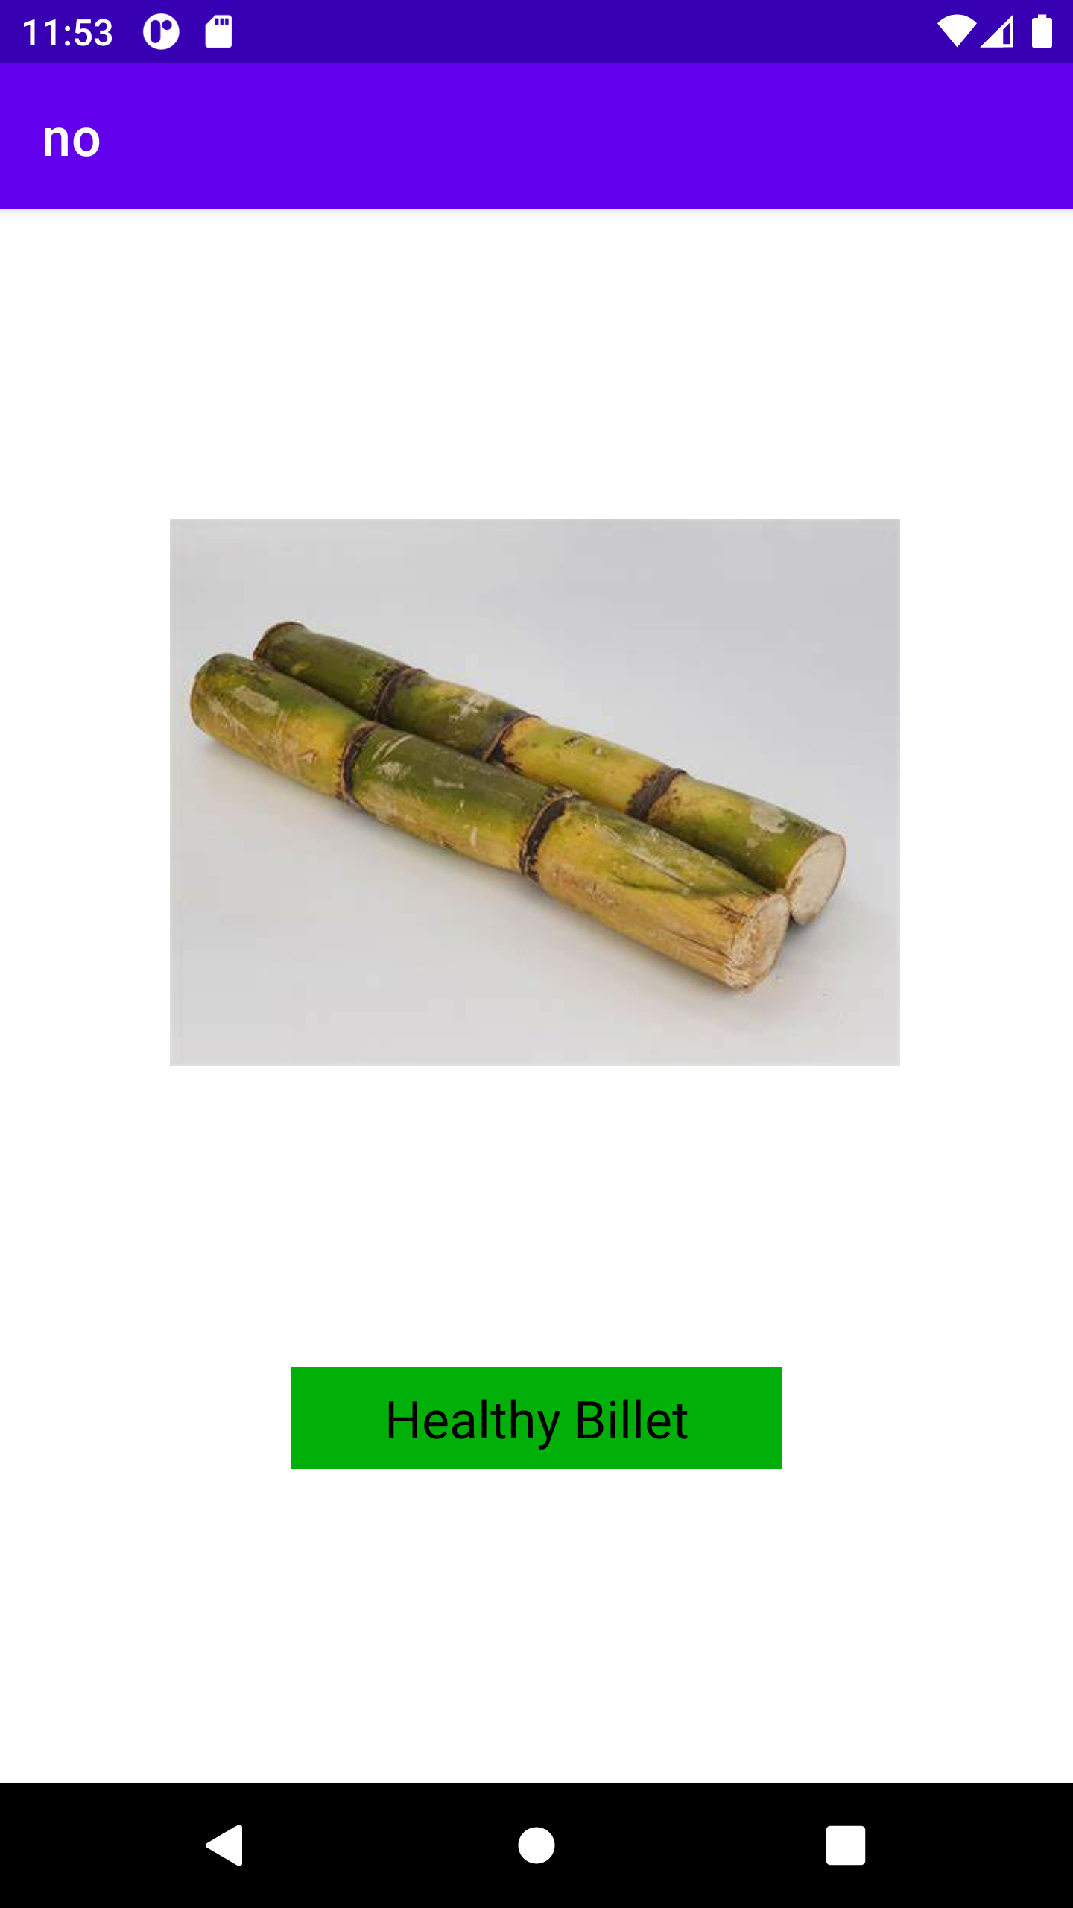
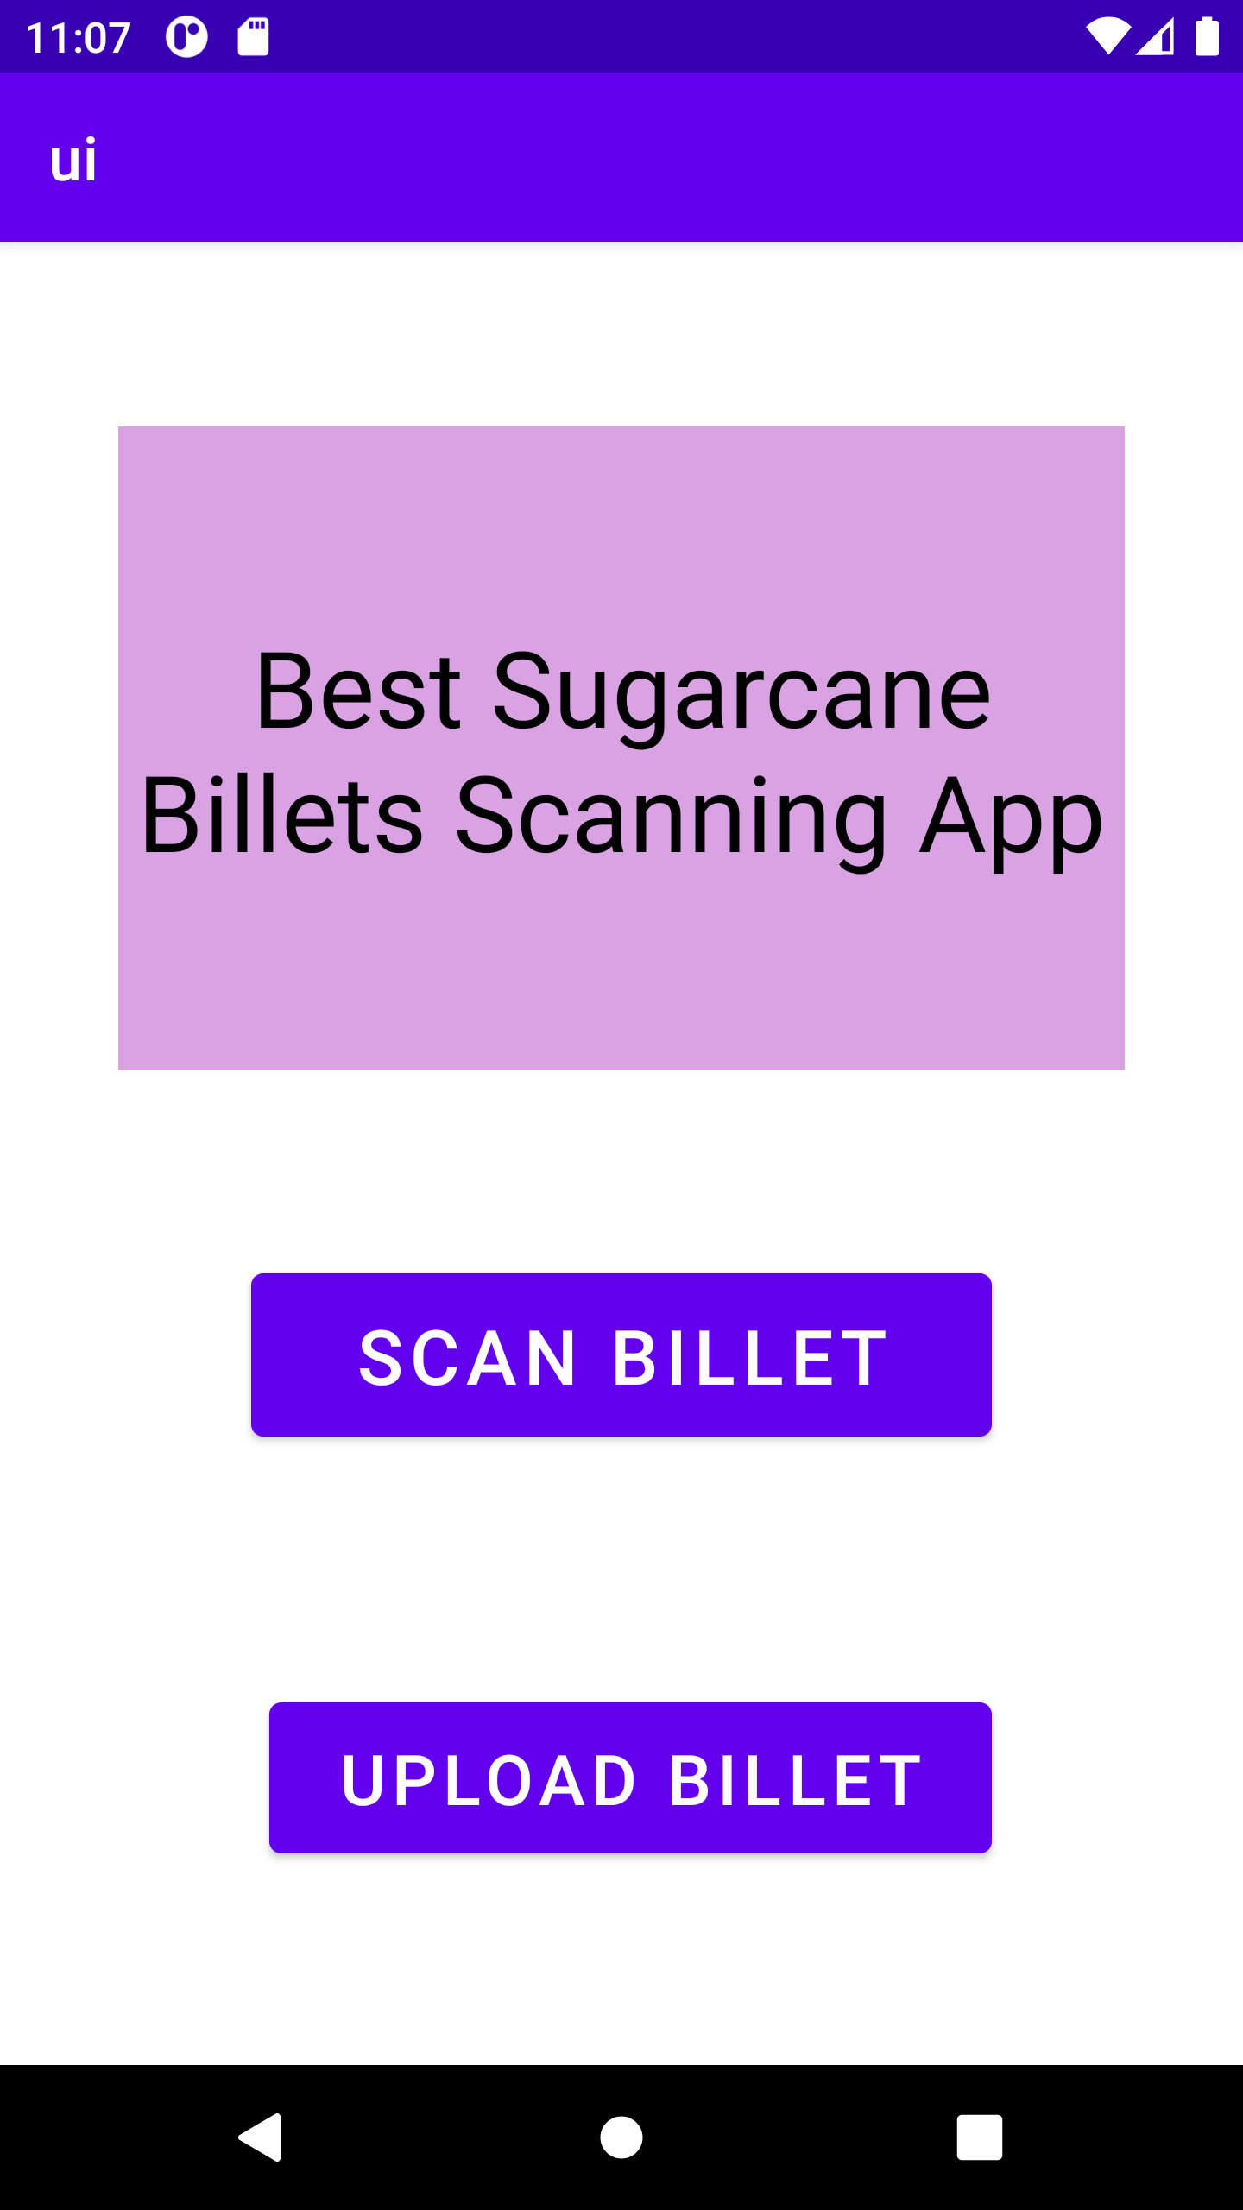
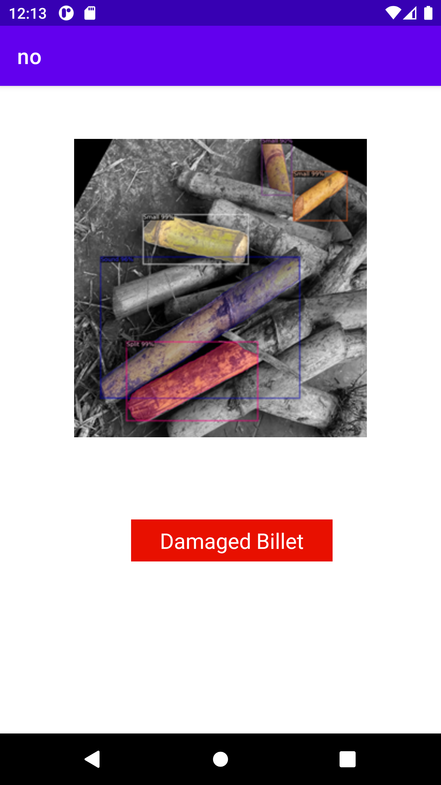
Expected Outcomes:
Application Development : An app, it should detect the damaged sugarcane billets by comparing it with dataset. if it detects any damage in billets then billets are damaged and not healthy for cultivation. otherwise billets are healthy and can be cultivated.

Slide 7
Dr.M.S.Sheshgiri College of Engineering & Technology
Belagavi Campus
THANK YOU

